Slide 1
THE FUNDAMENTALS

Slide 2
^{How to promote a product}
^{in your point of sale?}

Slide 3
The promotion of a product more commonly known as Merchandising serves to sell better. To attract the attention of your consumers and encourage them to buy, it’s important to know how to stage a dedicated space within your business. You don't have to be an expert in the field, a few simple tips can ensure you a really good impact! Today, Yon-Ka offers its valuable advice on how to sell more easily ...

Slide 4
^{Fit the theme!} To do so, you just need a few simple analysis tips that will help you decipher it every time! Start by analyzing display, yes, but how? By identifying colors, shapes, materials, ... It is the combination of these elements that transmits a strong message, a first EMOTION without the need to say any words. Besides, isn’t it often said that a picture is ^{worth more than 1000 words ...}
1/

Slide 5
Keep the offer simple and clear. Too much information, color, volume and shape can confuse and detract from the message. For this reason, it is better to change your offer more regularly than to propose several offers at the same time. The message will be clearer and more impactful.
2/

Slide 6
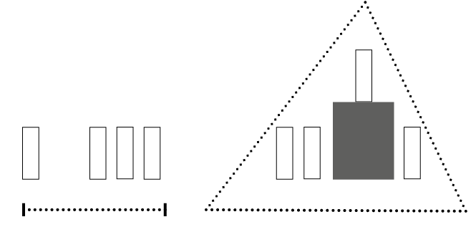
^{Structure the display} Work on the volume of your merchandising in line or in triangle. (ex: multiply the product on a shelf and place a stud with the product on it to maximize the “wow effect”.)
3/
In line
In triangle

Slide 7
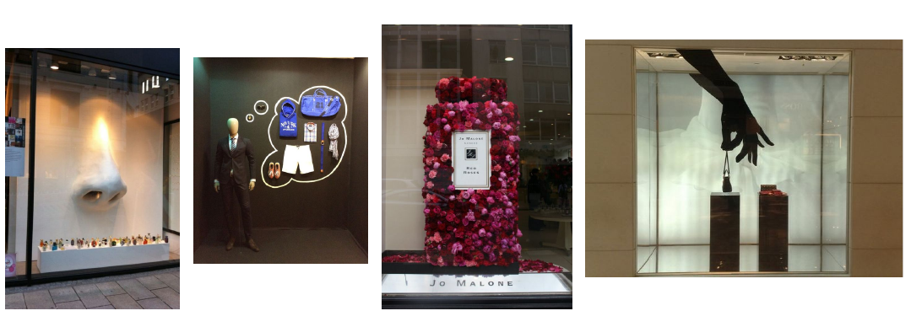
^{Dare !} Yes, let your imagination run wild, dare to use color, dare to use patterns, dare to think big! (ex: a small product placed on a huge colored chair, with marked lighting on the small product).
4/
IMAGING THOUGHT
A model in a suit imagining his weekend outfit
WINDOW STICKERS
A large stylized hand stickered on the window that mimics the holding of a bag positioned in the window
UNUSUAL PROPORTIONS
A gigantic nose that smells of perfumes
SHAPED FLOWERS
A multitude of flowers
that form a giant flask

Slide 8
^{Equip yourself} with basic furniture & supports First of all, it is important, when you want to animate your point of sale, to have some basic elements that will serve as supports to display your products or display, such as podiums, cases, steles, cubes, tables, poster holder to hang ... A smart investment, inexpensive and reusable which will allow you to modulate your next windows display as you wish!
5/
Mistake to avoid:
Do not put any products or display on the floor!

Slide 9
