Slide 1

The Experience of
Phyto-Aromatic Skincare
Notes:
Welcome to all of you. We are delighted to see you again. Thank you for attending.
We are here today for preparing with you the first post-summer action to be held in September, the ELIXIR VITAL campaign.

Slide 2
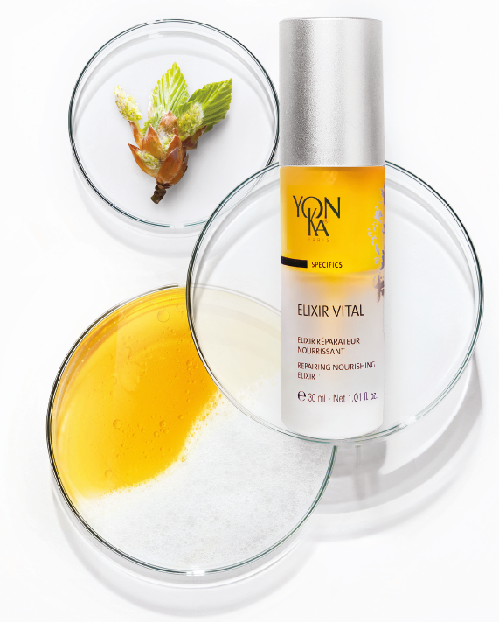

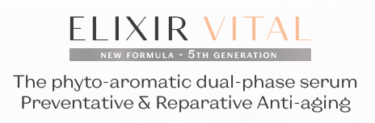

Notes:
You will see we have designed this ELIXIR VITAL campaign a bit like the launch of a new product.
Maybe you are surprised about that. Why ELIXIR VITAL?
It is not a new product and many of you have been knowing the product for a long time.
But in fact we would like you to re-discover this product, to consider it a bit differently, with a new approach. And of course, you will then do the same thing with your salons and spas, and so on through to the consumers. And among those consumers probably a number does not even know the product yet. Because when we look at the sales, it is very disappointing
Many of us are convinced it is a great product, but it is not such a good seller. And it should be!
There is a big potential in our opinion, but we have to work on it.
Moreover we have improved the formulation in 2019 and because of the COVID crisis, we haven’t been able to carry the proper communication about it. So we have decided to now take the opportunity to focus on this ELIXIR VITAL new generation and position it the way it deserves.
Today, the speakers will be Luna Armand for the marketing aspects and Sophie Basson for the technical/training side.
As usual we count on your active participation though the chat bar.
And of course we’ll keep some time at the end of the presentation for your questions and for getting your feedback. For the time being please turn off your mics for a better connection and comfort for everybody.
So Luna, could you please first tell us a bit more about the reasons for this ELIXIR VITAL project?

Slide 3
Context
Notes:
Let’s talk first about the context, and why this decision to activate again Elixir Vital.

Slide 4

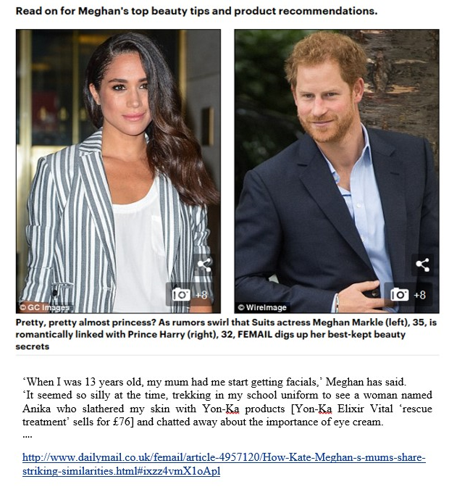
Why an Elixir Vital activation ?
An high market potential
Notes:
After having analyzed the face cosmetics market through market studies, after having interviewed Yon-Ka institutes, and following the numerous consumer feedbacks we have collected over the years, there is no doubt that Elixir Vital is a little-known product, which corresponds in every way to consumers' expectations.
We are convinced that Elixir Vital is a must-have, a cult product that not only meets all the expectations of consumers but also perfectly matches Yon-Ka's expectations for the future. The consumer insights are incredible, and even Meghan Markle is convinced by our Elixir.

Slide 5
Elixir Vital,
Consumer feedback
Notes:
As we just told you, the consumer testimonials are incredible and this is one of the reasons why we think this product is below its potential.

Slide 6
This elixir will transform your skin. It is extremely repairing and nourishing. Ideal for the fall and winter months.
"
Amy.

Slide 7
Anytime my skin needs a boost either du to over sun exposure or even winter blues, this is the must have! It's my sos product that just brings back my skin to a healthy glow.
"
Marie-Pierre Morin.

Slide 8
I've been using Yon-Ka products for 25 years. I tried this on a whim, and noticed results in the first week. WOW. Now that I've been using it regularly, my skin reacts quickly with very positive results. I don't know how to explain it... brighter, toned, the railroad tracks on my forehead are not as pronounced, and the parts of my face that don't have wrinkles the skin is just all around better.
"
Maxine.

Slide 9

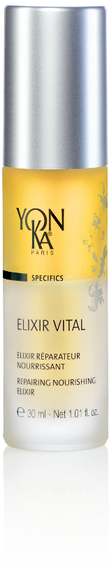
Why an Elixir Vital activation ?
An opportunity to put the spotlight
on this product
Notes:
In order to boost this product, and through an activation worthy of a real launch,
We are now adapting Elixir Vital to consumers' expectations while remaining faithful to the historical promises of this pioneering product. A reaffirmation of its effectiveness, a harmonized application method, a more organic and responsible formula.
Let us introduce you to the new activation strategy of Elixir Vital, that will become a must-have for all those in search of sensoriality, efficiency and naturality

Slide 10
Introduction
Notes:
Sophie, from the training, will explain to us how Elixir Vital can deliver on all the promises of this very ambitious name:
Because who says Elixir Vital says a skin full of life, healthy and in good health.

Slide 11
What characterizes a healthy skin ?
Hydrated skin
Soothed skin
Skin
full of vitality
Comfortable skin
Notes:
TRAINING
speaking of skin full of life in good health, could you tell me the characteristics of healthy skin?
what characterizes healthy skin ?
How do we recognize it ?
Indeed, it is a well hydrated skin, comfortable, soothed and full of vitality. It is a skin that will age less quickly. To guarantee this good health, it is essential to have a reinforced and balanced skin barrier.

Slide 12
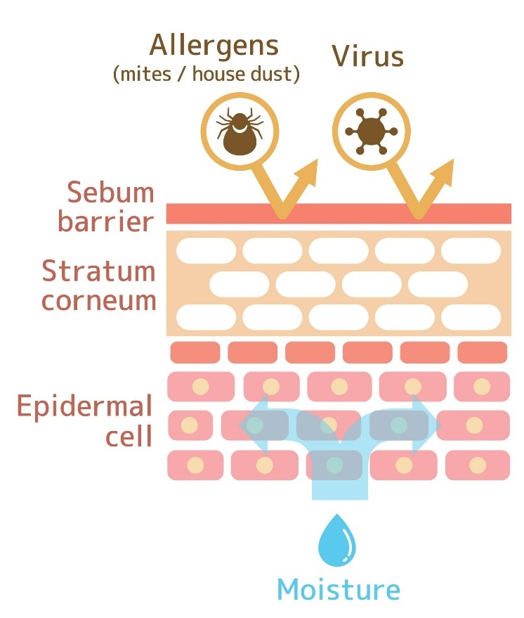
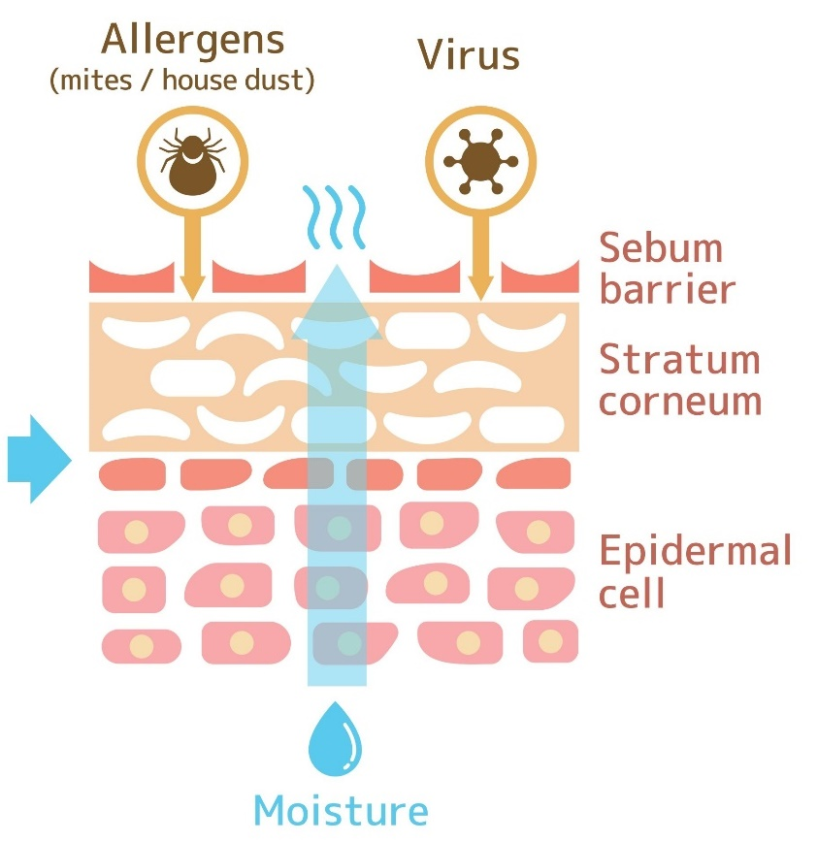
The skin barrier,
key to skin youthfulness & well-being
Balanced skin barrier
Damaged skin barrier
Notes:
TRAINING
Indeed, the skin barrier is the key to youth and well-being.
As a reminder, the skin barrier is the essential interface between the body and the outside world. It corresponds to the stratum corneum, the most superficial part of the epidermis. The stratum corneum is covered with a protective coat called the hydrolipidic film. It is our protective shield! As its name indicates it is made up of 2 phases, a hydrolic phase (sweat) and lipidic (sebum) which confers an acid Ph = 5,5
The balance of its 2 phases is essential because it guarantees a supple, soft, protected skin...
What happens when the hydrolipidic film is altered?
The barrier becomes permeable, it thus lets the liquids evaporate. This is called desiccation or insensible water loss. In this case, the skin is dehydrated, fine lines and even expression lines appear, and they will deepen over the years.
Without its protective shield, the skin also becomes more prone to external aggressions, it is therefore more sensitive, more reactive skin.
Yon-Ka understood the importance of this skin barrier over 55 years ago.

Slide 13
Precursor of professional biomimetic multi-phase skincare

Slide 14
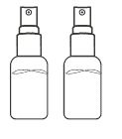



Multi-phase skincare through time
Mesonium 200
Mesonium 201
Mesonium 202
Mesonium 1
Mesonium 2
Serum Vital
Elixir Vital,
5th generation
Elixir Vital
1965
1993
2012
2017
Professional expertise extends to the home
Notes:
LUNA
More than 55 years ago, Yon-Ka pioneered the creation of multi-phase professional skincare, inspired by the skin's hydrolipidic film, with the creation of 3 professional ampoules. These were the first biomimetic formulas, designed to be used in synergy in order to pool their effectiveness and respond precisely to the problem of the alteration of the hydrolipidic film.
The products Mesonium 200 and 201 merge to create Mesonium 1 and Mesonium 202 becomes Mesonium 2 that you know today in professional products. These products are present in the vast majority of our protocols.
In 2012, our laboratories succeeded in merging these ultra-concentrated professional formulas, a synergy of repairing and revitalizing active ingredients from phyto-aromatherapy, to create a single product for consumers: the Vital Serum, which in 2017 became Elixir Vital.
This year, we are announcing to consumers the 5th generation, with a new formula for even more naturalness with Elixir Vital.

Slide 15
Elixir Vital, 5th generation
Formula & efficacy

Slide 16



A new formula anchored in naturalness
92%
of ingredients of natural origin
43%
of organic ingredients
Vegan
Gluten-free
Notes:
LUNA
Why did we want to create a new formula?
Simply to meet the expectations of consumers who today are looking for 2 things mainly: naturalness and efficiency.
Elixir Vital, 5th generation fits perfectly into this context of naturalness since it contains 92% of ingredients of natural origin including 43% of organic ingredients. It is also vegan and gluten-free.

Slide 17


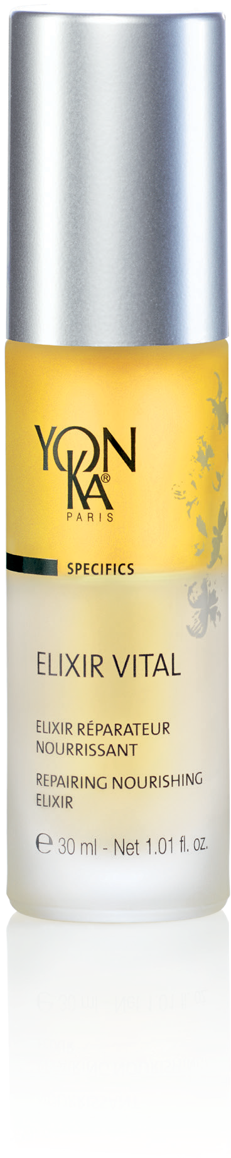

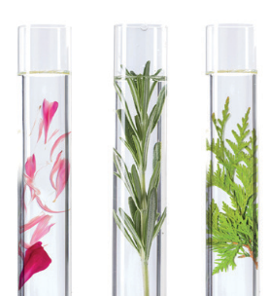

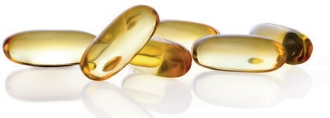
The heart of the formula
Organic beech buds peptides
Soy buds peptides
Rich in amino acids
Organic soy and sunflower oil,
non-GMO corn oil
Rich in omegas 3,6,9
Restructuring and hydrating
Nourishing and repairing
Niacinamide
Vitamin B5
Yon-Ka Quintessence
Rebalancing and intensifies the power of the formula
Soothing and revitalizing
Notes:
I would now like to take you on a journey into the heart of the new Elixir Vital formula.
The main active ingredients of Vital Elixir are organic beech buds peptides and soy buds peptides. These active ingredients are rich in amino acids and have restructuring and moisturizing properties.
out.
The buds peptides we can source contain 19 amino acids, including the 8 essential to the skin. Without compromising on the effectiveness or sensoriality of the formula. For the moment the update has not been done on the finished products, but will be done on the next production. The update has been done everywhere it was possible: product sheets, website, product brochure, and will intervene on the packaging and instructions as soon as the current stocks are sold
The Elixir Vital is also composed of a mixture of vegetable oils such as organic soy and sunflower oil, non GMO corn oil with nourishing and repairing properties. These vegetable oils recreate the oily phase of the hydrolipidic film. They are rich in omegas 3,6,9 which are essential to our body and which will prevent skin aging. As a reminder, we do not synthesize omegas, so it is very important to provide them through cosmetics, food (oily fish, oilseeds...) and food supplements.
The Elixir Vital is also composed of the star ingredient of the moment, Niacinamide. We did not communicate about Niacinamide, which was already present in the product but which we called Vitamin B3 or Vitamin PP (it’s the same but with other names), but given the extent of consumer enthusiasm for this active ingredient, we wanted to name it by its best known and recognized name. Indeed, you could not miss it, we talk about this asset in the professional press, in the women's press ... Naturally synthesized by the human body, it plays a role in all our organs. It stimulates the production of ceramides (the lipids that form the cement between the cells of the epidermis), the skin is thus stronger, less permeable to external irritating agents. Associated with vitamin B5, they are thus recognized for their soothing and revitalizing virtues.
Finally, we find our olfactory imprint, our DNA that makes us unique, the Quintessence. Recognized for its rebalancing and calming virtues, it also potentiates and multiplies the power of our formula.

Slide 18
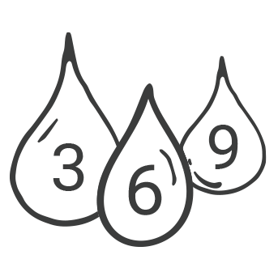

Elixir Vital – 4th and 5th generation
The differences
+
organic ingredients
+
Omega 3
+
responsible
& green sourcing
Notes:
the main differences between the 4th and 5th generation of elixir vital are :
More organic ingredients (de combien à combien)
Richer in omega 3, & always as much omega 6 and 9
More responsible & green sourcing

Slide 19
Visible, proven clinical efficacy*
Skin is
revitalized
88%
Skin is
soothed and nourished
83%
Skin is
comfortable and hydrated
92%
Skin is smoother
83%
*Use test, application once or twice a day for 4 consecutive weeks, on the face, by 24 women aged 35 to 67, with dry or very dry, dehydrated, fatigued skin lacking radiance and tone.
Now more that ever, Elixir Vital draws on the benefits of nature
and the efficacy of science To exalt the senses !
Notes:
LUNA
In addition to its strong naturalness, the visible clinical effectiveness of Elixir Vital is no longer to be proven!
In fact, after 4 weeks of use morning and night, the panelists found their skin
more revitalized at 88%,
soothed and nourished at 83%,
comfortable and hydrated at 92%
and smoothed at 83%.
These results highlight the ability of Elixir Vital to recreate the hydrolipidic film in a biomimetic way but also its action on skin aging.

Slide 20
Let’s play!
Quizz
Notes:
It's time to play a little. For each statement, answer true or false.

Slide 21

Elixir Vital mimics the protective
hydrolipidic film
of the skin
Notes:
TRAINING
1st assertion : the 2 phases imitate the protective hydrolipidic film - true - indeed the lipidic phase is reproduced thanks to the synergy of the organic vegetable oils of soy and sunflower and of corn oil and the hydrous phase with the association of the organic beech buds peptides and soy bud peptides.

Slide 22
Elixir Vital contains …
43%
of ingredients of natural origin
92%
of ingredients of natural origin
76%
of ingredients of natural origin
Notes:
2ème question : Elixir Vital contains 92% of ingredients of natural origin INCLUDING 43% of ingredien of natural origin

Slide 23
Niacinamide soothes and
has an anti-inflammatory action
Notes:
4th statement: Niacinamide soothes and has an anti-inflammatory action - true - Indeed, as a reminder, niacinamide stimulates the production of ceramides (the lipids that form the cement between the cells of the epidermis), the skin is thus stronger, less permeable to external irritating agents and therefore soothed

Slide 24
Elixir Vital smoothes wrinkles
Notes:
5th statement: Elixir Vital smoothes wrinkles - true - As a reminder, in our clinical study conducted by an independent laboratory, our panelists found their skin 83% smoother after 4 weeks of use morning and night.

Slide 25
Elixir Vital treats dark spots
Notes:
7th statement: Elixir Vital treats dark spots - false - On the other hand, we recommend the ultra-concentrated essential white range which will prevent, treat and correct blemishes. An even complexion guaranteed thanks to the C-White complex (the combination of vitamin C and red algae)
Let's continue with Luna the presentation of the 5th generation of vital elixir

Slide 26
Elixir Vital, 5th generation
Double efficiency & double use

Slide 27
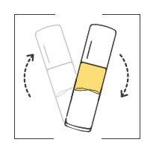
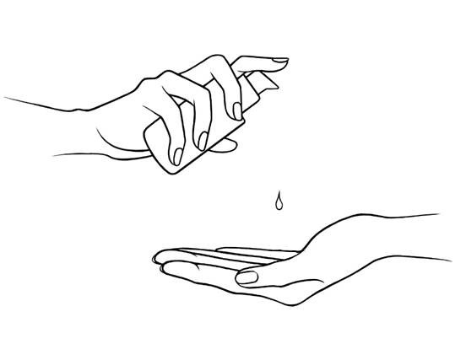

How to use ?
Blend the dual-phase texture
2 to 3 pumps
Alone or
under the usual care
USUAL CARE
+
+
The power of the 2 phases: hydric and lipidic, to blend at the last moment
to act in synergy and deliver their transformative power to the skin.
Notes:
LUNA
As you know if you are familiar with the existing Elixir Vital product, we never positioned it as a Serum because we said that the serum should be used alone.
However, after studying the best in class markets such as the USA and Korea, after collecting consumer opinions, and after studying the competition we do not want to restrict our product to a cure. Indeed, if we take the example of Clarins' Double Serum, which sells several million units, yet is neither pioneering nor natural, we confirm the potential of this product!
It is a product that has a galenic that corresponds perfectly to a Serum description, and that can be used under a cream for the skins that feel the need.

Slide 28
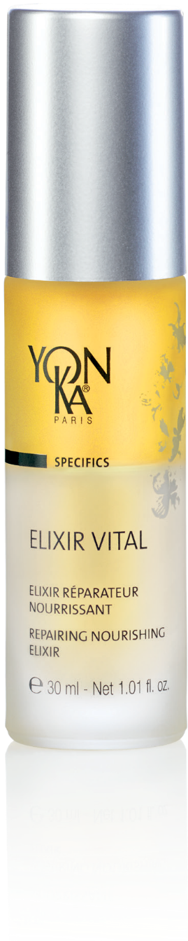
A double efficiency & a double-use
PREVENTATIVE
REPARATIVE
Hydrates
Nourishes
Revitalizes
Regenerates
Soothes
Smoothes
In anticipation all year round
Morning or evening
One month intensive treatment
Morning and evening
Notes:
LUNA
Let's continue with the double efficiency and double use of Elixir Vital.
We talk about double effectiveness because Elixir Vital will act both in prevention but also in repair.
Indeed, in prevention it will moisturize and nourish the skin by recreating the hydrolipidic film and also revitalize the skin. In this case, it will be used in prevention all year long, morning or evening. A bit like a food supplement, we treat the skin upstream in order to maintain its health and avoid the appearance of imbalance.
In repair, it will regenerate, soothe and smooth the skin. In this case, it will be used as an intensive treatment for one month, morning and night, to address a specific problem. Once this SOS treatment is complete, the client can switch back to his usual serum or stop using a serum.

Slide 29
To whom and how to advise ?
PREVENTATIVE
REPARATIVE
All skins
Tired skins
Damaged skins
Stressed skins
In anticipation all year round
Morning or evening
One month intensive treatment
Morning and evening
Alone or under the usual care
Notes:
LUNA
Who is Elixir Vital for?
As a preventive measure, Elixir Vital is intended for all skin types, all year round, morning or evening. The objective is to maintain the skin in good health.
In repair, the Elixir Vital is ideal in intensive treatment morning and evening for :
Tired skin, for example post pregnancy, illness, night working, at the change of season
Stressed skin: after a mechanical and/or climatic stress (sun, cold...)
Damaged skin: In pre-post operative treatment, post acne treatment, post-peeling...

Slide 30
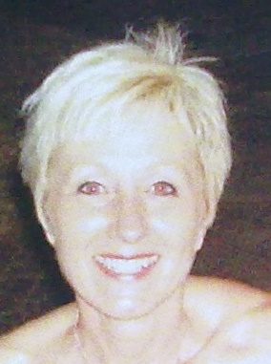
They can’t do without it !
Elaine Bryant
UK Training Manager
« When I’ve had girls come in saying that they are getting married and that their skin is breaking out, and very distressed with all the trials and tribulations of organising the Big Day, I just tell them to USE ELIXIR VITAL FOR A MONTH BEFORE and they are never disappointed as the Elixir works it’s wonders so that the skin is RADIENT and PERFECT on the day. »
Notes:
When I’ve had girls come in saying that they are getting married and that their skin is breaking out, and very distressed with all the trials and tribulations of organising the Big Day, I just tell them to use Elixir Vital for a month before and they are never disappointed as the Elixir works it’s wonders so that the skin is radient and perfect on the day.
When we were still in the Mesonium days and the poor therapist came on training, she had recently finished intensive medical treatments for acne and strong medication, her skin was really traumatised and she was very concious of it. During training we kept treatment to a minimum but did carry out a hydralessance using mesonium and the skin responded well to this. She then purchased some mesonium and when she returned for Module II of training was so happy with the results she could see from the Mesonium, the skin had calmed down, did not look so unbalanced the scar tissue was not so inflammed. She was over the moon. If this is the result we had with Mesonium you can imagine now with the improved formula of Elixir Vital.
We had a stressed headmistress come as model on training, she thought her skin was sensitive but actually more dehydrated. After treatment the therapist recommended a few products including Serum Vital (now Elixir Vital) the next time I saw the client she told me that she was exceptionally impressed as not only she was noting the results on the skin. In the supermarket the checkout cashier asked her what she used on her skin as it was beautiful and wanted to use the same thing !!!! To this day she still LOVES her Yon-Ka and says there is nothing else that compares !!! The client’s skin was black.

Slide 31
Let’s play!
True/False
Notes:
As for the ^{first} quiz, here are some statements that you will have to answer true or false.

Slide 32
Elixir Vital can be used every day, all year long
Notes:
TRAINING
1st statement: Elixir Vital can be used every day all year long - true - indeed in the case of prevention, it is possible to use it in anticipation of imbalance all year round morning or evening.

Slide 33
The intensive treatment of Elixir Vital lasts 1 month
Notes:
2nd statement: the intensive treatment of Elixir Vital lasts 1 month - true - the pump delivers approximately 0.15 ml. At the rate of 3 presses per application, this allows for 33 days of use at a rate of 2 uses per day

Slide 34
Elixir Vital can be used post-peeling
Notes:
3rd statement: Elixir Vital can be used after a peel - true - indeed, Yon-Ka peels have a Ph of 3.5, so it is important after a peel to restore the hydrolipidic film which has a Ph of about 5.5.

Slide 35
I can apply sun protection over Elixir Vital
Notes:
4th statement: I can apply a sunscreen over Elixir Vital - true - Elixir Vital does not contain any sunscreen so it is possible to use our SPF 50 over it

Slide 36
Elixir Vital can only be used with a care cream
Notes:
5th statement: Elixir Vital can be used with a skin care cream - false - It can be used alone or with your usual skin care product depending on your skin type and current needs. For mature skin, it is recommended to apply a skin care cream afterwards.

Slide 37
I can use Elixir Vital under my night cream and
another serum in the morning under my day cream
Notes:
6th statement: I can use Elixir Vital under my night cream and another serum in the morning under my day cream - true
Elixir Vital is perfectly integrated into a personalized beauty routine, according to the diagnosis established beforehand.

Slide 38
Elixir Vital can be used by sensitive skin
with imperfections
Notes:
8th statement: Elixir Vital can be used by sensitive skin with imperfections - true - Elixir Vital will help recreate the skin's natural protective barrier, making it less permeable and less prone to external aggression. In addition, niacinamide's anti-inflammatory properties will help soothe the skin. The imperfections will be able to be treated locally with the range Purity. Clogged pores and hyperkeratosis are at the origin of the increase of the production of sebum and the appearance of imperfections. Think of recommending to exfoliate the skin to avoid imperfections.

Slide 39
Elixir Vital is not suitable for oily skin
Notes:
9th statement: Elixir Vital is not suitable for oily skin - false - People with oily skin are looking for a matte skin without imperfections, so they tend to strip their skin by using products that are too abrasive, astringent ... and end up altering the hydrolipid film. Unfortunately it is the opposite action that occurs, the skin feels attacked and to protect itself it will produce even more sebum, it is the beginning of a vicious circle. This is why we recommend that oily skin use Elixir Vital to recreate the natural protective barrier.

Slide 40
The serum offer
Notes:
Let's rediscover together the Yon-Ka serum offer, where we will find the Elixir Vital in the company of the other serums

Slide 41
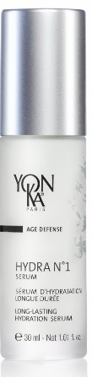
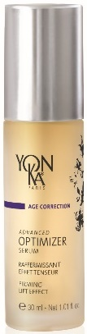
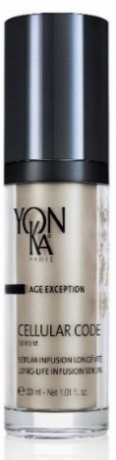

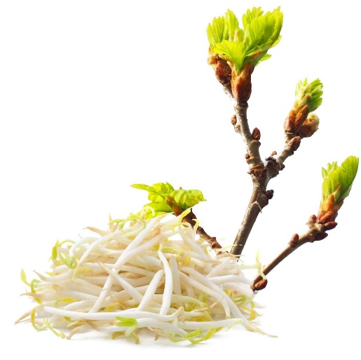

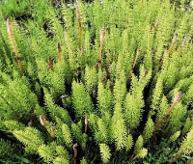

Serums for in-depth action
HYDRATION
FIRMNESS
GLOBAL ANTI-AGING
PREVENTATIVE
& REPARATIVE
ANTI-AGING
Cell-Energy
Complex
Hydra n1 Serum
Advanced Optimizer Serum
Cellular Code Serum
Elixir Vital
Notes:
TRAINING
Let's review the most important information and the positioning of each serum:
- For whom?
- Product advantages ?
HYDRA N1 SERUM = HYDRATION
This moisturizing serum with hyaluronic acid is the perfect treatment for very dehydrated skin, providing deep and long-lasting hydration
Product advantages
Contains 93% natural ingredients
Intensely moisturizes for a long period of time
The skin is soft, supple and plump
Anti-ageing action (or preserves the youth of the skin)
ADVANCED OPTIMIZER SERUM = FIRMNESS
Advanced Optimizer Serum Rich in hibiscus peptides that stimulate collagen production, it visibly firms the skin of the face and neck. The features are as if redefined, the skin more toned and smoother.
Product advantages
Contains hibiscus peptides and horsetail extracts
Firms the face and neck
Boosts the effectiveness of Advanced Optimizer Cream
Provides an immediate tightening effect
CELLULAR CODE SERUM = GLOBAL ANTI-AGING
Cellular Code promotes the reactivation of the skin's youthful code thanks to the "Cell-Energy" complex. Day after day, this intelligent serum energizes and regenerates the epidermis. Wrinkles and signs of fatigue fade away, the skin becomes smoother, firmer and more radiant.
Product advantages
Contains 96% natural ingredients
Provides the skin with energy and firmness
Resets its youth code
Smoothes out the signs of fatigue
ELIXIR VITAL = ANTI-AGING PREVENTION & REPAIR
This face serum is the multi-regenerating SOS treatment, preventive & reparative anti aging. Highly concentrated in plant extracts, it is rich in vitalizing amino acids and a nutritive, soothing and anti-aging vitamin cocktail
Product advantages
- Contains 92% natural ingredients, including 43% organic ingredients, vegan and gluten free
Repairs and revitalizes deficient and tired skin
The skin is soothed and regenerated
Fine texture and fast absorption

Slide 42
Let’s play!
Quiz
Notes:
Now let's test your knowledge of the Yon-Ka serum offer with some case studies.

Slide 43
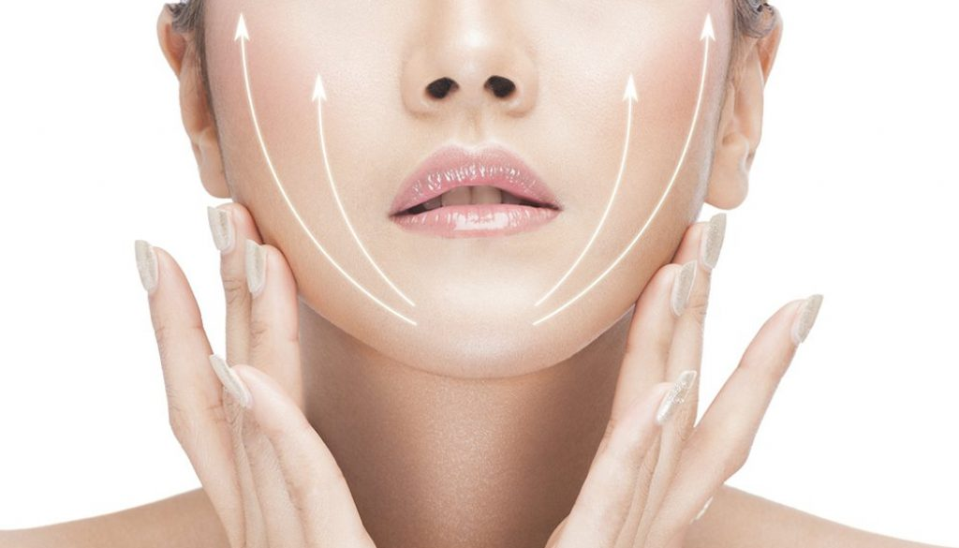
I have sagging skin around my face and arms,
my ideal serum is...
Notes:
^{1st} case : .
Indeed, thanks to hibiscus peptides and horsetail, Advanced Optimizer Serum will help firm and redensify tissues.

Slide 44
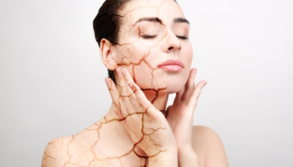
I feel tightness and discomfort on my skin
after the shower, my ideal serum ...
Notes:
2nd case : ....
For dehydrated skin prone to tightness and discomfort, Hydra N1 Serum is the ideal ally. The association of imperata cylindrica and hyaluronic acid will guarantee a deep and long-lasting hydration. The skin will find all its softness, flexibility and the fine lines of dehydration will disappear.

Slide 45
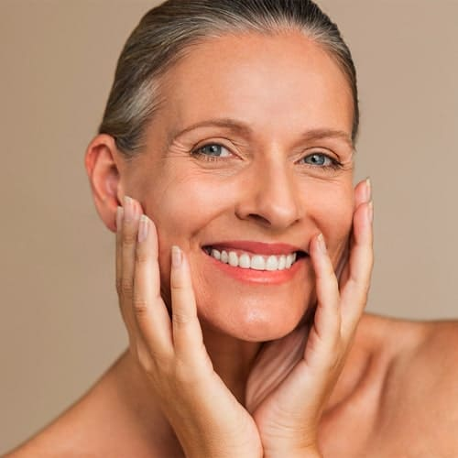
I have mature skin, wrinkles, lack of firmness, pigment spots and dull complexion,
my ideal serum is ...
Notes:
3rd case : ....
Cellular Code Serum is the ideal ally to reactivate the skin's youth code. Thanks to the "Cell-Energy" complex, a combination of super-powerful natural active ingredients, it combats cellular aging and treats all signs of aging at 360°.

Slide 46


I have just given birth and I am very tired and I don't recognize my skin anymore, my ideal serum is ...
Notes:
4th case : ....
Pregnancy is a period of great hormonal fluctuation and it is sometimes difficult to recognize one's own skin. In this case, Elixir Vital is the ally of the moment. Used as a repair treatment, in a one month treatment morning and evening, it will restore the skin's natural protective barrier, soothe the skin and rebalance the skin.

Slide 47
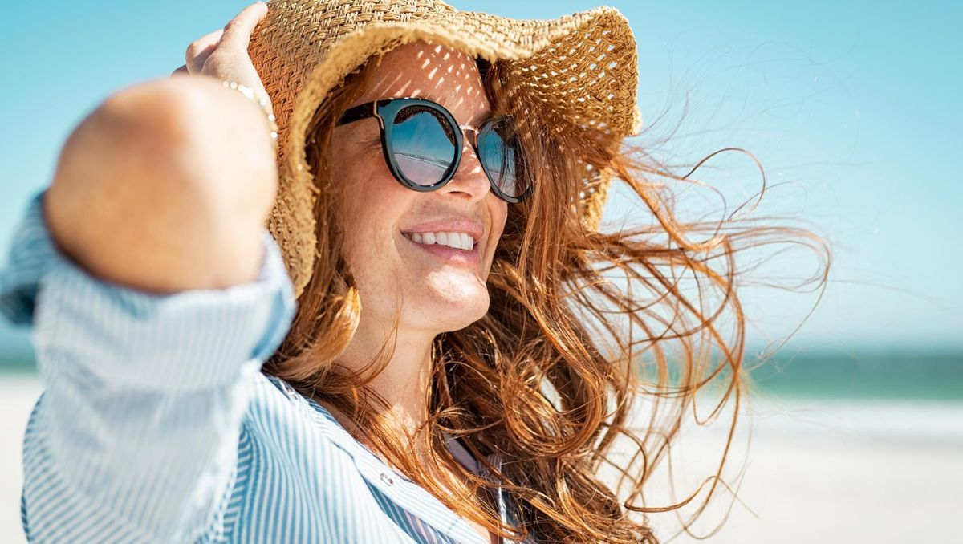
I am 45 years old and I have just spent a month in Martinique, my skin is damaged by the sun and heat,
my ideal serum is ...
Notes:
5th case : ....
In this case, the skin is altered, suffering because of climatic stress. Elixir Vital is therefore the ideal ally in a one-month treatment, morning and evening, to repair and rebalance the skin.

Slide 48
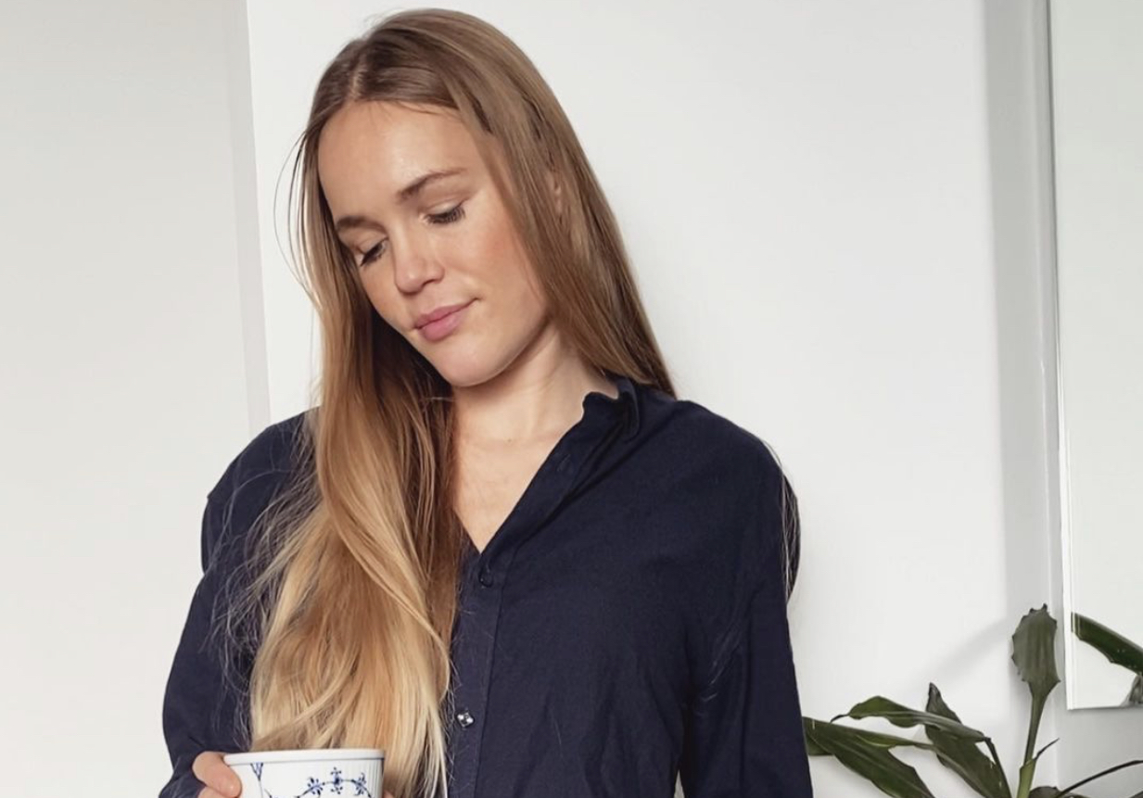
I am 30 years old, my skin is normal but I am looking to preserve the health and vitality of my skin to anticipate the signs of aging my ideal serum is …
Notes:
6th case : ....
In this case Elixir Vital is the ideal ally As a preventive measure. Elixir Vital is intended for all skin types, all year round, morning or evening. The objective is to maintain the skin in good health.

Slide 49
To remember
Notes:
Let's look at the most important information to remember in order to present and sell Elixir Vital

Slide 50
The 5 key points to remember
1
Phyto-aromatic
dual-phase serum
5
Double-use
2
92%
of ingredients
of natural origin
4
Double-efficiency
3
43%
of organic ingredients
Notes:
TRAINING
To finalize this webinar, we suggest you share with us what you think are the 5 key points to remember about Elixir Vital.
What information do you consider essential to the knowledge of the product?
what are the sales arguments that you would put forward to present the elixir vital ?

Slide 51
The summary
For whom ?
RESTRUCTURING
HYDRATING
All skin types, tired,
stressed and damaged skin
Organic beech buds peptides
Soy buds peptides
Why ?
Preventative
& Reparative anti-aging
NOURISHING
REPAIRING
How to use ?
Organic soy and sunflower oil
Non-GMO corn
Alone or under his usual care
When ?
SOOTHING
REVITALIZING
Daily morning or evening
One month treatment in the morning and evening
Niacinamide and Vitamin B5
Notes:
TRAINING
To summarize, Elixir Vital is a double phyto-aromatic serum for skin aging prevention and repair .
It is composed of Organic beech buds peptides and Soy buds peptides rich in amino acids and restructuring and hydrating properties but also of organic soy oil, sunflower, and non GMO corn oil with nourishing and repairing virtues and finally the niacinamide and the vitamin B5, soothing and revitalizing.
This cocktail of active ingredients is ideal for all skin types as a preventive measure and for tired, stressed and damaged skin as a repair measure. Apply alone or under your usual skin care product and daily morning or evening as prevention and as a one-month intensive treatment morning and evening as repair.
Feel free to print this summary slide for your sales people or to put in your institutes.
Thank you for your participation. I'll let Luna present the different tools developed for this operation.

Slide 52
360° activation
Notes:
activation will be available on the Espace professionel

Slide 53
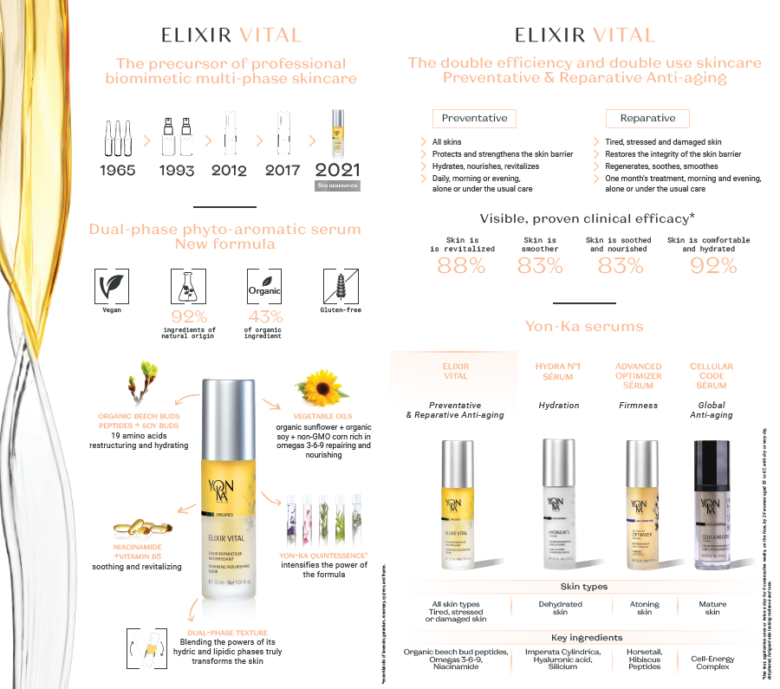
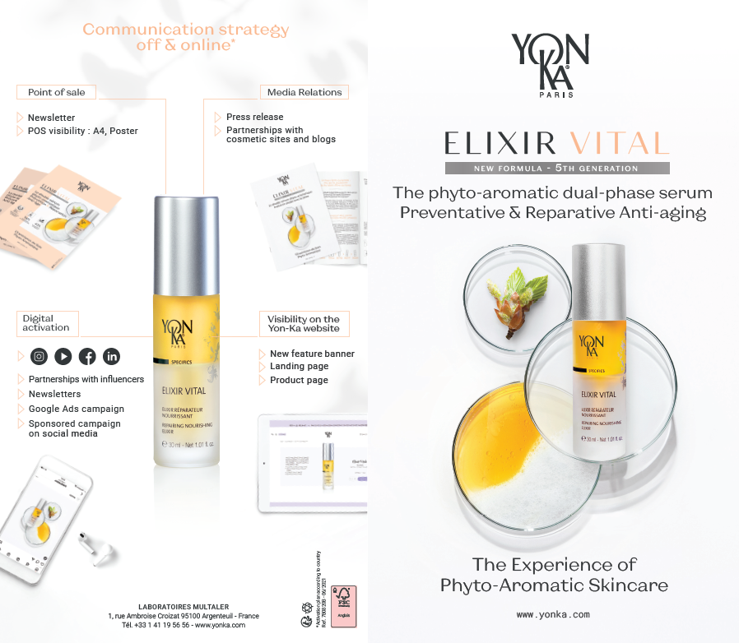
Assets available for activation
Sales Presentation
Notes:
This sales pitch is already available in print and digital versions in English and French. It is a tool that will help you keep in mind the main elements of this product repositioning.

Slide 54
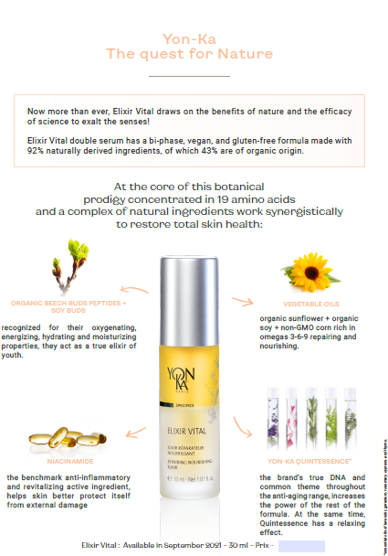
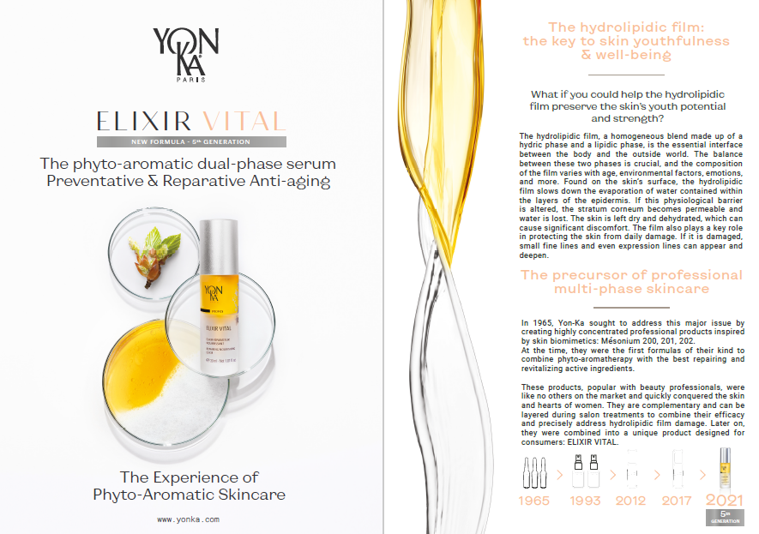
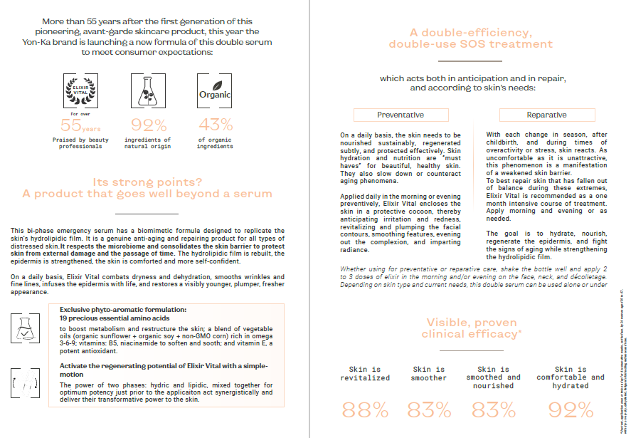
Assets available for activation
Press release
Notes:
In addition to the poster and in order to make the point of sale more dynamic, whether on the counter, in the window or in the stand, we have developed a French/English podium highlighting the main promises on two phases in French and on the other two in English. This podium is already available and will arrive flat.

Slide 55
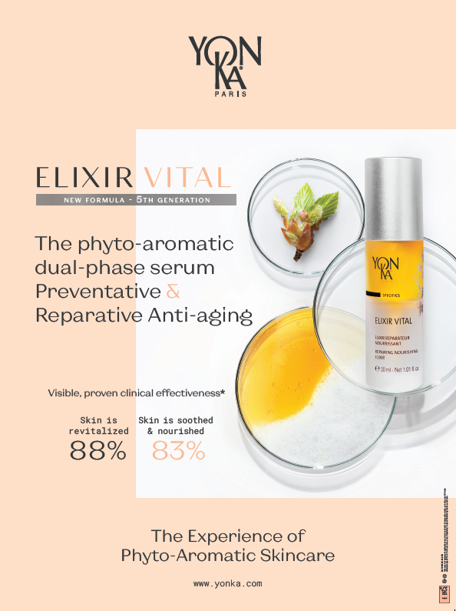
Assets available for activation
Poster
Notes:
We also want the product to be highly visible at the point of sale, so a poster has been developed highlighting the results that prove the effectiveness of the product and the very graphic and two-phase aspect of the product.
The poster is already available in print and digital version in English and French

Slide 56
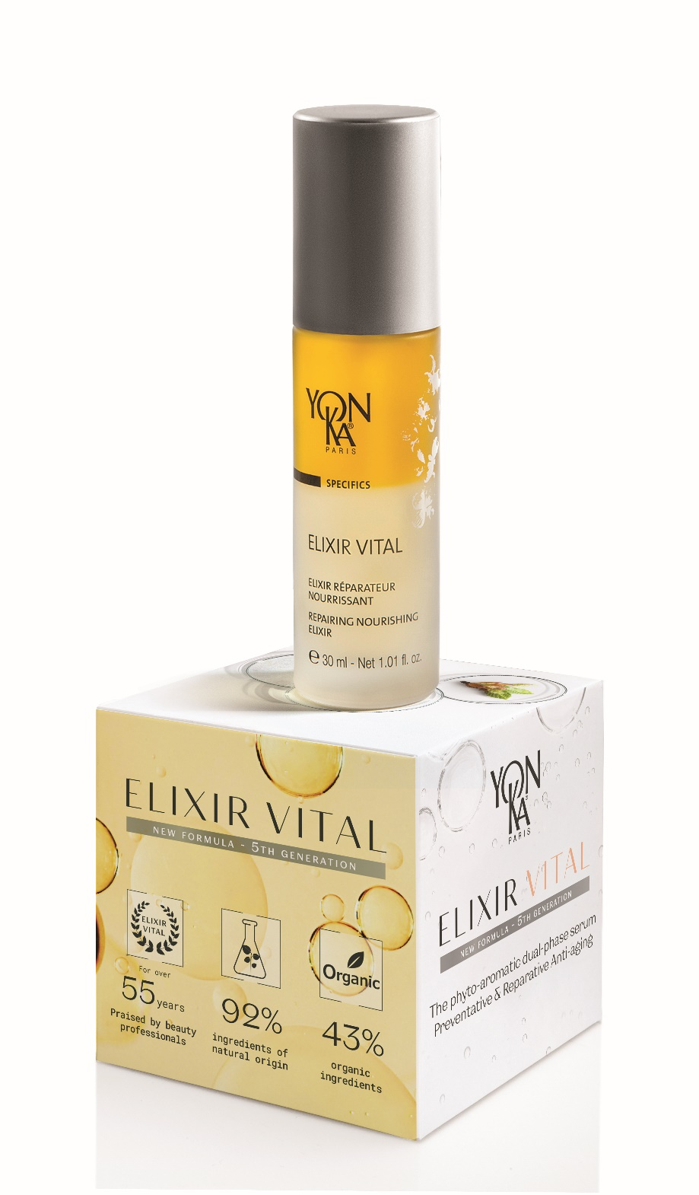
Assets available for activation
Podium
Notes:
In addition to the poster and in order to make the point of sale more dynamic, whether on the counter, in the window or in the booth, we have developed a French/English podium highlighting the main promises on two phases in French and on the other two in English. This podium is already available.

Slide 57
Assets available for activation
Mail signature
Notes:
We will develop an email signature, so that all your collaborators can see the product during your exchanges. The signature will be available in July.

Slide 58
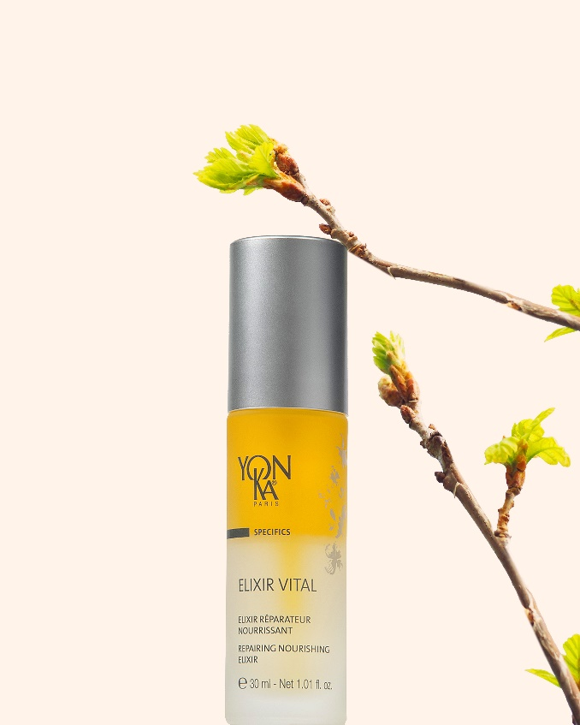
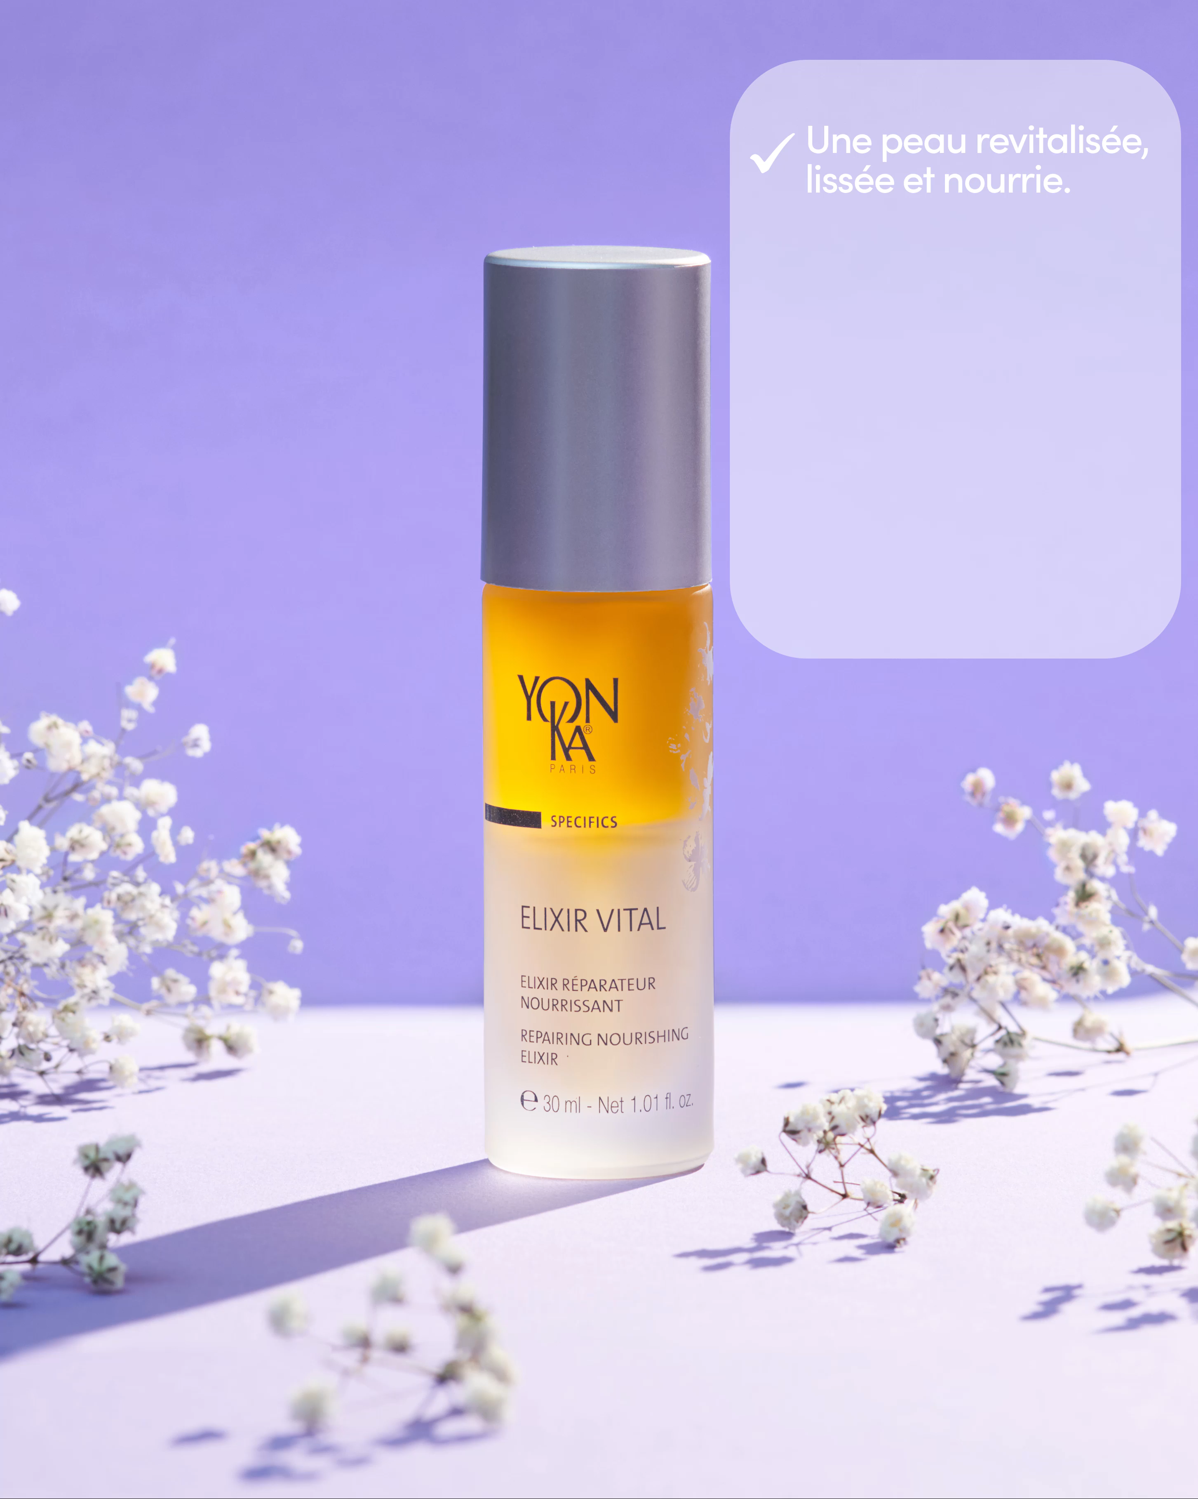
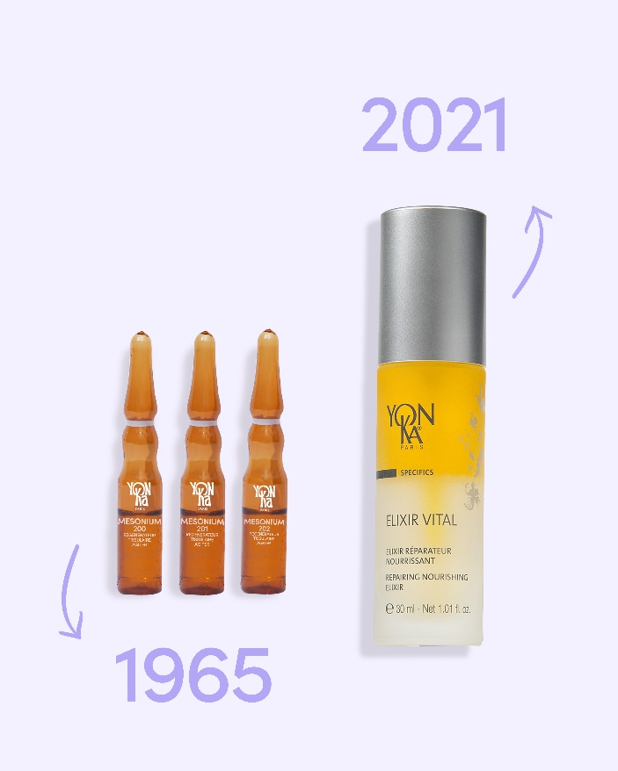
Assets available for activation
Media Kit
A complete digital activation
Planning with texts and images
Notes:
We do not only want a physical activation but also a big digital activation. For this, a complete media kit of 9 posts, with 8 series of several stories in French and in english were developed by our digital team.
We count on your participation on digital platforms to make this product viral and create a real international buzz!
The complete media kit, including the 9 posts and associated stories, the 2 newsletters, as well as the updated website page will be available next week in French and English.

Slide 59
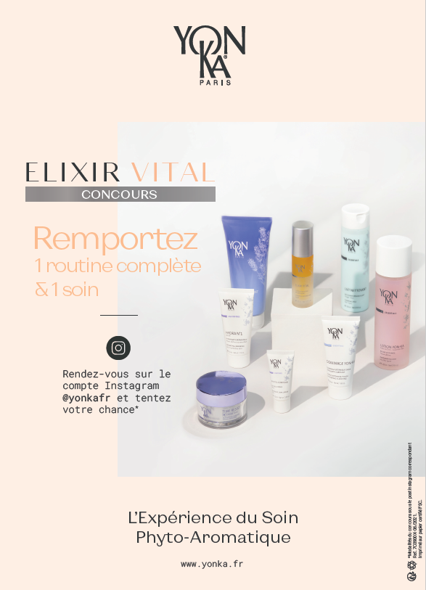
Assets available for activation
Digital Contest
Win 1 treatment & 1 complete routine
Go to the Instagram account account @yonka and try your chance*
In the routine : 1 makeup remover + 1 Lotion + 1 contours treatment
+ 1 Elixir Vital + 1 scrub + 1 mask
Conditions :
Follow the Instagram account
Like the post
Identify 2 friends
Identify the nearest Yon-Ka institute
Notes:
To encourage the creation of virality on social networks, we have set up a contest. In order for the institutes to participate, we wanted to include them in the prize draw by giving them the opportunity to win a treatment and a product routine to be picked up at the institute, and by asking participants to identify the Yon-Ka center closest to their home.
We encourage you to run the same contest in your country to increase the chances of seeing it invade social networks.

Slide 60
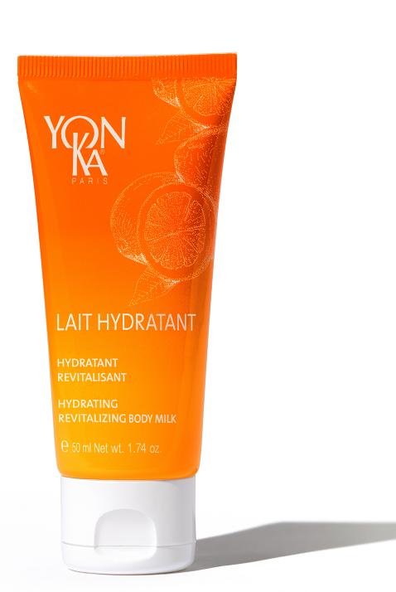
CONSUMER OFFER
September 2021
1 ELIXIR VITAL purchased
1 LAIT HYDRATANT for free
travel size
Notes:
You see we have developed a lot of tools for improving the visibility and the understanding of the product. So please make the best use of them, share them with your spas and salons, use them for social media and the press. September has to be the ELIXIR VITAL month everywhere!
It will help to boost the sales, but we know it is always better when consumers, and also spas and salons, get some incentive with purchase.
Though we do not recommend any discount on the price since we want to keep a premium image for the product.
Our suggestion is to offer to consumers a complementary product as a part of the home routine. Travel size products are particularly convenient for that kind of gift with purchase.
We recommend the body LAIT HYDRATANT, of the AROMA-FUSION VITALITY line, our mandarin sweet orange body milk.
With its repairing, hydrating and nourishing benefits for the body it is a very consistent association with ELIXIR VITAL for the face.
We have then a perfect face and body duo.

Slide 61
POINTS OF SALE OFFER
4 ELIXIR VITAL purchased
FOR FREE
=
Notes:
So for offering LAIT HYDRATANT travel size to their clients, your accounts have to get from you 1 for free with each ELIXIR VITAL purchased.
But we also recommend that you make a very special offer for ELIXIR VITAL, like a 4+1 offer, ie 4 products charged + 1 for free.
The free product can be used as a tester for consumers and also for their staff to test it if they do not know the product so well. And when your accounts order more than 4, like 8 or 12 it is like they even get a better purchasing price because they receive more free products but they need only one tester..
In order to reach a higher value of order from your spas and salons, you may also make a special offer for all the serums of the Yon-Ka range, including ELIXIR VITAL.

Slide 62
DISTRIBUTOR OFFER
order placed in July
50 ELIXIR VITAL
for the price of 40
4 + 1 for free
LAIT HYDRATANT
travel size
at half price
Notes:
To help you to make those offers to your accounts, we grant you very generous terms on ELIXIR VITAL and LAIT HYDRATANT travel size:
When you order of full case of 50 ELIXIR VITAL, you pay 40 and you get 10 FOR FREE. Thus you can offer the 4+1 to your accounts at no cost at all from your end.
And for LAIT HYDRATANT travel size you get from us 50% discount on the usual price.
For taking advantage of those terms you have to place your order now, in July, and ask for a shipment in July or August, for running the campaign in September. Djamila is about sending to you the special order form for this campaign.
So you have seen our 360° strategy for boosting the sales of ELIXIR VITAL as Luna said, and we do hope we’ll succeed together.
That’s it for us and we would like now to listen to your comments and maybe answer your questions if you have some. So please go ahead, it’s your turn!

Slide 63
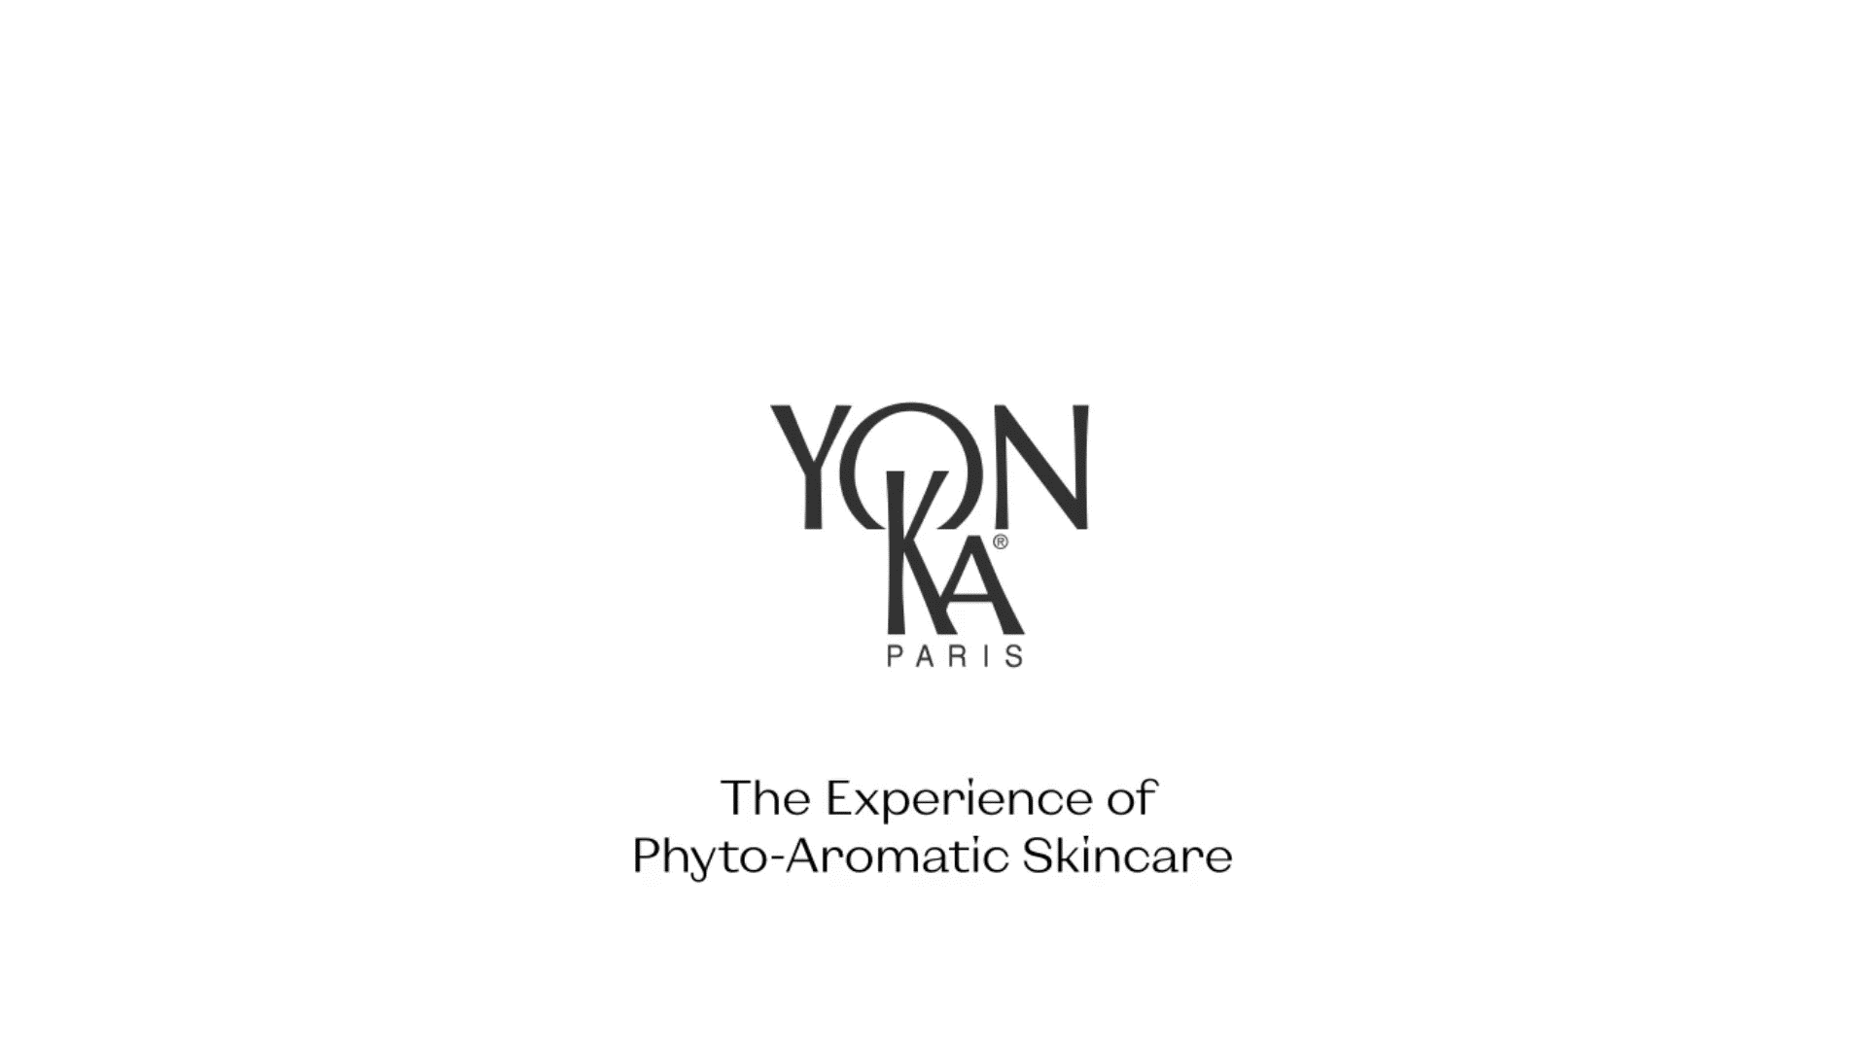
Assets available for activation
Video

Slide 64
Questions?
Notes:
Do you have any question?

Slide 65
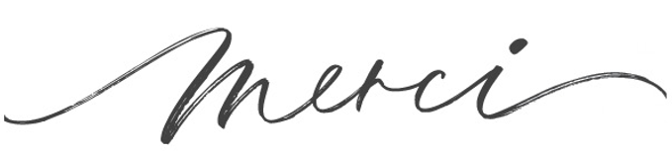
Notes:
Thank you for your attention and participation.
We were delighted to share this webinar with you and this highlight of Elixir Vital, 5th generation.
We remain available for any further information and wish you a nice day.

