Slide 1
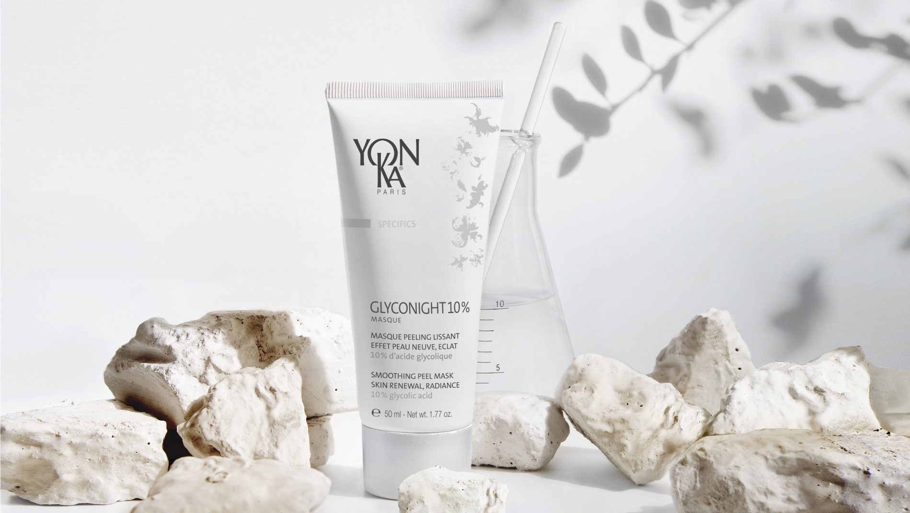
WELCOME EVERYONE

Slide 2

quizz
The skin and night

Slide 3
quizz
HOW MANY DAYS DO WE SLEEP A YEAR ?
a. 118 days
b. 43 days
c. 16 days

Slide 4


quizz
Answer by true or false
At night the skin renews 2 to 3 times faster than during the day.
b. Skin's cells renewal is at its peak between 2:00 am and 4:00 am
c. The skin is more receptive at night
d. There is a peak in microcirculation between 11:00 pm and 4:00 am.
e. At night the skin produces more sebum than during the day.

Slide 5

Zoom on the biological clock of the skin
DAY
PROTECTION
REGENERATION
NIGHT

Slide 6
What is cell renewal ?
Notes:
We will do a little reminder about what is cell renewal, what is this process our skin is doing every 28 days,

Slide 7
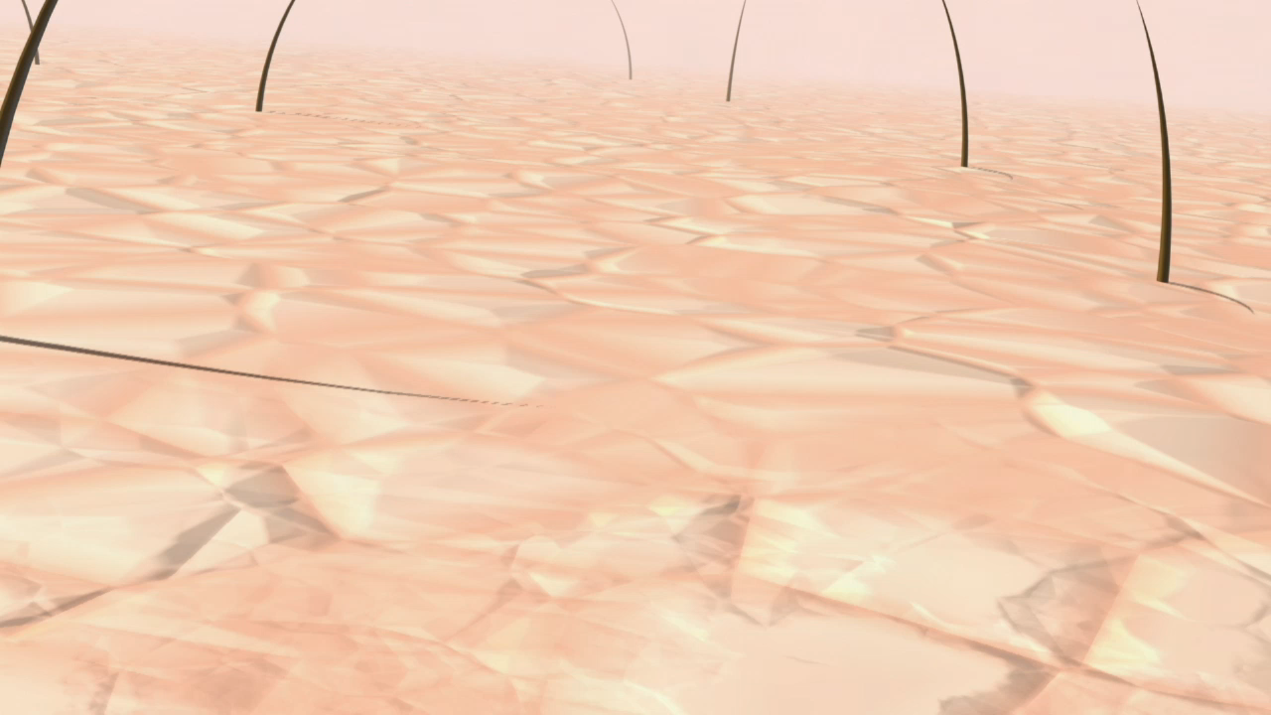

Cell renewal
Cell renewal process
The epidermis is constantly being renewed. In this natural process, dead skin cells flake off and are replaced about once every 28 days.
1/ At the beginning of the cycle, cells known as keratinocytes emerge as specialized cells.
2/ When they migrate to the surface of the skin, the keratinocytes flatten and harden.
3/ When they reach the stratum corneum, the keratinocytes are converted to corneocytes, which are the dead cells that create the skin’s natural protective barrier.
4/ While new cells migrate to the surface of the skin, the accumulated corneocytes naturally flake off (shedding).
Source : Nouvelles Esthétiques
Notes:
As you can see on this short video, you have different steps in the cell renewal process,
1/ At the beginning of the cycle, cells known as keratinocytes emerge as specialized cells.
2/ When they migrate to the surface of the skin, the keratinocytes flatten and harden.
3/ When they reach the stratum corneum, the keratinocytes are converted to corneocytes, which are the dead cells that create the skin’s natural protective barrier.
4/ While new cells migrate to the surface of the skin, the accumulated corneocytes naturally flake off (shedding).
It is therefore important to help the skin in this process of cell renewal. Some factors can discrupt the skin renewal

Slide 8
quizz
What are the factors
that disrupt the process
of cell renewal ?

Slide 9

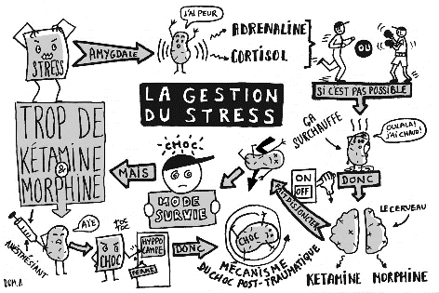
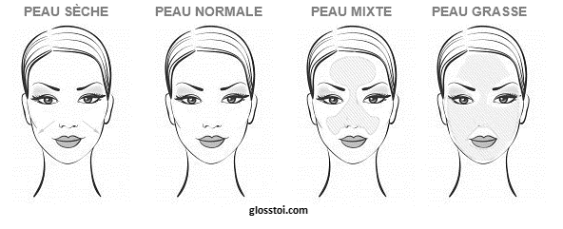



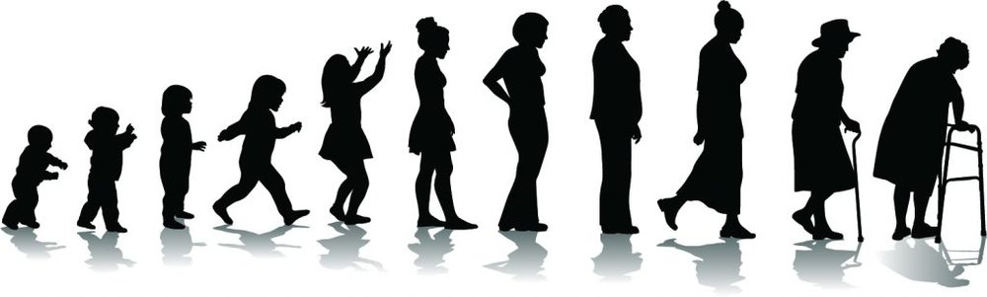
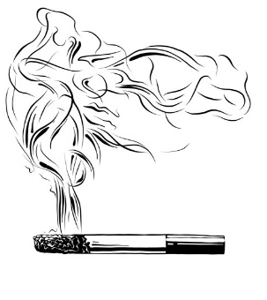
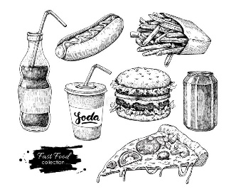
quizz
the internal factors
The external factors
Skin Types
Pollution
Hormonal disorder
Stress
Sun
Age
Disease
Smoking
Unbalanced diet
It is therefore important to help the skin in this process of cell renewal.

Slide 10
What are ahas ?

Slide 11
Definition of aha
The aha
AHA means : Alpha-hydroxy acid. AHAs are of natural or synthetic origins.
They are therefore a kind of very powerful exfoliator.
They smooth the skin by removing its dead cells, bringing an immediate healthy glow effect.
In addition to this keratolytic effect, each has a complementary action

Slide 12
The different types of AHA
the ahas
Citric Acid
Lactic Acid
Mandelic Acid
Malic Acid
Tartaric acid
Glycolic Acid
Fermentation of milk and fruit sugar extract, pulses.
Ideal for sensitive and dry skin
Bitter almond extract
Ideal for sensitive skin
Extract from sugar cane, pineapple or synthetic
The smallest AHA therefore the most effective one
Citrus fruit extract
Apple, pear and grape extracts
Grape extract
keratolytic
Radiance booster
Astringent
Moisturising
Depigmenting
Hydrating
Antioxidant
Anti-inflammatory
Anti-wrinkle

Slide 13


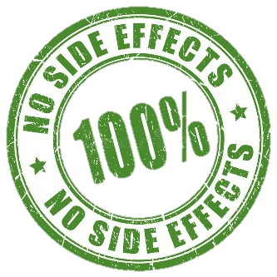

Yon-ka legitimacy
Market trends
New markets and consumers needs.
effectiveness
Safety
Naturality
Sustainability
Matching Yon-Ka context
Yon-Ka: Legitimacy in its response to the need for “new skin”
A pioneer in AHA skin peels
Known for its professional peels in spas and beauty salons
First in the use of night masks
Notes:
The market and the consumer needs are evolving, and we found out 4 pilars that are now leading the cosmetic market :
Search for effectiveness: the product must be proven to be effective through clinical and instrumental tests, with before/after visuals.
Quest for safety and reassurance: products with proven tolerance, free of controversial ingredients, with as much information as possible about the formula.
Quest for natural products, still growing rapidly. Growing need for natural products with organic ingredients.
Always environmentally friendly, with sustainable development criteria: importance of recyclable packaging.
Our new product is matching this needs and also matching with the Yon-Ka expertise and makes us legetimate.
Yon-Ka already has a strong reputation for the quality of its professional peels in institutes and spas, which gives the brand high credibility when it comes to offering a product for individuals to use at home in their quest for “new skin.” We were pioneer in the use of AHA in our products, we already have a large range of professional peels. We’re also pioneer in the use of night masks (Hydra No. 1 Mask).
Launching a night mask with glycolic acid as a primary active ingredient, already known to be effective, is in keeping with the market trend and is an excellent opportunity to increase revenues for the Yon-Ka brand and satisfy customers.
At the same time as the quest to restore a youthful look, the cosmetics market has thriving trends with the following criteria:
Search for effectiveness: the product must be proven to be effective through clinical and instrumental tests, with before/after visuals.
Quest for safety and reassurance: products with proven tolerance, free of controversial ingredients, with as much information as possible about the formula.
Quest for natural products, still growing rapidly. Growing need for natural products with organic ingredients.
Always environmentally friendly, with sustainable development criteria: importance of recyclable packaging.
Yon-Ka already has a strong reputation for the quality of its professional peels in institutes and spas, which gives the brand high credibility when it comes to offering a product for individuals to use at home in their quest for “new skin.”
Yon-Ka was a pioneer in the use of night masks (Hydra No. 1 Mask). Since K-beauty has grown in popularity, night masks have become very trendy in the market. Consumers love them for their simplicity of use and for the fact that they work (leaving a mask on all night optimizes the delivery of the active ingredients).
In Yon-Ka’s product line, Alpha-Peel and Alpha-Fluid meet the need to reveal new skin (Specifics range, Resurfacing subcategory), but glycolic acid is not the star ingredient in those products (it is a combination of AHAs). cf. focus on positioning in relation to existing products.
Launching a night mask with glycolic acid as a primary active ingredient, already known to be effective, is in keeping with the market trend and is an excellent opportunity to increase revenues for the Yon-Ka brand and satisfy customers.

Slide 14
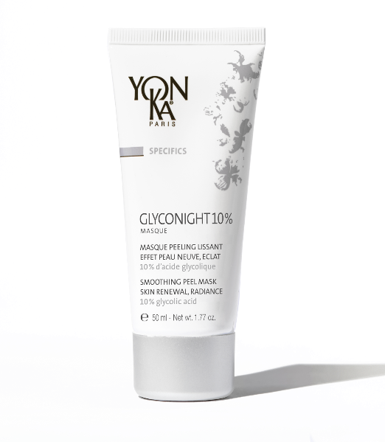
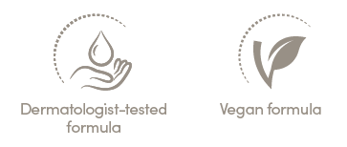
Yon-Ka’s solution
GLYCONIGHT 10% MASK
Smoothing peel mask, skin renewal, radiance
10% pure glycolic acid
Immediate and reinforced efficiency through the duration of the course
Anti-aging, New skin appearance, Radiance
Tube 50 ml
Recommended price
Zone Euro : 59 € / USA : 79 USD
Notes:
To meet the "new skin" expectations of our consumers with an innovative product Assert our scientific expertise thanks to this innovation: a product concentrated in glycolic acid with a clean composition.
The formulation developed by our doctors of medicine and pharmacy is indeed a real feat.

Slide 15
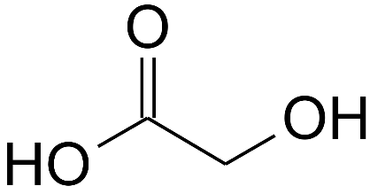
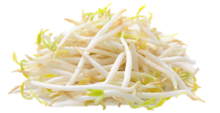
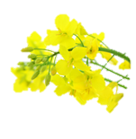

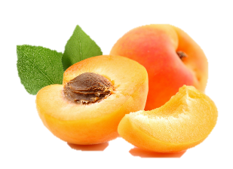

Actions & Ingredients
SMOOTHING ANTI-WRINKLE | 10% pure glycolic acid
SOOTHING | Natural polysaccharides
HYDRATION | Vegetable glycerin
RADIANCE | Brown algae & Organic apricot kernel oil
BALANCING/ CALMING EFFECT | Yon-Ka Quintessence (Lavender, geranium, rosemary, cypress and thyme)
DLUO = 30 months
PAO = 6 months
Notes:
SMOOTHING ANTI-WRINKLE
10% pure glycolic acid
Origin: Synthesis - 70% aqueous solution of glycolic acid.
See Questions/Answers to see why we selected synthetic glycolic acid.
Glycolic acid is the smallest AHA, with the highest penetrating power, making it the most effective at aiding cell renewal and eliminating dead skin cells. (See Fruit acid FOCUS in the appendices).
Action: It is used to
Reduce the attachment of epidermal cells to each other (corneocytes, skin cells that make up the stratum corneum, the most superficial layer of the epidermis) = removes dead cells, thus improving skin texture, which becomes smoother, the complexion more uniform (acts on hyperkeratosis, balances excessive sebum production, therefore also beneficial for acne-prone oily skin). It promotes the renewal of epidermal cells.
It affects physiological and environmental skin aging (caused by the sun) by increasing the production of the components that make up the dermis. It promotes increased collagen fibers in the papillary dermis, reduces the appearance of wrinkles and fine lines, adds elasticity and firmness, fades dark spots, and improves complexion radiance.
It contributes to skin hydration by improving the ability of the stratum corneum to lock in water (it has a hygroscopic effect).
Thanks to the cell renewal promoted by glycolic acid, the skin will also be better prepared to absorb the anti-aging active ingredients included in the additional treatments.
RADIANCE
BROWN ALGAE (ASCOPHYLLUM NODOSUM)
Origin: Edible algae found in the Atlantic Ocean. This active ingredient is found in Brittany, France.
Part used: All parts of the algae
Actions: brown algae it widely known in the scientific community and is heavily researched. With daily exposure to UV radiation, this algae has been able to develop a color regulation system that researchers used as inspiration when formulating the active ingredient, which evens out the complexion, fades dark spots, and improves skin radiance and an even appearance.
Further information:
This algae stimulates cell renewal and natural exfoliation of the skin. It thus activates the process of melanin elimination -> perfecting complexion evenness and illumination
Details of the test to be found in the appendix.
More specifically, it inhibits melanin synthesis by blocking both the molecule that induces melanogenesis and the enzyme responsible for melanin production (tyrosinase). It visibly lightens dark spots and pigmentation contrast, thereby improving complexion radiance and evenness.
COSMOS APPROVED ingredient
Melanogenesis: process whereby melanin is produced in the melanocytes.
ORGANIC APRICOT KERNEL OIL (PRUNUS ARMENIACA (APRICOT) KERNEL OIL)
Origin: The apricots used to produce this oil are harvested in Europe and the oil is made in France. Tree of the Rosaceae family. Its name means ‘early’ in Arabic because it usually flowers in early spring. The apricot kernel oil is quickly absorbed, without leaving a greasy feel.
Composition: the oil extracted from the core is composed mainly of 2 essential fatty acids (EFA):
Oleic Acid = Omega 9 (Ω9) : 58-80%
Linoleic Acid = Omega 6 (Ω6) : 10-35%
These fatty acids are recognized for their nourishing and softening properties. By helping to rebuild lipid “mortar” and stimulating the proper cohesion of skin cells, they improve the skin’s radiance and suppleness.
COSMOS CERTIFIED ingredient EFA: Essential fatty acids. EFAs are fatty acids which are essential to the growth and proper functioning of the human body. But our bodies do not know how to produce them so we must source them from elsewhere.
SOOTHING
NATURAL POLYSACCHARIDES (GUM-2 BIOSACCHARIDE)
Origin: Biotechnology
Ingredients: polysaccharide (complex sugar made up of several simple sugar molecules) obtained through natural bacterial fermentation using corn sorbitol and soy peptone as substrates.
Action: soothing
decreases inflammatory reactions caused by damage to the skin by limiting the propagation of cellular messages within the cells triggered by rhamnose and galactose sugars and by glucuronic acid.
releases feel-good beta endorphins, which reduce inflammation by combining protection and well-being.
Details of the test to be found in the appendix (soothing effect of the polysaccharides).
HYDRATION
VEGETABLE GLYCERIN (GLYCERIN)
Origin: It is one of the most ancient humectants whose moisturizing activity is undeniable. Vegetable glycerin is mainly native from Europe and comes mainly from canola.
Action: With humectant and hydrating actions, it reduces the speed at which water evaporates from the surface of the skin. It softens skin and makes it feel more supple while reducing roughness.
ECOCERT ingredient
BALANCING CALMING EFFECT
YON-KA QUINTESSENCE (LAVANDULA ANGUSTIFOLIA (LAVENDER) OIL - PELARGONIUM GRAVEOLENS LEAF OIL -ROSMARINUS OFFICINALIS (ROSEMARY) LEAF OIL - CUPRESSUS SEMPERVIRENS OIL - THYMUS VULGARIS (THYME) FLOWER/LEAF OIL)
A treasured formula found throughout the brand’s products and treatments, this exclusive blend combines 5 essential oils with extraordinary powers and synergetic properties. Used in different degrees of concentration and always pre-measured to ensure absolute safety and optimum results, this olfactory experience can be either balancing, calming, relaxing or energizing, depending on what is needed.
Origin of the essential oils: lavender (France, Haute Provence region), geranium (Egypt), rosemary (Morocco), cypress (France, Haute Provence region), thyme (Spain).
Skin actions: Firming, regenerating, antiseptic, bactericidal, astringent, regulating.
Psychotropic actions: calming, balancing, stimulating

Slide 16


A breakthrough in formulation
A clean formula with 10% pure glycolic acid
Glyconight 10% is the 1st night peel mask combining a high percentage of glycolic acid and a clean formula.
PEG,
PPG,
acrylates,
silicones,
SLS and SLES sulfates,
phenoxyethanol,
chlorphenesin,
parabens,
triclosan and triclocarban,
formaldehydes
formaldehyde-releasing agents
phtalates,
mineral oils,
hydroquinone,
synthetic fragrances,
synthetic dyes,
titanium dioxide,
MIT,
EDTA,
synthetic propylene glycol,
nylon
Formulated without :
It is a true breakthrough in formulation, since some of these controversial
ingredients are widely used to stabilize formulas with a high concentration
of pure glycolic acid.
Notes:
The formula of Glyconight 10% Mask is real breakthough in formulation. We are the first to succeed in the creation of a night mask with an as high as 10% glycolic acid (one of the higher possible on the market) withouth using any controversial ingredient. This controversial ingredients are usefull for the stabilization of the formula, and that was the biggest challenge.

Slide 17

Zoom on our glycolic acid
Yon-Ka chooses synthetic glycolic acid:
Control of the formulation (feasibility, stability, glycolic acid concentration)
Regulatory compliance for targeted markets
Notes:
Glycolic acid can be produced synthetically, or it can be extracted naturally from plants.
Today, in our plant extracts, the “natural” glycolic acid is present as a component along with other AHAs. To reach a concentration of 10% pure glycolic acid in the finished product, the natural extract would need to be included at such a high percentage that it would be very difficult, if not impossible, to formulate a stable O/W emulsion. Moreover, the maximum regulatory percentage limits for these extracts would be exceeded.
The use of synthetic glycolic acid in our mask therefore makes it possible to control the feasibility and stability of our emulsion, to comply from a regulatory point of view for the target markets, and also to control any variations in the % and therefore the dosage of glycolic acid in the product.
And yet, our product still has 81% ingredients of natural origin.

Slide 18
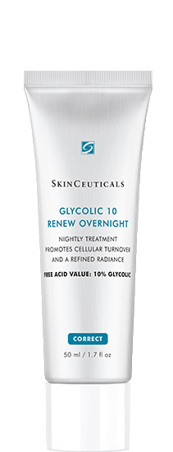
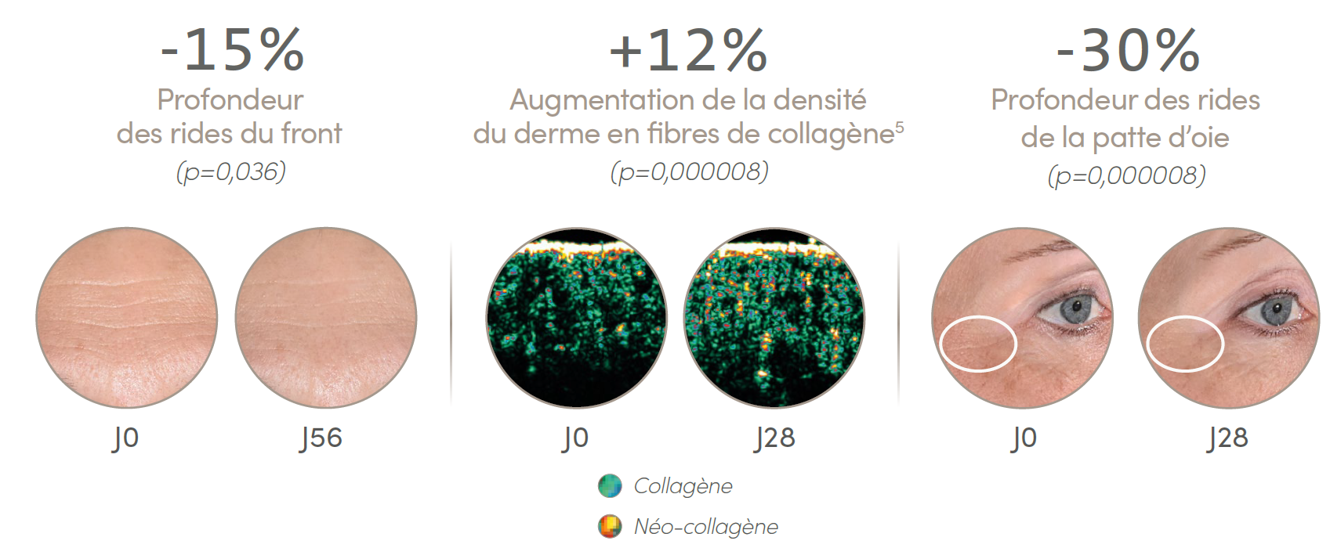
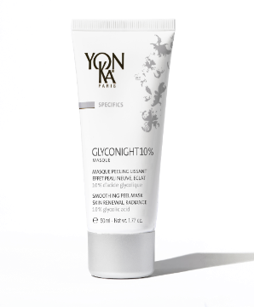
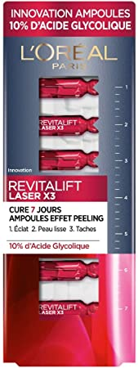
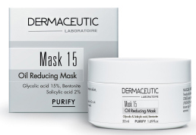
Glycolic Acid Products competition
Notes:
We did a complete competition analysis, you have access on the professionnal space. But we don’t have access to all the local webstites or brands so if you could have a look on the local competition it will allow us to be prepared for it and better answer.
Here we only selected the most similar products, that are claiming the hight percentage of glycolic acid. The two mask you can see have formula with a lot of controversial ingredients.
Then, the new loreal product is clean, but without any sensoriality and without claim the night effect we have.

Slide 19
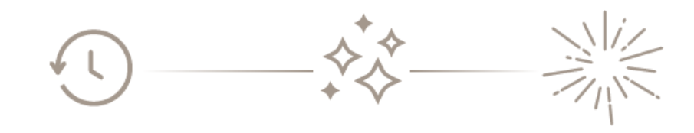
Proven, visible, triple-action effectiveness
Triple-action effectiveness
Enhanced effect with each application
D0
D7
D28
D56
Anti-aging
New skin
appearance
Radiance
In 1 night, the skin is more beautiful, smoother, and the radiance boost effect is visible³.
In 1 week, the skin texture is transformed, the complexion glows, the new skin result sets in³.
In 1 month, the wrinkles, even deep ones, fade, the skin is denser, and can appear up to 5 years younger⁴.
Notes:
Glyconight 10% mask has a triple action proven effectiveness with impressive Immediate results reinforced over the course of the applications
The results are obvious even after the first application and intensify with continuous use2.
In 1 night, the skin is more beautiful, smoother, and the radiance boost effect is visible3.
In 1 week, the skin texture is transformed, the complexion glows, the new skin result sets in3.
In 1 month, the wrinkles, even deep ones, fade, the skin is denser, and can appear up to 5 years younger4.
2Results proven in a clinical and instrumental study conducted by dermatologists + self-assessment - 15 volunteers aged 20 to 39 (1 month) and 15 volunteers aged
40 to 55 (2 months). Product applied all night long, every other night for the first week and every night for the weeks thereafter. 3Self-questionnaire after 1 and 3 uses - 15 volunteers aged 20 to 39 (1 month) and 15 volunteers aged 40 to 55.
4Clinical and instrumental study conducted by dermatologist - 15 volunteers from 20 to 39 years old (1 month) and 15 volunteers from 40 to 55 years old (2 months). Product applied all night long, every other night for the first week and every night for the weeks thereafter. Average results for both groups after 1 month. Estimated gain in years: 40-55 age group, among those who answered the question (n=10 at D28).
The results are obvious even after the first application and intensify with continuous use2.
In 1 night, the skin is more beautiful, smoother, and the radiance boost effect is visible3.
In 1 week, the skin texture is transformed, the complexion glows, the new skin result sets in3.
In 1 month, the wrinkles, even deep ones, fade, the skin is denser, and can appear up to 5 years younger4.

Slide 20
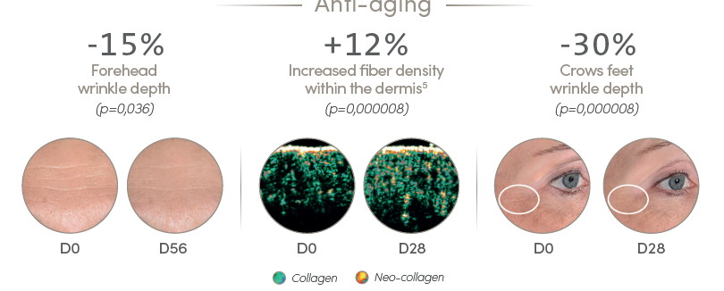
Clinical and instrumental study
Anti-aging effectiveness⁴
4Clinical and instrumental study conducted by dermatologist - 15 volunteers from 20 to 39 years old (1 month) and 15 volunteers from 40 to 55 years old (2 months). Product applied all night long, every other night for the first week and every night for the weeks thereafter. Average results for both groups after 1 month. Estimated gain in years: 40-55 age group, among those who answered the question (n=10 at D28). 5Ultrasound examination to analyze dermal density in subjects from the 40-55 y.o. group.
Notes:
2Results proven in a clinical and instrumental study conducted by dermatologists + self-assessment - 15 volunteers aged 20 to 39 (1 month) and 15 volunteers aged
40 to 55 (2 months). Product applied all night long, every other night for the first week and every night for the weeks thereafter. 3Self-questionnaire after 1 and 3 uses - 15 volunteers aged 20 to 39 (1 month) and 15 volunteers aged 40 to 55.
4Clinical and instrumental study conducted by dermatologist - 15 volunteers from 20 to 39 years old (1 month) and 15 volunteers from 40 to 55 years old (2 months). Product applied all night long, every other night for the first week and every night for the weeks thereafter. Average results for both groups after 1 month. Estimated gain in years: 40-55 age group, among those who answered the question (n=10 at D28).
5Ultrasound examination to analyze dermal density in subjects from the 40-55 y.o. group.
Clinical and instrumental study showed anti-aging effectiveness
- A reduction in forehead wrinkle depth of -15% in 1 month on average
- An increase in the density of the dermis of +12% in 1 month on average (slightly denser = more plumped up, therefore fewer wrinkles, smoother, firmer skin = anti-aging effect).
In green = collagenen
In yellow = neo collagenesis (step just before collagen)
One can imagine the stakes of a tent (=dermal fibers). If the stakes are numerous and straight, the tent (= skin) holds well in place. If the pegs sag or break (no fibers, or broken fibers), the tent collapses (skin sags, wrinkles deepen, skin is less firm).
With GLYCONIGHT 10% MASK, stakes (=fibers) are added to the tent (=skin).
- A reduction in the depth of the crow's feet of -30% in an average of 1 month.

Slide 21
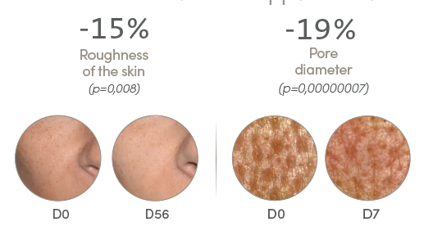
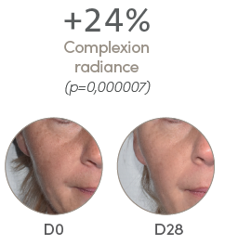
Clinical and instrumental study
New skin appearance effectiveness⁴
Radiance effectiveness⁴
4Clinical and instrumental study conducted by dermatologist - 15 volunteers from 20 to 39 years old (1 month) and 15 volunteers from 40 to 55 years old (2 months). Product applied all night long, every other night for the first week and every night for the weeks thereafter. Average results for both groups after 1 month. Estimated gain in years: 40-55 age group, among those who answered the question (n=10 at D28).
Notes:
Clinical and instrumental study showed new skin appearance effectiveness
The pore diameter decreases by 19% in 1 month (already a visible effect after 7 days as shown in the photo D0/D7).
The texture of the skin also improves, the skin texture is refined, the skin is less rough (smoothed micro-reliefs): -15% roughness in 1 month on average
Clinical and instrumental study showed radiance effectiveness
+24% more radiance on average after one month of use.

Slide 22
Intergenerational
For millenials
For more mature skin
Blemish-free skin
An anti-aging effect
(wrinkles++/firmness/dark spots)
and radiance
Radiance and treatment
for first wrinkles
Notes:
Another big strengh of this product is that it’s an intergenerational and transversal product.
It is aimed at women and men and meets the following consumer expectations
- For the millennials (20/40 years old): Blemish free skin, radiance and treatment of the first wrinkles.
- For more mature skin (40-55 years old): an anti-aging effect (wrinkles++/ firmness/spots) and radiance.
As a corollary, it also:
- recruits younger consumers who will go on to develop loyalty to the brand. As a target, the millennials in particular (20 to 40++ years old) use a large number of skincare products. Giving them a source of immediate satisfaction is a major asset in developing and recruiting this customer base.
- reinforces the mature skin target (40 to 55++ years old), currently the brand’s core clientele, who are constantly seeking younger-looking skin.
GLYCONIGHT 10% MASK is an intergenerational and transversal product.
It is aimed at women and men and meets the following consumer expectations
- For the millennials (20/40 years old): Blemish free skin, radiance and treatment of the first wrinkles.
- For more mature skin (40-55 years old): an anti-aging effect (wrinkles++/ firmness/spots) and radiance.
As a corollary, it also:
- recruits younger consumers who will go on to develop loyalty to the brand. As a target, the millennials in particular (20 to 40++ years old) use a large number of skincare products. Giving them a source of immediate satisfaction is a major asset in developing and recruiting this customer base.
- reinforces the mature skin target (40 to 55++ years old), currently the brand’s core clientele, who are constantly seeking younger-looking skin.

Slide 23
A truly multi-purpose mask
radiance-boosting mask
maintenance treatment
intensive course of treatment
(1 to 2 months)
Use every other night for the first week, then every night for each of the following weeks.
Repeat this course of treatment two or three times a year.
Apply once at night for an incredibly more radiant complexion the next morning.
Use every other night for one week.
The product advantage
May also be applied to the neckline to make it look visibly smoother, like new skin.
It’s a great way to prime skin before a medical peel.
Notes:
It’s also a mutli purpose mask, depending on what you want as result or the time you have
Radiance boost mask: apply once at night for a radiance boost the next morning.
Maintenance treatment: use every other night for one week
Intensive course of treatment (1 to 2 months): use every other night for the first week, then every night for each of the following weeks. Repeat this course of treatment twice or three times a year.
The product advantage
Can also be applied on the neckline to smooth away wrinkles visibly and restore its youthful appearance.
It’s an effective way to prime skin before a medical peel.
At night, after removing makeup and cleansing, apply a thin layer of the mask to the face and neck. Leave on all night. Rinse off with tepid water the next morning.
Intensive course of treatment (1 to 2 months): use every other night for the first week, then every night for each of the following weeks. Repeat this course of treatment twice or three times a year.
Maintenance treatment: use every other night for one week.
Radiance boost mask: apply once at night for a radiance boost the next morning.
The product advantage
Can also be applied on the neckline to smooth away wrinkles visibly and restore its youthful appearance.
It’s an effective way to prime skin before a medical peel.

Slide 24
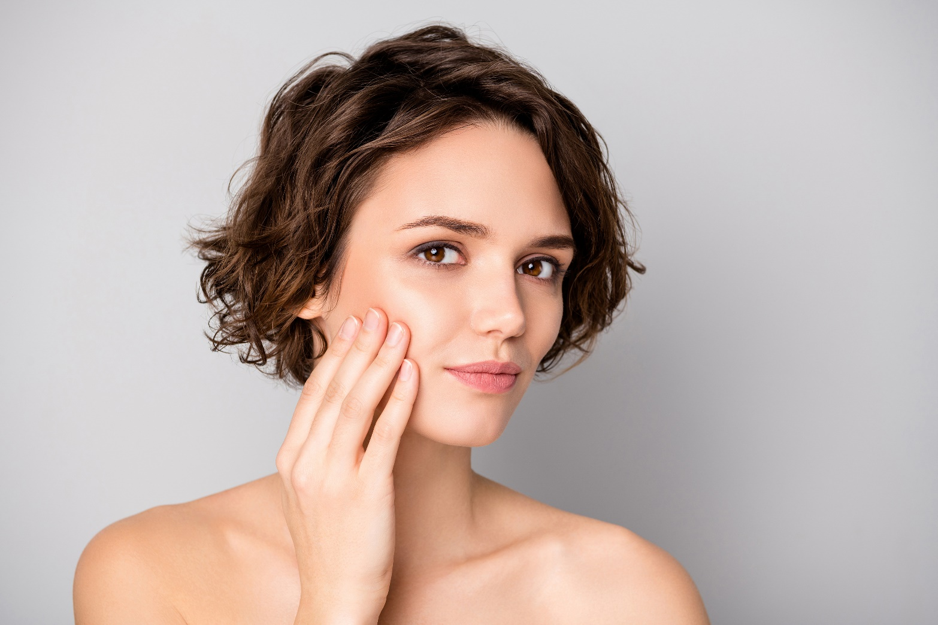


INSIGHT
I have a dull skin, with dilated pores, I have a few imperfections and I don't have time for exfoliation.
My day cream suits me but I am looking for an active product for the night.

Slide 25
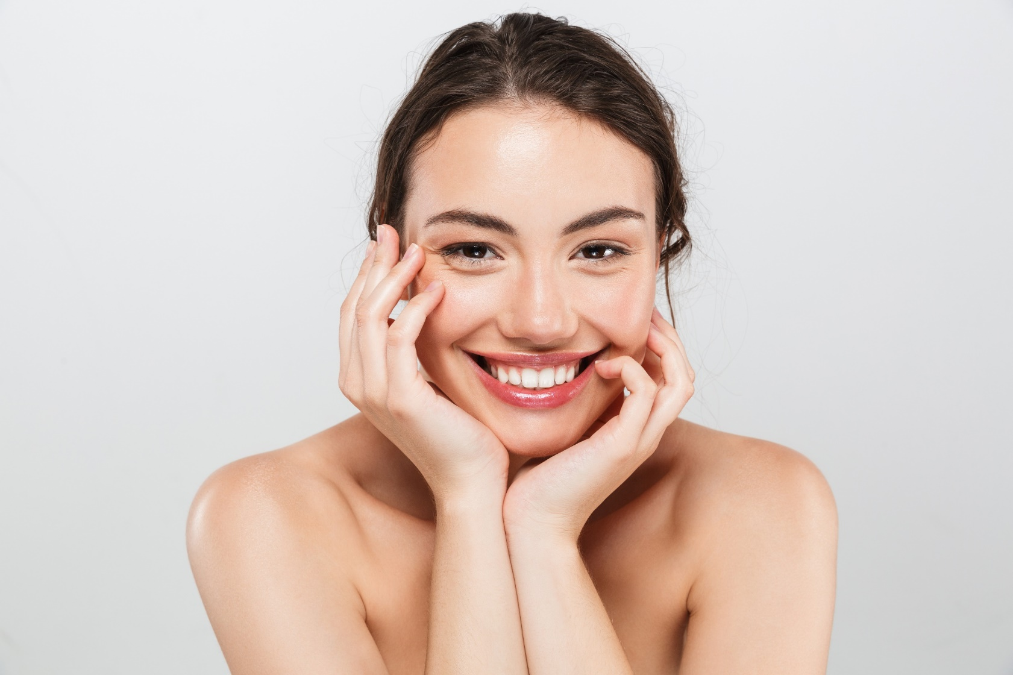
INSIGHT
I have a very important appointment tomorrow, I'm looking for a product that provides an immediate radiance boost.

Slide 26

INSIGHT
I have a blurred complexion and I notice the appearance of the first wrinkles on the crow's feet.
I have started a new skincare treatment and am looking for a product that will enhance the results.

Slide 27
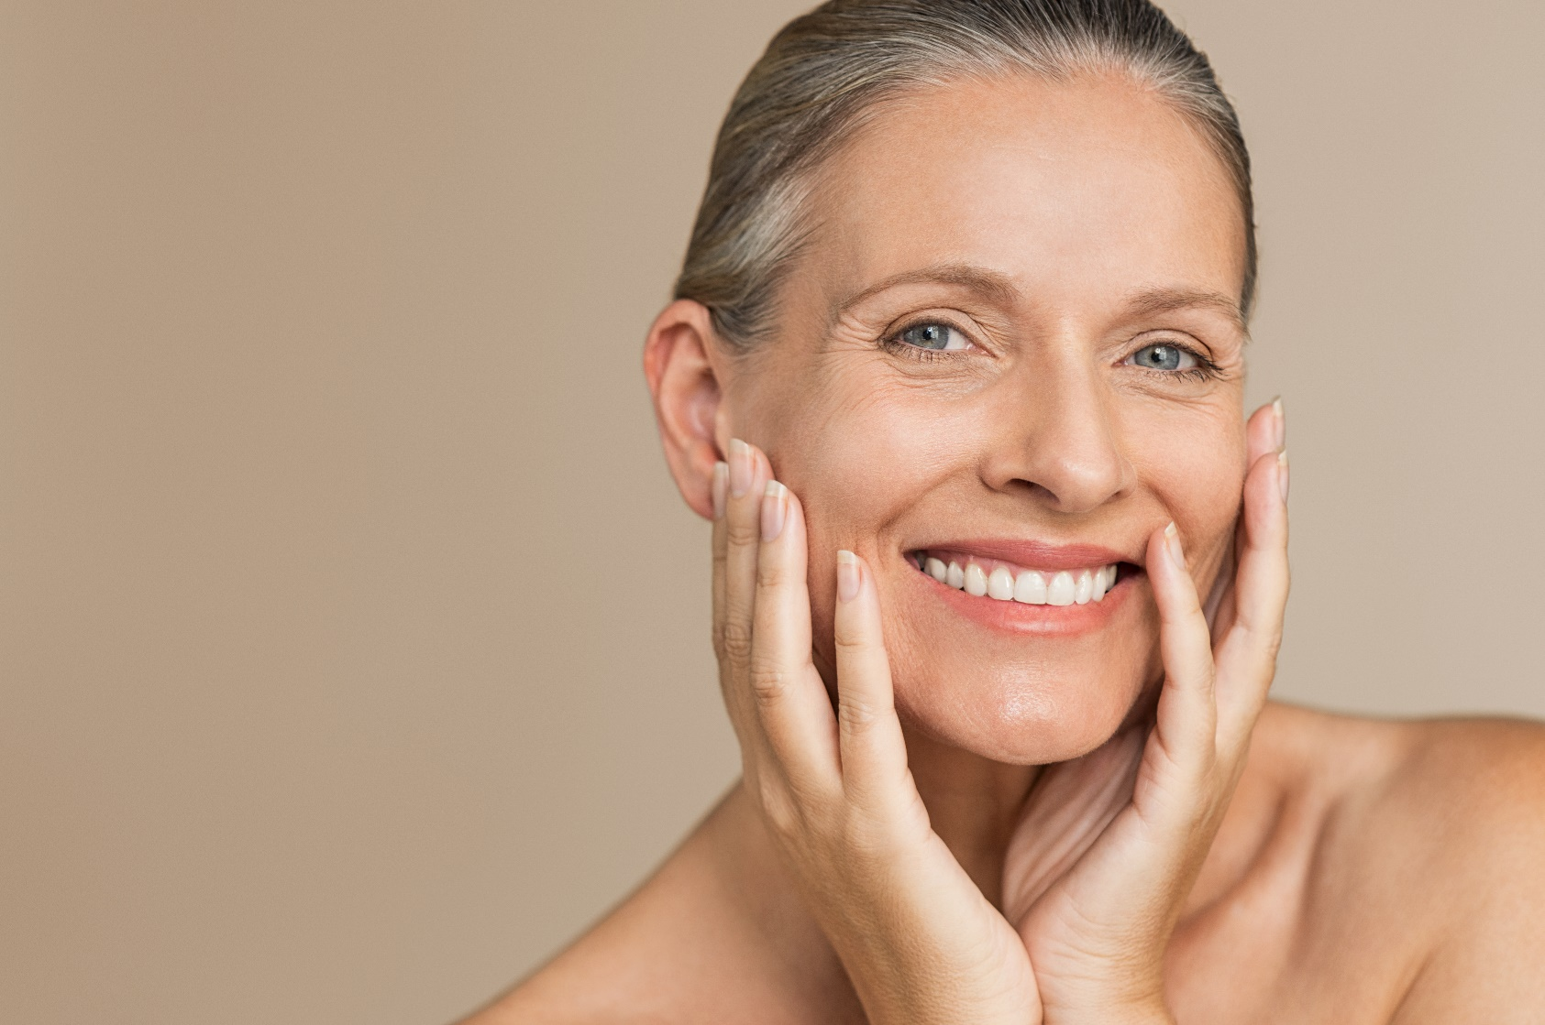
INSIGHT
I have a dull, uneven complexion and deep wrinkles.
I am about to receive a professional peel and I want to prepare my skin.

Slide 28
Precautions for use
Follow the instructions for use.
Avoid contact with eyes and lips.
Always apply sunscreen during the day.
In the event of persistent redness or irritation, discontinue use and see a doctor.
Do not apply this mask just before or just after hair removal
Do not apply this mask just before a treating skin with retinoic acid, or if your skin is sensitive to glycolic acid.
This product must be used infrequently and for limited periods of time.
To see if you can tolerate glycolic acid, apply a small amount to the inside of your elbow or behind your ear. If redness and violent sensations of discomfort appear, remove and try again the next day to confirm or not the intolerance.
Notes:
This product has a high concentration of glycolic acid so it can lead to reactions so there are some prevention to do in order to avoid any problem of tolerance.

Slide 29
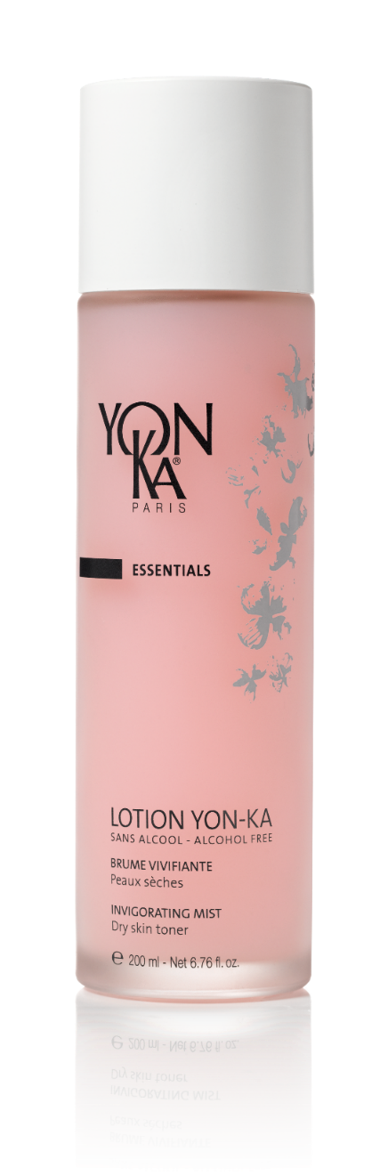
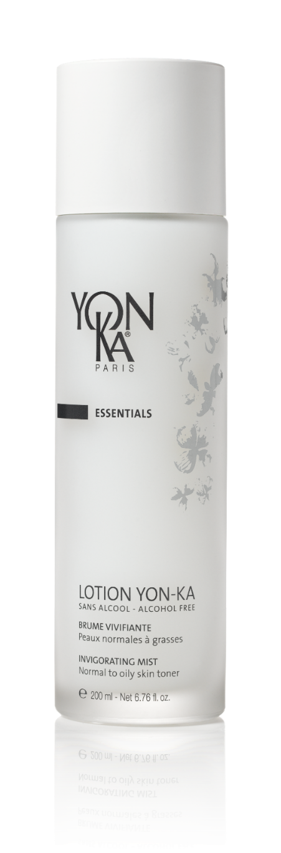
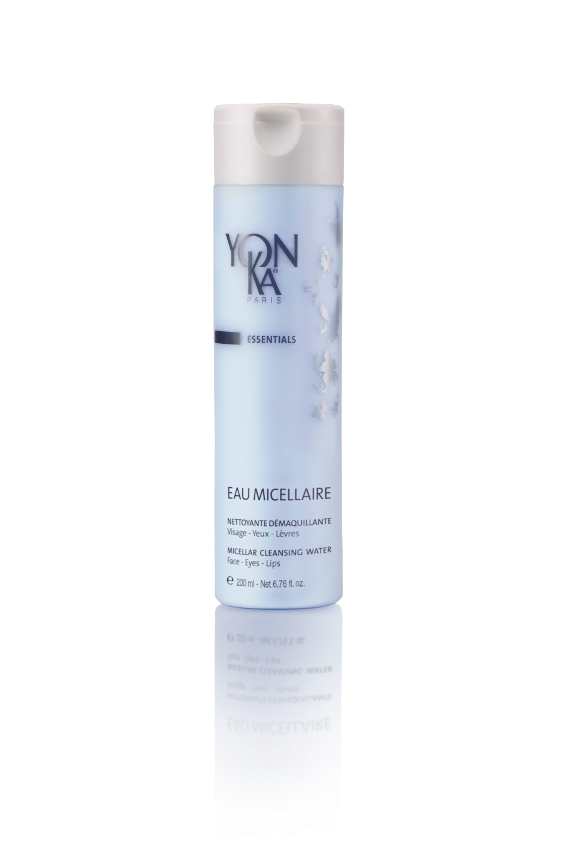
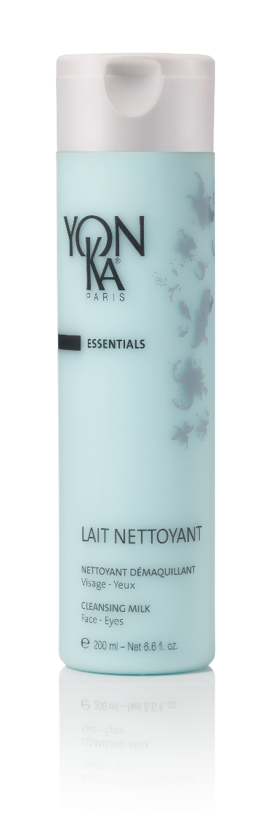
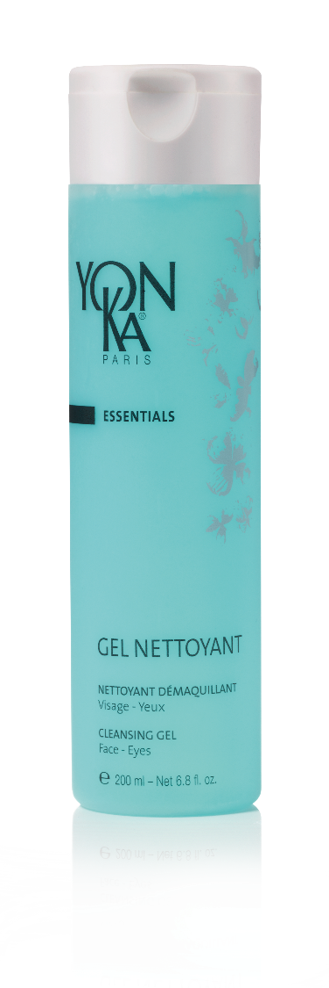
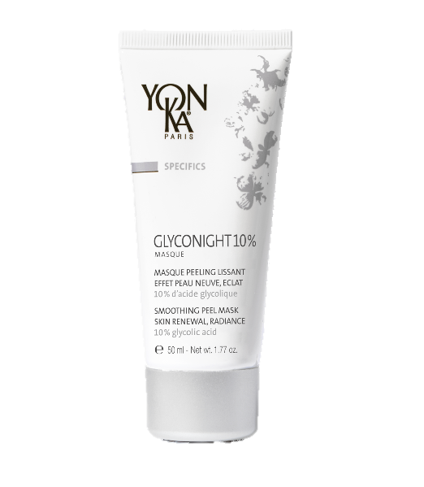

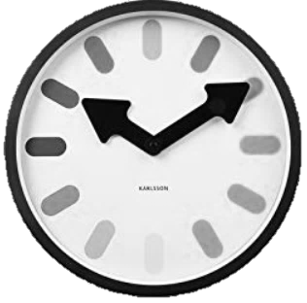


Fits perfectly into
your Yon-Ka routine
+
+
DAILY CARE
+ SUN PROTECTION
The following morning
Daily care
& Sun protection
Yon-Ka Cleaner- Makeup remover
Yon-Ka Lotion
To make penetrate well
GLYCONIGHT 10%
Mask
Notes:
At night, after cleansing and make-up removal, spray the Yon-Ka Lotion to make it penetrate well by effleurages, apply the mask in a thin layer on the face and neck (and the décolleté).
Leave on overnight. Rinse thoroughly with warm water the next morning.
In the morning, apply your daily care and sunscreen
At night, after cleansing and make-up removal, spray the Yon-Ka Lotion to make it penetrate well by effleurages, apply the mask in a thin layer on the face and neck (and the décolleté).
Leave on overnight. Rinse thoroughly with warm water the next morning.
In the morning, apply your daily care and sunscreen.

Slide 30
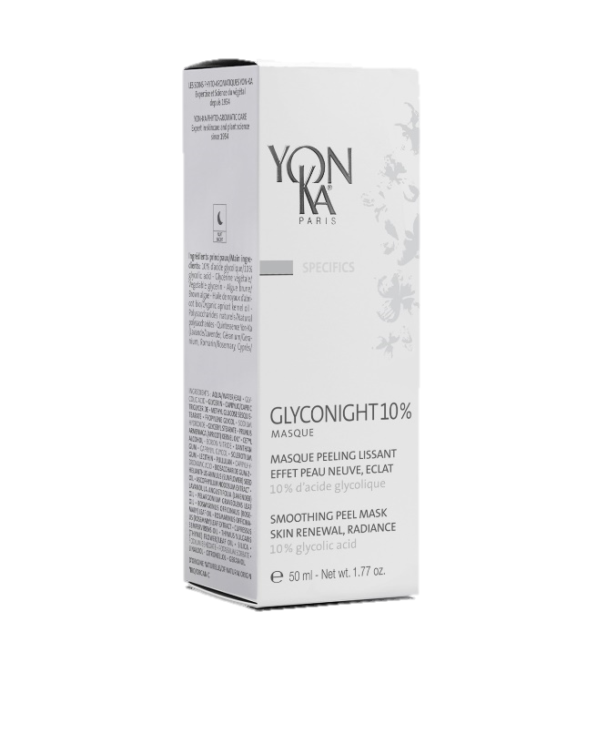
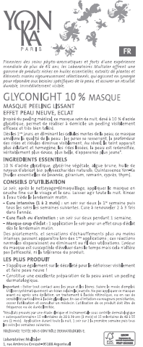
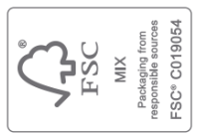

Recyclable packaging
Leaflet
FSC paper
Vegetable-based inks
Recyclable
Shiny white tube with matte silver lid - 50 ml
HDPE
Recyclable
Recyclable
Box
Notes:
In our roadmap, we want to be more sustainable and respectful of our environment
Primary packaging: Shiny white tube with matte silver lid - 50 ml
HDPE tube, recyclable.
The retail tubes are shiny white, with a matte silver lid to better promote the product’s technicality and scientific nature.
Secondary packaging: Box with the decor of the SPECIFICS category
Recyclable box - FSC logo on the flap
The box falls in line with the boxes in the SPECIFICS range: matte white on the front and right side, branded Yon-Ka logo printed by gray, 2 pearly gray sides on the left and at the back.
Leaflet: All of our leaflets are printed on FSC paper with vegetable-based inks. 100% recyclable leaflet, with FSC logo.
Forest Stewardship Council certification logo. The Forest Stewardship Council (FSC) is an environmental seal of approval whose purpose is to ensure that the production of wood and wood-based products complies with procedures that guarantee sustainable forest management.
Primary packaging: Shiny white tube with matte silver lid - 50 ml
HDPE tube, recyclable.
The retail tubes are shiny white, with a matte silver lid to better promote the product’s technicality and scientific nature.
Secondary packaging: Box with the decor of the SPECIFICS category
Recyclable box - FSC logo on the flap
The box falls in line with the boxes in the SPECIFICS range: matte white on the front and right side, branded Yon-Ka logo printed by gray, 2 pearly gray sides on the left and at the back.
Leaflet: All of our leaflets are printed on FSC paper with vegetable-based inks. 100% recyclable leaflet, with FSC logo.
Forest Stewardship Council certification logo. The Forest Stewardship Council (FSC) is an environmental seal of approval whose purpose is to ensure that the production of wood and wood-based products complies with procedures that guarantee sustainable forest management.
*according to the recycling criteria of the French market

Slide 31
quizz
Which yon-ka ranges
contain fruit acids ?

Slide 32
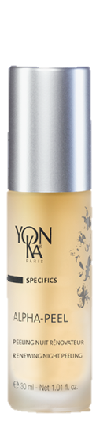
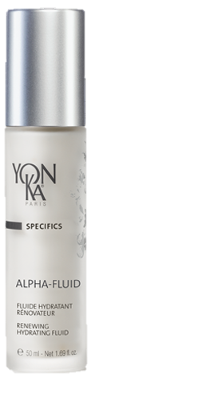
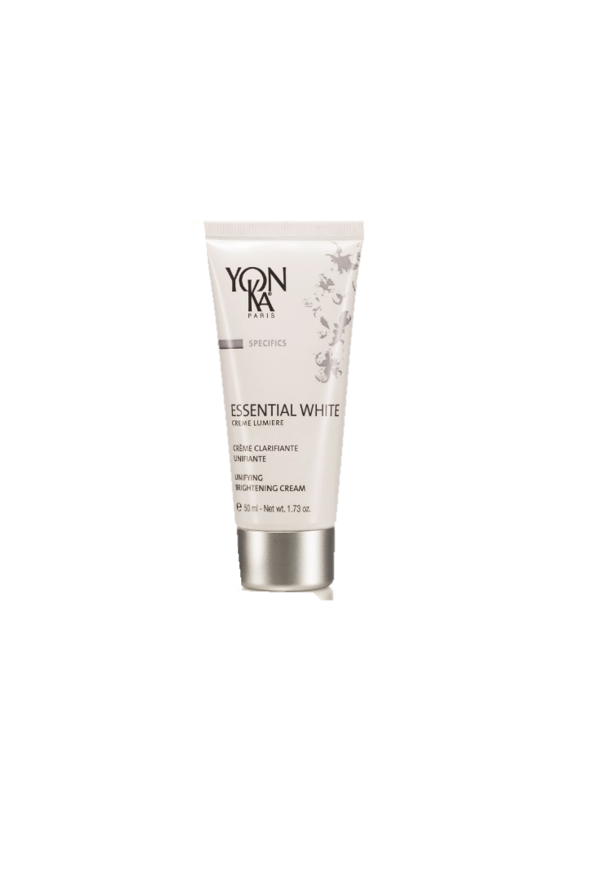
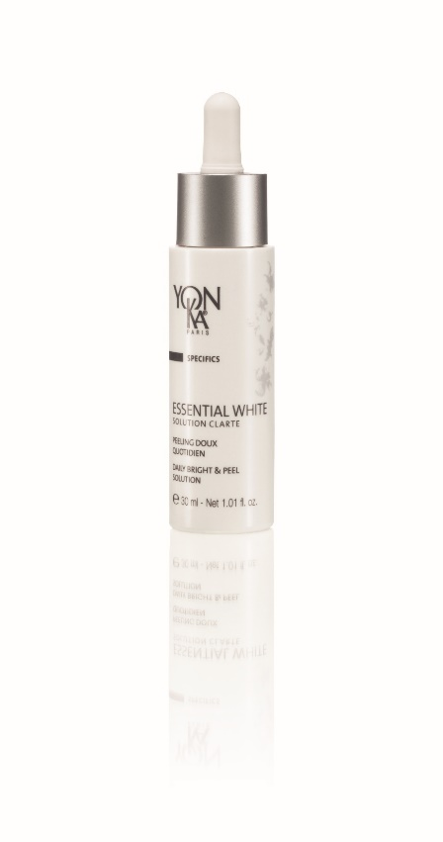
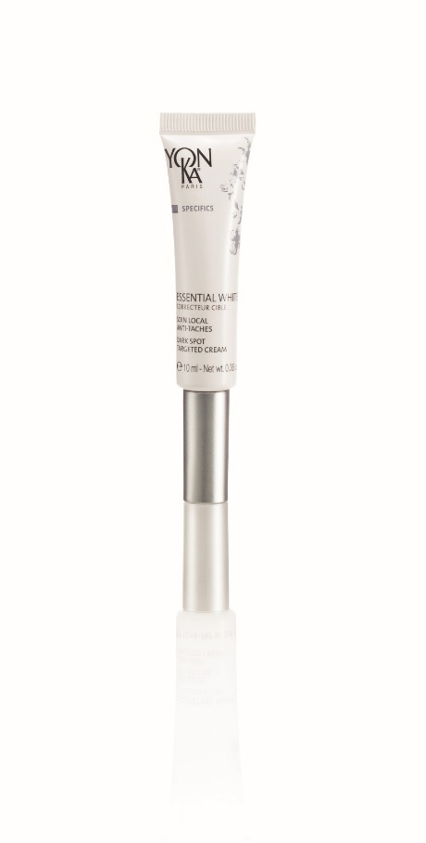
quizz
The alpha range
The essential white range

Slide 33
quizz
What are the differences
between alpha range & glyconight 10% masque ?

Slide 34
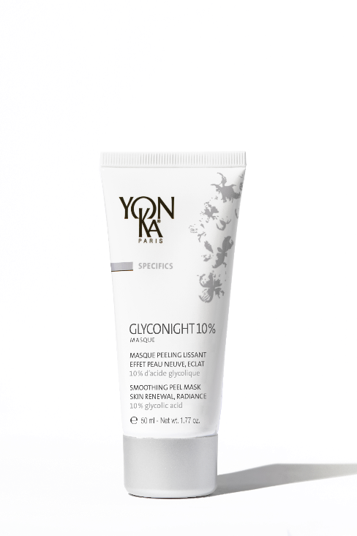
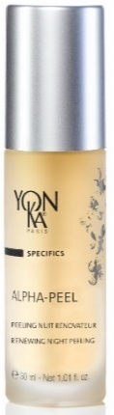
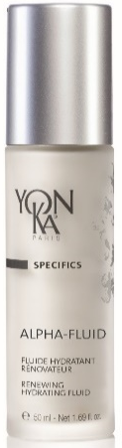
quizz
30ml
50ml
50ml
PROMISE
Renewing – Hydration - Radiance
1
Anti-aging – new skin- radiance
2% & 8% of fruit acids
(lactic, glycolic, citric, tartaric acids
INGREDIENTS
2
10% pure glycolic acid
Duo use – 1 month cure
Morning & evening
Complexion radiance – Flash cure – Intensive cure
Night
USE
3
Skins that do not tolerate
high concentration glycolic acid
(including dry to very dry skin)
Intergenerational product
Skins tolerating high concentration glycolic acid
TARGET
4
TEXTURE
Gel / Fluid
5
Cream mask

Slide 35
quizz
What are the differences
between essential white & Glyconight 10% Masque ?

Slide 36
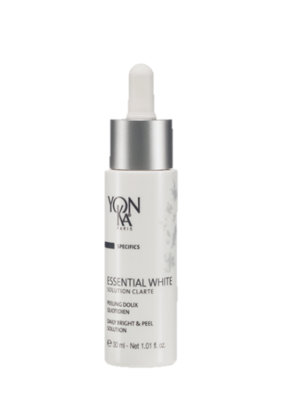
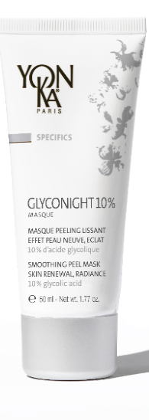
quizz
30ml
50ml
PROMISE
Brightening effect – Unifying
1
Anti-aging – new skin- radiance
5% of fruit acids
(glycolic, lactic, salicylic acids)
10% of pure glycolic acid
INGREDIENTS
2
Complexion radiance–flash cure –intensive cure
Daily – Twice a day
Morning & Evening
USE
3
Night
Intergenerational
Skin tolerating high concentration
glycolic acid
All skin types
TARGET
4
TEXTURE
Gel / Fluid
5
Cream mask

Slide 37
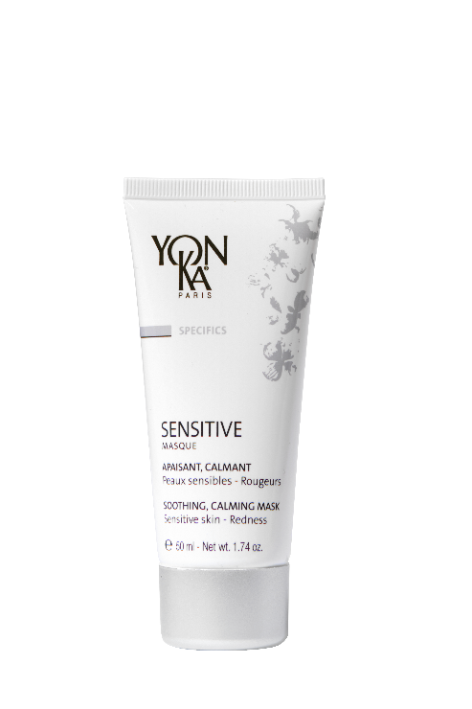
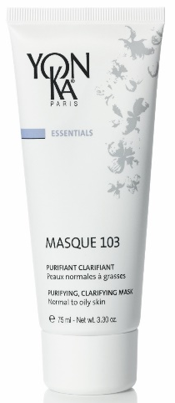
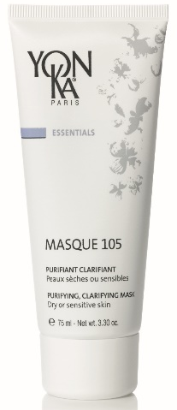
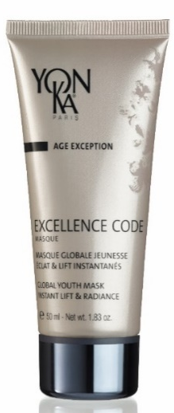

mask range review
PURIFYING
HYDRATING
SOOTHING
SMOOTHING, RENEWING,
BRIGHTENING
SMOOTHING, LIFTING, UNIFYING
MASQUE
105/103
HYDRA N°1
MASQUE
SENSITIVE
MASQUE
GLYCONIGHT 10% MASQUE
EXCELLENCE CODE MASQUE

Slide 38


Positioning
in retail product

Slide 39


Positioning in professional skincare
60% of Yon-Ka essential face treatment protocols include a skin peel

Slide 40



professional peels review
EXFOLIATING
PURIFYING
EXFOLIATING
RENEWING
EXFOLIATING
UNIFYING
ACTIVE
MICRO-PEEL
ALPHA EXFOLIATEUR
ESSENTIAL WHITE
PEELING LUMIERE
Notes:
ACTIVE MICRO-PEEL
20,82% AHA/BHA (10% lactic acid + lactic, mandelic, salicylic, ascorbic acids+ cider vinegar)
Treatment : GRAND CLASSIQUE, VITAL DEFENSE, ELASTINE, EXCELLENCE CODE, PURITY TREATMENT, MEN INTENSIVE
ALPHA-EXFOLIATEUR
30% AHA/BHA (20% lactic acid + 3% glycolic acid+ citric + salicylic + tartaric acids)
Treatments : TIME RESIST, OPTIMIZER, ALPHA-VITAL
ESSENTIAL WHITE PEELING LUMIERE
30% glycolic acid+ salicylic + ascorbic acids+ brown algae, time defying vitamin C
Treatment : ESSENTIAL WHITE

Slide 41
quizz
What are the
5 key points to remember ?

Slide 42
To remember
10 % pure glycolic acid
Clean peeling: a breakthrough in formulation
Triple-action effectiveness: anti-aging, skin renewal, radiance
Triple use: radiance boost mask, maintenance treatment, intensive course of treatment
Intergenerational product

Slide 43
quizz
Answer by true or false
a. Glyconight 10% masque can be used with a night cream
b. Glyconight 10% masque can be used with a soft peel or scrub
c. Glyconight 10% masque can be used with a booster
d. Glyconight 10% masque can be used at any time of the year
e. Glyconight 10% masque can be used daily throughout the year

Slide 44
-15%
forehead
Wrinkle depth
+12% increased collagen fiber density in the dermis
-30%
Crows’ feet wrinkle depth
+24%
-15%
Roughness of the skin
-19%
Pore diameter
Anti-aging
Radiance
New skin
Radiance-Boost mask
Efficacy
10%
Pure glycolic Acid
Anti-wrinkles /Smoothing
Maintenance treatment
Radiance
GLYCONIGHT 10% MASQUE
Organic apricot kernel oil
Use
Active ingredients
Intensive
Course treatment
Natural
Polysaccharides
Soothing
Competitive benefits
Vegetable glycerin
Hydrating
A breakthrough in formulation
Intergenerational
Triple use /
Triple efficacy
Clean Formula with 10% of glycolic Acid
For millenials
For more mature
consumers

Slide 45







Activation
Press Release EN
Ref. 7K0400B
Sales presentation EN
Ref. 7B0780B
POS visibility
A4 FR/EN Ref. 7C0820X
Panel EN Ref. 7D1000B

Slide 46



Activation
Sample card
Ref. 02530
Segmentation panel FR/EN
Ref. 7C0307C
Product sheet EN
Ref. 7L0520B

Slide 47

Visibility on the Yon-Ka website
New feature banner
Product page
Landing page
Ecom focus: sampling

Slide 48
Digital Activation available in the Kit Media
Partnerships with influencers
Newsletters
Partnerships with cosmetics sites and blogs
Google Ads campaign
Sponsored campaign on social medias
*Activation plan according to country

Slide 49


