Slide 1
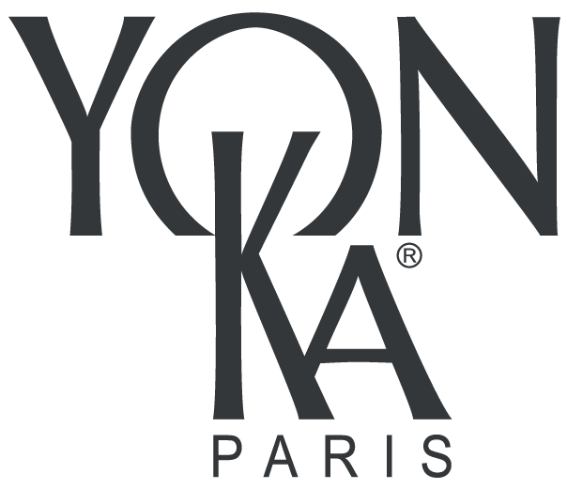
The Phyto-Aromatic
Experience
Notes:
Welcome to all and thank you for your presence.
Let me introduce myself, my name is X and I am accompanied by X .
We are delighted to meet you again to introduce you to our new ephemeral treatment.

Slide 2
Context
Notes:
Before presenting our new ephemeral skin care product in more detail, we would like to offer you a retrospective of the past year.

Slide 3
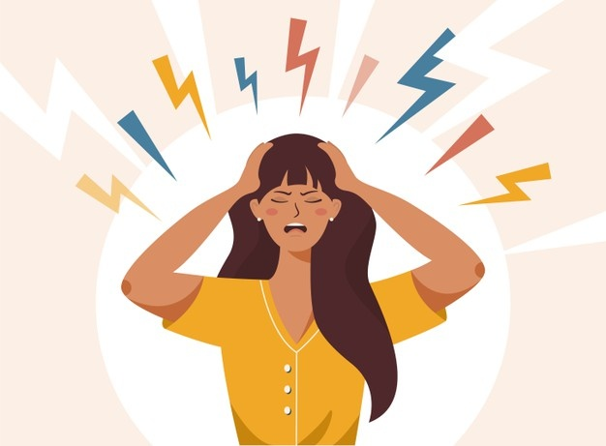
Our life since 1 year...
STRESS
HOME WORKING
LOCKDOWN
Notes:
If you had to define your daily life for the past year, what would you say?
For the past year, we have been accumulating stress. An anxiety-provoking context, negative thoughts... have only increased our anxiety.
For many people, daily life has changed. A professional activity stopped, telecommuting.... Sedentary lifestyle, bad posture, frozen shoulder syndrome... many physical ailments have appeared.
And eventually, in an unprecedented way, we also experienced moments of confinement. Isolation and a poor social life have accentuated the malaise.
Finally, for the past year, our body and mind have been put to the test.

Slide 4
A new ephemeral care, why?
Animate the end of the year celebrations
with a care that corresponds to our need for...
Energizing
Relaxing
Escape
Notes:
It is with this in mind that we have created our new ephemeral treatment.
We offer you to liven up the holidays with the perfect gift!
A treatment for everyone that corresponds to the need to relax, energize and escape.

Slide 5
And you, where would you like to go?
Notes:
Before we reveal our holiday destination, tell me where would you like to go?
All these destinations are beautiful ....

Slide 6
Yon-Ka invites you to travel...
Notes:
Yon-Ka invites you to travel ....

Slide 7
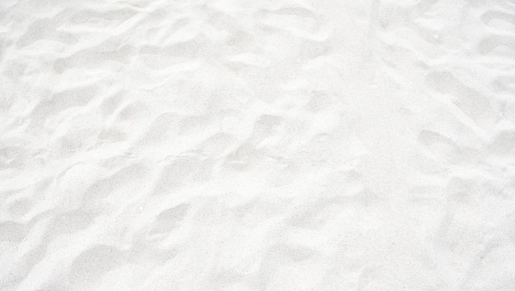
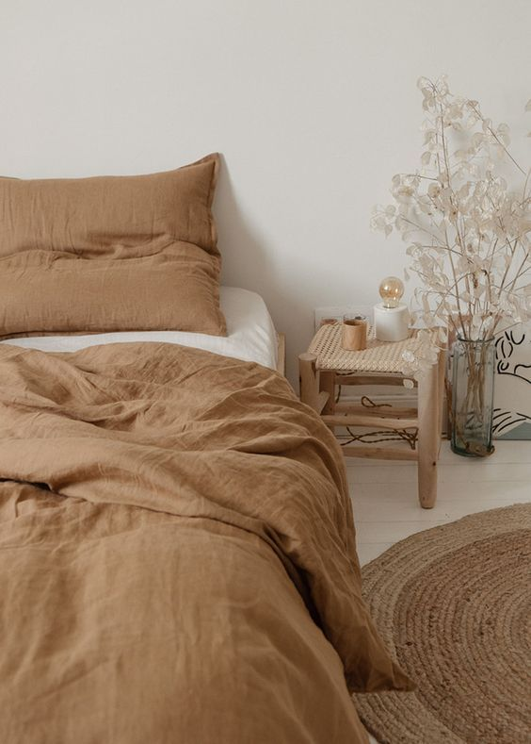
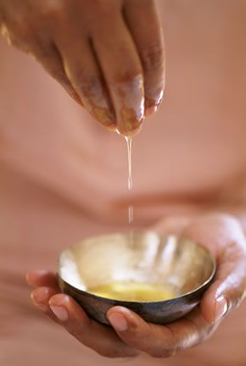
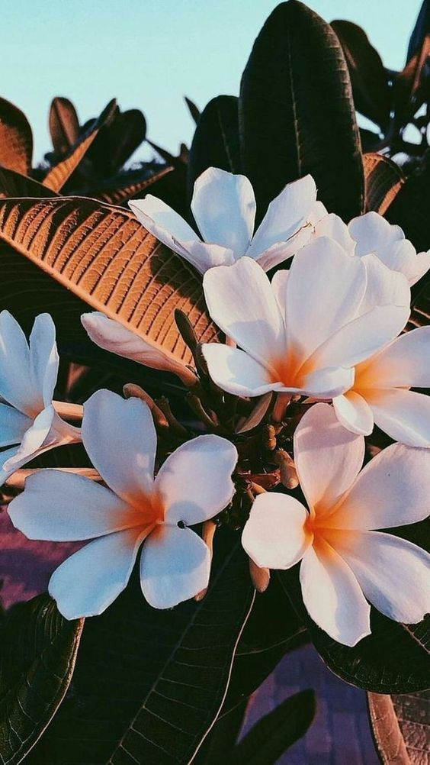
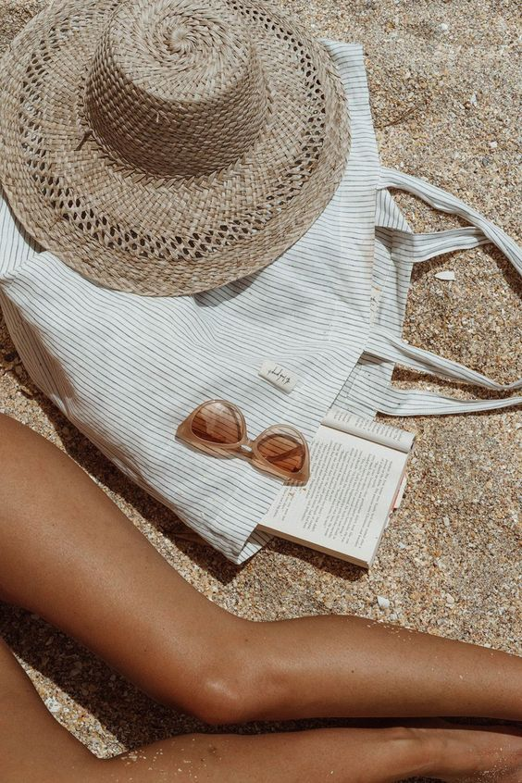
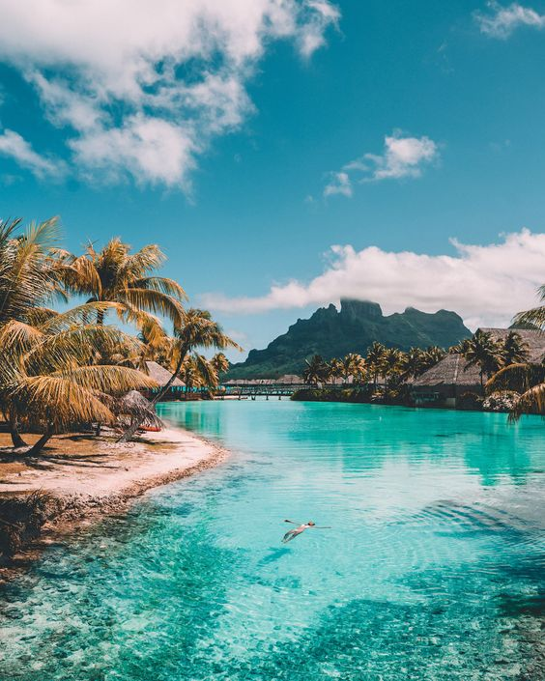
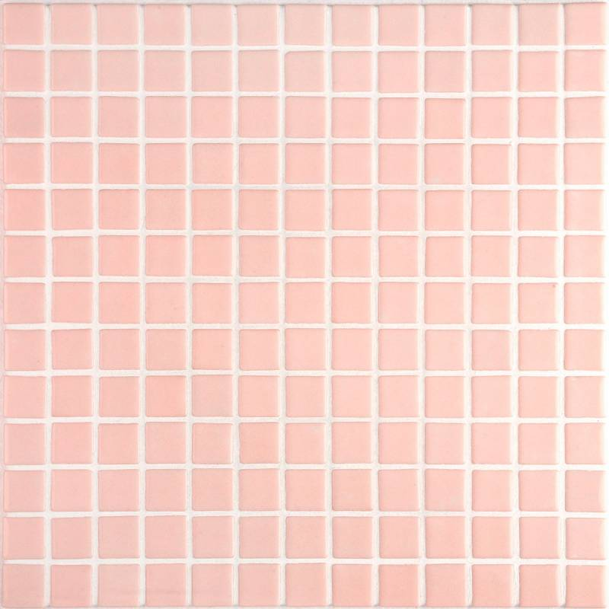
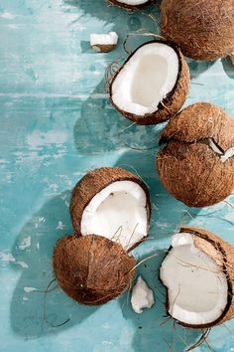
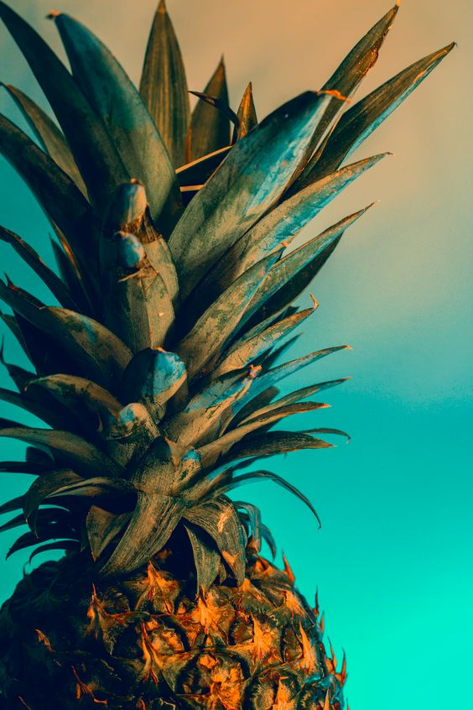
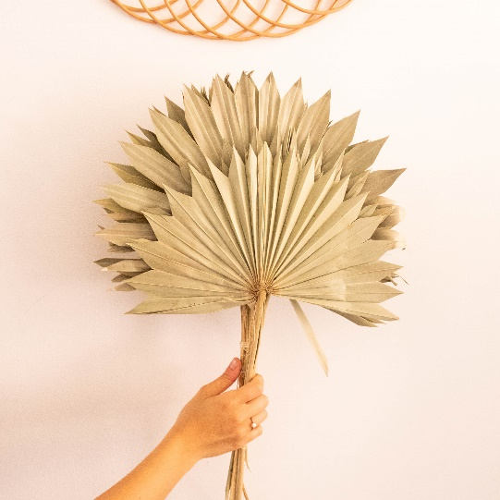
In the heart of Polynesia...
Notes:
In the heart of Polynesia ....
This moodboard reveals all our sources of inspiration to create this treatment.
In a few words, our objective with this new treatment is to offer our customers a sunny, generous, enveloping trip to a paradise island for Christmas...
What could be warmer at Christmas time than to travel in the sun, with your feet in the warm sand, listening to the lapping of the Pacific Ocean tides.
Discover the sweet and sunny fragrances of tiare flower and jasmine.
Succumb to a bit of greed by tasting the tender flesh of a fresh coconut.
To hydrate yourself, sipping a delicious exotic fruit juice.
And finally, to enjoy the warmth of the hot oil on your body, to let go, to refocus, to be fully conscious, to live an authentic and generous moment...
Are you ready to make this journey with us?

Slide 8
Mahana, the alliance of wellness and expertise
Notes:
We are taking you along with us to discover the Mahana treatment, the alliance of wellness and Yon-Ka expertise.
You are probably wondering what Mahana means?

Slide 9
Mahana,
means Sun in Polynesian
The sun at the heart of our new treatment
Notes:
Well, Mahana means the sun in Polynesian language.
Why did we choose this name?
Simply to immerse you in this sunny universe, with a warm and comforting atmosphere.
This sun is the main thread of our new treatment.
Indeed, at the heart of Mahana is the cranial massage. It is based on 10 stripes that symbolize the rays of the sun.
All these rays converge towards the vertex, the meeting point of all the meridians in Chinese medicine and also the 7th chakra, in Ayurvedic medicine.
Our goal is to bring an influx of energy to the vertex in order to diffuse it throughout the body.

Slide 10
Taurumi,
as a source of inspiration
Taurumi, tau means "to lay" and rumi "to knead".
Spirit
Body
Taurumi
Soul
Heart
Notes:
In addition to the Polynesian name, we were also inspired by a therapeutic and spiritual Polynesian practice : Taurumi
What is Taurumi?
Taurumi, which means tau (to lay) and rumi (to knead), is practiced from birth. It is part of the customs and traditions of Polynesian culture and has a holistic dimension. Through touch, Taurumi connects the body, mind, heart and soul to allow each individual to open up to the world.
This massage always starts with the scalp and ends with the feet, going through the arms, legs and belly. The aim is to chase away bad vibes that disturb the spirit, to « ground them " and boost the energy (mana) throughout the whole body.

Slide 11
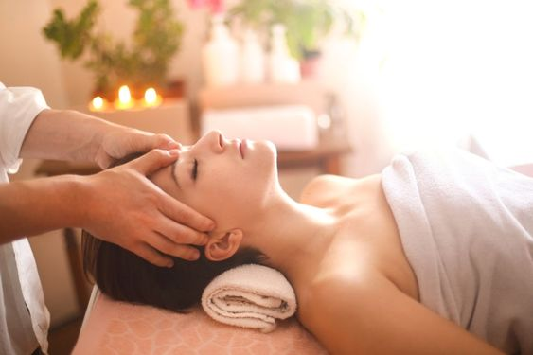
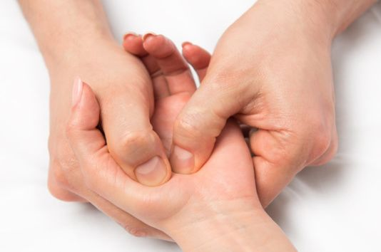
Taurumi,
a star massage
Clear your mind
Hands
Opening up to others
Living
in the present moment
Feet
Anchoring yourself to the ground
Notes:
Like the Taurumi, we have created a star massage of the 5 extremities starting with the scalp to the hands and feet.
- Do you have any idea how many thoughts we have every day?
6,200 thoughts a day go through our minds - this heavy mental load prevents us from being in the present moment. With Mahana, we offer the client the opportunity to clear his/her mind.
(team of psychologists from Queen's University, Canada)
- Our hands grab, hold, squeeze, push. They are also used to communicate by complementing or replacing speech. Therefore, they are often the seat of more or less strong tensions, which can go up the arm, up to the shoulder. Thanks to Mahana, we release the accumulated tensions and we allow the client to open up to the world around, to share, to exchange...
Do you know the average of steps we do per day ?
We walk an average of 6,000 to 7,000 steps per day; by the end of our lives, our feet will have walked 2.5 times around the earth. Our feet are therefore very solicited, they carry us every day and poor footing has an impact on our entire body, generating tension and pain. Thanks to Mahana, we allow the client to anchor himself/herself to the ground, to regain a certain balance and finally return to the fundamentals "the Earth".
This star massage of the body extremities was for Yon-Ka, the ideal response to living in the present moment, reconnecting with oneself and the world around us.

Slide 12
Steps of the Mahana treatment 60’ / Option 30’
Notes:
Following this introduction, we now invite you to discover the steps of the Mahana Care that we propose in 2 versions: 30' and 60'.

Slide 13
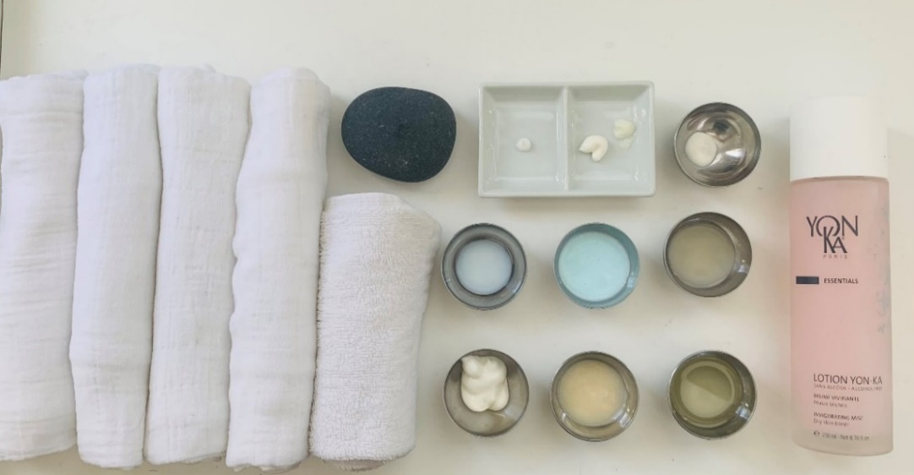
Mahana,
a careful preparation
To fly to Polynesia, we recommend to place the products,
linens and accessories in the towel warmer.
Linens &
accessories
Products
4 hot compresses
(soaked in 1L of water + 1 to 3 drops of « RELAX » Aromatic Concentrate
1 guest towel
1 body hot stone
2 medium-sized towels
2 damp half cottons
Lucas
Emulsion Concentree (1/2 pump)
Lait nettoyant warmed (3g)
Gommage Yon-Ka warmed (5g)
Lotion Yon-Ka PS
Hydra n1 Creme warmed + Nutri+ (4g + 1/2 pump)
Hydra n1 Masque warmed (5g)
Huile de Massage warmed + « Relax » Aromatic Concentrate
(2 to 3 pumps + 3 drops)
Hydra n1 Serum (1g)
Hydra n1 Creme (1g)
Phyto 152 (0.5g)
For the 30min option, only products, linens and accessories in color are required.
To facilitate the correct dosage, 0.5=1 grain of rice, 1g=1 hazelnut, 5g=1 nut
Notes:
As an expert practitioner, you know the importance of preparing your treatments.
Anticipating allows you to be in the best conditions to perform a treatment.
In the Mahana treatment, beforehand preparation is essential
Indeed, to transmit the Polynesian universe and its warm, cocooning atmosphere, we recommend heating all the necessary products as well as the linen in the towel warmer.
Let's have a look at the elements to prepare.
In terms of products, you will need:
EMULSION CONCENTREE - ½ pump
Warmed LAIT NETTOYANT- 3g
Warmed GOMMAGE YON-KA - 5g
LOTION YON-KA PS
Warmed HYDRA N1 CREME + NUTRI+ (= 4g + ½ ampoula)
Warmed HYDRA N1 MASQUE - 5g
Warmed MASSAGE OIL – 2 to 3 pumps + Concentré Aromatique "RELAX" - 3 drops (be careful not to heat the Concentré Aromatique because of its high concentration in active ingredient, just add it once the oil is already warm)
Warmed HYDRA N1 SERUM - 1g
Warmed HYDRA N1 CREME - 1g
PHYTO 152 - 0,5 g
To facilitate the dosage, 0.5 g = 1 grain of rice, 1g = 1 hazelnut, 5g = 1 nut
The colored products are those to be prepared for the 30' option.
In terms of linens and accessories
- 1 warm guest towel soaked with concentré aromatique relax
- Prepare 4 warm compresses (3 drops of concentré aromatique "RELAX" diluted in 1l of water) and place them in the towel warmer
Prepare 1 other warm guest towel without concentré aromatic to remove the mask « ponchon » and place it in the towel warmer
Place 2 medium towels, one at head level folded in 2 horizontally, with upward opening (to allow us to slide the hot stone under the neck of the client and make a nice folding on the eyes) and the other medium towel, lying flat, at foot level (to dry them after the warm compress)
Prepare 2 half damp cottons to protect the eyes during the Introduction Signature
1 big hot stone (body stone) in the towel warmer

Slide 14
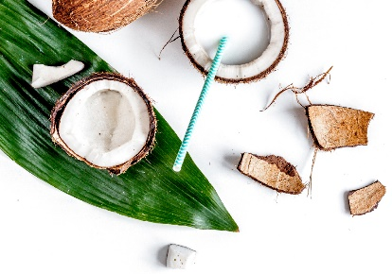
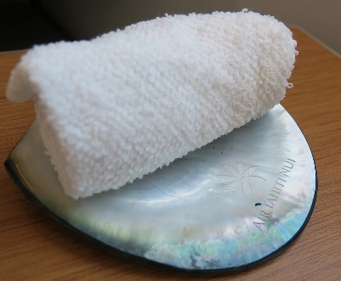
Mahana,
an experiential treatment
Create a welcome and end-of-care ceremony
Be a good and caring listener
Invite the client to remove his/her jewelry
Validate the installation and comfort
Validate the thermal, sound and light environment
Ask if there is any particular sensitive area (to avoid)
Ask for the type of pressure desired and suggest the use of Massage Oil during the cranial massage.
Taking charge
Awaken all the senses
Notes:
To make this new treatment an immersive and experiential one, here are our recommendations.
1. Create a welcome and end-of-care ceremony
Welcome: warm towel soaked with concentré aromatique relax and offer a jasmine-based herbal tea for example
After care: coconut water + exotic snacks
2. Be a good and caring listener
- Invite the client to remove his/her jewelry (rings, necklace, earrings, bracelet)
- Validate the installation and the comfort (propose the heated mattress, raise the legs, trip to Polynesia music..)
- Validate the thermal, sound and light ambiance (heating table, soft light ambiance, sound level ....)
- Ask if there are particular areas of sensitivity (cervical, trapezius, ticklish feet...)
- Ask for the type of pressure desired and suggest the use of Massage Oil during the cranial massage (if the client want oil, make sure to add a pump of HUILE DE MASSAGE , so 2 and a half pumps in total.
3. Surprise the client with a treatment that awakens all the senses
- Vision : plv, cabin decoration, soft and cosy light atmosphere, window display, screen video of Polynesia
- Hearing : Yon-ka Travel in Polynesia music
- Smell: Concentré Aromatique « Relax) on stones, fresh jasmine flower
- Taste: vanilla jasmine tea, exotic fruit smoothie, coconut water, coconut shortbread, fresh mango fruit, coconut slices
- Touch: an enveloping hand with pressure adapted to the client's wishes, products warmed in the towel warmer, create a texture bar with the Gommage Sucre and the Huile Délicieuse or with all the scrubs and oils

Slide 15
Mahana 60min
A facial treatment with energetic, aromatic and relaxing star massage - head, hands, feet-
inspired by a Polynesian ritual.
Steps | Duration | Products
Make-up removal, cleansing | 4’ | Lait Nettoyant warmed
Introduction Signature Aromatic awakening Aromatic compress | 2’ | Emulsion Concentree on the hands of the therapist "RELAX" Aromatic concentrate with warm compress
Skin diagnosis | 2’
Soft peeling | 5’ | Gommage Yon-Ka warmed
Lucas spray | 3’ | Emulsion Concentree 7V
Face, neck and décolleté massage | 6’ | Hydra N1 Cream warmed + NUTRI+
Face and neck mask | 2’ | Hydra N1 Masque warmed
Mahana massage Scalp, neck and trapezius | 20’ | No product required It is possible to massage with warmed Massage Oil alone Or "RELAX" Aromatic Concentrate according to the client's wishes
Hand massage | 5’ | "RELAX" Aromatic concentrate with warm compress Massage Oil warmed + "RELAX" Aromatic Concentrate
Foot massage Wash your hands and remove your mask | 5’ | "RELAX" Aromatic concentrate with warm compress Massage Oil warmed + "RELAX" Aromatic Concentrate
Face and neck mask | 3’ | Rinse with Yon-Ka pouch
Base | 1’ | Adapted eye contour Hydra N1 Serum Hydra N1 Creme
Conclusion Signature Aromatic awakening Body stretching Back massage | 2’ | PHYTO 52 Massage Oil warmed + "RELAX" Aromatic Concentrate
Notes:
We have seen the preparation of the treatment room as well as the care of the client, let's now discover the steps of the Mahana 60' treatment
Cleansing, make up removal with warmed LAIT NETTOYANT
introduction signature. The only difference here is that you are using a warm compress soaked with « RELAX » Aromatic Concentrate (3 drops diluted in 1l of water) instead of Phyto Bain
Skin diagnosis
Soft peeling with warmed GOMMAGE YON-KA
Lucas spray (dilution 7V)
Face, neck and décolleté massage with warmed HYDRA N°1 CREME + ½ ampoula of NUTRI+. 6 minutes of massage represents 1 repetition of each movement.
Application of warmed HYDRA N°1 MASQUE
Until now I’m sure you are comfortable with all the steps.
Then the scalp, neck and trapezius massage, during 20 min, with or without oil, according to the wish of the consumer.
Hand massage , the same movements as the hand massage in the aroma luxe protocol
Foot massage, the same movements as the foot massage in the aroma luxe protocol
Rinse the mask HYDRA N°1 off with a warm Yon-Ka pochon
Application of the base
End of treatment with the conclusion signature, same as you already know, just use the HUILE DE MASSAGE + "RELAX" Aromatic Concentrate instead of LAIT HYDRATANT

Slide 16
Mahana 30min
A treatment with energetic, aromatic and relaxing star massage -head, hands, feet-
inspired by a Polynesian ritual.
Steps | Duration | Products
Introduction Signature Aromatic awakening Aromatic compress | 2’ | Emulsion Concentree on the hands of the therapist "RELAX" Aromatic concentrate with warm compress
Mahana massage Scalp, neck and trapezius | 16’ | No product required It is possible to massage with warmed Massage Oil alone Or "RELAX" Aromatic Concentrate according to the customer's wish
Hand massage | 5’ | "RELAX" Aromatic concentrate with warm compress Massage Oil warmed + "RELAX" Aromatic Concentrate
Foot massage Wash your hands | 5’ | "RELAX" Aromatic concentrate with warm compress Massage Oil warmed + "RELAX" Aromatic Concentrate
Conclusion Signature Aromatic awakening Body stretching Back massage | 2’ | PHYTO 52 MASSAGE OIL warmed + "RELAX" Aromatic concentrate
When the MAHANA 30mn treatment is carried out addition to another Yon-Ka treatment which already features the Signature Introduction and Conclusion, the time to massage the scalp, neck and trapezius increases to 20mn. All techniques that are done with 2 hands are doubled.
Notes:
we also offer a 30 minute option.
This option is perfect for bringing serenity and peace in a short term treatment.
It also allows you to perform this Mahana short option in addition to another Yon-Ka treatment, or another beauty treatment ( nails, hairdresser, make up, if you want to release all the tension before an event for example ☺ )
If you perfom the Mahana 30 minutes in addition to an other Yon-Ka treatment that already includes the signature introduction and conclusion, you have 4 minutes left, so you obtain 20 minutes scalp, neck and trapezius massage instead of 16’.

Slide 17
Mahana Star Massage Video

Slide 18
Star massage,
the main techniques
1
2
3
4
5
SMOOTHING
Straight or circular smoothing with Large comb
Straight or circular smoothing with small comb
Mobilization
sound
Friction
Rocking
Stretching
Notes:
Before getting into the heart of the matter with the video, we suggest you discover the main techniques that make the star massage.
There are 5 techniques that guarantee a deep relaxation of the reflex and musculo-tendinous zones. Once you can perform those 5 techniques, you can easily perform the full scalp massage.
[Remember to show each technique on the malleable head].
The first technique corresponds to smoothing that we call large smoothed & circular comb (this technique is done with 4 fingers) and small smoothed & circular comb (this technique is done with the thumb). They make it possible to delimit the zones of work and to massage them with precision. The gesture is slow and the pressure supported for a deep relaxation. Be careful not to pull the hair and to validate the pressure after a few maneuvers.
The second technique is mobilization, with all your fingertips. It is a more global movement that works in the extension of the smoothing technique.
The third is the sound friction. This superficial and increasingly rapid movement activates the micro-circulation and provides energy.
The fourth is rocking. This technique echoes the rocking of the sea, it is a comforting movement that calms the mind and helps to let go.
Finally, each massaged area ends with a stretch that allows you to become aware of your body and to come back to the present moment.

Slide 19
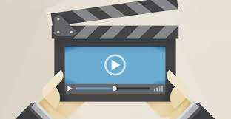
Star massage,
the video
Notes:
I wanted to show you on my beautiful and very calm model, the paths of the 6 sun rays on a hemi scalp as well as the path of the unification maneuver.
As you can see the 3 first sun rays are located on the top of the head and the last 3 one are located behind
Remember, for each sun rays, 2 types of movements :
Straight lissage
Circular lissage
The 1st sun ray is the only one performed with the fingertips, all the others are with the thumb
Now let's watch the training video, I will comment on all the maneuvers, feel free to ask me to stop if you need to.

Slide 20
Mahana,
the benefits
01
02
03
04
Relax
intensely
Release
tension areas
Restore
energy
Quiet
the mind
The
60 minutes advantages
The
30 minutes
advantages
Deeply moisturizes
Illuminates the complexion
Short treatment for immediate relaxation
Can be done without undressing
Complementary care
Notes:
Now that you have discovered the treatment, what do you think are the benefits it brings?
Whether in its 60' or 30' version, Mahana will intensely relax the body and mind, release areas of tension, boost energy and calm the mind.
For the 60min version, the facial will illuminate the complexion and provide intense hydration.
The 30-minute version is the perfect short treatment for immediate relaxation, the ideal complementary treatment for people in a hurry.

Slide 21
Exchanges
Notes:
After viewing this new treatment, I would like to get your impressions.

Slide 22
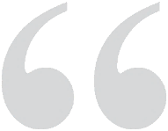
Mahana,
what do you think?
The floor is yours!
Notes:
What do you think about it?
Do you feel able of practicing it after this digital training? From our side, we recommend that you practice at least 3 times before the client practice.
How do you plan to promote it in your institutes?

Slide 23
Selling and promoting Mahana

Slide 24
Mahana,
sell it in 1 sentence
Mahana 60min
A facial treatment with energetic, aromatic and relaxing star massage
- head, hands, feet - inspired by a Polynesian ritual.
Mahana 30min
A treatment with energetic, aromatic and relaxing star massage
- head, hands, feet - inspired by a Polynesian ritual.
Notes:
If you had to define the Mahana 60' & 30' treatment, what would you say?
Here are the key phrases to describe and sell care.

Slide 25
As a gift,
a treatment for all !
Men & Women of all ages
People who are stressed and lack energy
People in a hurry
Modest people
Tied neck and trapezius
Pregnant women
Notes:
Contraindications
Cervical problems
Severe migraines
Mycoses

Slide 26
In addition
to a treatment
Facial treatment 30’/60'
Mahana 30’
Hand and feet care
Hair care
Notes:
Finally, it is possible to include Mahana 30' in a 30' or 60' facial, a hand or foot treatment and a hair treatment for our hair styling partners.

Slide 27
Extending the benefits at home
Notes:
As we have seen, the Mahana treatment can be completed with a Christmas kit.
In order to extend the benefits at home, we suggest you focus on the following ...

Slide 28
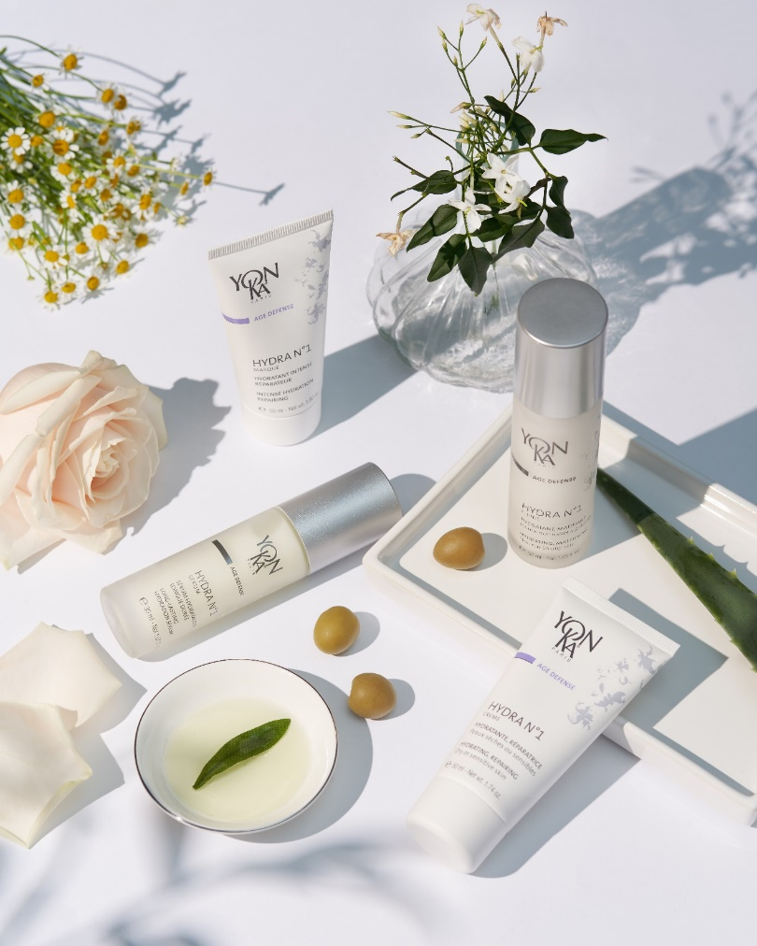
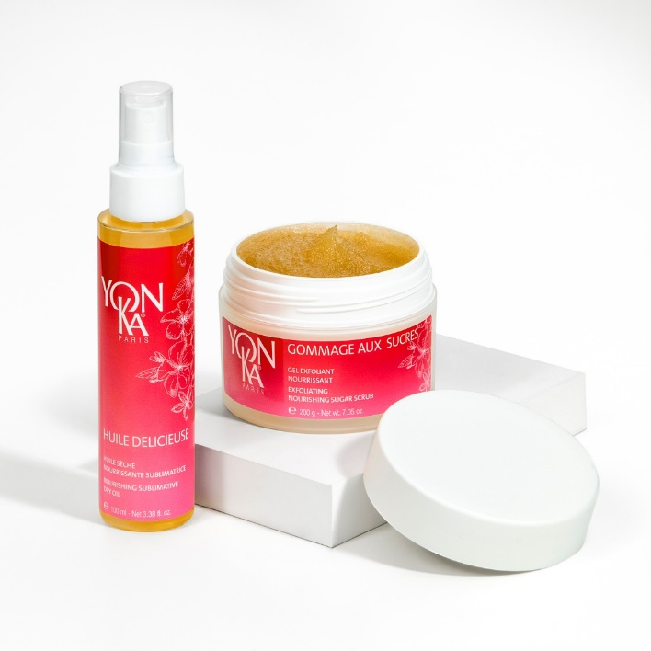
A complete face & body program
Relax range
Hydra n°1 Range
Notes:
The complete face and body program composed of the « Hydra n1 » range and the « Relax » range.

Slide 29
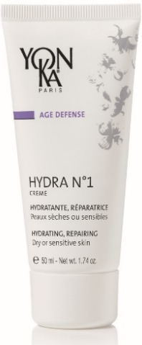
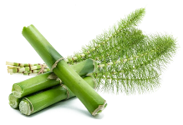
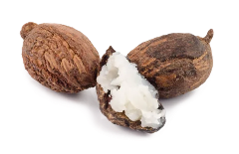
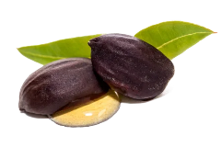
Hydra N°1 Range
Moisturizers for optimal hydration with Imperata Cylindrica
HYDRATE
IN DEPTH
MOISTURIZE
MATTIFY
MOISTURIZE
REPLENISH
MOISTURIZE
REPAIR
Hydra N°1 Serum
Hydra N°1 Fluide
Hydra N°1 Creme
Hydra N°1 Masque
Notes:
The Hydra n1 range guarantees optimal, intense and long-lasting hydration thanks to a star active ingredient; do you remember which active ingredient?
Indeed it is the imperata cylindrica. This tall red plant has a hygroscopic role. It has the capacity to capture water and to retain it up to 24 hours.
In this range, we find 4 flagship products:
The Hydra n1 serum which will hydrate in depth thanks to the addition of low molecular weight hyaluronic acid
The Hydra n1 fluid which will at the same time hydrate and mattify thanks to silica. It is thus the ideal product for normal to mixed skins
The Hydra n1 cream is rather intended for dry or sensitive skins since the shea butter will bring comfort to these skins
And finally the Hydra n1 mask enriched with jojoba to repair. Use 2 to 3 times a week and even as a sleeping mask!
This is the ideal program for all dehydrated skin.

Slide 30
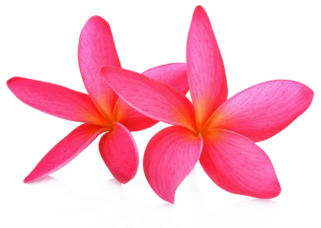
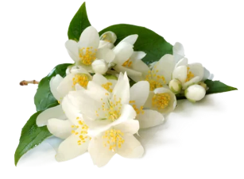
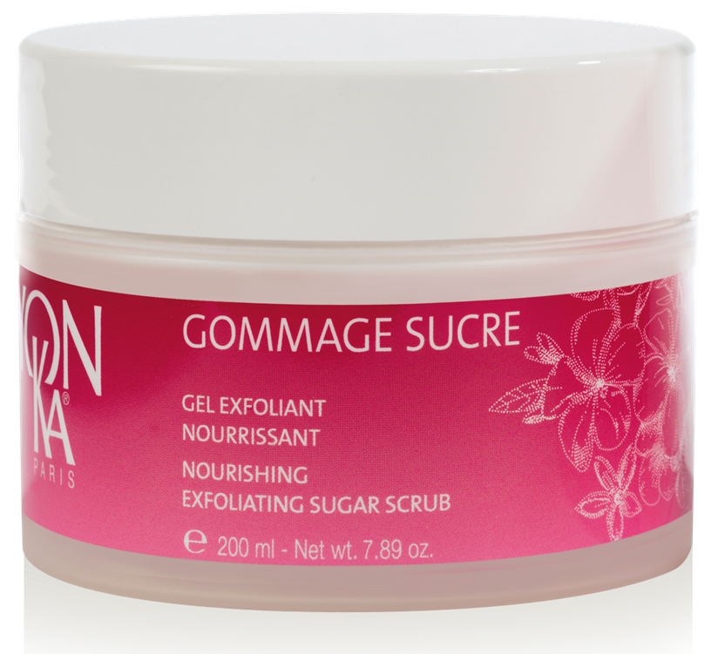
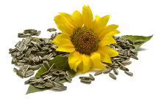
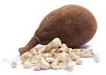
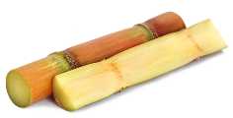
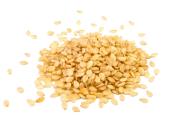
Relax Range
A complete relaxing program with sweet and bewitching scents of Tiare Flower and Jasmine
EXFOLIATE - NOURISH
NOURISH
Gommage aux Sucres
Huile Délicieuse
Notes:
To complete this facial offer, let's now focus on the « Relax » range. This range that you know perfectly well with its sweet and bewitching scents of Tiare Flower and Jasmine
invites you to escape. This subtle alliance of warm and delicate floral scents soothes, calms and relaxes.
As a reminder, we propose a program in 2 steps:
Once or twice a week: exfoliate and nourish with the sugar scrub made of organic cane sugar, white sugar and organic sunflower oil.
According to you, what are the advantages of this scrub? Indeed we are on an ultra greedy to transformation texture, ideal for dry skins
2. Daily: nourish with the delicious oil and the synergy of its 3 vegetable oils: sesame, baobab, organic sunflower
Do you remember the tip for use that we can give to our customers? Indeed, it is possible to use it on the lengths and ends of dry and damaged hair for a repairing effect.

Slide 31
Beauty and well-being tips
for a 360° experience
Rejuvenate in the middle of nature
Take a bath regularly
Avoid screens before bedtime
Practice activities: yoga...
Take time for yourself!
Listen to relaxing music
Notes:
In order to accompany your prescription, Yon-Ka advises you to give some beauty & well-being tips to your customers.
The idea is to give counsels that will optimize the results of the care and products and make the experience fully successful.
Personally, what do you do to relax after a hard or exhausting day?
Here are some beauty and well-being tips to prolong the benefits of Mahana's home care:
Avoid eating sugar before bedtime
Avoid screens before bedtime, prefer reading
Take a bath once a week
Organize time for yourself (e.g., going out with friends, going to the movies, getting a massage)
*Realize breathing exercises
*Listening to relaxing music
Rejuvenate in the middle of nature
*Foot bath and self-massage
*Go swimming, practice yoga, meditation, pilates, stretching
Practicing cardiac coherence (imported in Europe by Dr. David Servan-Schreiber. It consists in synchronizing the breathing and the heartbeat in order to bring calmness to the body) - small bamboo application
It is therefore essential to get to know yourself and to listen to your body on a daily basis.

Slide 32
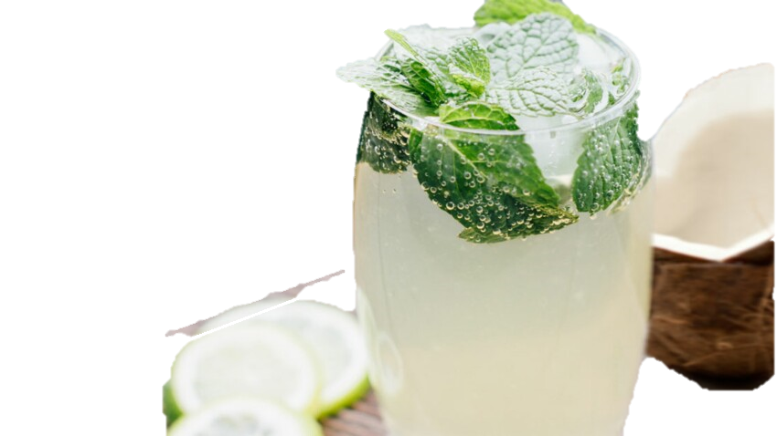
The Mahana mocktail
Lime and coconut water mocktail:
Ingredients
40ml Organic Lime Syrup
60ml
1 mint twig
Coconut water
Sparkling water
Preparation time: 5 min
Pour the coconut water and organic lime syrup into a shaker halfway up the sides.
filled with ice cubes.
Shake and strain into a glass.
Complete with sparkling water.
Garnish with a sprig of fresh mint and a slice of lime.
Notes:
To accompany the Mahana treatment, here is an example of a mocktail recipe to offer post treatment to your clients.
To your shakers!

Slide 33
To remember
Notes:
We now offer you 2 summary sheets of Mahana treatments.
We recommend that you print these sheets and post them in your common staff rooms or give them to your sales staff.

Slide 34
Mahana 60min
Facial with energetic, aromatic and relaxing star massage -head, hands, feet-
inspired by a Polynesian ritual.
Results
01
02
03
04
05
06
Relax
intensely
Release areas of tension
Restore
energy
Quiet
the mind
Moisturize
in depth
Illuminate
the complexion
Main Steps
In treatment
01
Moisturizing face care
Once a week for 4 weeks for enhanced benefits
02
Scalp and trapezius and neck massage
Without Moderation
03
Hands massage
04
Feet massage
Once a month to maintain the benefits
Target
Transversal and mixed
Recommended price
79€
Duration
60 minutes
Notes:
Here are the main elements to remember about the Mahana 60min treatment.

Slide 35
Mahana 30min
Energetic, aromatic and relaxing star massage -head, hands, feet-
inspired by a Polynesian ritual.
Results
01
02
03
04
Relax
intensely
Release areas of tension
Restore
energy
Quiet
the mind
Main Steps
In treatment
Once a week for 4 weeks for enhanced benefits
01
Scalp, trapezius and neck massage
02
Hands massage
Without Moderation
03
Feet massage
Once a month to maintain the benefits or as a supplement to another care.
Target
Transversal and mixed
Recommended price
50€
Duration
30 minutes
Notes:
And also those of the Mahana Care 30min.

Slide 36
360° activation
Notes:
To make this new ephemeral treatment a success, we propose a 360° activation.
All the elements will of course be available on the pro space.

Slide 37
Training
To review
Technical Guide
To train
Video
Notes:
At first, at the training level, we provide you with both the technical guide to review and the video to practice.

Slide 38
Offline Communication
Visibility at the point of sale
Poster & A4
Promotional & Teasing video
Notes:
In order to accompany you for communication and visibility of this new care within your institutes, we have developed different support elements:
Poster
Video to put on your digital counters

Slide 39
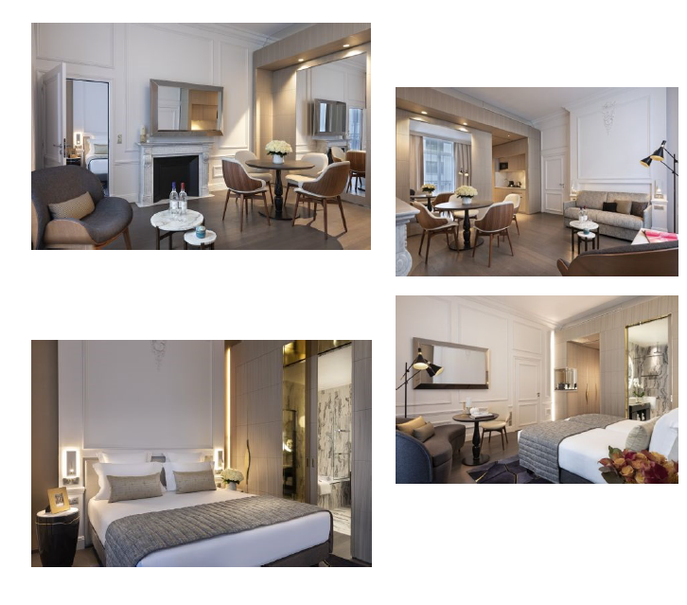
Offline communication
Visibility in the press
Press Kit & Journalist Event
Notes:
The press kit is available in French and English only in digital version. In France, we activate it through a press agency TRUST ME, with whom we realized 12 care on journalists within a Parisian hotel. We are therefore expecting great press coverage!

Slide 40
Online Communication
DIgital Media Kit
4 posts instagram/facebook
Post 1 : Teasing
Can you guess the new destination of the Yon-Ka ephemeral care?
We'll give you some clues!
👉My first clue: this destination is 15,907 km away.
👉My second clue are these emoji 🌺 coconut, island, sun
👉My third clue: the addictive sun scent in our Relax body line is inspired by this destination, So did you find it?
Tell us all about it in comments 👇
#beauty #skincare#yonka #soin #spa #massages #soinvisage
Post 2 : Launch
Post 3 : Focus scalp massage
Post 4 : Focus hands & feet
Notes:
To accompany this offline communication, we also developed a media kit composed of 4 Posts of a digital contest and a highlight on the homepage of the Yon-Ka website.
Feel free to do the same on your own websites and networks.
The goal is to make this new ephemeral skin care product known so that it becomes a must-have for the end-of-year celebrations.

Slide 41
Exchanges Questions and answers
Notes:
Before we leave, I would like to take your questions.
Feel free to ask any questions and I will be happy to answer them.

Slide 42
Notes:
This webinar is now over. I wanted to thank you for your participation and your proactivity. I was delighted to spend this time with you and to have introduced you to our new treatment which I hope will be a great success with your clients. Do not hesitate to come back to your trainer if you have additional questions or if you wish to have a personalized accompaniment. We are at your side.
To finish our immersion in Polynesia, I say goodbye in Polynesian " Nana ".
See you soon

