Slide 1
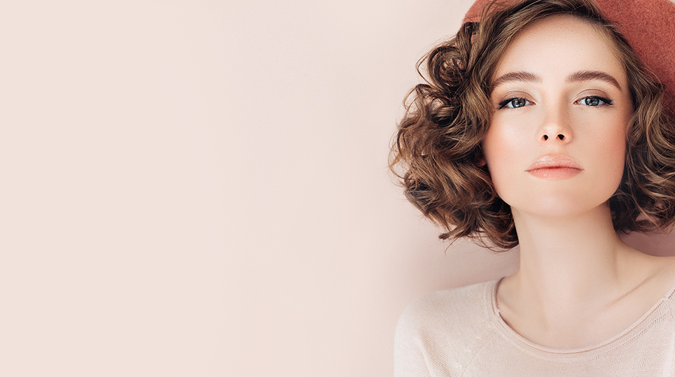
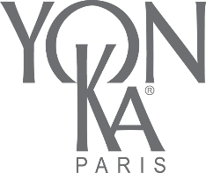
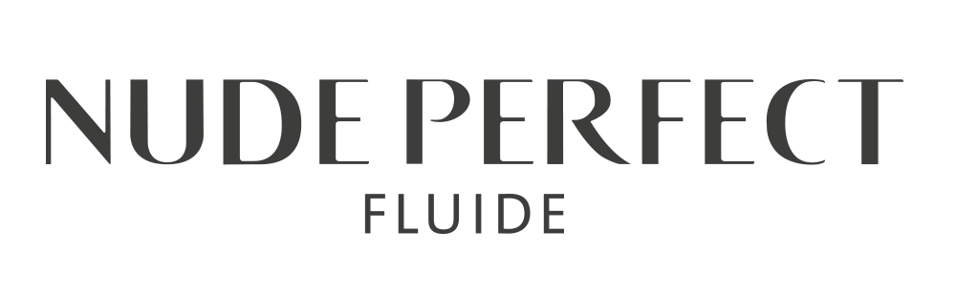
Notes:
Welcome everyone, thank you for being with us for this presentation of Nude Perfect.
We decided to bring this product back to the forefront because, as you all know, it was launched during a specific period and we really believe in the success of this product, thanks to its incredible formula.
I am sure you are already familiar with this product, so this presentation will be like a review for you.
at the end of the presentation, we count on you to give us your testimony and impressions of this product.
Finally, before we start, please note that the webinar is being recorded, you can turn the camera off if you prefer, although I prefer to have you facing me. and please be aware of the noise if you leave your microphone on.
So let's start

Slide 2
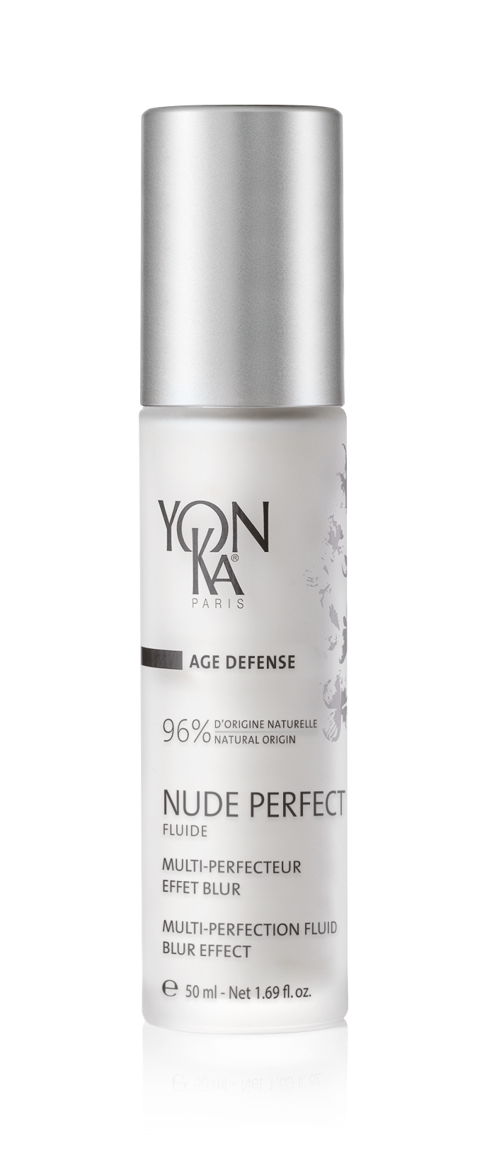
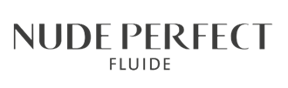



Multi-perfection fluid, blur effect
Perfect skin, naturally.
Naturalness
Short-term + long-term effect
One-step
Notes:
Lets start with the main informations to give to your clients to introduce them Nude perfect fluid :
The catchphrase is : Perfect skin, naturally.
and the 3 main advantages to be highlighted are :
NATURALNESS : Highly natural formula (96% natural-origin ingredients) free of silicone.
With a short-term soft-focus effect and long-term multi-perfection.
In one single step to achieve perfection and protection against pollution & blue light
Nude Perfect is a new-generation multi-perfection fluid with an instant blurring effect*
It clearly improves the skin’s texture and reveals a naturally more radiant and uniform complexion.
It lastingly minimizes the skin’s imperfections and refines its texture, visibly tightens pores, and blurs wrinkles and fine lines.
The skin gradually becomes smoother and more beautiful, even without makeup¹.

Slide 3



INTER-GENERATIONAL
MILLENNIALS
QUEST FOR PERFECT SKIN
THE ALLY OF REMOTE WORK
AGE DEFENSE
HYDRATION
NUTRITION
PERFECTION
MATIFYING
VITALITY
Notes:
Regarding the Classification, nude perfect is positioning in the age defense range
The target customers :
those looking for perfect skin, the quest for perfect skin is inter-generational. (influencer)
The age bracket is generally between 20-40 years and above (millennials).
The ally of remote work thanks to its light and matifying texture and its anti blue light property ! So perfect for those who work at home

Slide 4
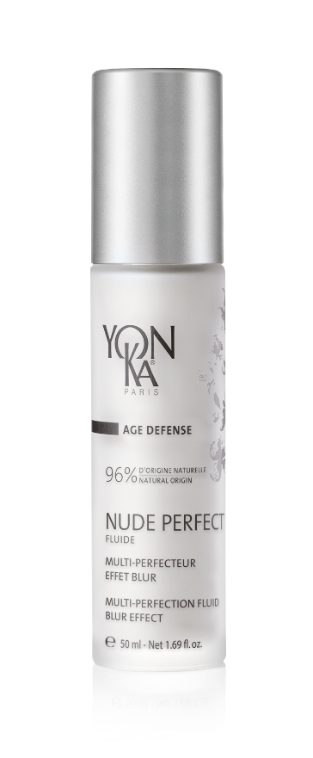


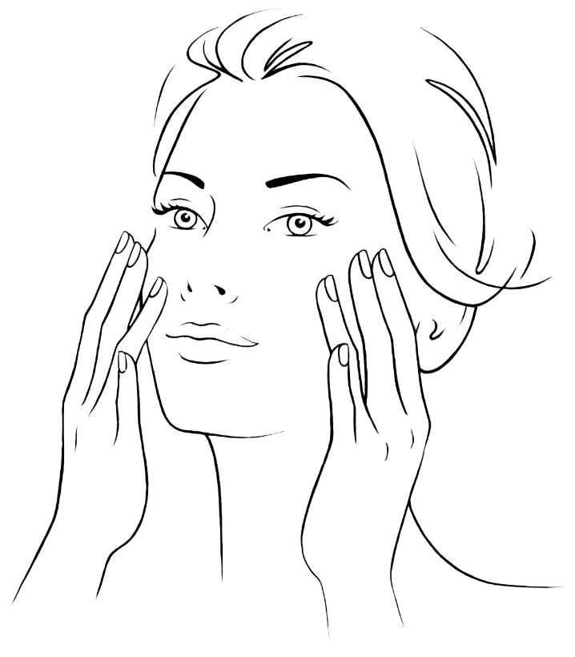


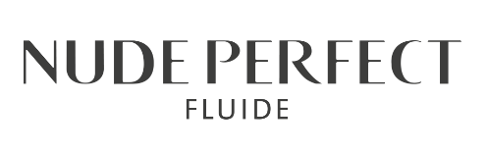

How to use
+
SCRUB
MASK
SERUM
+
Scrub + Mask
2 to 3 times per week
BBD = 30 months
PAO =
Yon-Ka Serum
- optimum comfort -
Daily
Notes:
Integrated into your morning and evening beauty routine, this fluid, with its matte, velvety finish, is applied after cleansing the skin and spraying on Yon-Ka Lotion.
Yon-Ka tip
According to your skin type, apply a Yon-Ka serum before the Nude Perfect fluid for optimum comfort.
(Caution: do not mix Nude Perfect with a booster)
In addition, adopt the Yon-Ka Scrub + Mask routine 2 to 3 times a week.
You need 2 to 3 pumps per use to cover the entire face.
Duration of use for one 50 ml bottle: 1½ to 2 months (when used twice a day).

Slide 5
2 actions
1. INSTANT ACTION
A STUNNING
SURFACE EFFECT
Improves skin quality
Smoothes wrinkles and fine lines
Even the complexion
2. LONG TERME ACTION
DEEPLY PERFECTING
TREATMENT
Minimizes imperfections and irregularities
Refines the skin’s surface
Tightens pores
Notes:
our product can be used
as a primer before makeup for its instant soft-focus effect (improves the quality of the skin, smoothes wrinkles and lines and even out the complexion)
Used as a primer = remember to offer it to salons that sell makeup as it can be used as a pre-makeup treatment!
as a long-term treatment against imperfections and a multi-perfecting effect (minimizes imperfections and irregularities, refines the surface of the skin and tightens the pores)
Let’s see now with Céline the competitive advantages and our promises

Slide 6



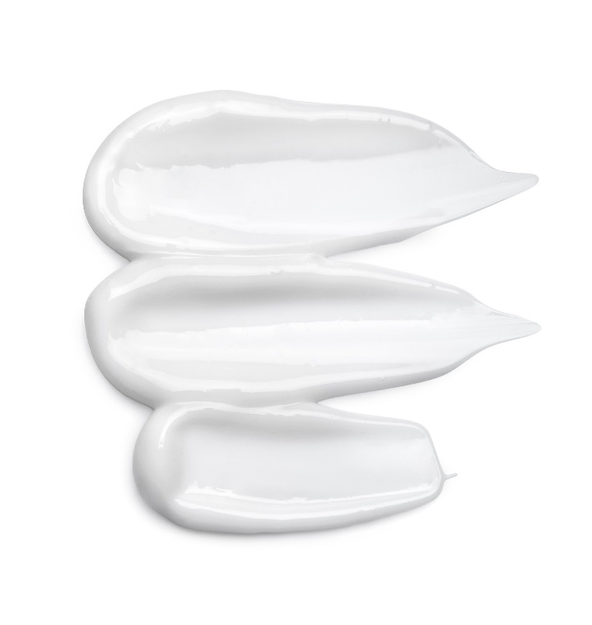

A clean formula
Packed with natural-origin ingredients – ISO 16128 standard
Formulated with no controversial ingredients (silicone, PEG, Phenoxy, mineral oil, etc.)
Formula prioritizing COSMOS certified ingredients or those compliant with the standard
Formula tested by dermatologists - Noncomedogenic
R.50 ml
Notes:
Packed with natural-origin ingredients – ISO standard
Note that on the bottle, in addition to the product name, product subtitles, and method of use (which are all usually present), the percentage of natural-origin ingredients as defined by the ISO 16128 standard is also listed since this is a real competitive advantage for a soft-focus product.
Formulated with no controversial ingredients - Silicone-free formula
Without: PEG, acrylates, silicones, phenoxyethanol, chlorphenesin, SLS or SLES sulfates, parabens, formaldehydes, formaldehyde-releasing agents, phtalates, mineral oil, hydroquinone, triclosan and triclocarbane, synthetic fragrance.
Formula prioritizing COSMOS certified ingredients or those compliant with the standard
*2 COSMOS-certified organic ingredients Ashwagandha and prickly pear cactus
*Many COSMOS-approved ingredients (compliant with the COSMOS standard) - Mineral sheets, rice powder, amino acid powder, jojoba, crithmum, Sophora japonica flower, high molecular weight hyaluronic acid
COSMOS = harmonized European standard for organic cosmetics – Our product is not COSMOS-certified, but most of our ingredients comply with the standard (approved ingredients) or are certified.
Certified ingredients are the organic ingredients (this is the case for the prickly pear cactus and ashwagandha).
Approved ingredients are verified raw materials of natural origin.
COSMOS ORGANIC COSMOS NATURAL COSMOS CERTIFIED COSMOS APPROVED
Logo color Green Blue Black and white Black and white
Finished product/ingredient Organic finished product Natural finished product Organic ingredient Approved ingredient
Conditions COSMOS organic certification Natural certification COSMOS organic certification Approved by COSMOS
Respect for animal life: in compliance with current European regulations, we do not test our products on animals.
No animal-origin ingredients are used (except beeswax from living animals).
Dermatologist-tested - noncomedogenic

Slide 7
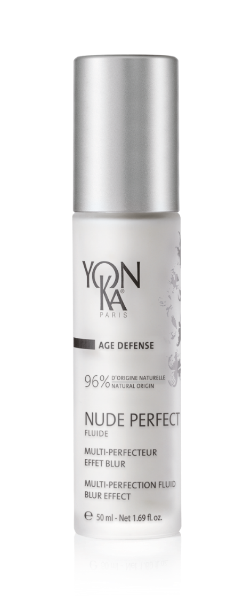
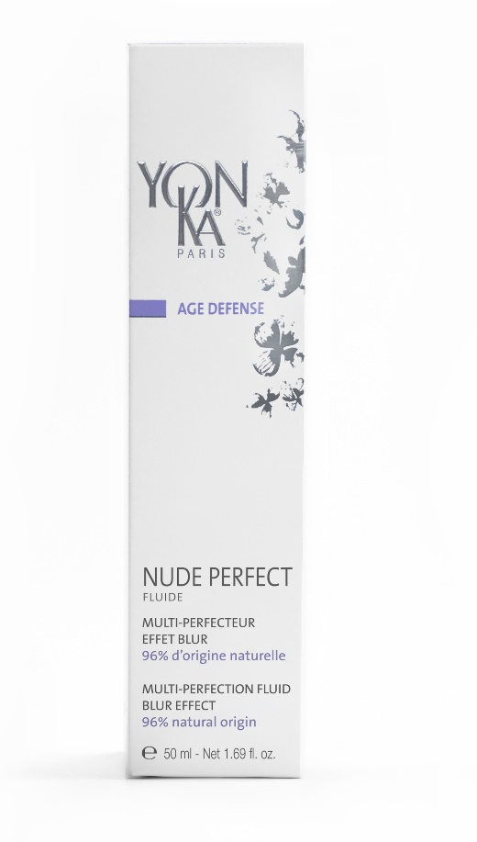
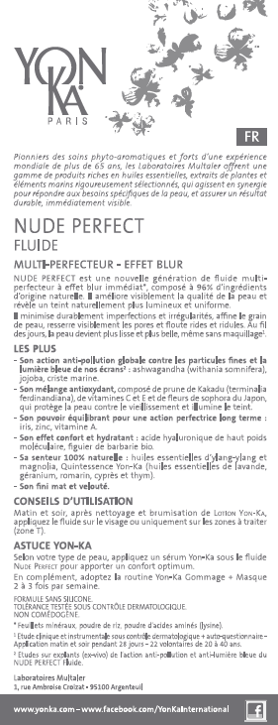


Eco-responsible packaging
Leaflet
FSC paper
Vegetable-based inks
Recyclable
50 ml glass bottle
Recyclable
Cap made of recyclable PP
Box
Recyclable
Notes:
Primary packaging: Frosted glass pump bottle, printed
2 colors - 50 ml
100% recyclable glass bottle* (*according to the recycling criteria of the French market)
Cap made of 100% recyclable PP
PP C706-21NA HP (Braskem) is food-safe and free of bisphenol, halogen, PAH, etc.
Secondary packaging: Box with the design from the AGE DEFENSE category
Our box is not made of recycled paper, but it can be recycled.
Leaflet: All of our leaflets are printed on FSC paper with vegetable-based inks.
100% recyclable leaflet.
This logo is not yet printed on our leaflets, but it will be added to future printings.
Forest Stewardship Council certification logo. The Forest Stewardship Council (FSC) is an environmental seal of approval whose purpose is to ensure that the production of wood and wood-based products complies with procedures that guarantee sustainable forest management.

Slide 8
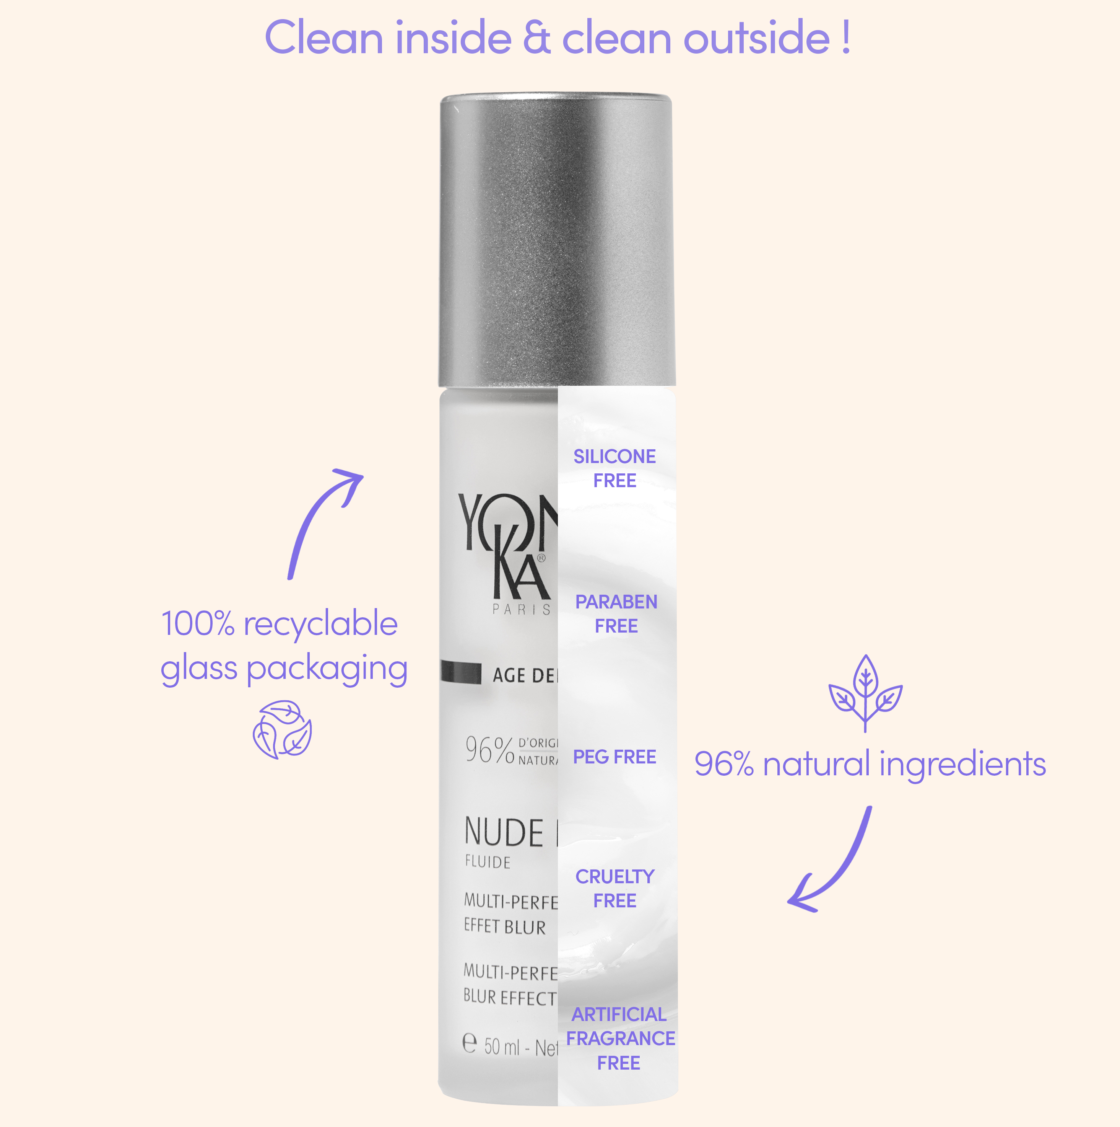
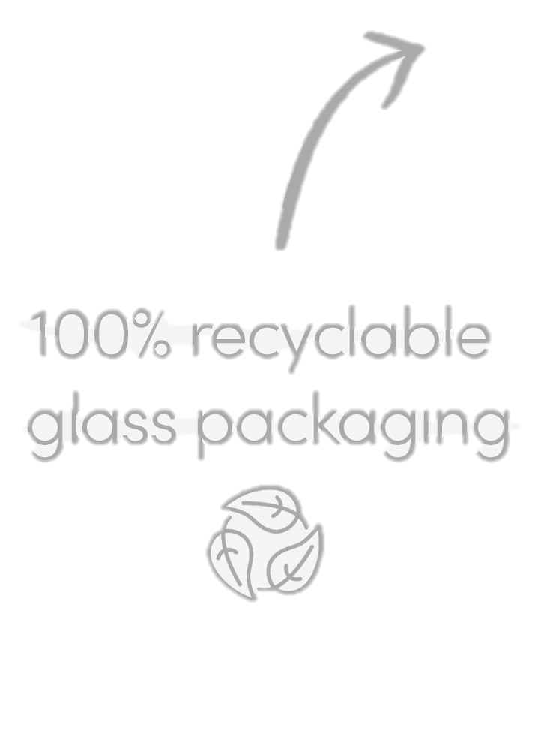
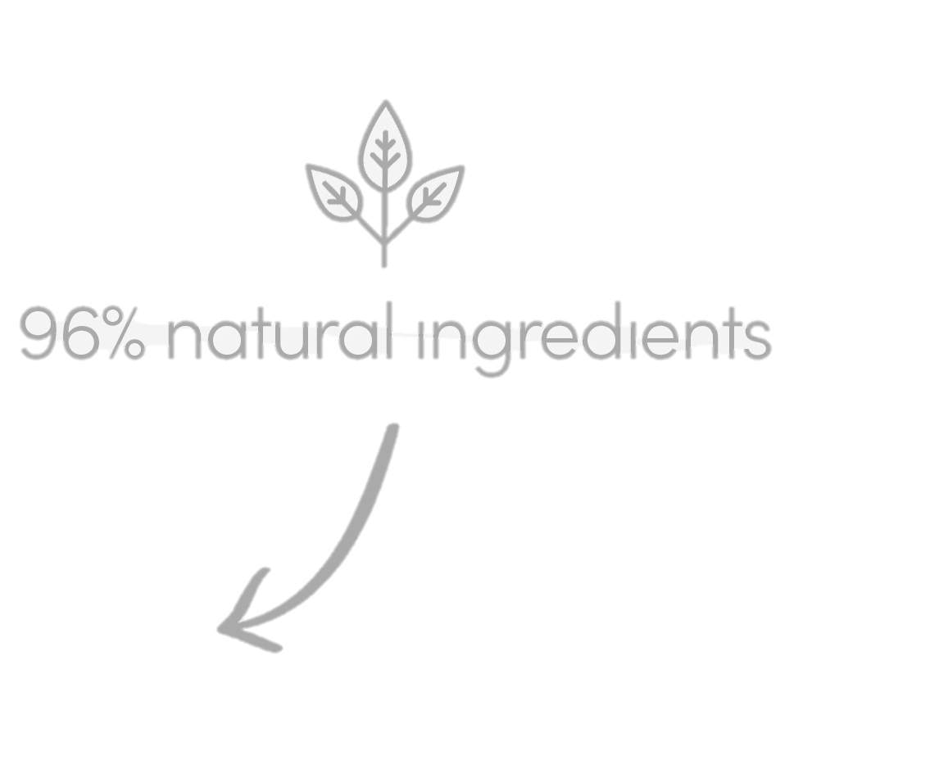
Clean inside & clean outside !
Notes:
Primary packaging: Frosted glass pump bottle, printed
2 colors - 50 ml
100% recyclable glass bottle* (*according to the recycling criteria of the French market)
Cap made of 100% recyclable PP
PP C706-21NA HP (Braskem) is food-safe and free of bisphenol, halogen, PAH, etc.
Secondary packaging: Box with the design from the AGE DEFENSE category
Our box is not made of recycled paper, but it can be recycled.
Leaflet: All of our leaflets are printed on FSC paper with vegetable-based inks.
100% recyclable leaflet.
This logo is not yet printed on our leaflets, but it will be added to future printings.
Forest Stewardship Council certification logo. The Forest Stewardship Council (FSC) is an environmental seal of approval whose purpose is to ensure that the production of wood and wood-based products complies with procedures that guarantee sustainable forest management.

Slide 9
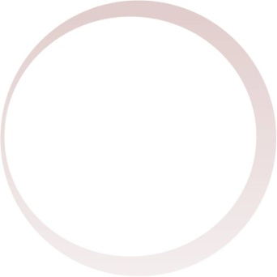
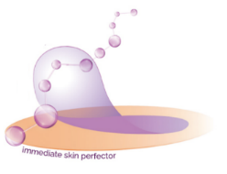
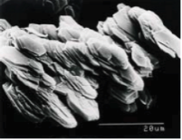
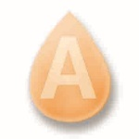
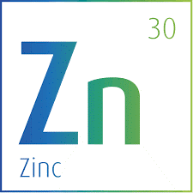
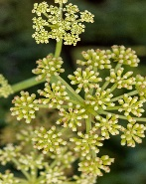
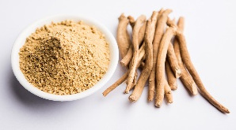
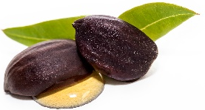
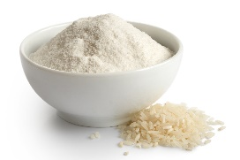
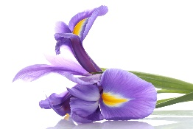


Formula
ACTIONS & ACTIVE INGREDIENTS
96% ingredients of natural origin
MINERAL SHEETS
RICE POWDER
AMINO ACID POWDER
IRIS
ZINC
VITAMIN A
JOJOBA
CRITHMUM
ORGANIC ASHWAGANDHA
Matifying
Soft focus effect
Blur effect
Shine control
Purifying
Balancing
Soothing
Sebum regulating
Anti environmental pollution
Anti digital pollution (blue light)
R.50 ml
Notes:
let's look at the formula in detail :
A MIMICKING SOFT FOCUS EFFECT THAT BLURS AND MATTIFIES
For a blur effect without the use of silicones, Yon-Ka integrates ultra-effective mineral sheets into its formula. Based on corneotherapy, Their innovative helix structure opens on the surface of the skin to fill out the skin texture and smooth out roughness.
we will see later the action of the mineral sheets at the surface of the skin the skin
This action is enhanced with rice powder and amico acid powder for a mattifying and intense blur effect.
A PURIFYING AND BALANCING POWER
The synergistic combination of Iris, zinc, and vitamin A, with their sebum regulating, purifying, anti-bacteriostatic and anti-inflammatory properties, helps to purify and soothe the skin for a long term perfecting action.
PROTECTION AGAINST ENVIRONMENTAL POLLUTION
As we all know, pollution is more than just a global environmental concern. It is also one of the causes of premature aging.
To protect against pollution, Yon-Ka has combined jojoba and crithmum which promotes good cohesion in surface cells and act as an urban pollution shields (especially fine particles)
AND DIGITAL POLLUTION
Exposure to blue light increases cell fatigue, which has the effect of dulling the complexion.
To neutralize blue light, the formula contains organic ashwagandha to protect the epidermis from the effects of light emitted by screens. Skin is profoundly renforced and visibly revitalized. The signs of fatigue disappear, giving way to a radiant complexion.

Slide 10

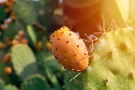

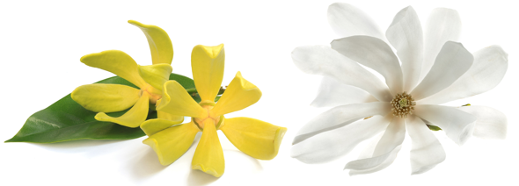
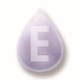
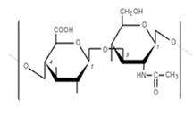
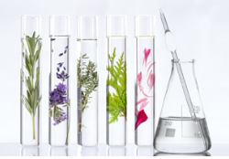

Formula
ACTIONS & ACTIVE INGREDIENTS
96% ingredients of natural origin
SOPHORA
JAPONICA FLOWER
KAKADU PLUM
VITAMINS C, E
HIGH MOLECULAR WEIGHT
HYALURONIC ACID
ORGANIC PRICKLY
PEAR CACTUS
YLANG-YLANG AND MAGNOLIA ESSENTIAL OILS
YON-KA QUINTESSENCE
Protect against oxidative stress
Boost radiance
Hydrate
Bring comfort
Balancing fragrance 100% natural
R.50 ml
Notes:
PROTECTION AGAINST FREE RADICALS
To effectively protect against oxidative stress, NUDE PERFECT Fluid contains a combination of antioxidants with proven effectiveness. Sophora japonica extract, kakadu plum extract, vitamin C, and vitamin E work in synergy to effectively protect the skin from free radicals and boost its radiance.
BRINGS COMFORT AND HYDRATION
Nude Perfect’s formula is infused with hydrating high molecular weight hyaluronic acid and organic prickly pear cactus (from Bolivia).
FRAGRANCE
Enhanced with Yon-Ka Quintessence and a delicate all-natural scent combining ylang-ylang and magnolia
here is a complete and very effective formula, let's have a look at the major 2 innovations of this product

Slide 11
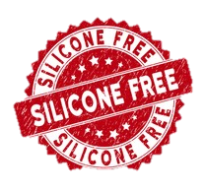
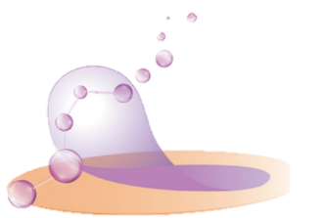
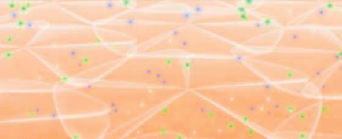
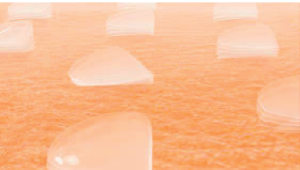
Innovation
HAVE A PERFECT SKIN WITHOUT FILTERS OR PHOTOSHOP
BLUR EFFECT
Stratum corneum
Mineral sheets
Stratum corneum :
Smoothed skin texture
Results :
Immediate smoothing effect: unfolds on the skin's surface, instantly fills in the skin's micro-relief and refines the skin's texture
Immediate blurring effect: hides the imperfections on the surface of the skin.
Notes:
First big innovation of this product. Blur effect without silicones
We integrated mineral sheets Forming like a second skin on the epidermis
These sheets will act as a real renovator of the corneus layer to correct and obtain a perfecting action on the whole skin:
Immediate smoothing effect: unfolds on the skin's surface, instantly fills in the skin's micro-relief and refines the skin's texture (reducing surface depressions) for visibly smoothed skin.
Immediate blurring effect: allows to diffuse and retransmit the light according to several directional angles for a blurring effect which hides the imperfections on the surface of the skin.
In plus of these 2 immediate results, we also have a Restructuring effect in 2 weeks: the contribution of structural biomolecules at the level of the corneocytes makes it possible to repair the underlying structures of the skin: more luminous complexion, softer and smoother skin, refined skin texture, reduced imperfections.

Slide 12

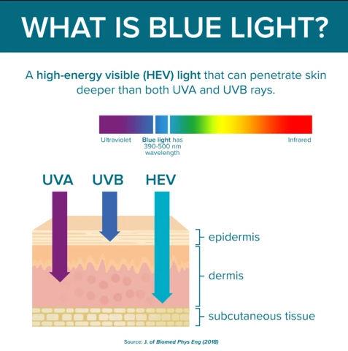
Innovation
ANTI BLUE LIGHT
Top 3 of the factors responsible for premature skin aging:
Sun
Pollution
Blue light
Yon-Ka answer : Organic Ashwagandha
Protection of the viability of keratinocytes in the epidermis
Protection of fibroblast metabolism in the dermis
Results : - Deeply strengthens the skin
- Revitalizes the skin
- Makes signs of fatigue disappear
- Gives radiance to the complexion
Blue light = a hight-energy visible (HEV) light that can penetrate skin deeper than both UVA and UVB rays
Notes:
The second innovation is : anti blue light
The blue lights of our screens penetrate deeper than both UVA & UVB rays into the dermis and gradually reduce the capacity of the skin cells to regenerate. The consequences are not immediately visible but premature skin aging does exist. As the skin regenerates less and less, fine lines and wrinkles appear on the surface and the skin also loses its plumpness and elasticity.
Blue light generates an oxidative stress and free radicals at the level of cutaneous cells. Photo-ageing process is thus accelerated.
With 6h/day spent on average in front of a screen, blue light is now one of the main environmental factors responsible for cutaneous ageing with sun and pollution.
Yon-Ka has therefore decided to fight againt this phenomenon by adding organic ashwagandha to its formula:
Protect the viability of keratinocytes in the epidermis
Protect fibroblast metabolism in the dermis
Results : - Deeply strengthens the skin
- Revitalizes the skin
- Makes signs of fatigue disappear
- Gives radiance to the complexion

Slide 13
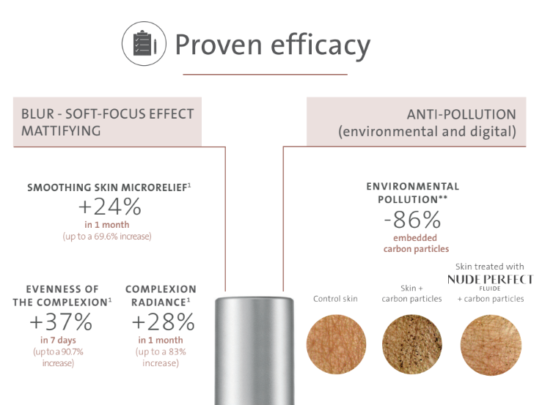
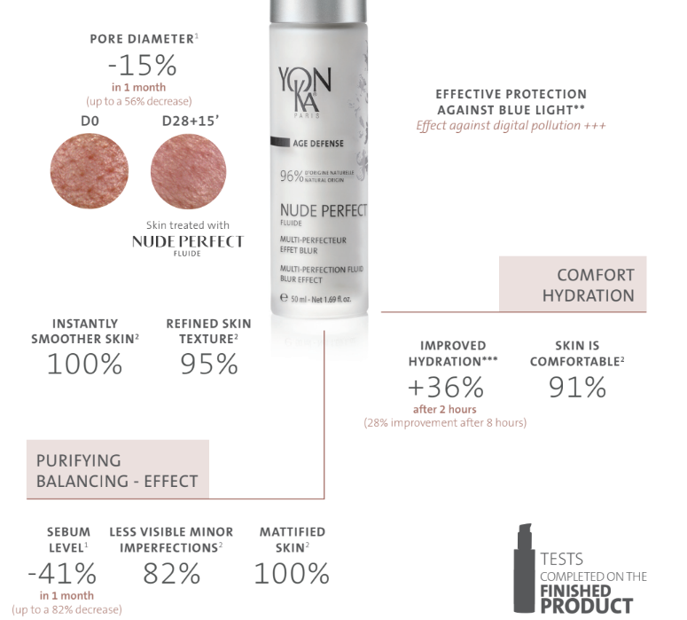

Proven efficacy
BLUR – SOFT-FOCUS EFFECT
MATTIFYING
PURIFYING
BALANCING EFFECT
ANTI-POLLUTION
Notes:
Few words regarding the results
A clinical study with instrument-based measurements show very interesting blur and matifying results after 28 days of using twice daily :
The skin's microrelief is 24% smoother
the complexion is 37% more even
reduction in pore diameter by an average of 15%.
Thanks to a self questionnary we can advance a very nice purifying and balancing effect :
Minor imperfections are less visible for 82% of subjects
The skin is mattified for all subjects
The skin is instantly smooth for all
And the skin texture is refined for 95% of them
And thanks to an ex vivo tests we can aim that the nude perfect protects againt the carbon partciles : -86%
*Clinical study carried out under a dermatologist’s supervision of 22 subjetcs, between 20 and 40 years old, after 28 days of using NUDE PERFECT twice daily
¹ instrument-based measurements
² self questionnaire
** Ex-vivo tests performed on human skin explants
*** corneometry test – 10 volunteers – 18 to 70 years old

Slide 14
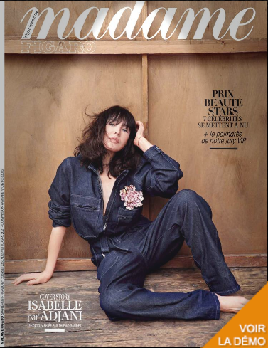

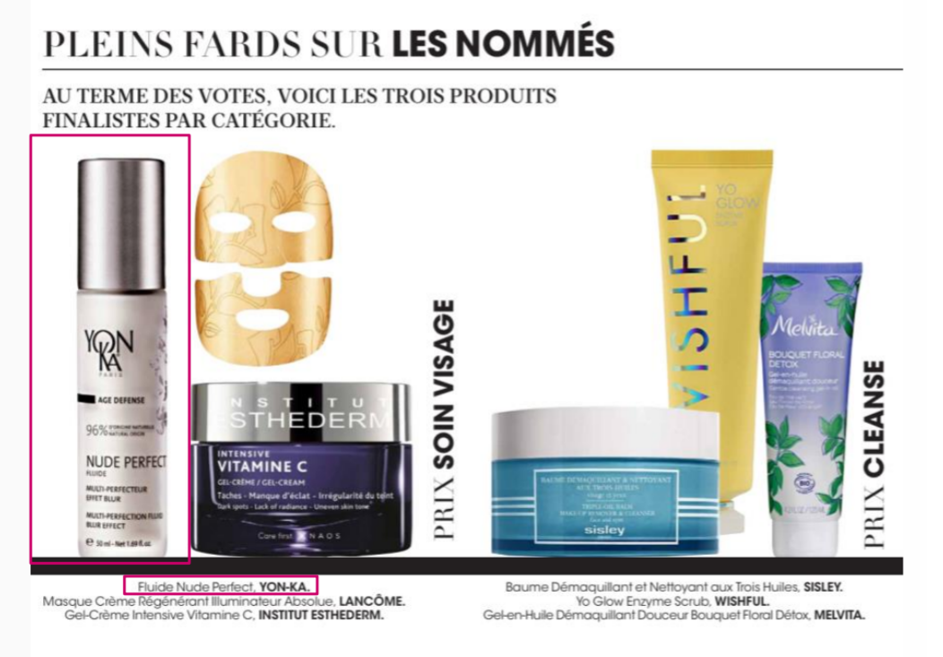
13th edition of the MADAME FIGARO
BEAUTY STARS PRIZE :
Nude Perfect Fluid was one of the 3 nominated
Our product has been tested and approved by a VIP jury, composed of more than 145 famous actors and actresses!
Monica Bellucci – Catherine Deneuve – Emmanuelle Béart – Nathalie Baye – Leïla Bekhti – Estelle Lefebure – Jean Dujardin – Raphaël Personnaz – Omar Sy – Gaspart Ulliel …
Notes:
Top 3 (hors nettoyants) des ventes
Top 10 sur l’année

Slide 15
Quizz
FIND THE RIGHT ANSWER :
1. What is the percentage of ingredients of natural origin ?
2. What are the 2 innovations of Nude Perfect Fluid ?
3. What is the active ingredient capable of fighting blue light?
a : mineral sheets
b : sophora japonica flower
c : organic ashwagandha
4. For whom Nude Perfect is intended ?
Millennials, influencers, men & women, client looking for perfect skin, women who wear make-up, person who works behind a screen, normal to combination skin
5. Can you name 3 properties of Nude Perfect Fluid ?
Notes:
1. 96%
2. Blur effect without silicon & anti blue light
3. Organic ashwagandha
4. TARGET FOCUS
The quest for perfect skin is inter-generational.
The age bracket of 20–40+ years (millennials) is the most concerned with the quest for perfect skin.
These targets are heavy consumers of skincare and beauty (AGE DEFENSE / start of AGE CORRECTION).
Remote work
5. Blur effect / soft focus / matifying / purifying / balancing / anti pollution (environnemental & blue light) / anti oxydative stress

Slide 16

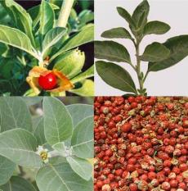

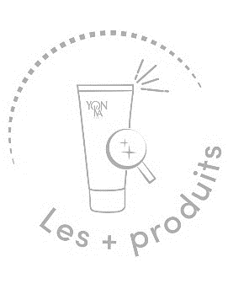
Nude Perfect
96% natural origin multi-perfection fluid, blur effect
Perfect skin effect
Evens the complexion
Purifies, matifies
Smoothes the micro relief (lines, dilated pores, imperfections)
With Mineral sheets and
Organic Ashwagandha
Instantly smoother skin : 100%*
Eveness of complexion : +37%**
Silicone-free formula
Soft focus and blur effect
Anti-pollution
The ally of remote work
50 ml
*self questionnaire
**instrument-based measurements (in 7 days)
Clinical study carried out under a dermatologist’s supervision of 22 subjetcs, between 20 and 40 years old, after 28 days of using NUDE PERFECT twice daily

Slide 17
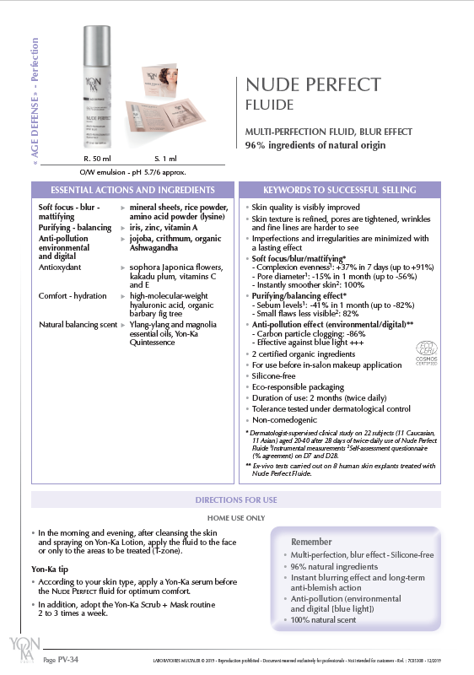
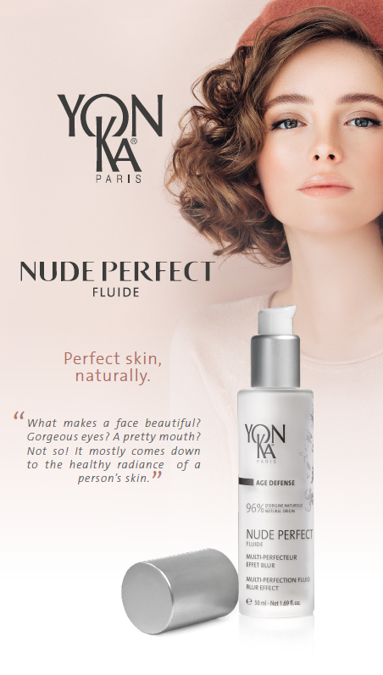
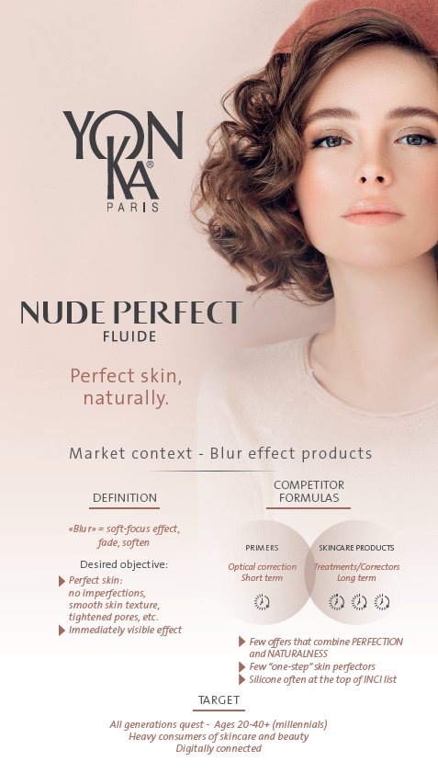
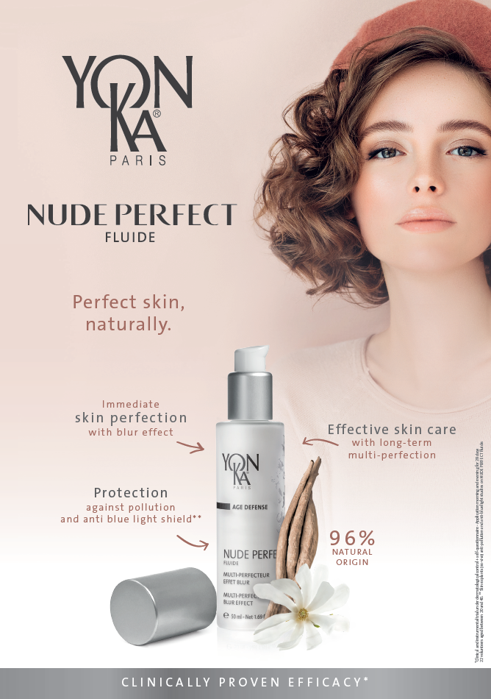
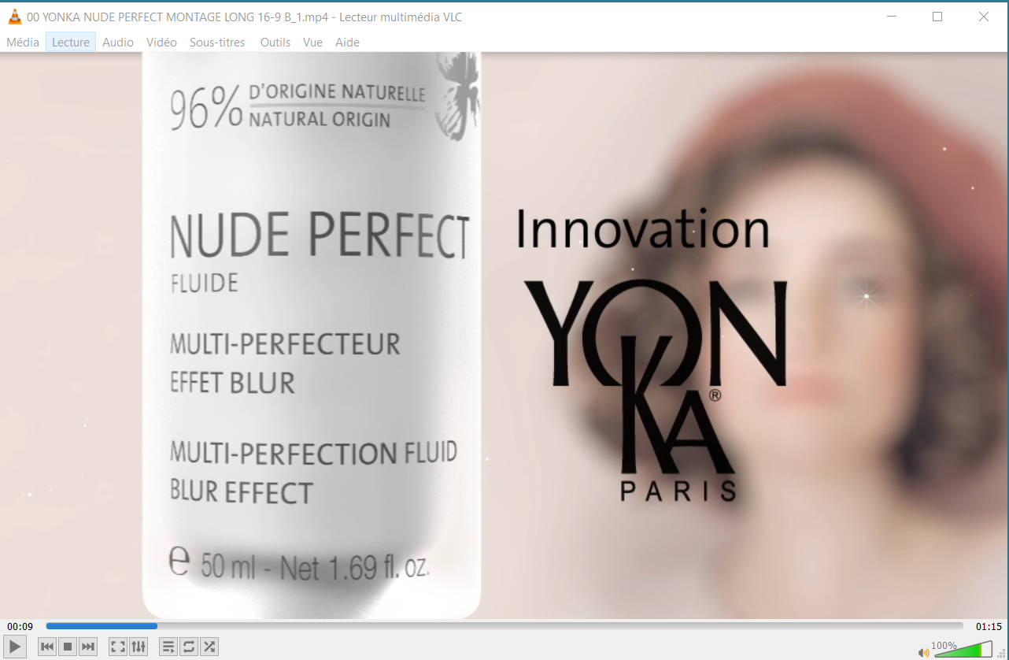
Communication tools
Product
sheet
Press file
Sales presentation
A4 poster for glorifyer
Sample Card
1 ml blister
Nude Perfect video
Notes:
And also integrated into the beauty prescription and the segmentation poster +A3 segmentation sheet

Slide 18
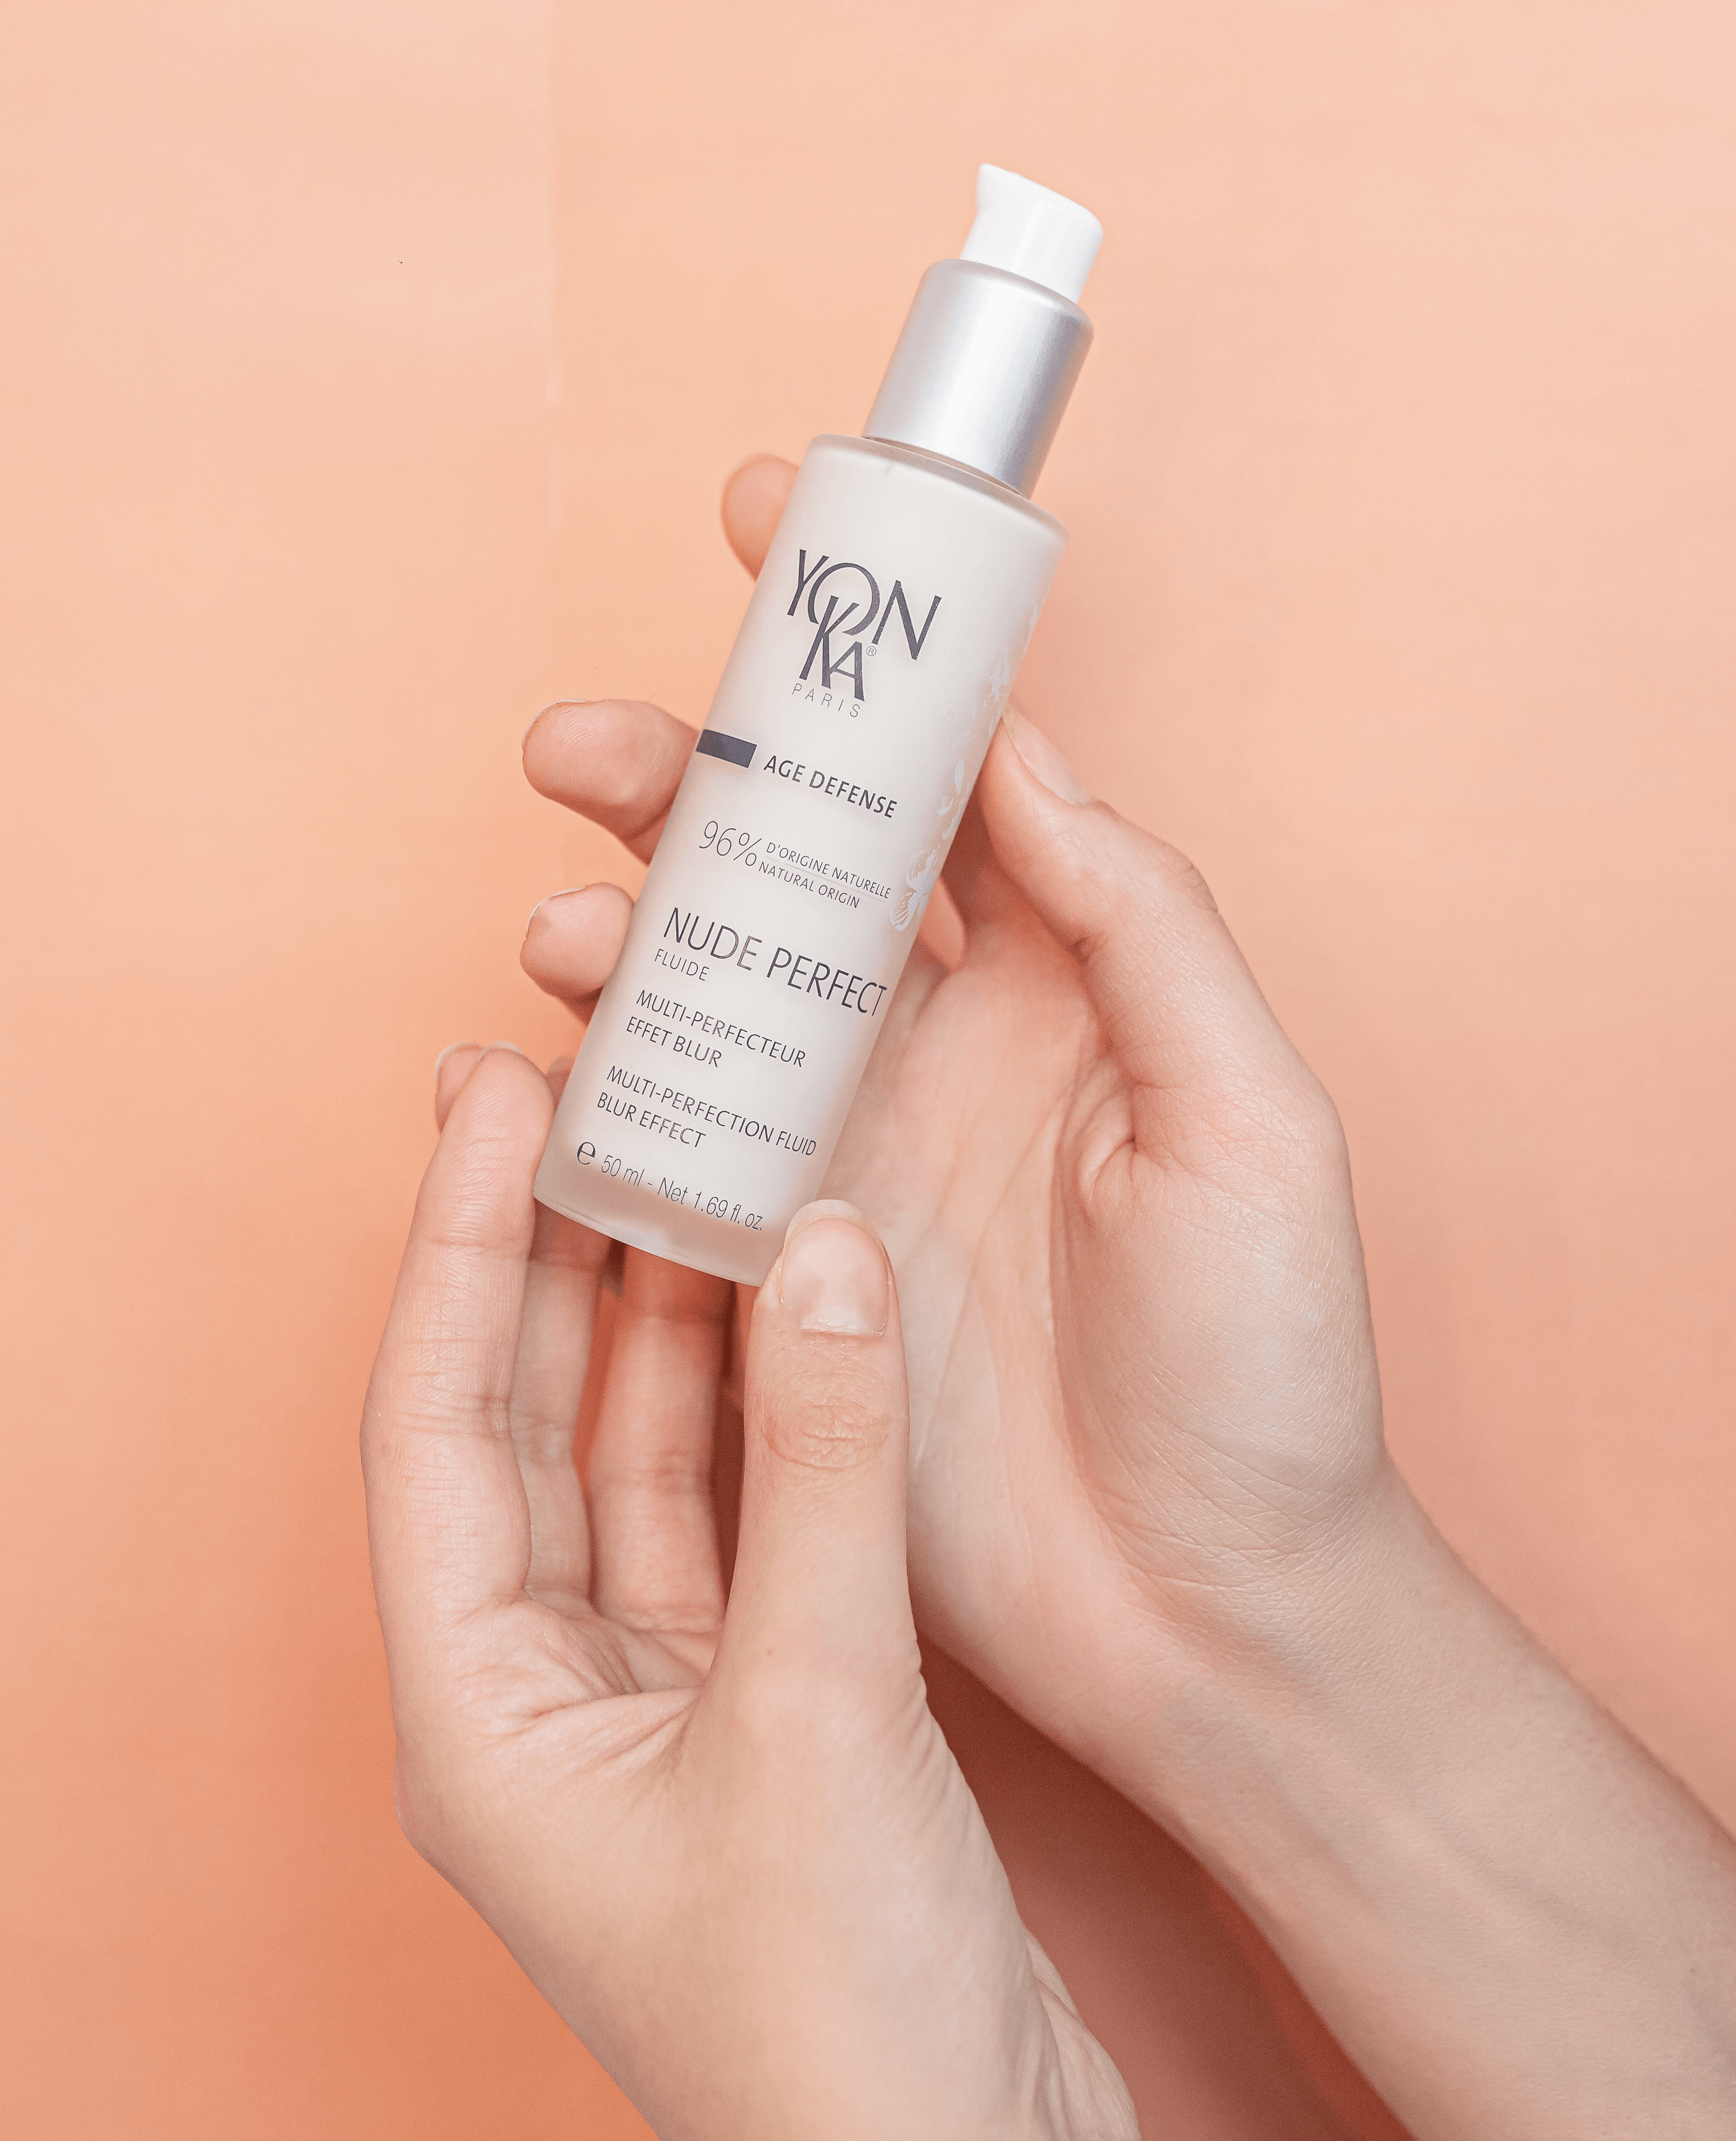
Feed Back
What do you think of Nude Perfect Fluid ?
What do you like most about the product?
What do your customers think ?
According to you, what is/are the best argument(s) to sell the product?
Tell us what you think of the effectiveness of the product?
What could you say about the scent of the product (essential oils of magnolia, ylang-ylang and Yon-Ka Quintessence)? Do you like it?
Notes:
Please share with us your feed back, felling

Slide 19
