Slide 1
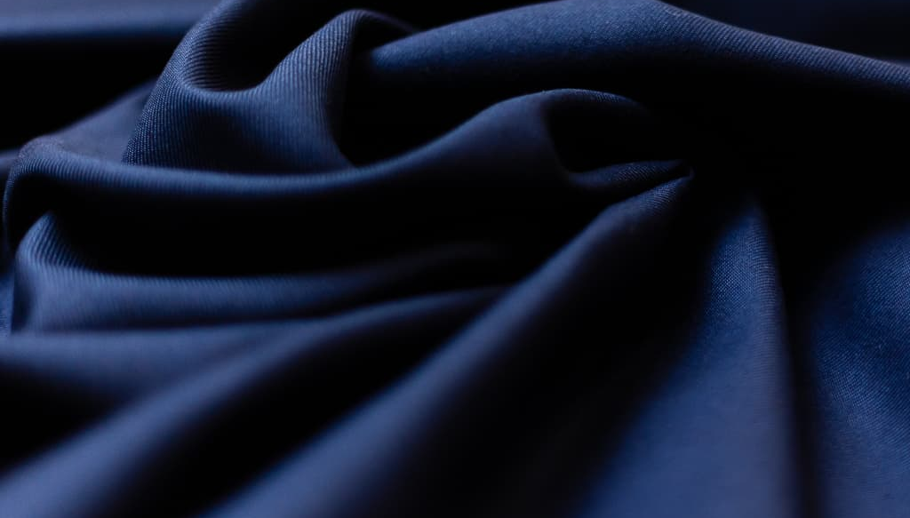
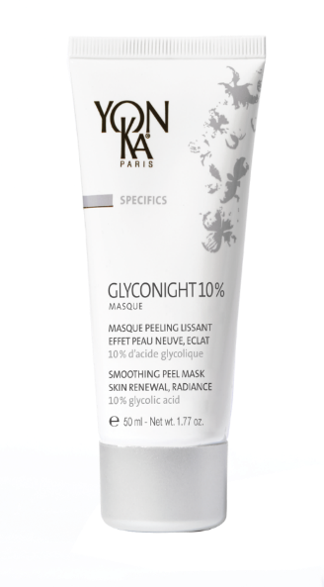
The Yon-Ka night offer

Slide 2
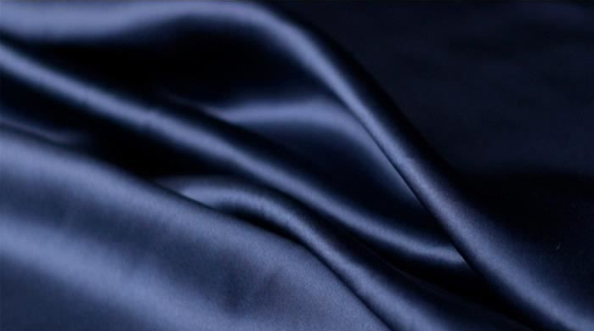
The Yon-Ka training team is very happy to announce the birth of Ari, Sophie's baby.

Slide 3
The chronobiology,
Kezako ?

Slide 4
Chronobiology, Kezako ?
It is the study of biological rhythm.
Thus, depending on the time of day, the skin has different needs.
Every living being has
A biological rhythm.
The objectives :
Provide the skin with
what it needs,
at the right time,
to optimise its care.
That of the skin is
A "circadian" rhythm
(24h).
Notes:
What is Chronobiology ?
Chronobiology is the science of biological rhythm
Every living being has a biological rhythm.
That of the skin is a « circadian » rhythm, which means it occurs during a whole day (24h). The skin cells detect differences in luminosity and adapt to them to activate their skin defense or regeneration functions,
Thus, depending on the time of day, the skin has different needs.
The objective of skin chronobiology is to provide our skin with what it needs, at the right time, to optimize its care.

Slide 5
The needs of the skin
According to chronobiology

Slide 6
DAY
Very low cell regeneration
Objectives
Limit dehydration
Guarantee better protection against external elements (cold, wind, sun, pollution, etc.)
.
Very low TEWL
Maximum sebum production
Notes:
In the morning, cellular activity is no longer present.
What is important: Cleanse, tone and protect the skin to prepare it for the day ahead. .
During the day, the cells regenerate very little.
We also have a very low TransEpidermal Water Loss (TEWL)
While the production of sebum is at its maximum, around 12.
All these phenomenons do not happen by chance:
By doing so, the skin limits its dehydration
and guarantees a better protection against external elements
During the day, the skin plays a role of shield and needs to be protected.

Slide 7
NIGHT
Peak of cell regeneration
The skin is more receptive
The active ingredients penetrate better and are more effective.
.
Peak of the microcirculation
More permeable skin
Notes:
As nature is so well done, when we rest, the skin wakes up:
The epidermal cells are renewed.
Between 11:00 pm and 4:00 am its regeneration peak is reached.
Microcirculation is also stimulated to reoxygenate and detoxify the cells.
It is particularly intense between midnight and 4:00 am. This blood flow allows the elimination of toxins and the supply of nutrients to help the process of good cellular regeneration.
TransEpidermal Water Loss (TEWL) is also at its highest level, indicating a lower level of barrier function or increased skin permeability.
Therefore, it is at night that the skin is more receptive
that the active ingredients penetrate better and are the most effective.
If you want a substance to penetrate the skin, give it at night!

Slide 8
Ready to follow the natural rhythm of our skin with the right night care?

Slide 9
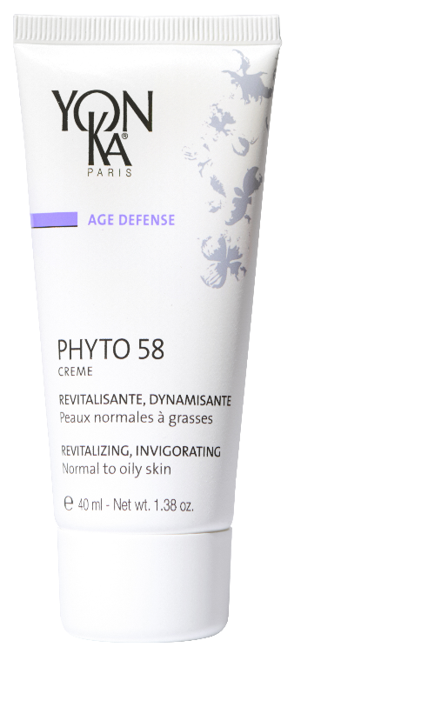
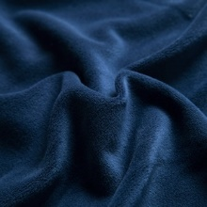
Dull skin Asphyxiated skin
First wrinkles
Adapt your
night care
Loss of firmness
Deep wrikles

Slide 10
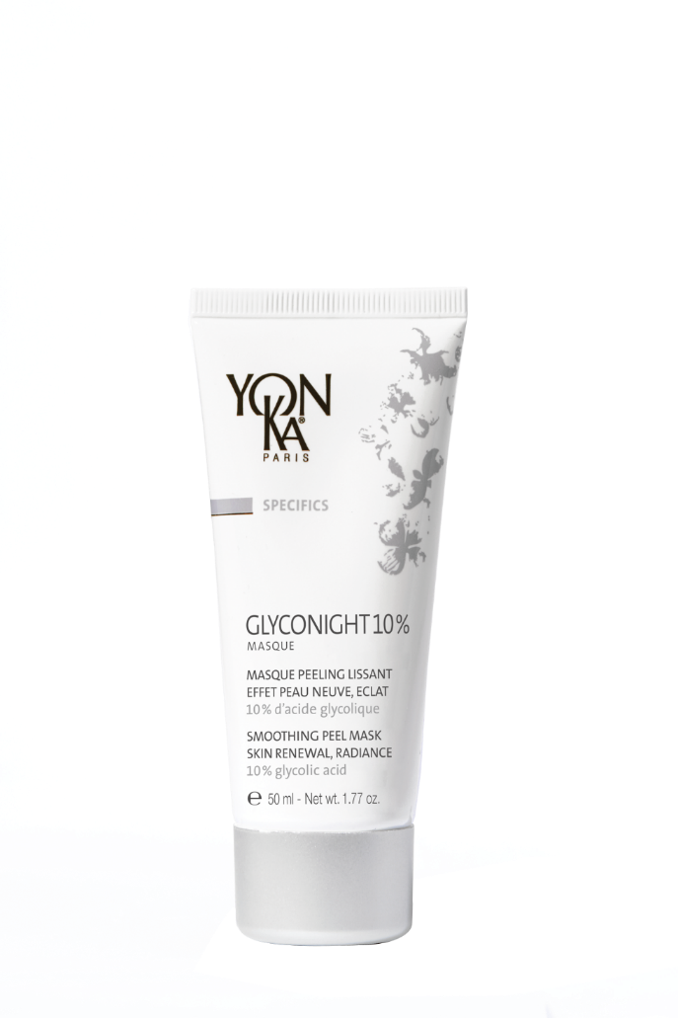
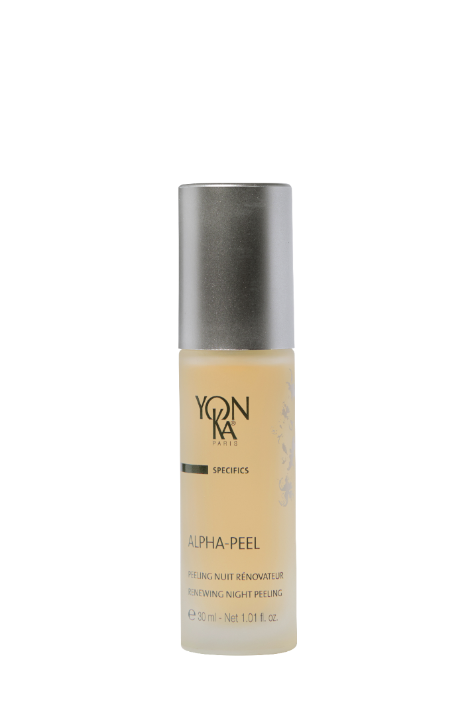
Roughness, Dilated Pores
Uneven skin
Adapt your
night care
Fine lines
Roughness, dilated Pores
Dullness
Signs of aging

Slide 11
Let’s play !
Which day creams would be suitable with each of the phyto 58?
PAMPLEMOUSSE PS/PNG
VITAL DEFENSE
Radiance
Anti pollution shield
Notes:
> PAMPLEMOUSSE PS OR PNG FOR RADIANCE
> Or VITAL DEFENSE FOR ANTI OXIDANT/ANTI POLLUTION PROTECTION

Slide 12
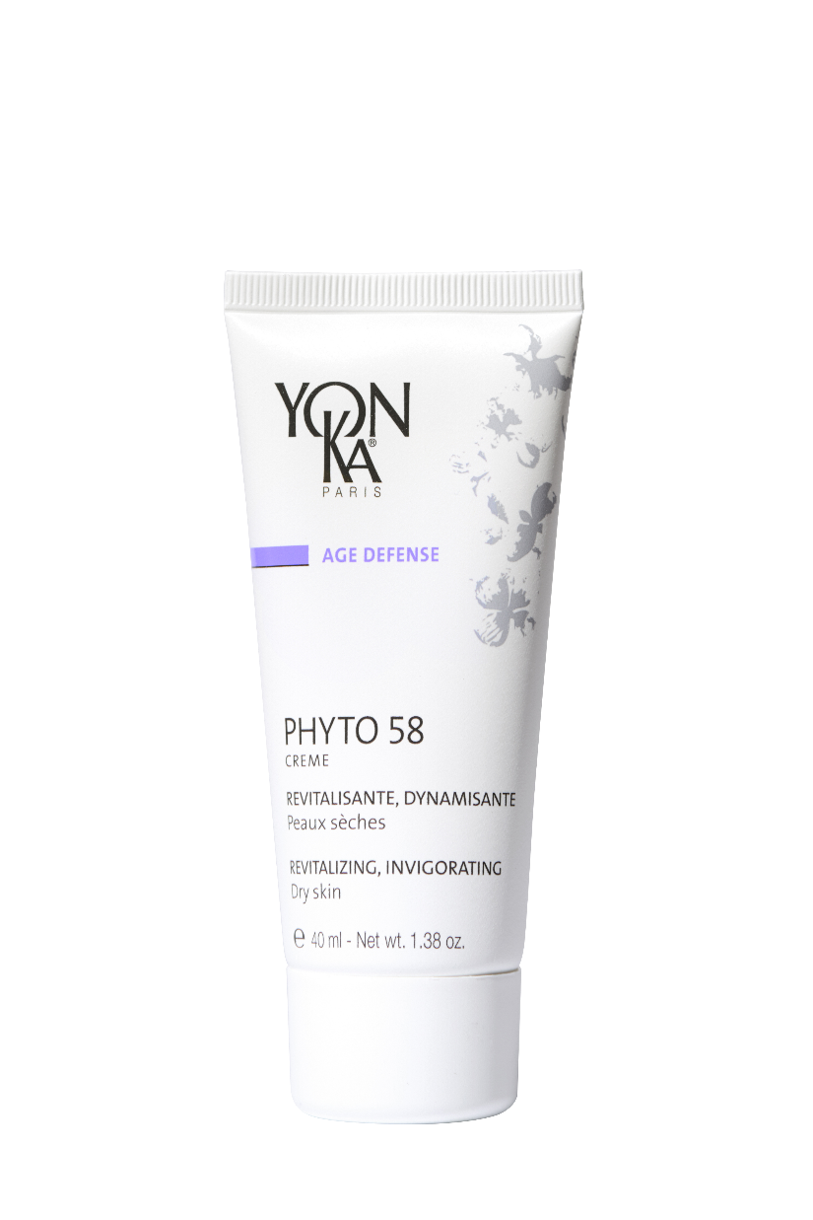
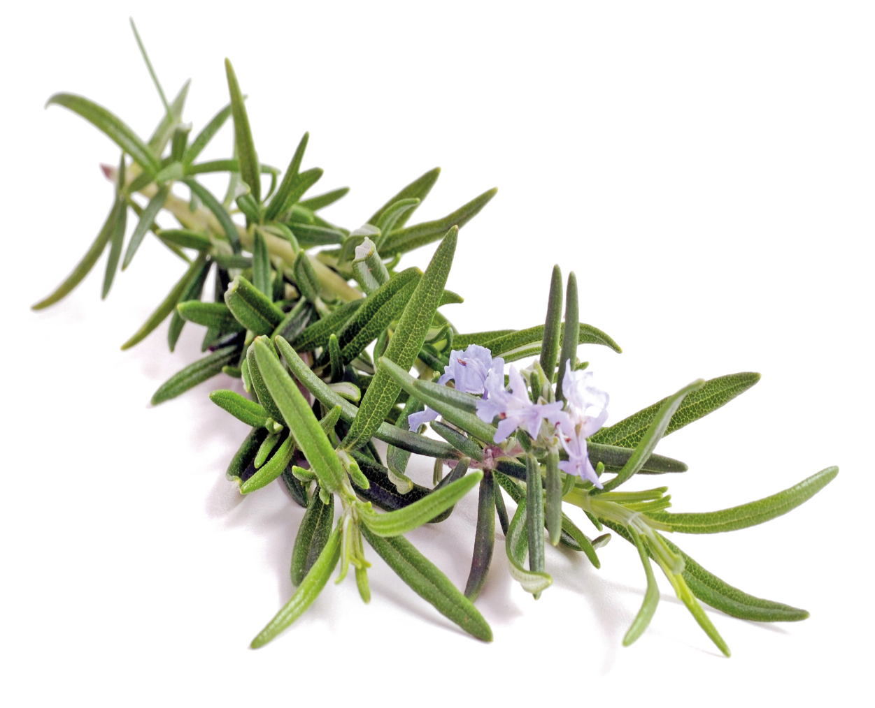
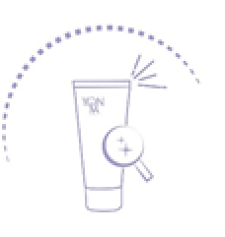
PHYTO 58 PS/PNG
Anti-dullness night care, guaranteed glow effect for dull, asphyxiated and tired skin
Detoxifies
Brightens
Tightens dilated pores
Erases the signs of fatigue
Dull complexion,
Asphyxiated & tired skin
All ages
Cible
Skin is revitalized: 94%*
* Usage test, application on face & neck for 4 consecutive weeks by 18 women aged 26 to 32 yrs with dull, fragile skin & uneven complexion
Notes:
PHYTO 58 PS/PNG 89% INO / PNG 90% INO PS
Because : Phyto 58 PS or PNG is
Promise
Anti-dullness night care, guaranteed glow effect for dull, asphyxiated and tired skin
Benefits
Detoxifies the skin
Brightens the complexion
Tightens dilated pores
Erases the signs of fatigue
Target
The ideal treatment for people who find their complexion dull
Tired and asphyxiated skin at any age!
Results
The skin is revitalized : 94%*
(Use test, application on face and neck for 4 consecutive weeks by 18 women aged 26 to 32 years with dull, fragile skin and a blurred complexion)

Slide 13
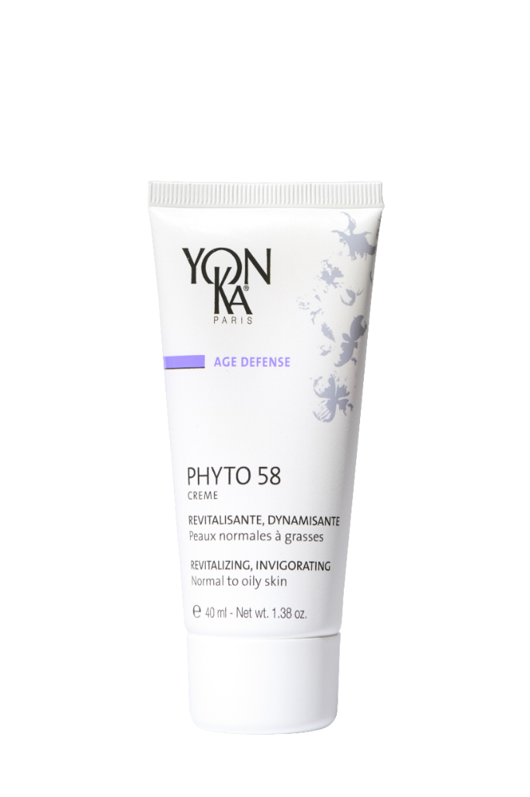
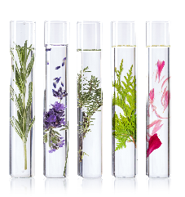
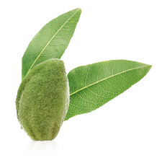
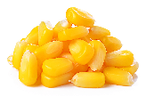
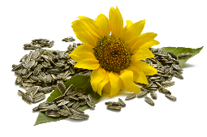
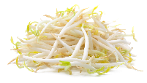
PHYTO 58 PS/PNG
In the evening, after cleansing and misting with Yon-Ka Lotion,
apply the appropriate PHYTO 58 cream to the face and neck.
Depending on your your skin’s needs, combine this cream with a few drops of one of your favorite booster or with a serum.
.
PHYTO 58
PS
PHYTO 58
PNG
Rosemary & Quintessence
Revitalizing, energizing,
detoxifying
Vitamin E
Antioxidant
Vitamin A
Regenerating
Organic Sweet almond oil
Nourishing Soothing
Repairing
Organic Sunflower, soy and
corn oils
Regenerating
Vitamin F
Anti -dehydrating
Notes:
Home use
In the evening, after cleansing and misting with Yon-Ka Lotion, apply the appropriate Phyto 58 cream to the face and neck.
Professional use
- Face, neck and décolleté massage
Tips
Depending on your skin's needs, combine this cream with a few drops of one of your favorite boosters or with a serum.
Of course inside we have :
Ingredients
Rosemary & Quintessence = Revitalizing, energizing and detoxifying
Vitamin F: anti dehydrating
Vitamin E: Antioxidant
Vitamin A: Regenerating
Organic sweet almond oil = nourishing, soothing, repairing (PS formula)
Organic sunflower, soy and corn oil = softening and repairing (PNG formula)
This cream can be applied in the morning for a «shock treatment» that will whip your complexion into shape but it doesn’t replace a night cream.
With Phyto 58 face cream, say goodbye to dullness !

Slide 14
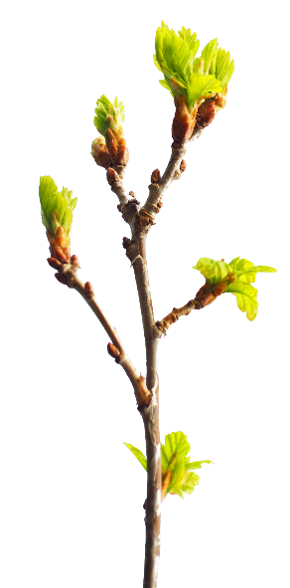
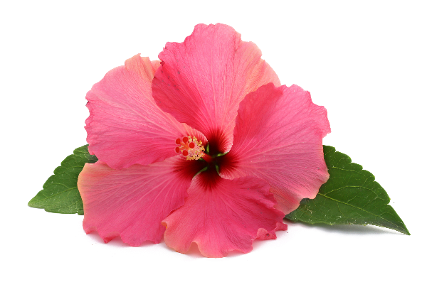
Let’s play !
Phyto 52 contains …
Rosemary
Beech bud Peptides
Hibiscus Peptides
Notes:
No hibiscus peptides in PHYTO 52
Hibiscus peptides in the advanced optimizer range (serum and gel lift)

Slide 15
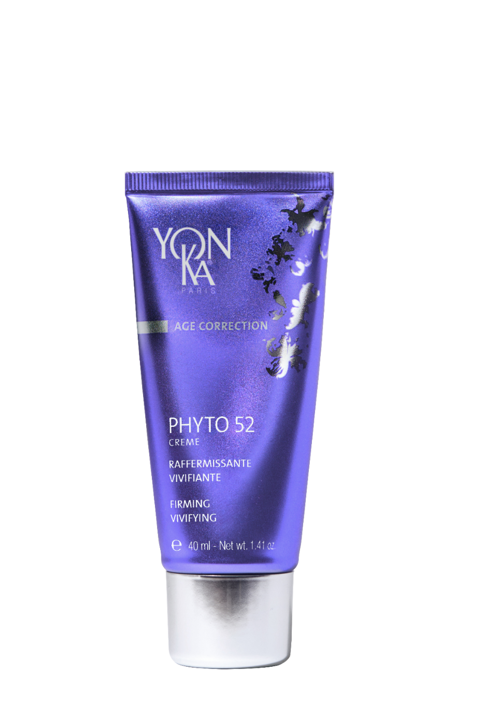
PHYTO 52
Firming and vivifying night cream
Firms
Vivifies
Clarifies the complexion
Atone skin
Cible
Tired skin is vitalized and toned.
Notes:
PHYTO 52 : 92% ION
Promise
Firming and vivifying night cream
Benefits
Firms
Vivifies
Clarifies the complexion
Target
Atone skin / skin lacking in firmness
Results
Tired skin is energized and toned

Slide 16
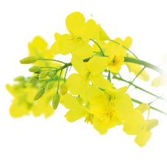
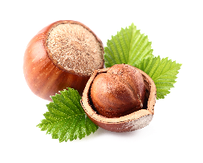
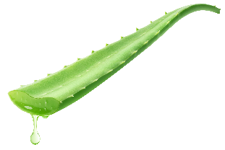
PHYTO 52
In the evening, after cleansing and misting with Yon-Ka Lotion,
apply the PHYTO 52 cream by effleurage and small tonic pinches on the face and neck.
For an intensive firming treatment: Add the LIFT+ booster to your cream for 1 month.
Apply locally on dilated pores, milia and microcystic acne.
Rosemary & Quintessence
Firming/ Draining/
Toning/ Detoxifying
Beech bud peptides
Restructuring, smoothing regenerating
Hazelnut oil
Nourishing, repairing
Aloe Vera, vegetal glycerin
moisturizing, softening
Vitamin E
Antioxidant
Notes:
Home use
In the evening, thoroughly cleanse the face and neck and mist with Yon-Ka Lotion adapted to your skin type. Apply Phyto 52 and massage the cream into the skin with light strokes and gentle pinches.
Professionnal use
Massage
Tips
For an intensive firming treatment : Add the LIFT+ booster to your cream for 1 month.
Apply locally on dilated pores, milium and microcystic acne
Ingredients
Rosemary and quintessence: Firming/ Draining/ Toning/ Detoxifying
Beech bud peptides: Restructuring / Smoothing / Regenerating
Hazelnut oil: Nourishing, repairing
Aloe vera, vegetal glycerin: moisturizing, softening
Vitamin E: Anti oxidant
Description
With this multi-functional, ultra-penetrating night cream, the aromatic and oxygenating power of rosemary and Yon-Ka Quintessence is used to visibly firm the skin while you sleep. Phyto 52 invigorates and brightens the complexion, refines the skin texture. Applied locally, it tightens dilated pores. Its fresh and invigorating scent energizes you instantly. When you wake up, your skin is more radiant and firmer. This cream will quickly become one of your favorite creams!

Slide 17
Let’s play !
I have a poor complexion and I live in the city, which night cream can I use??
PHYTO 58
PHYTO52
Notes:
With Phyto 58 face cream we could say goodbye to dull complexion. A concentrate of rosemary and vitamins that is highly effective!
This night treatment restores vitality to dull, asphyxiated and tired skin. Thanks to its regenerating, detoxifying and revitalizing active ingredients, it tones the skin, tightens the pores, evens and brightens the complexion. Enriched with nutritive oils, vitamins A, E, F, it will quickly become one of your favorite aromatic care!

Slide 18
Let’s play !
The oval of my face starts slackening,
which night cream can I use?
PHYTO 58
PHYTO 52
Notes:
PHYTO 52: thanks to the aromatic and oxygenating power of rosemary and Yon-Ka Quintessence it visibly firm the skin while you sleep.

Slide 19
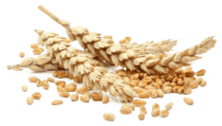
Let’s play !
What are the key active ingredients
of Elastine Nuit?
Beech bud peptides
Wheat
Germ oil
Milk peptides
Elastin peptides
Notes:
No beech bud peptides

Slide 20
ELASTINE NUIT
The ideal night care to fight the first wrinkles while you sleep
Smoothes
Regenerates
Preserves skin elasticity
Skin with superficial wrinkles
Cible
Visibly reduces fine lines & wrinkles
Skin regains its elasticity
Notes:
ELASTINE NUIT 85% ION
Benefits
Smoothes
Regenerates
Preserves skin elasticity
Target
Skin with superficial wrinkles
Results
Visibly reduces fine lines and wrinkles
Skin regains its elasticity

Slide 21
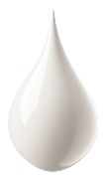
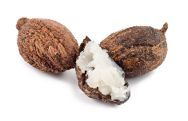
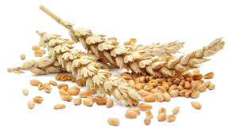
ELASTINE NUIT
In the evening, after cleansing and misting with Yon-Ka Lotion apply ELASTINE NUIT cream by effleurages on the face and the neck
Depending on your skin's needs, combine this cream with a few drops of one of your favorite booster products or a serum.
Without Essential oil.
Elastin and milk peptides
Anti-wrinkle, smoothing
Shea butter
Repairing, protective
soy peptides
Restructuring
Vitamin C
Antioxydant
wheat germ oil
Regenerating
Notes:
Home use
In the evening, after cleansing and misting with Yon-Ka Lotion.
Apply the Elastine Nuit cream by effleurages on the face and the neck
Depending on your skin's needs, combine this cream with a few drops of one of your favorite booster products or a serum.
Without essential oil.
Ingredients
Common base
Elastin and milk peptide: anti-wrinkle, smoothing
Shea butter: repairing, protective
Elastin night
Soy peptides: restructuring
Vitamin C: anti-oxidant
Wheat germ oil: regenerating
Description
It is the ideal night care to fight the first wrinkles, to hydrate and nourish the skin while you sleep thanks to the 19 amino acids associated with the restructuring soy peptides, the antioxidant vitamin C and the regenerating wheat germ oil. When you wake up in the morning, wrinkles and fine lines are reduced and the skin is plumped up, more supple and toned.

Slide 22
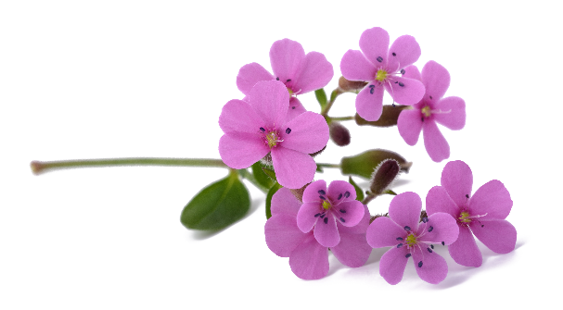
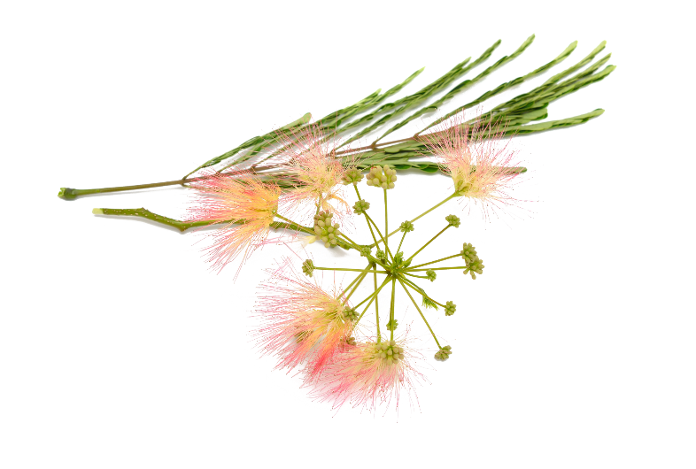
Let’s play !
Time Resist Nuit contains…
Youth Energy lipoaminoacid
Saponaria pumila
Silk tree extract
Notes:
All these ingredients are present in time resist nuit !

Slide 23
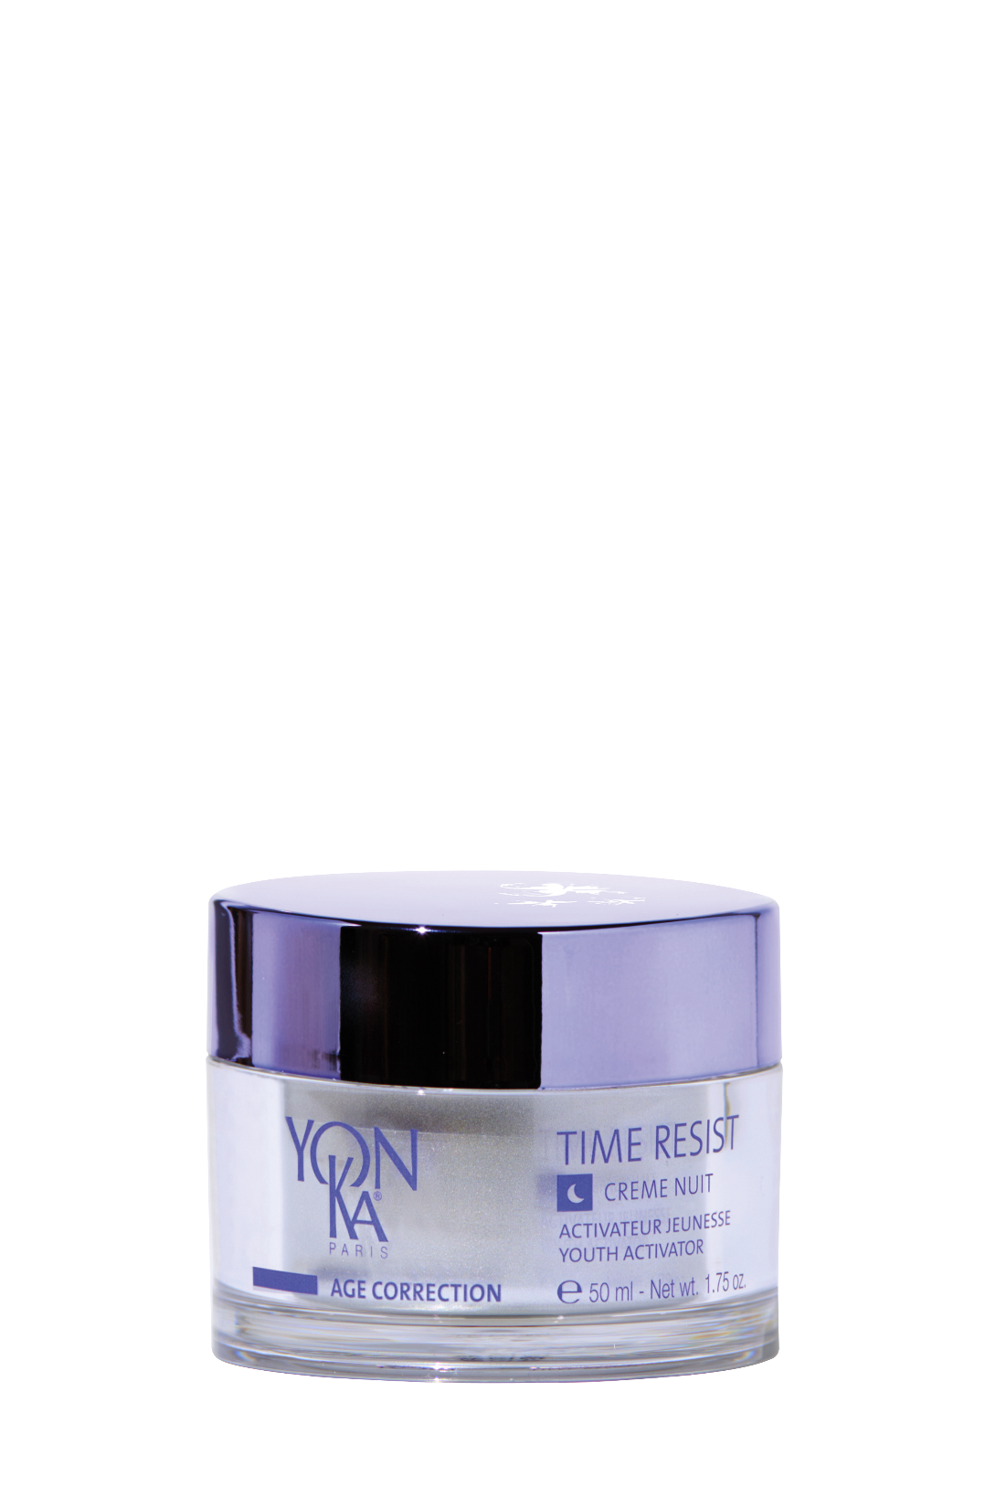
TIME RESIST NUIT
Youth activator, anti-fatigue smoothing night care
Redensifies
Prevents and corrects the signs of aging
Protects the skin's stem cells
Fights against the signs of fatigue
Skin with
deep wrinkles
Cible
Total surface area of wrinkles: - 82%
The skin is smoother
On waking, the skin appears rested: 76%
(5) EVALUATION INSTRUMENTALE – Mesure par analyse vidéo (logiciel Quantirides) de données sur les rides après application pendant 4 semaines de la crème TIME RESIST NUIT (meilleur résultat obtenu) (6)TEST CONSOMMATEUR – Autoévaluation après application de la crème TIME RESIST NUIT le soir par 20 femmes de 40 à 55 ans pendant 4 semaines
Notes:
TIME RESIST NUIT 90% ION
Promise
Youth activator, anti fatigue smoothing night care
Benefits
Prevents and corrects the signs of aging
Protects the skin's stem cells
Fights against the signs of fatigue
Target :
Skin with deep wrinkles
Results:
Wrinkle surface reduced by 82%.
The skin is smoother
Upon waking up, the skin appears rested for 76% of panelists

Slide 24
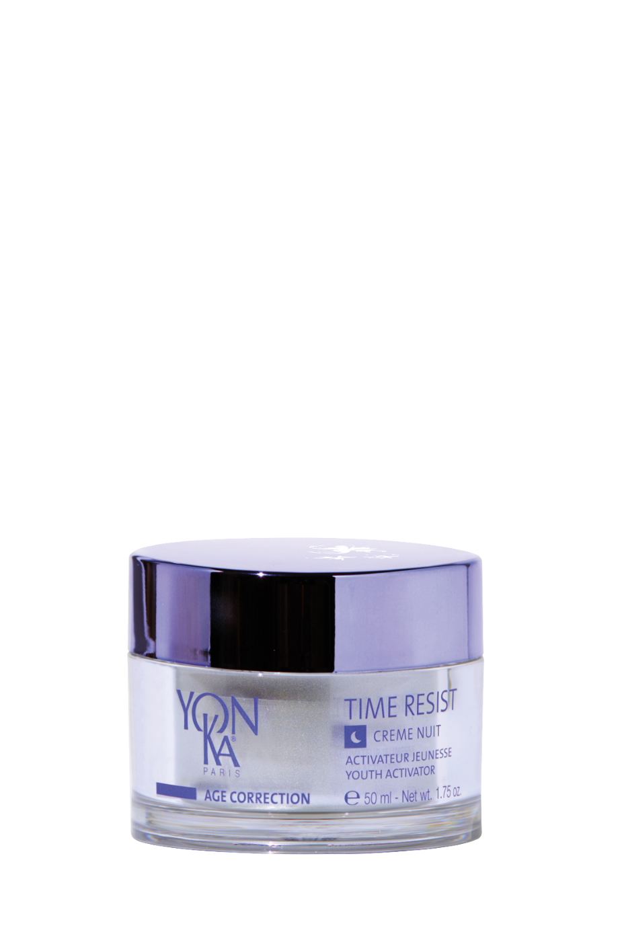
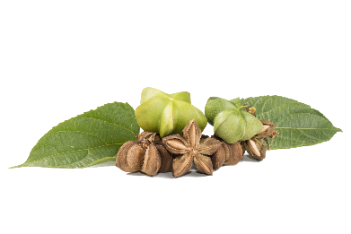
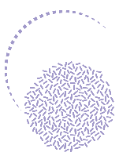
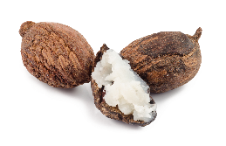
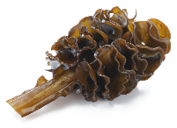
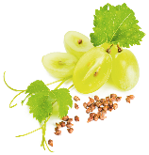
TIME RESIST NUIT
In the evening, after cleansing and misting with Yon-Ka Lotion apply TIME RESIST NUIT by effleurages on the face and the neck
Its Airless « touch and slide » patented jar for a protected formula.
A single press delivers the right quantity for an optimal application, which allows to save product over time
Saponaria pumila plant-based stem cells
protects and revitalizes the dermal stem cells
Youth Energy lipoaminoacid
Anti inflamm’aging
Wakame extract
Redensifying, stimulates the production of collagen, elastin and HA
Silk tree extract
Anti glycation
Euglena gracilis extract
Regenerating
Sacha inchi oil
nourishing, soothing,
softening
Vegetable glycerin, grape seed oil, shea butter
Moisturizing, nourishing
Notes:
Home use :
In the evening, after cleansing and misting with Yon-Ka Lotion apply TIME RESIST NUIT by effleurages on the face and the neck
Tips :
Its Airless « touch and slide » patented jar for a protected formula.
A single press delivers the right quantity for an optimal application, which allows to save product over time.
Ingredients :
Common base
Saponaria Pumila Stem Cells: protects and preserves the dermal stem cells.
Action:
The extraordinary survival potential of Saponaria Pumila allows them to protect and revitalize the dermal stem cells so that they have the weapons to protect themselves against the environmental stresses that are the main cause of skin aging.
In concrete terms, at the heart of the TIME RESIST formula, the plant stem cells of Saponaria Pumila:
- Protects dermal stem cells from the harmful effects of UV and visible light
- Maintains the vitality of the dermal stem cells and thus their capacity for self-renewal.
- Increases the density of the dermis by protecting it against breaks in its architecture (arrangement of elastin and collagen fibers).
Improves the firmness and elasticity of the skin
The plant stem cells create a cocoon around the skin's stem cells, protecting them from external aggressions and their degradation over time.
The Youth Energy lipoaminoacid : Protects and strengthens the skin's defenses against chronic and silent reactions > Inflamm’aging.
Breaks the bad circle: aggressions > free radicals > inflammaging > free radicals > inflammaging...
Some individuals have developed a resistance to inflamm'aging that ensures a harmonious aging. They are naturally resistant to stress and age-related diseases
Due to its anti-inflamm'aging activity, this lipoamino acid has several more or less direct actions at the skin and cell level. In particular, it acts directly on the reduction of the quantity of IL-6, a key marker of inflammation
Reduction of the quantity of IL-6 (inflamm'aging marker)
Protection of the extracellular matrix (reduction of collagenase activity)
Construction of the collagen network
Improvement of the micro-vascular network
Wakame: redensifying
It reactivates 14 genes involved in the re-densification of the extracellular matrix of the dermis by acting on 3 elements:
Collagen: Activates the genes involved in the synthesis, maturation and assembly of collagen fibers
Elastin: Activates the genes involved in the synthesis, maturation and assembly of elastin fibers.
Hyaluronic acid: Activates the genes involved in the synthesis of hyaluronic acid
Silk tree: anti-glycation
It is a plant extract specially developed to fight against signs of fatigue thanks to its action on the detoxification processes of cellular metabolism.
It fights the cutaneous signs of fatigue caused by glycation and glycoxidation.
It maintains the mechanical viability of the cells and their optimal production of energy, rebalances the synthesis of melatonin by the fibroblasts tired by glycation and ensures the elimination of cellular waste.
Note: Glycation: fixation of a sugar on proteins causing a structural rearrangement. These glycated proteins cannot be destroyed naturally by our cells' destruction systems. These products then pile up in the cells without being able to get rid of them. Little by little, these substances cause a dysfunction of the cell's metabolism and eventually lead to its death.
Euglena gracilis : regenerating
source of vitality and cellular energy thanks to the stimulation of the production of ATP: + 48 % in 2 hours
Euglena gracilis has a metabolism similar to that of skin cells with a metabolism controlled by the alternation of light and darkness (day/night).
Moreover, it contains phosphoinositides that will act as a precursor to stimulate the skin cells.
Sacha inchi oil: Nourishing, soothing, softening
Vegetable Glycerin, Grape seed oil, Shea butter: Hydrating, nourishing
Description
Time Resist Night, youth activator, acts in duo with Time Resist Day to prevent and correct the signs of aging by fighting the processes responsible for premature aging of the skin, commonly called "Inflamm'aging". An effectiveness linked to the unique combination of stem cells from an alpine plant, saponaria pumila, and the Youth Energy! amino acid complex, enriched with anti-wrinkle and smoothing active ingredients: regenerating euglena gracilis extracts, anti-glycation silk tree extracts and highly nutritious Sacha Inchi oil. Overnight, the skin is nourished and smoothed, signs of fatigue are reduced and the complexion glows with a new radiance.

Slide 25
Let’s play !
I have fine lines that are appearing, which night cream can I use?
ELASTINE NUIT
TIME RESIST NUIT
Notes:
ELASTINE NUIT : It is the ideal night care to fight the first wrinkles, to hydrate and nourish the skin while you sleep.
When you wake up in the morning, wrinkles and fine lines disappear and the skin is plumped up, more supple and toned.

Slide 26
Let’s play !
I have deep and pronounced wrinkles, which day cream can I use?
ELASTINE JOUR
TIME RESIST JOUR
Notes:
Time Resist Nuit works in combination with Time Resist Jour to prevent and correct the signs of aging by fighting the processes responsible for premature skin aging, commonly known as "Inflamm'aging" and plumping up even the deepest wrinkles.

Slide 27
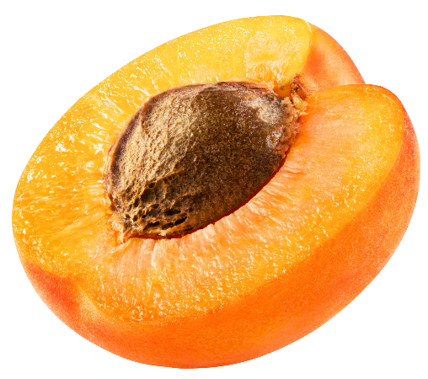
Let’s play !
Glyconight 10% masque contains …
pure glycolic acid
Organic apricot kernel oil
Vitamin B5
Notes:
No vitamin B5

Slide 28
GLYCONIGHT 10% MASQUE
The clean peel that gives your skin a new breath
Immediate radiance from the first use
Skin texture is refined and pores are tightened
Smoothes fine lines and wrinkles
For millennials
(Blemish-free skin, radiance and treatment of first wrinkles)
For more mature skin
(An anti-aging effect (wrinkles++/firmness/spot) and radiance)
Cible
Radiance of the complexion: + 24%*.
Pore size: -19%*
Depth of crow's feet wrinkles: -30%*
*Etude clinique réalisée sous le contrôle d’un dermatologue sur 15 volontaires de 20 à 39 ans (1 mois) et 15 volontaires de 40 à 55 ans (2mois) - Moyenne des résultats sur l'ensemble des 2 groupes à 1 mois sauf densité du derme groupe 40-55 ans uniquement..
Notes:
GLYCONIGHT 10% MASQUE 81% ION
Description
The clean peel that gives the skin a new breath.
Benefits
Immediate radiance from the first use
Skin texture is refined and pores are tightened
Smoothes wrinkles and fine lines
Target
For millenials (Blemish-free skin, radiance and treatment of the first wrinkles)
For more mature skin (anti-aging effect (wrinkles++/firmness/spots) and radiance)
Results
Radiance of the complexion: + 24
Pore size: -19
Depth of crow's feet wrinkles: -30
(Clinical study conducted under the supervision of a dermatologist on 15 volunteers aged 20 to 39 (1 month) and 15 volunteers aged 40 to 55 (2 months) - Average results for both groups at 1 month, except for the density of the dermis in the 40-55 age group.

Slide 29
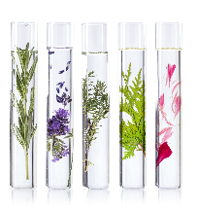
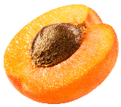
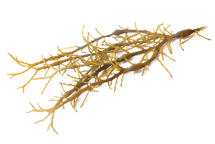
GLYCONIGHT 10% MASQUE
At night, after removing make up and cleansing, spray Yon-Ka Lotion and penetrate with effleurage movement then apply a thin layer of the mask to the face and neck.
Leave on all night. Rinse off with tepid water the next morning.
TRIPLE USE :
1 : Radiance-boosting mask: apply once at night for a radiance boost the next morning
2 : Maintenance treatment: use every other night for one or two weeks
3 : Intensive course of treatment (1 to 2 month): use every other night for the first week, then every night for each of the following weeks.
Repeat this course of treatment twice or three times a year
Can also be applied on the neckline to smooth away wrinkles visibly and restore its youthful appearance It’s an effective way to prime skin before a medical peel
10% pure glycolic acid
Smoothing - anti-wrinkles
Organic apricot kernel oil, brown algae
Radiance
Natural polysaccharides
Soothing
Vegetable glycerin
Moisturizing
Yon-Ka Quintessence
Balancing -
Calming effect
Notes:
Home use :
At night, after removing make up and cleansing, spray Yon-Ka Lotion and penetrate with effleurage movement then apply a thin layer of the mask to the face and neck.
Leave on all night. Rinse off with tepid water the next morning.
TRIPLE USE :
1 : Radiance-boosting mask: apply once at night for a radiance boost the next morning (to boost radiance)
2 : Maintenance treatment: use every other night for one or two weeks (new skin effect )
3 : Intensive course of treatment (1 to 2 month): use every other night for the first week, then every night for each of the following weeks. (for a reinforced anti-aging or new skin result)
Repeat this course of treatment twice or three times a year
Can also be applied on the neckline to smooth away wrinkles visibly and restore its youthful appearance It’s an effective way to prime skin before a medical peel
Ingrédients
10% pure glycolic acid: smoothing, anti-wrinkle
Organic apricot kernel oil and brown algae: radiance
Natural polysaccharides: soothing
Vegetable glycerin: moisturizing
Quintessence: Balancing, calming
Precaution of use
• Avoid contact with eyes and lips
• Always apply sunscreen during the day
• In the event of persistent redness or irritation, discontinue use and see a doctor
• Do not apply this mask just before or just after hair removal or hair coloring or bleaching or sunburn
Do not apply at the same time as a retinoic acid-based treatment, or if your skin is sensitive to glycolic acid
This product must be used infrequently and for limited periods of time
To see if you can tolerate glycolic acid, apply a small amount to the inside of the elbow or behind the ear.
If redness and violent sensations of discomfort appear, remove and try again the next day to confirm or not the intolerance.
Remember to use the sample!
The Glyconight 10% Mask has a triple proven effectiveness: anti-aging, new skin effect, radiance. The results are seen from the first moment you wake up, and get stronger with each application!

Slide 30
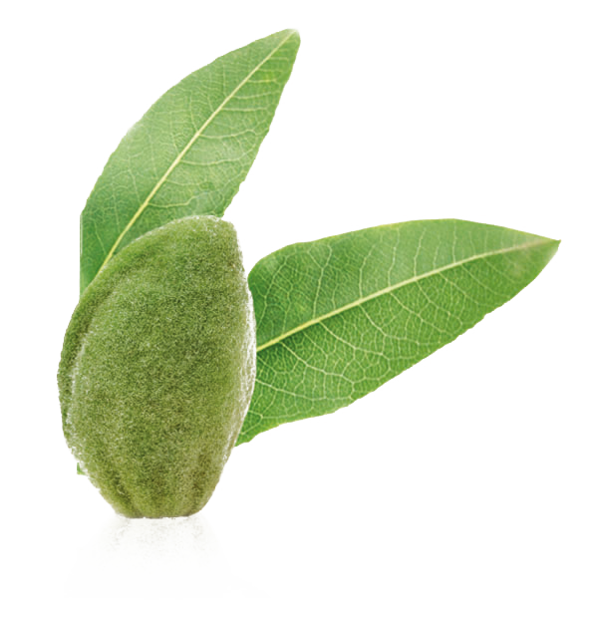
Let’s play !
Alpha peel contains …
AHAs
(Passion fruit, grape, pineapple)
Beech bud peptides
Sweet almond peptides
Notes:
No sweet almond peptides that are presents in the ALPHA FLUID
AHAs (= fruit acids*) *Passion fruit, grape, pineapple

Slide 31
ALPHA PEEL
Gently renovating night peel for fresh & radiant skin
Renewing
Regenerating
Smoothing
Dull & uneven complexion
Dilated pores
Cible
Refined skin texture: 72%
More radiant skin: 78%
*Test d’usage, auto évaluation application 1 à 2 fois par jour sur visage et cou pendant 4 semaines consécutives par 18 volontaires adultes.
Notes:
ALPHA-PEEL 83% ION
Promise
Gently renovating night peel for fresh & radiant skin
Benefits
Renovating
Regenerating
Smoothing
Targets
Dull & uneven complexion
Dilated pores
Results
Refined skin texture for 72% of panelists
More radiant skin for 78% of panelists

Slide 32
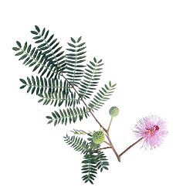
ALPHA PEEL
In the evening, after cleansing and misting with Yon-Ka Lotion apply ALPHA PEEL (5pumps) by effleurages on the face and the neck, avoiding the lips and eyelids during 1 month.
Ideal for scars after acne or at each season change.
Use in treatment with ALPHA FLUID : The perfect duo with AHAs for a lasting improvement in skin texture
AHAs
Passion fruit, grape, pineapple
Renewing
Mimosa tenuiflora
Regenerating
hyaluronic acid, urea, aloe vera
Hydrating
Vitamin B5
Soothing
Beech bud peptides
Smoothing
Notes:
Home use
In the evening, after cleansing and misting with Yon-Ka Lotion apply ALPHA PEEL (5pumps) by effleurages on the face and the neck, avoiding the lips and eyelids during 1 month.
Ideal for scars after acne or at each season change.
Use in treatment with ALPHA FLUID : The perfect duo with fruit acids for a lasting improvement in skin texture
Precaution of use
• Avoid contact with eyes and lips
• Always apply sunscreen during the day
• In the event of persistent redness or irritation, discontinue use and see a doctor
• Do not apply this mask just before or just after hair removal or hair coloring or bleaching or sunburn
Avoid the use in case of sun exposure and dermatological treatment with RETIN A.
This product must be used infrequently and for limited periods of time
Ingredients :
Fruit acids (passion fruit, grape, pineapple) : renewing
Mimosa tenuiflora: regenerating
Beech bud peptides: smoothing
Hyaluronic acid, urea, aloe vera: moisturizing
Vitamin B5: Soothing
Description
This renewing gel peel with precisely dosed fruit acids gently removes dead cells and visibly improves the quality of the skin on the face, neck and décolleté. Alpha-Peel is used in the evening, preferably as a one-month treatment for a maximum "new skin" action. The complexion is unified, gains in brightness, the grain of skin is refined, the wrinkles and fine lines are smoothed.
Product advantages
Gentle peeling with fruit acids
Eliminates dead cells, tightens pores
Restores radiance and softness to the skin
Works at night for a healthy glow upon waking

Slide 33
Let’s play !
I have uneven complexion, sensitive skin and acne scars?
ALPHA PEEL
GLYCONIGHT 10% MASQUE
Notes:
The Alpha peel treatment is more suitable for dry skin and for those who cannot tolerate high concentrations of glycolic acid.
The glyconight mask is for all skin types that can tolerate high concentrations of glycolic acid.
Here we have the word “sensitive”
In terms of composition, the Alpha peel Alpha fluid contains 2% glycolic acid and 8% other types of AHA. The mask contains 10% glycolic acid.
The use is also different. The Alpha peel Alpha Fluid cure is used as a one-month cure as opposed to a triple use for the Glyconight mask, as a radiance boost, a flash cure or an intensive wax.
This renewing gel peel with precisely dosed fruit acids gently eliminates dead cells and visibly improves the quality of the skin on the face, neck and décolleté. Alpha-Peel is used in the evening, preferably as a one-month treatment for a maximum "new skin" action. The complexion is unified, gains in brightness, the texture of the skin is refined, the wrinkles and fine lines are smoothed.

Slide 34
Let’s play !
I have a loss of firmness and acne scars?
ALPHA PEEL
GLYCONIGHT 10% MASQUE
Notes:
Glyconight’ Efficiency tests have allowed us to highlight very interesting results:
On the new skin effect
the smoothing of wrinkles
and The increase in collagen production for an overall anti-aging effect.
the density of collagen fibers in the dermis is increased by 12%.
the depth of forehead wrinkles is decreased by -15%
- 30% depth of crow's feet wrinkles

Slide 35
Summary
Elastine Nuit
Glyconight
10% masque
Phyto 58 ps/png
Phyto 52
Time Resist Nuit
Alpha Peel
Dull skin
Asphyxiated
Lack of firmness
Fine lines, wrinkles
Deep
wrinkles
Dull, uneven complexion
For millennials: boosts radiance and minimizes first wrinkles
For more mature consumers : an anti-aging effect (wrinkles++/ firmness/spots) and radiance

Slide 36
The offer

Slide 37
20% discount with the purchase of 2 products including 1 night product

Slide 38
Boost your night care
by optimizing your sleep

Slide 39
Ayurvedic moon milk
Preparation time 10 minutes
350 ml oat milk
1 cinnamon stick
1/2 tablespoon ground cinnamon
2 stars of anise
1 pinch of nutmeg
1/2 tablespoon vanilla powder
1 tablespoon maple syrup
1 teaspoon acai powder
tryptophan
the ally of a peaceful sleep!
Notes:
ayurvedic moon milk recipe.
According to Ayurvedic tradition, moon milk is a cup of hot milk that is drunk just before going to bed, to fight insomnia.
It usually contains milk (almond, oat or coconut milk are preferred as they are known to contain tryptophan, an amino acid that helps sleep),
honey or maple syrup
and is often flavoured with herbs and spices such as nutmeg, cinnamon, acai and cardamom that help soothe and prepare for sleep.
You'll have a great night!
Tryptohan: an amino acid that is a precursor to melatonin (the sleep hormone), the key hormone for restful sleep. Fill up on tryptophan by eating dates, figs, melon, legumes (lentils, chickpeas), pumpkin or sesame seeds, bananas.

Slide 40
PROCHAINEMENT

