Slide 1
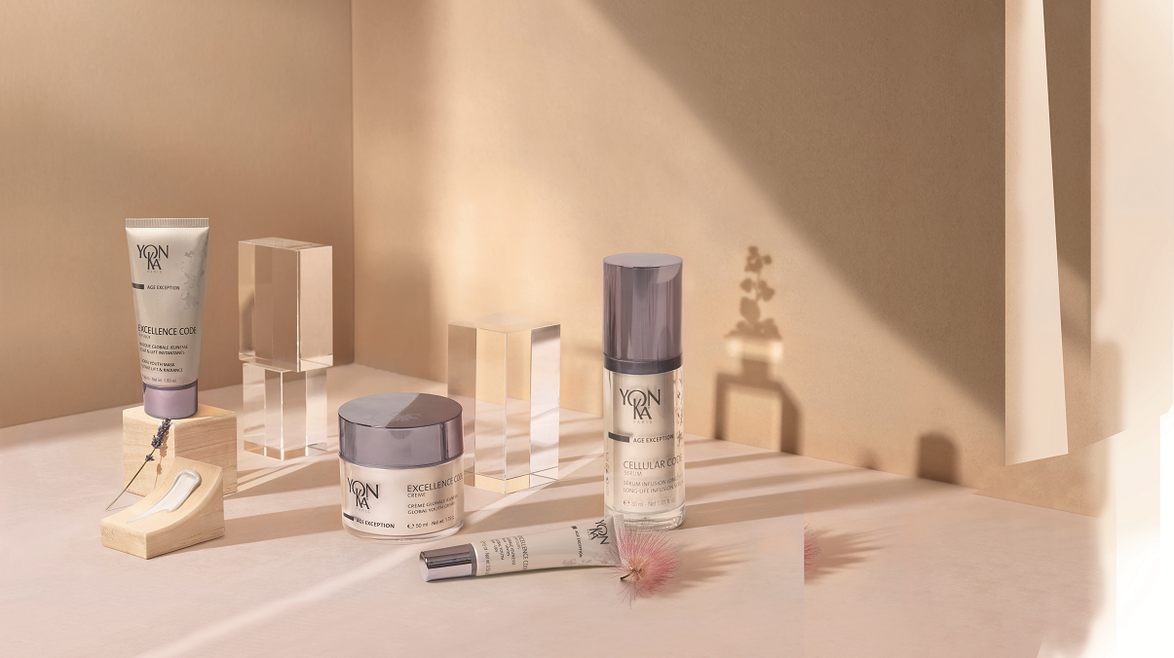
AGE EXCEPTION

Slide 2
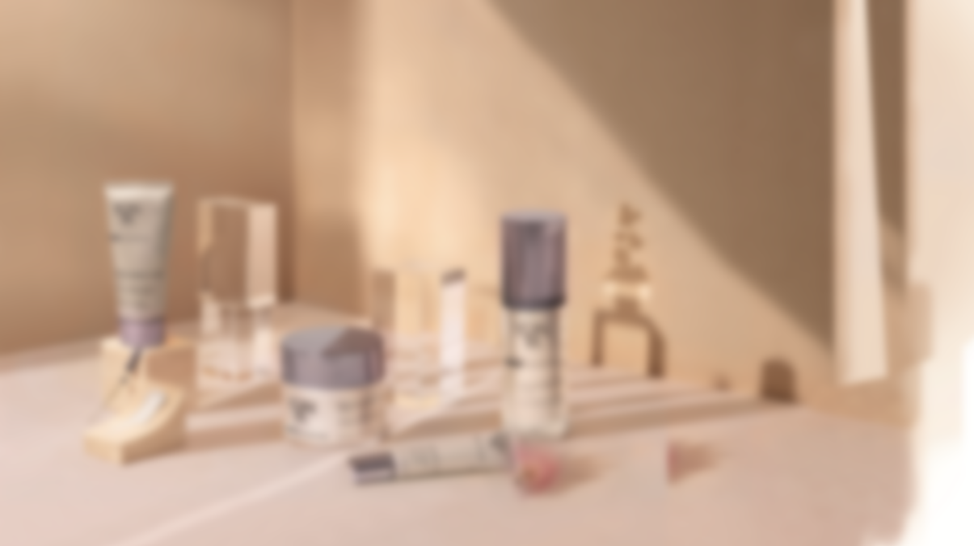
Skin aging

Slide 3
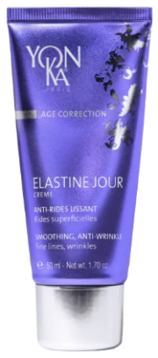
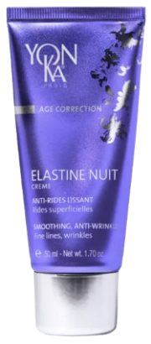
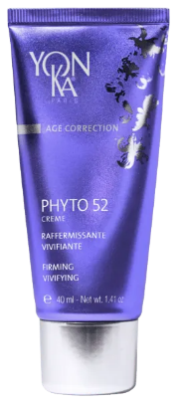
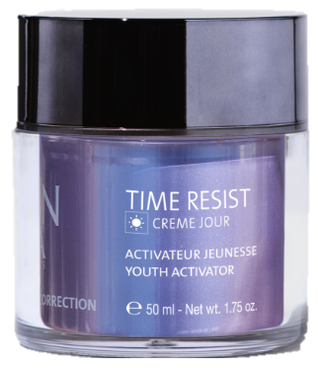
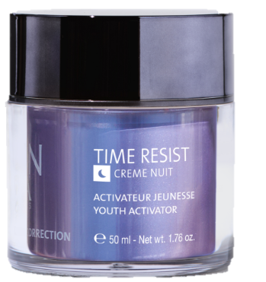
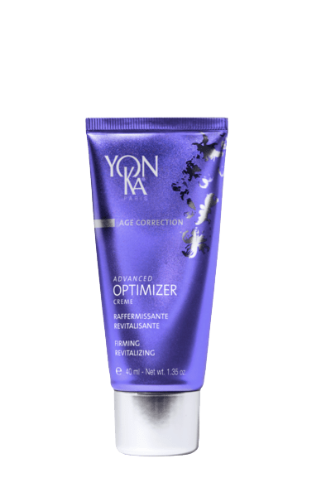
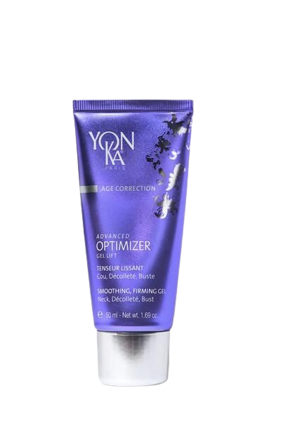
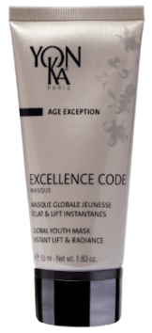
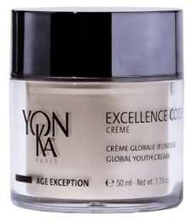
Visible signs of age
First wrinkles
Superficial wrinkles
Lack of tonicity
Less toned skin
More wrinkles
Deeper wrinkles
Wrinkles, sagging, lack of comfort, dark spots, lack of radiance
Loss of volume, sagging
Notes:
For the first and superficial wrinkles, the Elastine Day and Night duo : on the forehead, eye and lips contours, all the expressions area
To firm up skin that lacks tonicity, we have Phyto 52 : oval of the face
To fill in the deepest wrinkles and preserve the skin's youthfulness, the Time Resist duo is ideal.
To treat sagging and loss and modification of facial volumes, the advanced optimizer range is perfect.
And finally, when the skin shows all these signs of aging, the Age Exception range is recommended.
Of course you have to adapt your recommendation according to the skin type and needs but this slide can help you to organize and classify the range of products.

Slide 4
Journey to the heart of the skin
Dehydration
STRATUM CORNEUM
thickening of the stratum corneum
Wrinkles and fine lines
EPIDERMIS
thinning of the epidermis
flattening of the Dermo Epidermal Junction
Decreasing production of hyaluronic acid
DERMIS
Damaged elastin fibers
Damaged collagen fibers
HYPODERMIS
+ appearance of small blood vessels, dark spots and irregular complexion, dryness, decreased
skin immune responses, …
MUSCLE
Notes:
With age, the morphology of the skin changes: We can observe
> A reduction in the synthesis of lipids. The hydrolipidic film is unbalanced and the protective barrier damaged. The skin becomes dehydrated.
> A slowdown in cell renewal and, as a result, a thickening of the corneous layer = the complexion becomes dull and rough
> The appearance of the first wrinkles and fine lines
> A flattening of the Dermo Epidermal Junction. This leads to a decrease in the exchanges between the dermis and the epidermis and accentuates the slowing down of cell renewal. This also causes a thinning of the epidermis (= the skin becomes thinner, more fragile)
> The skin's main water reserve, hyaluronic acid, decreases day by day causing a loss of density and hydration
> Typically, a reduction in the size and number of fibroblasts is observed, which implies a disorganization of the dermis structure = the lower part of the face, cheekbones, eyes and eyebrows start to sag.
This leads to an alteration of the elastin fibers (loss of suppleness, firmness, deepening of wrinkles)
As well as an alteration of the collagen fibers which become rigid and are destroyed by collagenase = leading to a loss of firmness and elasticity; more wrinkles
> And, not visible on this illustration but observed on the skin :
A slowing down of the microcirculation and the appearance of small blood vessels .
Irregularities in the body's melanogenesis, causing the appearance of dark spots and an irregular complexion
An atrophy of the sebaceous glands and therefore a dryness of the skin
A reduction in the number of Langerhans cells which will impact and reduce the skin's immune responses.
Finally, it could be said that mature skin has specific needs and expectations that must be met to deal with all these changes.
It is exactly the answer that the AGE EXCEPTION range will bring them.

Slide 5
The Products

Slide 6
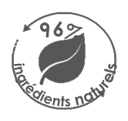
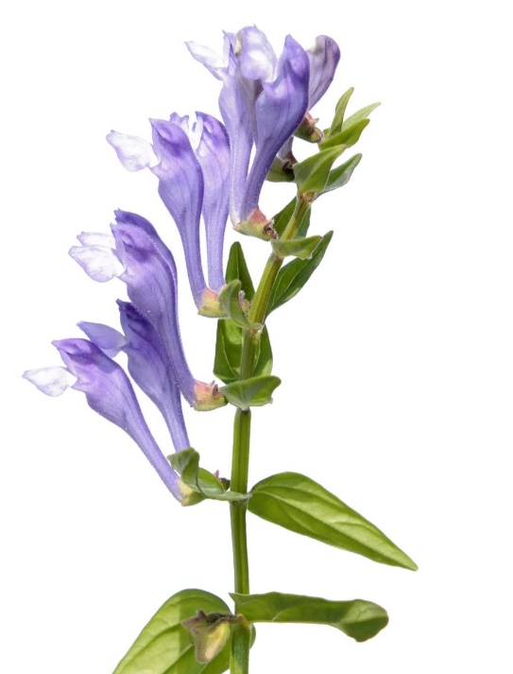
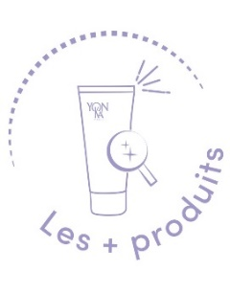
Cellular Code Serum
The smart serum which reprograms the skin’s youth code
With Cell-Energy complex
Smoothed wrinkles
Improved firmness
Regenerated and radiant skin
Reduced signs of fatigue
Reinforces the potential of defense against aggressions
Multiplication of Langerhans cells: +146 %
Restores harmonious communication between cells and promotes regeneration
Communication between the dermis and the DEJ: +124 %
30 ml
Its unique Cell-energy complex
Its 7 patents
Its fine and silky texture
Its airless pump bottle
7 PATENTS
Notes:
LE CELLULAR CODE SERUM :
DESCRIPTIF
The smart serum which reprograms the skin’s youth code
“Like a real elixir of youth”. This serum helps reactivate the skin's youth code thanks to the "Cell-Energy" complex that fight against skin aging.
This serum energizes and regenerates the skin. Wrinkles are smoothed, firmness are improved, skin is regenerated and radiant, signs of fatigue are reduced.
RESULTATS
It Reinforces the potential of defense against aggressions
Multiplication of Langerhans cells: +146 %
Restores an harmonious communication between cells and promotes regeneration
Communication between the dermis and the EDJ: +124 %
LES + PRODUITS
We love
Its unique Cell-energy complex
Its 7 patents
Its fine and silky texture
Its airless pump bottle

Slide 7
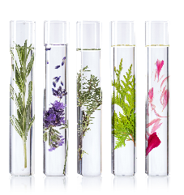
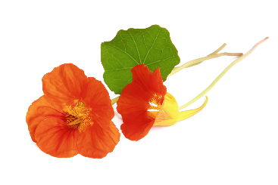
Cellular Code Serum
Morning and /or evening, after cleansing and spraying with Lotion Yon-Ka, apply the serum (2 to 3 pumps) to the face and neck, before your usual cream
= Cell-energy complex
Lipo-aminoacid
Boosts Cellular longevity / Restores clear communication between cells / Reinforces the defense potential of the skin against assaults
D-Ribose
Cellular energy
Accelerates the synthesis of
ATP (the cell’s energy reserve))
Baicalin
Boosts Cellular longevity
Garden nasturtium extract
Oxygenates skin cells and
improves the radiance of the
complexion
Yon-Ka Quintessence bergamot, citrus fruits, mandarin, rose, tonka bean, guaiac wood
Vitalizing - Energizing
Notes:
At home :
Morning and /or evening, after cleansing and spraying with Lotion Yon-Ka, apply the serum (2 to 3 pumps) to the face and neck, before your usual cream
Ingrédients
Lipo-aminoacid : Boosts Cellular longevity / Restores clear communication between cells / Reinforces the defense potential of the skin against assaults
(alanine-based, an amino acid derived from biotechnology)
D-ribose : Cellular energy - Accelerates the synthesis of ATP (the cell’s energy reserve) (natural complex sugar derived from corn)
Baicalin : Boosts cellular longevity
(a polyphenol extracted from Scutellaria Baicalensis root)
Garden nastturtium extract : Oxygenates skin cells and improves the radiance of the complexion
these four ingredients together form the cell energy complex
We also have the Yon-Ka Quintessence with essentials oils of bergamot, citrus fruits, mandarin, rose, tonka bean and guaiac wood to Vitalizes and Energizes

Slide 8
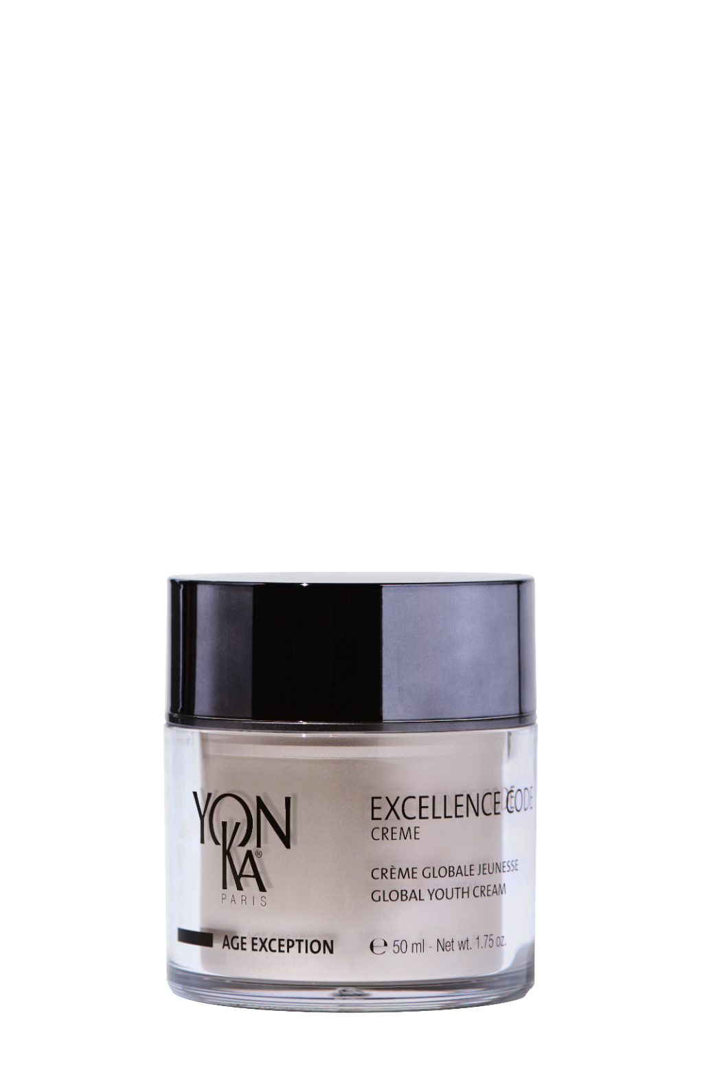
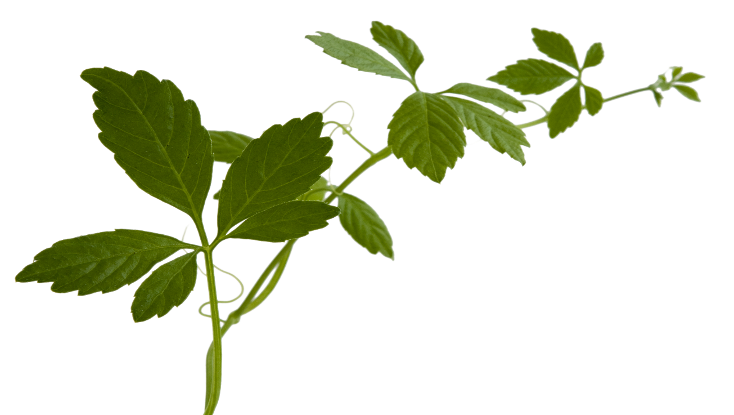
Excellence code Creme
A unique product for unique results on all signs of aging
ingrédients naturels
94%
Regenerates and restructures
Firms and smoothes
Homogenizes, illuminates and revitalizes
4 PATENTS
Depth of wrinkles -24%
Skin firmness +33%
Intensity of discoloration -25%
Brightness of complexion +33%
Comfort and nutrition 95%
Its 360° action
Its 4 patents
Its airless jar
Its melting and comfortable texture
Clinical measurements (Firmness, discoloration, brightness), instrumental evaluation (depth of wrinkles) and usage tests (nutrition&comfort) - 4 consecutive weeks - 42 women (average age: 57 years) - Best results
Notes:
EXCELLENCE CODE CREME 94% ION
Descriptif
A unique product for unique results on all signs of aging
Bénéfices
Regenerates and restructures
Firms and smoothes
Homogenizes, illuminates and revitalizes.
Résultats
Reduces Depth of wrinkles -24%
Increase Skin firmness +33%
Decreases Intensity of discoloration -25%
Improves Brightness of complexion +33%
Improves Comfort and nutrition 95%
Les + Produits
We love
Its 360° action
Its 4 patents
Its airless jar
Its melting and comfortable texture

Slide 9
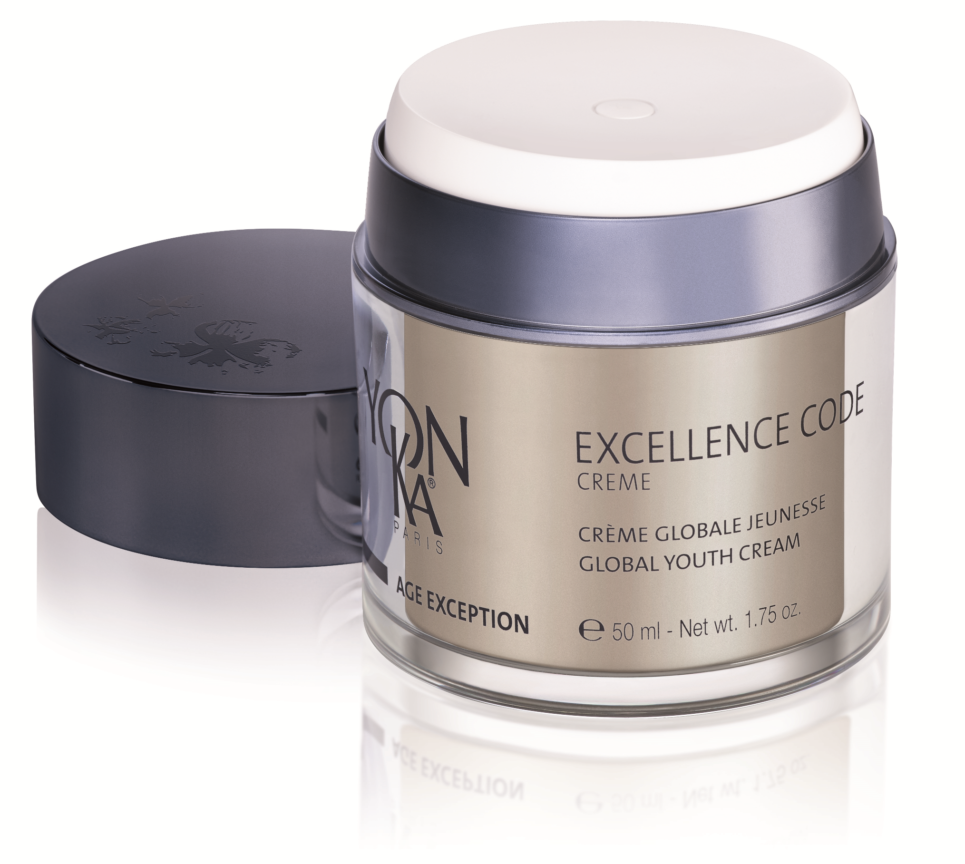
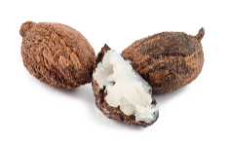
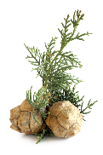
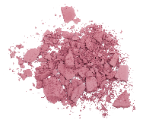
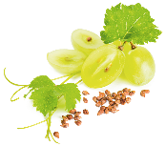
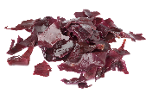
Excellence Code Crème
In the morning and evening, after cleansing and spraying on Lotion Yon-Ka, apply the cream to the face and neck.
For an enhanced anti-aging effect, use the Cellular Code serum beforehand.
Excellence Code Crème acts on 3 levels
On Epidermis and skin barrier
On Dermo-epidermal junction and dermis
On discoloration and skin radiance
immortality herb
Regenerating
restructuring
Co-enzyme Q10 &
Vitamin E
Anti-free radicals
avocado and
grape seed oils,
shea butter,
hyaluronic acid
Nutrition - resistance -
hydration
thistle, vitamin A
Dermoprotective -
repairing
complex of silicon - amino acid
Anti-glycation
yeast and nutgrass extracts
Firmness and bounce
complex of bamboo silica, pea extract
Anti-wrinkle -
smoothing
Red algae extract
Clear – even textured complexion
natural light-reflecting pink pigments
Illuminating the skin
+ solomon’s seal, arnica and cypress Brightening effect
+ Yon-Ka Quintessence, bergamot, lemon, mandarin, rose, tonka bean and guaiac wood E.O.
Notes:
At home :
In the morning and evening, after cleansing and spraying on Lotion Yon-Ka, apply the cream to the face and neck.
For an enhanced anti-aging effect, use the Cellular Code serum beforehand.
*After removing the lid, press the white top to release the cream. The harder you press, the larger the dose
*By pressing completely, the jar delivers 0.5 ml of cream
Ingrédients
Excellence code cream acts on 3 levels :
*First one : on epidermis and skin barrier
Immortality herb : regenerating and restructuring
vit E et coenzyme 10 : anti free radicals
Avocado and grape seed oils, shea butter and hyaluronic acid : nutrition, hydration and resistance (to the hydrolipidic film)
Thistle and vit A : Dermoprotective – repairing
*Second action level : on dermo-epidermal junction and dermis
Complex of silicon – amino acid : Anti-glycation. (prevents the sugar from fixing on the proteins and thus causing the degradation of collagen and elastin)
Yeast and nutgrass extract : firmness and bounce
Complex of bamboo silica & pea extract : antiwrinkle – smoothing Boosts the synthesis of collagen and elastin.
*third and last action level : on discoloration and skin radiance : Acts on the pigmentation process and on the microcirculation
Red algae extract : Clear – even textured complexion
Natural light-reflecting pink pigments : illuminating the skin
Solomon’s seal arnica and cypress : brightening effect
+ Yon-Ka Quintessence, bergamot, lemon, mandarin, rose, tonka bean and guaiac wood E.O. : vitalizing & replenishing effects
Reminder:
The stratum corneum is like a structure made of
bricks (the corneocytes - which are formed from the keratinocytes that are in the lower layers of the epidermis)
mortar (the intercellular lipid cement = lipids)
When the skin is in good condition, it guarantees the role of barrier function (which also prevents excessive evaporation of water, i.e., IEP = insensible water loss)
With age and external aggressions (UV, stress, pollution, tobacco), the integrity of the cutaneous barrier is altered = this brick and mortar structure is altered and therefore the EIP is greater and the lipids in the horny layer decrease (the horny layer of an 80 year old person contains 65% less epidermal lipids than a 25 year old).
The lack of lipids leads to an increase in sensitivity to environmental attacks, the skin has a reduced capacity for regeneration/repair and loses its ability to retain water.
The result: it becomes tight, dry, rough, dehydrated, dull, loses its bounce, becomes marked, heals less well.
The DEJ is the interface between the epidermis and the dermis - it supports the epidermis, filters the exchanges between the dermis and the epidermis. With age, the DEJ flattens out - fewer sinuosities = fewer exchanges and less cohesion between the two tissues. Consequently, the epidermis wrinkles, the skin is less firm and less taut and wrinkles appear.
In the basal layer of the epidermis, we find the melanocytes which contain the melanosomes. It is within these melanosomes that the synthesis of melanin takes place, responsible for the pigmentation of the skin.
Melanocytes are able to transmit their melanosomes to neighboring keratinocytes. (idea of an octopus = melanocytes that release ink = melanosomes) (1 melanocyte for approximately 36 keratinocytes). These will then migrate to the surface of the skin via the keratinocytes (via cell renewal).
With age and exposure to the sun, melanocyte activity increases: melanin synthesis is stimulated and the transfer of melanosomes to keratinocytes accelerates. This leads to a disruption of the melanin production and distribution mechanism. The melanin is then distributed irregularly in the skin and accumulates on the surface of the epidermis, resulting in uneven skin pigmentation and the formation of surface spots.
In addition, mature skin is characterized by poor functioning and degeneration of the skin's micro-vessels. The small vessels become congested and the vascularization decreases. The nutrition of the cells is less good, the metabolism slows down and the skin becomes paler.

Slide 10
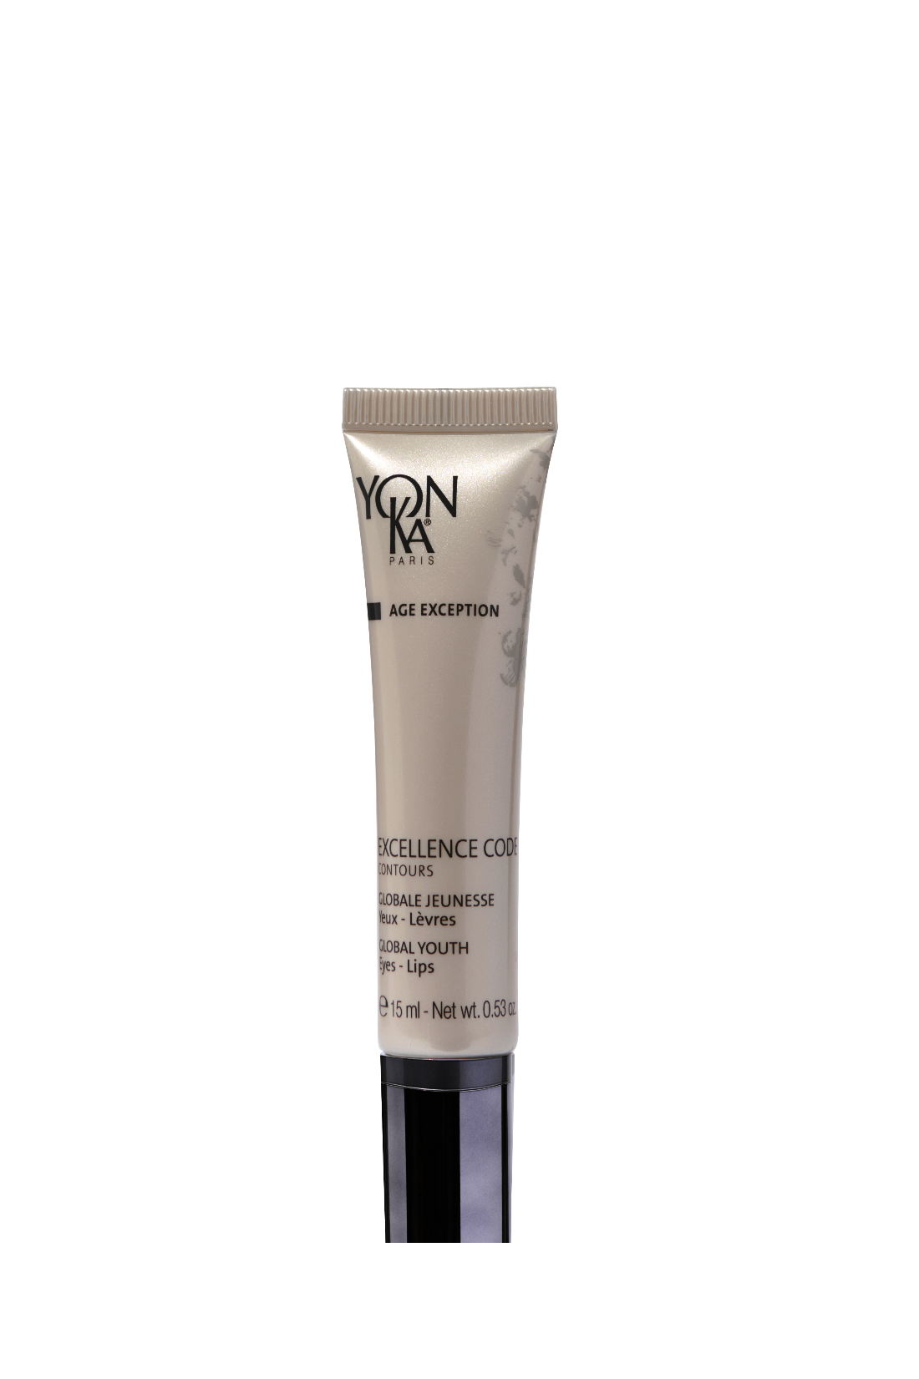
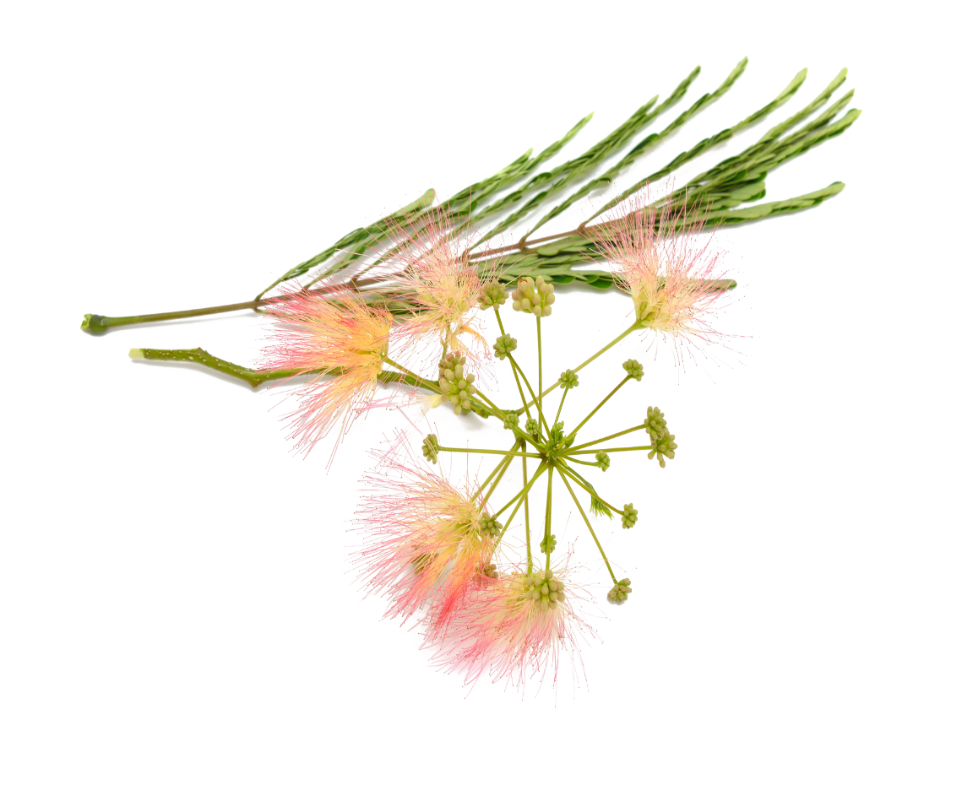
Excellence code contours
ingrédients naturels
94%
The 5-in-1 global anti-aging eye & lip contour
Plumps and smoothes wrinkles
Anti puffiness & dark circles
Lifts & firms
illuminating and blurring immediate effect
Anti dark spot
Length of crow's feet wrinkles: - 48%
Upper eyelid lifting effect: 61%
Appearance of puffiness: -34%
Intensity of dark circles: -50%
5 PATENTS
5-in-1 treatment that visibly reduces the signs of aging
Extreme-precision applicator with cooling effect in ZAMAC* (zinc, aluminum, magnesium, copper)
*Clinical scoring (dark circles, puffiness, lip wrinkles - 22 women), instrumental assessment (crow’s feet wrinkles - 19 women), in vivo test on ingredients (lifting effect - 18 women) - Best results obtained.
Notes:
EXCELLENCE CODE CONTOURS 94% ION
Descriptif
The 5-in-1 global anti-aging eye & lip contour
Bénéfices
Plumps and smoothes wrinkles
Anti puffiness & dark circles
Lifts & firms
illuminating and blurring immediate effect
Anti dark spot
Résultats
Length of crow's feet wrinkles: reduced by 48%
Upper eyelid lifting effect: improved by 61%
Appearance of bags: reduced by 34%
Intensity of dark circles: reduced by 50%
Les + produits
We love
5-in-1 treatment that visibly reduces the signs of aging
Extreme-precision applicator with cooling effect in ZAMAC* (zinc, aluminum, magnesium, copper)
*Clinical scoring (dark circles, puffiness, lip wrinkles - 22 women), instrumental assessment (crow’s feet wrinkles - 19 women), in vivo test on ingredients (lifting effect - 18 women) - Best results obtained.

Slide 11
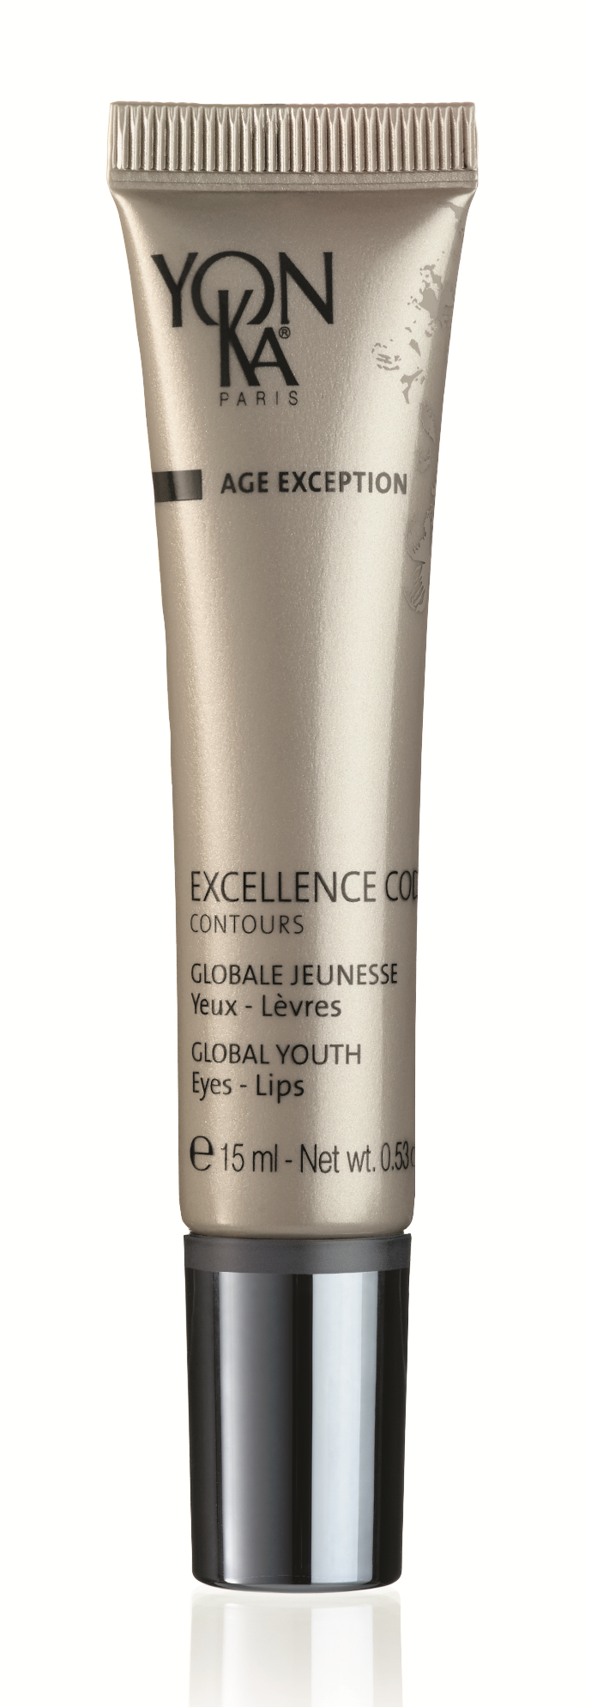
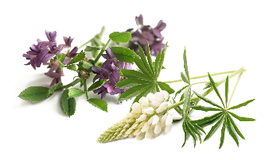
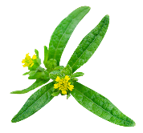
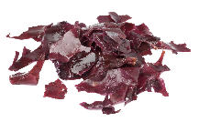
Excellence code Contours
In the morning and evening, apply a small amount
of cream to your eye and lip contour.
Massage with the applicator.
Hyaluronic acid + konjac
Wrinkle filler -
smoothing - hydrating
Complex of white lupin and alfalfa, persian silk tree and St. Paul’s wort Anti-puffiness - anti-dark circles -
upper eyelid-lifting effect
Natural light-reflecting pink pigments organic
Illuminating
and blurring effect
Red algae
Garden nasturtium
Clear and even
complexion
Organic thistle, vitamin A, avocado and grape seed oils, mango butter, bisabolol
Repairing - soothing
Co-enzyme Q10, vit. E
Anti-free radials
Bergamot, lemon,
mandarin, rose,tonka bean
and guaiac wood E.O
Refreshing – calming
Notes:
Utilisation à domicile
Remove makeup and cleanse your face carefully then mist with Yon-Ka Lotion adapted to your skin type. In the morning and evening, apply a small amount of cream around your eyes and lips. Massage the cream into your skin with your finger or with the applicator for a cool effect. Repeat each movement 3 times, insisting on the wrinkles.
Ingrédients
hyaluronic acid + konjac : (Filling sphere) wrinkle filler, smoothing, hydrating (plumps up to 6 times the wrinkle)
complex of white lupin and alfalfa + persian silk tree and St. Paul’s wort : Anti-puffiness - anti-dark circles - upper eyelid-lifting effect
Natural light-reflecting pink pigments organic : illuminating and blurring immediate effect
(surface corrector: smoothed skin, improved radiance of the complexion while maintaining a transparent finish) (ecocert validated pink mineral - Silica bead encapsulating titanium dioxide which masks imperfections by blurring them)
Red algae + Garden nasturtium : Clear and even complexion
Organic thistle, vitamin A, avocado and grape seed oils, mango butter, bisabolol: Réparateur, apaisant
Co-enzyme Q10 + vitamin E : anti-free radicals
Bergamot, lemon, mandarin, rose,tonka bean and guaiac wood E.O : refreshing and calming
Infos +
Organic soft focus powder : mineral material validated by ecocert
Silica bead encapsulating titanium dioxide
Mask imperfections by blurring them, perfecting effect
(wrinkle-filling effect + surface corrector: smoothed skin, improved complexion radiance while maintaining a transparent finish).
White lupin :
Europe, China
Parts used: seeds
Thanks to its richness in oligopeptides and oligosaccharides, it
- reduces puffiness under the eyes by stimulating lymphatic drainage to promote the elimination of liquids present in the skin tissue and reduce edema
- limits skin slackening to strengthen the fine and fragile skin around the eyes
Alfalfa: Alfalfa, the "queen of forage plants", sometimes called "great clover" or "Burgundy hay", is a species of dicotyledonous plant of the Fabaceae family, subfamily Faboideae, native to the temperate regions of the Near East and Central Asia.
Divine herb: Native to India, it is widespread in several tropical countries including Madagascar where it is used by local people as a medicinal plant with a calming and healing effect. High herb of about 50 cm (Asteraceae), also called "Heals quickly".
Parts used: darutoside (diterpene) extracted from the plant
Silk tree: Plant of the Mimosaceae family originates from Asia and, due to the ornamental quality of its flowers, is now found on all continents from the Himalayan foothills to the gardens of New York.
Its flowers form a graceful plume, generally pink in color, reminiscent of the silky brushes of make-up artists or eyelashes. Its leaves have the particularity to open in the sunlight and to close at night, a phenomenon called nyctinasty. This is why Persian poets have nicknamed it the "night sleeper". In Haikus, these short Japanese poems, it conveys the idea of joy and gladness.
Parts used: bark
The duo silk tree + divine herb allows to have a lifting effect on the upper eyelid and to reduce dark circles
ANTI-FATIGUE - SMOOTHING
5 PATENTS
*1 patent on the white lupin-alfalfa association
*1 patent on the encapsulation of hyaluronic acid via konjac microcapsules
*1 patent on the manufacturing process of soft focus powder
*1 patent on the silk tree-divine herb association
*1 patent on the zamac application cannula (zinc, mg, aluminum, copper) = energy storage
POPULAR PRODUCT
75% of consumers find this contour more effective than their usual contour

Slide 12
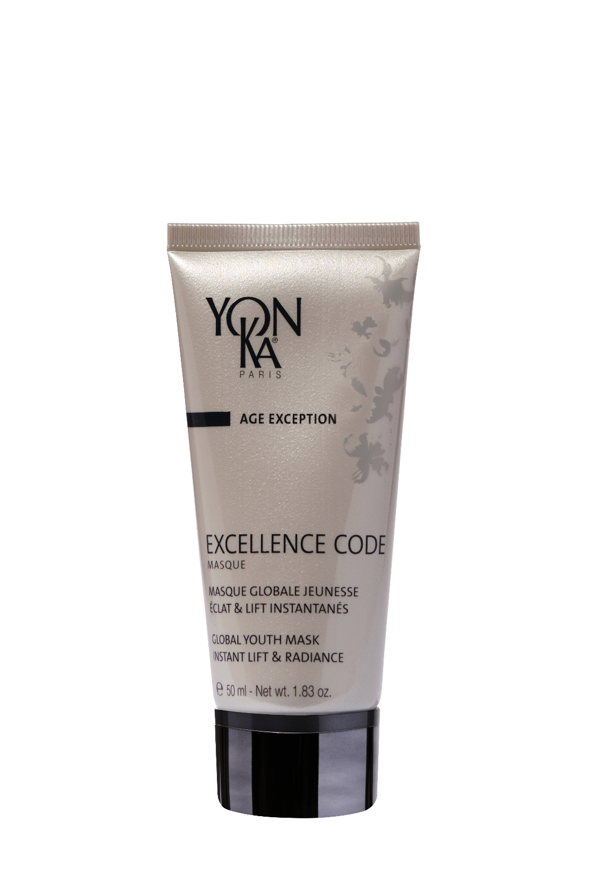
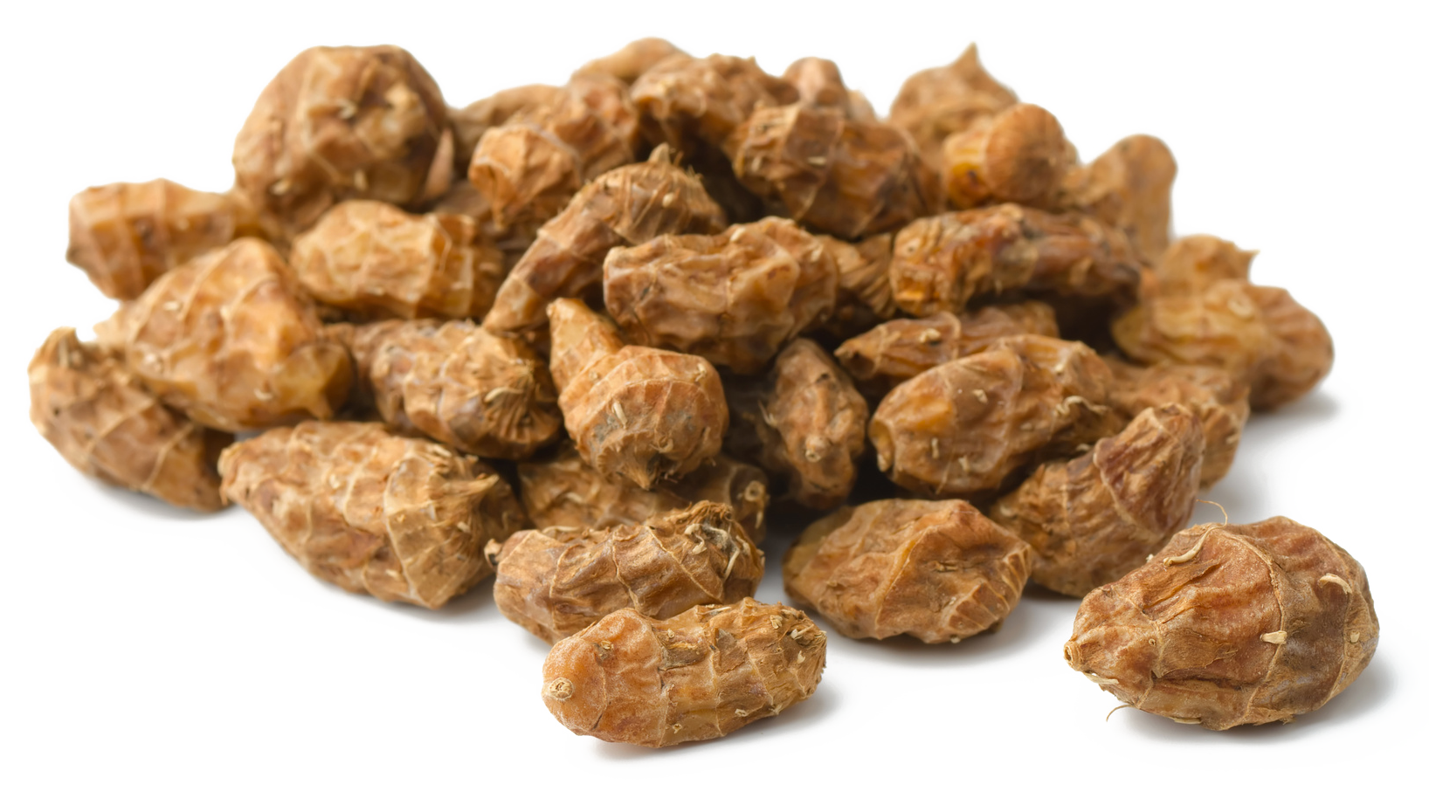
Excellence code Masque
ingrédients naturels
GLOBAL YOUTH MASK INSTANT LIFT & RADIANCE
91%
Instant lifting effect
Improves the elasticity and firmness
Plumps and smoothes
Hydrates and brightens
*Instant lift effect: +61%
*Anti-wrinkles – smoothing effect : -31%
*Genuine complexion radiance : +95%
No need to rinse
Ideal in sleeping mask
All skin types – from the first signs of aging
2 PATENTS
Open test supervised by dermatologists on 11 women aged between 50 and 64 (clinical scoring) Average results after 2 applications (D1 and D3)
Notes:
EXCELLENCE CODE MASQUE 91% ION
Descriptif
GLOBAL YOUTH MASK INSTANT LIFT & RADIANCE
Bénéfits
This mask-care, with nutgrass known for its immediate lifting effect, helps to visibly fight against the signs of aging.
It improves the elasticity and firmness of the skin and acts as a youth concentrate.
The marks of fatigue disappear, the skin is plumped up and appears visibly smoother
More luminous, hydrated and younger.
Résults
*Instant lift effect: +61%
*Anti-wrinkles – smoothing effect : -31%
*Genuine complexion radiance : +95%
Les + produit
No need to rinse
Possibility of using it as a sleeping mask (to increase the effects of the active ingredients during the night and a visible result in the morning)
From the first signs of aging, we love the creamy and velvety texture of Excellence Code Masque and its delicate and natural scent
2 patents
Open-test sous contrôle dermatologique :
Open test supervised by dermatologists on 11 women aged between 50 and 64 (clinical scoring) Average results after 2 applications (D1 and D3)

Slide 13
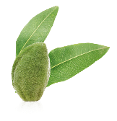
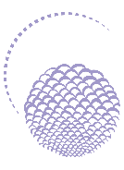
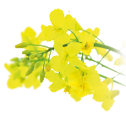
Excellence code Masque
1 to 2 times a week, after cleansing, apply the mask generously to the face and neck.
Leave on for 15 minutes, then spray on Yon-Ka Lotion. Massage in gently, then absorb the excess with a tissue paper.
Can be used as a sleeping mask !
Nutgrass + sweet almond proteins
Instant lift -
Firmness and bounce
Marine collagen
Anti-wrinkle
smoothing
Fruit acids
Anti-wrinkle
smoothing
exfoliating
Hyaluronic acid +
Vegetable glycerin
Hydrating
grape seed oil, allantoin
vitamins PP + B5
Nourishing –
repairing
Red algae
Radiant - even
complexion
Vitamins A C E
Anti-oxydant
regenerating
Yon-Ka Quintessence, bergamot, lemon, mandarin, rose, tonka bean, and guaïac wood E.O.
Vitalizing - replenishing
Notes:
At home :
1 to 2 times a week, after cleansing, apply the mask generously to the face and neck. Leave on for 15 minutes, then spray on Yon-Ka Lotion. Massage in gently, then absorb the excess with a tissue paper.
Possibilité de l’utiliser en sleeping masque
Can be used as a sleeping mask !
Ingrédients
Nutgrass + sweet almond proteins : Instant lift - Firmness and bounce
Fruit acids : Anti-wrinkle - smoothing - exfoliating
Marine collagen,: Anti-wrinkle - smoothing
Hyaluronic acid + Vegetable glycerin : hydrating
Grape seed oil, allantoin, vitamins PP and B5: nourishing – repairing
Red algae : Radiant - even complexion
Vitamins ACE : Anti-oxydant, regenerating
Yon-Ka Quintessence, bergamot, lemon, mandarin, rose, tonka bean, and guaïac wood E.O. : Vitalizing - replenishing
Info +
High molecular weight hyaluronic acid obtained by natural biotechnological process = surface action (smoothing and plumping effect)
Forms a moisturizing and protective film capable of maintaining water in the tissues and slowing down its evaporation (insensitive water loss) without being occlusive or greasy
The internal hydrous circulation is maintained + the film leaves the skin soft and silky
Vegetable glycerin :
Reduces the speed of water evaporation.
Comes mainly from rapeseed - Origin: Malaysia and Belgium.
Grape seed oil
Restructuring, it reduces the insensible loss of water, thus bringing comfort and elasticity (fatty acids)
Rich in omega 6 and 9 - Origin: Mediterranean (France, Italy)
Vitamin B5: Maintains moisture in the various skin layers, it is moisturizing and healing.
Vitamin PP: Stimulates the synthesis of lipids in the horny layer, thus limiting water loss (vitamin B3).
Allantoin: Synthetic, France
Fruit acids stimulate cell renewal thanks to their exfoliating properties. They improve the radiance and texture of the skin.
Origin: Europe, blend made in Italy
Parts used: Blueberry: Berry / Fruit, Sugar cane: Stalks, Maple: Tree sap, Orange and Lemon: Whole fruit
The marine collagen acts on wrinkles and fine lines by forming a smoothing and protective film on the skin.
Parts used: fish skin (Molva molva species = white ling)
Origin : North Atlantic
Nutgrass : will act at the heart of the papillary dermis by reinforcing the network of fibers and stimulating the synthesis of collagens specific to the papillary dermis (+500% collagen XII)
It reinforces the mesh structure and deformability of the papillary dermis, thus improving the firmness and the spring effect of the skin.

Slide 14
Questions

Slide 15
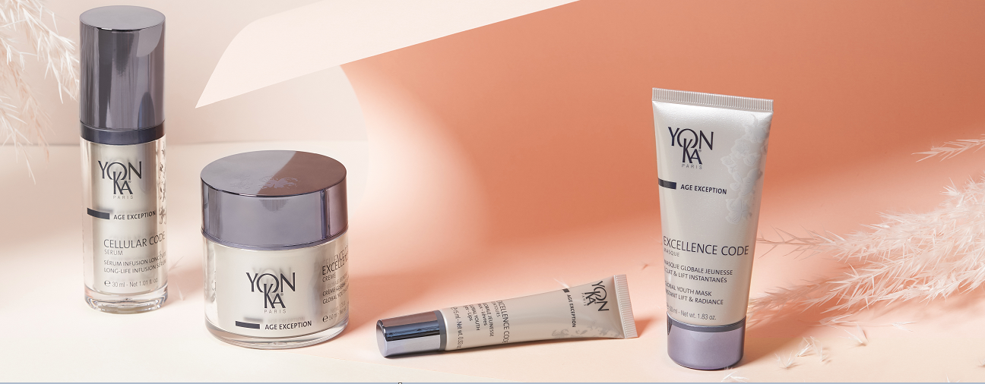
CAN I USE CELLULAR CODE SERUM IF I DO NOT HAVE MATURE SKIN?
As the product acts on the aging of the cells, one can start using this product as soon as the signs of aging appear.
This product has been thought and designed specifically for mature skin in order to act on cellular senescence, and not in "prevention" (for that there are the products of the AGE DEFENSE ranges). There is no point in going too fast!
It is important to always refer to the skin's condition.
The biological age and the age of the skin do not always correspond. Even more so if the cellular metabolism has been slowed down by some kind of aggression, illness for example.
Notes:
As the product acts on the aging of the cells, one can start using this product as soon as the signs of aging appear.
This product has been thought and designed specifically for mature skin in order to act on cellular senescence, and not in "prevention" (for that there are the products of the AGE DEFENSE ranges). There is no point in going too fast!
It is important to always refer to the skin's condition.
The biological age and the age of the skin do not always correspond. Even more so if the cellular metabolism has been slowed down by some kind of aggression, illness for example.
Thus to be used on a skin which shows signs of ageing and which starts to see its cellular metabolism slowing down

Slide 16
HOW TO CHOOSE BETWEEN ELIXIR VITAL AND CELLULAR CODE SERUM?
ELIXIR VITAL is part of the SPECIFICS / Repair range.
It works as a super repairer and regenerator of damaged, tired, altered and in prevention for all skin types at any ages! Its purpose is to reproduce the Hydrolipidic film by acting by bio-mimicry.
It can be applied alone or as a serum under the usual cream.
CELLULAR CODE SERUM acts on the state of the cells themselves, on their functions and their longevity.
It provides the cells with all the necessary elements to reset the skin's youthfulness and "regain the cellular function of a person 10 years younger".
These are two different levels of action for two kinds of needs !
Notes:
ELIXIR VITAL is part of the SPECIFICS / Repair range.
It works as a super repairer and regenerator of damaged, tired, altered and in prevention for all skin types at any ages! Its purpose is to reproduce the Hydrolipidic film by acting by bio-mimicry.
It can be applied alone or as a serum under the usual cream.
CELLULAR CODE SERUM acts on the state of the cells themselves, on their functions and their longevity.
It provides the cells with all the necessary elements to reset the skin's youthfulness and "regain the cellular function of a person 10 years younger".
These are two different levels of action for two kinds of needs.

Slide 17
WHAT IS THE MATERIAL OF THE CELLULAR CODE CONTOUR APPLICATOR ?
This PATENTED metal applicator has a rounded ergonomic shape, with an inclination studied for maximum safety when applying on the eye and lip contour.
It is made of ZAMAC = Zinc, Aluminium, Magnesium, Copper.
It is an alloy of metals selected for their safety.
Notes:
This PATENTED metal applicator has a rounded ergonomic shape, with an inclination studied for maximum safety when applying on the eye and lip contour.
It is made of ZAMAC = Zinc, Aluminium, Magnesium, Copper.
It is an alloy of metals selected for their safety.

Slide 18
IS THE COMBINATION OF SERUM AND CREAM ESSENTIAL?
The association is not obligatory, however, if the cells are not in good conditions to be stimulated, EXCELLENCE CODE CREME will have a less rapid and probably less visible result. The serum will boost the results
Notes:
The association is not obligatory, however, if the cells are not in good conditions to be stimulated, EXCELLENCE CODE CREME will have a less rapid and probably less visible result. The serum will boost the results

Slide 19
MY CLIENTS DO NOT HAVE THE BUDGET FOR
AGE EXCEPTION?
As its name indicates, this range provides exceptional results on all signs of aging: lack of radiance, dark spots, sagging, wrinkles, dryness...
Skin aging is the number one priority for women and they are ready to invest in order to delay it.
The ingredients contained in this range are patented and super-powerful.
Efficiency tests have shown more than satisfactory results!
To try the AGE EXCEPTION range is to adopt it!
The textures are sensorial and the packaging is also qualitative and perfectly hygienic.
Notes:
As its name indicates, this range provides exceptional results on all signs of aging: lack of radiance, dark spots, sagging, wrinkles, dryness...
Skin aging is the number one priority for women and they are ready to invest in order to delay it.
The ingredients contained in this range are patented and super-powerful.
Efficiency tests have shown more than satisfactory results!
To try the AGE EXCEPTION range is to adopt it!
The textures are sensorial and the packaging is also qualitative and perfectly hygienic.
EXCELLENCE CODE CREAM can be used day and night, the equivalent of 2 products in 1.
Advise your clients to use the EXCELLENCE CODE MASK, its result is visible and immediate. Used as a night mask. It is suitable for all skin types and all ages: to try it is to adopt it.

Slide 20
Offers

Slide 21
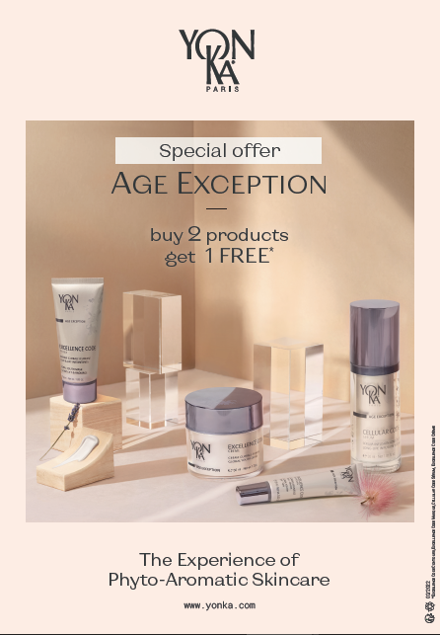
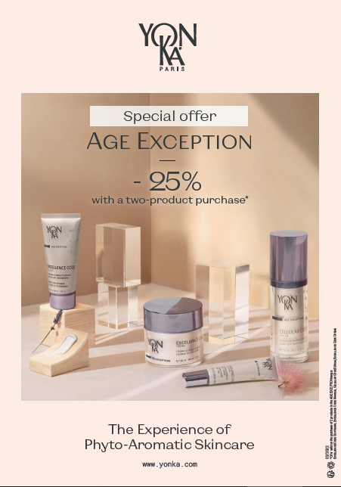
Notes:
Two differents options :
1 product offered with the purchase of 2
Or 25% discount with a 2 product purchase
We also have new communication tools : you can see it to the newsletter of april (with the dyptique, and the countertop display and the A4)

Slide 22
