Slide 1
Notes:
before we start the presentation and recording, I would like to go around the table and ask everyone to tell me how you train your beauticians in your country
training at the training centre or in beauty salons? How many people? how many days? training program ?
if you don't want to talk, you can write it in the chat bar, I really appreciate your feedbacks

Slide 2
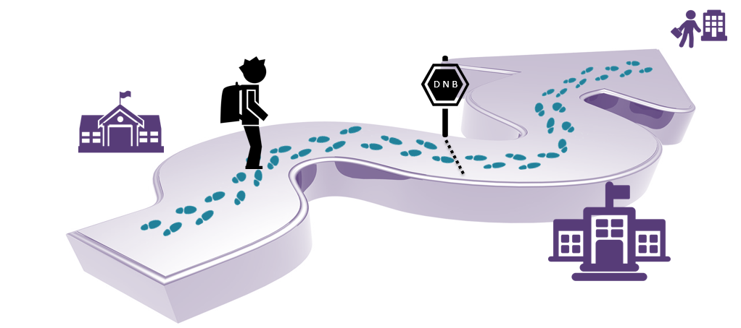
My training path
IMMERSION TRAINING LEVEL 1
VALIDATION TRAINING
LEVEL 2
Notes:
The Yon-Ka training course is divided into 2 parts:
the 5-day immersion training
the one-day validation training
Today I am going to present you the immersion training, its programme and its implementation. All the training tools are available.

Slide 3
Planning IMMERSION Level 1 "new version in line with the new guide
D1 | D2 | D3 | D4 | D5
BRAND THEORY THE ESSENTIALS/CONTOURS/SERUMS | AGE DEFENSE THEORY/SENSITIVE SKINS, IMPERFECTIONS BOOSTERS | THEORY NEW SKIN, SPECIFICS AGE CORRECTIONMEN AND SUN | AGE EXCEPTION THEORY | MAHANA PRACTICE
PRACTICE common steps | PRACTICE ACTIVE MICRO PEEL Grade 1 peeling, blackhead removal, MASQUE MODELANT, steam and hot stone massage | PRACTICE peeling ALPHA EXFOLIATEUR Grade 2, anti-aging techniques, MASQUE LIFT | PRATIQUE PEELING LUMIERE Grade 3, MASQUE BIO CELLULOSE, Techniques for eyes and lips | PRACTICAL VALIDATION OF A COMPLETE TREATMENT
Notes:
This is how the 5-day training course is organised.
We distinguish the theoretical part, rather in the morning to privilege the attention of the participants and the practical part in the afternoon.
The learning is done in a progressive way and coherent with our facial treatment offer.
Indeed, we start by learning the common and essential steps and as the days go by we learn more technical steps.
The participants are evaluated throughout the week thanks to educational games but also during the last day with the practice of a complete facial in autonomy
In France we organise the immersion over a week but you can divide the days over several weeks depending on your market

Slide 4
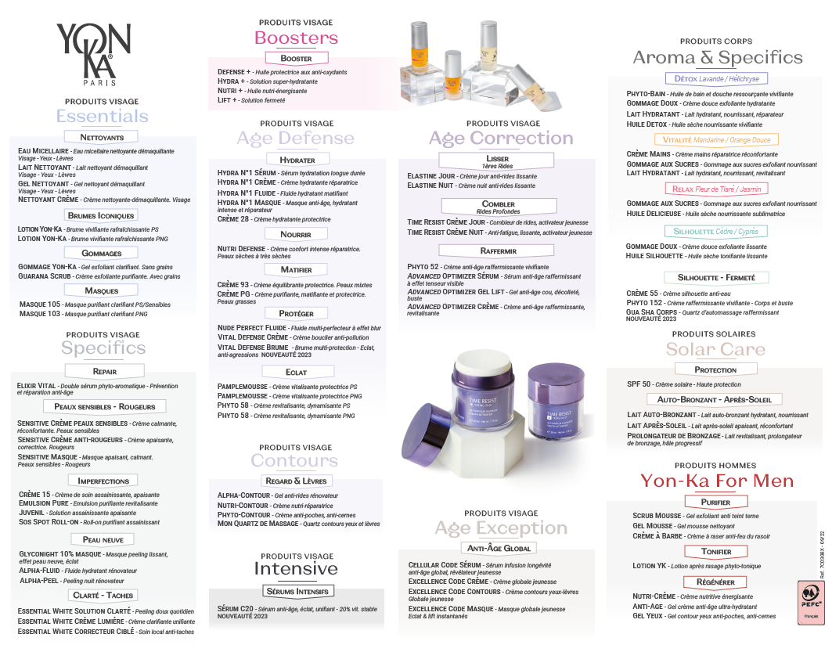
Which products which day?
D1
D2
D3
D4
D5
Notes:
here is the progress of the theoretical learning day by day

Slide 5
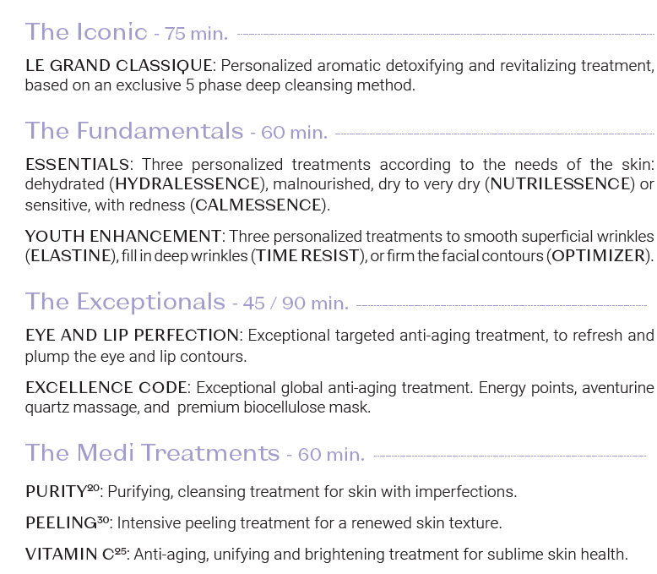
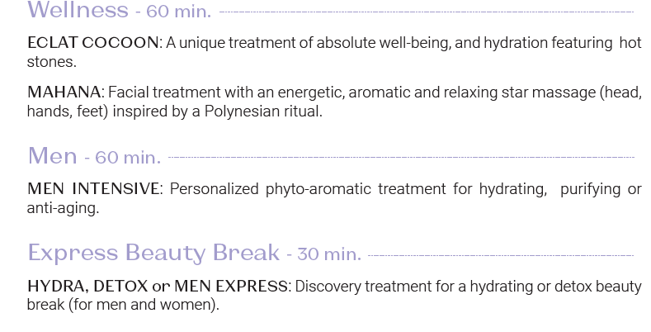
Which treatment which day?
D1
D2
D3
D4
D5
Notes:
And here is a representation of the practical learning progress day by day
Now let's find out about the support and the key steps

Slide 6
Day 1
10 am-01 pm
2 pm-6 pm
Immersion in the Yon-Ka universe
CLEANSERS
ICONIC MISTS
GOMMAGE
MASQUE 103/105
CONTOURS
SERUMS
The fundamental steps :
Make-up removal
Introduction Signature
GOMMAGE YON-KA
Lucas spray
Yon-Ka massage
MASQUE 103/105
Contour base
Conclusion Signature
Notes:
on the 1st day, to allow participants who come from far away, we start at 10 am

Slide 7
Immersion in the Yon-Ka universe
Notes:
the presentation of the brand is essential, so we spend at least an hour explaining the philosophy, the history, the commitments...

Slide 8
Products theory

Slide 9
Theory of the common steps
Notes:
Afternoon

Slide 10
Practice
Make-up removal
Introduction Signature
GOMMAGE YON-KA
Lucas spray
Yon-Ka massage
MASQUE 103/105
Contour base
Conclusion Signature

Slide 11
Day 2
9 am - 12:30 pm
1:30 pm - 5:30 pm
“Product card” game
BOOSTERS
AGE DEFENSE
SENSITIVE SKINS
IMPERFECTIONS
PEELING ACTIVE MICRO PEEL Grade 1
Extraction of blackheads
Massage under steam Hot stone massage
MASQUE MODELANT

Slide 12
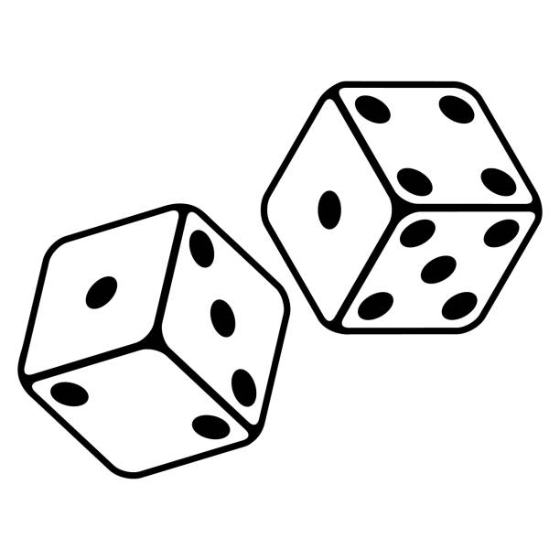
« Product card » game
Each participant picks a "product card“ (from day 1) at random and has to make the others guess it by giving information (for example: active ingredients, who the product is for, how it is used etc)
If the participant manages to make the right guess, she picks a product (sample) from a bag

Slide 13
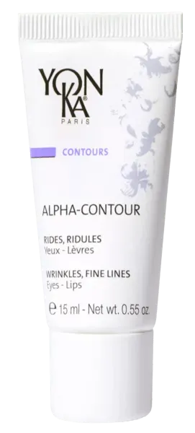
GEL NETTOYANT
LOTION PS
GOMMAGE YON-KA
MASQUE 105 PS
ALPHA CONTOUR
ELIXIR VITAL

Slide 14
Products theory
Explication of the according protocol
Ask them to find the most suitable recommandation

Slide 15
Practice
PEELING ACTIVE MICRO PEEL Grade 1
Extraction of blackheads
Massage under steam Hot stone massage
MASQUE MODELANT

Slide 16
Day 3
9 am -12:30 pm
1 pm - 5:30 pm
« Relay » Game
RENEWING
AGE CORRECTION
MEN
SOLARS
PEELING ALPHA EXFOLIATEUR Grade 2
Anti-aging Techniques
MASQUE LIFT

Slide 17
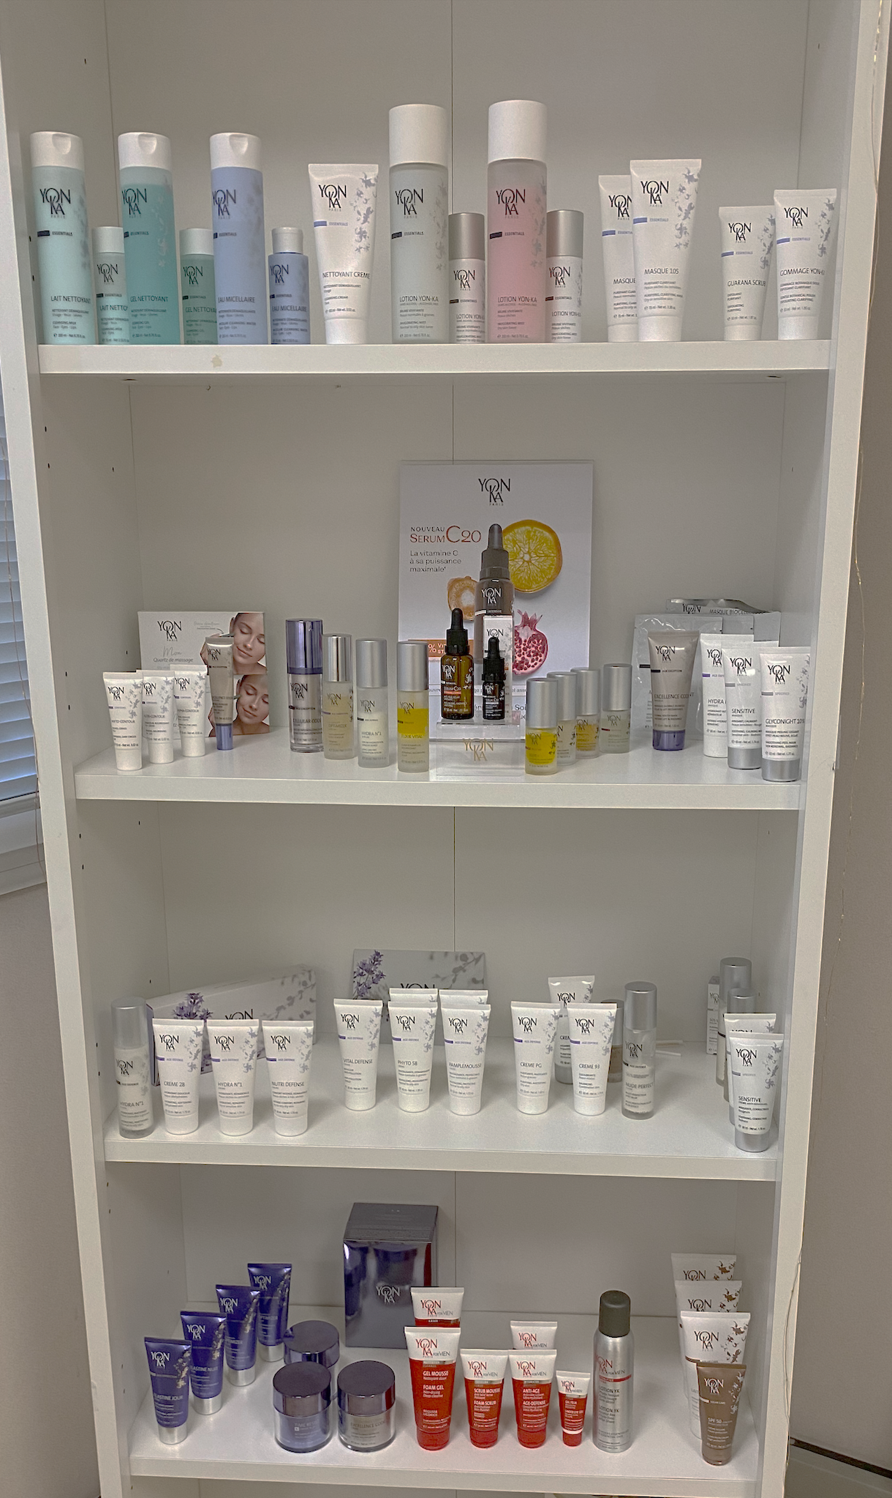
« Relay » Game
The trainer gives a product at random to a participant who has to give one information about the product and pass it on to his/her neighbor until there is nothing more to say.
The participant who manages to give the last information wins a product (sample) from a bag
Choose a product seen on day 1 or 2

Slide 18
Products theory

Slide 19
Practice
PEELING ALPHA EXFOLIATEUR Grade 2
Anti-aging Techniques
MASQUE LIFT

Slide 20
Day 4
9:00 a.m. - 12:30 p.m.
1:30 pm - 5:30 pm
The Great Quiz!
AGE EXCEPTION
PEELING LUMIERE Grade 3
Eye and lip techniques with and without quartz
MASQUE BIOCELLULOSE

Slide 21
The Great Quiz
Great Quiz, a whole series of questions to review the whole training. Each participant has a buzzer to answer. Good points are counted at the end.
The trainer can choose from a wide range of questions, classified by category
For the winner 1 jar of honey, for the second and third one sample each.

Slide 22
Products theory

Slide 23
Practice
PEELING LUMIERE Grade 3
Eye and lip techniques with and without quartz
MASQUE BIOCELLULOSE

Slide 24
Day 5
10:00 a.m. - 1:30 p.m.
2:30-4:00 pm
MAHANA
Practical validation of a complete treatment

Slide 25
Morning
MAHANA THEORY
MAHANA PRACTICE

Slide 26
Afternoon
Each participant picks a one-hour treatment which she/he must perform on her/his own in its entirety. The trainer will evaluate each of the steps
Hydralessence
Calmessence
Nutrilessence
Elastine
Time Resist
Optimizer
Pureté 20
Peeling30
Vitamin C25
Eclat cocoon
Name | Skin diagnosis | Introduction signature | Peeling / gommage | Lucas spray | Yon-Ka Massage | Mask | Conclusion signature | + | -
Evaluation form

Slide 27
End of training
From the third day on, participants are able to fill the beauty prescription during the practice. With the information collected during the skin diagnosis, we can thus adapt the end of training gifts.
Each participant leaves with a bag that contains :
1 adapted cream (sale size)
1 cleansing milk or gel (travel size)
1 PS or PNG lotion (travel size)

Slide 28
End of training
IMMERSION TRAINING LEVEL 1
VALIDATION TRAINING
LEVEL 2
Notes:
6 months to a year after the immersion training, we have to call back our clients to participate in the validation training
at our next Yon-Ka rendez-vous we will look at this validation training day together

Slide 29
Thanhs !

