Slide 1
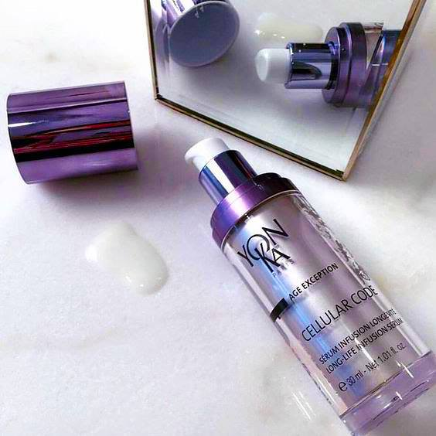
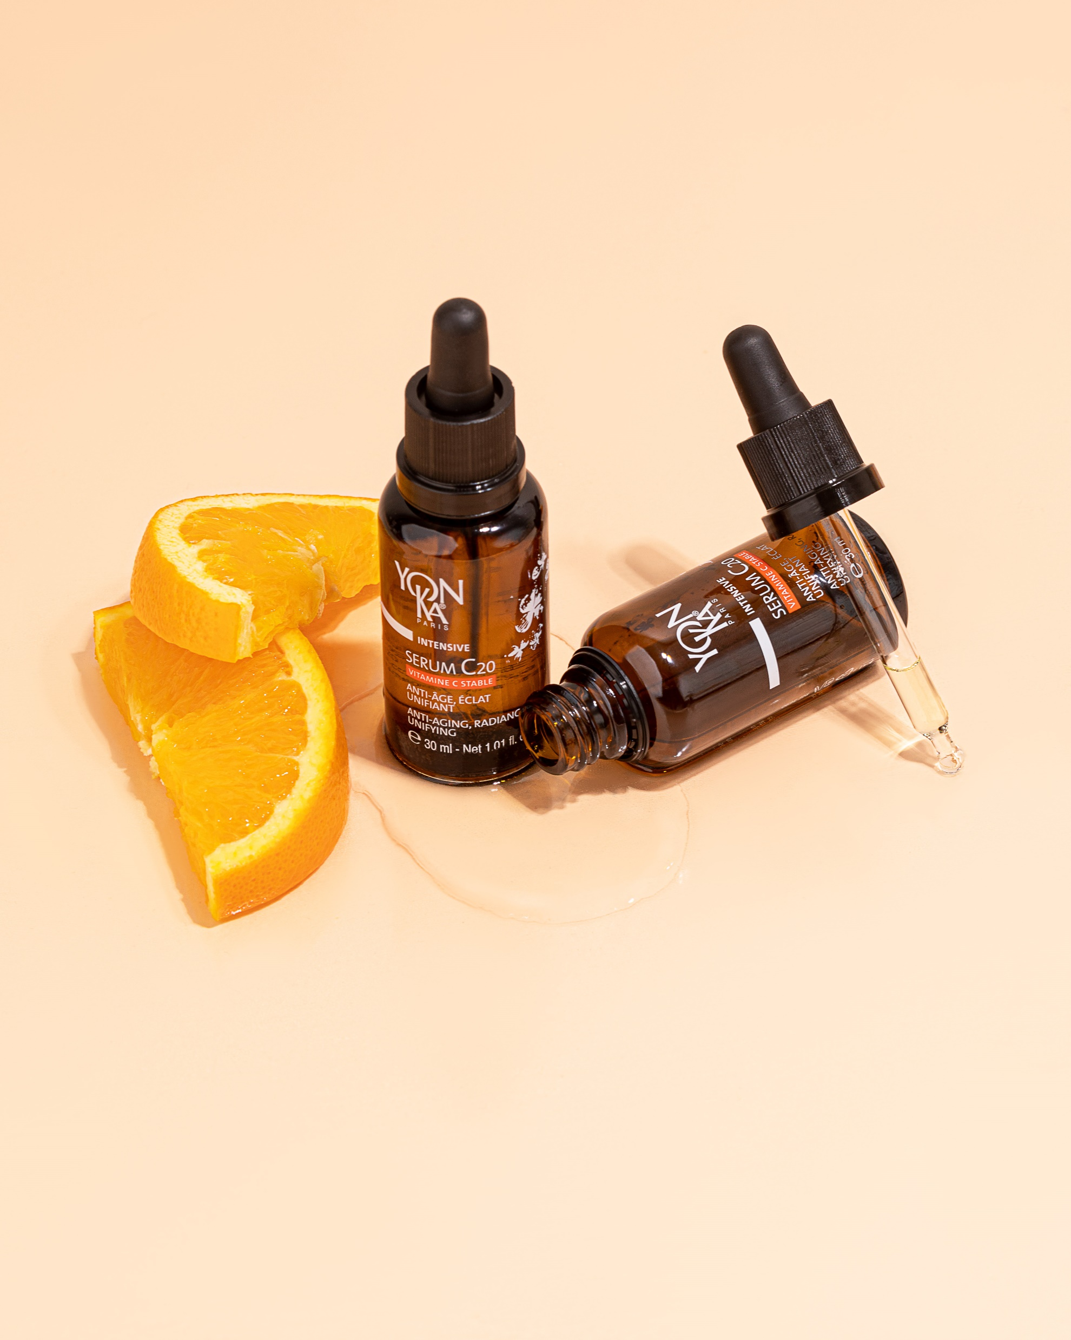
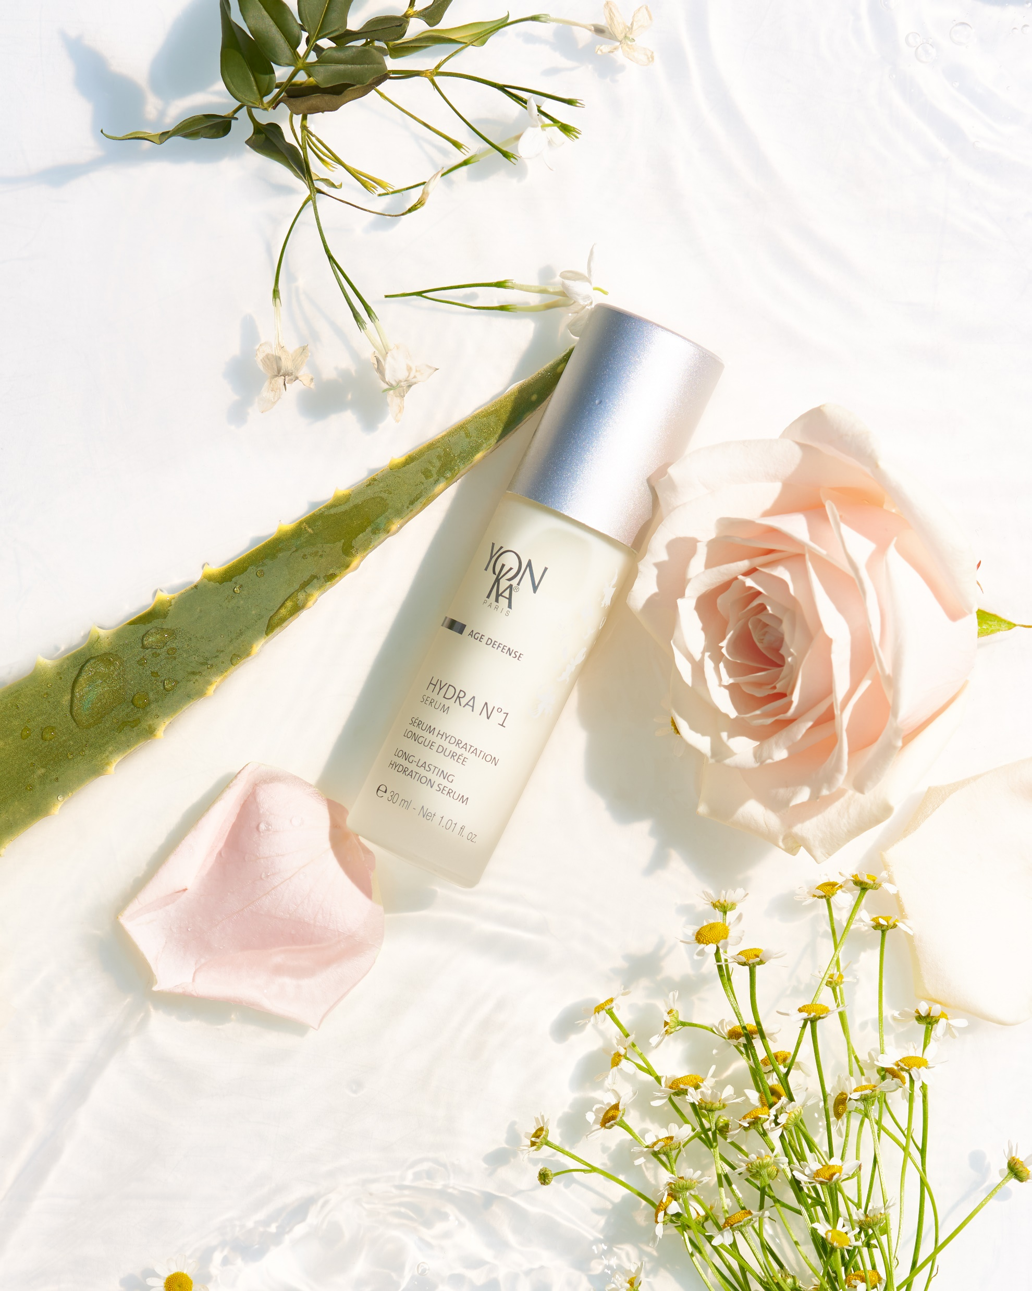
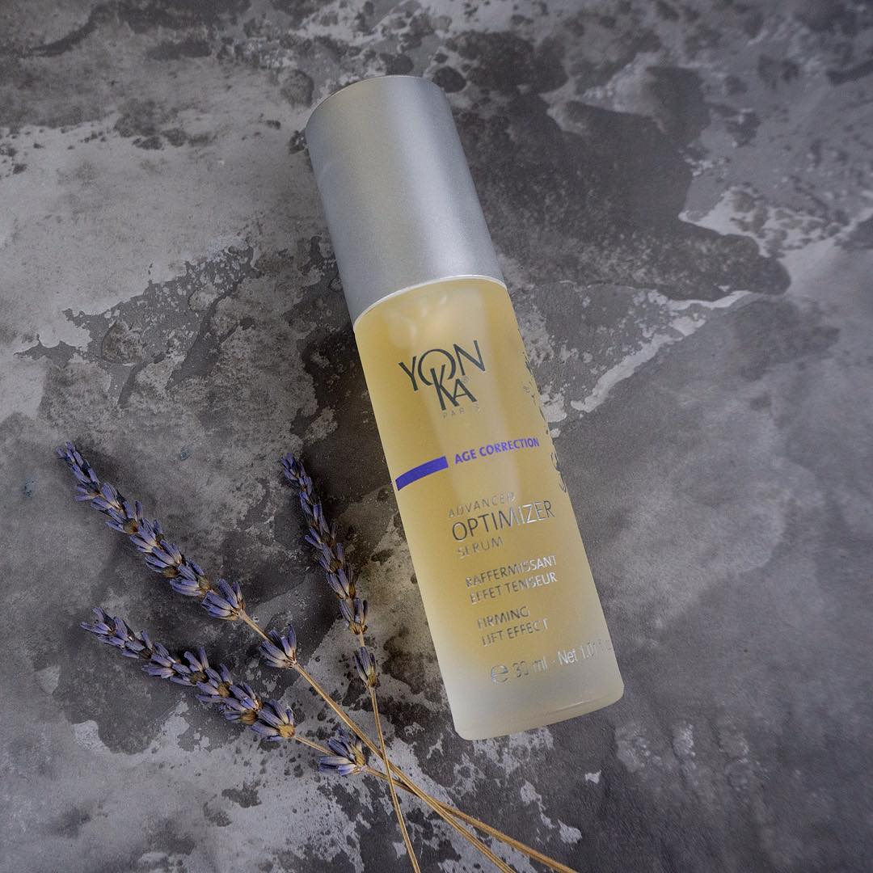
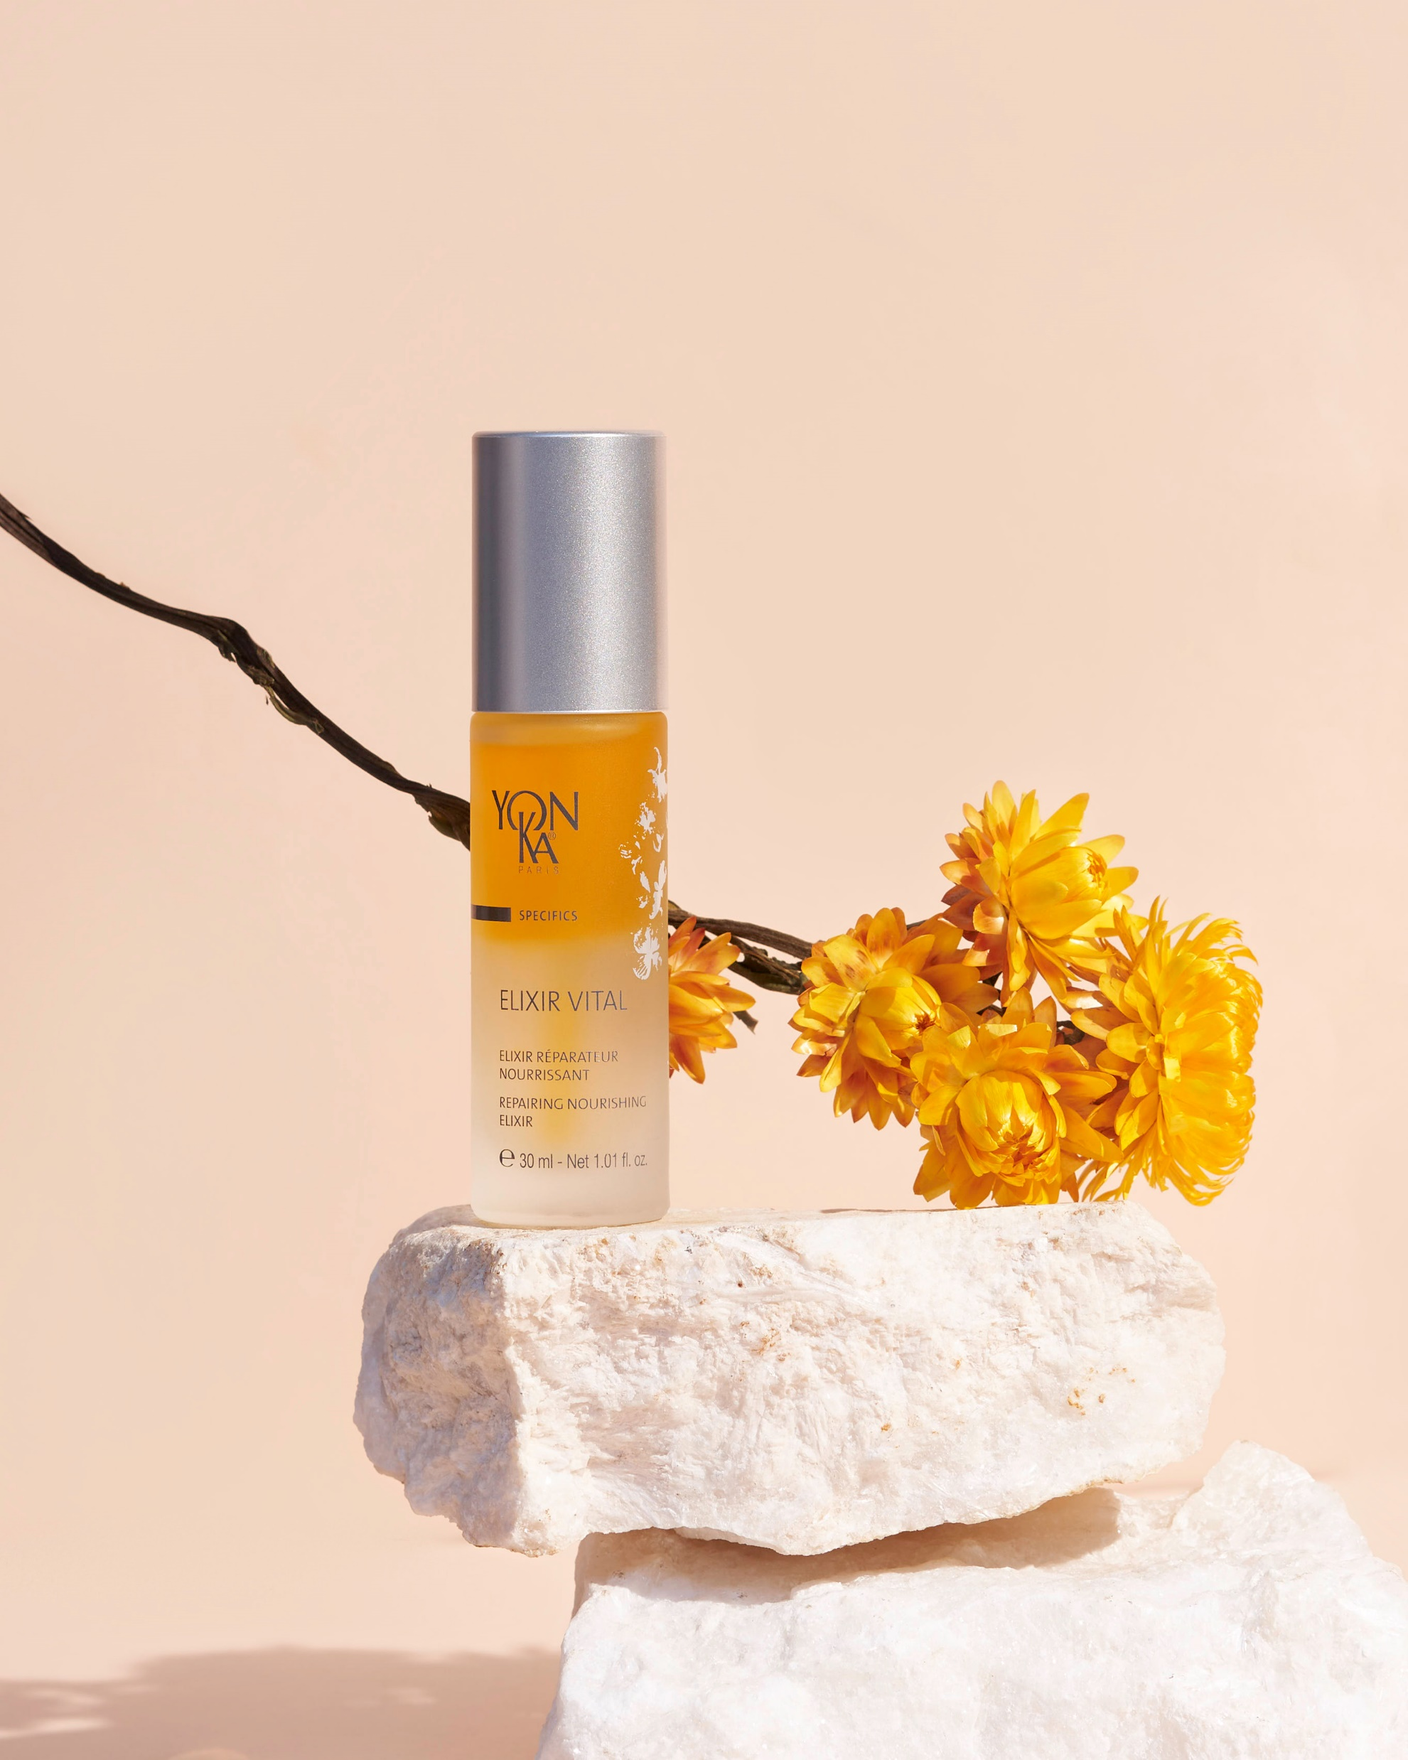
Yon-Ka Serums

Slide 2

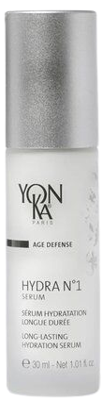
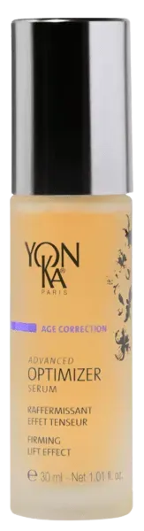
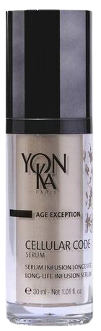
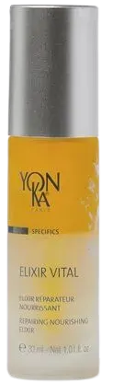
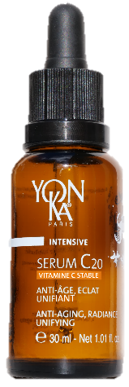
SERUMS
Serums for in-depth actions and optimized results
NEW
HYDRATING
FIRMING
GLOBAL ANTI-AGING
PREVENTION &
REPAIR ANTI-AGING
ANTI AGING - RADIANCE
UNIFYING
HYDRA 1 SERUM
ADVANCED
OPTIMIZER SERUM
CELLULAR CODE
SERUM
ELIXIR VITAL
SERUM C20
Notes:
As you know, now we have 5 serums, in order to meet each need.

Slide 3
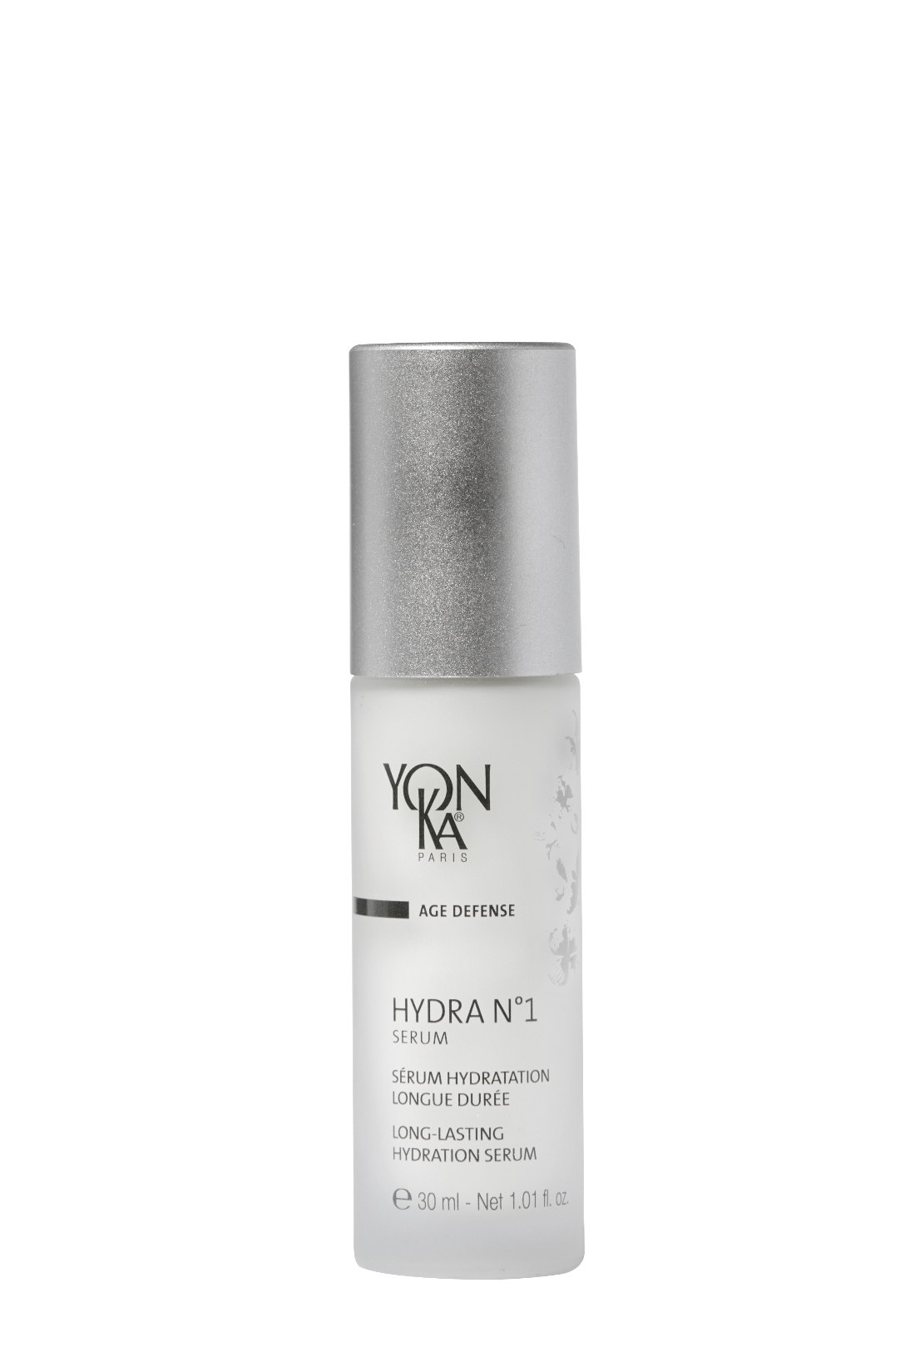



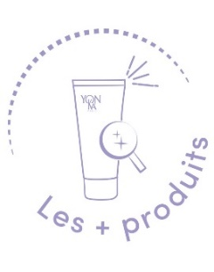
HYDRA N°1 SERUM
The ally of thirsty skin!
SOS serum for very dehydrated skin
Deep and long-lasting hydration
Restructuring and redensifying effect
Soft, supple and plumped up skin
With hydra n°1 creme
+144% of hydration immediately and +102% after 8 hours
With hydra n°1 fluide
+122% of hydration immediately and +76% after 8 hours
93% of Ingredients of Natural Origin
Quickly absorbed gel texture
Natural fragrance of rose, jasmine and chamomile
Notes:
First product : HYDRA N°1 SERUM : the ally of thirsty skin !
Description :
This moisturizing serum with hyaluronic acid is the SOS treatment for very dehydrated skin, providing deep and long-lasting hydration. Enriched with restructuring and redensifying active ingredients, the skin is intensely soft, supple and plumped up
Results :
Combined with hydra n°1 crème
+144% of hydration immediately and +102% after 8 hours
With hydra n°1 fluide
+122% of hydration immediately and +76% after 8 hours
What we love :
93% of Ingredients of Natural Origin
Quickly absorbed gel texture
Natural fragrance of rose, jasmine and chamomile
When combined with HYDRA NO. 1 cream
100%*: Skin hydrated
100%*: Skin nourished
85%*: Skin smoothed, fine lines from dehydration smoothed
80%**: skin looks younger, complexion radiant
95%**: Skin comfortable, suppler and revitalised
80%*: Skin soothed
(a) Skin hydration measured by corneometry, with combination of HYDRA No. 1 Serum and Cream on 10 volunteers ages 19 to 65 with skin prone to dryness.
(b) Skin hydration measured by corneometry, with combination of HYDRA No. 1 Serum and Fluid on 10 volunteers ages 19 to 63 with skin prone to dryness.
*Self-assessment – Clinical study with 20 women ages 26 to 50, dehydrated and dry skin. HYDRA No. 1 Serum and Cream were applied twice daily for four weeks. Non-comedogenic.

Slide 4
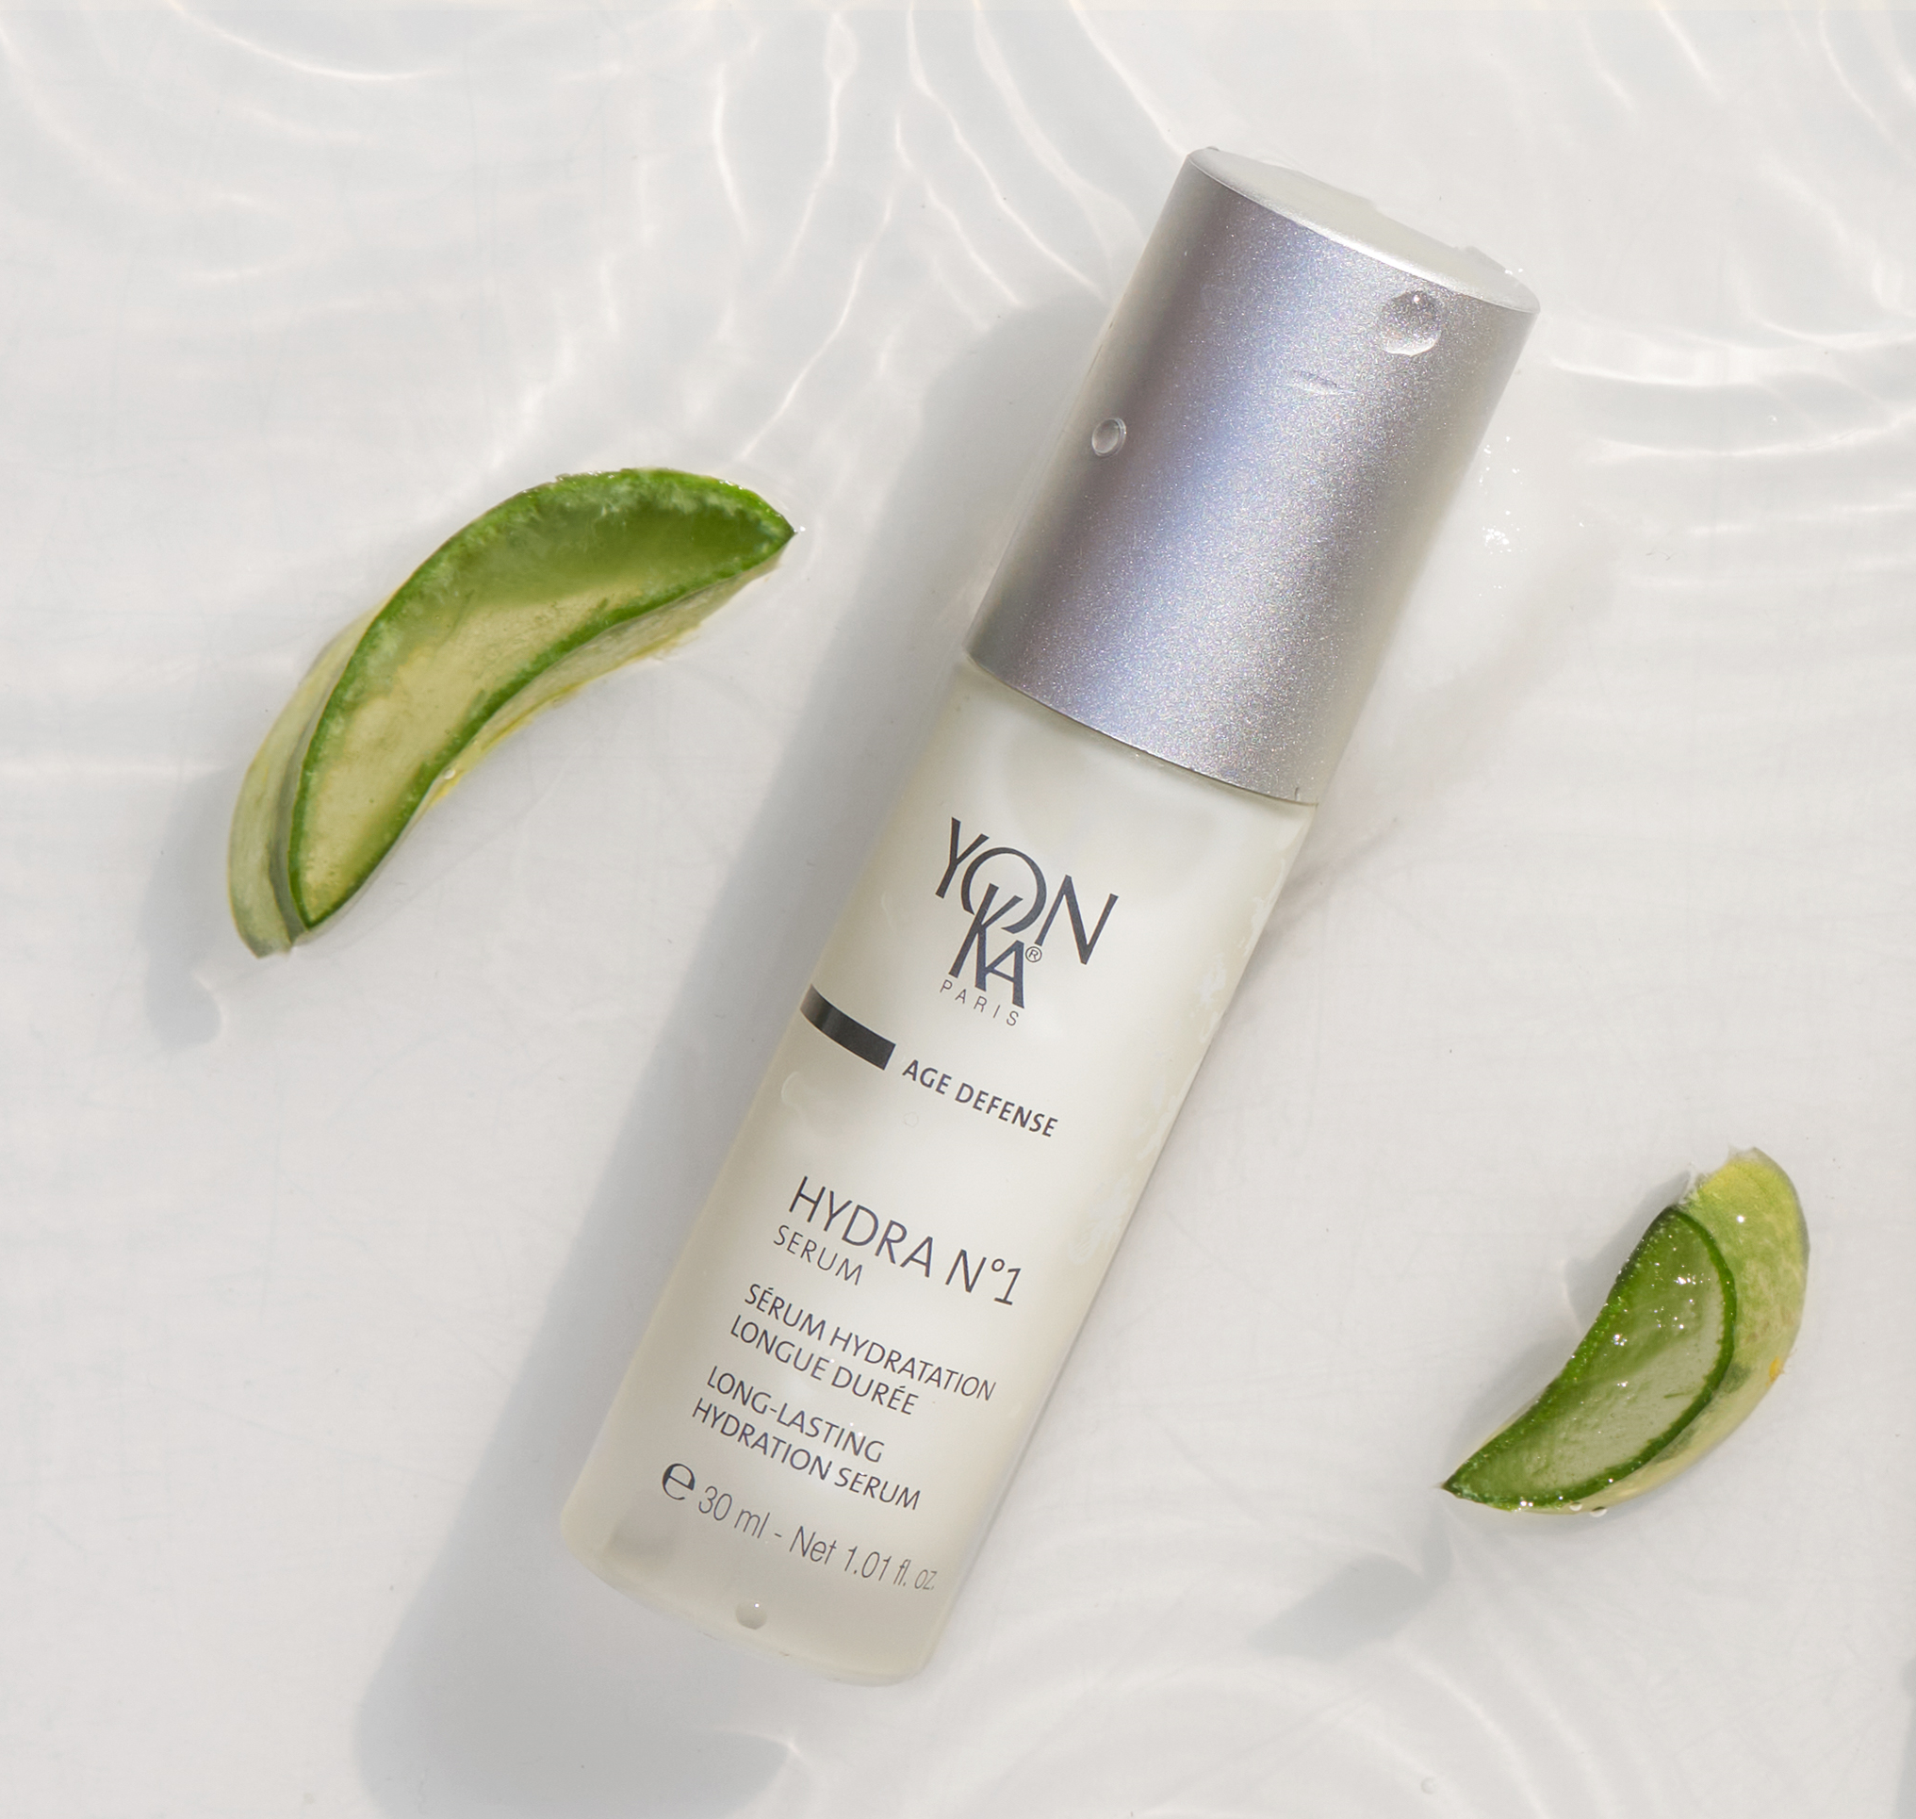

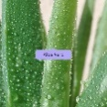
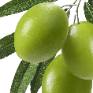
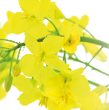








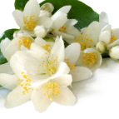

HYDRA N°1 SERUM
▪ Perfect for everyone: men, women, all ages, all skin types, all year round!
▪ As an intensive course before and after the summer and/or winter.
▪ 1 pump added to the foundation for a long lasting hold!
▪ In addition, use Hydra N°1 Masque one to three times a week.
+
+
+
Hydrating Complex
Organic aloe vera, olive phytosqualane, imperata cylindrica, vitamins ACE, Low Molecular weight HA
vegetal glycerin, serine, PCA et polysaccharides
Hydrating
Yeast extract and silicon
Restructuring - redensifying
rose, chamomile and
jasmine E.O
Balancing - relaxing
Notes:
▪ Perfect for everyone: men, women, all ages, all skin types, all year round!
▪ it could be used As an intensive course before and after the summer and/or winter.
▪ it could be combiend with the foundation : 1 pump added to the foundation for a long lasting hold!
▪ In addition, use Hydra N°1 Masque one to three times a week.
▪ Hydra n°1 serum – with nude perfect or creme anti-rougeurs - TOP TOP
"My skin is uncomfortable and tight
"My skin is flaky "
"My foundation is not lasting "
"I just came back from the sun, my skin is dull and uncomfortable “
Ingredients :
Hydrating complex with :
Organic aloe vera & olive phytosqualane : Hydrating, Reinforces the skin's barrier function:
imperata cylindrica : hygroscopic = Intense and long-lasting hydration
Low Molecular weight HA : deep hydration, skin cell renewal, redensifying and restucturing
Vitamins ACE : protect the cells , regenerating and antioxydant.
Polysacharides, serine, PCA, vegetal glycerin : hydrating
+
YEAST EXTRACT : Restructuring - redensifying : helps to form a lipidic cement
SILICON (=silicium) : replenishes the skin's water reserves. It stimulates the multiplication of fibroblasts.
Present in many foods.
It has been observed that silicon is essential for the synthesis of collagen and elastin fibers. The deficit in organic silicon from the forties causes a significant drying of the skin and the appearance of wrinkles. Organic silicon derivatives (silanols) are therefore indicated to act on wrinkles, stretch marks and to improve the elasticity of the skin.
+
rose, chamomile and jasmine E.O : Balancing - relaxing (fragrance of the hydra n°1 range)
VEGETAL GLYCERIN (ECOCERT ingredient, comes from European rapeseed) Action: Humectant and moisturizing, it reduces the speed of water evaporation from the surface of the skin, softens, smoothes and reduces roughness.
SERINE: amino acid that is part of the Natural Moisturizing Factor (NMF) which is the moisturizing factor that maintains the skin's normal hydration
PCA: PYRROLIDONE CARBOXYLIC ACID = part of the NMF, hygroscopic > maintains water in the skin
Origin: Beetroot
POLYSACCHARIDE : Immediate and long-lasting moisturizing power, brings a silky touch
Origin: biotechnology
Composition: polysaccharide (complex sugar composed of several molecules of simple sugars) obtained by natural bacterial fermentation whose substrates are corn sorbitol and soy peptone.

Slide 5
ADVANCED OPTIMIZER SERUM
Redensifying serum that tightens the skin
Firms the face and neck
Provides an immediate tightening effect
Tone and smoothes the skin
Proven effectiveness after 4 weeks
89 %* : The serum has a tightening effect
89 %* : Toned, smoother skin
89 %* : Firmer and denser skin
*Self-evaluation - Clinical study on 19 women aged 47 to 55. 2 applications per day
Boosts the effectiveness of Advanced Optimizer Crème
Its fluid texture instantly penetrates
Notes:
Proven results Tolerance tested under dermatological control
Proven effectiveness after 4 weeks:
89 %* : The serum has a tightening effect
89 %* : Toned, smoother skin
89 %* : Firmer and denser skin
79%* : Contour of the face is redefined, clearer
95%*: Nourished skin
100%* : Hydrated skin
*Self-evaluation - Clinical study on 19 women aged 47 to 55. 2 applications per day for 4 weeks

Slide 6
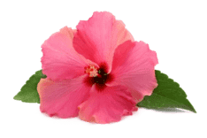

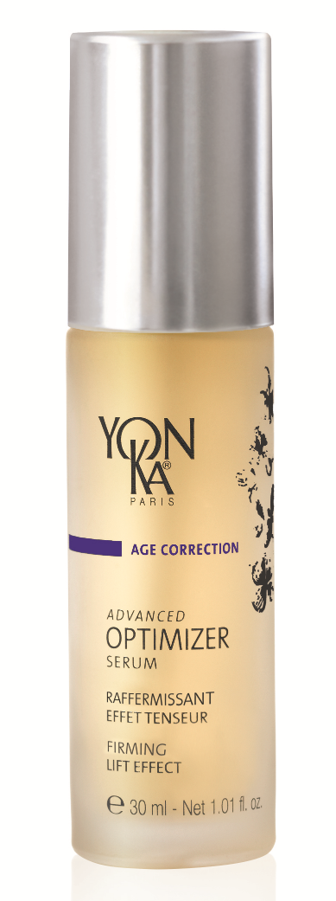
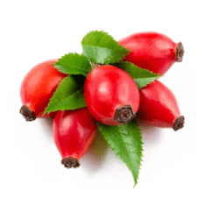


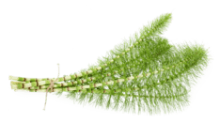
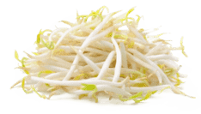
ADVANCED OPTIMIZER SERUM
HIBISCUS PEPTIDES
Stimulate the production of collagen & Glycoaminoglycan
Firming, tightening
HYALURONIC ACID
Smoothing, plumping
WILD-ROSE
Firming
MARINE COLLAGEN
Smoothing, hydrating
HORSETAIL
Firming
SOY PEPTIDES
Restructuring, smoothing
Use :
Morning and/or evening before your usual cream (2 to 3 pumps) on the face and neck
Notes:
Firming/Tensing = Hibiscus peptides
Firming = Wild-rose (Vit C)
Regenerating = Horsetail (rich in silicon)
Smoothing,plumping = hyaluronic acid*
Hydrating/Smoothing = Marine collagen
Restructuring = Soy peptides
- Smoothing and firming effect- Best synergy with the Serum and the Cream- At home: 30-day treatment with the Cream. For a better result, use the Optimizer treatment at the Beauty Salon 1x/week for 1 month and then as a maintenance treatment 1x/month.

Slide 7
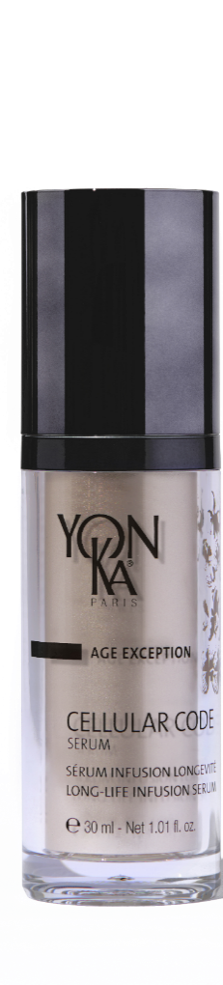
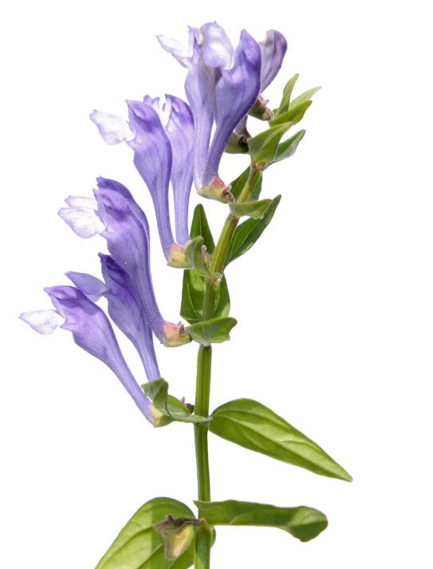
CELLULAR CODE SERUM
The smart serum which reprograms the skin’s youth code
Smoothed wrinkles
Improved firmness
Regenerated and radiant skin
Reduced signs of fatigue
With Cell-Energy complex
Reinforces the potential of defense against aggressions
Multiplication of Langerhans cells: +146 %
Restores harmonious communication between cells and promotes regeneration
Communication between the dermis and the DEJ: +124 %
Its unique Cell-energy complex
96% of Ingredients of Natural Origin
Its fine and silky texture
Its airless pump bottle
30 ml
Notes:
LE CELLULAR CODE SERUM :
DESCRIPTIF
The smart serum which reprograms the skin’s youth code
“Like a real elixir of youth”. This serum helps reactivate the skin's youth code thanks to the "Cell-Energy" complex that fight against skin aging.
This serum energizes and regenerates the skin. Wrinkles are smoothed, firmness are improved, skin is regenerated and radiant, signs of fatigue are reduced.
RESULTATS
It Reinforces the potential of defense against aggressions
Multiplication of Langerhans cells: +146 %
Restores an harmonious communication between cells and promotes regeneration
Communication between the dermis and the EDJ: +124 %
LES + PRODUITS
We love
Its unique Cell-energy complex
Its 96% of ingredients of natural origin
Its fine and silky texture
Its airless pump bottle

Slide 8




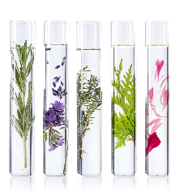



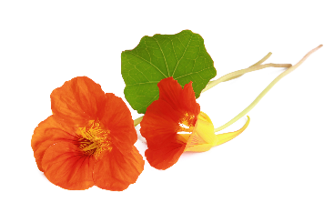




CELLULAR CODE SERUM
Morning and /or evening, after cleansing and spraying with Lotion Yon-Ka, apply the serum (2 to 3 pumps) to the face and neck, before your usual cream
= Cell-energy complex
Lipo-aminoacid
Boosts Cellular longevity / Restores clear communication between cells / Reinforces the defense potential of the skin against assaults
D-Ribose
Cellular energy
Accelerates the synthesis of
ATP (the cell’s energy reserve))
Baicalin
Boosts Cellular longevity
Garden nasturtium extract
Oxygenates skin cells and
improves the radiance of the
complexion
Yon-Ka Quintessence bergamot, citrus fruits, mandarin, rose, tonka bean, guaiac wood
Vitalizing - Energizing
Notes:
At home :
Morning and /or evening, after cleansing and spraying with Lotion Yon-Ka, apply the serum (2 to 3 pumps) to the face and neck, before your usual cream
Ingrédients
Lipo-aminoacid : Boosts Cellular longevity / Restores clear communication between cells / Reinforces the defense potential of the skin against assaults
(alanine-based, an amino acid derived from biotechnology)
D-ribose : Cellular energy - Accelerates the synthesis of ATP (the cell’s energy reserve) (natural complex sugar derived from corn)
Baicalin : Boosts cellular longevity
(a polyphenol extracted from Scutellaria Baicalensis root)
Garden nastturtium extract : Oxygenates skin cells and improves the radiance of the complexion
these four ingredients together form the cell energy complex
We also have the Yon-Ka Quintessence with essentials oils of bergamot, citrus fruits, mandarin, rose, tonka bean and guaiac wood to Vitalizes and Energizes

Slide 9
ELIXIR VITAL
Nourishing repairing Elixir
Restructuring and hydrating
Nourishing and repairing
Soothing and revitalizing
Rebalancing
After 4 weeks of use morning and night
Revitalized skin (88%)
Soothed and nourished (83%)
Comfortable and hydrated (92%)
Smoothed (83%)
92% of ingredients of natural origin with 43% of organic ingredients
Phyto-aromatic dual-phase serum (alone or under the usual care)
Notes:
The phyto-aromatic dual-phase serum - Preventative & Reparative Anti-aging
• Exclusive phyto-aromatic formulation
with 19 amino-acids
• Pioneer of biomimetic formula
• 92% ingredients of natural origin including
43% organic ingredients
• Vegan and gluten-free formula
In addition to its strong naturalness, the visible clinical effectiveness of Elixir Vital is no longer to be proven!
In fact, after 4 weeks of use morning and night, the panelists found their skin
more revitalized at 88%,
soothed and nourished at 83%,
comfortable and hydrated at 92%
and smoothed at 83%.
These results highlight the ability of Elixir Vital to recreate the hydrolipidic film in a biomimetic way but also its action on skin aging.
*Self-assessment – Clinical study with 24 women ages 35 to 67 with dry to very dry dehydrated, fatigued, lifeless skin lacking tone, at a rate of two applications per day for four weeks.

Slide 10
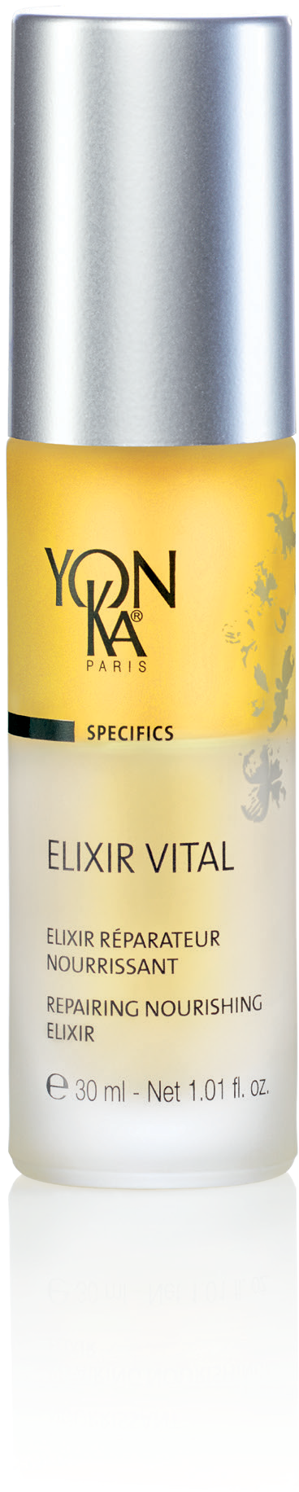


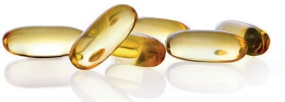

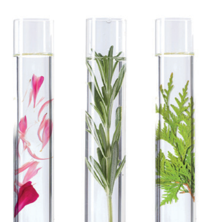

ELIXIR VITAL
Anti-aging Prevention & Repair
PREVENTATIVE
Organic beech buds peptides
Soy peptides
Rich in amino acids
All skins
Restructuring and hydrating
In anticipation all year round
Morning or evening
Organic soy and sunflower oil,
non-GMO corn oil
Rich in omegas 3,6,9
Nourishing and repairing
REPARATIVE
Niacinamide / Vitamin B5
Soothing and revitalizing
Tired skins
Damaged skins
Stressed skins
Yon-Ka Quintessence
One month intensive treatment
Morning and evening
Rebalancing and intensifies the power of the formula
Notes:
The main active ingredients of Vital Elixir are organic beech buds peptides and soy peptides. These active ingredients are rich in amino acids and have restructuring and moisturizing properties.
The Elixir Vital is also composed of a mixture of vegetable oils such as organic soy and sunflower oil, non GMO corn oil with nourishing and repairing properties. These vegetable oils recreate the oily phase of the hydrolipidic film. They are rich in omegas 3,6,9 which are essential to our body and which will prevent skin aging. As a reminder, we do not synthesize omegas, so it is very important to provide them through cosmetics, food (oily fish, oilseeds...) and food supplements.
The Elixir Vital is also composed of Niacinamide (also called Vitamin B3 or Vitamin PP) Naturally synthesized by the human body, it plays a role in all our organs. It stimulates the production of ceramides (the lipids that form the cement between the cells of the epidermis), the skin is thus stronger, less permeable to external irritating agents. Associated with vitamin B5, they are thus recognized for their soothing and revitalizing virtues.
Finally, we find our olfactory imprint, our DNA that makes us unique, the Quintessence. Recognized for its rebalancing and calming virtues, it also potentiates and multiplies the power of our formula.
Who is Elixir Vital for?
As a preventive measure, Elixir Vital is intended for all skin types, all year round, morning or evening. The objective is to maintain the skin in good health.
In repair, the Elixir Vital is ideal in intensive treatment morning and evening for :
Tired skin, for example post pregnancy, illness, night working, at the change of season
Stressed skin: after a mechanical and/or climatic stress (sun, cold...)
Damaged skin: In pre-post operative treatment, post acne treatment, post-peeling...
in prevention it will moisturize and nourish the skin by recreating the hydrolipidic film and also revitalize the skin. In this case, it will be used in prevention all year long, morning or evening. A bit like a food supplement, we treat the skin upstream in order to maintain its health and avoid the appearance of imbalance.
In repair, it will regenerate, soothe and smooth the skin. In this case, it will be used as an intensive treatment for one month, morning and night, to address a specific problem. Once this SOS treatment is complete, the client can switch back to his usual serum or stop using a serum.

Slide 11
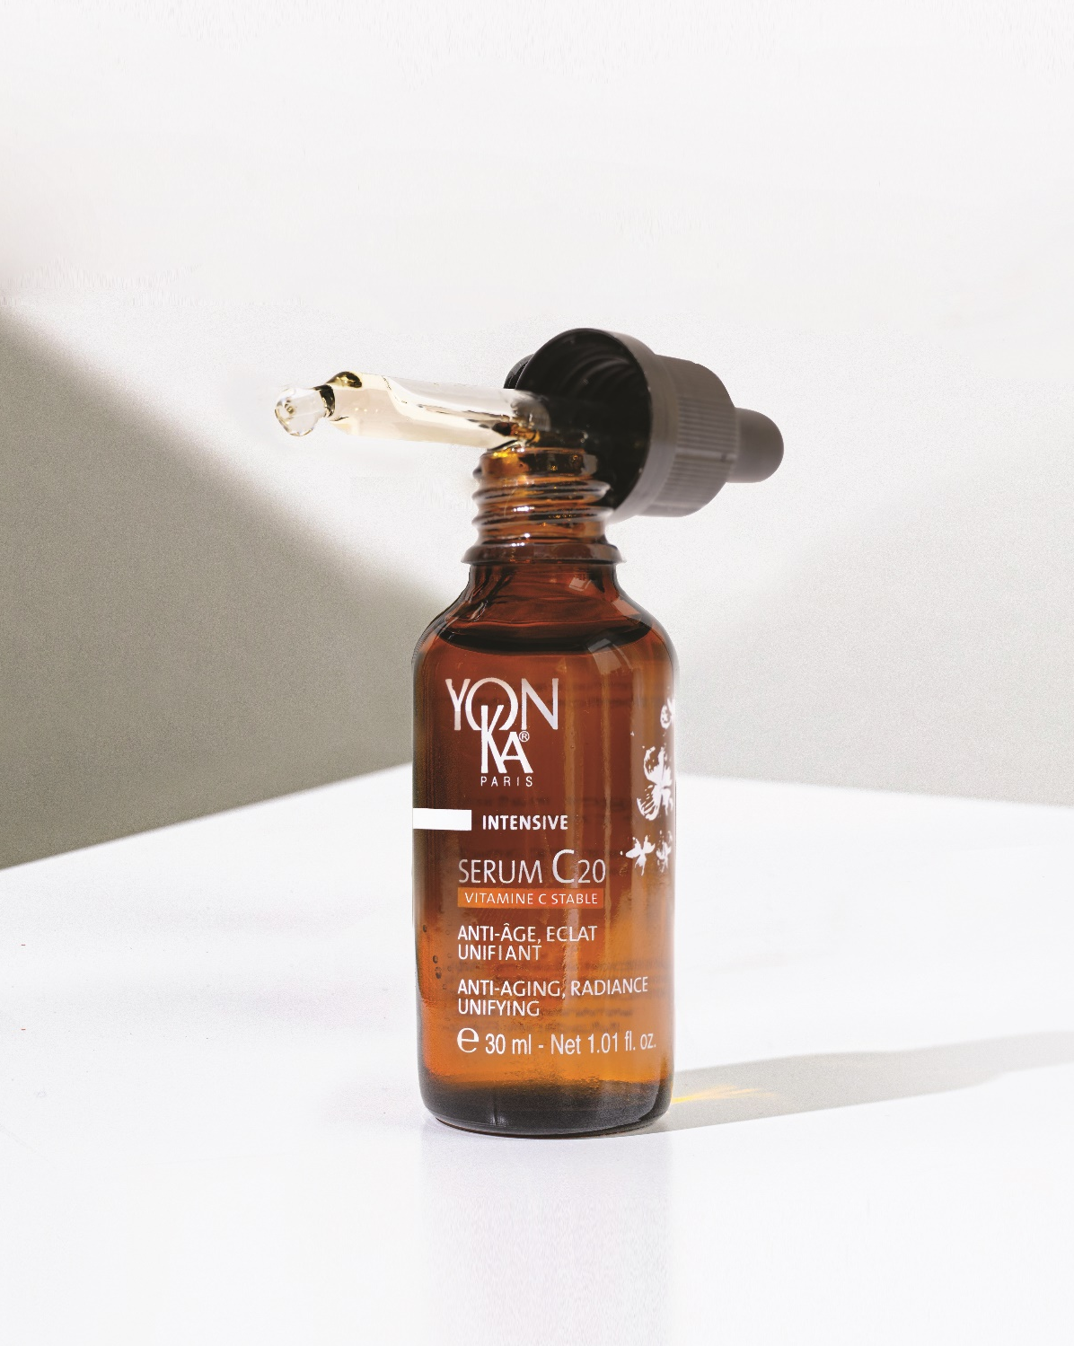
SERUM C20
Efficiency and sensoriality with 20% of stable vitamin C
Anti-aging
Radiance
Anti dark spot
After 5 days :
Measurable and visible efficacy on complexion radiance and even skin tone
After 14 days :
Wrinkle volume is reduced and skin is visibly smoother
After 28 days :
Features are smoothed1, skin is visibly younger and springier, the color of dark spots is less intense2
After 56 days :
The anti-dark spot effectiveness is intensified
99,9% ingredients of natural origin
Stable Vitamin C new generation
Oleo-serum with a non-greasy satin finish
Notes:
From 5 days :
Measured* and visible* effectiveness on the radiance and evenness of the complexion:
Nearly 9 out of 10 women: convinced by the radiance effect and the healthy glow action**.
100% of women: have adopted the product**' & wish to continue using it**'.
After 14 days :
Wrinkle volume is reduced*** Skin is visibly smoother:
Nearly 9 out of 10 women: skin quality is better, more beautiful*** 100% of women: find that skin is visibly smoother.
100% of women: find that the skin is awakened, more luminous and the complexion is radiant**.
After 28 days:
The features are smoothed*, the skin is visibly younger and plumper, the colour of spots is less intense**:
+58% more even skin tone***.
+18% improvement in skin tone***.
-30% reduction in wrinkle depth***.
Tests carried out on 21 women - Application morning and evening. *Scoring for complexion radiance and chromametric analysis for complexion homogeneity - **Self-assessment - **'the product is easily integrated into the skin care routine.***Instrumental measurements
The + :
Formulated with 99.9% ingredient of natural origin, this new-generation sensorial serum is incredibly effective
This new generation of stable vitamin C is fat-soluble for improved bio-assimilation

Slide 12
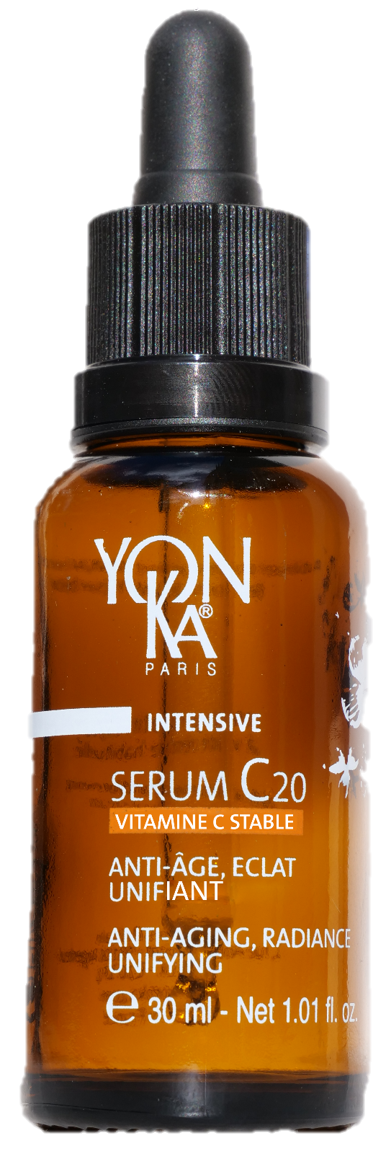


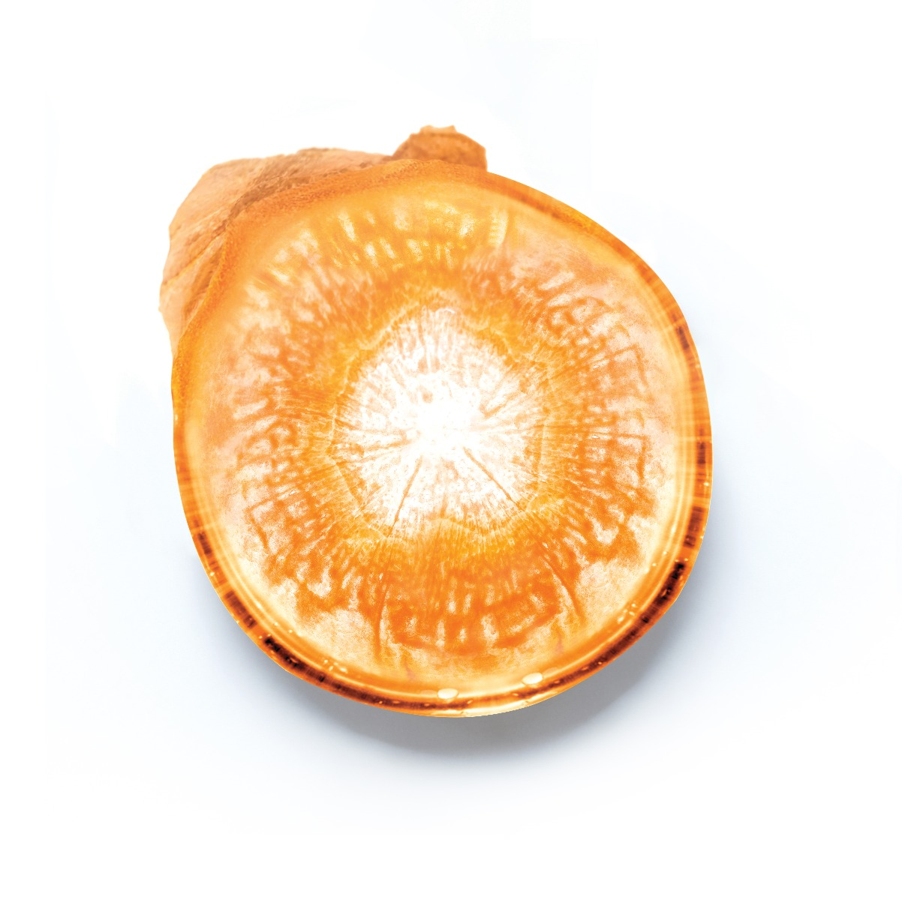
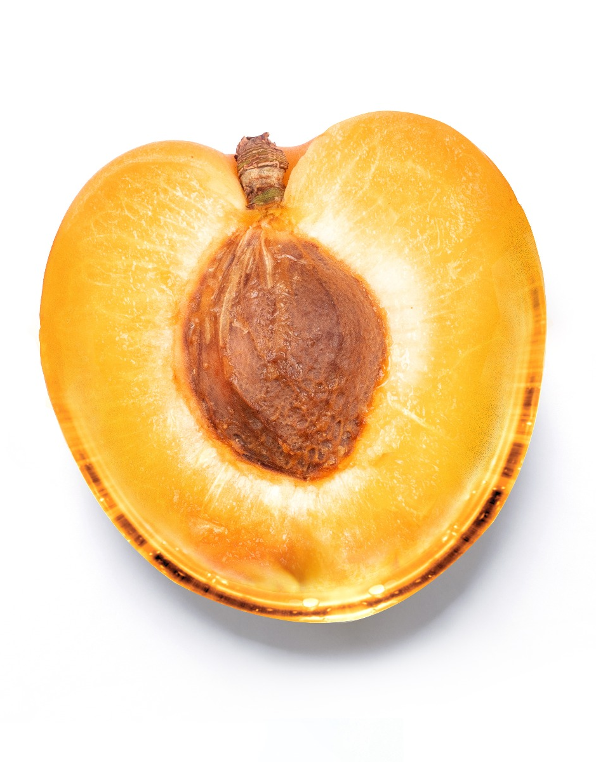
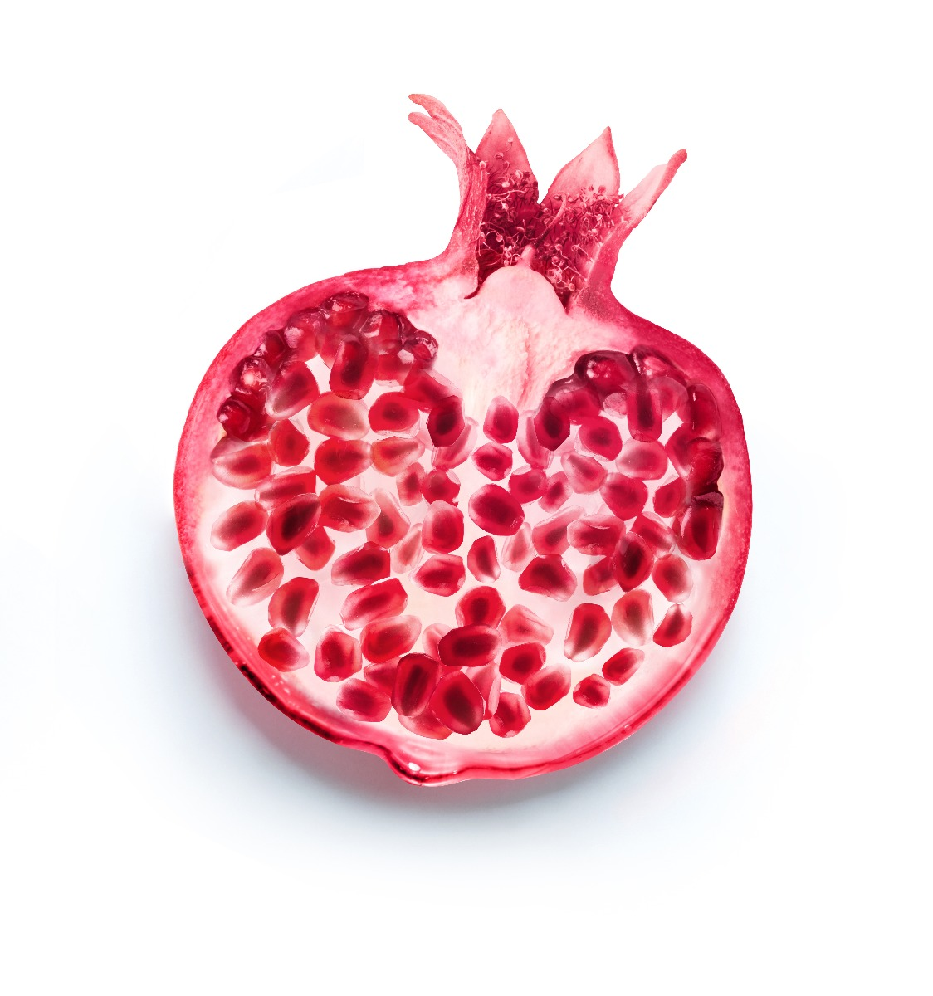
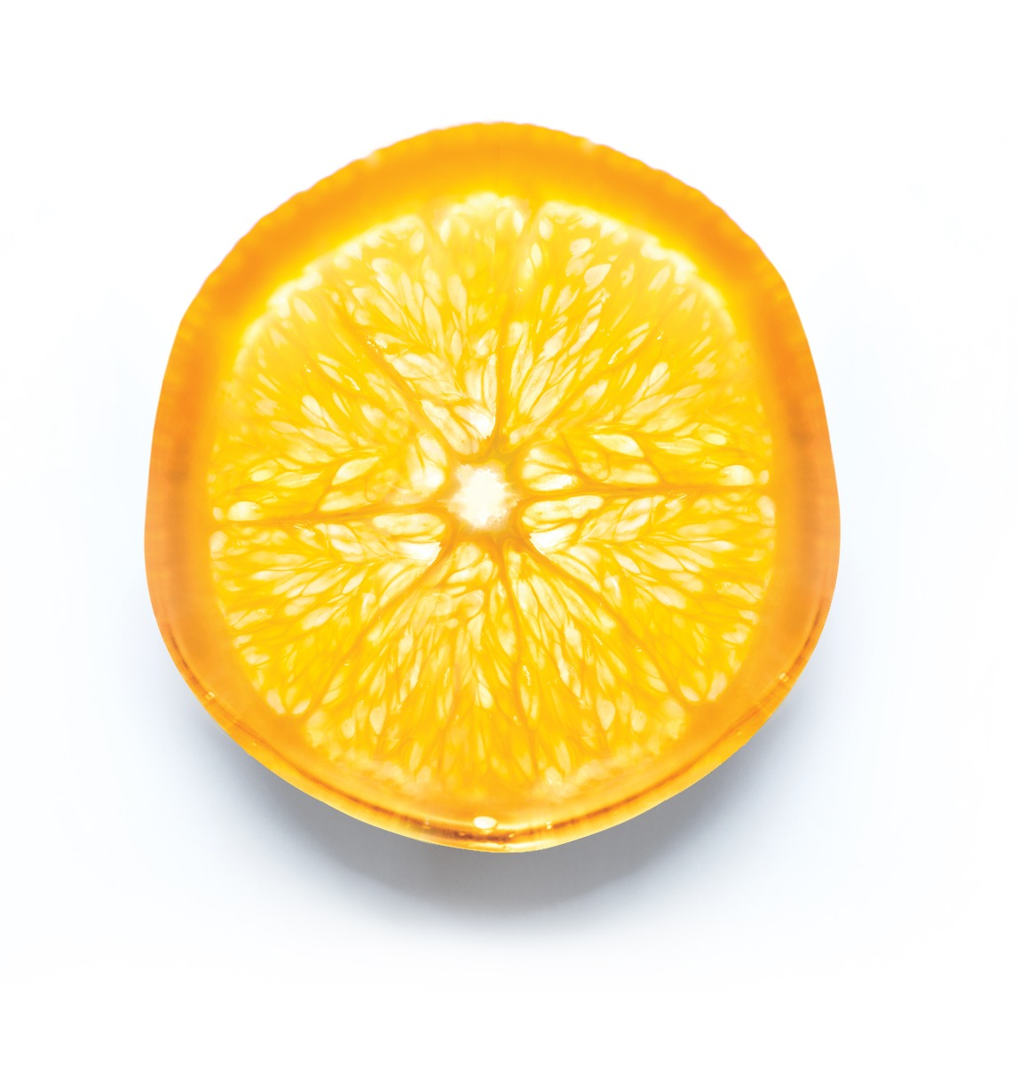
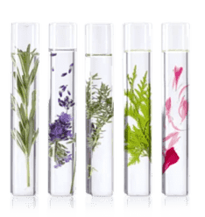
SERUM C20
All skin types
even sensitive
All year long
Or in a cure
20% of stable vitamin C
Anti-aging, Anti-oxidant,
Acts on melanogenesis
Turmeric native cells
Anti-aging, Anti-oxidant
Organic Apricot oil
Rich in Vitamin A
Acts on radiance
Pomegranate native cells
Radiance, Anti-oxidant
Sweet Orange essential oil
Acts on skin tonicity
Yon-Ka Quintessence
Potentiates the formula power
Notes:
20% of stable vitamin C :
100% natural origin, this stable form of vitamin C concentrates all the power and effectiveness of vitamin C without its disadvantages:
Ultra-stable to light, heat, air (the vitamin C molecule is stabilized 4 times), its power is guaranteed throughout its use.
Non-acidic and therefore better tolerated, it is biocompatible with all skin types (dermatologically tested on all skin types, even sensitive skin. Good tolerance).
Liposoluble for a bio-assimilation and a penetration optimized
Tumeric ; Stimulating action on epidermis and dermis
Help the skin to be firmer and more elastic.
It completes the protective
and anti-aging action of vitamin C.
Pomegranate : Action on cellular oxygenation and melanogenesis
Help the skin to be more luminous and more uniform.
They reinforce the radiance and
anti-dark spot action of Vitamin C
Organic apricot oil :
extracted from the kernel is composed mainly of Omega 9 and Omega 6, known for their nourishing, softening and smoothing properties.
This organic apricot oil is also rich in vitamins A and E (photo-protective, anti-oxidant), phytosterols (restoration of the barrier function, UV protection, anti-aging skin). Endowed with a "complexion illuminating" power (healthy glow effect), it is therefore particularly recommended in toning treatment formulas intended for dull, devitalized and dehydrated skin. Its rapid penetration, without leaving an oily feel, is suitable for all skin types, even oily and combination.

Slide 13
LET’S PLAY!
Notes:
FORMATION

Slide 14
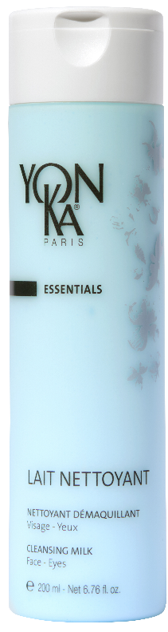
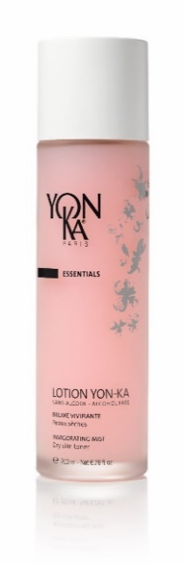
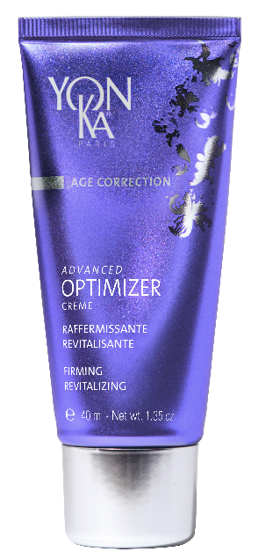
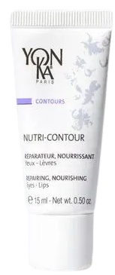
"Your client has dry skin and wants to tone and firm her skin”
WHICH BEAUTY ROUTINE TO RECOMMEND ?
ADVANCED
OPTIMIZER SERUM
1
2
3
4
I cleanse
I prepare
I treat
I protect

Slide 15
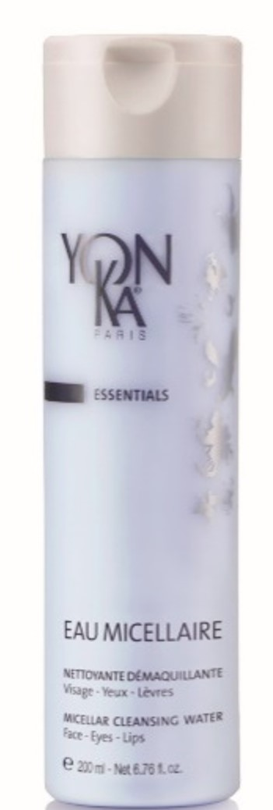
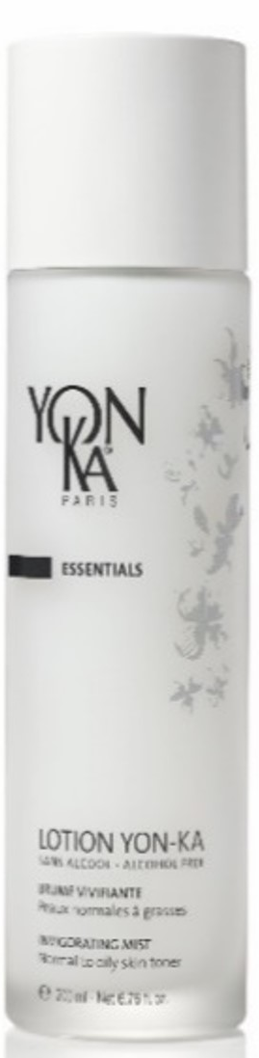
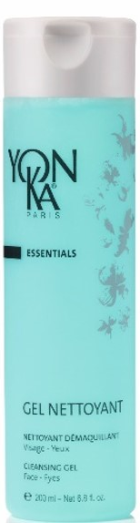
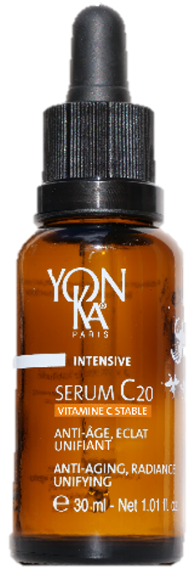
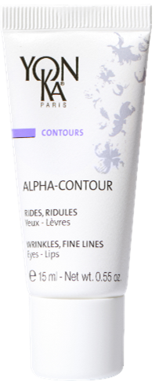
"Your client has combination skin and wishes to treat the signs of aging, unify and give radiance to her skin.”
WHICH BEAUTY ROUTINE TO RECOMMEND ?
SERUM C20
1
2
3
I cleanse
I prepare
I treat

Slide 16

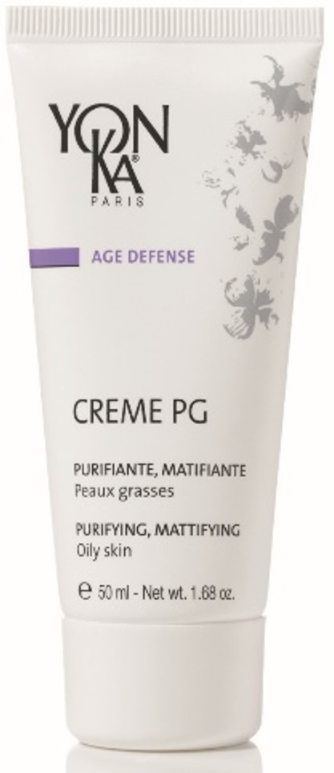
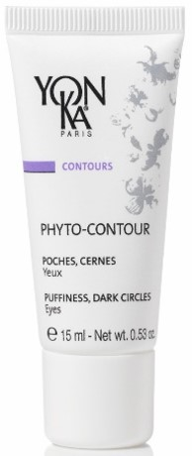
"Your client has oily, damaged skin and wants to revitalize, repair and hydrate her skin".
WHICH BEAUTY ROUTINE TO RECOMMEND ?
ELIXIR VITAL
1
2
3
4
I cleanse
I prepare
I treat
I protect

Slide 17
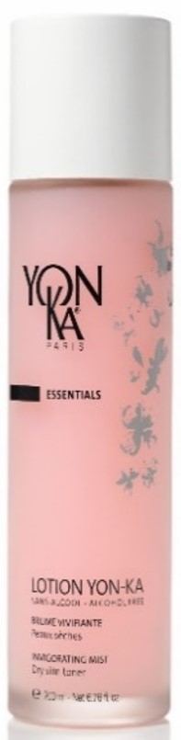
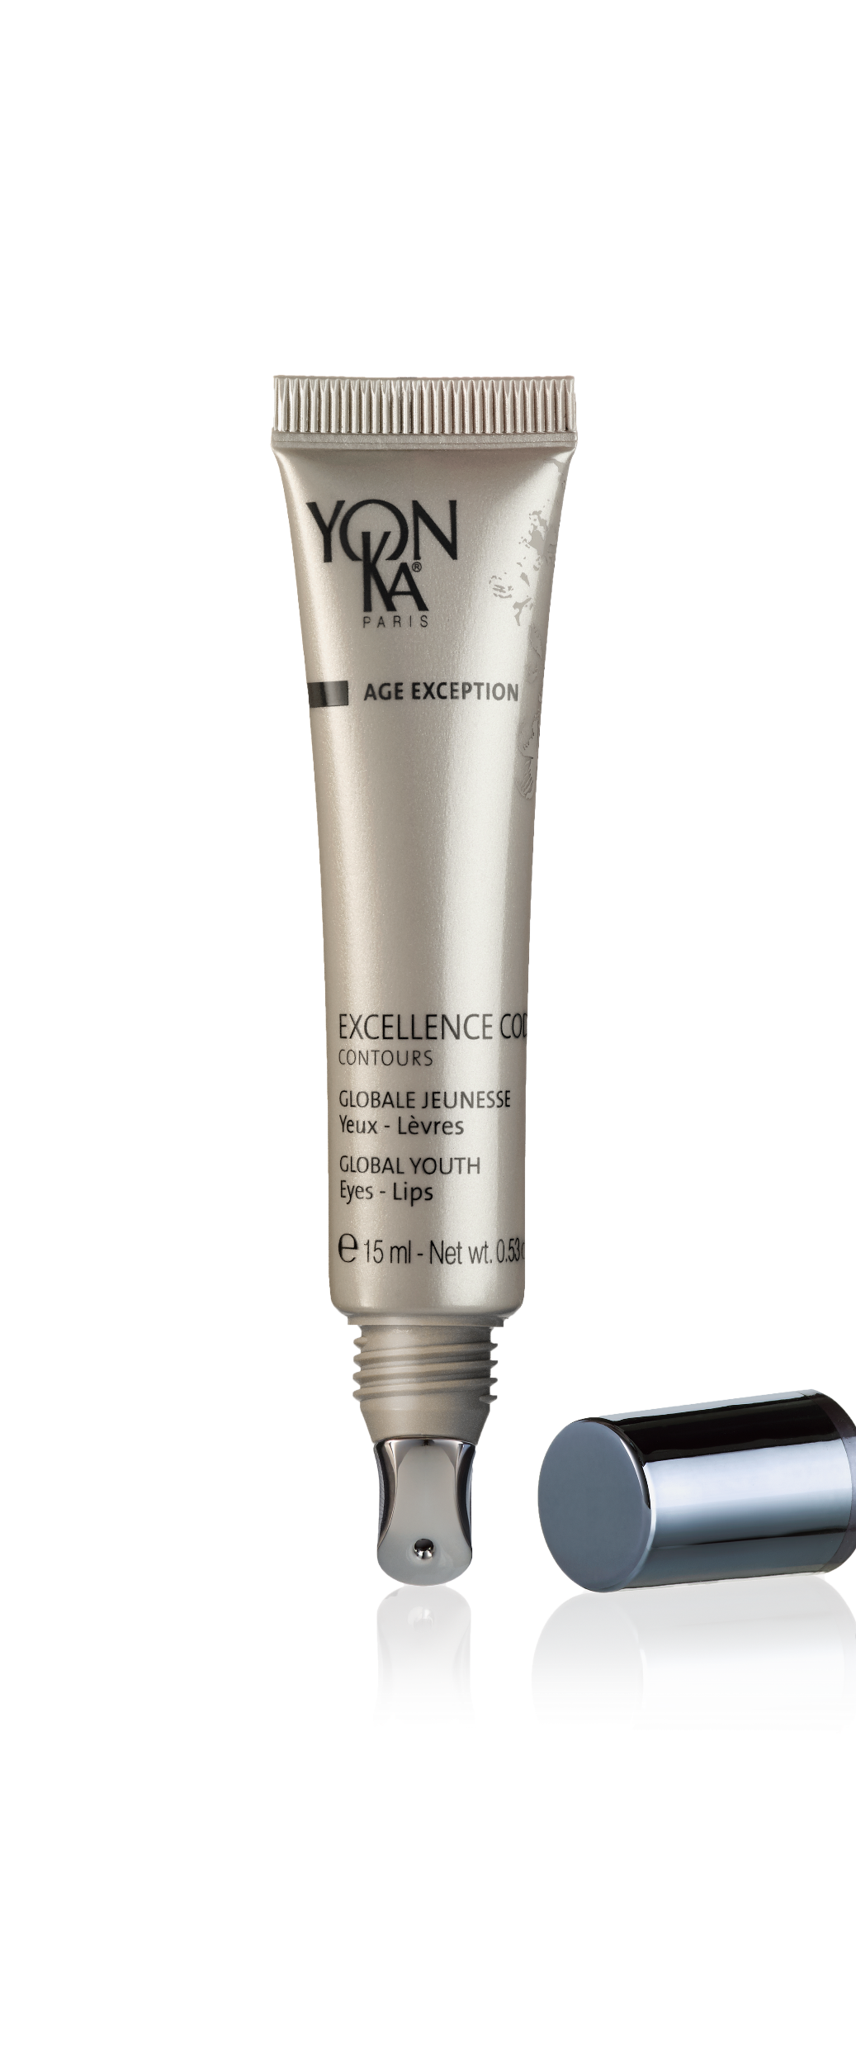

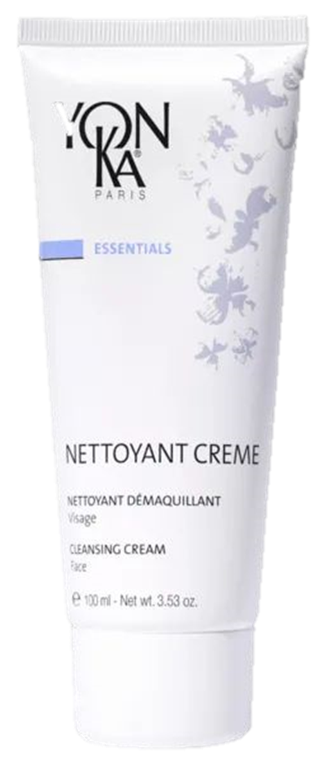

"Your client has a mature skin and wants to treat all the signs of aging.”
WHICH BEAUTY ROUTINE TO RECOMMEND ?
CELLULAR CODE
1
2
3
4
I cleanse
I prepare
I treat
I protect

Slide 18

Commercial offer

Slide 19
SPARTED
Play Everyday
Notes:
FORMATION

Slide 20
MAGIC CODE:
RDVSERUMEN
Notes:
The app is also available on computer on the link below :
https://yonka.sparted.com/app
Create an account, add your family name, first name, email and passeword
Enter the magic code YK1954
Click on start and choose your segmentation
Let’s play and don’t forget to activate your notifications.

Slide 21
THANK YOU !
Notes:
FORMATION

