Slide 1
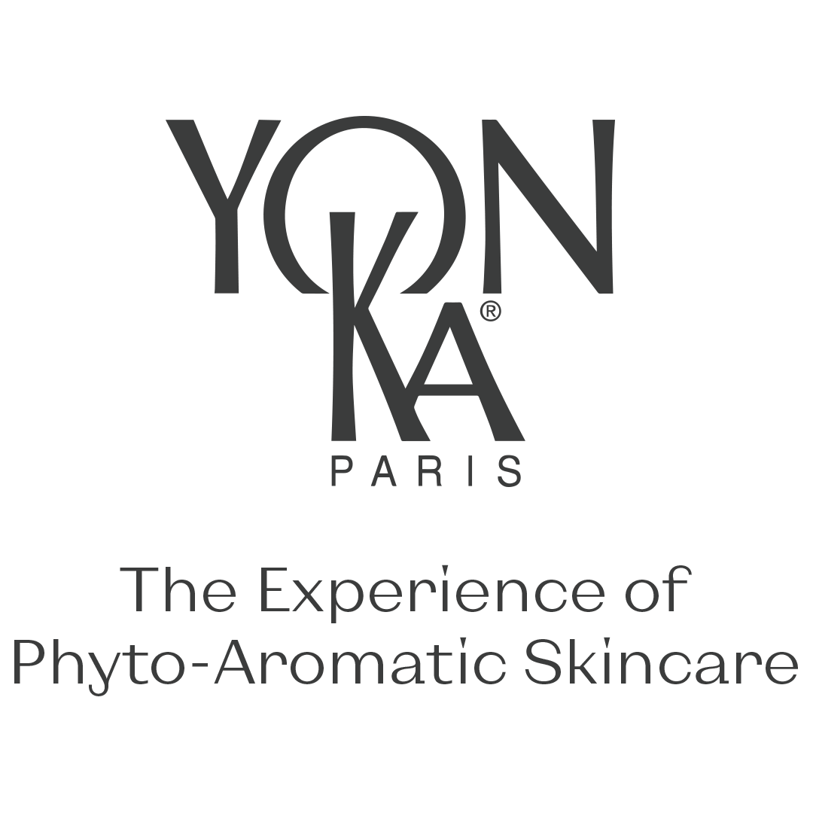

Slide 2
Fresh skin

Slide 3
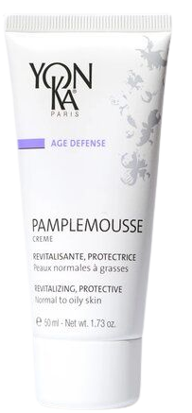

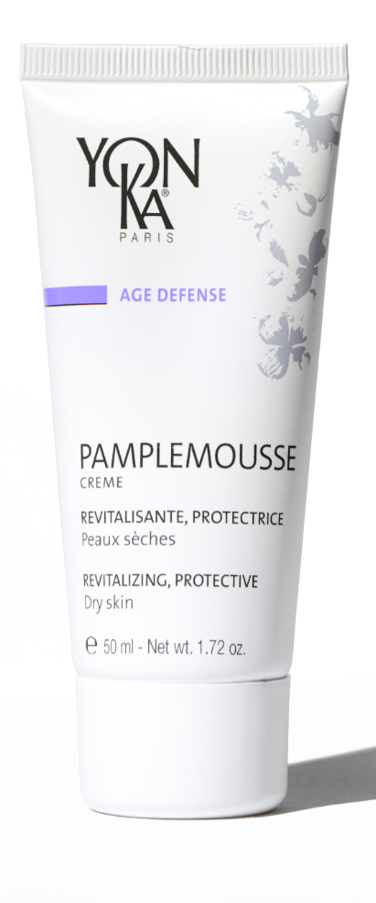

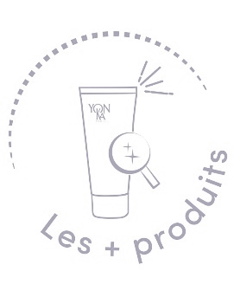
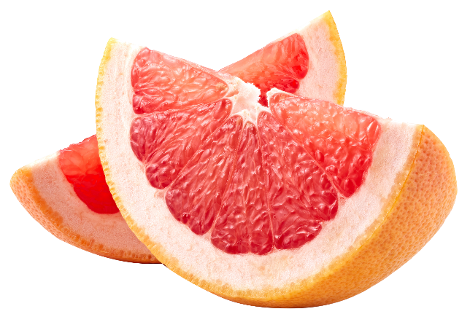
With essential oils of grapefruit, lime, sweet orange, lemon
PAMPLEMOUSSE PS/PNG
Revitalizing creams and radiance booster
Energizes skin lacking radiance
Nourishes and protects the skin against daily aggressions
The skin is supple, radiant and comfortable
Refines skin texture and tightens pores (PNG formula)
Nourished and comfortable skin: 76%* (PS formula)
Luminous complexion: 70%** (PNG formula)
Invigorating 100% natural citrus fragrance
Light and melting texture
50 ml
*Self-evaluation - Clinical study with 21 women aged 30 to 60, all with dry skin. Application twice a day for 4 weeks of the PS formula
** Self-assessment - Clinical study with 20 women aged 30 to 61, all with oily combination skin. Application twice a day for 4 weeks of the PNG formula
Morning & evening
Notes:
PAMPLEMOUSSE PS/PNG
Description
Pamplemousse is the best radiance cream for the face. Rich in vitamin C and essential citrus oils, it brightens the complexion and revitalizes the skin. Enriched with fruit extracts, olive oil and pumpkin seed oil, this anti-oxidant vitality treatment brings freshness, suppleness and comfort to the skin. The skin is unified, matified, nourished and comfortable. We like its light and melting texture with an invigorating 100% natural citrus fragrance.
Promise
Revitalizing cream, radiance booster
For whom?
All skin types
Dull, asphyxiated complexion
Smoker
« I have a dull skin and uneven complexion
"I am tired and have large pores
Home use
In the morning and/or evening, remove make-up/clean face and neck and mist with Yon-Ka Lotion. Then apply the appropriate grapefruit cream.
Use in the treatment room
- Face, neck and décolleté massage
End of treatment cream
Product advantages
Contains 97% natural ingredients (PS formula) and 98% natural ingredients (PNG formula)
Nourishes and protects the skin against daily aggressions
The skin is supple, radiant and comfortable
Refines skin texture and tightens pores (PNG formula)
Energizes skin lacking radiance through the action of vitamin C
Nourished and comfortable skin: 76%* (Self-assessment - Clinical study with 21 women aged 30 to 60, all with dry skin. Application twice a day for 4 weeks of the PS formula)
Luminous complexion: 70%** (Self-assessment - Clinical study with 20 women aged 30 to 61, all with oily combination skin. Application twice a day for 4 weeks of the PNG formula)

Slide 4
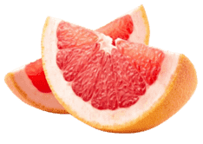
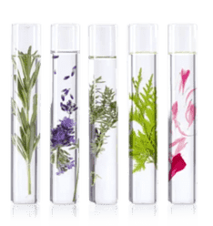
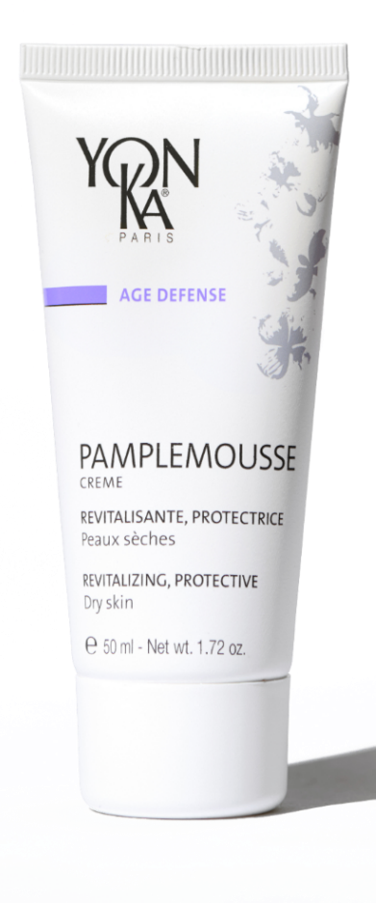

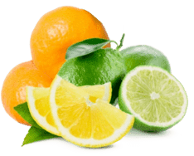

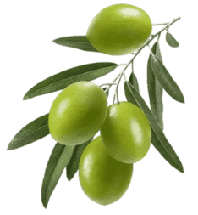


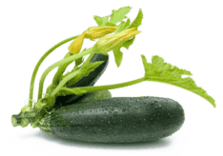
PAMPLEMOUSSE PS/PNG
Grapefruit extract and essential oil
Revitalising
Radiance booster
Quintessence YON-KA
Revitalising
Renewing
Balancing,,,
Without artificial fragrances
Without Alcohol
Citrus essential oil
Revitalising
Astringent
Organic extra virgin oil
Protecting
Nourishing
Without Parabens
Organic virgin pumpkin seed oil
Nourishing
Protecting
Vitamin C
Antioxidant
Notes:
Ingredients
Citrus E.O. = vitalizing
Vit C = brightness
Nourishing = olive oil - pumpkin seed oil
The difference between PS and PNG (PS: higher oil phase with olive oil, pumpkin seed oil and
PNG: higher concentration of HE)

Slide 5
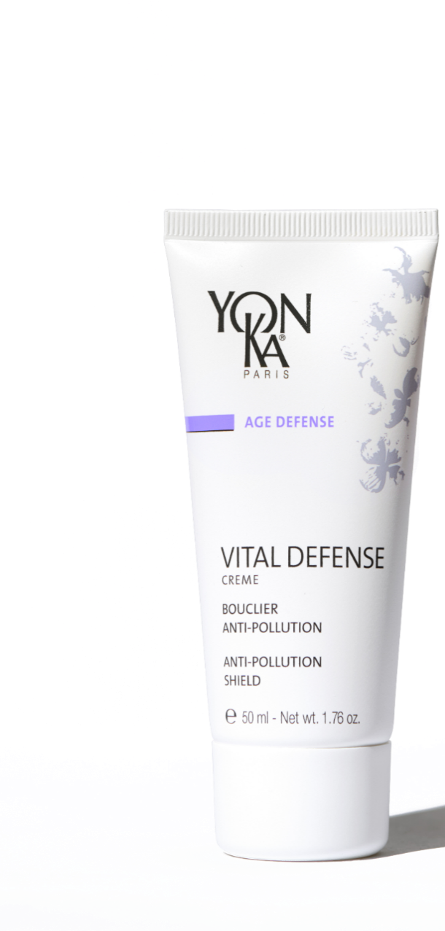
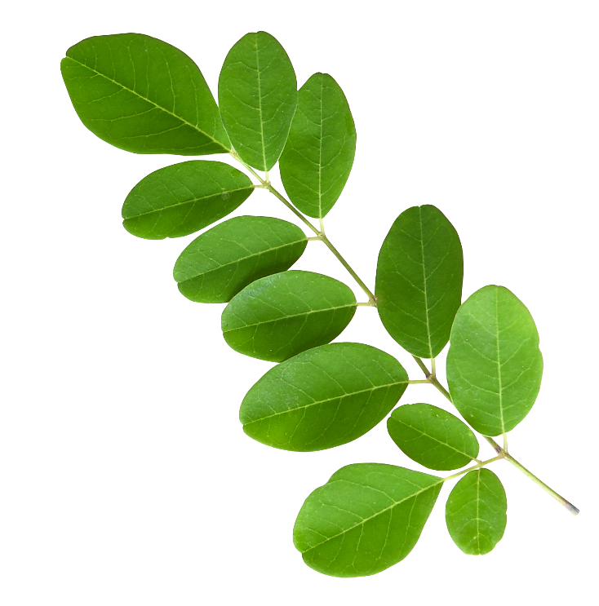
VITAL DEFENSE
Anti-pollution and anti-oxidant shield - Ideal for city dwellers
Fight against oxidative stress
Preserves youthfulness
Hydrates the skin
The skin regains its radiance, softness and vitality
The skin breathes, is oxygenated and protected: 89%*
50 ml
100% natural citrus and magnolia scent
Ideal for smokers and people working outdoors
*Use test, application on face and neck for 4 consecutive weeks by 18 women aged 26 to 32 years with dull, weakened skin and a blurred complexion.
Morning
Notes:
VITAL DEFENSE
Description
Vital Defense is the ultimate anti-pollution shield. This day cream for all skin types is particularly suitable for city dwellers exposed to daily environmental pollution: tobacco, dust, fine particles, .... Thanks to its moringa extracts and anti-oxidant ingredients such as organic myrtle, co-enzyme Q10, vitamins C and E, it helps the skin to fight against oxidative stress and preserve its youthfulness. Intensely moisturized and revitalized, the skin regains its radiance, softness and vitality.
We like its melting texture, its pleasant scent of sweet orange, mandarin and magnolia 100% natural.
Promise
Anti-pollution and anti-oxidant shield cream
For whom?
All skin types
Ideal for urban environments
People working outdoors
"My skin is exposed all day long, I'm looking for a cream that protects me.
"My first wrinkles are starting to appear"
"I live in Paris, my skin is very exposed to pollution
Home use
In the morning, after cleansing and misting with Yon-Ka Lotion, apply Vital Defense cream to the face and neck.
Use in the treatment room
- Face, neck and décolleté massage
End of treatment cream
Tips
Depending on your skin's needs, combine this cream with 1 to 2 pumps of one of the following boosters: Hydra + to moisturize, Nutri + to nourish and regenerate, Lift + to firm, Defense + to fight against environmental aggressions.
Product advantages
Contains moringa peptides and organic myrtle
Nourishes, protects and moisturizes
The skin is radiant
A real anti-pollution shield

Slide 6
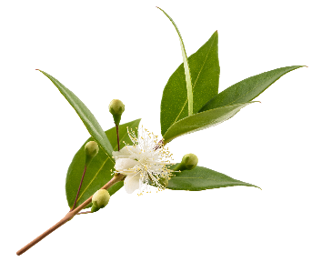

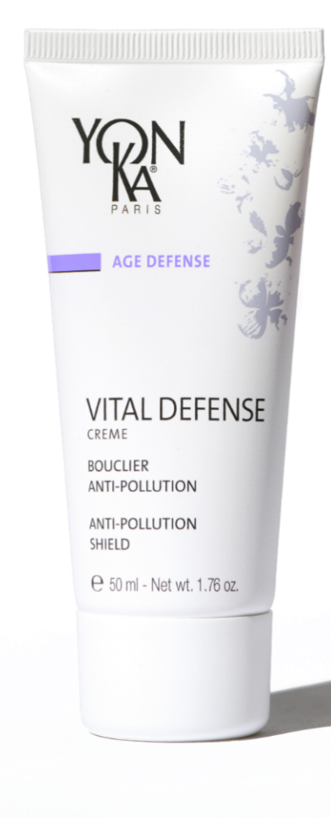
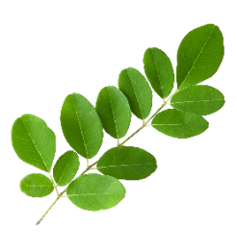
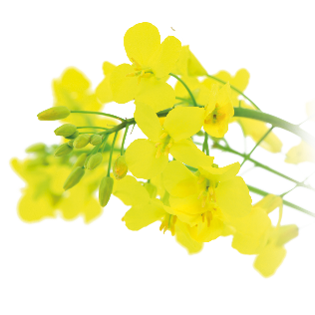
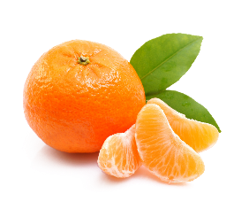
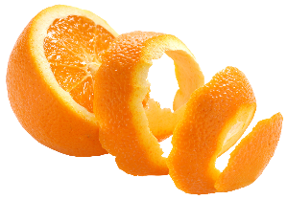
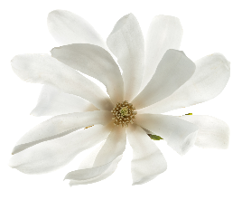

VITAL DÉFENSE
Organic myrtle
Antioxidant
Strengthens the skin's natural self-defence system
Vitamins A, C, E
Antioxidant
Regenerating
Without artificial fragrances
Without Alcohol
Vegetable glycerine
Hydrating
Softening
Moringa peptides
Anti pollution
Without Parabens
Olive phytosqualane
Hydrating
Repairing
Sweet orange,
Magnolia, Mandarin essential oils
Revitalising
Co-enzyme Q10
Antioxidant
Notes:
INGREDIENTS
Organic Myrtle: Anti oxydant - Limits the propagation of Free Radicals / Reinforces the skin's natural self-defense system
Moringa: Anti Pollution. Protects the epidermis against polluting aggressions. Purifies the skin by eliminating the asphyxiating micro-particles produced by the environment.
Coenzyme Q10: Powerful antioxidant. Protects the skin from the harmful effects of free radicals
Vitamin A: Regenerating, promotes cell renewal
Vitamin C: Protective, anti-oxidant, known to induce collagen production
Vitamin E: Powerful antioxidants. Protects the skin from the harmful effects of free radicals
Vegetable glycerin, serine, urea: Moisturizing
EO Magnolia, sweet orange, mandarin: vitalizing
Thanks to its active ingredients, Vital Defense helps the skin to fight against oxidative stress and preserves its youthfulness.
Intensely hydrated and revitalized, the skin regains its radiance, softness and vitality.
The Common Myrtle (Myrtus communis) is a bushy shrub cultivated around the Mediterranean basin of about 3-4 meters in height. It is a very fragrant shrub, whether it is the leaves, the white flowers, or the small berries.
Its leaves are small (2-5 cm long, oval, glazed, dark green) and persistent.
The flowers of the myrtle are white, and appear in spring. They are very fragrant.
The fruits are ellipsoidal oblong berries, purple-black in color, 1/2 to 1 cm in diameter. The organic myrtle extract used in VITAL DEFENSE comes from the leaf.
The Moringa oleifera is an exotic tree that reaches between 5-10 m in height, also called in Africa "Nebeday", the tree that never dies.
Native to India, it grows in tropical and subtropical regions in Africa and Asia. Its tuberous root allows it to go without water for several months.
It produces white flowers that give fruits resembling long pods, containing 7 to 20 spherical seeds.
The Moringa peptides used in VITAL DEFENSE come from the seeds.

Slide 7
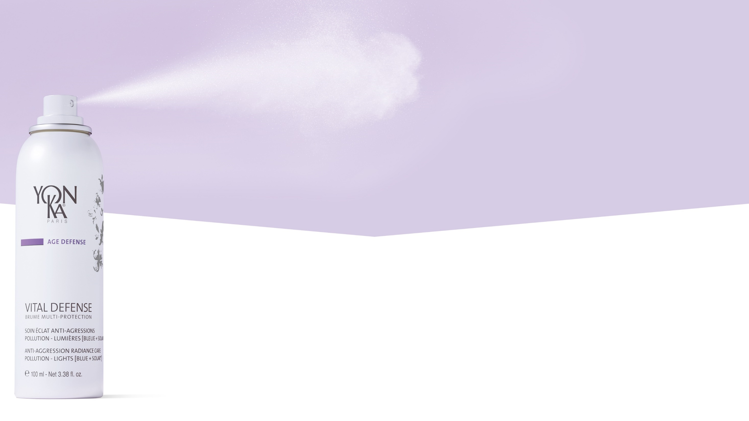
Vital Defense
multi-protection mist
ANTI-AGRESSIONS RADIANCE CARE
POLLUTION – LIGHTS [BLUE + SOLAR*]
*Does not contain sunscreen
Notes:
To satisfy this growing need for protection against external aggression and to help our skin
Yon-Ka has developed a real protective bubble,
The VITAL DEFENSE MULTI-PROTECTION MIST
A treatment capable of creating the perfect anti-aggression radiance shield in a few seconds.
With this product, Yon-Ka extends its VITAL DEFENSE range (which already includes a cream).

Slide 8
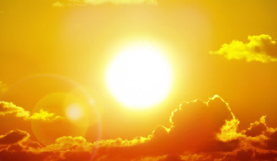

Multi protection against:
Pollution, UV, Blue light
UV, IR
Solar radiation
UV / IR / Blue light
+
Artificial light rays
6h per day exposure to
artificial blue light*
RADIATION
Blue light
Skin continuously exposed to many types of aggressions
Notes:
In addition to pollution, there are other insidious/invisible factors that are : the light radiation
2 different types : Solar radiation and artificial light rays
Depending on their wavelength, they are called UV, infrared and blue light.
The second the artificial light :we are exposed to an average of 6 hours/day of artificial blue light,
Polluted air combined to light radiation we can say that the damage on skin is cumulative!

Slide 9
The different types of solar radiations
UV : 2 types
UVB: Responsible for sunburn and many skin cancers.
UVA: Penetrate deeper into the dermis, responsible for skin aging (pigment spots, wrinkles), and in the long run skin cancers.
UV
HEV/ Blue light:
Responsible for half of the production of free radicals and 25% of cellular damage. Painless, it amplifies accelerated skin aging.
Blue light
IR
IR :
Create heat. They intensify the damaging effects of UV and HEV. Produce free radicals that alter the functioning of the mitochondria (the cells' energy centers) and fibroblasts (loss of firmness)
Notes:
The luminous radiation (solar) which arrives on earth is made up of 3 great categories of rays: UV (Ultraviolet), HEV (High Visible Energy) of which 1/3 is represented by the blue light and IR (Infra-red).
UV represents 5 to 10% of solar radiation
About 45% for the HEV
About 45% for the IR
UV
2 types of UV arrive on earth, UVB and UVA (There is a 3rd category, UVC, which stopped by the ozone layer do not reach the surface of the globe).
The HEV (High Visible Energy) / Blue Light
Responsible for half of the production of free radicals and 25% of cellular damage (alters the structure of epidermal cells and fibroblasts, decreases the production of collagen and elastin, and increases the production and activation of tyrosinase responsible for the appearance of long-lasting spots). Painless, it amplifies accelerated skin aging.
IR
Create heat. They aggravate the harmful effects of UV and HEV. Produce free radicals that alter the functioning of the mitochondria (the cells' energy centers) and fibroblasts (loss of firmness)

Slide 10
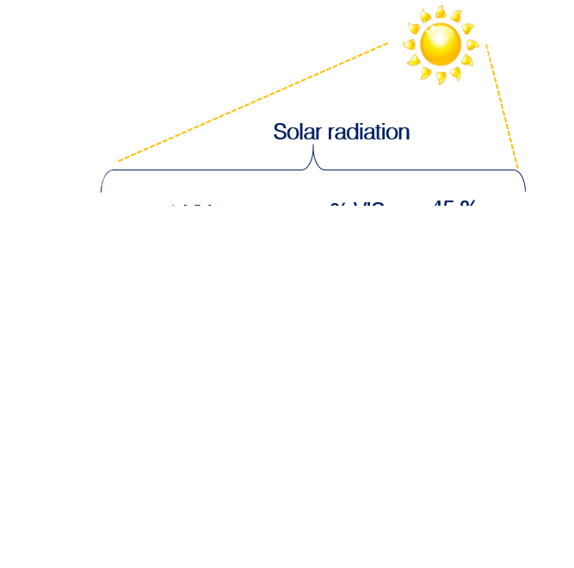
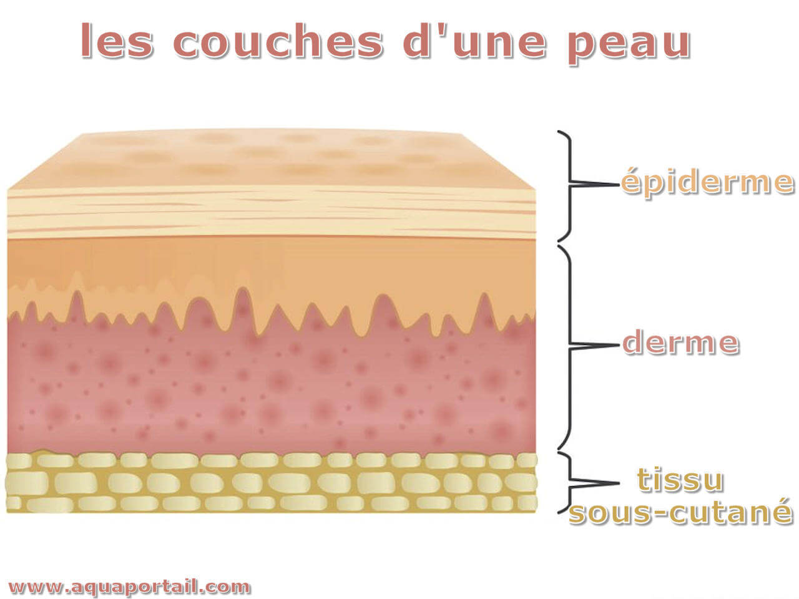
The different types of solar radiations
SOLAR RADIATION
UV
HEV
IR
UVB
UVA
VISIBLE
LIGHT
INFRAREDS
RAYS
Sunburn, burns
Skin cancers
Skin aging, wrinkles
Skin cancers
Production of free radicals,
cellular damage
Heat stroke
Increase in the deleterious effects of UV
NEGATIVE EFFECTS
EPIDERMIS
DERMIS
HYPODERMIS
Notes:
We are subjected to light rays every day of the year. They affect us all day long, even on cloudy days, even through windows.
UV:
UVB represent 10% of UV rays. They are responsible for sunburns, burns, blisters and many skin cancers.
90% of UV rays are UVA. They penetrate deeper into the dermis, and are responsible for pigment spots, skin aging, wrinkles, and over time skin cancers.
HEV / Blue light
Located in the extension of UVA (its wavelength is between 380 and 500 nanometers, compared to 290 to 400 nanometers for UVA and UVB), HEV blue light attacks all cellular constituents, such as lipids, proteins and DNA, causing deep cellular damage to the skin in the long term. With its intense energy - which gives it its name High Energy Visible - blue light is responsible for almost half of the production of free radicals and 25% of cellular damage during sun exposure (1). It has been shown that blue light, by attacking cellular DNA, alters the structure of epidermal cells (keratinocytes) and dermal cells (fibroblasts) and reduces the production of collagen and elastin. Painless, unlike UV light that burns and IR light that heats up, blue light insidiously amplifies accelerated skin aging and is responsible for the appearance of lasting dark spots. In fact, it increases the production and activation of tyrosinase, a key enzyme in the pigmentation process, responsible for longer-lasting pigmentation. Every day our skin, regardless of the weather, is exposed to blue light. In addition to natural blue light (sunlight), we are exposed to artificial blue light from LED lighting, computer screens, televisions and smartphones... Even if the intensity is 1000 times less than that emitted by the sun, the 6 hours of exposure per day (2) to this artificial blue light adds to that of the sun and insidiously amplifies its deleterious effects.
(1) Zastrow L, Groth N, Klein F et al. The Missing Link - Light-Induced (280-1,600 nm) Free Radical Formation in Human Skin. Skin Pharmacology and Physiology 2009;22: 31-44(2) Partner data
Infrareds
They penetrate the hypodermis. Being absorbed by liquid substances, they will agitate the water molecules and thus cause heat. They are responsible for heat stroke with the rise in temperature of the exposed tissues, before the effects of UV rays are felt. They potentiate the deleterious effects of UV and blue light. Big purveyors of free radicals, IR alters the functioning of mitochondria (energy centers of cells) and fibroblasts which altered a support tissue and at the mercy of MMP1 enzymes boosted by IR (MMP1 degrade the extracellular matrix).

Slide 11
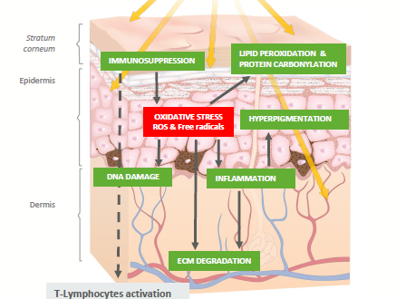

Pollution, UV, Blue Light
Many skin consequences
Weakened cutaneous barrier, dehydration
Lack of cellular oxygenation, dull complexion without radiance
Uneven complexion and hyperpigmentation
Premature aging : Wrinkles,
loss of elasticity,...
Notes:
As we know, these aggressions have many consequences:
Schematically, the impact of these aggressions on the skin is simple: aggressions => chain reactions => oxidative stress (alteration and weakening of the skin barrier, lack of cellular oxygenation, inflammation, degradation of the extracellular matrix, stimulation of melanocytes).
The results on the skin are dehydration, a dull and uneven complexion, premature aging with the appearance of wrinkles, loss of elasticity, spots,...
You understood it, it is time to find THE adapted protection!

Slide 12
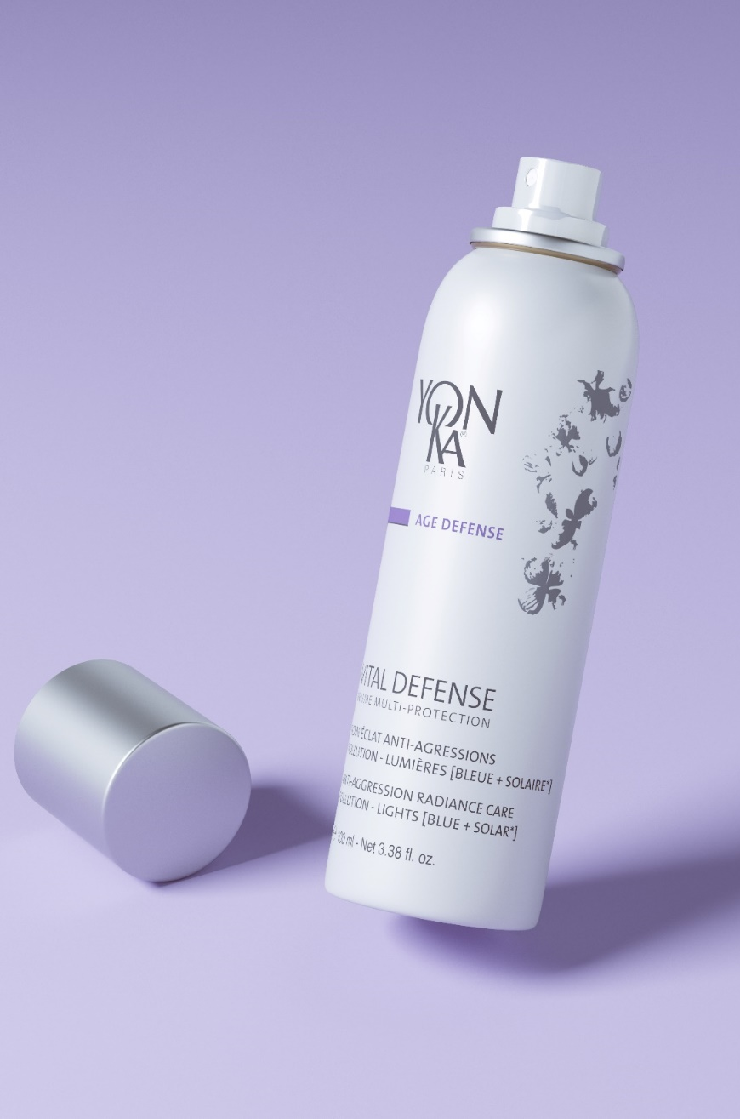
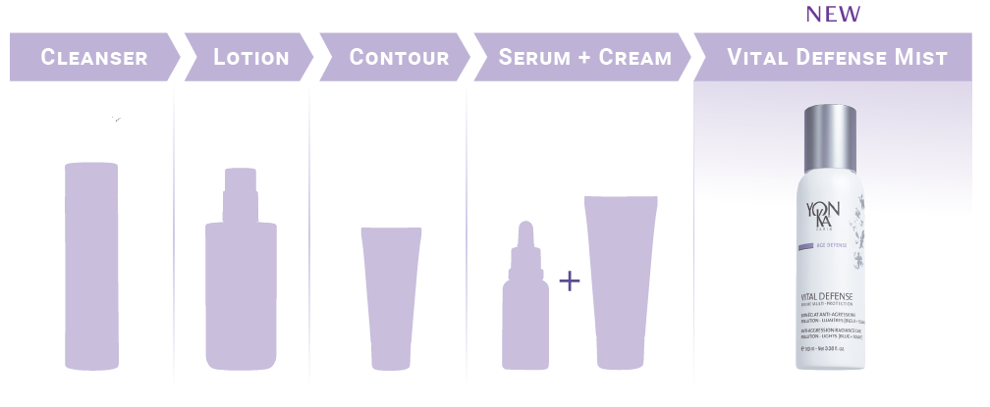
BRUME MULTI PROTECTION
VITAL DÉFENSE
New
Forms an anti-aggression shield (Pollution – UV* – Blue light)
Boosts the skin's self-defense systems
Soothes and moisturizes
Fixes make-up all day long
99% of ingredients of natural origin
Texture suitable for all skin types, even sensitive
100 ml
800 spray
Morning and at any time of the day
Notes:
Forms an anti-aggression shield (Pollution – UV* – Blue light)
Boosts the skin's self-defense systems
Soothes and moisturizes
Fixes make-up all day long
99% of ingredients of natural origin
Texture suitable for all skin types, even sensitive

Slide 13
BRUME MULTI PROTECTION
VITAL DÉFENSE
New
ANTI-AGRESSIONS RADIANCE CARE
POLLUTION – LIGHTS [BLUE + SOLAR*]
ANTI-POLLUTION ACTION
ANTI-ADHESION
- 64%
After 7 DAYS RADIANCE ENHANCER(3)
Radiance of the complexion + 16%⁽³⁾
Complexion uniformity + 40%⁽³⁾
Without Vital Defense
Multi-protection Mist
With Vital Defense
Multi-protection Mist*
ANTI-BLUE LIGHT ACTION
UV ANTI-AGRESSION ACTION
BLUE LIGHT**
-31.4%
of free radicals
UV RADIATION***
-49.4%
of free radicals
* Ex-vivo test with Vital Defense Mist / Carbon particle pollution model
**Ex-vivo test with Vital Defense Mist / Anti-radical protection against blue light
*** Ex-vivo test with Vital Defense Mist / Anti-radical protection against UV rays

Slide 14
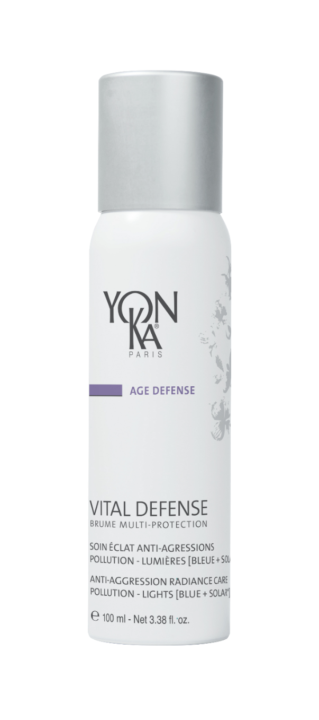
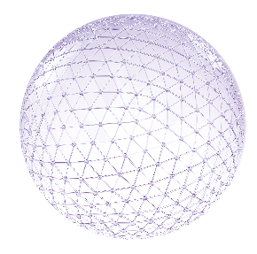
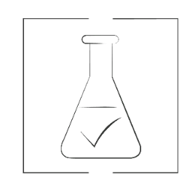


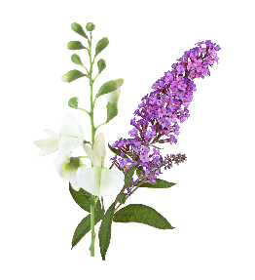
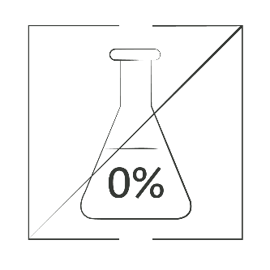

BRUME MULTI PROTECTION
VITAL DÉFENSE
New
Clean
Biosaccharide
Protective, anti-pollution and anti-particulate shield, obtained by Green Sciences
Vegan without GMO
Vitamin B5
Soothing
Hydrating
Without Alcohol
Plant polyphenols
(Sophora Japonica + Butterfly tree)
Multi-protective anti-oxidants - Target the deleterious effects of light rays
Without solar filters
99%
NATURAL ORIGIN INGREDIENTS
Sweet orange,
Magnolia, Mandarin essential oils
Revitalising

Slide 15
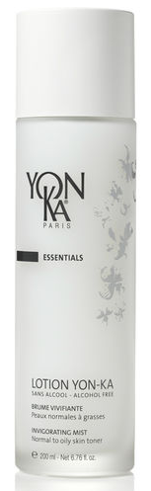
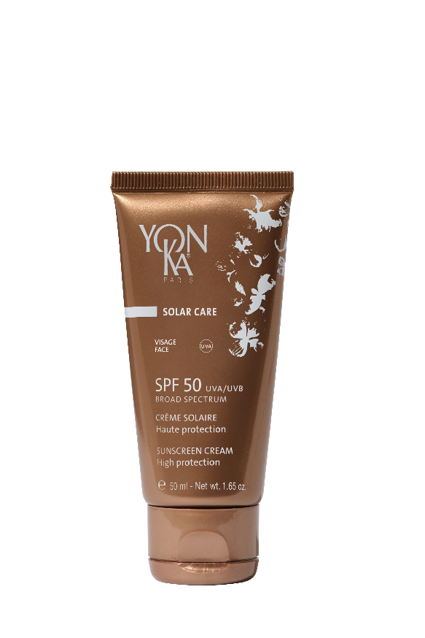
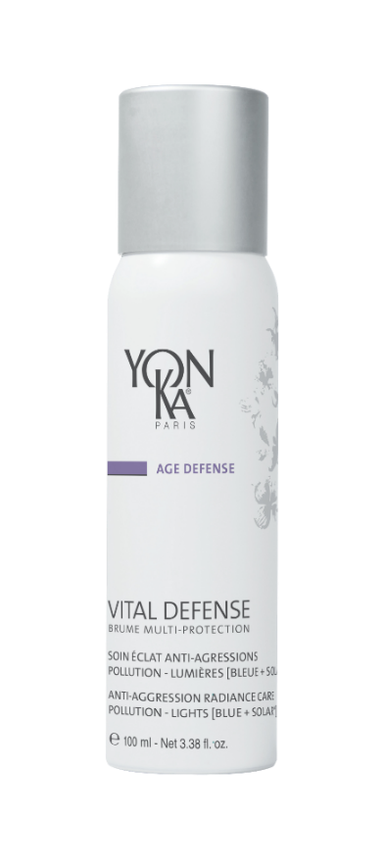
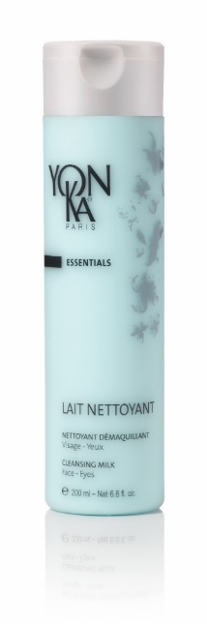
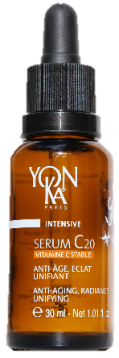
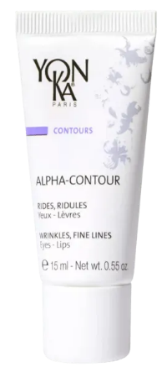
An anti-aggressions beauty routine
«I want to protect my skin from the harmful effects of UV rays and even out my complexion»
BRUME MULTI-PROTECTION
1
2
3
4
I clean
I prepare
I treat and hydrate
I protect
Notes:
You all know it by now, our previous launch, the SERUM C20 will help fight the signs of aging, pigment spots and bring radiance. Once again, followed by the mist, we obtain an ideal routine to protect the skin while optimizing its radiance.
we think to protect the skin of the sun with the spf 50 before misting the mist

Slide 16
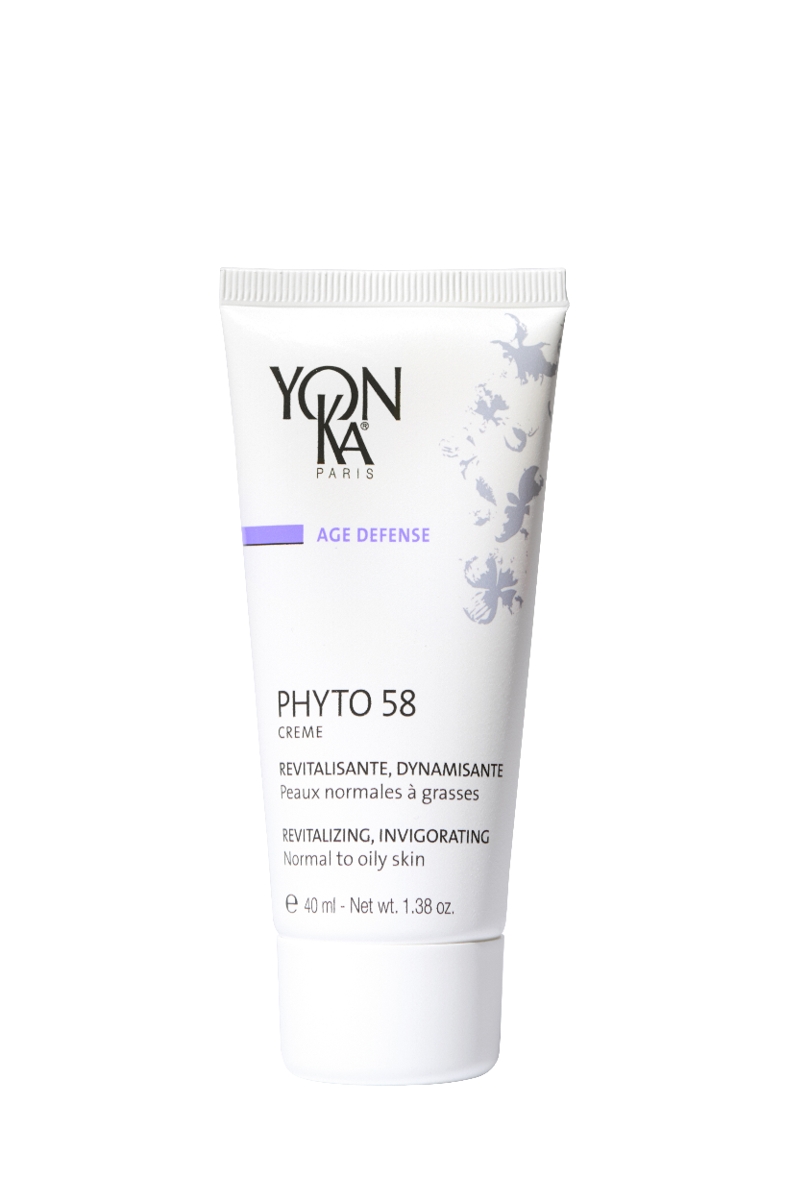
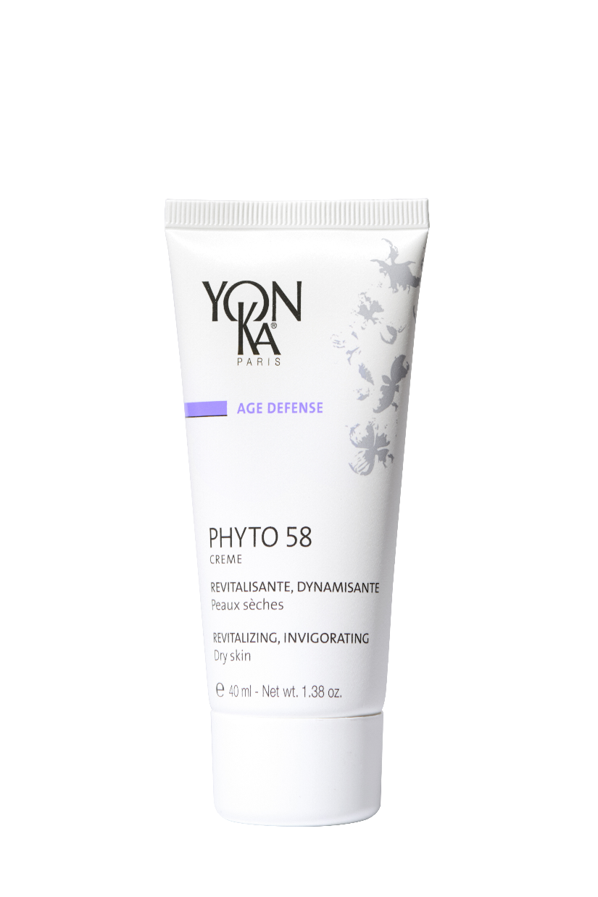

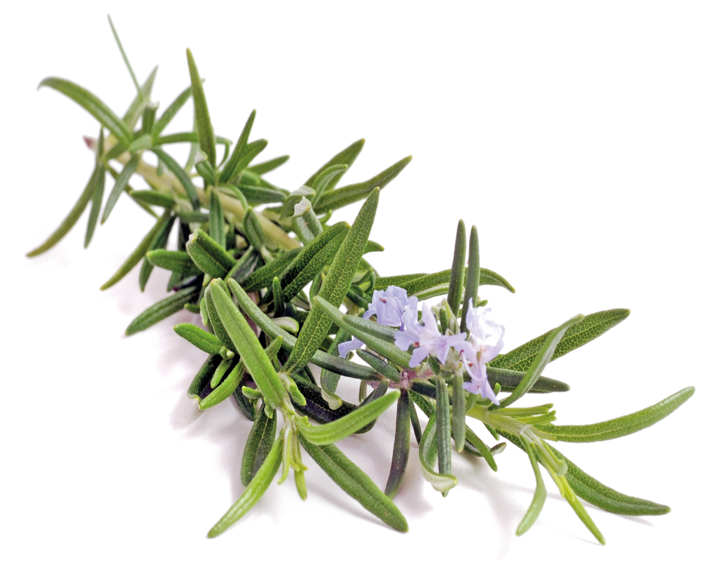
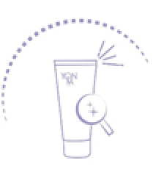

PHYTO 58 PS/PNG
Anti-dullness night care, guaranteed glow effect for dull, asphyxiated and tired skin
Detoxifies
Brightens
Tightens dilated pores
Erases the signs of fatigue
Dull complexion,
Asphyxiated & tired skin
All ages
Cible
Skin is revitalized: 94%*
50 ml
* Usage test, application on face & neck for 4 consecutive weeks by 18 women aged 26 to 32 yrs with dull, fragile skin & uneven complexion
Night
Notes:
PHYTO 58 PS/PNG
Description
Say goodbye to grey skin with Phyto 58 face cream. A concentrate of rosemary and sweet almond oil that is incredibly effective! This night treatment restores vitality to dull, asphyxiated and tired skin. Thanks to its regenerating, detoxifying and revitalizing active ingredients, it tones the skin, tightens the pores, evens out and brightens the complexion. Enriched with nutritive oils, vitamins A, E, F, it will quickly become one of your favorite aromatic care!
Promise
Revitalizing night care with a guaranteed glow effect for dull, asphyxiated and tired skin
For whom?
All skin types
Dull complexion
Asphyxiated skins
All ages
"My skin is dull"
"I am looking for a night care for radiance
Home use
In the evening, after cleansing and misting with Yon-Ka Lotion, apply the appropriate Phyto 58 cream to the face and neck.
Use in the treatment room
- Face, neck and décolleté massage
End of treatment cream
Tips
Depending on your skin's needs, combine this cream with 1 to 2 pumps of one of the following boosters: Hydra + to moisturize, Nutri + to nourish and regenerate, Lift + to firm, Defense + to fight against environmental aggressions.
Product advantages
- Revitalizing, oxygenating
Evens and brightens the complexion
Erases signs of fatigue
The skin is energized: 94%* (Use test, application on face and neck for 4 consecutive weeks by 18 women aged 26 to 32 with dull, weakened skin and a blotchy complexion)

Slide 17

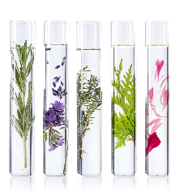
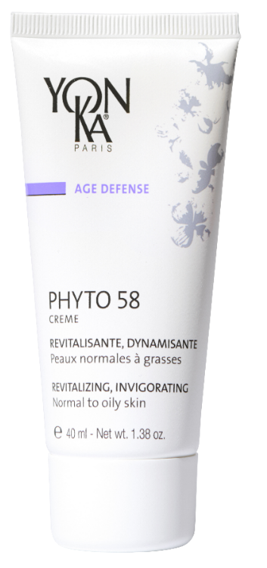


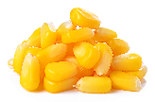
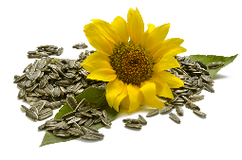
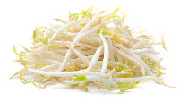

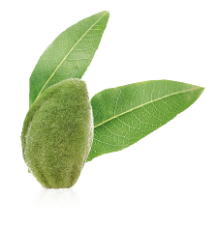


PHYTO 58 PS/PNG
Rosemary & Quintessence
Revitalizing, energizing,
detoxifying
PHYTO 58
PNG
Without artificial fragrances
Organic Sunflower, soy and
corn oils
Regenerating
Without Alcohol
PHYTO 58
PS
Vitamin F
Anti -dehydrating
Without Parabens
Organic Sweet almond oil
Nourishing Soothing
Repairing
Vitamin E
Antioxidant
Vitamin A
Regenerating
Notes:
Ingredients
Rosemary= detoxifying, energizing (PNG formula=7,2% and PS formula=3%)
Sweet almond oil = nourishing (PS formula)
Sunflower oil = regenerating (PNG formula)

Slide 18

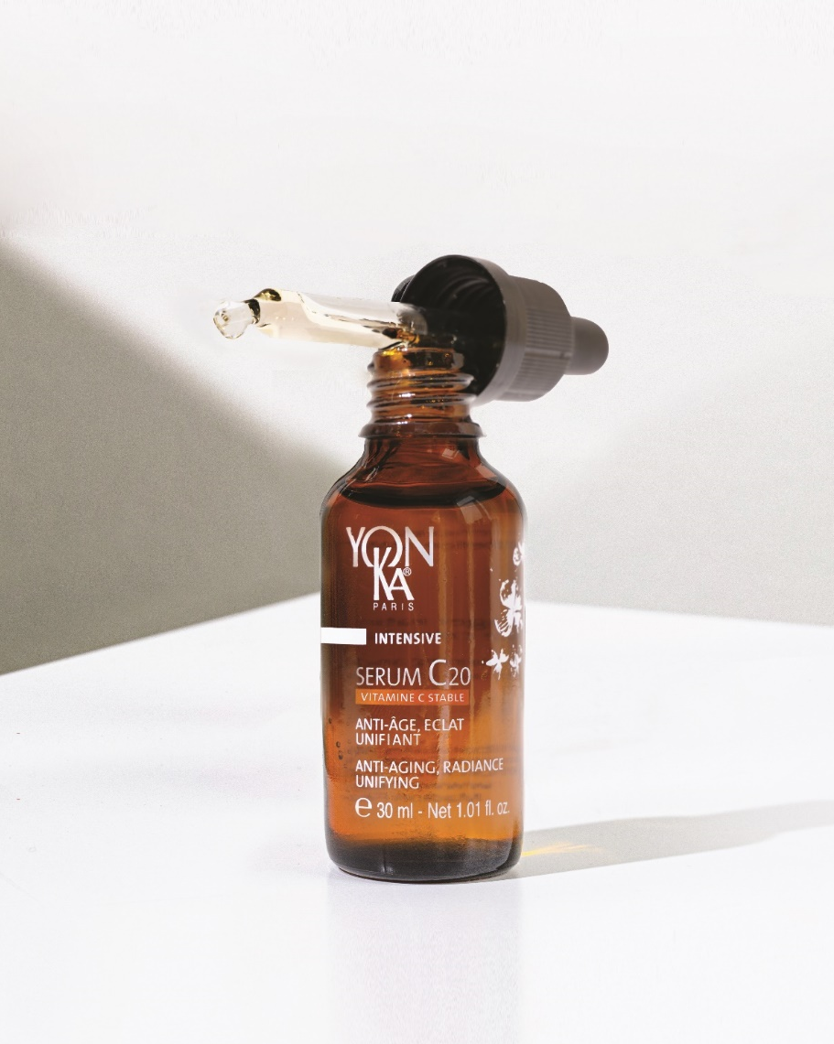

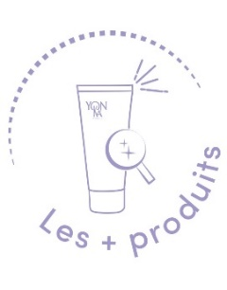
SERUM C20
Efficiency and sensoriality with 20% of stable vitamin C
Anti-aging
Radiance
Anti dark spot
After 5 days :
Measurable and visible efficacy on complexion radiance and even skin tone
After 14 days :
Wrinkle volume is reduced and skin is visibly smoother
After 28 days :
Features are smoothed1, skin is visibly younger and springier, the color of dark spots is less intense2
After 56 days :
The anti-dark spot effectiveness is intensified
99,9% ingredients of natural origin
Stable Vitamin C new generation
Oleo-serum with a non-greasy satin finish
Notes:
From 5 days :
Measured* and visible* effectiveness on the radiance and evenness of the complexion:
Nearly 9 out of 10 women: convinced by the radiance effect and the healthy glow action**.
100% of women: have adopted the product**' & wish to continue using it**'.
After 14 days :
Wrinkle volume is reduced*** Skin is visibly smoother:
Nearly 9 out of 10 women: skin quality is better, more beautiful*** 100% of women: find that skin is visibly smoother.
100% of women: find that the skin is awakened, more luminous and the complexion is radiant**.
After 28 days:
The features are smoothed*, the skin is visibly younger and plumper, the colour of spots is less intense**:
+58% more even skin tone***.
+18% improvement in skin tone***.
-30% reduction in wrinkle depth***.
Tests carried out on 21 women - Application morning and evening. *Scoring for complexion radiance and chromametric analysis for complexion homogeneity - **Self-assessment - **'the product is easily integrated into the skin care routine.***Instrumental measurements
The + :
Formulated with 99.9% ingredient of natural origin, this new-generation sensorial serum is incredibly effective
This new generation of stable vitamin C is fat-soluble for improved bio-assimilation

Slide 19







SERUM C20
All skin types
even sensitive
All year long
Or in a cure
20% of stable vitamin C
Anti-aging, Anti-oxidant,
Acts on melanogenesis
Turmeric native cells
Anti-aging, Anti-oxidant
Organic Apricot oil
Rich in Vitamin A
Acts on radiance
Pomegranate native cells
Radiance, Anti-oxidant
Sweet Orange essential oil
Acts on skin tonicity
Yon-Ka Quintessence
Potentiates the formula power
Notes:
20% of stable vitamin C :
100% natural origin, this stable form of vitamin C concentrates all the power and effectiveness of vitamin C without its disadvantages:
Ultra-stable to light, heat, air (the vitamin C molecule is stabilized 4 times), its power is guaranteed throughout its use.
Non-acidic and therefore better tolerated, it is biocompatible with all skin types (dermatologically tested on all skin types, even sensitive skin. Good tolerance).
Liposoluble for a bio-assimilation and a penetration optimized
Tumeric ; Stimulating action on epidermis and dermis
Help the skin to be firmer and more elastic.
It completes the protective
and anti-aging action of vitamin C.
Pomegranate : Action on cellular oxygenation and melanogenesis
Help the skin to be more luminous and more uniform.
They reinforce the radiance and
anti-dark spot action of Vitamin C
Organic apricot oil :
extracted from the kernel is composed mainly of Omega 9 and Omega 6, known for their nourishing, softening and smoothing properties.
This organic apricot oil is also rich in vitamins A and E (photo-protective, anti-oxidant), phytosterols (restoration of the barrier function, UV protection, anti-aging skin). Endowed with a "complexion illuminating" power (healthy glow effect), it is therefore particularly recommended in toning treatment formulas intended for dull, devitalized and dehydrated skin. Its rapid penetration, without leaving an oily feel, is suitable for all skin types, even oily and combination.

Slide 20


Anti-aging, radiance, unifying treatment for more
beautiful skin
Notes:
A cabin treatment with an evocative name: Vitamin C25
An anti-aging, radiance and unifying treatment for a sublimated skin

Slide 21
VITAMIN C25
Notes:
This treatment is intended for women and men of all ages, for dull, tired skin showing signs of photoaging and/or pigmentation spots.
It is recommended as a 1-month treatment, once a week for 4 weeks, for enhanced anti-aging benefits.
And to maintain the benefits once a month.
Recommended prices:
EURO ZONE: 120€ to 150€.
US ZONE : $225 to $275

Slide 22


VITAMIN C²⁵
Dedicated professional product
1 ampoule of SERUM C25 per treatment
Visible results with only 1 treatment
25 % stabilized vitamin C
30 % glycolic acid
New specific protocol
Associated with the Peeling Lumière
Possibility to personalize all Yon-Ka treatments with the Sérum C25
+
Notes:
FORMATION
To accompany the C20 Serum, we find a dedicated professional product in ampoule form, the C25 Serum with 25% stabilized vitamin C.
This ampoule is part of our Vitamin C25 treatment, with visible results from the first treatment thanks to the effectiveness of our stable vitamin C and the use of the Light Peel with 30% glycolic acid.
The Serum C25 ampoule can easily be integrated into all of our facial treatments during the Yon-Ka massage, always with the objective of personalization.

Slide 23




CREME MAINS
Nourishing, ultra-comforting and multi-vitamin hand cream - 3 in 1
Nourrishes
Hydrates
Repairs
Keeps hand and nail youthful
Nourished skin: 89%*
Skin repaired : 79%*
100% natural toning citrus scent
Can be applied as a night mask for hands and feet
50 ml
*Use test under dermatological control carried out on 20 women aged 18 to 70, at a rate of 2 to 3 applications per week for 4 weeks.
At any time of the day
Notes:
CREME MAINS
DESCRIPTIVE
This 3-in-1 Hand Cream, with essences of mandarin and sweet orange, nourishes, moisturizes and intensely repairs very dry and damaged hands.
Multivitamin, rich in shea butter and vegetable glycerin, it preserves the youthfulness of hands and nails and envelops them in a pleasant 100% natural citrus scent with toning and revitalizing notes.
PROMISE
Repairing and ultra-comforting hand cream
FOR WHOM?
All skin types
"I like the lemon scent.
"I wash my hands very often and they are completely malnourished.
EFFICACY (use test under dermatological control - self-evaluation on 19 women aged 18 to 42 - 1 application for 28 days)
Skin repaired: 79
Nourished skin: 89
HOME USE
At any time of the day, apply the cream on clean and dry hands.
USE IN THE TREATMENT ROOM
*Hand massage
*Mask for hands and feet in case of manicure or pedicure
PRODUCT ADVANTAGES
- Contains 97% natural ingredients
- Nourishes and repairs with shea butter and grape seed oil -
Leaves skin moisturized, soft and satin-like -
Preserves the youthfulness of hands
TIPS
- For very damaged hands, renew the application, in the evening, in thick layer. Wear cotton gloves all night to help repair the epidermis and get soft hands in the morning.
- Can also be applied on the feet, to soften and smooth the dry and rough zones and to nourish the skin.

Slide 24





CREME MAINS
Shea butter
Nourishing
Protecting
Repairing
Sweet orange essential oil
Rebalancing
Without artificial fragrances
Mandarin essential oil
Stress relieving
Vegetable glycerine
Hydrating
Softening
Without Alcohol
Grapeseed oil
Restructuring
Nourishing
Repairing
Vitamins A, C, E
Antioxidant
Regenerating
Notes:
INGREDIENTS
Shea butter = repairer
Grape seed oil = nourishing
Bisabolol = comforting, soothing
Vitamins A, C, E = Anti-oxidant

Slide 25

LAIT HYDRATANT
Body milk revitalizing for immediate comfort
Hydrates
Softens
Revitalizes
Hydrated skin: 100%*
Revitalized skin: 100%*
Contains 96% natural ingredients
Penetrates quickly without leaving a greasy film
50 ml
*Use test under dermatological control carried out on 20 women aged 18 to 70, at a rate of 2 to 3 applications per week for 4 weeks.
Morning and/or evening
Notes:
LAIT HYDRATANT
DESCRIPTIVE
This triple action body lotion, with essences of mandarin, sweet orange and sweet almond oil, moisturizes, softens and revitalizes the skin.
Its fresh and light texture brings an immediate comfort. The Vitality Moisturizing Milk, penetrates quickly without greasy effect and allows to get dressed immediately after the application.
Its soft scent of citrus fruits 100% natural, leaves the skin delicately scented.
PROMISE
Moisturizing and revitalizing milk
FOR WHOM?
Ideal for dehydrated skin
"I like fruity and tangy scents".
"My skin is dehydrated and I only like fluid textures.
EFFICACY (use test under dermatological control - self-evaluation on 20 women - 1 to 2 applications/day for 28 days)
Moisturized skin: 100%.
Revitalized skin: 100%.
HOME USE
Morning and/or evening, after showering or bathing and toweling off well, apply the milk in a thin layer all over the body.
PRODUCT ADVANTAGES
- Contains 96% natural ingredients
- Moisturizes and softens
- Skin is immediately comforted -
Penetrates quickly without leaving a greasy film (ideal for people in a hurry or who don't use a body product because they find it greasy)
TIPS
For even more velvety skin, exfoliate the body once or twice a week with the Vitality Sugar Scrub.

Slide 26

LAIT HYDRATANT
Organic Sweet almond oil
Nourishing Soothing
Repairing
Sweet orange essential oil
Rebalancing
Without artificial fragrances
Mandarin essential oil
Stress relieving
Without Alcohol
Organic ginseng
Energising
Grapeseed oil
Restructuring
Nourishing
Repairing
Vitamin E
Antioxidant
Notes:
INGREDIENTS
Vegetable glycerin = moisturizer
Organic sweet almond oil = repairer
Organic ginseng = energizing

Slide 27


GOMMAGE AUX SUCRES
Nourishing body scrub
Exfoliates and nourishes the skin
Eliminates dead cells and roughness
The skin becomes smooth and soft
Soft skin: 95%*
More beautiful skin: 95%*
200 ml
Double exfoliating and nourishing action
Texture to transform
Once or twice a week
*use test under dermatological control - self-evaluation on 19 women aged 20 to 67 years - 2 to 3 times/week for 27 days
Notes:
GOMMAGE AUX SUCRES
DESCRIPTIVE
This Vitality Body Scrub with 2 sugars and essences of mandarin and sweet orange, exfoliates and nourishes the skin. Its ultra-gourmand texture transforms into milk on contact with water; its natural and fruity fragrance envelops you with energizing and revitalizing notes.
Rid of dead cells and roughness, your skin becomes smooth and soft.
PROMISE
Nourishing body scrub - a chewy scrub that gives you a boost
FOR WHOM?
All skin types
"I like fruity and tangy scents".
"I like grainy scrubs and my skin is dry«
EFFICACY (use test under dermatological control - self-evaluation on 19 women aged 20 to 67 years - 2 to 3 times/week for 27 days)
Soft skin: 95%.
More beautiful skin: 95%.
HOME USE
Once or twice a week, apply the scrub on wet skin, massage and rinse with warm water.
Note: Vitality Scrub should be applied to dry skin on rough areas such as heels, knees and elbows for greater effectiveness.
USE IN THE TREATMENT ROOM
- Apply and massage the SUGAR SCRUB to an area
Add water and massage the scrub according to the protocol
PRODUCT ADVANTAGES
- Delicious scent of mandarin and sweet orange-
Double exfoliating and nourishing action-
Skin is clean, soft and smooth-
Texture to transform
TIPS
After the Vitality Sugar Scrub, remember to moisturize your skin with the Vitality Moisturizing Milk.

Slide 28

GOMMAGE AUX SUCRES
Sweet orange essential oil
Rebalancing
Without artificial fragrances
Mandarin essential oil
Stress relieving
Without Alcohol
Organic cane sugar and white sugar
Exfoliating
Quintessence YON-KA
Revitalising
Renewing
Balancing,,,
Organic sunflower oil
Nourishing
Softening
Notes:
INGREDIENTS
Organic cane sugar and white sugar = exfoliating
Organic sunflower oil = nourishing

Slide 29



DELICE DE CORSE 1h30
CORSICAN DELIGHT
Mandarin-Sweet Orange
Notes:
USE
Scrub: 2 doses max of aromatic concentrate + scrub
Massage: max. 2 doses of aromatic concentrate + massage oil
Specific techniques: max. 2 doses of aromatic concentrate + massage oil + cream 55

Slide 30



AROMA-ENERGY massage
Re-balancing massage with hand and foot acupressure; a sustained pressure
with the finger tips on specific zones of the hands and feet remove energy
blockages, relieve stress and relax. With your new-found energy, you will be
able to resume daily tasks with energy and positivity.
Massage oil
Aromatic concentrate
Notes:
Re-balancing massage with hand and foot acupressure; a sustained pressure
with the finger tips on specific zones of the hands and feet remove energy
blockages, relieve stress and relax. With your new-found energy, you will be
able to resume daily tasks with energy and positivity.

Slide 31
YON-KA DIGITOPRESSURE TECHNIQUES

Slide 32
YON-KA DIGITOPRESSURE TECHNIQUES

Slide 33


Test your knowledge with
Play Everyday!
Magic code : FRESH

Slide 34

To download the app
Play everyday

Slide 35


Slide 36
Thanhs !

