Slide 1
PERSONALISED DIAGNOSIS IN 20' TOP CHRONO
Notes:
Hello everyone. I am Sophie, international trainer for Yon-Ka and I am very happy to welcome you for this training session which aims to give you all the keys to carry out a good skin diagnosis with your clients.
Of course, these key diagnostic steps are essential sales steps that you can implement in your institutes but also remotely.

Slide 2
THE PROGRAM
Notes:
Without further ado, here is the program of this training...

Slide 3
1
2
3
Objectives of the webinar
WHY OFFER
THIS SERVICE?
The 3 key steps
Notes:
First, we will focus on the 3 objectives of this webinar. Then, you will understand why it is important to offer this service and finally the 3 main steps of the diagnosis.

Slide 4
THE OBJECTIVES OF THE WEBINAR
Notes:
What are the 3 objectives of this webinar?

Slide 5

Objective 1
Objective 2
Objective 3
Keep in touch
&
strengthen the link with your customers
prospect
Increase
your turnover
sales & care
Notes:
First of all, to keep in touch and strengthen the link with your customers.
The ^{second} objective is to find new customers. By posting this new service on your Facebook page, for example, your customers can forward the invitation to their friends if they are satisfied.
Finally, and of course, this personalised diagnosis aims to boost your turnover by optimising your clients' beauty routine, introducing them to unknown products and even anticipating your appointments for salon treatments adapted to their needs.

Slide 6
WHY OFFER THIS SERVICE?
Notes:
Why did we decide to focus on skin diagnosis?

Slide 7
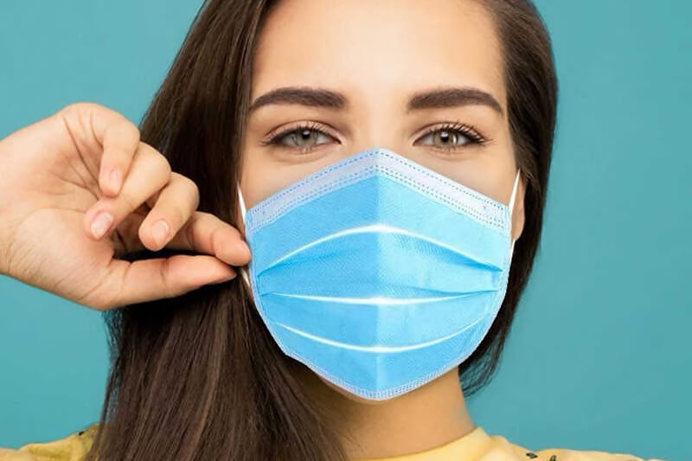
THE SKIN CHANGES....
Notes:
You have no doubt noticed it in your family and friends... When you wear a mask, your skin changes. It breathes less well, shines more for some or is more sensitive and uncomfortable for others. Imperfections appear, redness... it's the perfect opportunity to insist on the importance of a good skin cleansing and to present some adapted Yon-Ka products in more detail.

Slide 8
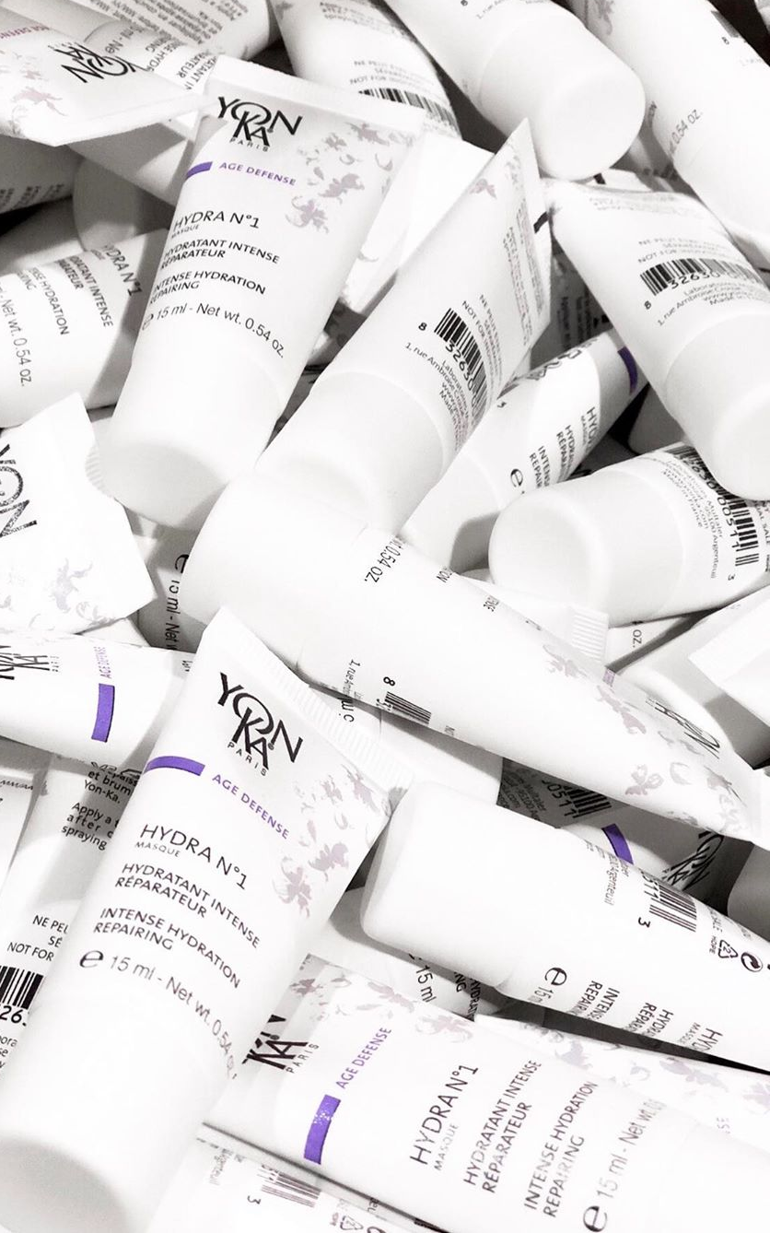
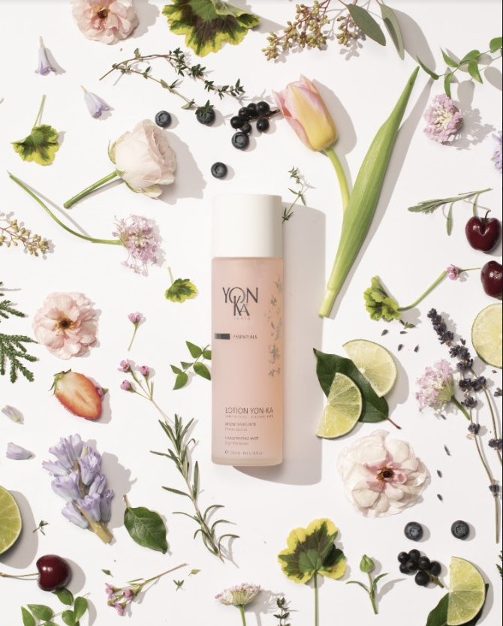
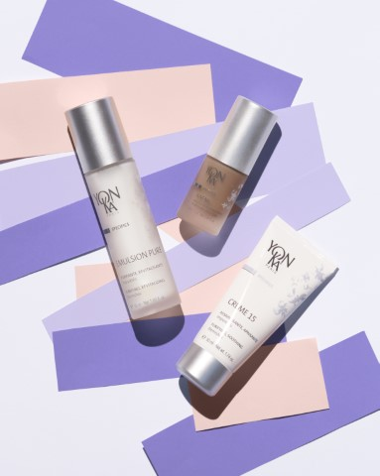
WHICH PRODUCTS
CHOOSE ?
Notes:
The second reason is that it is not always easy to choose from all the products. It is interesting to analyse the client's habits in order to help her to adopt the gestures adapted to her skin in order to select the product that suits her best.

Slide 9
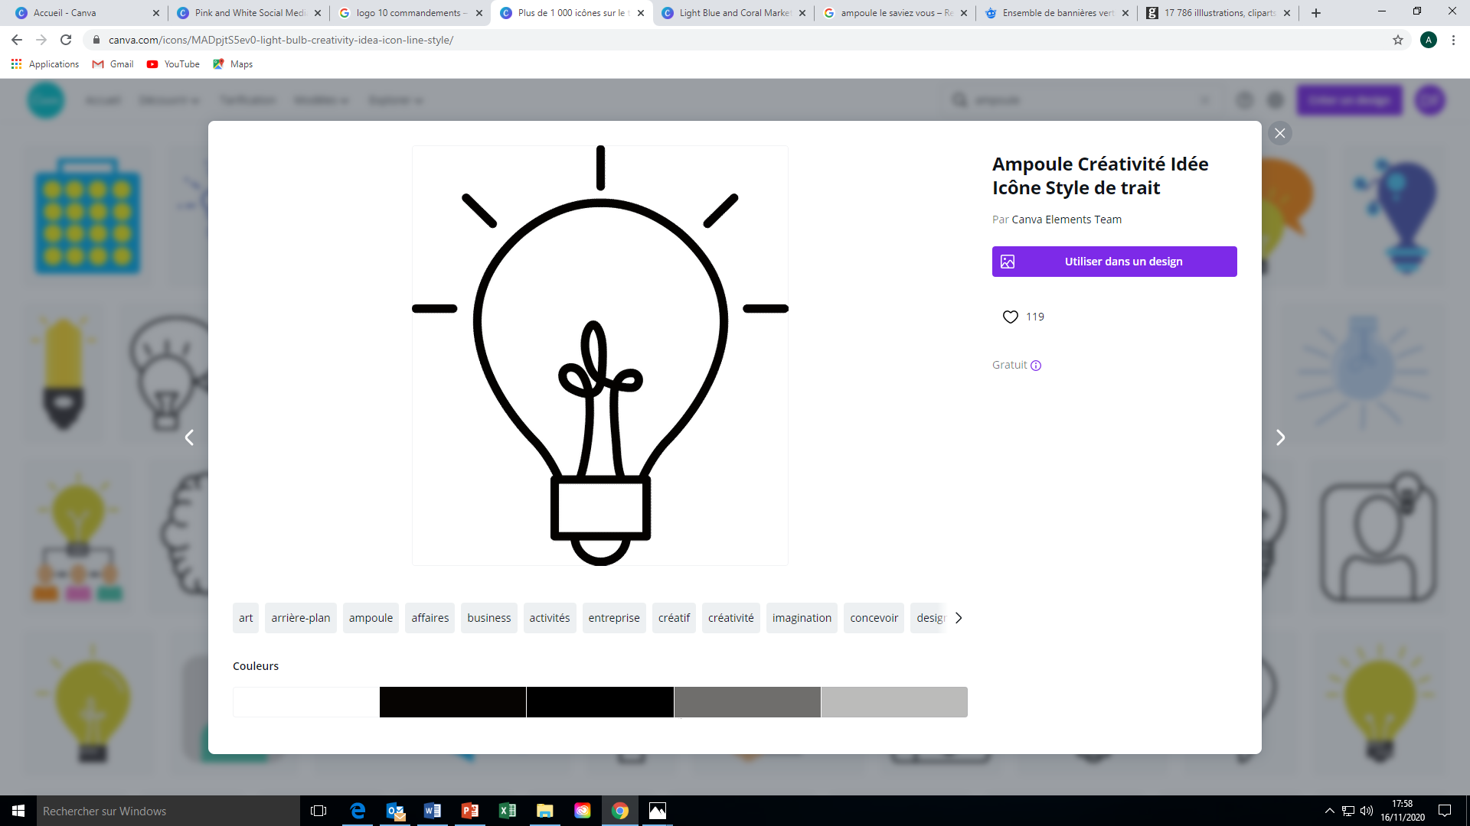
Only 8% of women use a serum
1 in 3 women does not use a night cream
60% of women
do not know
their skin type
1 in 3 women over 45 does not use a specific eye cream
DID YOU KNOW THAT?
Notes:
DID YOU KNOW THAT :
60% of women do not know their skin type
Only 8% of women use a serum
1 in 3 women does not use a night cream
1 in 3 women over 45 does not use a specific eye cream
These few figures are the results of a study conducted by Beauty Track France. The survey was carried out among 3200 French women aged between15 to 75 in 2018 and proves to us how much your expertise and advice can contribute to improving your customers' skin problems.
These figures clearly illustrate that not all customers have all the knowledge in terms of cosmetics, and not all of them have acquired the essential gestures due to lack of time or knowledge. Your advice is therefore essential to accompany them and guide them in adopting the right gestures and routines.

Slide 10
THE 3 KEY STEPS
Notes:
Here are the 3 key steps of a good skin diagnosis

Slide 11
BEFORE
DURING
AFTER
Communicate
Listening & exchanging
Retain and transform
Notes:
Before: I will communicate about my skin diagnosis offer. I will plan my appointments while always keeping 10 minutes between each diagnosis to avoid any delay.
During: I will welcome my client like a "princess", in a personalized and unique way by mentioning her name (she is not an average client!); I will ask her questions about her care habits from morning to night, I will take notes on what I find interesting, I will congratulate her and I will make a suitable recommendation.
Afterwards: I will detail the offer I am making, the terms of delivery of the products, propose that she sponsor a friend to also carry out a diagnosis, and open up the discussion on the operations of the moment.

Slide 12
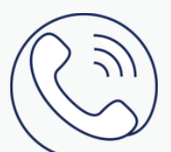

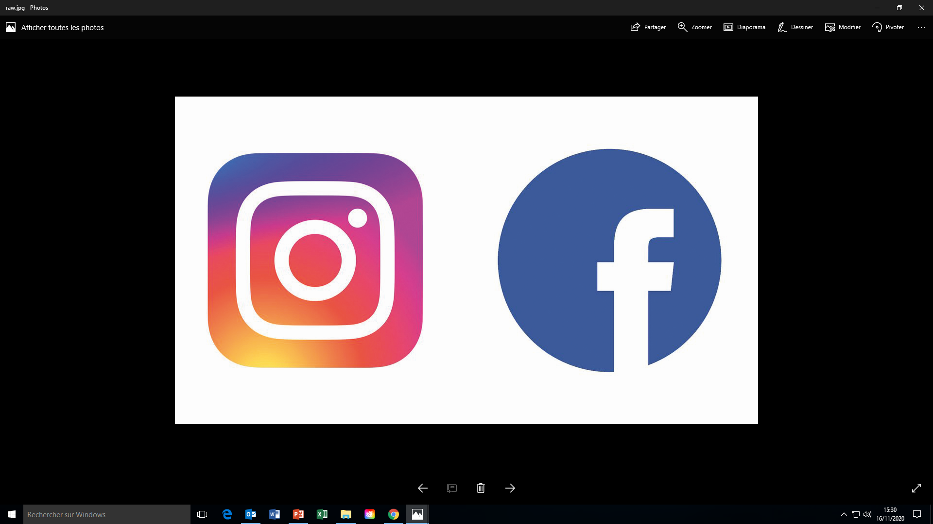

HOW TO COMMUNICATE?
Notes:
HOW TO COMMUNICATE
Any means of communication about this new service is of interest.
This can be by telephone. You probably have a special relationship with some of your clients. Do not hesitate to pick up the phone just to check up on them and offer them this service. You can also send a text to your clients with a link to make an appointment.
Maintaining good relations with the shopkeepers in your neighbourhood is a real asset.
You can also ask your local council for information on the actions taken by shopkeepers.
Publish this new offer on your website, Facebook and Instagram pages. We do not recommend charging for this service but you can add value to it, for example 20€ on your treatment card and offer it as a gift.

Slide 13
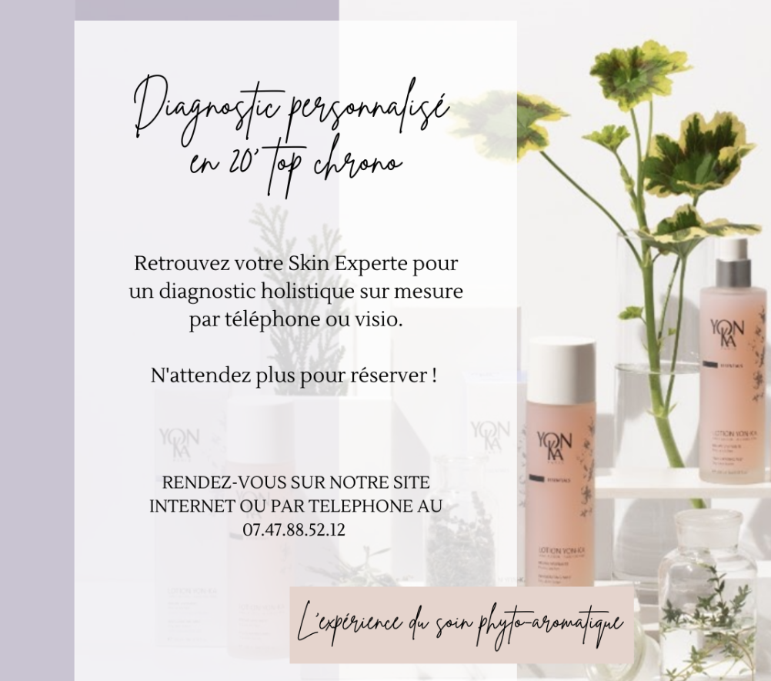
Content
*Catchphrase
*Explanation of the service
*Access procedures
Crello
Canva
Unfold
Think about
Notes:
Here is an example of an invitation for a personalised diagnosis that you could publish. It must contain :
The catchphrase (here, "Personalized diagnosis in 20 minutes")
Explanation of the service ("Meet your skin expert for a tailor-made holistic diagnosis by phone or video);
How to access (appointment on our website or by phone...)
Think of the different platforms that allow you to create beautiful layouts at no cost (CANVA, CRELLO, UNFOLD...)

Slide 14
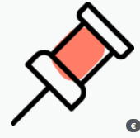

TO REMEMBER
#1 Care for the content
#2 Vehicle
your DNA
in the message
#3 Communicate on all networks
#4 Plan specific and strategic time slots
Notes:
To summarise this first part, remember to :
Take care of the content of your message to make it appealing
To convey the DNA of your institute, it has its own identity.
Communicate on all networks; do not limit yourself
Plan specific and strategic time slots (never more than 2 hours in a row to enable you to send recommendations the same day, allow 10 minutes between 2 diagnosis, extend calls in the evening or on Sundays if necessary).

Slide 15

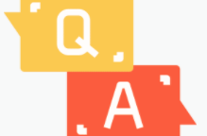
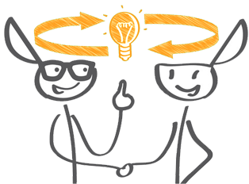

CONDUCT OF THE APPEAL
4 KEY STEPS
Home
Diagnosis
Recommendation
Taking leave
1
2
3
4
Notes:
Let's look in detail at the 4 key stages of the call: the welcome, the diagnosis, the recommendation and the exit.

Slide 16
THE WELCOME
Home
1
Notes:
I welcome my client in a personalised way according to :
If she is a new client
If she is an existing client
I introduce myself
I introduce the brand - I explain the process and the purpose of the meeting.
I conclude by asking her why she wanted to make an appointment for this coaching today and what he/she expects from it.

Slide 17
THE DIAGNOSIS
Diagnosis
2
Notes:
We will look in detail at the questions to ask next.
The most important thing is :
Listen carefully to my client's answers – do not hesitate to take notes
Be interested in everything she tells me.
Ask questions to deepen the answers.

Slide 18
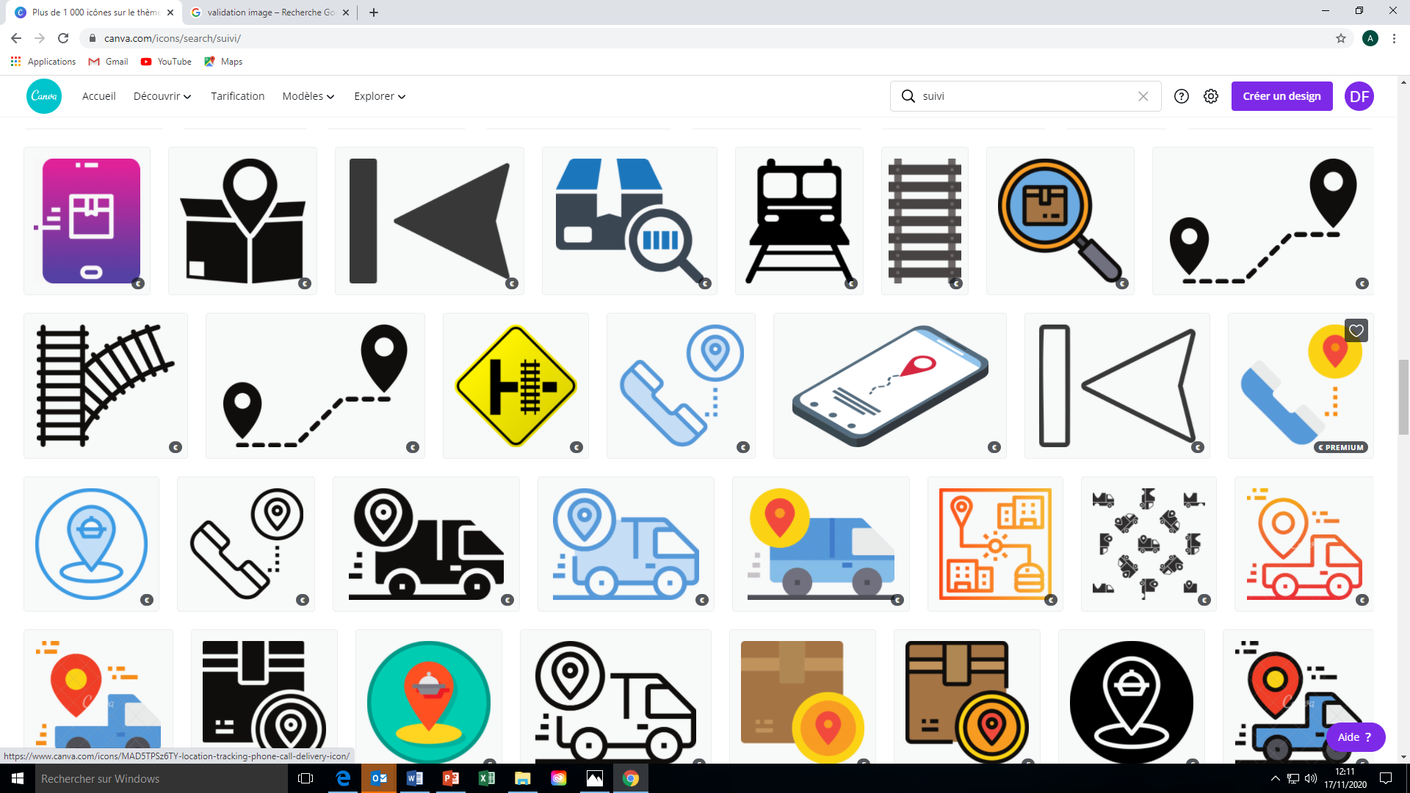
DIAGNOSIS - STEP BY STEP
2
1
DEEPENING PHASE
PHASE
FROM
DISCOVERY
Notes:
There are 2 main phases in skin diagnosis, the discovery phase and the deepening phase.

Slide 19

STEP 1
STEP
1
Discovery phase
Notes:
During the discovery phase, I will ask as many open questions as possible in order to create a climate of exchange and sharing.
The aim is to glean as much information as possible without the client feeling that she is being interrogated.

Slide 20
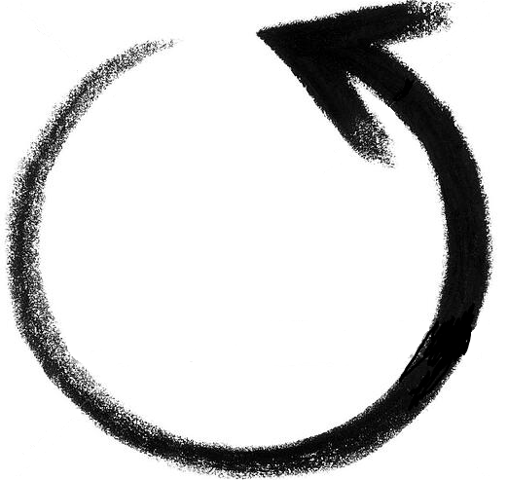
STEP 1
DISCOVERY PHASE
Her beauty routine
Her cosmetic preferences
360°
Her priorities
Her way of life
Her skin
Notes:
This phase will allow me to know my client's beauty routine in the morning and in the evening, her cosmetic preferences in terms of texture, perfume, her lifestyle, if she lives in the city, if she smokes, if she sleeps well, her skin type according to her feelings and her beauty priorities.
At the end of this stage, I should feel as if I have entered my client's bathroom and know her entire routine.

Slide 21
STEP 1
DISCOVERY PHASE
1. How does your skin feel today?
2. If you had to define your skin, what would you say?
3. What type of skin do you think you have?
Notes:
I am sure you already know all these questions but here is a list of the most important ones
First of all 1. How does your skin feel today?
2. If you had to define your skin, what would you say?
3. What type of skin do you think you have?

Slide 22
STEP 1
DISCOVERY PHASE
4. What is your morning skincare routine? (Cleansers, lotion, contour, serum, cream)
5. What is your evening skincare routine?
6. What is your weekly skincare routine?
How often do you use scrubs and masks?
Notes:
when you know the skin type it time to look at their skincare habits from morning to night, the products they use, with this kind of questions :
4. What is your morning skincare routine? (Cleansers, lotion, contour, serum, cream)
5. What is your evening skincare routine?
6. What is your weekly skincare routine?
How often do you use scrubs and masks?

Slide 23
STEP 1
DISCOVERY PHASE
7. How much time do you spend on your daily care routine?
8. How long have you been using your products?
What do you like about these products and what could be improved?
9. What type of texture or packaging do you like?
Notes:
And to finish the discovery step, questions to refine the client's preferences:
7. How much time do you spend on your daily care routine?
8. How long have you been using your products?
What do you like about these products and what could be improved?
9. What type of texture or packaging do you like?

Slide 24
STEP 1
DISCOVERY PHASE
TO REMEMBER
#1 Have the impression
to have entered the
the client's bathroom
#2 Visualize
all the products she uses
#3 Why, how long, what she likes, what she doesn't like
#4 Her lifestyle
#5 Her expectations
Notes:
To summarise, at the end of this discovery stage, you should :
To feel like you've walked into her bathroom and seen all the products she uses, what she likes, what she doesn't like, how much time she has for her skincare routine, her lifestyle, her expectations for the diagnosis and for her skin.

Slide 25
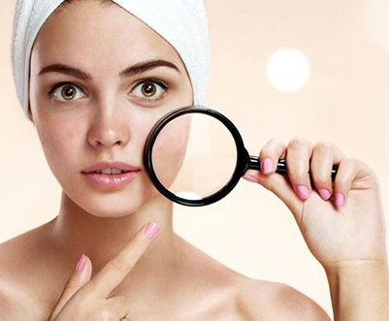
STEP 2
DEEPENING PHASE
STEP
2
deepening
Notes:
During this phase, you will ask questions related to your client's lifestyle, which will allow you to communicate personalized beauty and well-being tips.

Slide 26
STEP 2
DEEPENING PHASE
1. How would you define your diet?
2. Do you feel that your sleep is satisfactory?
3. Are you going through a stressful period?
4. Do you practice any sport?
5. Do you smoke?
6. Are there any other elements you would like me to consider in this personalised coaching?
Notes:
These are an example of non-exhaustive questions you can ask:
"How would you define your diet? »
"Do you feel that your sleep is satisfactory? »
« Are you going through a stressful period »
But then again, if she hasn't told you about it before:
"Do you practice a sport activity? »
"Do you smoke? »
"Are there any other elements you would like me to consider in this personalised coaching? »
these questions are interesting to determine an adapted beauty routine and to give impactful advice

Slide 27
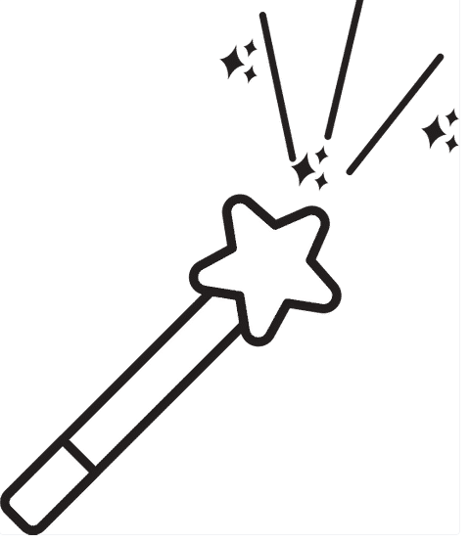
STEP 2
DEEPENING PHASE
If you had a magic wand, what would you like to improve?
Notes:
To conclude my diagnosis, I validate her priorities with my magic question:
"Thank you for all this valuable information. I have taken note of everything you have told me. I see that you already have very good care habits. Now I have one last question to ask you before we discuss your personal recommendation: If you had a magic wand, what would you like to improve first? »

Slide 28
THE RECOMMENDATION
Recommendation
3
Notes:
In this ^{third} step, I reformulate her priority and present her with my recommendation for an ideal routine that will allow her to achieve her goals.
The aim is to improve her existing routine with the products and to give her the beauty & well-being tips related to her expectations.

Slide 29
THE RECOMMENDATION
1. Describe the client's skin condition
2. Bounce back on your priorities and make the recommendation by integrating the products into your existing routine
3. Complete your routine with treatments in a salon
4. Complete your routine with beauty and well-being tips
Notes:
First of all, it is important to always congratulate the client on her good habits and encourage her to continue
Then explain the benefits of each recommended product and its use in the routine according to her skin condition.
I also talk to her about institute treatments.
and i complete the recommendation with beauty and well being tips according to the informations you glean during the deepening phase
At the end of my recommendation, I remember to check that I have met my client's expectations and questions.

Slide 30
TAKING LEAVE
Taking leave
4
Notes:
We have already reached the last step: taking leave. It is essential to take care of these last seconds because it is the last impression you will leave on your client.
Here are the points to remember.

Slide 31
TAKING LEAVE
1. Thanking for the exchange
2. Explain the sending of the email and its content - revalidate email address
3. Explain the offer and how to collect the products
Notes:
I thank my client for our exchange and explain that she will receive an email with her personalized recommendation.
If necessary, I validate the e-mail address of my customer file and I take the opportunity to update it.
I explain to her how to buy the products and present her with a personalised offer.
(-20% observed on average among competitors)

Slide 32
TAKING LEAVE
4. Explain that you are available for any further information
5. Offer to make an appointment
6. Invite them to follow you on the networks
Notes:
I suggest that she anticipates an appointment at the beauty salon and show her the current commercial operations.
I invite her to follow the next offers on social networks.

Slide 33
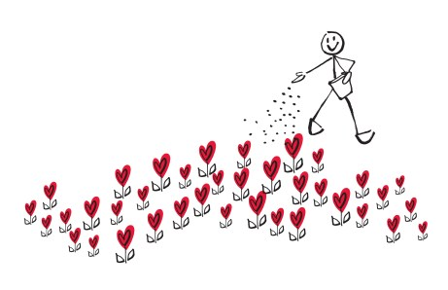
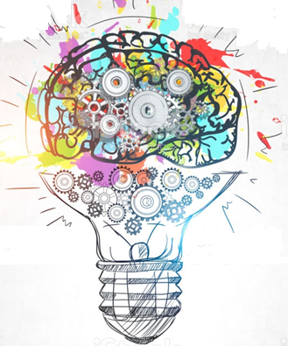
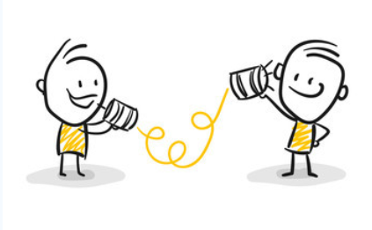







THE 10 GOLDEN RULES
AN EXPERT DIAGNOSIS
1
2
3
4
5
knowledge
Active listening
Empathy-benevolence
value
Adapted speech
6
7
8
9
10
customisation
Optimised routine
Overall proposal
Impartiality
Freedom from
of its own brakes
Notes:
To conclude, here are the 10 golden rules to remember in order to succeed in my diagnosis:
1. Knowledge: I know my products inside out so I can suggest the most suitable product(s) for my client. Knowledge is a fundamental element because it conveys the beautician's expertise and allows her to be more confident and precise in her recommendation
2. Active listening: I retain, bounce back and rephrase everything my client tells me (teleworking, wearing a mask, lack of time, tiredness, etc.) - I do not hesitate to take notes
3. Benevolent empathy: I put myself in her shoes, I make her feel understood, I show indulgence, I am not judgmental - she must feel recognised
4. Valuing: I congratulate her on all her good habits
5. Adapted discourse: I do not make my discourse too complex, I explain terms that are too scientific for her to understand. I adapt my speech according to the profile of my client (informed or beginner, sensitive to novelty, sensitive to safety, price, efficiency....)
6. Personalisation: the recommendation must be truly tailor-made and adapted to the needs of my clients. It is always different because the concerns and lifestyles are not the same from one client to another
7. Optimised routine: even if I use the ideal Yon-ka routine (from make-up removal to complementary products), I highlight the 2/3 products that are essential for a rapid improvement. I don't change a cream if it suits the client, but I can recommend a booster if her skin is tighter.
8. Global proposal: I offer advice on beauty products but also tips related to one's lifestyle (recommended diet for one's skin type for example).
9. Impartiality: I do not denigrate the competing products that are used and I am not influenced by the impression and image that the customer conveys
10. Free yourself from your own inhibitions: do not see counselling as a forced sales act. The client is looking for a result and advice to achieve it. I am therefore there to accompany her and give her all the keys to achieve it.
I don't put myself in the place of my client's wallet, so I don't have to worry about price. If she doesn't buy the recommended products when she needs them, she will go and buy them elsewhere.
I am also free of the time brake. I am gaining confidence and I am not afraid to put forward my expertise and the products I work with.
To be a beautician is to carry out treatments but above all to be able to offer a global treatment which includes treatments, products and advice. And it doesn't matter if the client buys or not. The objective is to show her professionalism and to build customer loyalty.
You now have all the keys in hand to carry out an expert and personalised skin diagnosis, by telephone, video conference or even face to face. We are at your side if you need any further information or support.

Slide 34

DIAGNOSTIS TRAINING TOOLS
Notes:
Finally, Do not hesitate to ask the training department for the tools set up to help you during your diagnosis

Slide 35
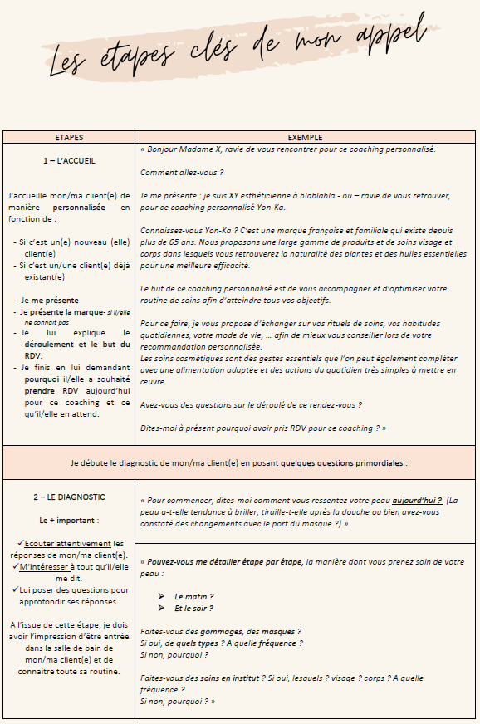
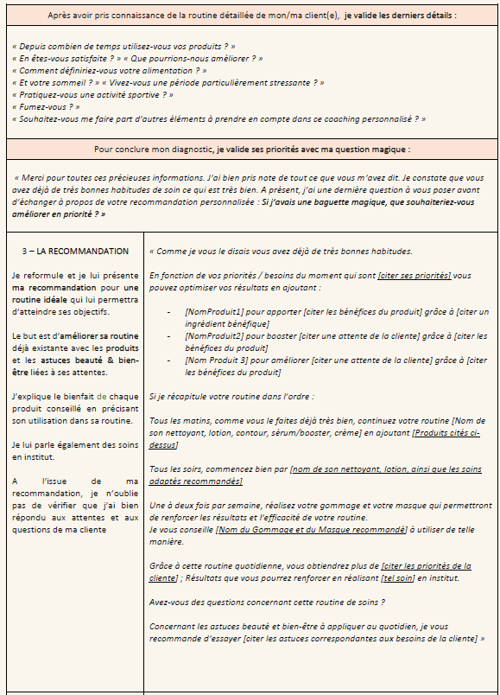
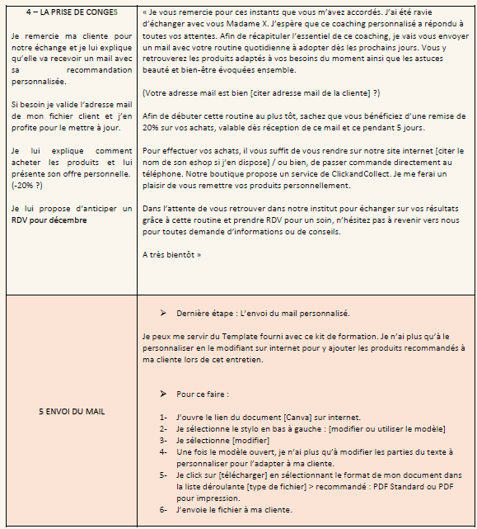
DIAGNOSTIC SCRIPT
Notes:
The training department offers you different supports such as the diagnosis script for your calls with the different stages of the diagnosis and the questions to ask.

Slide 36

BEAUTY & WELLNESS TIPS
 | For oily skins | For dry skins | For sensitive skins | For mature skins
 | Favour foods rich in vitamin B (pulses, green vegetables, seeds, etc.) | Favour foods rich in vegetable oils, oilseeds, avocados, oily fish | Favour essential fatty acids and add 2 tablespoons of rapeseed or walnut oil to your daily meals, salmon, sardines, mackerel, avocado, oilseeds, etc. | Favour foods rich in essential fatty acids (oilseeds, fish, etc.), antioxidant fruits and vegetables (raspberries, green tea, etc.)
 | Avoid alcohol, refined sugars |  | Remember to moisturise well and not use too many products. | Test food supplements based on marine collagen, hyaluronic acid, folic acid (activates cell renewal), coenzyme Q10 (brings energy to the cells), zinc (fights against oxidative stress)
 | Drinking burdock tea |  | Avoid alcohol and spicy food
 | Make a steam bath with tea tree essential oils | Avoid tap water and pat the skin dry | Avoid tap water and cotton wool and use washable wipes instead | Practice relaxing activities (yoga, relaxation, etc.)
 | Do not strip your skin | Avoid overheated places and pollution | Control the humidity, avoid pollution and sudden temperature changes. | Practice self-massage and facial exercises
 | Have impeccable hygiene (hands, nails, telephone, make-up brushes, sheets...) | Opt for layering | Use sun protection | Avoid yo-yo dieting
 |  | Avoid make-up, use a few drops of foundation mixed with the cream |  | Maintain a healthy lifestyle, exercise
 |  | Add drops of Argan oil to your bath
IN
OUT
Notes:
And also some beauty and wellness tips IN (what goes in the body, what we should eat for example) and OUT (what we can do outside) to complete your diagnosis.

Slide 37
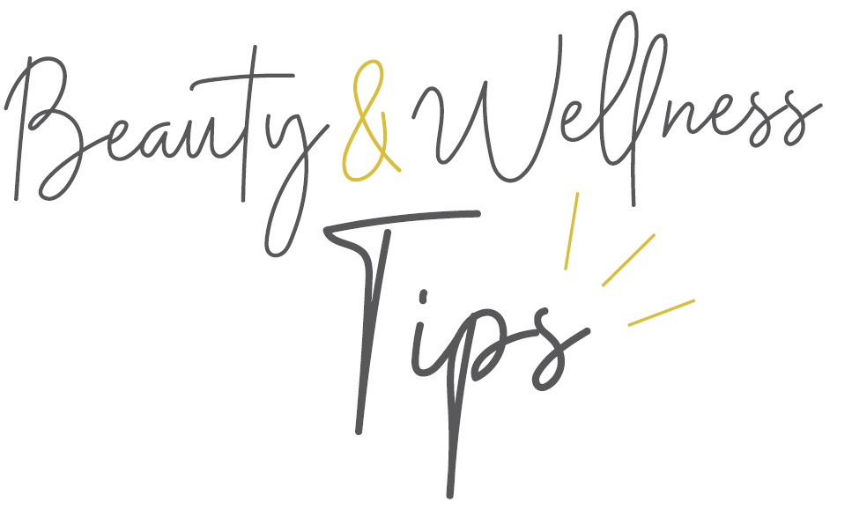
BEAUTY & WELLNESS TIPS
 | For skins in need of brightness | For skins with pigmentation spots | For dehydrated skins | For eye and lip contours
 | Eat a balanced diet rich in vitamin C, do a detox with black radish/artichoke, drink green tea and a glass of lemon juice every morning | Opt for a diet rich in antioxidants | Watermelon, grapefruit, orange, cucumber, courgette, tomato... + fatty acids such as olive and rapeseed oils, oilseeds or fatty fish such as sardines and mackerel
 |  |  | Drink 1.5l of water in small sips, do not wait until you are thirsty to drink, and prefer hot drinks when it is hot. Coconut water is very hydrating, low in calories and quickly absorbed by our cells
 | Have a good night's sleep (when we are tired, the body provides the necessary nutrients to our vital organs at the expense of the skin) | Use SPF daily and wear a hat | Mixing your moisturising serum with your foundation | Use specific products because the skin is thinner and more fragile. Do not hesitate to put the eye contours in the refrigerator
 | Beware of pollution and screens (blue light penetrates to the dermis and reduces the capacity of our cells to regenerate) | Apply cotton wool of lemon juice, white birch bark or parsley to your brown spots | Complete your mask routine and do a moisturising serum treatment | Practice self-massage and eye yoga
 | Exercise to eliminate toxins | Be patient, wait 2 to 3 months before seeing the spots fade away | Avoid air conditioning | Get a good night's sleep
 | Tonic massage of the face which will reactivate the microcirculation, oxygenate and drain |  |  | Wear sunglasses
 | Go to the hammam or take a steam bath with a few drops of grapefruit essential oil |  |  | Use cold tea bags or spoons under the eyes to decongest the eyes
IN
OUT

Slide 38
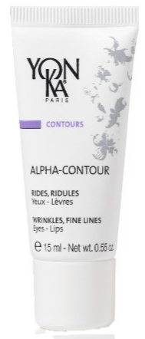
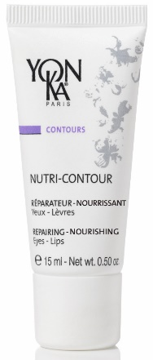
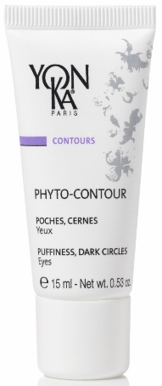
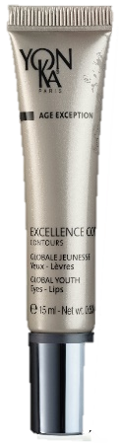
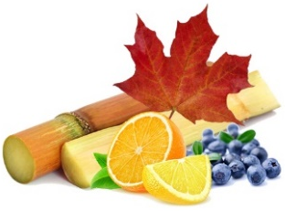

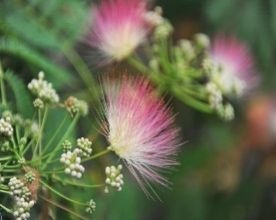
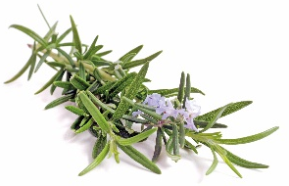
MY CURRENT ALLIES
TAKE CARE OF THESE FRAGILE AREAS
ALPHA-CONTOUR
NUTRI-CONTOUR
PHYTO-CONTOUR
EXCELLENCE CODE CONTOURS
Anti-wrinkle eye & lip care
Intense nourishment and
repair eye & lip care
Fatigue-relieving eye
contour care
The global anti-ageing eye & lip
care with 5 patents
Notes:
Here are some products that we recommend you focus on. The skin around the eyes is thinner, the skin around the lips more fragile, these areas deserve special attention. These products can be suggested to all those who do not use an eye contour product in their routine and deplore fine lines, dark circles and puffiness. Do not hesitate to give application tips.
Anti-wrinkle with ALPHA-CONTOUR
Nourishing and comforting with NUTRI-CONTOUR
Anti-dark circles and puffiness with PHYTO-CONTOUR
And a global anti-ageing action with EXCELLENCE CODE-CONTOURS.

Slide 39
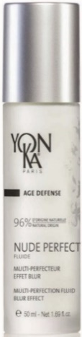
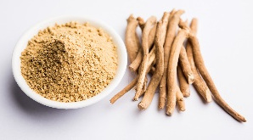
MY CURRENT ALLIES
Stop blue lights AND POLLUTION!
NUDE PERFECT FLUID
Perfect skin, naturally
Notes:
We spend more and more time on our screens and are often surrounded by pollution in the city. This is the perfect time to recommend NUDE PERFECT for its anti blue light action.
Ideal with its perfect skin effect. And the perfect ally of remote work

Slide 40
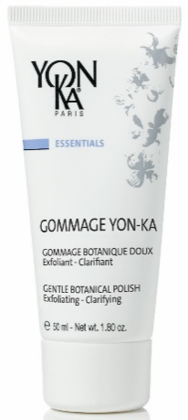

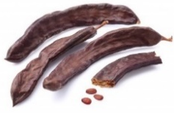
MY CURRENT ALLIES
BOOST THE EFFECTIVENESS OF YOUR CREAMS!
GOMMAGE YON-KA
Exfoliates and hydrates
Notes:
This scrub has the particularity of being applied to the fragile areas around the lips and eyes. Gentle, particle-free and enriched with carob bean gum, it removes all dead skin cells from the surface of the skin to enhance the effectiveness of its daily routine.

Slide 41
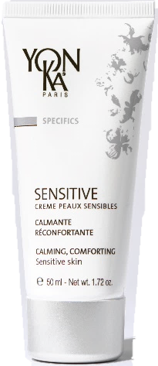
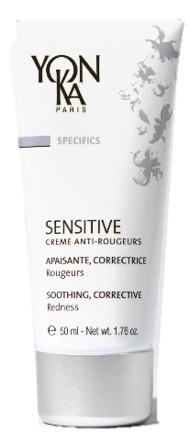
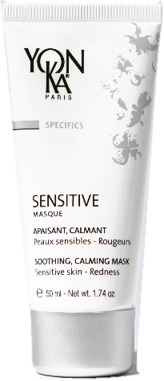
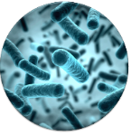


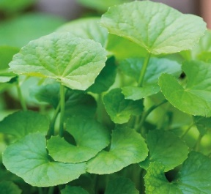

MY CURRENT ALLIES
I need peace and quiet and so does my skin!
SENSITIVE SKIN CREAM
SENSITIVE ANTI-REDNESS CREAM
SENSITIVE CREAM MASK
Basic treatment for sensitive and reactive skin
The extinguisher for reddened skin
Soothing and calming bandage effect mask
Notes:
More and more customers complain of sensitive skin: the SENSITIVE range is a superb soothing ally if they complain of redness, discomfort or itching.

Slide 42
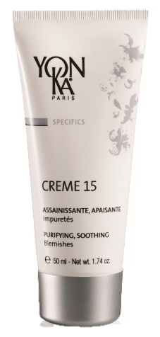
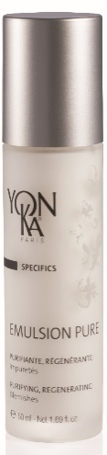
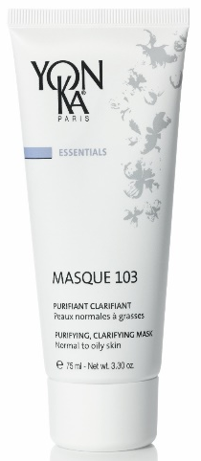
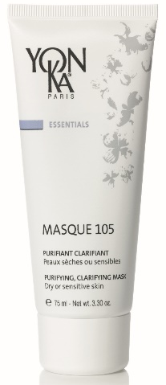
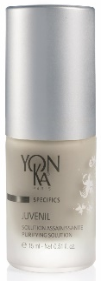

MY CURRENT ALLIES
Say goodbye to imperfections!
CREAM 15
JUVENIL
EMULSION PURE
MASK 103/105
Purifying and soothing
localised care cream
Sanitizing and soothing
solution
Purifying SOS lotion with
5 essential oils
Purifying-clearing Mask 103 for normal to oily skin. Purifying-soothing MASK 105 for dry to sensitive skin
Notes:
Whatever our age and skin type, we are all confronted with small and large pimples. Because the skin is asphyxiated, we propose a deep cleansing and our specific products to find a healthy and purified skin.

Slide 43
THANK YOU FOR YOUR ATTENTION
Notes:
This training ends with a little quote : "Take care of your skin because you will have it for the rest of your life".
Once again, Do not hesitate to ask the training department for the tools set up to help you during your diagnosis
Thank you very much for your attention. Please do not hesitate to ask questions and give us feedback. We wish you every success. TAKE CARE AND See you soon

