Slide 1
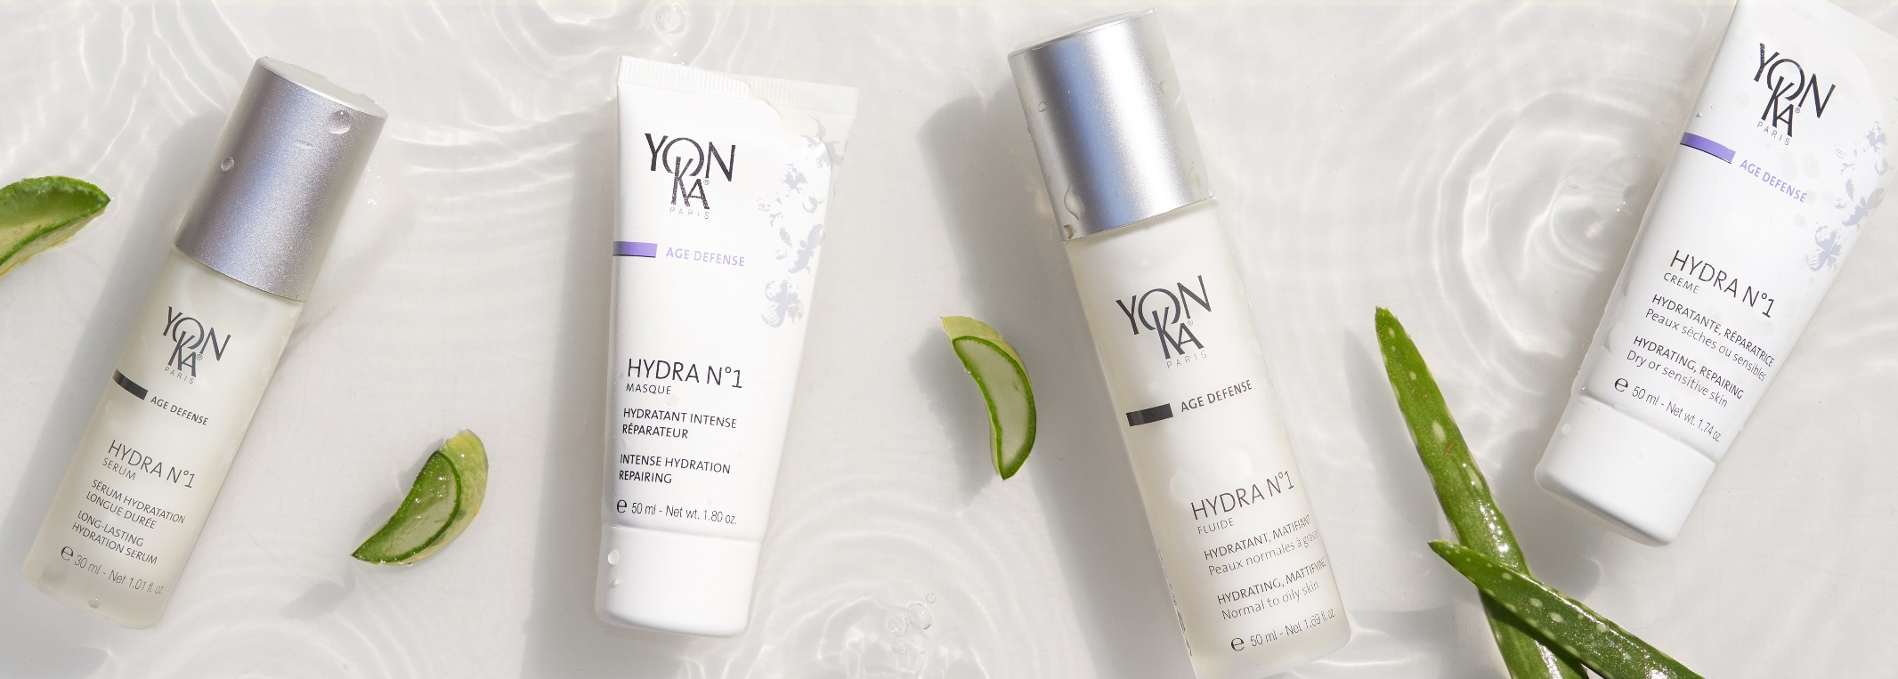
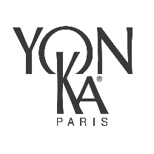
Hydra n°1
Notes:
As a reminder, this webinar will focus on the products of the hydra n°1 range. These are products that you already know, and this presentation is at your disposal to reproduce it with your customers.

Slide 2
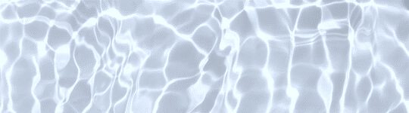

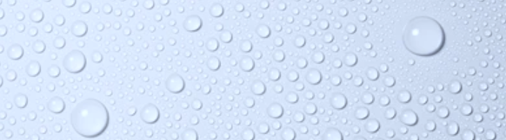
Hydration is …
A universal and fundamental need
At any age
For all skin types
It preserves: appearance, suppleness, softness, tonicity and radiance.
Well hydrated, the skin goes through the years better!
Notes:
Hydration is a universal and fundamental need
At any age,
And concerns all skin types:
No skin is immune to dehydration:
Mistreated" skins: by the use of unsuitable, aggressive products, or by dermo-aesthetic interventions
Dry skin: which is also inevitably dehydrated
Older skin: because with age the epidermis becomes thinner and the barrier function is less effective.
And all skin types because of daily aggressions such as wind, sun, heat, pollution dry environment, etc.. all these factors reduce the natural water reserve of the skin.
Hydration is essential because it has an important role in the quality of the skin:
it preserves its appearance, suppleness, softness, tonicity and its radiance.
This is why moisturizing the skin helps to prevent the signs of aging: Well hydrated skin goes through the years better!

Slide 3
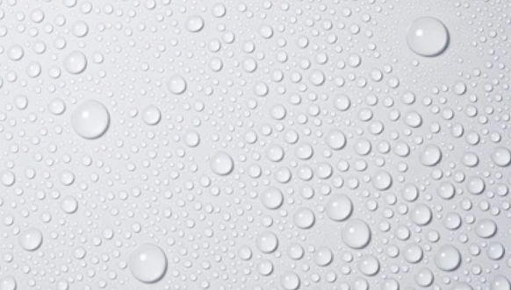
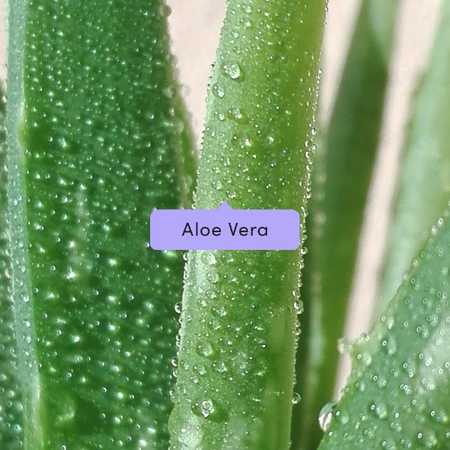
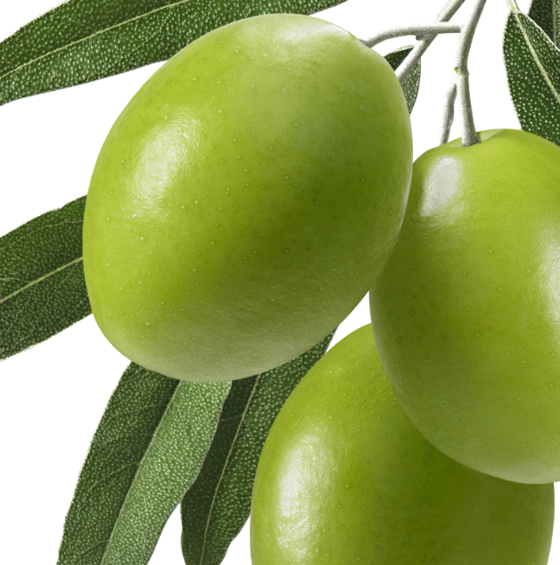



A common hydrating complex
Olive
Phytosqualane
Hyaluronic Acid*
Vitamins
Imperata cylindrica
Notes:
And to have a perfectly hydrated skin, Yon-Ka has developed a HYDRATING COMPLEX especially for the range Hydra
n°1
this complex is composed of :
Aloe Vera
Imperata cylindrica
Olive Phytosqualane
Hyaluronic Acid* (two different molecular weight) *Except HYDRA N°1 SERUM which contains only low molecular weight HA and hydra n°1 Mask which does not contain HA.
And vitamins A, C et E.

Slide 4
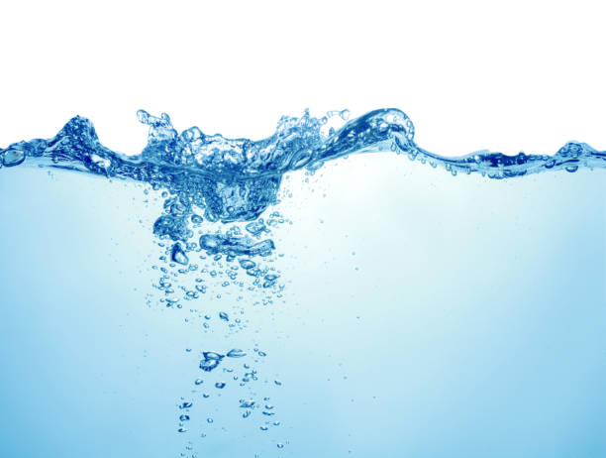
For hydration at all levels
STRATUM CORNEUM
Reinforces the skin's barrier function:
ALOE VERA & OLIVE PHYTOSQUALANE
EPIDERMIS
Avoids TransEpidermal Water Loss (TEWL)
IMPERATA CYLINDRICA
Maintains water in the skin
HIGH MOLECULAR WEIGHT HYALURONIC ACID AND/OR PCA
DERMIS
Restores water reserves
LOW MOLECULAR WEIGHT HYALURONIC ACID AND/OR SILICON
Protects the molecules that fix water
VITAMINS A, C, E
Notes:
And to ensure a good hydration, it is necessary to act at all levels of the skin: This is exactly what the complex will do!
First at the level of the stratum corneum
To reinforce the skin's barrier function and rebalance the Hydrolipidic film : thanks to ALOE VERA(hydrating) & OLIVE PHYTOSQUALANE (anti-dehydrating)
ALOE VERA : Ancestral moisturizing active ingredient.
Due to its genetic structure, it has very interesting characteristics for the skin: skin hydration, healing, cell regeneration.
Botanical miracle, baptized "plant of immortality" by the Egyptians. It is also called "divine plant", "elixir of youth", "silent healer" or "harmony remedy".
Composed of more than 70 nutrients including minerals, amino acids and vitamins, it is provided with essential and exceptional properties..
OLIVE PHYTOSQUALANE : Reinforces the HLF
Squalane is one of the main components of human sebum and the hydrolipidic film.
Here extracted from the olive.
Allows an easy application and a good penetration in the skin.
>
Second, at the level of the epidermis
To avoid TransEpidermal Water Loss (TEWL) and to maintain water in the skin.
Thanks to :
IMPERATA CYLINDRICA : INTENSE AND LONG-LASTING HYDRATION
Ancestral moisturizing active ingredient.
Subtropical plant native to Asia or Australia.
It is a grass still called Saccharum cylindricum which belongs to the common saccharum family (sugar cane).
It populates the sandy and saline areas along the sea or the flooded and deserted areas of the Australian desert where it manages to survive.
Its roots contain starches, sugar, and are rich in potassium.
This plant has the ability to trap water in the cells and maintain this capital. *
Maintains water in the skin = thanks to hygroscopic ingredients* = which means that trap water like :
HIGH MOLECULAR WEIGHT HYALURONIC ACID and/or PCA
HYALURONIC ACID
Ingredient produced by biosynthesis from plant substrates
Natural component of the skin: GAG (glycoaminoglycan) the most abundant in the skin
it can retain more than a thousand times its weight in water.
It also known to stimulate cellular renewal of the skin which increases its density (=anti-ageing action)
Thanks to it: the skin is naturally plump and smooth
High molecular weight = surface action
forms a moisturizing and protective film able to maintain a rate of hydration and to slow down its evaporation without being occlusive or greasy + immediate smoothing and plumping effect
PCA : PYRROLIDONE CARBOXYLIC ACID = hygroscopic
Origin: Beet
Part of the composition of our Natural Moisturizing Factor,
>
Last, at the dermis level
To restore water reserves with the low molecular weight hyaluronic Acid and/or silicon
LOW MOLECULAR WEIGHT HYALURONIC ACID
Acts in depth, boost the renewal of skin cells, provide a long lasting hydration + plumps the skin.
SILICON : essential for the synthesis of collagen and elastin fibers
Present in many foods. It induces or regulates the multiplication of fibroblasts.
The lack of organic silicon from the forties causes a significant drying of the skin and the appearance of wrinkles. Organic silicon derivatives are indicated to act on wrinkles, stretch marks and to improve the elasticity of the skin.
And to protect the cells with the VITAMINS A (regenerating) C, E (antioxydant)
_________________________________
MOLECULAR WEIGHT (extrait de Plurielles.fr – Le poids moléculaire dans nos crèmes, kézako ? )
In the formulas of cosmetic products, there are many active ingredients developed in laboratories and whose size can vary, including "polymers". A polymer is an ingredient made up of identical sub-units, like a chain of several links. The molecular weight indicates the length of the chain which is the sum total of the weight of each link.
So the more links there are, the longer the chain and the higher its weight, which indicates its size: heavy molecules are therefore large molecules.
What's the difference?
The molecules contained in the skincare products rest on the skin while waiting to be absorbed by the epidermis. But they do not penetrate in the same way according to their size! The largest ones remain on the surface of the epidermis, those of average size pass the cutaneous barrier and the smallest act in-depth.
Benefits and effects
Combining in a cream an active ingredient present in different molecular weights makes it possible to exploit all its abilities, at different levels in the skin, and to cumulate its effects. This is the interest of a care product with a molecule in two sizes: to act at several levels, on the surface and in depth.
Exemple de l'acide hyaluronique
Its molecules expand with water like sponges. And its use of low and high molecular weight allows it to act on the surface with an immediate smoothing and plumping effect, thus attenuating micro-relief and fine lines, as well as in depth with a low molecular weight hyaluronic acid which, by penetrating much further into the skin, restores its maximum level of hydration and replenishes it from the inside.

Slide 5
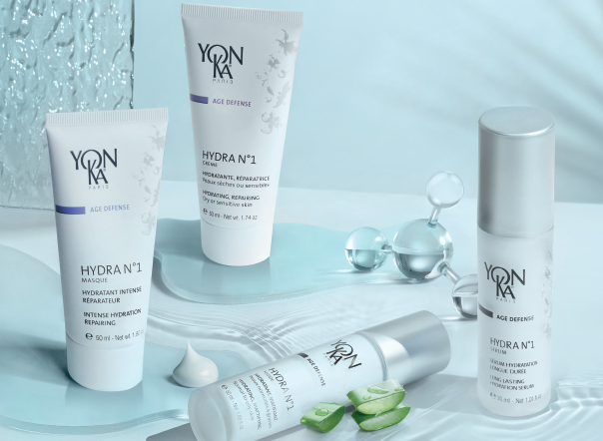
Hydra n°1
One range, different needs
Notes:
our 4 products of the hydra n°1 range will act at all these levels for an optimized hydration

Slide 6
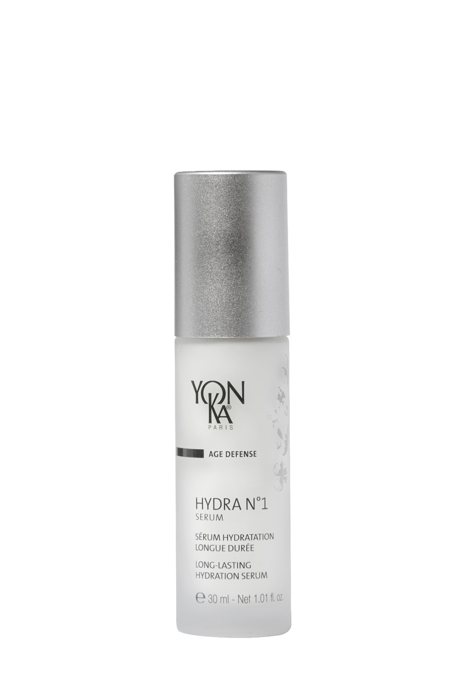


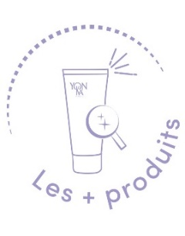
Hydra n°1 Serum
The ally of thirsty skin!
+ Serine et PCA
SOS serum for very dehydrated skin
Deep and long-lasting hydration
Restructuring and redensifying effect
Soft, supple and plumped up skin
With hydra n°1 creme
+144% of hydration immediately and +102% after 8 hours
With hydra n°1 fluide
+122% of hydration immediately and +76% after 8 hours
93% of Ingredients of Natural Origin
Quickly absorbed gel texture
Natural fragrance of rose, jasmine and chamomile
Notes:
First product : HYDRA N°1 SERUM : the ally of thirsty skin !
Description :
This moisturizing serum with hyaluronic acid is the SOS treatment for very dehydrated skin, providing deep and long-lasting hydration. Enriched with restructuring and redensifying active ingredients, the skin is intensely soft, supple and plumped up
Results :
Combined with hydra n°1 crème
+144% of hydration immediately and +102% after 8 hours
With hydra n°1 fluide
+122% of hydration immediately and +76% after 8 hours
What we love :
93% of Ingredients of Natural Origin
Quickly absorbed gel texture
Natural fragrance of rose, jasmine and chamomile

Slide 7
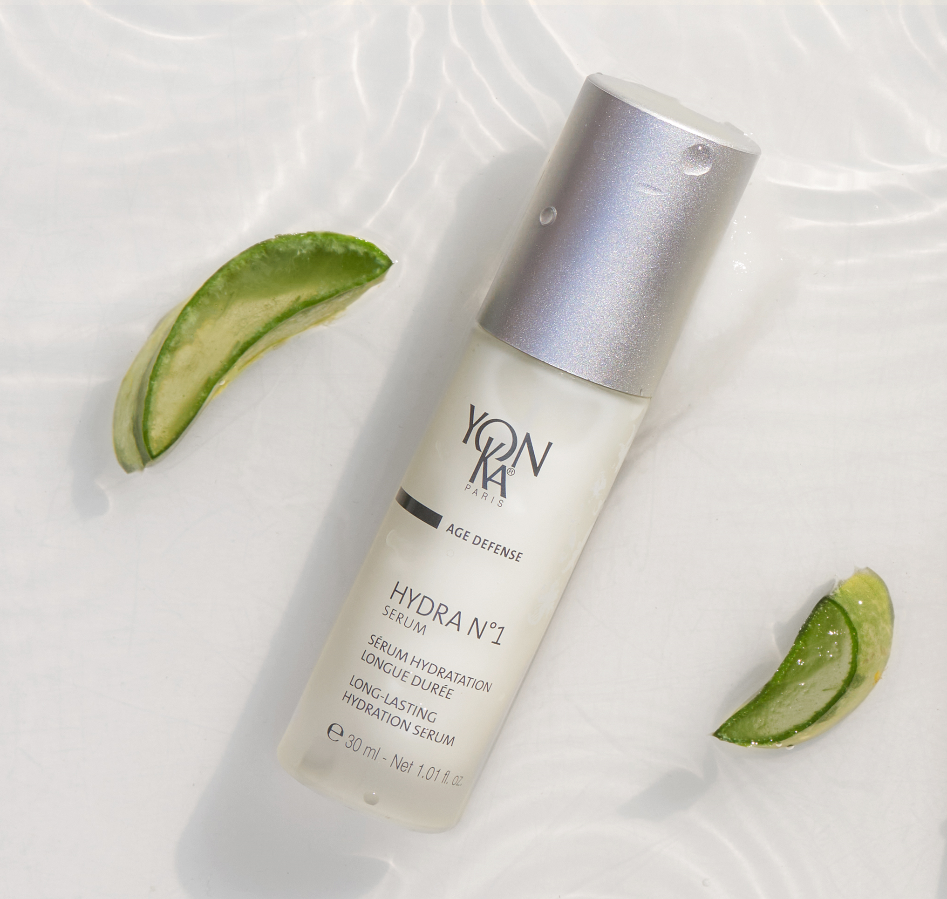

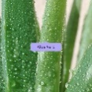
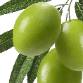
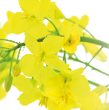








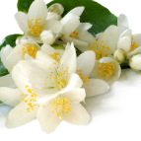

Hydra n°1 Serum
▪ Perfect for everyone: men, women, all ages, all skin types, all year round!
▪ As an intensive course before and after the summer and/or winter.
▪ 1 pump added to the foundation for a long lasting hold!
▪ In addition, use Hydra N°1 Masque one to three times a week.
+
+
+
Hydrating Complex
Organic aloe vera, olive phytosqualane, imperata cylindrica, vitamins ACE, Low Molecular weight HA
vegetal glycerin, serine, PCA et polysaccharides
Hydrating
Yeast extract and silicon
Restructuring - redensifying
rose, chamomile and
jasmine E.O
Balancing - relaxing
Notes:
▪ Perfect for everyone: men, women, all ages, all skin types, all year round!
▪ it could be used As an intensive course before and after the summer and/or winter.
▪ it could be combiend with the foundation : 1 pump added to the foundation for a long lasting hold!
▪ In addition, use Hydra N°1 Masque one to three times a week.
▪ Hydra n°1 serum – with nude perfect or creme anti-rougeurs - TOP TOP
"My skin is uncomfortable and tight
"My skin is flaky "
"My foundation is not lasting "
"I just came back from the sun, my skin is dull and uncomfortable “
Ingredients :
Hydrating complex with :
Organic aloe vera & olive phytosqualane : Hydrating, Reinforces the skin's barrier function:
imperata cylindrica : hygroscopic = Intense and long-lasting hydration
Low Molecular weight HA : deep hydration, skin cell renewal, redensifying and restucturing
Vitamins ACE : protect the cells , regenerating and antioxydant.
Polysacharides, serine, PCA, vegetal glycerin : hydrating
+
YEAST EXTRACT : Restructuring - redensifying : helps to form a lipidic cement
SILICON : replenishes the skin's water reserves. It stimulates the multiplication of fibroblasts.
Present in many foods.
It has been observed that silicon is essential for the synthesis of collagen and elastin fibers. The deficit in organic silicon from the forties causes a significant drying of the skin and the appearance of wrinkles. Organic silicon derivatives (silanols) are therefore indicated to act on wrinkles, stretch marks and to improve the elasticity of the skin.
+
rose, chamomile and jasmine E.O : Balancing - relaxing (fragrance of the hydra n°1 range)
VEGETAL GLYCERIN (ECOCERT ingredient, comes from European rapeseed) Action: Humectant and moisturizing, it reduces the speed of water evaporation from the surface of the skin, softens, smoothes and reduces roughness.
SERINE: amino acid that is part of the Natural Moisturizing Factor (NMF) which is the moisturizing factor that maintains the skin's normal hydration
PCA: PYRROLIDONE CARBOXYLIC ACID = part of the NMF, hygroscopic > maintains water in the skin
Origin: Beetroot
POLYSACCHARIDE : Immediate and long-lasting moisturizing power, brings a silky touch
Origin: biotechnology
Composition: polysaccharide (complex sugar composed of several molecules of simple sugars) obtained by natural bacterial fermentation whose substrates are corn sorbitol and soy peptone.

Slide 8
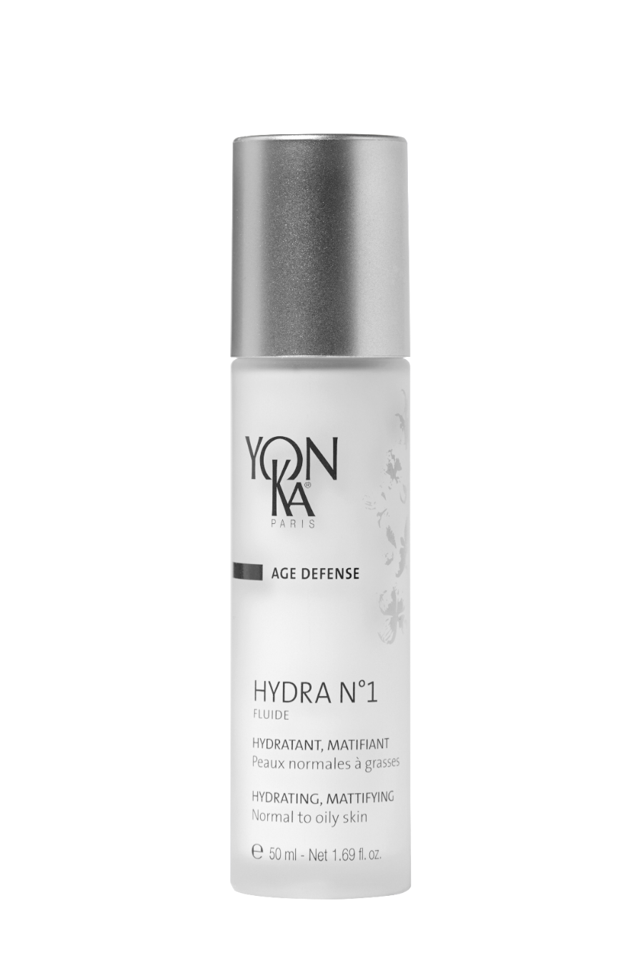
Hydra n°1 Fluide
The ultra hydrating and mattifying fluid!
Non-greasy, quickly absorbed mattifying fluid
Replenishes normal to oily skin
Soft, supple, radiant and plumped-up skin
+ Aloe vera
Intense and long-lasting hydration
+110% immediately and +59% after 8 hours
Used with hydra n°1 serum
+122% immediately and +76% after 8 hours
Gel-cream texture
Mattifying effect on the T-zone
Natural fragrance of rose, jasmine and chamomile
Notes:
HYDRA N1 FLUIDE : The ultra hydrating and mattifying fluid! (88% ION)
Description :
Your skin is oily or combination, but feels dehydrated! You will appreciate Hydra N°1 Fluid, a non-greasy and quickly absorbed mattifying fluid. It Replenishes normal to oily skin. And leaves a Soft, supple, radiant and plumped-up skin
Results
Intense and long-lasting hydration:
+110% immediately
+59% after 8 hours
Used with hydra n°1 serum
+122% immediately and
+76% after 8 hours
What we love
Gel-cream texture
Mattifying effect on the T-zone
Natural fragrance of rose, jasmine and chamomile

Slide 9
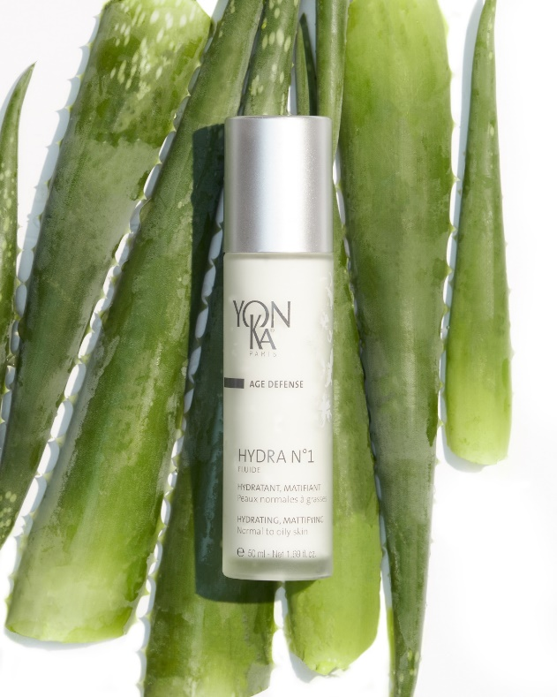
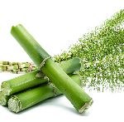


Hydra n°1 Fluide
▪ Ideal for oily or combination dehydrated skin..
▪ Light texture ideal for summer.
▪ In addition, use Hydra N°1 Masque one to three times a week.
▪ To maximize results, combine with a Serum or a Booster
+
+
+
+
Hydrating Complex
Organic aloe vera, olive phytosqualane, imperata cylindrica, vitamins ACE, Low and High Molecular weight HA
silica
Mattifying
vegetal glycerin, PCA et polysaccharides
Hydrating
silicon
Restructuring - redensifying
rose, chamomile and
jasmine E.O
Balancing - relaxing
Notes:
Tips
▪ Ideal for oily or combination dehydrated skin..
▪ Light texture ideal for summer.
▪ In addition, use Hydra N°1 Masque one to three times a week.
▪ To maximize results, combine with a Serum or a Booster
"My skin is uncomfortable and tight on my cheeks but I tend to shine on my forehead.
"I just came back from the sun and my skin is slightly dehydrated "
Ingredients :
Complexe hydratant :
Hydrating complex with :
Organic aloe vera & olive phytosqualane : Hydrating, Reinforces the skin's barrier function:
imperata cylindrica : hygroscopic = Intense and long-lasting hydration
Low Molecular weight HA : deep hydration, skin cell renewal, redensifying and restucturing
High Molecular weigh HA = surface action : forms a moisturizing and protective film able to maintain a rate of hydration and to slow down its evaporation without being occlusive or greasy + immediate smoothing and plumping effect
Vitamins ACE : protect the cells , regenerating and antioxydant.
+
SILICA : MATTIFYING : (ECOCERT) Made of porous spheres - Absorbs excess sebum & provides a soft and slippery touch
+
VEGETAL GLYCERIN, PCA ET POLYSACCHARIDES : Hydrating
+
SILICON : replenishes the skin's water reserves. It stimulates the multiplication of fibroblasts.
+
ROSE, CHAMOMILE AND JASMINE E.O : Balancing - relaxing

Slide 10
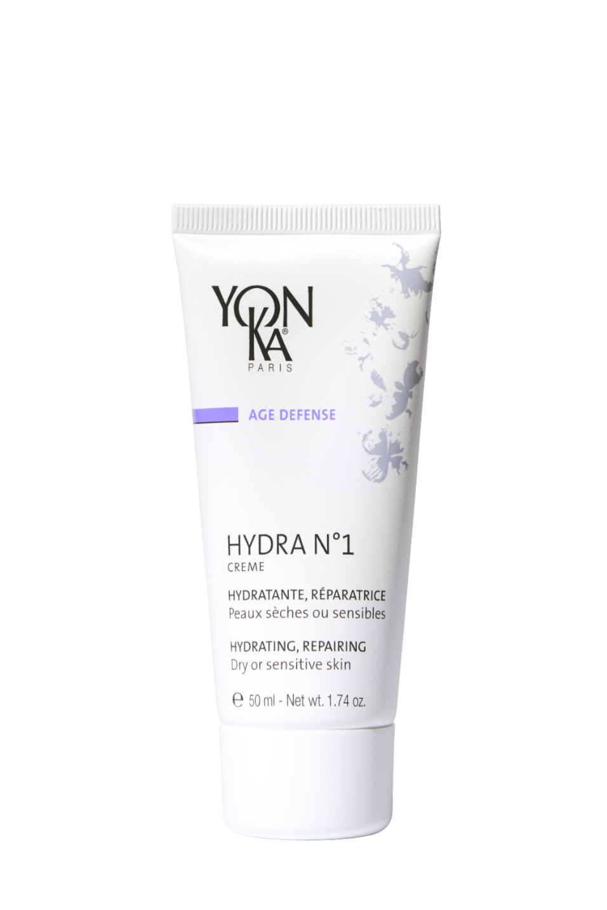
Hydra n°1 Creme
A real comforting cocoon for very dehydrated skin
Reinforces the skin's barrier function
Provides immediate comfort
Soft, supple, radiant and plump skin
+ Vitamin B5
Intense and long-lasting hydrating power:
+138% immediately and +86% after 8 hours
Used with hydra n°1 Serum
+144% immediately +102% after 8 hours
94% Natural Origin Ingredients
Rich in repairing ingredients
Notes:
HYDRA N1 CREME - 94% ION
Description
This intense and long-lasting moisturizing cream is a real comforting cocoon for very dehydrated skin.
Hydra N° 1 Cream Reinforces the skin's barrier function - Provides immediate comfort – the skin becomes Soft, supple, radiant and plump.
Results
intense and long-lasting hydrating power:
+138% immediately and +86% after 8 hours
Used with hydra n°1 serum
+144% immediately +102% after 8 hours
What we love
94% Natural Origin Ingredients
Rich in repairing ingredients

Slide 11
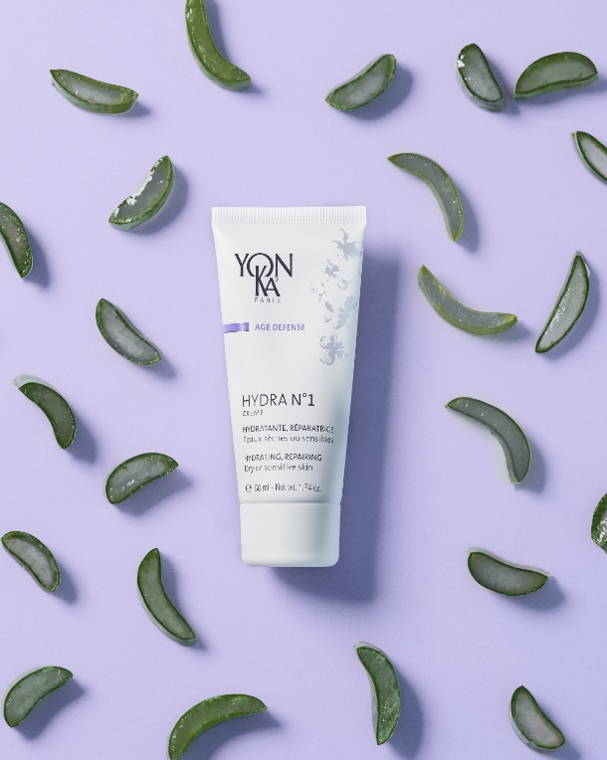
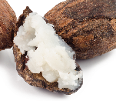
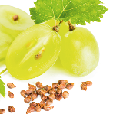
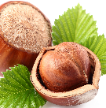





Hydra n°1 Creme
▪ Ultra-comforting cocooning texture
▪ Ideal mixed with foundation for very dehydrated skin.
▪ In addition, use Hydra N°1 Masque one to three times a week.
▪ To maximize results, combine with a Serum or a Booster
+
Hydrating Complex
Organic aloe vera, olive phytosqualane, imperata cylindrica, vitamins ACE, Low and High Molecular weight HA
shea butter, grape seed oil, hazelnut oil,
Repairing
Vegetal glycerin
Hydrating
Yeast extract and silicon
Restructuring - redensifying
Vitamin B5
Soothing
Vitamin F
Anti dehydrating
rose, chamomile and
jasmine E.O
Balancing - relaxing
Notes:
Tips
▪ Ultra-comforting cocooning texture
▪ Ideal mixed with foundation for very dehydrated skin.
▪ In addition, use Hydra N°1 Masque one to three times a week.
▪ To maximize results, combine with a Serum or a Booster
"When I get out of the shower, my skin is uncomfortable and tight”
"When I put on makeup, my foundation runs into the creases"
Ingrédients :
Complexe hydratant :
Hydrating complex with :
Organic aloe vera & olive phytosqualane : Hydrating, Reinforces the skin's barrier function:
imperata cylindrica : hygroscopic = Intense and long-lasting hydration
Low Molecular weight HA : deep hydration, skin cell renewal, redensifying and restucturing
High Molecular weigh HA = surface action : forms a moisturizing and protective film able to maintain a rate of hydration and to slow down its evaporation without being occlusive or greasy + immediate smoothing and plumping effect
Vitamins ACE : protect the cells , regenerating and antioxydant.
+ Shea Butter, grape seed oil and hazelnut oil : repairing
SHEA BUTTER : Nourishing, smoothing, healing
Vegetable butter extracted from the shea nut (shea tree: Central Africa, savannah trees)
Rich in unsaponifiables and vitamins (A, D, E, F)
GRAPE SEED OIL : moisturizing and restructuring
reduces TEWL, restores elasticity.
rich in linoleic acid (75%) provides the skin with essential fatty acids (linoleic acid, oleic acid, stearic acid, palmitic acid)
Presence of bioflavonoids, oligomeric proanthocyanidins, which are excellent anti-oxidants. Several researches have demonstrated the influence of proanthocyanidins on the stability of collagen and the health of elastin.
HAZELNUT OIL : High moisturizing power Helps the penetration of active ingredients such as aromatherapy.
Origin: extracted from the fruit of the hazel tree (Corylus Avellana)
Action: : high phospholipid content / high resistance to oxidation / non-comedogenic
+
VEGETAL GLYCERIN : hydrating
+
YEAST EXTRACT AND SILICON : Restructuring - redensifying
+
VITAMIN B5 : Soothing
hygroscopic ~ healing ~ reaches the deep layers of the skin while leaving a thin film on the surface.
VITAMIN F : Antidehydrating
composed mainly of linoleic acid
ROSE, CHAMOMILE AND JASMINE E.O : Balancing - relaxing

Slide 12
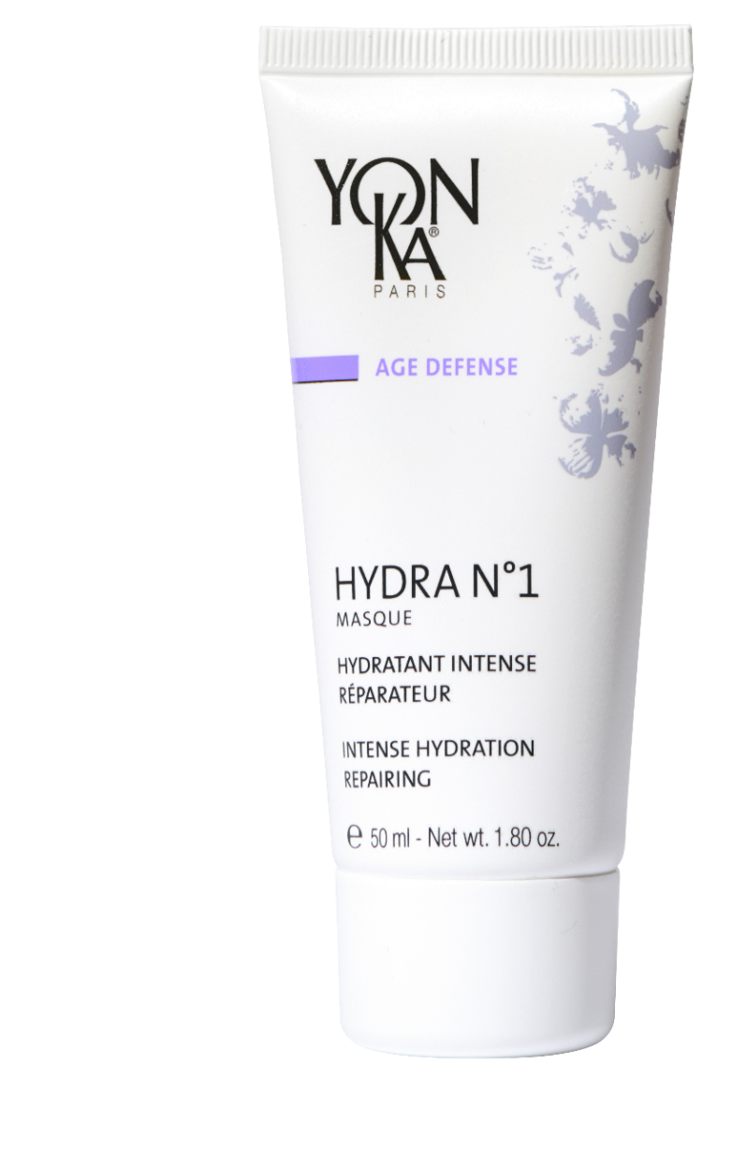

Hydra n°1 Masque
a moisturizing bath for all dehydrated skin
+ Jojoba
Smoothes the skin's surface
Reduces fine lines
Softer, firmer skin
Preserves the skin's youthful appearance
Intense hydrating action:
+124% after 2h
+73% after 8h
Gel-cream texture
Rich in vitamins
Can be used as a sleeping mask
Notes:
HYDRA N1 MASQUE : 89% ION
This mask is the best face mask for all dehydrated skin.
It Smoothes the skin's surface
Reduces fine lines
leaves the skin softer and firmer
Preserves the skin's youthful appearance
Results
Intense hydrating action:
+124% after 2h
+73% after 8 h*
* Clinical corneometry test - 10 adult volunteers
Les + produits
Gel-cream texture
Rich in vitamins A, E, C, B5 et en Jojoba
Can be used as a sleeping mask

Slide 13
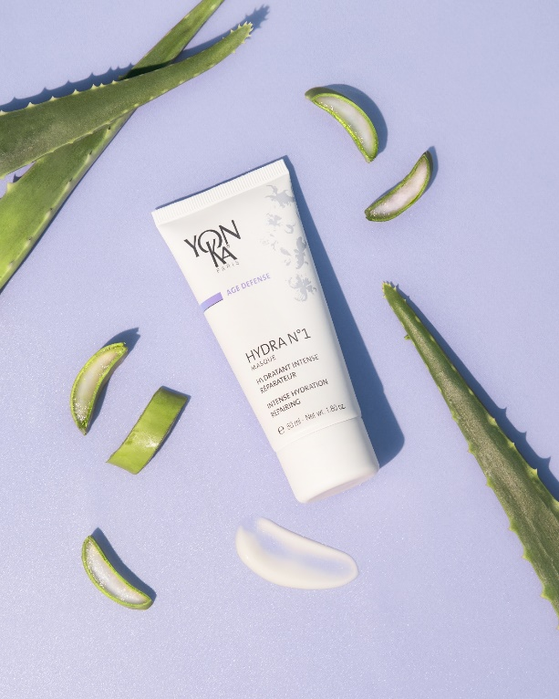

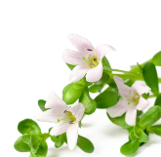


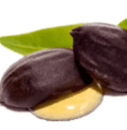


Hydra n°1 masque
▪ 1 to 3 times a week : Apply in thick layer to the face and neck. Leave on for 20 min. to an hour according to the needs. Absorb the excess with a tissue. Do not rinse off.
▪ For very dehydrated skin : Use as a sleeping mask for 1 week instead of your usual cream.
▪ Very damaged skin (excess of sun exposure, microdermabrasion…) : Use as a sleeping mask for 3 weeks instead of your usual cream.
Personnal tips : Add Hydra n°1 serum before applying your mask - take a steam bath while applying the mask
+
Imperata cylindrica, organic aloe vera bio, olive phytosqualane, vegetal glycerin, PCA
Hydratant
rose, chamomile and
shiu E.O
Balancing - relaxing
Vitamin A and silicon derivative
Regenerating
Bacopa monniera
Vitamins E, C
Antioxydant
Jojoba
Reparing
Vitamin B5
et bisabolol
Soothing
Notes:
Tips
▪ 1 to 3 times a week : Apply in thick layer to the face and neck. Leave on for 20 min. to an hour according to the needs. Absorb the excess with a tissue. Do not rinse off.
▪ For very dehydrated skin : Use as a sleeping mask for 1 week instead of your usual cream.
▪ Very damaged skin (excess of sun exposure, microdermabrasion…) : Use as a sleeping mask for 3 weeks instead of your usual cream.
▪ Personnal tips : Add hydra N°1 serum before applying your mask - take a steam bath while applying the mask
Ingredients :
imperata cylindrica, organic aloe vera bio, olive phytosqualane, vegetal glycerin, PCA : Hydrating
+
Vitamin A and silicon derivative : Regenerating
+
Bacopa monniera, Vitamins e ET c : Anti-radical and anti-oxidant
Origin: Indo-Pakistani continent. Leaf extract. Plant recognized for its soothing properties in Ayurvedic medicine
+
JOJOBA : ANTI DEHYDRATING – REPAIRING
+
VITAMIN B5 : Soothing
hygroscopic ~ healing
BISABOLOL : Soothing
Origin: Brazil, extracted from a tree, Vanillosmopsis erythropappa - same active ingredient as chamomile
Extracted from wood oil - Action: anti-inflammatory, antibacterial and antimycotic, inhibiting action against UV-induced erythema
ROSE CHAMOMILLE ET SHIU EO : Balancing and relaxing
Cinnamomum camphora à linalool (H.E. de shiu/Shiu leaf oil)
Origin: China
also called Japanese laurel
Extraction method : Distillation of the leaves of the shiu sho tree
Action : Used for its perfume, soothing, relaxing
Scent close to the essential oil of lavender
ROSA DAMASCENE (Rose E.O. / Rose flower Oil)
Origin: Turkey
Method of extraction: Distillation of the flowers
Action: Used for its perfume, softening, relaxing, anti-wrinkle
JASMINUM SAMBAC (Jasmine E.O./Jasmine Oil)
Origin : India
Extraction method : Ethanol extraction of the concrete
Action : Used for its perfume, softening
ANTHEMIS NOBILIS (Chamomile EO)
Origin: Central Europe. Cultivated in Europe (Belgium, England, Italy, France). The Egyptians venerated it.
Extraction method: Steam distillation of the flowers
Action: Anti-inflammatory, healing, antiseptic and antispasmodic

Slide 14
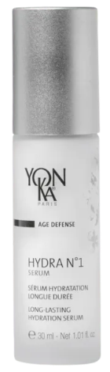

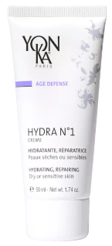
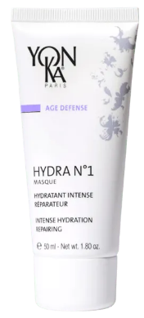
The Yon-Ka hydrating range
to moisturize and mattify dehydrated combination skin
with HA + Silica
to deeply moisturize
Low Molecular Weight Hyaluronic Acid
to moisturize and comfort very dehydrated, uncomfortable skin
with HA + vit B5
to hydrate
and repair
imperata cylindrica + jojoba
Hydra n°1 Serum
Hydra n°1 Fluide
Hydra n°1 Creme
Hydra n°1 Masque
Notes:
Hydra n°1 serum: to deeply moisturize thanks to Low Molecular Weight Hyaluronic Acid + Serine and PCA
Hydra n°1 fluid: to moisturize and mattify dehydrated combination skin with HA + Sillice
Hydra n°1 cream: to moisturize and comfort very dehydrated, uncomfortable skin thanks to HA + Shea butter and vitamin B5
The mask Hydra n°1: to hydrate and repair all the thirsty skins thanks to the imperata cylindrica + jojoba
we have 4 products, to meet different needs
which can be used all year round, punctually or as a cure, alone or combined!

Slide 15
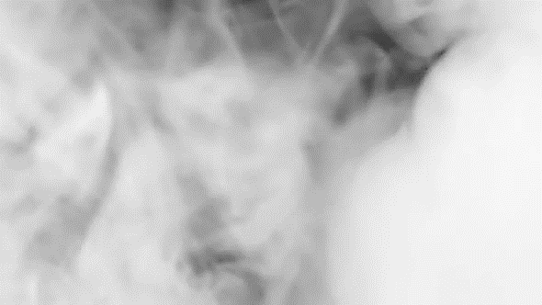
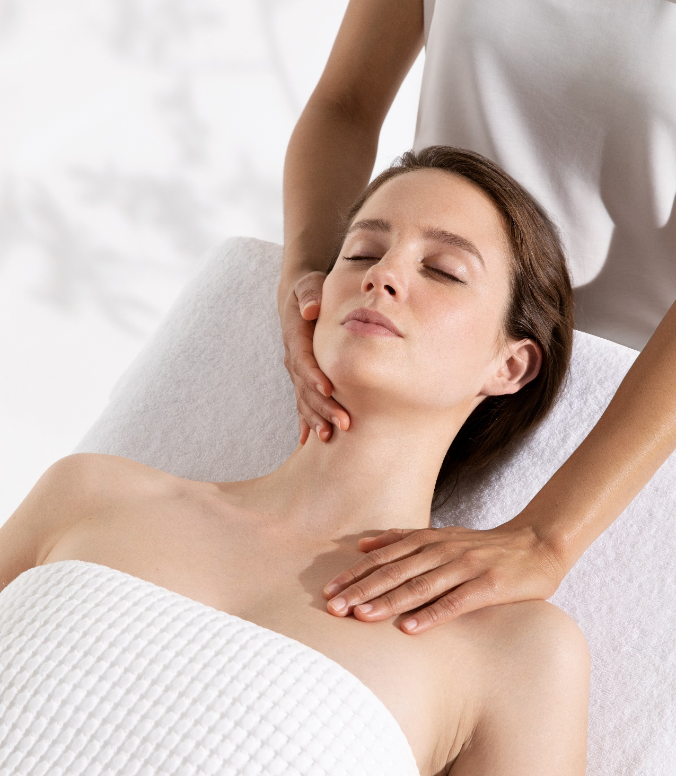
professionnal treatment

Slide 16
Hydralessence in 2’
An ultra-hydrating, refreshing facial to control the effects of extreme moisture loss
Results
01
02
03
04
Hydrate
the skin
refresh
The skin
Soothe
the skin
rebalance
The skin
Yon-ka plus :
Frequency
01
As a treatment course: Once a week for a month (4facials)
Routine care: once a month
Mask under steam
02
Blackhead extraction
target
Dehydrated skins
03
Double massage
Duration
04
Double mask
60mn
Notes:
Hydralessence : An ultra-hydrating, refreshing facial to control the effects of extreme moisture loss
Mask under steam to improve absorption of ingredients and boost results
Blackhead extraction, following the yon-ka steps (preparation with hydra+ and post extraction with crème 15 and emulsion concentrée)
Double massage for double relaxation
Double mask for double efficiency
Frequency :
As a treatment course: Once a week for a month (4facials)
Routine care: once a month
Target : dehydrated skin
Duration : 1 hour

Slide 17
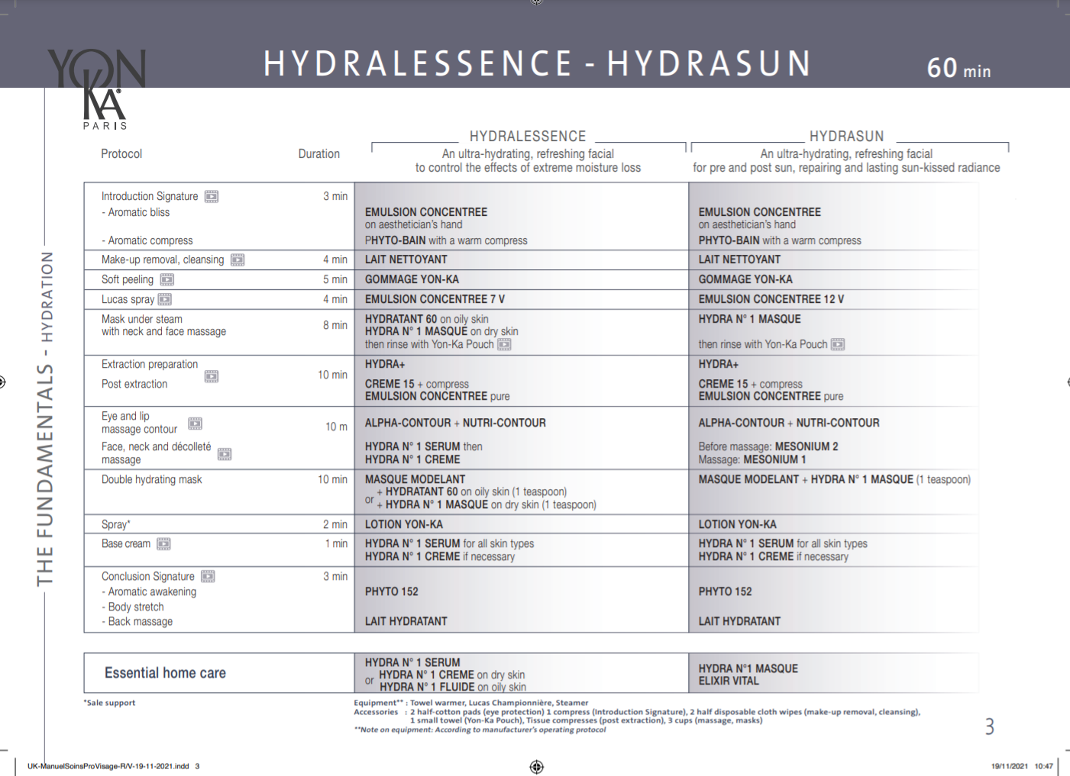
Notes:
A one-hour treatment that combines :
Yon-Ka's expertise with essential signature steps
Efficiency with an exclusive moisturizing treatment and the application of two thirst-quenching masks, one of which is massaged in under a fine warm mist
Relaxation and well-being of a very complete treatment with a double massage
One of the major assets of this treatment is its HYDRASUN version: ideal before or after exposure to the sun to ensure a unified and radiant tan, an intense hydration to prepare or repair the skin.
The results: skin that is replenished, soothed and rebalanced, soft and luminous once again.

Slide 18
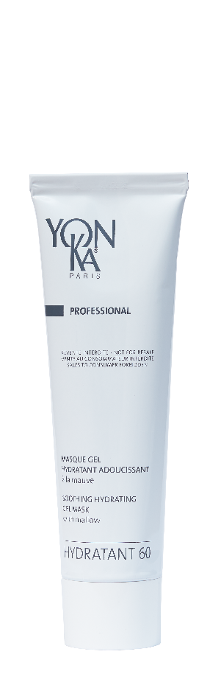
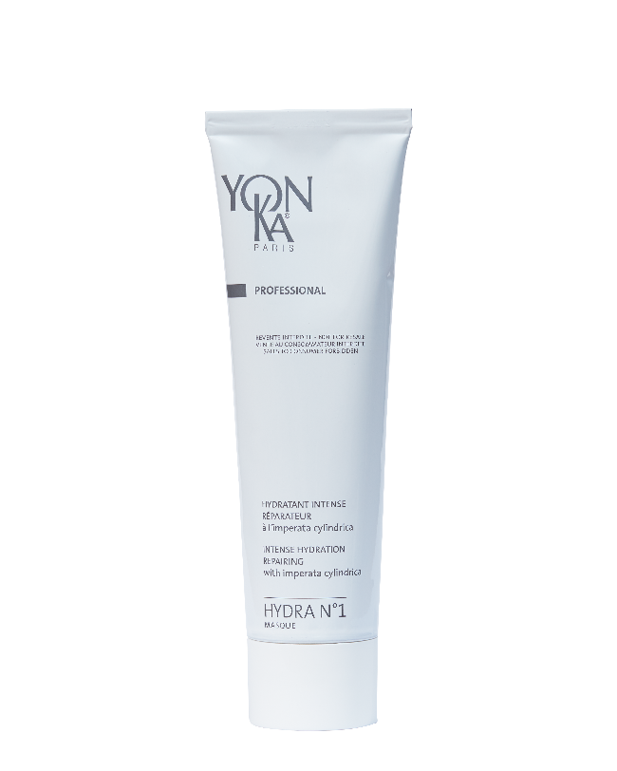
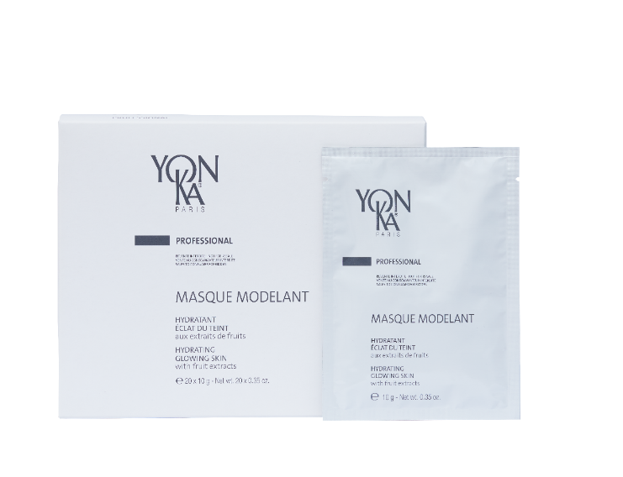
The hydrating products of the care
Moisturize
Combination and oily skin
Moisturize dry/dehydrated skin
Moisturize
Brighten
Hydratant 60
Hydra N°1
Masque
Masque Modelant
Notes:
Hydratant 60 :
Massage under steam and mixed with the modeling mask to maximize hydration.
For a Double Moisturizing Mask: prepare the Modeling Mask and add a teaspoon of Moisturizer 60
- Can be applied to lips and eyelids
Ingredients
Carob: Moisturizing - softening
Mallow: Soothing
Yon-Ka Quintessence, savory E.O., wild thyme: Refreshing
Moisturizes and softens
Gel mask
Fresh and natural scent
Non greasy
Could be apply to the eye contour area
Smoothes the skin, reduces wrinkles and fine lines
Ionophoresis: At the + pole
HYDRA N°1 MASK
Same as retail.
Massage under steam and mixed with the modeling mask to maximize hydration / Double dose of hydration.
MASQUE MODELANT : Peel-off mask – exclusive professional use
Mask alone in face treatment • Place 2 bags (of 10gr) in a bowl and add about 60 ml of fresh water.
Double Hydrating Mask: prepare Masque Modelant - Then, add a tea spoon of hydratant 60 or Masque N°1 (in hydralessence and hydrasun)
Masque Modelant + Pamplemousse: same preparation, application and removal as mentioned above. • in Eclat Cocoon
Mask alone in eyes and lips perfection treatment • Place 1 bag (of 10gr) in a bowl and add about 30 ml of fresh water
The temperature of the water is important: cool water or room temperature. If the water is too cold or too hot, the mask coagulates/dries out faster and it becomes difficult to apply.
aloe vera, algae (diatoms) : Hydratating
Blackcurrant (cassis), pineapple : Glowing Skin – soothing
Pilewort (Ficaire) : Anti-inflammatory
Green tea : Anti-oxydant

Slide 19
LET’S PLAY !

Slide 20
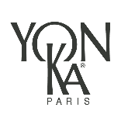
Let’s play !
What are the components of the hydrating complexe in the HYDRA N°1 range ?
A
Hyaluronic acid
PCA
Vegetale glycerin
Allantoin
Aloe vera
B
Rosemary
Cypress
Geranium
Lavender
Thyme
C
Hyaluronic Acid
Aloe Vera
Imperata Cylindrica
Olive Phytosqualane
Vit. A, C, E
Notes:
Thanks to this hydrating complex, HYDRA N°1 products act at all levels of the skin to provide intense hydration:
COUCHE-CORNEE
- Reinforce the barrier function of the skin: Phytosqualane of olive / Aloe vera
EPIDERME
- Regulate water transfers: Imperata cylindrica
- Maintain water in the skin: High molecular weight Hyaluronic acid and/or PCA
DERME
- Replenish water reserves: Low molecular weight hyaluronic acid and/or silicon
- Protect water-binding molecules: Vitamins A, C, E

Slide 21
Let’s play !
What is the mattifying active ingredient in
hydra n°1 fluide ?
A
Konjac
B
Silica
C
Silicon
Notes:
SILICA : MATTIFYING : (ECOCERT) Made of porous spheres - Absorbs excess sebum & provides a soft and slippery touch
Not to be confused with silicon: Restructuring - redensifying
SILICON : replenishes the skin's water reserves. Present in many foods. It induces or regulates the multiplication of fibroblasts.
It has been observed that silicon is essential for the synthesis of collagen and elastin fibers. The deficit in organic silicon from the forties causes a significant drying of the skin and the appearance of wrinkles. Organic silicon derivatives (silanols) are therefore indicated to act on wrinkles, stretch marks and to improve the elasticity of the skin.

Slide 22
Let’s play !
What are the star ingredients of the hydra n°1 masque ?
A
Hyaluronic Acid
+
NMF
(Serine et PCA)
B
Imperata cylindrica
+
Jojoba
C
Hyaluronic acid
+
Aloe vera
Notes:
> Imperata cylindrica + Jojoba
(AH + NMF : sérum)
(AH + Aloe vera : fluide)
Hydra n°1 Mask does not contain HA but PCA instead
PCA : PYRROLIDONE CARBOXYLIC ACID
Origin: Beetroot
Used in the composition of NMF, hygroscopic
+ Imperata cylindrica + Jojoba + Aloe vera bio, olive phytosqualane, glycerin ....

Slide 23
Let’s play !
What is the difference between hydrasun and hydralessence ?
Notes:
HYDRALESSENCE : An ultra-hydrating, refreshing facial to control the effects of extreme moisture loss
Hydrasun : An ultra-hydrating, refreshing facial for pre and post sun, repairing and lasting sun kissed-radiance.

Slide 24
The offer

Slide 25
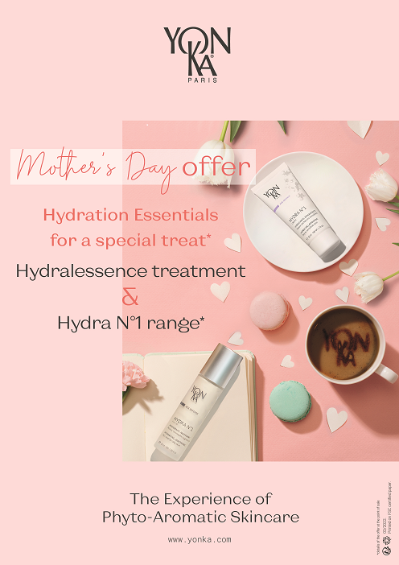
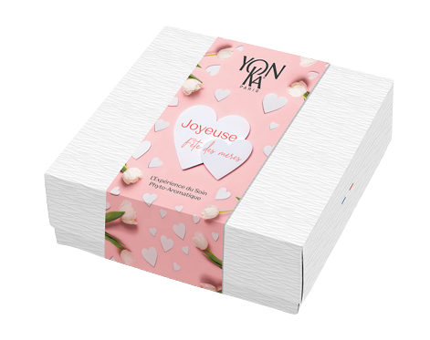
kakemono
SUGGESTED CONSUMER OFFER
With the purchase of a HYDRALESSENCE treatment
GET 25% OFF for every 2 products purchased
including 1 HYDRA N°1 product
Customizable institutional gift-box with personalized sleeves
Notes:
MIXED INSTITUTIONAL GIFT-BOX (EMPTY)
Paper-effect gift box - delivered flat (to be mounted)
Dim.: 21,5 x 21,5 x 7cm
Réf. 7F0940X
Standard packing: x 12
Availability : End of March 2022

Slide 26

VIDEO LOTION

Slide 27
