Slide 1
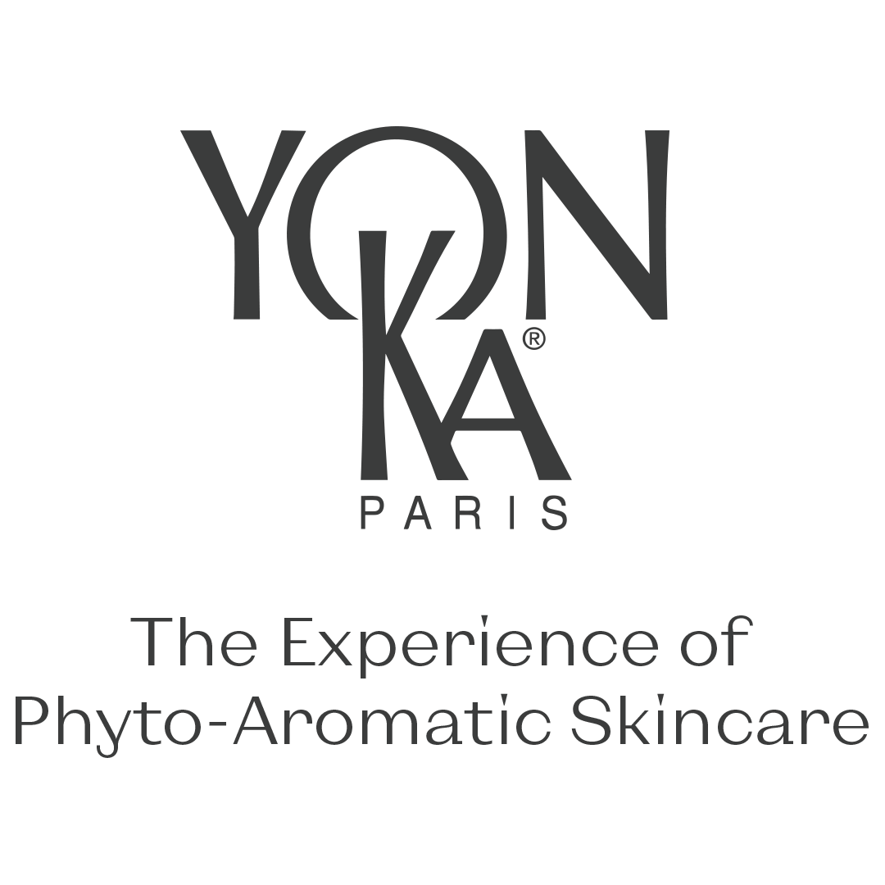

Slide 2
How to identify and treat SENSITIVE SKIN

Slide 3
How to identify a SENSITIVE SKIN
Skin hyper-reactivity to various factors :
Physical/Environmental
Chemical
Psychological
Hormonal, etc.
All skin types, all phototypes and all ages
Subjective…and sometimes objective signs
Notes:
What does it mean to have sensitive skin?
It is characterized by hyper-reactivity to certain factors that generally have no effect on "normal" epidermises: it therefore has lower tolerance than "normal" skin.
These sensitivity-triggering factors can be
Physical/Environmental: UV rays, cold, changes in temperature, wind, air-conditioning, friction
Chemical: cosmetics, soap, water, pollution
Psychological: stress, emotions, anxiety
Hormonal: menstrual cycles
Other factors: food (spices), alcohol, genetics
All skin types (normal, oily, dry, combination)
All phototypes are concerned (although dry, pale and fine skin is most likely to be affected)
All ages as well
Men and women are concerned, although women are more prone to sensitivity
How does hyper-reactivity show itself?
Sensitive skin is characterized by feelings of skin discomfort
Sensitivity is not necessarily permanent, its symptoms can sometimes be very discrete, not particularly clear and can happen by waves, or "episodes" of several days, months or even depending on the season.
All skin types can be sensitive, as sensitivity is not a skin type but rather a "skin condition", that is more or less transitory depending on each person's habits and genetics.

Slide 4
How to identify a SENSITIVE SKIN
Sensitive skin can manifest differently in different individuals.
Common signs and characteristics of sensitive skin :
REACTIVITY
REDNESS
DRYNESS
PRONE TO
ALLERGIE
FRAGILE BLOOD VESSELS
BUMPS & RASHES
BLUSHING & FLUSHING
PRONE TO SUNBURN
Notes:
Identifying sensitive skin can be a bit tricky, as it can manifest differently in different individuals. However, here are some common signs and characteristics of sensitive skin:
Reactivity: Sensitive skin tends to react easily to various triggers, such as certain skincare products, environmental factors (wind, sun, cold), or even stress. Common reactions include redness, itching, burning, or stinging sensations.
Redness: Persistent redness, particularly on the cheeks, nose, and forehead, can be an indicator of sensitive skin.
Dryness: Sensitive skin often experiences dryness, flakiness, and a feeling of tightness, especially after using certain products or being exposed to harsh weather conditions.
Prone to Allergies: Individuals with sensitive skin may be more prone to allergic reactions, which can be triggered by certain ingredients in cosmetics, detergents, or other products.
Fragile Blood Vessels: Sensitive skin may have visible blood vessels close to the surface, especially around the cheeks and nose. This condition is known as "telangiectasia."
Bumps and Rashes: Sensitive skin may develop small bumps, pustules, or rashes as a reaction to irritants.
Blushing and Flushing: Sensitive skin tends to blush or flush easily in response to various triggers like emotions, heat, or spicy foods.
Prone to Sunburn: Sensitive skin is more susceptible to sunburn and may experience a stronger reaction to sun exposure.

Slide 5
How to identify a SENSITIVE SKIN
Alternation of the skin’s barrier function
Environmental aggressions
Pollution, temperature variations, etc.
Lifestyle
Hygiene, cleaning products, stress, etc.
Ecoflora
Hydrolipidic film
+++++++++++++++++++++++
+ + + + + + + +
+ - - + - - + - - + - - + - - + - - +
Stratum corneum
Normal skin
Sensitive skin
Ecoflora : skin’s natural microbiological barrier made up of beneficial microbial flora
Ecoflora replaced by an opportunistic flora (-)
Hydrolipidic film + Stratum corneum is deficient
Notes:
Alteration of the skin's barrier function
Under the repeated influence of internal and external factors, skin barrier function is no longer optimal. This has consequences on several levels:
At the skin ecoflora level
The ecoflora is the skin's natural microbiological barrier. It can be found at the skin's surface, and is made up of mostly beneficial microbial flora. It protects the skin against pathogenic invasions, so serves as the first guard in charge of protecting skin: it alerts the organism and stimulates defense mechanisms.
Skin is perfectly protected as long as its Ecoflora is present in sufficient concentrations (here represented by +++).
However, it gets weaker with every aggression, and is replaced by an opportunistic and pathogenic flora (represented here by the ---). This flora causes skin imbalance that will lead to tingling, tautness and sources of discomfort.
= Need to stimulate natural defenses + reinstate balance within the skin's ecosystem (ensure a maximum of +++). The skin's natural defenses can be boosted using probiotics (lactobacillus for instance) and ecoflora balance can be restored using prebiotics (food for good bacteria).
Note: Skin flora = skin microbiotia = group of micro-organisms that cover the human body. Its composition varies according to the area of our body.
The flora is essentially made up of staphylococci and micrococcaceae. Corynebacteria, propionibacteria and yeasts can also be found, amongst others.
At the hydrolipidic film and stratum corneum level
This skin protection system becomes deficient and cause a loss of water (dehydration) and lack of lipids (drying), which in turn encourages the penetration of potentially irritating agents.
= Need to hydrate and nourish skin

Slide 6
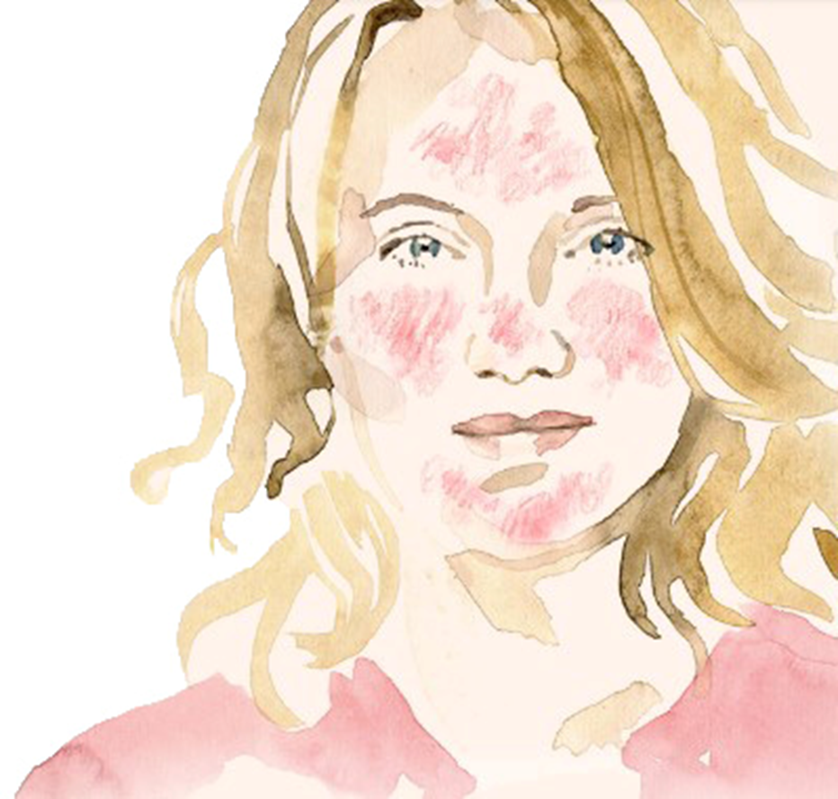
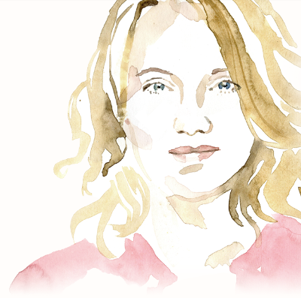
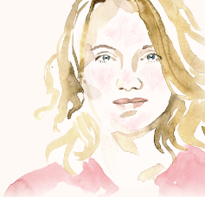
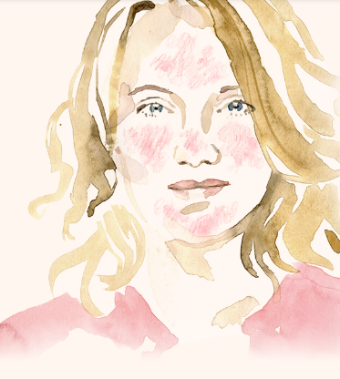
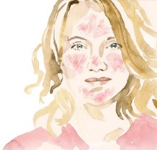
How to identify
SKIN WITH REDNESS
Diffuse or localized
Persistance
Intermittent or permanent
FLUSHES
Temporary acute
vascular reaction
ERYTHROSIS
Intermittent redness that becomes permanent
INFLAMMATORY REDNESS
caused by inflammatory reactions
ROSACEA
skin disease that requires medical attention
COUPEROSE
When the erythrosis develops and vessels can be seen
Notes:
Certain people's skin suffers from redness, often making it their number 1 priority. This concerns men as much as women
Where is redness generally located?
Redness can be
Diffuse (= all over the face)
Or localized – in this case it is generally located in the following areas: cheeks, nose, forehead, chin.
Redness can also be distinguished according to how long it lasts:
It can be
Intermittent (transitory, temporary, that come and go)
Or permanent (persistent)
When talking about redness, we can distinguish
Flushes: This is an acute vascular reaction that can result from stress or a high level of emotion, a change in temperature or food (too hot, too spicy, too much alcohol). This form of redness is temporary and can be embarrassing, but is not always a synonym of sensitivity. → psychosomatic reaction
Inflammatory redness: They are caused by inflammatory reactions
Erythrosis: Intermittent redness that becomes permanent. The vessels that normally dilate then retract never truly go back to their original status.
Couperose: When the erythrosis develops and certain vessels can be seen with the naked eye.
Lastly, rosacea (acne rosacea) is a skin disease that exists in several forms, with varying symptoms from one person to another. This affection requires medical attention.
The appearance of redness is brought on by a number of factors: environmental, chemical, psychological, hormonal, etc. Like we saw for sensitive skin, for instance UV rays, brutal variations in temperature, emotions, stress, food (too spicy, hot dishes), alcohol or hot drinks, smoking, intense physical exercise, genetics, etc.
Symptoms: Redness, obviously, but there can also be feelings of discomfort or hot sensations, etc.

Slide 7
How to identify
SKIN WITH REDNESS
From a skin point of view :
Inflammatory reaction
Redness - Heat
- Feelings of discomfort
Agressions
Inflammation mediators are activated
Neuropeptides are released
Vasodilation +++
Redness
Heat
Discomfort
Free radicals
Oxidative stress
Triggers
Notes:
aggression → inflammatory reaction → an alert message is sent (by activating the inflammation mediators = releasing cytokines and neuropeptides). This alert will lead to VASODILATION (= swelling of blood vessels), which has a bigger effect in people prone to redness.
Why?
The increased blood flow helps:
Bring in combative cells into the aggression site
Evacuate any destroyed cells and released toxins
As the vessels swell, local redness and hot sensations naturally appear. Discomfort can also be an issue.
To sum up, VASODILATION → REDNESS

Slide 8
How to identify and treat SENSITIVE SKIN
Your experiences
Notes:
With your help, I've collected some of your testimonials which we're going to look at together.I'd like to thank you for sharing your stories, which have been so enriching.

Slide 9
Your experience :
Ireland
« The majority of customers are sensitive here with dry dehydrated skin.
This is due to our climate being very harsh. The main skin concern here is rosacea and the Sensitive line and Hydra no 1 line seem to be the perfect fit here for this concern .»
HYDRA N°1
SENSITIVE
HYDRATE
INTENSIVELY
HYDRATING
MATIFYING
HYDRATE
COMFORTE
HYDRATING
REPAIRING
DESENSITIZE
SOOTHE
CORRECT
HYDRA N1 SERUM
HYDRA N1 FLUIDE
HYDRA N1 CREME
HYDRA N1 MASQUE
SENSITIVE CREME PEAUX SENSIBLES
SENSITIVE MASQUE PEAUX SENSIBLES
SENSITIVE CREME ANTI-ROUGEURS
Notes:
To be honest we never really have reactions with Yonka. Yonka seems to suit the Irish market very well. It's very rare we have customers come back with a response to Yonka.
The majority of customers are sensitive here with dry dehydrated skin. This is due to our climate being very harsh. The main skin concern here is rosacea and the sensitive line and Hydra no 1 line seem to be the perfect fit here for this concern.

Slide 10
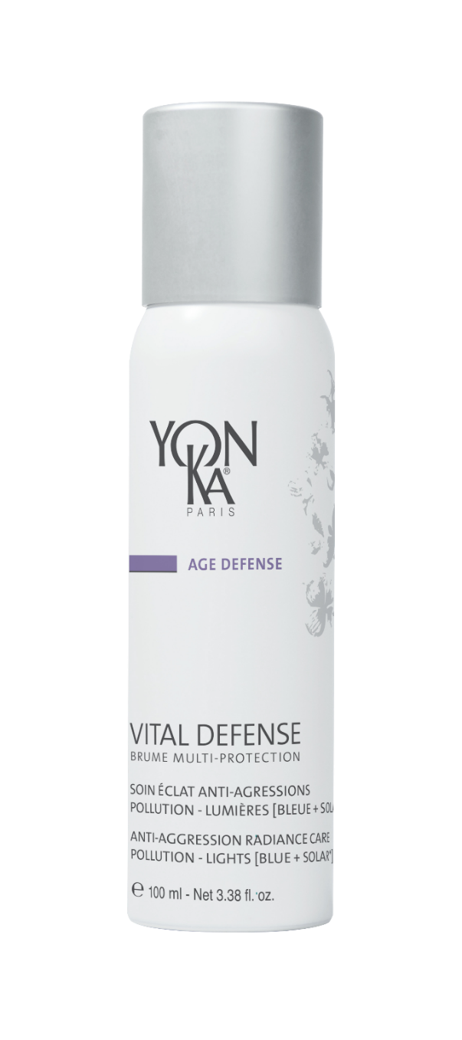
Your experience :
Bulgaria
« 42-year-old woman. Skin condition : sensitive, reactive - Visibly no redness, but in contact with the skin, even with a cleaning product, it gives a reaction. She takes care of her skin, visits professional care 3 times a month (Sensitive, Hydralessense, Elastin) »
MORNING
3x/week
Instead of Sensitive cream, as a night mask
or
EVENING
WEEKLY
2x/week
3x/month
Notes:
As a result of everything she does, there is improvement. It still responds to therapy, but the redness recovers much faster. The skin is smoothed, hydrated, complexion improved.
After the procedure, the skin is no longer as red as during the first visits.

Slide 11
Your experience :
Russia
1 MONTH
Lait Nettoyant
Morning & evening
Sensitive Masque
Morning
Hydra n°1 Masque
Evening
Notes:
The client has been using hormonal face cream for a long time.
In Russia, it is called Akriderm, the active ingredient is betamethasone dipropionate.
After the cancellation, steroid dermatitis began, I attached a photo.
Since the client works in another city, it was not possible to invite her to the procedures and the treatment was carried out only with the help of home care products.
We got fantastic results in 1 month. The photo was taken a month later, but the client herself says that after 2 weeks it was already in such a state as in the photo. The treatment was on only three Yon-ka products:, Sensitive mask, Hydra1 mask and cleansing milk.
Treatment prescribed by a doctor, our partner from Irkutsk, I advised on Yonka products.

Slide 12
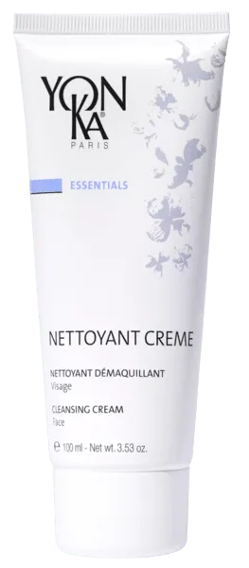
Your experience :
USA
« Client with a highly reactive skin. She can be described as having pre-rosacea »
Professional treatments : Calmessence
As needed
MORNING
EVENING
WEEKLY
or
Alternated
Alone or with the cream on top
2x/week
Notes:
I can share with you a very effective program that one of our client, uses to control her highly reactive skin. She can be described as having pre-rosacea.
Cleanse & Tone: Nettoyant Creme & Lotion PS
AM Treatments: Elixir Vital alternated with Anti-REdness Cream and SEnsitive Creme
PM TreatmentsL Elixir Vital alone or blended with Phyto 58 PNG
Special Treatments: Gommage 2 x's per week and Sensitive Mask as needed
Pro Treatment: Calmessence and the former Sensitive Treatment work very well

Slide 13
Your experience :
JAPAN
« Women in 70s who has sensitive skin who used to use Decleor for long time.»
BEAUTY PRESCRIPTION
Notes:
Women in 70s who has sensitive skin who used to use Decleor for long time.
Now using Nettoyant Crème, Lotion YON-KA(PS), Sensitive Masque, and Elixir Vital.
Her skin condition is getting very good using the above since then.
As for treatment, she has received YON-KA facial for once or twice

Slide 14
Your experience :
UK
CUSTOMER TESTIMONIAL :
Ever since I came to Elaine with skin issues I feel that Yon-Ka products have really helped calm my skin, kept it looking fresh and healthy. I have dehydrated skin and the Yon-KA Lotion really helps along with Hydra n°1 Masque, I have also had the Sensitive Crème Anti-rougeurs in desperate times when my skin had broke out due to stressful times or when I have been more active with dance and fitness. I have been using these products for at least 7 years now and they are my go to products for everyday.
FAVORITE PRODUCTS

Slide 15
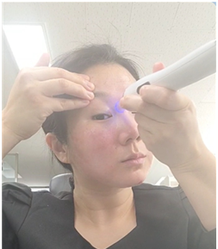
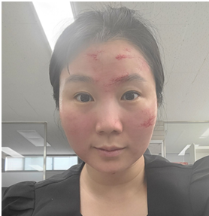
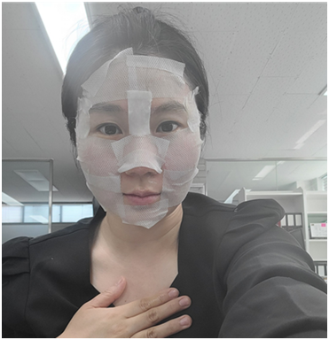
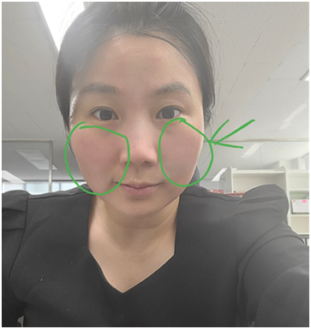
Your experience :
Korea
PROFESSIONAL USE
MTS with
Mesonium 2
After procedure
Emulsion Concentrée on a cotton pad
½ Mesonium 1, Crème 15, Emulsion Concentré diluted solution 12V
20 min
½ Mesonium 1 Crème 15
Sensitive Creme
Anti-rougeurs
Notes:
MTS = MICRO NEEDLING THERAPY SYSTEM
also known as "Microneedling" or "Collagen Induction Therapy" (CIT). MTS is a non-invasive skin treatment technique that uses micro-needles to create small punctures in the skin. These micro-needles can be mounted on an electrical device or a roller.
I am a trainer at Korean office. I don’t have a sensitive skin, but I myself tested how effective Sensitive Anti-Rougeurs is in relieving heat feelings and redness caused by increase of cytokine from stimulated skin. (MTS level = 0.25&0mm)
1) While using an MTS - she used Mesonium 2 (2 ml - a full vial)
2) After application of MTS - with a cotton pad applied with Emulsion Concentree, she washed away the bleeding areas.
3) Application of Masque - she applied Mesonium 1 (1ml) all over the face and applied Cream 15 (3ml), followed by application of Emulsion Concentree 12V.
She waited for 20 minutes.
4) Conclusion - She applied Mesonium 1 (0.5 ml), and applied Cream 15 (1.5ml), followed by application of Sensitive Anti-rougeurs (1ml) on the half of the face (the arrow area in the picture).
After application of MTS, I put a relieving mask pack on my face (and then apply Sensitive anti-Rougeurs inside the green area. Surprisingly, I found a great relieving effect. The stimulated areas on my face were supposed to feel heat and reddish but the relieving pack with Yonka products let the areas cool down with redness fading away.

Slide 16
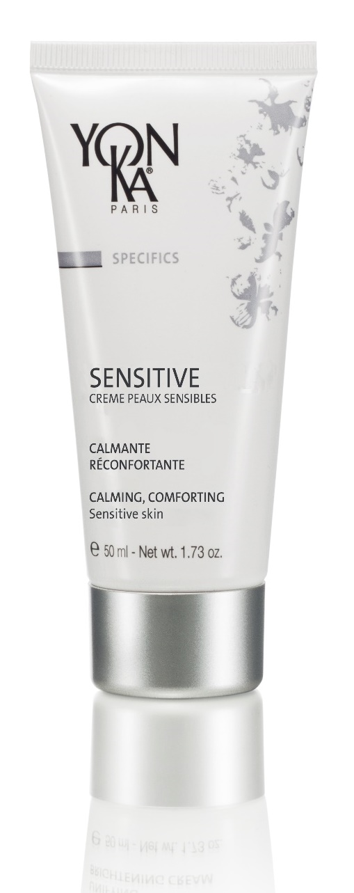
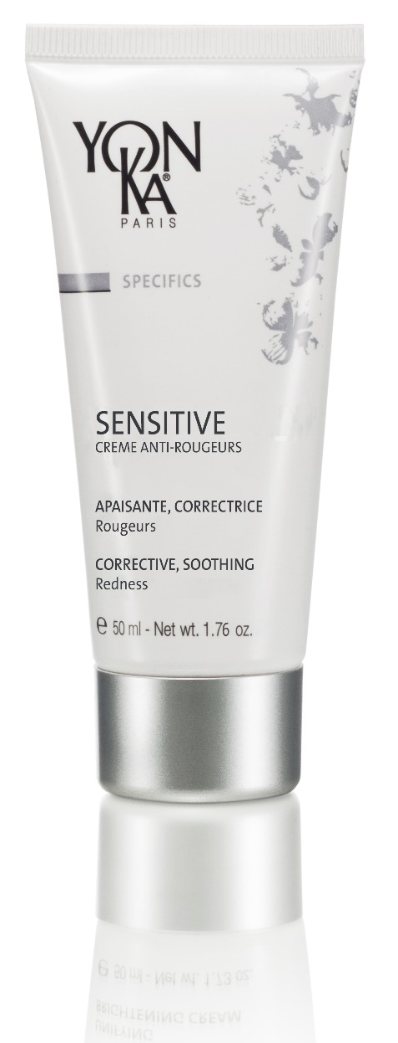
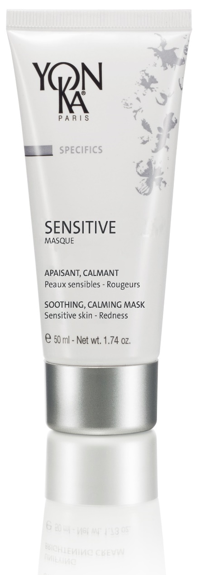
How to treat a SENSITIVE SKIN
SENSITIVE range

Slide 17
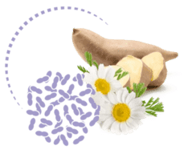
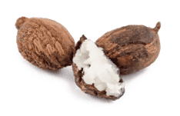
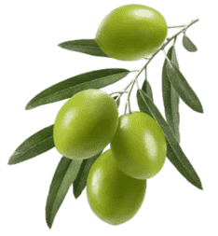
How to treat a SENSITIVE SKIN
Sensitive Crème Peaux Sensibles
Reducing skin hyper-reactivity and increasing skin tolerance
SENSIBIOTIC COMPLEX : CALMING – SOOTHING - DESENSITIZING
Without perfume or essential oil
Pre & Probiotics : reinforced skin ecosystem and boosted natural defense
Sea chamomile : desensitizing action
98% natural ingredients
BISABOLOL :
SOOTHING - REPAIRING
SHEA BUTTER :
NOURISHING - PROTECTIVE
OLIVE PHYTOSQUALANE :
HYDRATING
Notes:
Star active ingredient of this cream = SENSIBIOTIC complex, which is OUR COMPETITIVE ADVANTAGE
It is made up of pre- and probiotics, and sea chamomile.
Prebiotics are nutrients that favor the development and upkeep of the skin's ecoflora. They feed good ecoflora, that protects you from the growth of harmful bacteria that cause a number of cutaneous imbalances.
In our cream, we used oligosaccharides and the juice drawn from Yacon roots (also known as "plant-based Inca honey").
Probiotics are the "good bacteria" (+++) that boost the skin's natural defenses. In our cream, we used Lactobacillus (bacteria)
= By boosting natural defenses and reinforcing the skin's ecosystem → fewer pathogenic elements can penetrate the skin, it will feel less attacked → REDUCED SKIN REACTIVITY.
We have gone even further by associating pre- and probiotics to Sea chamomile. This plant is rich in amino-acids (alanin, prolin, etc.), flavonoids (quercetin), trace elements (Zn, Se) and minerals (Mg, Ca), making it an excellent soothing and anti-inflammatory active ingredient.
It has desensitizing action, thus making it possible to increase the skin's tolerance threshold.
These two innovative active ingredients make up the Sensibiotic complex, a true response to sensitive skin. Skin will be calmed, soothed, comforted and less sensitive.
The name of this complex reminds us both of the sensitive side, the pre-/probiotic side and the all-important treatment side.

Slide 18
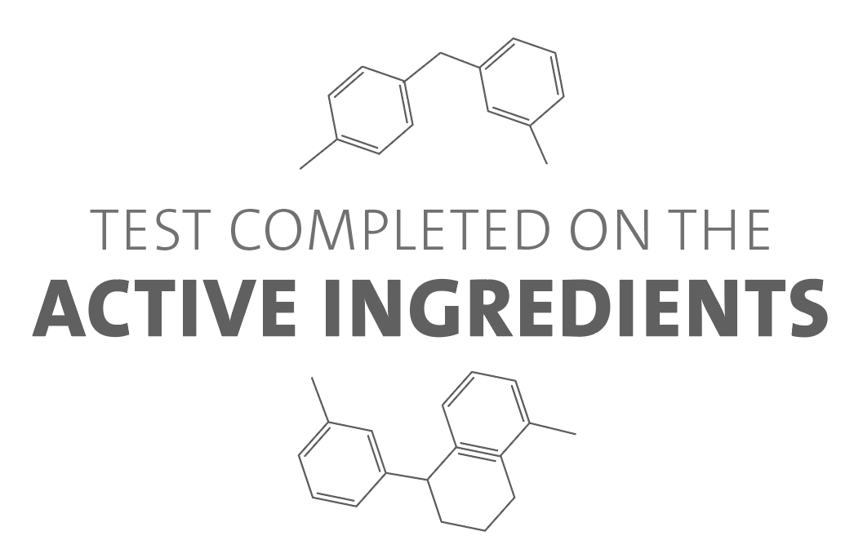
How to treat a SENSITIVE SKIN
Sensitive Crème Peaux Sensibles
EFFECTIVENESS OF ACTIVE INGREDIENTS
Action on skin defense
(boosted natural defenses)
Anti-inflammatory and soothing action
Level of skin defense*
+ 71% (β défensine 3)
Anti-inflammatory and soothing action
-51% (TNF-α)
Inhibited
release of substance P
-27% (release of substance P)
In vitro tests
on the active ingredients
contained in the Sensibiotic complex
Probiotics (lactobacillus)
Sea chamomile
Improved response to aggressions
Inflammatory
reaction
Tingling,
tautness,
itching
Soothing/Comforting - Less sensitive skin
Notes:
Tests were conducted on the active ingredients contained in our SENSITIVE CREME PEAUX SENSIBLES to prove their efficacy on
The boosting of natural defenses
The anti-inflammatory and soothing action.
The probiotics (lactobacullus) have proven in-vitro action on skin defenses.
Indeed, they trigger the synthesis of β defensins, which are anti-bacterial peptides involved in the skin's defense system.
By stimulating their synthesis (+71% vs. Control), the skin's defense levels increase, its natural protection is therefore reinforced, its ecoflora recovers its balance and sensitive skin is able to better respond to aggressions.
Defensins play a key role in the skin's defense system (part of immune system mechanisms), they are receptors dedicated to recognizing pathogens. They act directly by attaching themselves to the surface of pathogens and altering their cell walls, which causes them to die. hBD3 (β defensins 3) is the defensin with the widest bacterial spectrum.
As for sea chamomile, in-vitro tests proved its efficacy on inflammation and soothing (desensitizing action).
We noticed that the presence of aggressors caused an inflammatory reaction, and self-defense system was triggered:
Inflammation mediators are released
TNF is a cytokine (= protein synthesized by certain immune system cells) which is harmful because it causes inflammation.
sea chamomile inhibits this inflammation mediator (TNF-alpha -51%) and therefore reduces inflammatory reactions.
The inflammatory reaction also triggers
The release of neurotransmitters, and namely substance P, which is what causes unpleasant sensations (tingling, tautness, itching, pain).
This contributes to increasing the skin's inflammatory response, thus accentuating the irritation.
The sea chamomile is capable to inhibiting the release of this substance. Consequently, there are fewer feelings of discomfort, and thus less inflammation (the vicious circle is stopped), leading to soothing and comfort.

Slide 19
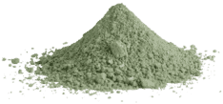
How to treat a SENSITIVE SKIN with redness
Sensitive Creme Anti-rougeurs
Soothing, corrective redness
CENTELLA ASIATICA + MIRABILIS JALAPA : anti-redness
Without perfume or essential oil
Reduced inflammation, vasodilatation and capillary visibility
98% natural ingredients
NATURAL GREEN PIGMENTS :
« CC » effect, color correction
BISABOLOL :
SOOTHING - REPAIRING
OLIVE PHYTOSQUALANE :
HYDRATING
Notes:
Focus on Centella asiatica and pigments, which are a bonus for this product and the competitive advantage for our SENSITIVE CREME ANTI-ROUGEURS.
Centella asiatica is a small herbaceous plant used in traditional Indian medicine for treating skin affections, ulcers and varicose veins. Also known as "Tiger Grass".
It reduces inflammation, vascular dilation, and visibly shrinks capillaries.
In addition to this active ingredient, we chose to use natural green pigments. Why? Green is a highly-acclaimed color by consumers looking for an immediate solution to their redness.
Based on the principles of colorimetry and complementary colors = when two opposite hues are placed one on top of the other, they cancel each other out. So all you need to do is determine the color of the problem to be hidden and apply a corrector of the opposite color for it to disappear.
Redness → red <> complementary color = green
→ CC CREAM effect (color correction), VISUAL effect
Pigment origin: mica/TiO2/SnO2
Centella + pigments = diminished redness
Immediately: visual effect, the green pigments neutralize the red
In the long term: anti-redness action thanks to the centella

Slide 20
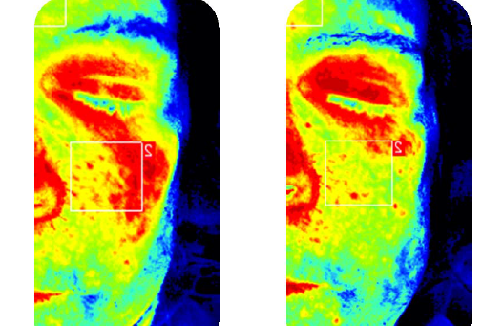
How to treat a SENSITIVE SKIN with redness
Sensitive Creme Anti-rougeurs
EFFECTIVENESS OF ACTIVE INGREDIENTS
Acts on reducing inflammation and vasodilation
Inhibits inflammation mediators
-54% (PGE2)
Blood flow
In vitro test on the centella asiatica
-30%
Inflammatory
reaction
T0
T6 semaines
Vessel dilation
Less redness - Soothing/Comfort
Notes:
Regarding the proven efficacy of all active ingredients used in our SENSITIVE CREME ANTI-ROUGEURS, centella asiatica demonstrated its action on inflammation and vasodilation (in vitro).
We noticed that the inflammatory response led to swelling of blood vessels (= vasodilation) and the appearance of redness.
If the inflammatory reaction is reduced, so is the vasodilation and therefore the redness.
By inhibiting the inflammation mediators, and namely PGE2 (prostaglandin E2), the centella asiatica reduces inflammation.
As a reminder, the Marvel of Peru (mirabilis jalapa) active ingredient also acts on inflammation mediators.
Furthermore, the centella reduces vasodilation in the capillaries - we can see in the photos that blood flow to the cheeks is reduced by 30% in the presence of centella (T6 weeks vs. T0 (80% of responders) → Reduced blood flow = proof of reduced vasodilation
Less inflammatory reaction, less vasodilation = less redness and ++ soothing and comfort.
Thanks to our cream, we can act on inflammation redness (active ingredients that limit inflammation and vasodilation)
Erythrosis and couperose: we cannot act from a cosmetic point of view, but we can diminish the symptoms (green color of the cream + vessel action of the centella)

Slide 21
How to treat a SENSITIVE SKIN with redness
Sensitive Creme Anti-rougeurs
Clinical scoring
Appearance of redness (cheeks): -31% in 1 month
Self-assessment
I love that this cream is green: 90%
Soothed skin: 95%
Hydrated skin: 90% - Nourished skin: 85%
T0
T 1 month
T0
T 1 month
Notes:
Clinical scoring - 20 women - Use of SENSITIVE CREME ANTI-ROUGEURS for 1 month in the morning and evening
Significantly reduced redness in the cheeks: -31%
Green color (self-assessment): 90% appreciate it
Note: HYDRATION TEST:
Self-assessment = skin is hydrated (90%)
Immediate and long-lasting hydration, confirmed by corneometry:
Increased hydration + 72% 2 hours after applying
+ 45% after 8 hours

Slide 22
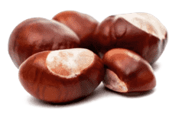
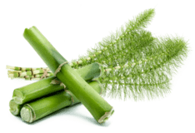
How to treat a SENSITIVE SKIN (with or without redness)
Sensitive Masque
Soothing, calming mask for sensitive skin – Redness-prone skin
With the Yon-Ka Quintessence
ARNICA: SOOTHING
HORSE CHESTNUT : ANTI-REDNESS
Rich in flavonoids, renowned for their stimulating and anti-inflammatory action
Improve irrigation
reduced capillary permeability
increased resistance of the vessel walls
soothing effect
94% natural ingredients
Without perfume
YARROW :
SOOTHING
GERMAN CHAMOMILE:
CALMING - SOOTHING
HORSETAIL:
NOURISHING - REGENERATING
Notes:
Arnica
We use arnica flower extract in our product. This plant is rich in flavonoids, renowned for their stimulating and anti-inflammatory action; they also improve irrigation. The flavonoids help with waste elimination and the circulation of extracellular liquids that cross the walls of small and weakened vessels.
It is the star active ingredient in our SENSITIVE Masque product, thanks to its soothing effect.
Horse chestnut
We use seed extracts, as they contain flavonoids and aescin.
Horse chestnut is renowned for the following actions:
- protection of the vascular network
reduced capillary permeability
increased resistance of the vessel walls (flavonoids)
as well as a soothing effect (aescin)
It therefore has an anti-redness effect.
Usage test under dermatological control (self-assessment) - 20 women with sensitive and ultra-reactive skin of all types (normal, combination, oily, dry, atopical), 60% of which present with redness - aged 21 to 60 - Use of SENSITIVE Masque twice a week for 1 month.
SKIN REACTIVITY
20 women aged 21 to 60 with ultra-sensitive skin, 60% of which present with redness
Skin reactivity = -52%
Assessed following a STINGING TEST (determines people's ability to feel tingling following the application of a lactic acid solution along their nasolabial folds. Skin reactivity is tested before the cream is applied, and again after 4 weeks of use).
Skin is less reactive = soothing effect proven by our SENSITIVE Masque

Slide 23
How to treat a SENSITIVE SKIN (with or without redness)
Masque Sensitive
Usage test (self-assessment)
Skin is soothed: 84%
Skin is durably comfortable: 89%
Soft and velvety skin: 95%
Skin reactivity: -52% after 28 days
→ The product's soothing effect was confirmed
Notes:
Usage test under dermatological control (self-assessment) - 20 women with sensitive and ultra-reactive skin of all types (normal, combination, oily, dry, atopical), 60% of which present with redness - aged 21 to 60 - Use of SENSITIVE Masque twice a week for 1 month.
SKIN REACTIVITY
20 women aged 21 to 60 with ultra-sensitive skin, 60% of which present with redness
Skin reactivity = -52%
Assessed following a STINGING TEST (determines people's ability to feel tingling following the application of a lactic acid solution along their nasolabial folds. Skin reactivity is tested before the cream is applied, and again after 4 weeks of use).
Skin is less reactive = soothing effect proven by our SENSITIVE Masque
Note: HYDRATION TEST:
Self-assessment = skin is hydrated (89%)

Slide 24
A “MUST HAVE” in cabin
MASQUE SENSITIVE
AFTER A PEELING
IN CASE OF PRODUCT REACTION
AFTER AN AESTHETIC MEDICAL PROCEDURE
AFTER WAXING

Slide 25
Product name | SENSITIVE CRÈME PEAUX SENSIBLES | SENSITIVE CRÈME ANTI-ROUGEURS | SENSITIVE MASQUE
Target | Sensitive skin | Redness | Sensitive skin - Redness
Star active ingredient | Sensibiotic complex | Centella asiatica | Arnica
Product advantages + | Sensibiotic Complex = action on the skin's ecoflora + desensitizing | Centella + pigments = immediate and long-term action on redness | Mask-cream rich in plant extracts = optimal soothing effect
Result | Less sensitive and less reactive skin calmed, comforted | Less redness Complexion even Soothed skin | Soothed skin Skin is comfortable Less redness
Key figures | Less sensitive and irritated skin: 90% Feelings of discomfort relieved immediately and durably: 90% (tautness, tingling, itching) Skin reactivity: -47% after 28 days | Appearance of redness (cheeks): -31% after 1 month Soothed skin: 85% | Skin is soothed: 84% Skin is durably comfortable: 89% Skin reactivity: -52% after 28 days

Slide 26
Your turn to play
How to identify and treat SENSITIVE SKIN

Slide 27
How to identify and treat SENSITIVE SKIN
What gives SENSTIVIE CREME ANTI ROUGEURS its "CC" effect?
A. Soft focus powders
B. Natural green pigments
C. Centella asiatica
D. Mineral sheets
Notes:
It's the natural green pigments that give CREME ANTI ROUGEURS its "CC" effect.
They instantly correct redness and even out the complexion.
Centella asiatica is present in the cream to soothe the skin.
The soft focus powders are found in EXCELLENCE CODE CONTOUR and EXCELLENCE CODE CREME.

Slide 28
How to identify and treat SENSITIVE SKIN
What is the common active ingredient in SENSITIVE CREME
and CREME ANTI ROUGEURS ?
A. Shea butter
B. Aloe vera
C. Bisabolol
D. Arnica
Notes:
The common active ingredient in SENSITIVE CREME and CREME ANIT ROUGEURS is Bisabolol, which has soothing and repairing properties.

Slide 29
How to identify and treat SENSITIVE SKIN
What are the active ingredients in SENSITIVE CRÈME ?
A. Quintessence
B. Pre and probiotics and sea chamomile
C. Aloe vera
D. Shea butter
Notes:
The active ingredients in SENSITIVE CREME are : Sensibiotic complex (pre- and probiotics and sea chamomile), shea butter and bisabolol.

Slide 30
How to identify and treat SENSITIVE SKIN
What are the benefits of CREME ANTI ROUGEURS ?
A. Soothing
B. Anti pollution
C. Corrector
D. Comforting
Notes:
SENSITIVE CREME ANTI ROUGEURS corrects redness and soothes sensitive, reactive skin.

Slide 31
How to identify and treat SENSITIVE SKIN
Which statements are true about the SENSITIVE MASQUE ?
A. Without essential oils
B. Cocktail of 20 plant extracts
C. Can be applied after waxing
D. Evens the complexion
Notes:
SENSITIVE MASK acts like a bandage, rich in plant extracts, calming and soothing sensations of itching, tightness and overheating, reducing redness and evening out the complexion.
Composed of a cocktail of 10 plant extracts.It can be used as a sleeping mask or as a classic application.

Slide 32
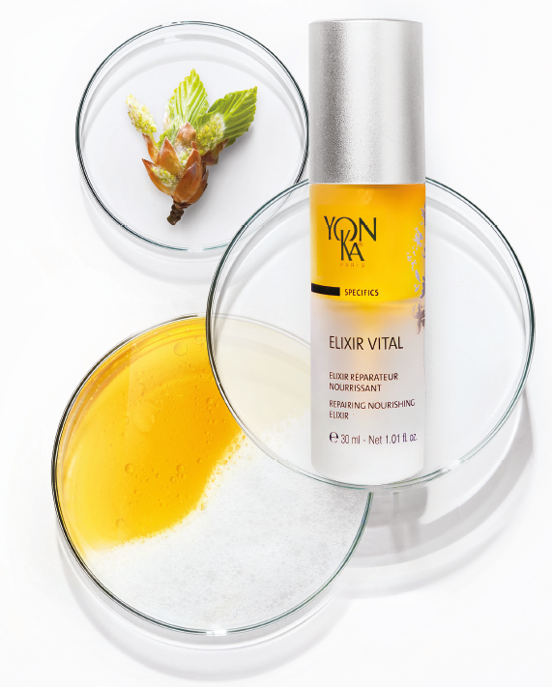
Our S.O.S ally
ELIXIR VITAL
92% of ingredients of natural origin
PREVENTATIVE
All skins
In anticipation all year round
Morning or evening
43% of organic ingredients
Vegan
REPARATIVE
Tired skins
Damaged skins
Stressed skins
Gluten-free
One month intensive treatment
Morning and evening
Notes:
Elixir Vital, 5th generation fits perfectly into this context of naturalness since it contains 92% of ingredients of natural origin including 43% of organic ingredients. It is also vegan and gluten-free.
Who is Elixir Vital for?
As a preventive measure, Elixir Vital is intended for all skin types, all year round, morning or evening. The objective is to maintain the skin in good health. in prevention it will moisturize and nourish the skin by recreating the hydrolipidic film and also revitalize the skin. In this case, it will be used in prevention all year long, morning or evening. A bit like a food supplement, we treat the skin upstream in order to maintain its health and avoid the appearance of imbalance.
In repair, the Elixir Vital is ideal in intensive treatment morning and evening for :
Tired skin, for example post pregnancy, illness, night working, at the change of season
Stressed skin: after a mechanical and/or climatic stress (sun, cold...)
Damaged skin: In pre-post operative treatment, post acne treatment, post-peeling...
In repair, it will regenerate, soothe and smooth the skin. In this case, it will be used as an intensive treatment for one month, morning and night, to address a specific problem. Once this SOS treatment is complete, the client can switch back to his usual serum or stop using a serum.

Slide 33
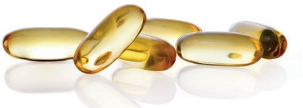
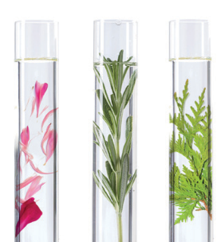
Our S.O.S ally
ELIXIR VITAL
Double phyto-aromatic serum for skin aging prevention and repair
NIACINAMIDE
VITAMIN B5
ORGANIC SOY AND SUNFLOWER OIL,
NON-GMO CORN OIL
Stimulates the production of ceramide, making the skin less permeable to external irritants
Soothing and revitalizing
Rich in omegas 3, 6 and 9
Recreates the oily phase of the hydrolipidic film
Nourishing and repairing
ORGANIC BEECH BUDS PEPTIDES
SOY PEPTIDES
YON-KA QUINTESSENCE
Rich in amino acids
Restructuring and hydrating
Rebalancing and intensifies
the power of the formula
Notes:
The main active ingredients of Vital Elixir are organic beech buds peptides and soy peptides. These active ingredients are rich in amino acids and have restructuring and moisturizing properties.
The buds peptides we can source contain 19 amino acids, including the 8 essential to the skin. Without compromising on the effectiveness or sensoriality of the formula. For the moment the update has not been done on the finished products, but will be done on the next production. The update has been done everywhere it was possible: product sheets, website, product brochure, and will intervene on the packaging and instructions as soon as the current stocks are sold
The Elixir Vital is also composed of a mixture of vegetable oils such as organic soy and sunflower oil, non GMO corn oil with nourishing and repairing properties. These vegetable oils recreate the oily phase of the hydrolipidic film. They are rich in omegas 3,6,9 which are essential to our body and which will prevent skin aging. As a reminder, we do not synthesize omegas, so it is very important to provide them through cosmetics, food (oily fish, oilseeds...) and food supplements.
The Elixir Vital is also composed of the star ingredient of the moment, Niacinamide. We did not communicate about Niacinamide, which was already present in the product but which we called Vitamin B3 or Vitamin PP (it’s the same but with other names), but given the extent of consumer enthusiasm for this active ingredient, we wanted to name it by its best known and recognized name. Indeed, you could not miss it, we talk about this asset in the professional press, in the women's press ... Naturally synthesized by the human body, it plays a role in all our organs. It stimulates the production of ceramides (the lipids that form the cement between the cells of the epidermis), the skin is thus stronger, less permeable to external irritating agents. Associated with vitamin B5, they are thus recognized for their soothing and revitalizing virtues.
Finally, we find our olfactory imprint, our DNA that makes us unique, the Quintessence. Recognized for its rebalancing and calming virtues, it also potentiates and multiplies the power of our formula.

Slide 34
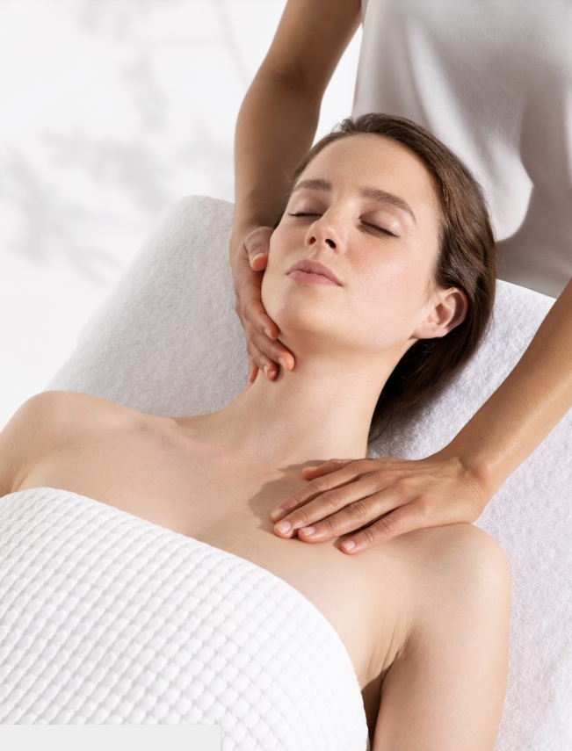
How to treat a SENSITIVE SKIN in cabin
CALMESSENCE

Slide 36
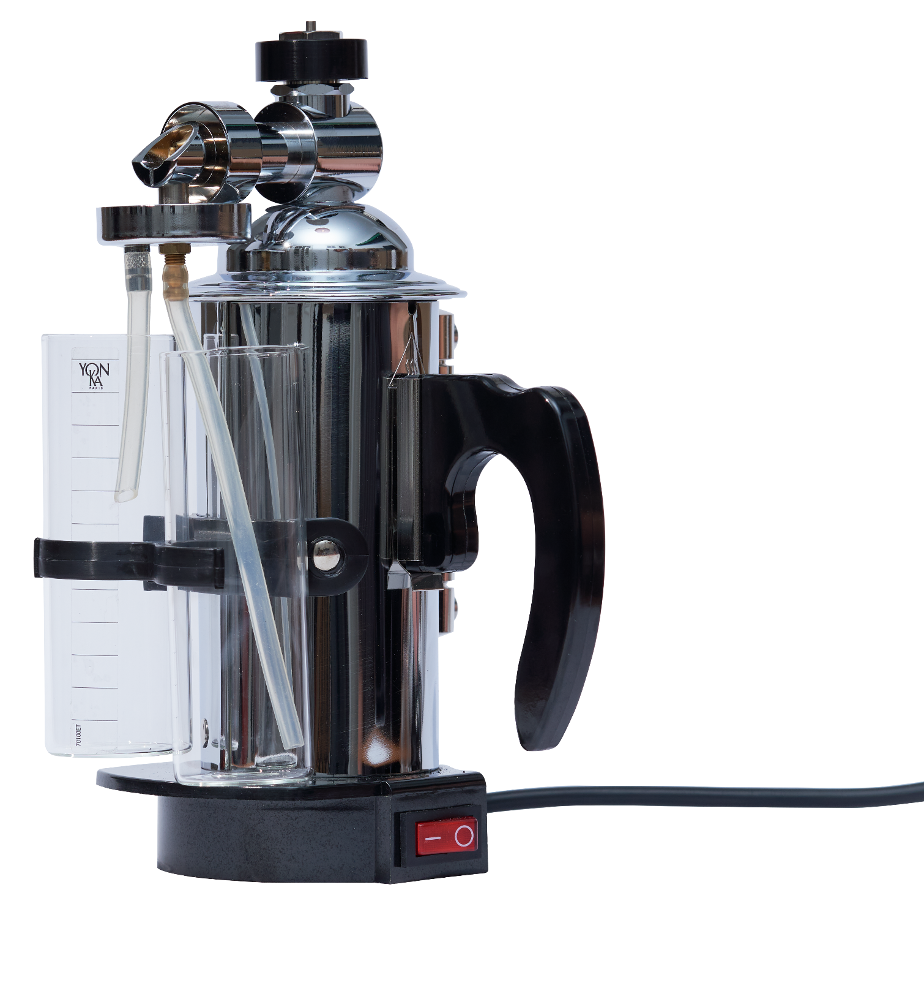
Key products & steps
1. Pulverization w/ 12V dilution
2. SENSITIVE MASQUE
3. MASQUE MODELANT

Slide 37
Thanhs !

