Slide 2
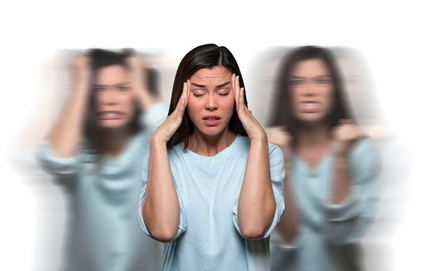
Stress & lack of sleep
A global phenomenon with a lasting impact
95%
Of the population is stressed or anxious*.
4 billion
people wake up
tired every day
100 billion $
spent worldwide annually
to solve this issue**
*https://www.ifop.com/wp-content/uploads/2022/05/communique-presse-mesbienfaits.pdf.
**https://worldsleepday.org/usetoolkit/talking-points
Notes:
A few figures :
95% of the population is stressed or anxious
Environmental stress (climate, pollution, etc.),
Lifestyles (psychological stress, overwork, the "always on the move" culture)
Stress due to unstable world situation (wars, pandemics, economy, etc.)
All these stressful situations degrade sleep quality: sleep disorders, difficulty falling asleep, night-time awakenings.
4 billion people wake up tired every day
This is a major concern for many people.
100 billion $ are spent worldwide annually to solve this issue**
https://www.who.int/fr/news/item/02-03-2022-covid-19-pandemic-triggers-25-increase-in-prevalence-of-anxiety-and-depression-worldwide

Slide 3

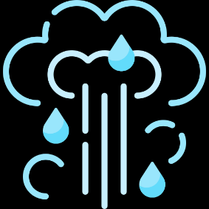
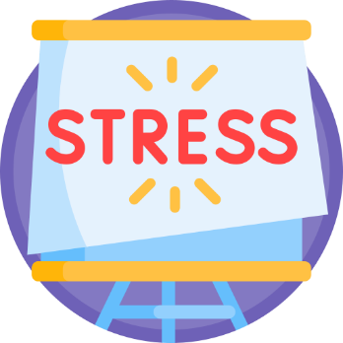
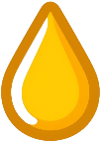
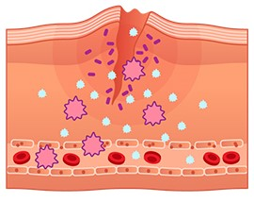
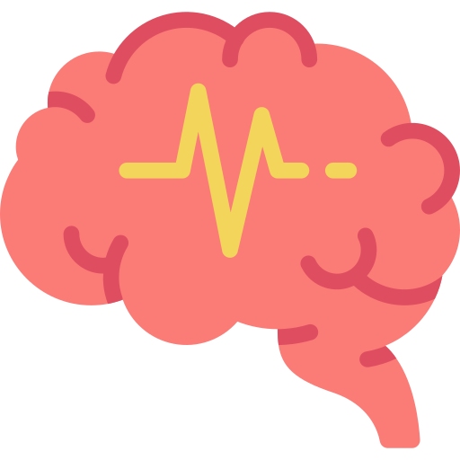
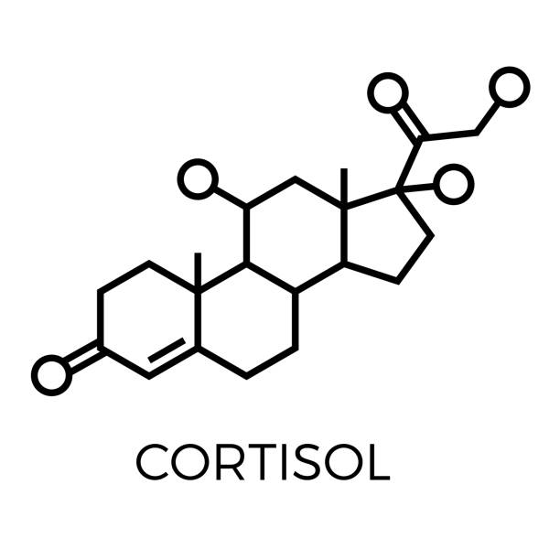
Stress & lack of sleep
5 visible skin consequences
Inflammation
Sebum excess
Transepidermal water loss
Impaired healing/cell renewal processes
Reduced immune defenses
Accelerated skin aging, acne (adults), loss of radiance, dehydration and irritation (redness)
Notes:
Stress and lack of sleep are a source of cellular oxidative stress and inflammatory phenomena.
Over time, this greatly upsets the skin's balance and prevents it from regenerating effectively during the night.
5 consequences of cutaneous stress on the skin :
Accelerated skin aging (it is estimated that extreme stress causes skin to age 2 times faster)
Acne (adult) - due to excess sebum
Loss of radiance
Dehydration
and irritation (altered skin barrier, redness).

Slide 4
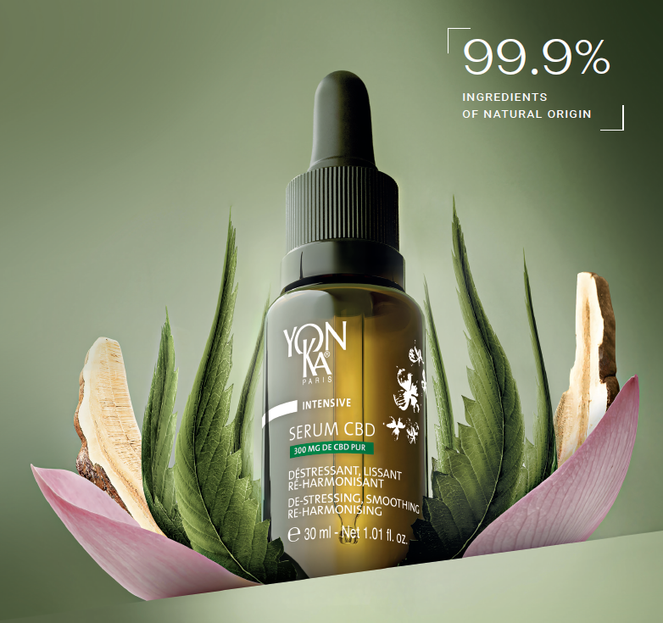
Yon-Ka’s
answer
NEW
SERUM CBD
De-stressing, smoothing &
re-harmonising night serum
300 mg PURE* CBD
*in a 30ml bottle
Notes:
The Yon-Ka answer?
CBD SERUM
A de-stressing, smoothing and re-harmonising night oleo-serum.
Contains 300 mg of pure CBD (in a 30ml bottle).
This is THE new Yon-Ka innovation to combat skin damage caused by stress and lack of sleep.
With this serum, every morning is a bloom of beauty.
Skin is visibly de-stressed, looking more beautiful and radiating new youthfulness.

Slide 5
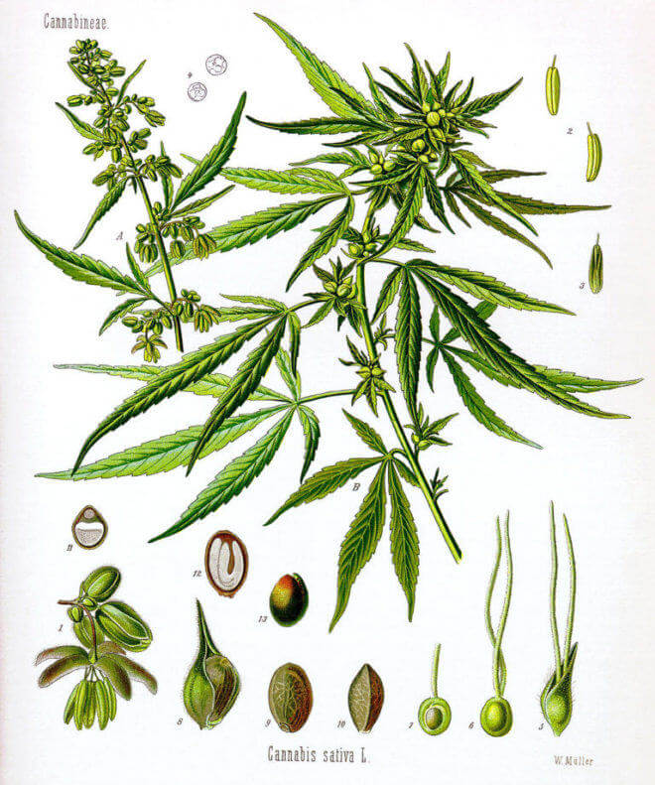

CannaBiDiol
What is CBD?
CHANVRE
SEEDS
Allow extraction of hemp oil
LEAVES
Allow CBD extraction
Cosmetic legislation regulates the CBD used: No psychotropic effect
0 < THC < 0.2%
Notes:
CBD is extracted from hemp and should not be confused with cannabis.
Botanically, it's the same species, Cannabis sativa L, but they are different varieties (cultivars*) with variations in morphology (size of stems, leaves, flowers) and composition.
Hemp is rich in CBD, but THC (TetraHydroCannabinol), the psychotropic molecule, is present in minute quantities (less than 0.2%).
*A cultivar is a plant variety bred, generally by selection, for its unique characteristics.

Slide 6
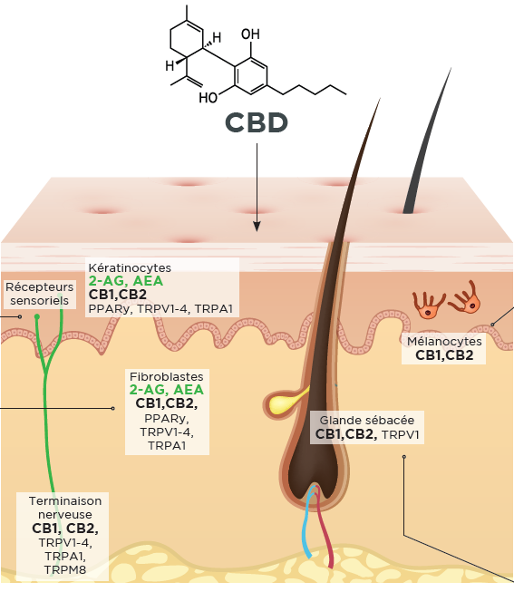
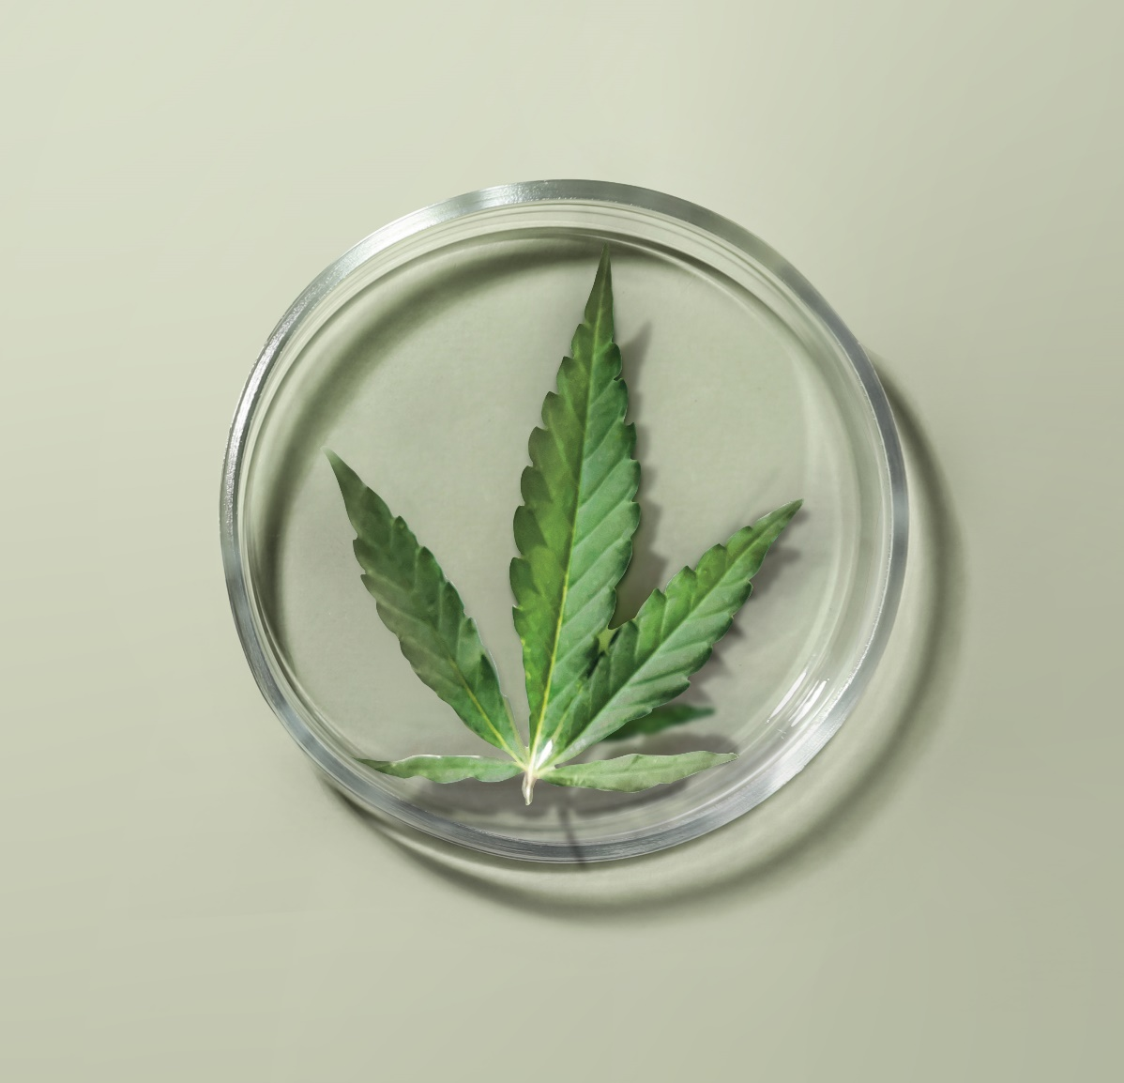
Multi-cellular action*
Focus on CBD
ANTI-INFLAMMATORY EFFECT
ANTIOXIDANT EFFECT
KERATINOCYTES
ANTI-AGEING EFFECT
FIBROBLASTS
SEBOCYTES
SEBOREGULATING EFFECT
MAST CELLS
ANTI-STRESS EFFECT
The skin's endocannabinoid system
* Scientific publications
Notes:
The efficacy of CBD on the skin has already been the subject of hundreds of scientific studies, demonstrating its remarkable effectiveness on numerous parameters.CBD interacts with a large number of cellular receptors, particularly those of the endocannabinoid system (CB1, CB2), which are expressed by all skin cells.
This gives CBD a wide range of actions and quite extraordinary power!
- Anti-inflammatory action: by inhibiting the synthesis of certain inflammation molecules (IL-6 and 8), CBD combats redness and irritation, and soothes sensitive skin. CBD also shows great promise in the treatment of certain pathologies such as eczema and psoriasis.
- Anti-aging action It boosts fibroblast expression of key proteins involved in dermal matrix quality (dermal-epidermal junction) and fibroblast-matrix interactions: collagen VII, integrin β-1 and integrin α-2. It also helps reduce the synthesis of certain MMPs).
- Anti-oxidant action Protects cells from free-radical attacks and boosts the cell defense system via NRF2.
- Seboregulating action It controls the multiplication of sebocytes and inhibits their lipid synthesis.
- Anti-stress action CBD also has numerous mind-soothing properties.
Preliminary studies demonstrate CBD's beneficial action on anxiety and stress. It is often used as a supplement to help alleviate the symptoms associated with these issues, particularly in the case of depressive episodes. Recent research has provided evidence of the essential role of the endocannabinoid system in skin homeostasis and function. As a non-psychotropic phytocannabinoid, similar to endogenous endocannabinoids, CBD is a biomimetic active ingredient. Applied to the skin, it could modulate the cutaneous endocannabinoid system.

Slide 7
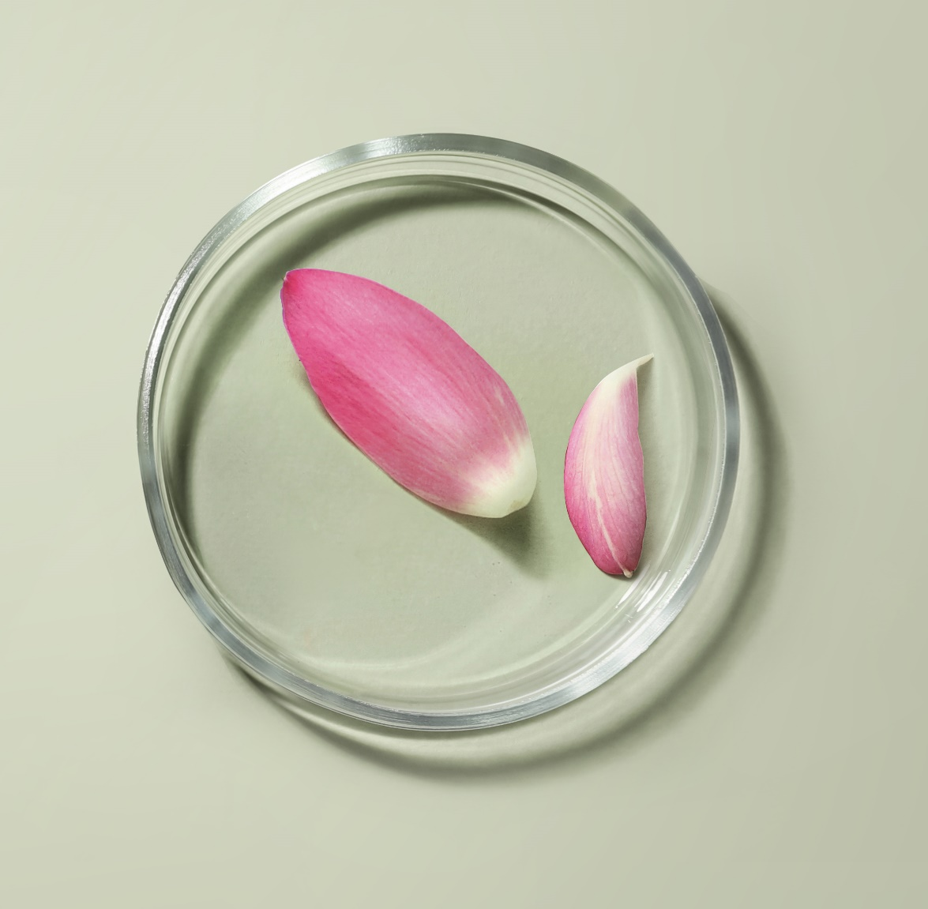
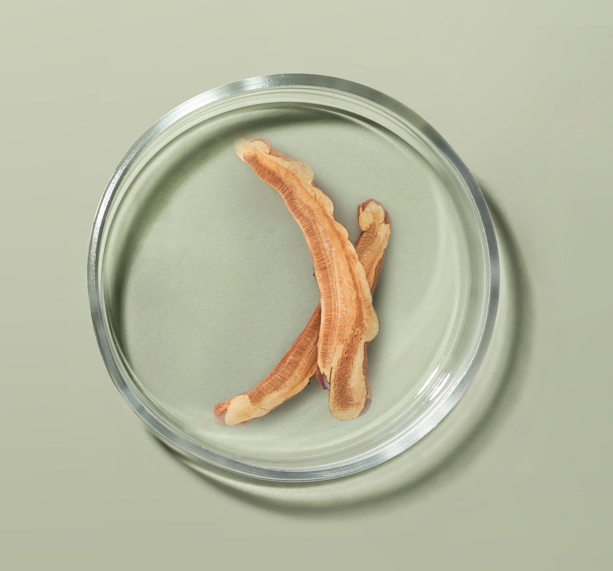
A high-performance formula
Synergy of powerful active ingredients
750,000 Native cells
of Sacred Lotus
Adaptogenic Reishi extract
De-stress, calm the skin and help reduce feelings of irritation.
It helps the skin adapt to stress and fatigue.
Anti-oxidant, Moisturizing.
Notes:
Native Sacred Lotus plant cells (obtained in France through biotechnology)
A fragile, sacred plant, the Lotus is the symbol of divine beauty and purity. Widely used in Ayurvedic medicine for its rebalancing properties, it helps combat sleep disorders and regain inner strength. Native Lotus plant cells have been shown to have an anti-stress effect on the skin, acting on the synthesis of several neurotransmitters:
Boosts expression of melatonin, a powerful antioxidant molecule known for its positive effect on relaxation and sleep, by +55%.
Reduces the synthesis of Substance P and Interleukins (-20 to -24%), which are mediators of inflammation.
Through these actions, Sacred Lotus native plant cells de-stress, calm the skin and help reduce feelings of irritation.
Adaptogenic Reishi extract:
Reishi, or "long-life mushroom", has been used in traditional Chinese medicine for its therapeutic virtues for over 2,000 years. Renowned for its adaptogenic power, it contains 150 antioxidants and nutrients (polyphenols, triterpenes...). A composition close to perfection, which explains why this mushroom is also widely used in nutrition.
Its many qualities help to maintain good health, while eliminating energy blockages responsible for insomnia. It helps the skin adapt to stress and fatigue. Antioxidant / Moisturizing

Slide 8
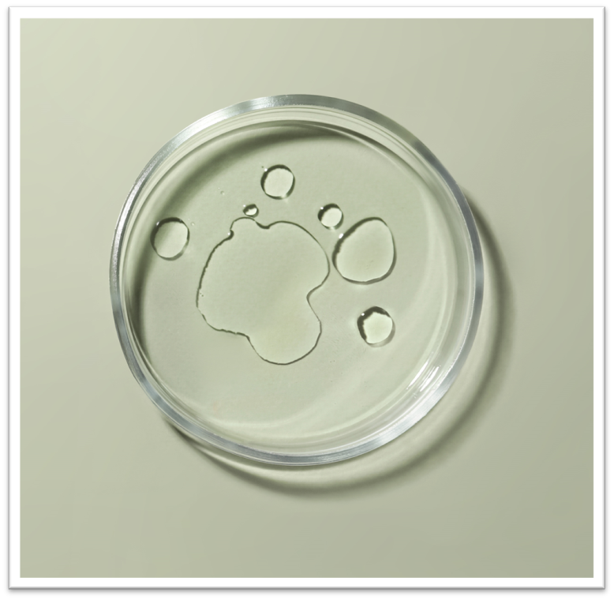
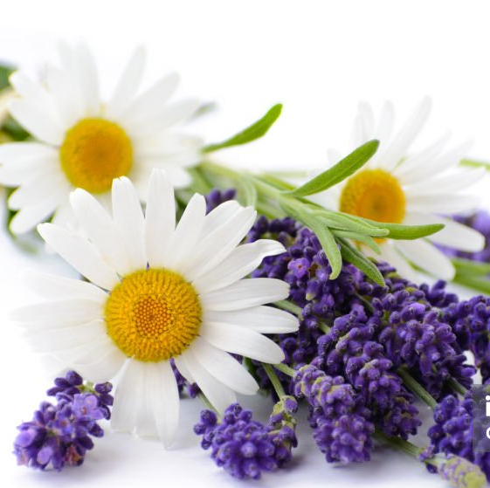
A high-performance formula
Synergy of powerful active ingredients
30% Organic vegetable oils
Hemp + Inca Inchi
Essential Oils Lavender + Chamomile + Neroli + Quintessence Yon-Ka
Hemp : Reduces irritation, Moisturizes, Regulates, Anti-Aging Action
Inca Inchi : Regenerates, Nourishes, Soothes
Invites relaxation and promotes sleep for an intensely regenerating night of high recovery
Notes:
In addition to these main active ingredients
30% organic plant oils of hemp and Inca Inchi, rich in omegas 3 and 6 and vitamins (A, E, B), to help rebalance skin disorders, whatever the skin type
Essential oils of lavender, chamomile and neroli for a relaxing, soothing effect, ideal before bedtime. Invites relaxation and promotes sleep for an intense, regenerating night of recuperation.
And, of course, the brand's signature Quintessence Yon-Ka, which enhances the formula.

Slide 9
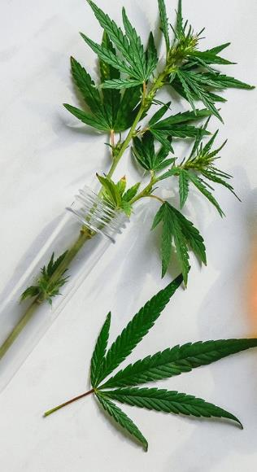
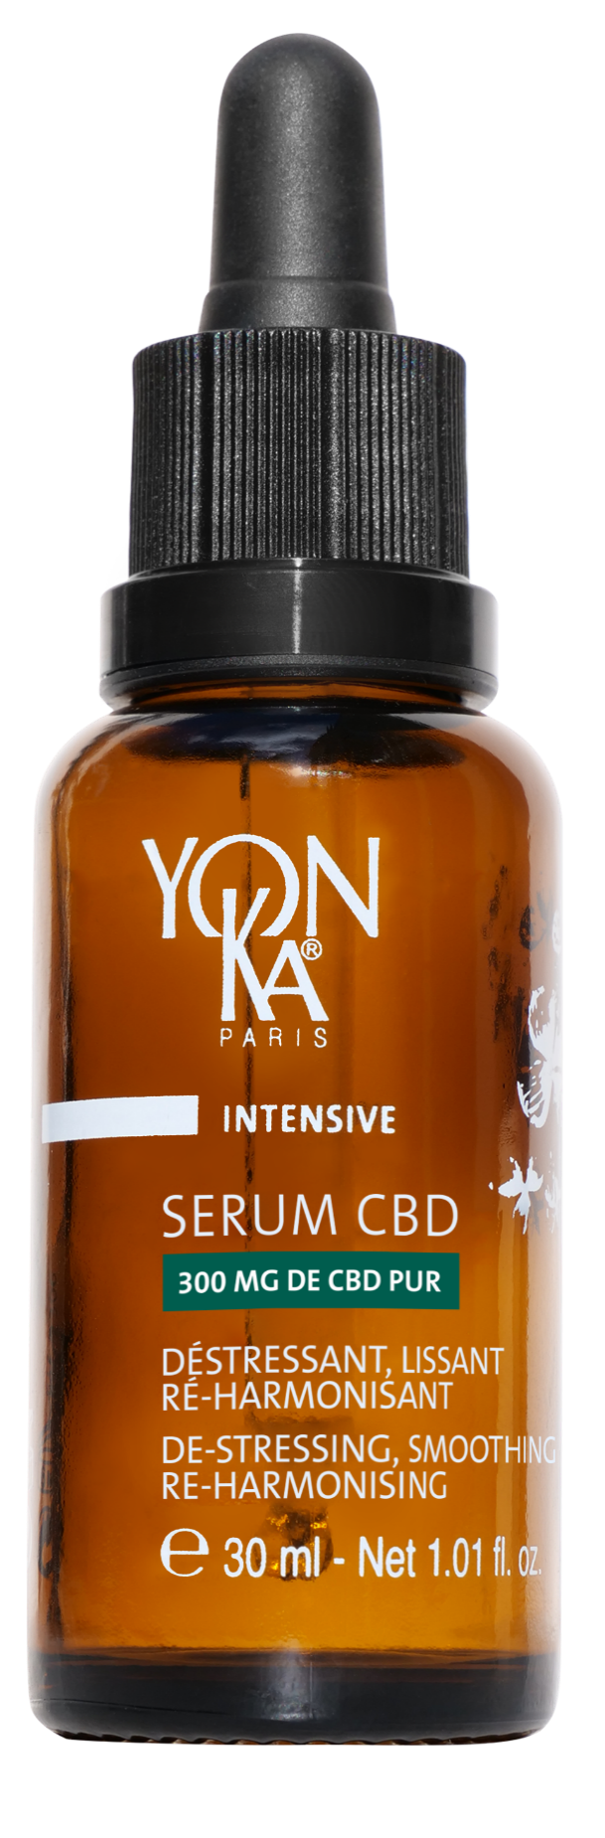
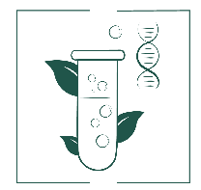
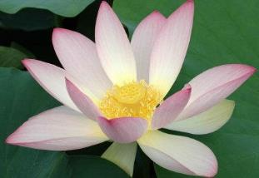
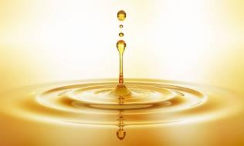
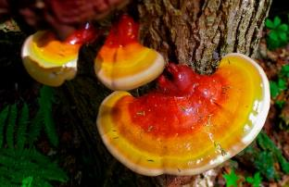
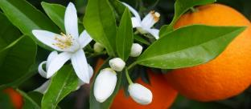
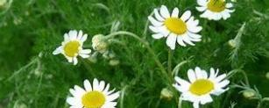
A complete, high-performance formula
DE-STRESSING, SMOOTHING, RE-HARMONISING OLEO-SERUM
99.9% ingredients of natural origin, vegan, non-GMO
750,000 Native cells of sacred lotus*
300 mg of pure CBD
Adaptogenic
mushroom extract
Reishi
30% Organic vegetable oils
Hemp + Inca Inchi
Essential oils
Lavender + Chamomile + Neroli
Quintessence Yon-Ka
*in a 30 ml bottle
Notes:
A complete, high-performance formula
% ION = 99.9% (30% organic) - Vegan, Non-GMO
300 mg pure CBD* (*for 30 ML = 1% pure CBD) ➔ Pure CBD (high-purity / solvent-free extraction process)
De-stress "body and soul", smooth, re-harmonize
It's like a yogi master for your skin!
Has no psychotropic action (= no THC)
Anti-inflammatory, antioxidant, anti-aging, regulator
100% natural (THC*-free - in compliance with regulations<0.2% )
Made from hemp grown sustainably in Colombia
30% organic plant oils Hemp + Inca Inchi
rich in omegas 3 - 6 and vitamin E = moisturizes, regulates and soothes for optimal comfort
Native sacred lotus plant cells = Anti-stress (stimulates the synthesis of melatonin, the molecule responsible for sleep and relaxation) 750,000 native sacred lotus cells in 30ml
10% adaptogenic Reishi mushroom extract (mushroom of immortality) = boosts resistance to stress
= helps skin adapt to stress and fatigue.
Relaxing and soothing essential oils Lavender + Chamomile + Neroli
Invites relaxation and promotes sleep for an intense, regenerating night of recuperation.
Quintessence Yon-Ka = Potentiates the power of the formula
0.1% tocopheryl acetate / vitamin E

Slide 10
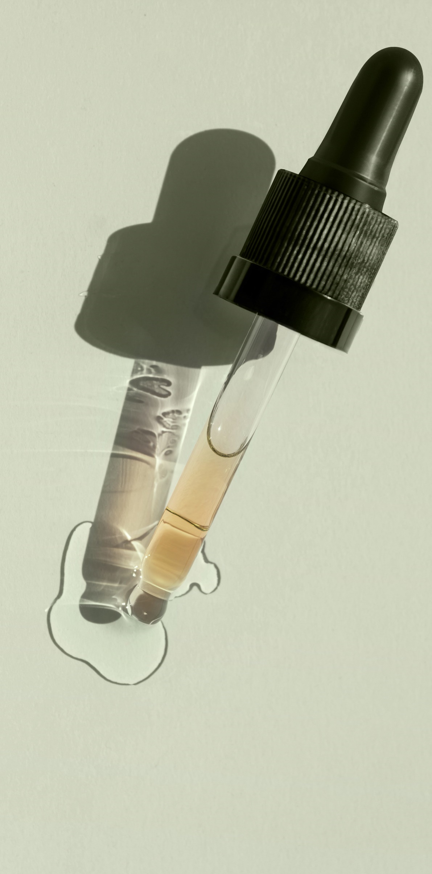
An oleo-serum texture
  Oleo-serum with a non-greasy finish
  Waterless
  Preservative-free
  Alcohol-free
  Non-comedogenic
A texture that penetrates quickly without leaving a greasy film,
that convinced users
100% this oleo-serum is pleasant to use ⁽¹⁾
97% integrates perfectly into your skin care routine ⁽¹⁾
Clinical study 32 women. 1 application per day (evening)
⁽¹⁾ Self-evaluation - 1 request
Notes:
An oily serum with a non-greasy finish
Waterless
Preservative-free
Alcohol-free
Non-comedogenic
A texture that penetrates quickly without leaving a greasy film,
that has convinced users of all skin types:
100% this oleo-serum is pleasant to use ⁽¹⁾
97% integrates perfectly into your skin care routine ⁽¹⁾

Slide 11

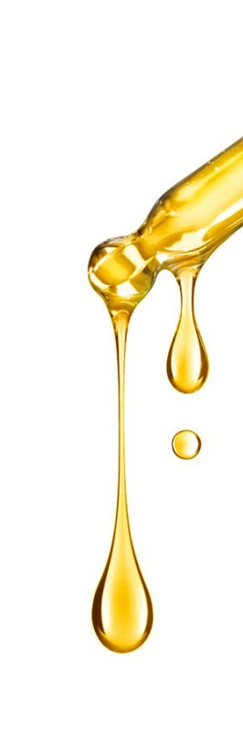
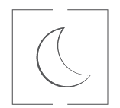
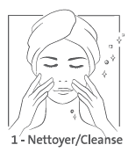
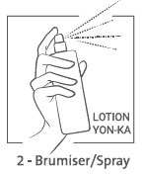
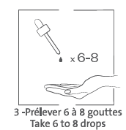
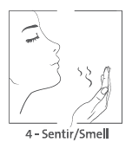
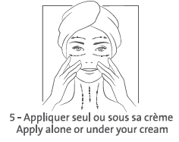
Serum CBD
For whom?
All ages, all skin types, stressed skin, even the most sensitive, with redness and pimples. Men & Women.
When?
In the evening, all year round
Instructions for use?
Notes:
Evenings, all year round,
1- cleanse the skin
2- Spray on the iconic Lotion Yon-Ka
3- take 6 to 8 drops of SERUM CBD
4- Warm your hands. Breathe in the soothing, relaxing scent,
5- then apply with gentle movements, alone or under your usual cream, depending on your mood and skin type.
Contraindicated (precautionary principle) in pregnant / breast-feeding women

Slide 12
Visible and proven efficacy from the very 1st night
Notes:
We conducted a clinical study with 1 application per day on 32 women in an independent laboratory.
Our Serum CDB sshowed exceptional results, which are felt and seen quickly.

Slide 13
De-stressing, smoothing effect
AFTER JUST 1 NIGHT
AFTER 7 DAYS
AFTER 28 DAYS
7/10
women¹
Skin seems de-stressed,
relaxed and more rested, just
as after a good night’s sleep
91%
Skin is more comfortable¹
88%
Less tauntness¹
+17%
Better skin quality²
-20%
wrinkles²
1-Clinical study - 32 women. 1 evening application - Self-evaluation after 1 night (skin seems destressed) / After 7 days (comfort, less tauntness)
2-Clinical study - 1 evening application, 28 days. Clinical scoring under dermatological control - 31 subjects (wrinkles) - 14 subjects with dry/sensitive skin - 18 subjects with combination to oily skin
3-Clinical study - 1 evening application, 28 days. Self-scoring - 13 subjects (tightness) - 6 subjects (discomfort = warming sensation)
Notes:
THE DESTRESSING, SMOOTHING ACTION first of all
As soon as you wake up ⁽¹⁾
For more than 7 out of 10 women, skin looks de-stressed, relaxed and more rested, as if it had had a good night's sleep.
After 7 days ⁽²⁾
For 91% of women, skin is more comfortable
for 88%, facial features are less drawn.
After 28 days
Skin quality is improved by 17% ⁽³⁾
-20% fewer wrinkles⁽⁴⁾
For more than 9 out of 10 women, skin is visibly more beautiful ⁽²⁾

Slide 14
Re-harmonising effect
DRY SKIN
COMBINATION TO OILY SKIN
SENSITIVE SKIN
-23%
dryness ²
-48%
tightness³
+17%
matte effect²
-15%
imperfections²
-86%
sensations of
discomfort³
-19%
redness²
A "self-adapting" formula for all skin types
1-Clinical study - 32 women. 1 evening application - Self-evaluation after 1 night (skin seems destressed) / After 7 days (comfort, less tauntness)
2-Clinical study - 1 evening application, 28 days. Clinical scoring under dermatological control - 31 subjects (wrinkles) - 14 subjects with dry/sensitive skin - 18 subjects with combination to oily skin
3-Clinical study - 1 evening application, 28 days. Self-scoring - 13 subjects (tightness) - 6 subjects (discomfort = warming sensation)
Notes:
This serum is exceptional in that it has a genuine re-harmonising action, meaning that its formula adapts to each skin type to target its specific problems.
This is how it works,
For dry skin, dryness and tightness are reduced.
For combination to oily skin, there's a mattifying effect and fewer imperfections.
For sensitive skin, sensations of discomfort and redness are reduced.
A real self-adapting formula for all skin types

Slide 15
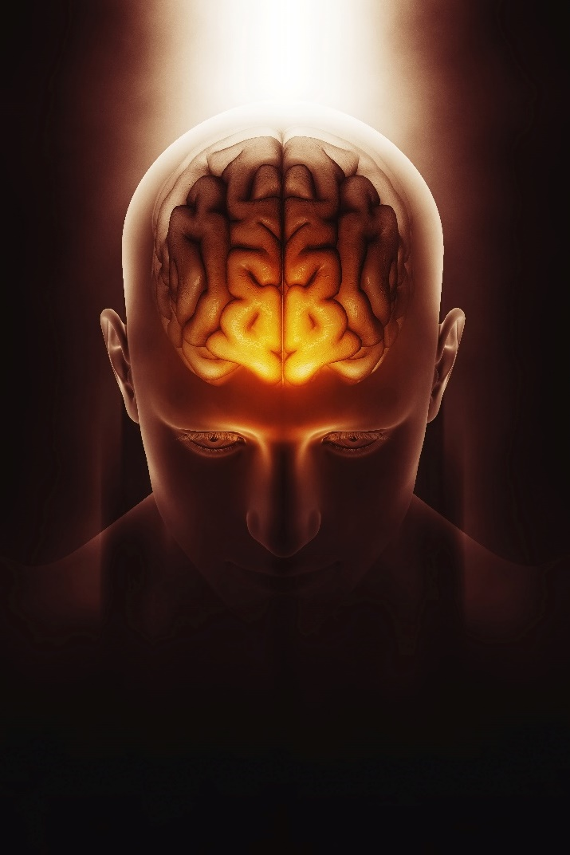
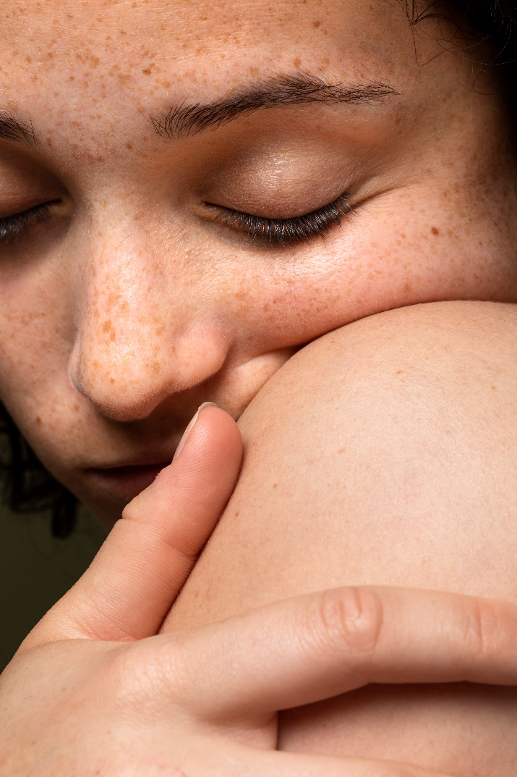
Action on emotions
Neuroscience
Study of the interactions between the skin, the brain and the nervous system:
Understanding how emotions influence skin health
Exploring ways to optimize skin care: NEUROCOSMETICS
Notes:
Neuroscience is the study of the functioning of the nervous system and its relationship with the organs. The brain and skin share the same embryonic origins - our epidermis and nervous system are intimately linked. Sensory neurons, like skin cells, establish contacts and secrete multiple substances that feed a permanent dialogue between the skin, the nervous system and the immune system. These close links could help us to understand how the nervous system, and in particular the psyche, can play a part in maintaining skin balance, and vice versa.

Slide 16
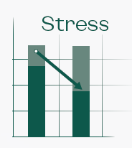
Action on emotions
Emotional test / PROSODY ^{New}
After 28 days
Reduced vocal stress load
Increase in positive emotions associated with a relaxing effect
Notes:
For the first time, Yon-Ka has gone beyond standard clinical tests and measurements to demonstrate the anti-stress efficacy of CBD Serum with a prosody test.Prosody is the way we speak. Intonation, accentuation, rhythm, flow and pauses are real markers. Indeed, the study of prosody and/or its disorders is increasingly being investigated, making it possible to detect and diagnose certain pathologies (autism, Parkinson's disease, schizophrenia, etc.) as early as possible, as well as to understand our state of stress and emotional state. Our study focuses on these last 2 points. This analysis is carried out using a specific algorithm, EmoVocTM, which, after processing the sound signal, enables us to evaluate the stress (1) and emotions (2) of the subjects.After 28 days of use, our CBD Serum has lived up to all its promises, showing a relaxing effect (by reducing stress) associated with a significant increase in positive emotions.
(1) quantified on the basis of various vocal parameters such as vocal intensity and frequency.
(2) calculated from the values of specific parameters extracted from the analysis of voice spectra.

Slide 17
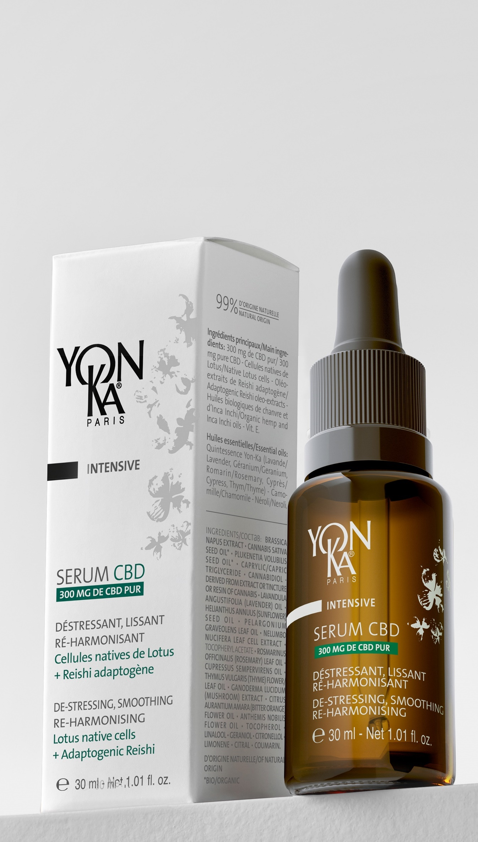


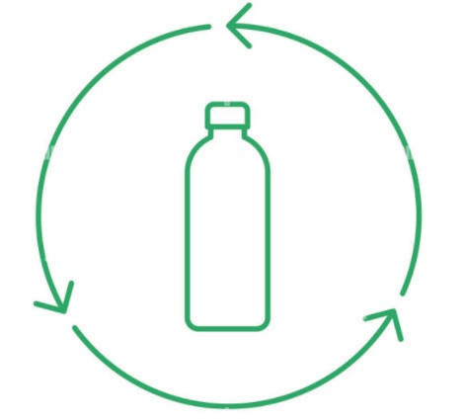


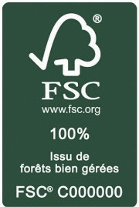
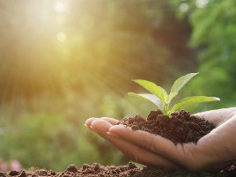
A product that meets to our commitments
FSC cardboard case
(from sustainably managed forests)
Primary packaging recyclable glass
Instructions printed on the back of the case to reduce paper consumption
2025 target: Savings of over 4 tons / year
Active ingredients
from Green Sciences
Sustainably grown ingredients
Notes:
Once again, with this product launch, Yon-Ka affirms its environmental commitments.
With FSC packaging, instructions printed on the back of the case, primary packaging in recyclable glass and the use of active ingredients derived from Green Sciences and cultivated sustainably (CBD and Sacred Lotus).

Slide 18
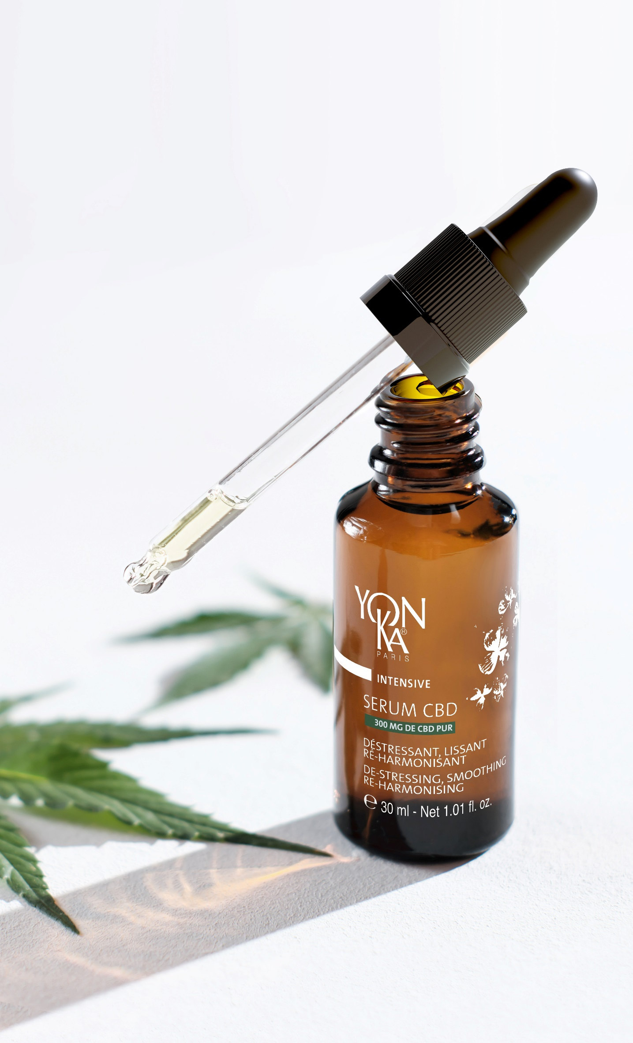
Serum CBD
Consumer insight / Trend
Stress, lack of sleep / CBD
Naturalness
99.9% ingredients of natural origin
Synergy of active ingredients
300mg pure CBD +
Native cells of sacred lotus + adaptogenic reishi
Skin/mind effectiveness
De-stressing - Smoothing - Re-harmonising
Sensoriality
Texture : Self-adapting oleo-serum
Fragrance: Lavender, Chamomile and Neroli
All year round
All skin types
even sensitive

Slide 19
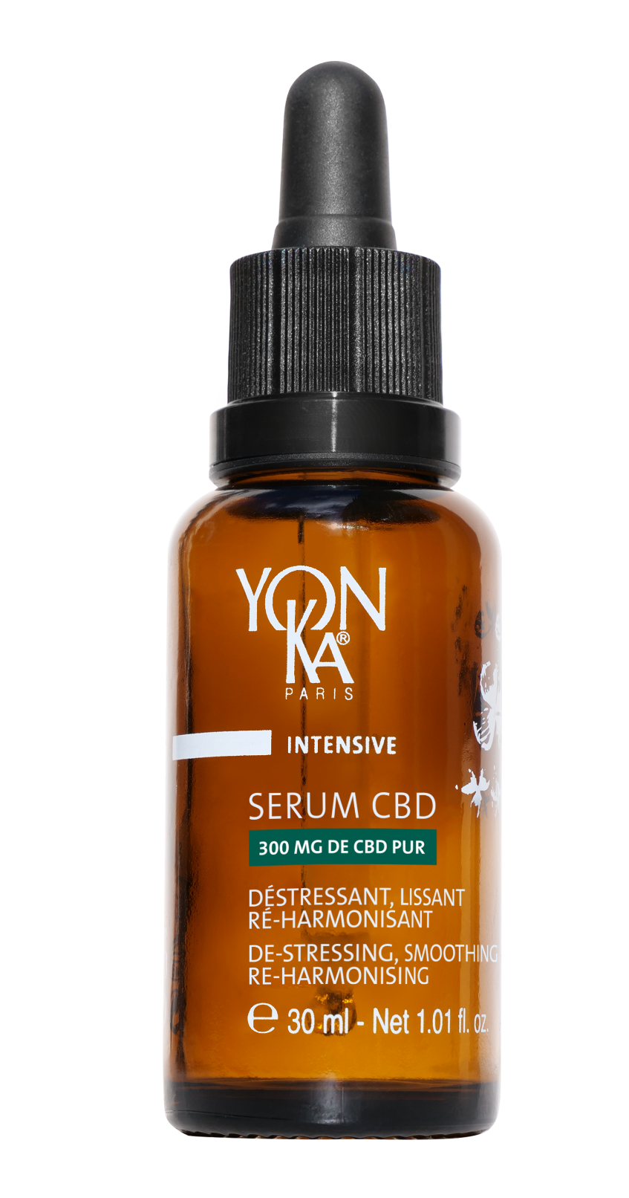
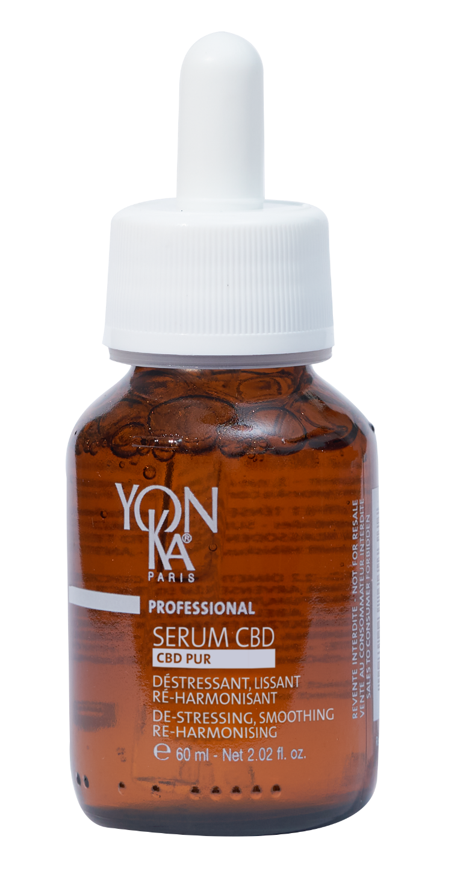
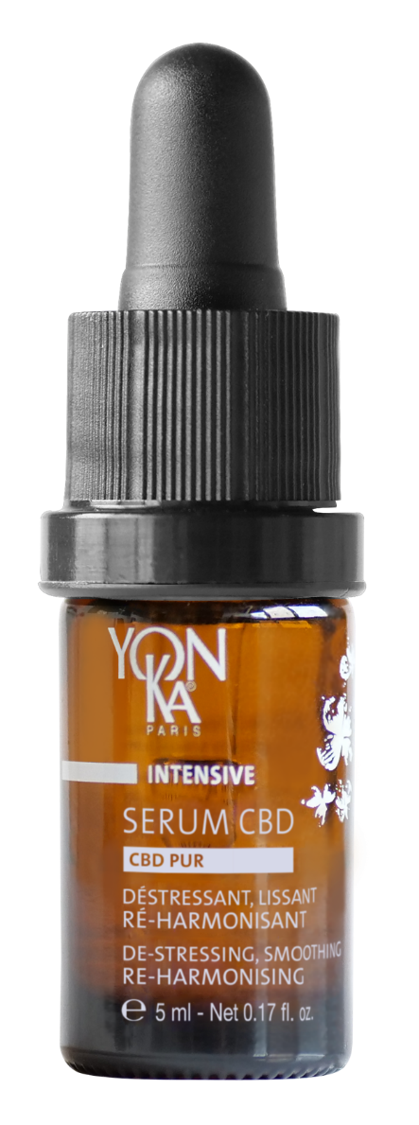
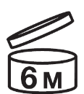
The CBD offer
International Launch March 4th, 2024
NEW TREATMENT
Retail size 30 ml
4 months of use (night)
Retail size 5 ml
20 days of use (night)
Professional size 60 ml
Best before:
30 months
Notes:
Retail size 30ml = XX € (4 months of use)
5ml = XX € (20 days of use – used 1x at night)
Professional size = 60ml (10 treatments of 90 min)
The CBD concentration is the same in all 3 formats ( 1% pure CBD) the number of mg of CBD varies according to the volume of the bottle.
Example: 300mg for 30ml and 600mg for 60ml

Slide 20
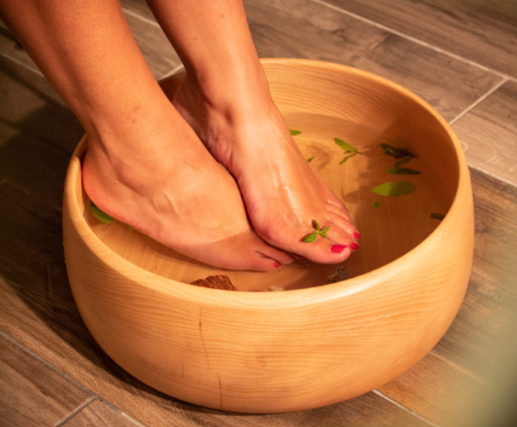
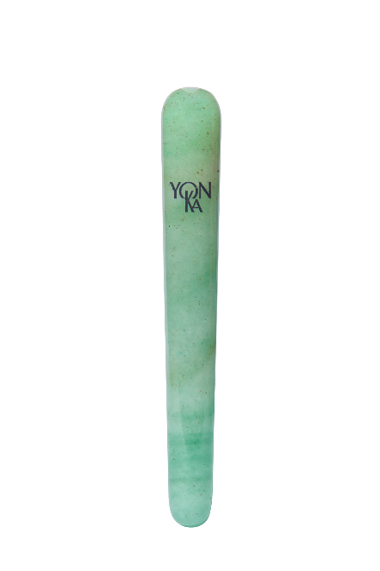
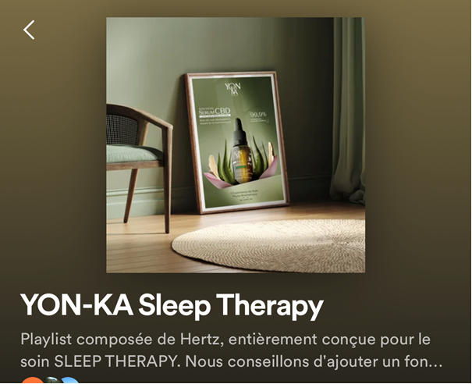
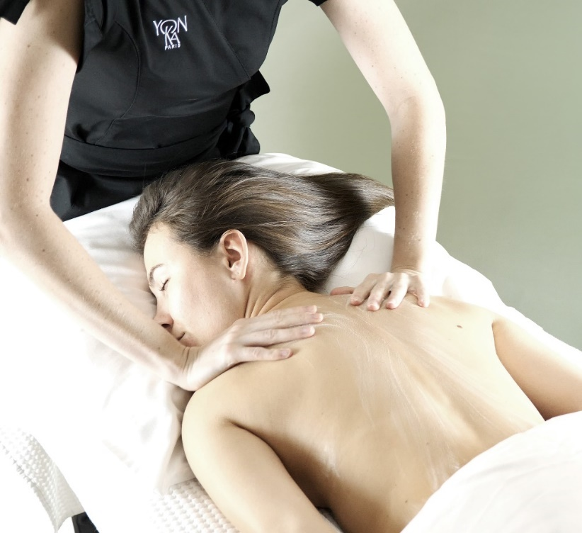
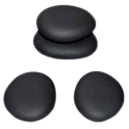
SLEEP THERAPY
90 min. – WELLNESS
The Yon-Ka +
PHYTO BAIN and stimulation of 9 personalized energy points (anti-insomnia, anti-anxiety, pain relief)
Use of accessories during treatment: quartz crystal (de-stressing techniques), hot stones (on areas of tension) for even greater relaxation
Unique and 14-step
multi-sensory experience (specially designed playlist and warmed products)
YON-KA Sleep Therapy
(Spotify)
30-minute option
to be combined with a face or body treatment (back, energy points) to restore restful sleep

Slide 21
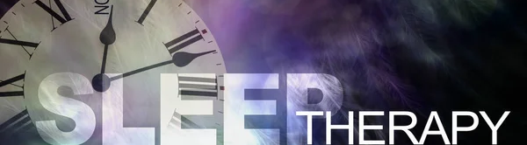
One new treatment – 2 versions :
CBD SLEEP THERAPY
PHYTO SLEEP THERAPY
De-stressing, smoothing and re-harmonising
face and back treatment
Double massage and energy points to release tension and promote restful sleep.

Slide 22
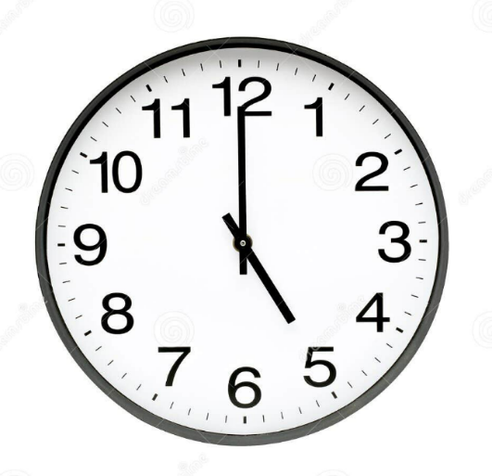
De-stressing, smoothing and re-harmonising face and back treatment with CBD for restful sleep
CBD
SLEEP THERAPY
PHYTO
SLEEP THERAPY
De-stressing and smoothing face and back treatment for restful sleep
90 min. - WELLNESS RANGE
Target
All ages, all stressed women and men, especially those with restless sleep patterns.
Indications
Tired skin
Frequency
Anytime: As soon as the need arises. Ideally from 5 p.m.
Recommended price:
€130 - €210 (euro zone) $275 - $325 (US)

Slide 23





SLEEP THERAPY products
Option PHYTO
HUILE DE MASSAGE
CONCENTRE AROMATIQUE DETOX
NUTRI +
SERUM
HYDRA N°1

Slide 24

CBD SLEEP THERAPY
Option PHYTO
HUILE NEUTRE + CONCENTRE AROMATIQUE DETOX
PHYTO 52/58 + NUTRI+ (1/2 ampoula)
PHYTO CONTOUR
SERUM HYDRA N°1
CREME PHYTO 58/52

Slide 25


STEP 1 : FOOT BATH (4min)
Special "Sleep ritual" questionnaire
"How are you feeling today?"
"What is the quality of your sleep right now?"
Insomnia: energy points = ankles
"On average, how many times do you wake up during the night?"
Anxiety: energy points = hand
"Do you have worries or anxious thoughts that keep you awake?"
"On a scale of 1 to 10, how would you estimate your stress level right now?"
Pain: energy points = face and skull
"Do you feel any muscle tension or pain? If so, where?"

Slide 26


STEP 4 : BACK MASSAGE AROMA LUXE (10min)
CBD
SLEEP THERAPY
PHYTO
SLEEP THERAPY

Slide 27





STEP 6 : ENERGY POINTS (10min)
Apply 20 circular pressures to each point in a counter-clockwise direction.
No product is required.
2 anti-insomnia points :
Improves sleep quality, helps to fight insomnia.
3 anti-anxiety points :
Calms the mind, fights anxiety and panic attacks.

Slide 28





4 pain-relieving points :
Relieves headaches, helps you get back to a restful sleep.

Slide 29
STEP 6 : ENERGY POINTS (10min)
Chinese name
TAIXI | Location: inner edge of the foot, between the medial malleolus and the Achilles tendon. Description and benefits: relieves insomnia.
SAN YIN JIAO | Location: inside of the leg. Starting at the top of the ankle, measure four finger sizes up the leg. Description and benefits: helps with insomnia, menstrual cramps, urinary problems and other pelvic problems.
SHEN MEN | Location: lower wrist, just below the lower part of the hand. Description and benefits: calms the mind and helps to resolve symptoms such as anxiety, worry, panic attacks and heart palpitations by deepening the inner connection with the spirit. This is a point for combating anxiety and panic attacks in the moment.
NEI GUAN | Location: anterior forearm, three fingerbreadths below the wrist, on the inside of the forearm, between the two tendons. Description and benefits: relieves nausea, stomach ache, motion sickness, carpal tunnel syndrome and headaches. This point is also very effective for emotions such as anxiety and panic.

Slide 30
STEP 6 : ENERGY POINTS (10min)
Chinese name
HE GU | Location: between the 1st and 2nd metacarpals, on the radial side of the middle of the 2nd metacarpal, at the highest point of the muscle when the thumb and index finger are brought together. Description and benefits: restores calm to people suffering from sleep disorders, excessive agitation or irritability. Stimulating this point can help relieve pain and headaches. It can be used in the middle of a migraine or as a preventative measure when you feel one coming on.
AN MIAN | Location: on each side of the neck, one finger behind each earlobe and move the fingers just behind the bony protuberance. Description and benefits: treats problems with falling asleep and waking up at night.
TAI YANG | Location: in the depression of the temples (about three centimetres from the eyebrows). Description and benefits: treats headaches and migraines, improves concentration and memory. Tai Yang is very relaxing and can be used to calm the mind.
YIN TANG | Location: middle of the 2 eyebrows. Description and benefits: connection with the chakras: The third eye chakra is said to unlock our ability to concentrate fully and see the big picture. This point relieves stress, anxiety and headaches.
BAI HUI | Location : apex of the head, highest point. Description and benefits: relieves anxiety and excessive thinking. Bai Hui is the point where the Conception Vessel meets the four meridians.

Slide 31

STEP 10 : DE-STRESSING TECHNIQUES (8min)
With the Yon-Ka massage crystals.
Repeach each movement x3 – No product is requred

Slide 32



SLEEP THERAPY
De-stressing, smoothing and re-harmonising face and back treatment with CBD for restful sleep
Stressed skin showing one or more of the characteristics of a lack of sleep: dehydration, dull complexion, fine lines and wrinkles, puffiness, sensitivity, acne, redness...
As soon as you feel the need,
ideally after 5pm.
Option Phyto Sleep Therapy
+
Possibility of customizing the
Yon-Ka facials with the
SERUM CBD

Slide 33


Slide 34

Thank you !

