Slide 1


Our tips
anti-insomnia
anti-anxiety
Pain relief

Slide 2
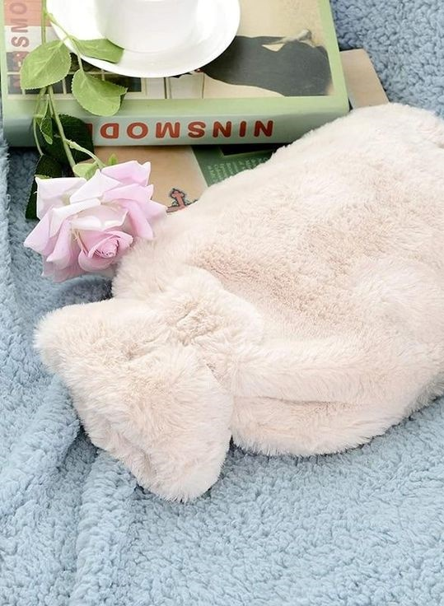
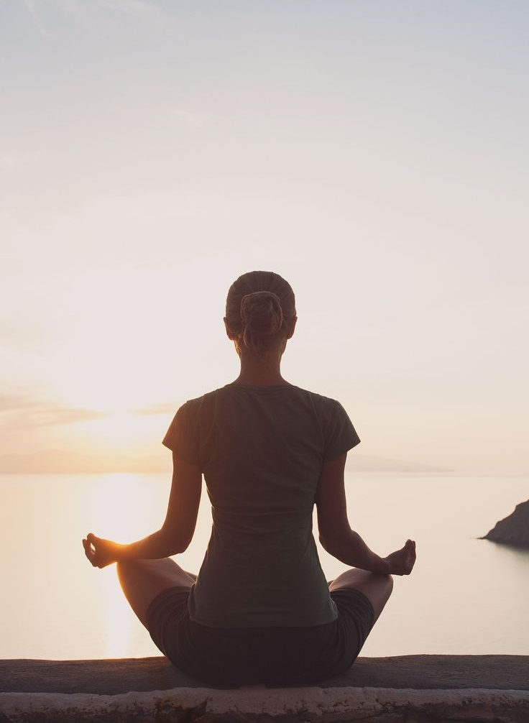
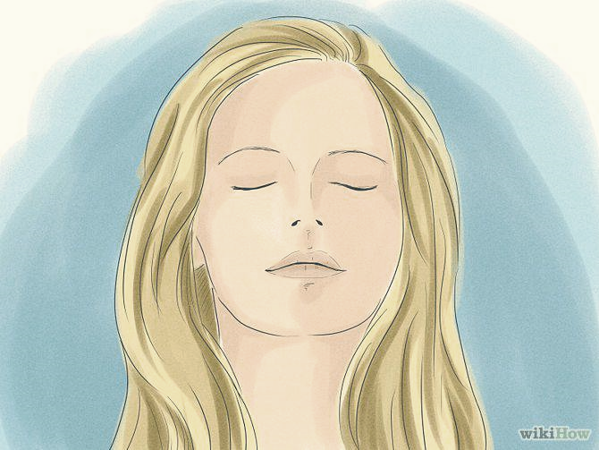
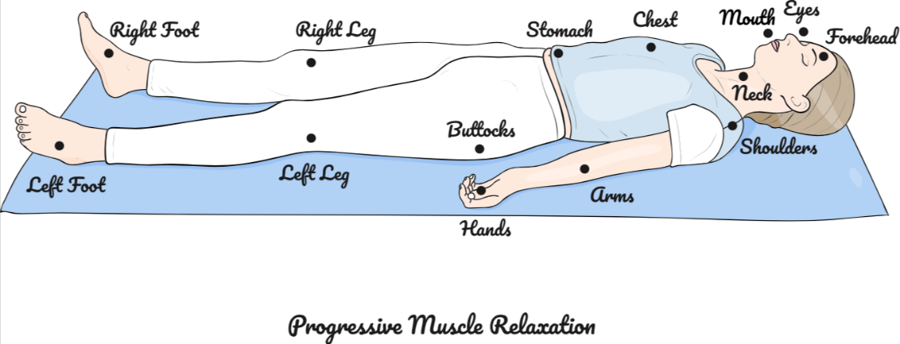
Our anti-insomnia tips
Pamper your body and mind
Progressive muscle relaxation: Relax by gradually tensing and relaxing every muscle in your body. Start with your feet, then slowly work your way up. Concentrate on the sensation of muscle relaxation with each exhalation, allowing tension to escape your body.
A hot-water bottle on the shoulders, back or feet (important, as the nerve endings are located on the feet).
The warmth encourages muscle relaxation.
A few minutes to relax before bed:
Meditation and/or self-massage of the temples and 3rd eye.
Notes:
As we have seen, the new Sleep Therapy treatment aims to de-stress, soothe and re-harmonise body and mind. To complement the benefits of the treatment in the institute, we also offer tips for home use.
ANTI INSOMNIA TIPS :
a timeless classic, the hot water bottle : whether on the shoulders, back or even feet the warmth generated will provide deep muscle relaxation.
Meditation and or self massage of the temples and 3rd eye : take some time for yourself, calm your body and mind before going to bed
Progressive muscle relaxation : using the visualisation of a wave of well-being, which sails over your breathing, relax muscle after muscle from the tips of your toes to the top of your head. A few minutes to release tension

Slide 3
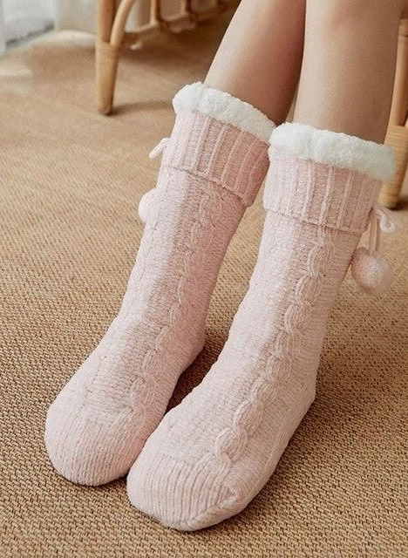

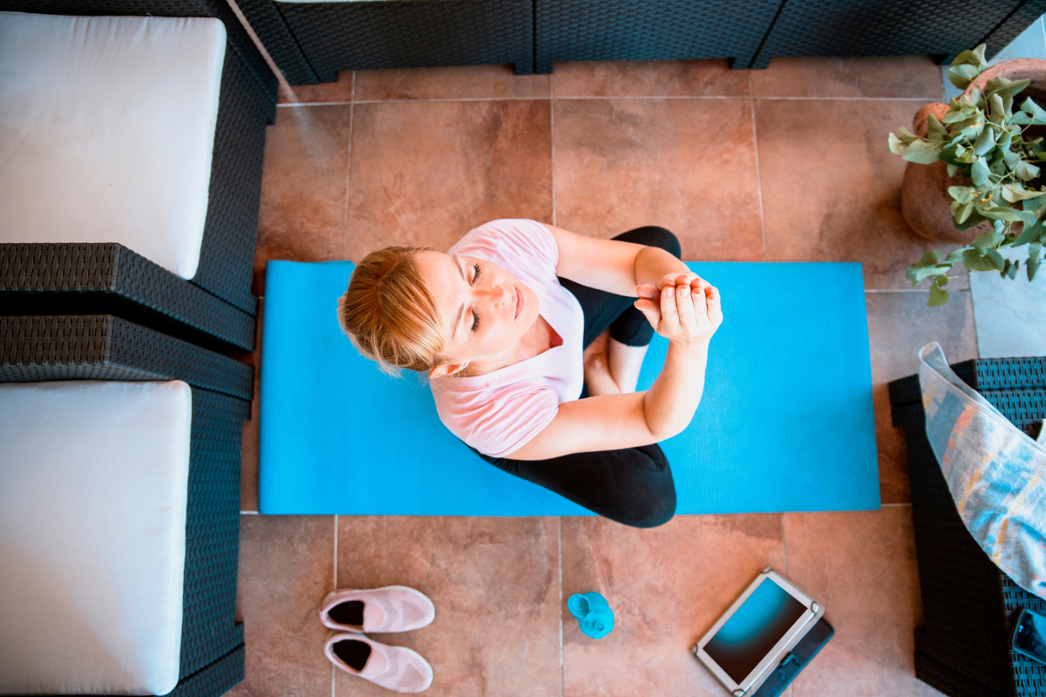
Our anti-anxiety tips
Get rid of all sources of stress
:
Autogenic training: This method involves concentrating on physical sensations and imagining yourself in a peaceful environment. Take time to feel the warmth, heaviness and relaxation of every part of your body, allowing your mind and body to relax deeply.
Opt for a pair of soft, comfortable slippers or booties as soon as you get home.
Dressing comfortably only for the night tells the body that it's time to go to sleep.
Notes:
ANTI ANXIETY TIPS :
In order to limit anxiety, it is important to establish a wellbeing routine:
when you get home after the day's work, opt for comfortable slippers
change your outfit for something more comfortable and pleasant
Autogenic training : a relaxation technique similar to self-hypnosis, which aims to bring about a state of disconnection to allow the body and mind to relax. by concentrating on fixed formulas. For example: "I'm calm. I'm completely calm. "My arms are heavy. "I breathe slowly and evenly. ...

Slide 4


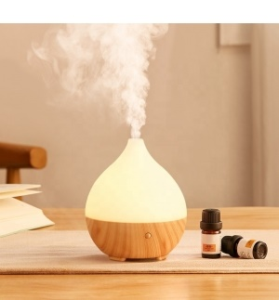
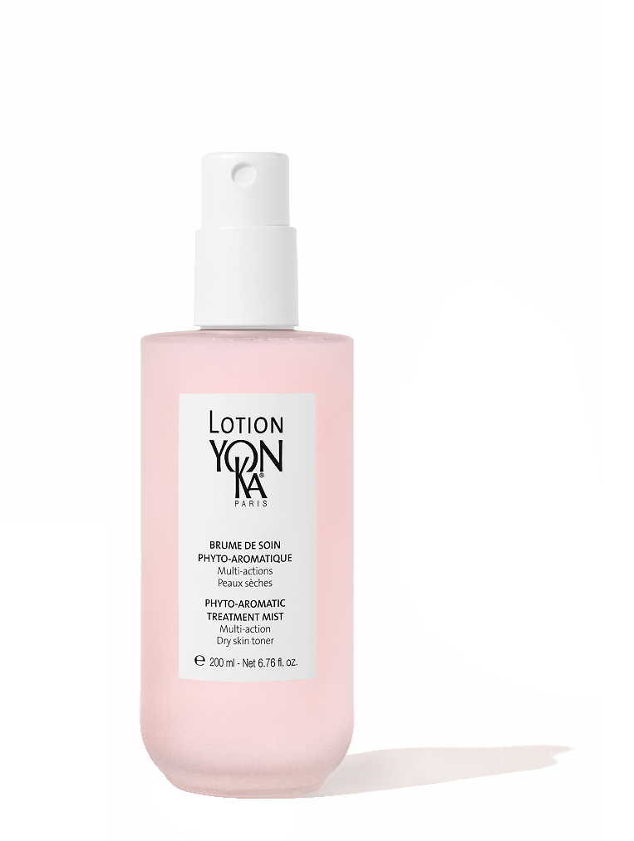
Our anti-anxiety tips
Create a relaxing, soothing atmosphere in your home
Light a candle with relaxing scents to create a pleasant atmosphere and encourage meditation and dive into a bath with PHYTO-BAIN.
Adapt the light:
Warm-colored bulbs, around 2700K, reproduce the light of sunset and can help stimulate the production of melatonin, the hormone associated with sleep.
Spray Lotion Yon-Ka on your face and lavender essential oil or incense in your home to enjoy the benefits of aromachology.
Notes:
ANTI ANXIETY TIPS :
As part of your well-being routine, light your Taiga candle to create a calm and peaceful atmosphere. Enjoy a rejuvenating and relaxing interlude, thanks to the subtle aromas combining the woody scents of Siberian pine, cypress and Virginia cedar. Don't hesitate to enhance this relaxing interlude with a foot bath containing a few drops of Phyto Bain and enjoy a real spa at home.
Prefer Warm-colored bulbs, around 2700K, reproduce the light of sunset and can help stimulate the production of melatonin, the hormone associated with sleep
spray on your face the Yon-Ka Lotion and diffuse lavender essential oils to release its aromachological power : reputed to combat stress and insomnia. As a calming agent, it soothes the nerves, helps the body and mind to relax and makes it easier to fall asleep.

Slide 5

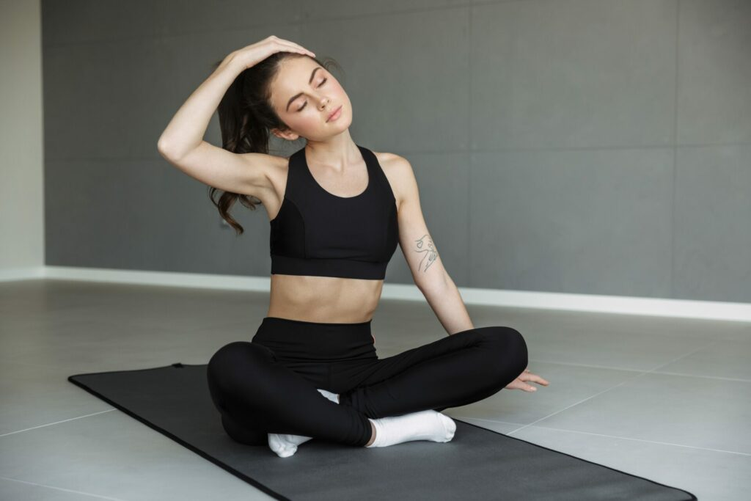
Our pain relief tips
Stretch the upper body first
Bear hug
This stretch works the rhomboids and trapezius muscles of the upper back. It relieves any discomfort or pain in the shoulder blades.
Neck stretch
Helps relieve tension in your head, neck and shoulders.
Start standing, with feet hip-width apart and arms as far apart as possible (without tiring yourself too much).
Cross one arm over the other at the elbows, reaching over opposite shoulders and grasping the back of the shoulders.
Gently pull your shoulders forward and hold the stretch for 20 seconds, remembering to breathe deeply.
Repeat the stretch, alternating to cross the arms on the opposite side.
Sit down in a comfortable armchair.
Bring your right hand to the top of your head or to your left ear.
Gently bring your right ear towards your right shoulder, holding this position for five breaths.
Repeat on the other side.
Then turn to look over your right shoulder, keeping the rest of your body facing forward. Hold this position for five breaths. Repeat on the other side.
Notes:
ANTI RELIEF TIPS
to relieve aches and pains, here are some easy stretches you can do at home:
BEAR HUG : to stretch the upper back , to stretch the upper back; while standing, grab your shoulder blades, crossing your arms as far as possible behind your back and hold the stretch for a few seconds before changing the crossing of your arms.
NECK STRECH : to relieve neck and shoulder tension : in a seated position, lean your head to one side, using your hand to maintain the stretch, then to the other side.

Slide 6
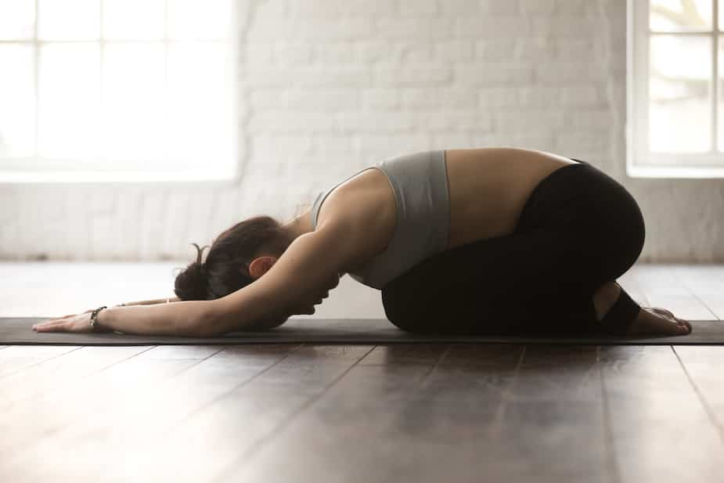
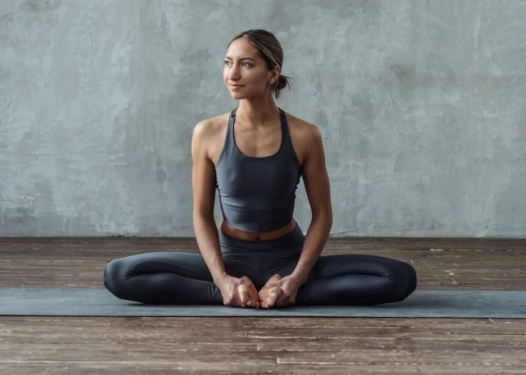
Our pain relief tips
Relieve back and thighs
Child's posture
Perfect for listening to your breathing, relaxing your body and reducing stress. It also relieves pain and tension in the back, shoulders and neck.
Butterfly
Helps relieve stiffness in the thighs and lower back. Softens the body.
Get down on all fours, shoulders level with hands.
Slowly rock forward on your arms, rounding your shoulders and bringing your lower back to the floor. Hold for 5 seconds.
Back away slowly and sit back on your heels.
Extend your arms and turn towards the floor to keep your neck in line with your spine. Hold for 5 seconds.
Sit upright with your spine and head aligned, your legs bent in front of your body and the soles of your feet touching. Place your hands on your feet.
Activate your abdominal muscles and gently bend your hips to lower yourself forward with a straight back, bringing your elbows to rest on your inner thighs.
Lightly push your thighs down as far as you can without discomfort. Hold for 15 to 30 seconds, release and rest for 30 seconds.
Notes:
ANTI RELIEF TIPS
CHILD’S POSTURE : relieves pain and tension in the back, shoulders and neck. has four paws on the ground, hands as far away from the head as possible and buttocks on the heels
BUTTERFLY : relieve stiffness in the thighs and lower back : in a seated position, with your back straight, bring your knees as close to the ground as possible by pressing gently on them
each of these exercises is performed with deep, regular breathing

