Slide 1
The Experience of
Phyto-Aromatic Skincare

Slide 3
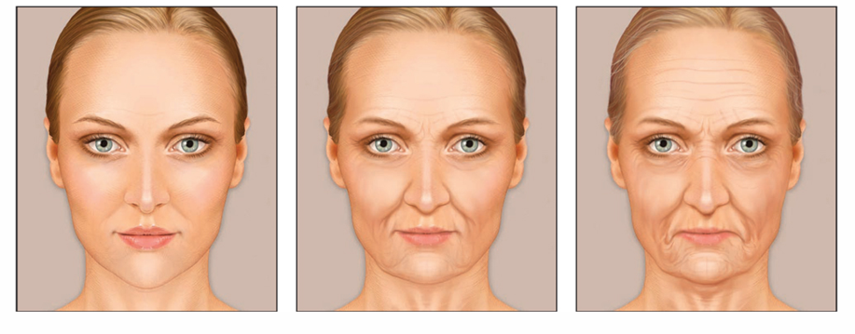
Skin physiology

Slide 4
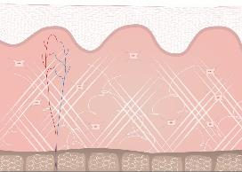
Skin structure
EPIDERMIS
DERMIS
HYPODERMIS
Notes:
Our skin is divided into 3 main layers, each playing a role in maintaining skin structure.
EPIDERMIS
The outer most skin level is known as the epidermis and is renewed approximately every four weeks through the elimination of dead superficial skin cells. It is about 0.1 mm thick and made up of 90% of keratinocytes.
It is broken down into 4 layers, each representing the keratinocytes' various stages of growth.
The basal layer is the link to the dermis. This is where the keratinocytes are produced, from epidermal stem cells.
DERMIS
The skin layer located just below the epidermis is called the dermis. It is 4 times thicker. It is home to all living structures: blood vessels, hair follicles, collagen and elastin fibers (produced by fibroblasts). And lastly the sweat and sebaceous glands.
With age, the dermis becomes thinner thus leading to the creation of wrinkles.
HYPODERMIS
The hypodermis is the deepest skin layer - it is made up of fatty cells known as adipocytes. This layer supports the upper skin layers. It protects and isolates them from body heat. It contains the energy resources required to nourish the skin, such as lipids and fatty acids.

Slide 5
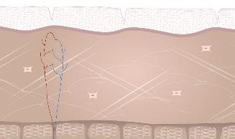
With age, skin morphology changes
IN YOUR OPINION, WHAT ARE MAINS CHANGES OF MATURE SKIN?
THINNER EPIDERMIS STRATUM CORNEUM
DEHYDRATED
REDUCED IMMUNE RESPONSE
DARK SPOTS
UNEVEN COMPLEXION
LOOSE OF ELASTICITY
DEPENING WRINKLES
LOSS OF DENSITY AND HYDRATION
APPEARANCE
OF SMALL BLOODVESSELS
Notes:
With age, skin morphology changes:
The skin shows reduced abilities in renewing itself (lowered proliferation and movement towards the surface of the keratinocytes) ➔ The epidermis' stratum corneum becomes thinner
Reduced lipid synthesis, leading to the formation of the skin's protective barrier ➔ Skin becomes dehydrated and dry much quicker
Reduced number of Langerhans cells ➔Reduced action in immune responses
irregularities in the body's melanogenesis ➔ dark spots and uneven complexion
Reduced size and number of fibroblasts ➔ disorganized dermis structure ➔ Lower part of the face, cheekbones, eyes and eyebrows start to sag
Altered elastin fibers and changes in collagen fibers (they become rigid and destroyed by collagenase ➔ loss of suppleness, firmness and elasticity. ➔ more deepening wrinkles
The skin's main water reserve - known as hyaluronic acid - decreases day by day ➔ loss of density and hydration
Slowed micro-circulation ➔ dull complexion, appearance of small blood vessels

Slide 6
Focus on DERMIS
EPIDERMIS
DERMIS
FIBROBLASTS : PRODUCE THE EXTRACELLULAR MATRIX
IMMUNE SYSTEM CELLS
HYPODERMIS
Notes:
DERMIS
Dermal cells form two different populations:
Fibroblasts, that produce the extracellular matrix - i.e. the dermis' base structure. They also produce collagen and elastin, which ensure skin rigidity and elasticity.
Immune system cells (dermal dendritic cells, mast cells and macrophages).
With age, the dermis becomes thinner thus leading to the creation of wrinkles.

Slide 7
EXTRACELLULAR MATRIX
FIBROBLAST
STRUCUTURAL PROTEINS
PROTEOGLYCANES
COLLAGEN
ELASTINE
HYALURONIC ACID
GAGs
Fibrous protein composed mainly of amino acids
-> Provide structure and resistance to the skin
Elastic protein rich in specific amino acids
-> Give the skin its elasticity and its ability to deform and return to its original shape
Extremely hydrating protein
-> Helps skin retain water while keeping it plump and hydrated.
Carbohydrate macromolecules
-> Contribute to the retention of water molecules, creating an elastic substance that resists mechanical stress.
Notes:
The extracellular matrix (ECM) refers to all the dermis' extracellular macromolecules, and is therefore the skin's largest component. It provides skin with its unique elasticity and firmness properties thanks to 2 types of molecules contained in the ECM and secreted by the fibroblasts:
Structural proteins: collagen, elastin
Proteoglycanes: proteins such as hyaluronic acid - which are extremely hydrating - and glucosaminoglycanes (GAGs).
The combination of these various components gives the ECM its properties and helps skin look younger.
With age the ECM loses in structure and skin loses in firmness, setting the face's negative expressions because of accentuated wrinkles .
Chemical composition:
Collagen is a fibrous protein composed mainly of amino acids such as glycine, proline and hydroxyproline. It forms long, thick, strong fibres which provide structure and resistance to the skin.
Elastin is an elastic protein rich in specific amino acids, notably glycine, alanine and valine. It comes in the form of fine, flexible fibres that give the skin its elasticity and its ability to deform and return to its original shape.
Functions :
Collagen ensures the structure and resistance of the skin. It acts as a 'scaffold' that maintains the skin's firmness and tone, helping to prevent skin slackening and premature ageing.
Elastin is responsible for the skin's elasticity. It allows the skin to bend, move and regain its shape after being stretched or deformed. Elastin prevents the skin from sagging and helps to maintain a youthful, firm appearance.
Structure and organisation :
Collagen fibres are thicker and more rigid. They form a dense network in the skin's dermis, providing mechanical strength and a solid structure.
Elastin fibres are thinner and more flexible. They are interwoven with the collagen fibres to form an elastic network that allows the skin to deform and return to its original shape.
Ageing:
As we age, collagen production decreases, leading to a loss of skin firmness and volume, as well as the appearance of fine lines and wrinkles.
The reduction in elastin production with age also contributes to skin sagging and loss of elasticity, leading to a less firm, more wrinkled appearance.
In summary, although collagen and elastin work together to ensure the skin's integrity and functionality, they have distinct properties and play specific roles in the skin's structure, firmness and elasticity.

Slide 8
WEAPONS AGAINST SKIN AGING
STEM CELLS
FIGHTING AGAINST "INFLAMM’AGING"

Slide 9
STEM CELLS
EPIDERMAL STEM CELLS
DERMAL STEM CELLS
Responsible for the daily regeneration of the epidermis;
-> Produce keratinocytes.
With the slowing of epidermal stem cell activity, skin becomes thinner, its hydrolipidic films grows more fragile, making skin dryer and more sensitive to external aggressors.
Directly involved into the maintaining of the skin architecture and elasticity.
-> Create fibroblasts
Decreased dermal stem cell activity and quantity leads to a reduced number of fibroblasts and thus of collagen and elastin fibers, hence a loss of firmness and elasticity.
Quantity, activity and "quality" of the skin's stem cells deteriorates over time; there are fewer of them, and they grow to be more "tired and damaged“ : This weakening process is one of the main causes of skin aging and the appearance of wrinkles
Notes:
On a daily basis, skin is required to face various forms of aggression. Skin must therefore renew itself constantly to maintain its condition. Stem cells enable these maintenance and repair processes: they are responsible for the skin's constant regeneration. Indeed, they can multiply into identical or different cells depending on your body's needs (for instance, 1 stem cell in the epidermis is capable of producing more than 100 billion cells).
To date, scientists have identified several types of skin stem cells:
Epidermal stem cells, responsible for the daily regeneration of the various skin layers in the epidermis, and thus its full regeneration every 28 days. Their main role is to produce keratinocytes, and are located in the epidermis' basal layer. With the slowing of epidermal stem cell activity, skin becomes thinner, its hydrolipidic films grows more fragile, making skin dryer and more fragile.
Decreased epidermal stem cells activity and quantity leads to the diminution of the epidermis renewal, which does not happen anymore every 28 days. So it becomes sensitive to external aggressors and the skin upper layer quality diminishes.
Dermal stem cells: located around hair follicles. Create fibroblasts (cells that then produce skin support cells, as well as elastin and collagen). Those stem cells are therefore directly involved into the maintaining of the skin architecture and elasticity.
Decreased dermal stem cell activity and quantity leads to a reduced number of fibroblasts and thus of collagen and elastin fibers, hence a loss of firmness and elasticity.
Stem cells repair and renew skin
- They are essential for preserving visibly young and beautiful skin. We proved that quantity, activity and "quality" of the skin's stem cells deteriorates over time; there are fewer of them, and they grow to be more "tired and damaged". (It is said we have ten times fewer at the age of 60 that in our early years). This weakening process is one of the main causes of skin aging and the appearance of wrinkles.

Slide 10
STEM CELLS
COSMETICS FOCUSED ON STEM CELLS
OBJETIVES
HOW ?
Protect the skin's stem cells :
-> against external aggressors and degradation overtime
Revitalize them
Keep their activity stable
Regenerating plant-based stem cells :
SAPONARIA PUMILA
Notes:
This is why the cosmetics industry has taken an interest in these natural treasures and how they operate to fight against aging.
Stem cells live in a micro-environment called a “nest", made up of other cells, growth factors, etc. The purpose of cosmetics is to provide all the elements required for improving this nest so cells can thrive and function optimally.
1st generation of cosmetics focused on stem cells (2008):
In this first generation, brands were interested in protecting the "niche" (micro-environment) in which the stem cells thrive. This solution was an answer to the stem cells' vulnerability, small quantity and reduced renewal capacity over time - their environment must therefore be protected to in turn protect the stem cell pool sustainably.
2nd generation of cosmetics focused on stem cells:
Consists in adding to anti-aging creams plant-based stem cells, cosmetic active ingredients extracted from plants through biotechnological means. Just like human stem cells, they have exceptional self-regeneration abilities to rekindle the skin's youthfulness. They are in fact capable of positively influencing skin stem cell function, by protecting them, revitalizing them and keeping their activity stable. Plant-based stem cells settled like a cocoon around skin stem cells protecting them against external aggressors and degradation overtime.
Indented first to act on the epidermal stem cells, the discovery about the exceptional power of the dermal stem cells offers today new possibilities.

Slide 11
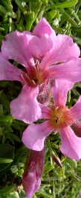
Focus on SAPONARIA PUMILA
One of the most ancient species of mountain fauna : survived the ICE AGE
Constantly exposed to :
High UV rays
Extremely cold temperatures
Developed protective and repairing properties to survive in its extreme environment.
Method of production : Biotechnologie Phyto CellTecTM
Create and harvest the plant-based stem cells using selected Saponaria tissues in special conditions. The plant-based stem cells are then harvested in bioreactors to obtain the required number of stem cells.
Action : (tests in vitro)
Protect dermal stem cells against harmful UV rays and visible light sources
Preserve dermal stem cells vitality and self-renewal ability
Increase dermal density by protecting it against breaks in its structure (arrangement of elastin and collagen fibers)
Improve skin firmness and elasticity
ORIGIN : Swiss Alps
Notes:
Saponaria Pumila protects and preserves the dermal stem cells.
History : During the ice age from 110 000 BC to 10000 BC, 90% of terrestrial life disappeared. Some plants survived this ice age, such as the nunataks. These extremophilic alpine plants survived the ice age because they migrated during periods of extreme cold to unglaciated mountain peaks called Nunatak (hence their name). They can still be found in the Alps and are considered the most ancient species of the alpine fauna. Saponaria Pumila is one of these Nunataks that, being constantly exposed to strong UV radiation but also very cold temperatures, has developed protective and restorative properties to survive its extreme environment.
Method of production: Eco-Innovation
A very small amount of plant material (e.g. a fruit or a leaf) is needed to establish a plant stem cell culture. Thus rare and endangered plants are preserved.
This technique does not require agricultural land
It is water-efficient compared to conventional processes
It does not require pesticides or fertilizers.
Action:
The extraordinary survival potential of Saponaria Pumila allows them to protect and revitalize the skin's stem cells (dermal stem cells) so that they have the weapons to protect themselves against environmental stresses that are the main cause of skin aging. This ability translates into:
Protection of dermal stem cells from the harmful effects of UV and visible light
Increase in the density of the dermis by protecting it against breaks in its architecture (arrangement of elastin and collagen fibres).
Thus, Saponaria pumila stem cells are able to allow dermal stem cells to maintain their regenerative potential despite UV exposure.

Slide 12
Fighting against "INFLAMM’AGING"
What is Inflamm’aging?
80%
Characterized by the chronic presence of interleukin 6 in the body
(major mark of inflammation)
Responsible for 80% of all pathologies to do with age and skin aging
With age, repetitive micro-inflammations spread through skin tissues and weaken the cells' defense systems:
Wrinkles
Dehydration
Skin slackening
Dull complexion
Etc…
OXYDATION
INFLAMMATION
SKIN AGING
Notes:
Inflammation is the skin's way of protecting itself against external aggressions. Its features include increased blood circulation, vascular dilation, leukocyte activation and the synthesis of mediator molecules (cytokines) that will trigger the elimination of toxic agents and help rebuild tissues. On the surface, you often notice the appearance of redness, swelling, heat and sometimes pain.
There are in fact two types of inflammation:
Acute inflammation: Occurs after a cut, an infection, a cough, a sprained ankle or appendicitis, and its effects are short-term and clearly visible. It has specific factors and well-known measurable impacts.
Chronic inflammation: long-lasting and results from general wear of the body. It can be triggered by "dangerous" environmental or societal conditions such as obesity, anorexia, lack of exercise, smoking, stress, pollution, excessive alcohol consumption, etc. It is our body's response to a stimulus it considers as a threat, even though it is not one. Most of the time we do not feel this type of inflammation, but it can be responsible for the appearance of visible signs of aging (wrinkles, skin slackening, etc.): This phenomenon is known as Inflamm’aging or silent aging.
What is Inflamm’aging?
Inflamm’aging is a contraction of the words "inflammation" and "aging". It is said to be responsible for 80% of all pathologies to do with age and skin aging. With age, repetitive micro-inflammations spread through skin tissues and weaken the cells' defense systems. Wrinkles, dehydration, skin slackening, dull complexion, etc. are the consequences of this.
It concerns all individuals and is characterized by the chronic presence of interleukin 6 in the body (IL-6, cytokines, a major mark of inflammation), the concentration of which increases with age.
This phenomenon is enhanced with age, due to internal or external stimuli:
environmental pollutants
UV rays (sun or artificial)
debris from the extracellular matrix
chemical agents
Etc.
What happens to the skin?
With age, the epidermis becomes thinner, more fragile and weaker in the face of aggressions (UV rays, pollution, smoking, etc.). To fight off these aggressions, your body will trigger an inflammatory response that generates free radicals. Free radicals are causing oxydatif damages to skin cells, proteins and lipids, wich modified, can’t fulfill their functions.
In normal physiological conditions, these free radicals are neutralized by the body's antioxidants defenses. However, with age, these defenses are diminished and free radicals build up. This imbalance is known as oxidative stress.
Oxidative stress will in turn generate inflammation mediators such as cytokines, and namely IL6. This increase in cytokines boosts the inflammation process (the inflammation process is itself producing free radicals). We created then a chronic and silent inflammatory circle. This inflammation is responsible for skin aging phenomena such as wrinkles, lines, skin slackening, loss of radiance, etc. This in known as inflamm'aging or silent aging.
When an infection occurs, immune system cells detect pathogens, and go then into an active mode releasing inflammation mediators into the extracellular environment. The inflammatory process is thus activated. Cytokines are well-known, this little proteins are responsible for the cells intercommunication orienting the immunity response according to the problem detected.
How to fight off inflamm’aging?
Oxidative stress can be prevented from the inside with a diet rich in antioxidants, vitamins, trace elements, etc., as well as a healthy lifestyle. Defenses can also be boosted by cosmetics that contain inflamm'aging-neutralizing ingredients. These active ingredients protect skin and its cells against chronic and silent reactions to external factors that cause skin aging.
Many ways:
Anti-oxidative molecule to reduce the oxidative stress than preserve inflammation.
Elements capable of diminish cytokines quantity ( inflammatory mediators) into the cells
Active ingredients that can protect the skin against external aggressors.
Etc…

Slide 13
Action :
Preserves the youthfulness of fibroblasts
Protection of the ECM
Builds the collagen network
Improves the micro-vascular network
Focus on YOUTH ENERGY LIPOAMINOACID
1st cosmetic active ingredient that acts against inflamm'aging by regulating interleukine-6 production
Origin: lipoaminoacid with excellent affinity with the skin
The structure of this active ingredient is the same as the PalGly molecule (biomimetic)
ANTI-INFLAMM’AGING ACTIVITY
Preserve the youthfulness of fibroblasts ⁽¹⁾
- 39 %
Reduction IL 6 quantity
Protection of the ECM⁽²⁾
- 100 %
Collagenase activity
Builts the collagen network⁽³⁾
+ 124 %
proteins that encourage collagen organisation
Improves the micro-vascular network⁽⁴⁾
+ 18 %
formation of new vessels and their organisation
PalGly moldecule :
Naturally present in the brain and skin, it presents anti-stress and anti-inflammatory properties.
Yon-Ka drew its inspiration from this serenity molecule
+ firmness⁽¹⁾
- wrinkles⁽⁶⁾
+ radiance⁽⁴⁾
Notes:
Youth Energy lipoaminoacid active ingredient that acts against inflamm'aging by regulating interleukine-6 production.
Background information: Some individuals have developed a resistance to inflamm'aging which allows them to age gracefully. Their bodies naturally resist the stress and illnesses brought on by aging. Hundred-year-olds are those who best represent this population. During the course of a study on pain and inflammation in 2008, a team of American researchers in pharmacology discovered the PalGly molecule. Naturally present in the brain and skin, it presents anti-stress and anti-inflammatory properties, which gave it its name: the bliss molecule. Yon-Ka drew its inspiration from this serenity molecule when creating the TIME RESIST creams, offering the biological secrets to graceful aging by inserting a biotechnological active ingredient that mimics the PalGly molecule in the heart of their formulas.
Origin: this active ingredient is a lipoaminoacid, a structure that shows excellent affinity with the skin. It is made up of a chain of 16 palmitic acid carbons, originating from vegetable palm oil, and an amino-acid - glycerin - prepared by synthesis. (Overall, it is 76% natural).
Creating a lipoaminoacid
The structure of this active ingredient is the same as the PalGly molecule.
Actions: Given its anti-inflamm'aging activity, this lipoaminoacid affects skin and its cells more or less directly, namely acting directly on the reduction of IL-6 quantities, a key marker in inflammation:
Tests conducted to verify YOUTH ENERGY efficiency:
Comparative in vitro tests, between aged fibroblasts treated with YOUTH ENERGY, non-treated aged fibroblasts and non-treated young fibroblasts.
In vitro tests comparing YOUTH ENERGY activity to another renowned anti-collagenese molecule
In vitro tests studying the behavior of these proteins - for fibroblasts treated with YOUTH ENERGY and non-treated.
In vitro tests studying cells and the changes in their micro-vascular networks
Ex vivo tests: applying YOUTH ENERGY on human skin explants and measuring skin brightness
Consumer tests: applying a cream containing the YOUTH ENERGY agent for 42 days in the morning and evening

Slide 14
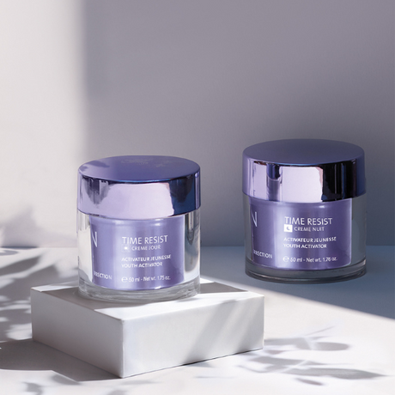
COMMON BASE
FILL IN DEEP WRINKLES
A must-have duo for filling and smoothing deep wrinkles
SAPONARIA PUMILA
Protects and preserves dermal stem cells
YOUTH ENERGY (lipoamino acid)
Anti-inflamm’aging action
WAKAME EXTRACT
Restore skin volume in the face for a visible anti-aging effect
VEGETABLE GLYCERIN
Preserves skin hydration by reducing water evaporation speed
SHEA BUTTER
Protects, soothes, hydrates and nourishes
GRAPE SEED OIL
Reduces transepidermal water loss, increases skin comfort and elasticity
TIME RESIST DAY/NIGHT
Notes:
Perfect duo for mature skin wanted to erase deep lines, have comfort and hydration troughtout the day
RESULTS: Wrinkles are visibly smoothed, skin shows more volume and density, signs of tiredness are diminished and complexion is much brighter.
Velvety and soft texture
COMMON BASE
SAPONARIA PUMILA: Protects and preserves dermal stem cells
In the heart of TIME RESIST formula, saponaria pumila plant based stem cells :
Protect cells against UV rays and visible light sources
Preserve cells vitality and self-renewal ability
Increase dermal density
Improve skin firmness and elasticity
YOUTH ENERGY: Protects and strengthens the skin's defenses against chronic and silent reactions; anti inflamm’aging action
Actions :
protects the skin from chronic and silent reactions induced by external aggressions and responsible for skin aging.
Reduction inflamm'aging
Protection of collagenase activity
Construction of the collagen
Improvement of the micro-vascular circulation
What is Inflamm’aging?
Inflamm’aging is a contraction of the words "inflammation" and "aging". It is responsible for 80% of all pathologies to do with age and skin aging. With age, repetitive micro-inflammations spread through skin tissues and weaken the cells' defense systems. Wrinkles, dehydration, skin slackening, dull complexion, etc. are the consequences of this. It concerns all individuals.
This phenomenon is enhanced with age, due to internal or external stimuli:
environmental pollutants
UV rays (sun or artificial)
chemical agents
Etc.
WAKAME restore skin volume in the face for a visible anti-aging effect by acting on 3 elements:
Collagen
Elastin
Hyaluronic Acid
Olfactory notes
A subtle association of Essential oil of Neroli, with delicate, flowery and sweet scents, and its calming and relaxing properties with The Yon-Ka Quintessence, perfect ally for the energizing and revitalizing scent.

Slide 15
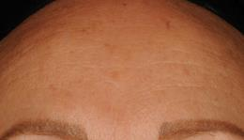
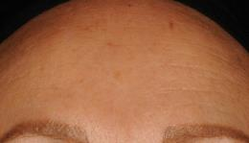
Proven effectiveness
 | DAY-NIGHT TIME RESIST DUO
Redensifying Youth Activator | Reduced IL-6 quantities: - 39%² Severity of nasolabial folds: up to -75%³ Severity of crow's feet: up to -62%³
Hydrating - nourishing | Skin is hydrated: 98%¹ Skin is nourished: 100%¹ Skin is comfortable following application and remains that way for several hours after: 100%¹
J0
J28
100%⁽¹⁾ of women found their skin looked younger
Notes:
(1)CONSUMER TEST – Self-evaluation after application of the TIME RESIST duo in the morning and evening by 45 women aged 35 to 55 for 4 weeks.
(2) ACTIVE INGREDIENT TESTING - comparative in vitro tests, between aged fibroblasts treated with YOUTH ENERGY, non-treated aged fibroblasts and non-treated young fibroblasts
(3)CLINICAL TEST – Dermatological evaluation after application of the TIME RESIST duo in the morning and evening by 20 women aged 40 to 55 for 4 weeks (best results) - The severity of wrinkles is quantified looking at it by a dermatologist according to a scale of pictures in 7 graduations (in the book Skin Aging Atlas, Vol. 1, Causasian Type (R.Bazin et E.Doublet). 0 is used for a face with superficial wrinkles (number, size and depth) and 7 is used for a face with lots of deep wrinkles (number, size and depth). Those kind of tests are really strict and controlled.

Slide 16
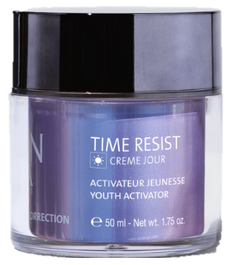
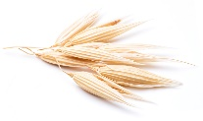
FILL IN DEEP WRINKLES
TIME RESIST JOUR
YOUTH ACTIVATOR – WRINKLE FILLER
High molecular weight
Hyaluronic acid
Filling sphères
Low molecular weignt hyaluronic acid + konjac
Oat polyose
Smoothes and plumps
Long lasting wrinkle filling
Smooth and hydrate
Smoothes and
lift the skin’s microrelief
Notes:
TIME RESIST DAY/NIGHT
Description
Time Resist Day, a youth activator, works in conjunction with Time Resist Night to prevent and correct the signs of aging by fighting the processes responsible for premature skin aging, commonly known as "Inflamm'aging". This effectiveness is due to the unique combination of stem cells from an alpine plant, Saponaria pumila, and the Youth Energy amino acid complex! Time Resist Jour is enriched with oat polyoses for a smoothing effect, konjac spheres to fill in wrinkles, and hyaluronic acid to provide the skin with all the moisture it needs. Your skin is plumped up and protected from the effects of time; it becomes more toned, appears smoother and visibly younger and more radiant. We appreciate its airless "touch and slide" jar, its soft and natural scent.
Promise
Time Resist Day Wrinkle Filler
For whom?
Skin with deep wrinkles
"I have marked wrinkles all over my face".
"I have wrinkled skin"
"My skin is dry«
Ingredients
Oat polyose: wrinkle filler
Oat polyoses allow to immediately and visibly smooth and lift the skin micro-relief. Indeed, it binds to the skin surface and forms a highly cohesive biological film capable of visibly tightening the skin. The smoothing/tensing effect is immediately visible, and long-term anti-wrinkle effectiveness has also been demonstrated.
Filling spheres (konjac + low molecular weight hyaluronic acid): wrinkle filler
Konjac is a root native to Asia which, once moistened, turns into a gel. It is often used as an appetite suppressant.
Konjac + hyaluronic acid encapsulated in the filling spheres allow to plump up the wrinkle up to 6 times.
Low molecular weight hyaluronic acid has a surface action (smoothing and plumping effect) because it forms a hydrated and protective film, is capable of maintaining water in the tissues, slowing down its evaporation (insensible water loss) and without being occlusive or greasy.
Home use
In the morning, after cleansing and misting with the appropriate Yon-Ka Lotion, apply Time Resist Jour to the entire face, neck and décolleté. Massage the cream into the skin with light strokes and gentle pinches.
Product advantages
Time Resist Day
Contains 96% natural ingredients
Unique combination of stem cells and Youth Energy Complex
Prevents and corrects the signs of aging
Wrinkles are filled in and smoothed out
The skin is soft, moisturized and plumped up
airless jar
The skin is younger: 100% (Clinical test - Evaluation by a dermatologist of the severity of wrinkles in the nasolabial fold after application of the TIME RESIST duo morning and evening by 20 women aged 40 to 55 for 4 weeks (best result obtained).
Wrinkles are less visible: 75% (Clinical test - Evaluation by a dermatologist of the severity of wrinkles in the nasolabial fold after application of the TIME RESIST duo morning and evening by 20 women aged 40 to 55 for 4 weeks (best result obtained).

Slide 17
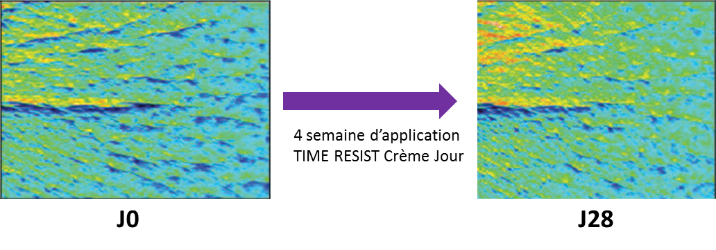
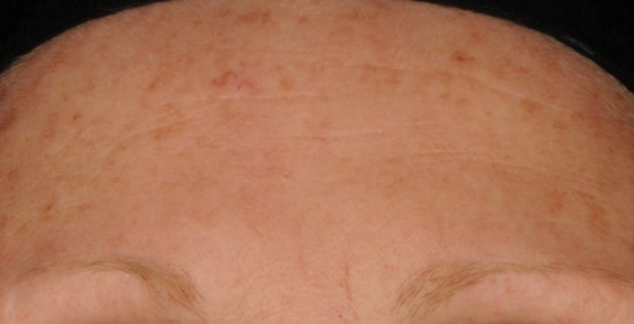
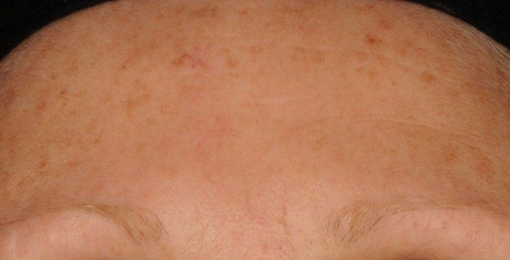
Proven effectiveness
 | TIME RESIST - JOUR
Wrinkle-filler – Smoothing | Total wrinkle length (mm²): up to - 67%⁽⁴⁾ Total number of wrinkles: up to - 70%⁽⁴⁾
J0
J28
Notes:
(4) INSTRUMENTAL EVALUATION - Measurement following video analysis (Quantirides software) of wrinkle data, after having applied the TIME RESIST DAY CREAM for 4 weeks (best results)

Slide 18
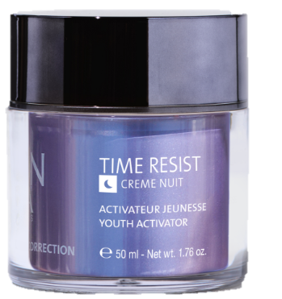
FILL IN DEEP WRINKLES
TIME RESIST NUIT
YOUTH ACTIVATOR – NOURISHING
Euglena gracilis
Organic Inca Inchi oil
Persian silk tree
Stimulates skin cells : source of vitality and cellular energy
Anti-inflammatory
Soothing
Nourishing
Softening
Anti-glycation
Notes:
TIME RESIST DAY/NIGHT
Description
Time Resist Nuit is enriched with anti-wrinkle and smoothing active ingredients: regenerating euglena gracilis extract, anti-glycation silk tree extract and highly nutritious Sacha Inchi oil. Overnight, the skin is nourished and smoothed, signs of fatigue are reduced and the complexion glows with a new radiance.
Promise
Time Resist Smoothing Anti-Fatigue Night
For whom?
Skin with deep wrinkles
"I have marked wrinkles all over my face".
"I have wrinkled skin"
"My skin is dry«
Time Resit Night
Silk tree: anti-glycation
It is a plant extract specially developed to fight against signs of fatigue thanks to its action on the detoxification processes of cellular metabolism. It fights skin signs of fatigue caused by glycation and glycoxidation. It maintains the mechanical viability of the cells and their optimal energy production, rebalances the synthesis of melatonin by fibroblasts tired by glycation and ensures the elimination of cellular waste.
Note: Glycation: the binding of a sugar to proteins causing a structural rearrangement. These glycated proteins cannot be destroyed naturally by our cells' own destruction systems. These products then pile up in the cells without being able to get rid of them. Gradually, these substances cause the cell's metabolism to malfunction and eventually lead to its death.
Euglena gracilis : regenerating
Euglene has a metabolism similar to that of skin cells with a metabolism controlled by the alternation of light and darkness (day/night). In addition, it contains phosphoinositides which act as a precursor to stimulate the skin cells. Euglene is therefore a source of vitality and cellular energy thanks to the stimulation of ATP production: +48% in 2 hours, the increase in IP3 production (a molecule involved in fibrobast/collagen communication) and the activation of calcium destocking, meaning the passage of the cell from a "resting" state to an "activated" state (Ca is involved in many metabolic reactions),
Home use
In the evening, after cleansing and removing make-up and applying the appropriate Yon-Ka Lotion, apply Time Resist Night to the entire face, neck and décolleté.
Product advantages
Time Resist Night
Contains 90% of natural ingredients
Unique combination of stem cells and Youth Energy Complex
Smoothes fine lines and wrinkles and reduces signs of fatigue
The skin is regenerated
The complexion is more radiant in the morning
airless jar

Slide 19
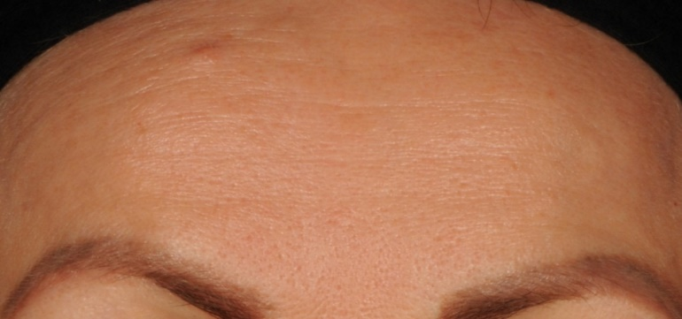
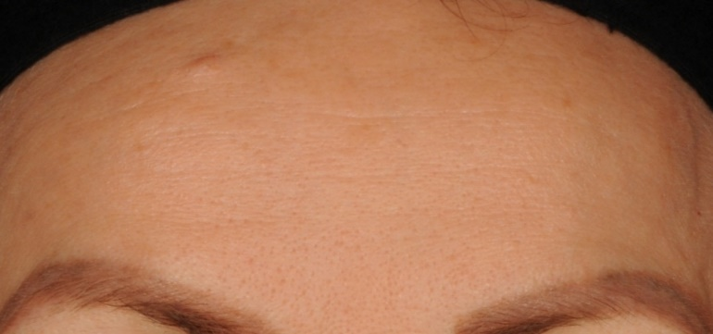
Proven effectiveness
 | TIME RESIST - NUIT
Anti-tiredness - smoothing | Total wrinkle surface: up to - 82%⁽⁵⁾ ➔Smoothed skin Skin looks rested when you wake up: 76%⁽⁶⁾
J0
J28
Notes:
(5) INSTRUMENTAL EVALUATION - Measurement following video analysis (Quantirides software) of wrinkle data, after having applied the TIME RESIST NIGHT CREAM for 4 weeks (best results)
(6)CONSUMER TEST – Self-evaluation after application of the TIME RESIST NIGHT CREAM in the evening by 20 women aged 40 to 55 for 4 weeks

Slide 20
The anti-aging techniques
- 8 min-

Slide 21
The anti-aging techniques
- 8 min-
Muscle toning
By exerting controlled pressure on the skin, pinching tone the underlying muscles, which can contribute to firming and smoothing the appearance of the skin.
Reduction of muscle tension
Relax the facial muscles, which can reduce accumulated tension and alleviate the appearance of wrinkles caused by repeated facial expressions.

Slide 22
The anti-aging techniques
- 8 min-
Deep Tissue Stimulation
Stimulate blood circulation and lymphatic drainage, promoting the removal of toxins and waste products from the skin.
Stimulation of Collagen Production
Stimulate the production of collagen and elastin fibers in the skin. Collagen and elastin are essential proteins that provide structure and elasticity to the skin, helping to improve its firmness and resilience.

Slide 23
The anti-aging techniques
- 8 min-
Tightening and Toning
Tighten and tone the facial muscles. The repetitive slapping motion stimulate the muscles and improve muscle tone and a firmer facial contour.
Improved Blood Circulation
Stimulate blood circulation in the skin, increase oxygen and nutrient delivery to the cells. Enhanced blood flow contribute to a healthier, more radiant complexion.

Slide 24
The anti-aging techniques
- 8 min-
Enhanced Lymphatic Drainage
Stimulate the lymphatic system, aiding in the removal of toxins and excess fluid from the facial tissues. Reduce puffiness and promote a more sculpted appearance.
Natural Facelift Effect
Lift and tighten effect on the face. By toning and firming the facial muscles and tissues, this technique improve facial contours and restore a more youthful appearance.

Slide 25
The anti-aging techniques
- 8 min-
Improved Skin Tone and Texture
Improve skin tone and texture by promoting cell turnover. This results in smoother, softer skin with a more even complexion.
Promotion of Product Absorption
Enhance the absorption of skincare products applied to the face. By massaging the skin, this technique helps products penetrate more deeply, maximizing their effectiveness.

Slide 26
LET'S PLAY!
GET YOUR PHONE READY AND SCAN THE QR CODE THAT WILL BE DISPLAYED
INDICATE YOUR NAME AND COUNTRY
PERSONALISE YOUR AVATAR IF YOU LIKE
READ THE QUESTION ON THE COMPUTER AND ANSWER IT ON YOUR PHONE

Slide 27
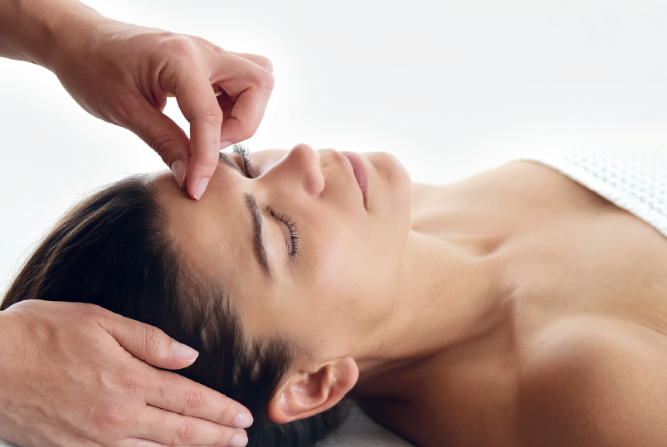
The anti-aging techniques
- 8 min-
DEMO

Slide 28
Thanhs !

