Slide 1
The Experience of
Phyto-Aromatic Skincare

Slide 2
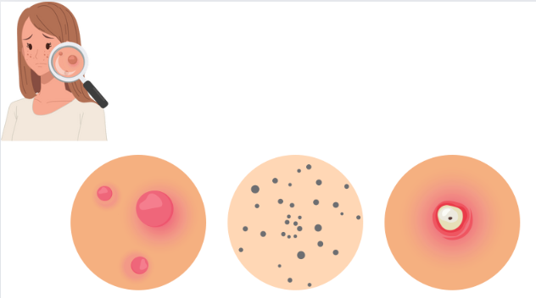
Knowing and identifying acne
Notes:
Today we're going to talk about acne, the different types of acne that exist and how to recognise them. We'll then take a look at the Yon-Ka Purity offer to review our anti-imperfection allies.

Slide 3
Acne: what is it ?
It is a disorder of the pilosebaceous follicle which combines several anomalies
20%
What is sebum ?
An oily film secreted naturally by the skin which maintains the skin's hydration, protects it from drying out and external aggression and keeps it supple.
When produced in excess, it is the cause of oily skin and acne pimples.
80%
Baby acne affects around 20% of newborns
HYPERPRODUCTION OF SEBUM produced by the sebaceous gland, active under the influence of hormones
OBSTRUCTION OF THE FOLLICULAR CANAL preventing the normal elimination of sebum
INFLAMMATION due to the proliferation of microbial agent
40%
Acne affects almost 80% of teenagers
To know more:
Propionobacterium acnes is a micro-organism found in follicles. In the presence of large quantities of sebum, it multiplies and contributes to the inflammation of the follicle.
Acne affects almost 40% of adult women
Notes:
What is sebum?
Sebum is the oily film secreted naturally by the skin. Its role is to keep the epidermis hydrated: it is part of the skin's hydrolipidic film. It protects the skin from drying out and external aggression, while keeping it supple. When it is produced in excess, it is the cause of oily skin, or acne pimples. When it is lacking, it is responsible for dry skin.
HYPERPRODUCTION OF SEBUM
This excessive secretion is the result of the action of sex hormones, whether at puberty or, in adult women, at certain times in the menstrual cycle or during pregnancy.
OBSTRUCTION OF THE FOLLICULAR CANAL
The walls of the canal that connects each orifice of the hair follicles to the surface of the skin tend to thicken, reducing its diameter and partially blocking the diffusion of sebum out of the follicle. This phenomenon, combined with excessive sebum production, leads to an accumulation of sebum in the follicle. The follicle increases in volume and sometimes ruptures under the pressure of the accumulated sebum. Seborrhoeic retention is responsible for the formation of comedones (blackheads and whiteheads).
INFLAMMATION
When a follicle is blocked and filled with sebum, inflammation can occur, linked both to the damage caused to the follicle by excess sebum and to the proliferation of a micro-organism called Propionobacterium acnes. This micro-organism is naturally present in the follicles. In the presence of large quantities of sebum (on which it feeds), Propionobacterium acnes multiplies excessively and contributes to inflammation of the follicle and surrounding skin. This leads to the formation of papules or nodules.The follicle may be superinfected by other bacteria present on the skin, leading to the appearance of a pustule or cyst containing pus.
Baby acne
This is an eruption of pimples similar to teenage acne that occurs in newborn babies. It is also due to hormonal changes: a drop in maternal hormones in the baby's body after birth. This acne does not require any specific treatment.

Slide 4






Acne can appear in various forms
WHAT ARE THE MAIN TYPES OF ACNE ?
ACNE VULGARIS
NODULAR ACNE
CYSTIC ACNE
PAPULO-PUSTULAR ACNE
ACNE CONGLOBATA
ACNE FULMINANS
Notes:
Acne is a common skin condition that can present in various types, often characterised by the severity of the rash and associated symptoms. Here are the main types of acne:
Acne vulgaris: This is the most common type of acne. It is characterised by pimples, blackheads, whiteheads and cysts. Acne vulgaris can vary in severity, from mild to severe.
Nodular acne: Nodular acne is characterised by deep, painful lesions under the skin called nodules. These nodules can be large and inflamed, and tend to persist for weeks or even months.
Cystic acne: Cystic acne is similar to nodular acne, but involves even deeper and more inflamed cysts. These cysts can be filled with pus and can leave significant scars
Papulo-pustular acne: This form of acne manifests itself as papules (small inflamed red pimples) and pustules (pus-filled pimples) on the skin. It can be moderate to severe and often requires medical treatment.
Acne conglobata: Acne conglobata is a severe form of acne characterised by large cysts, inflamed nodules and suppurative lesions. It can cause severe scarring and generally requires intensive medical treatment.
Acne fulminans: This is a rare and serious form of acne that suddenly manifests itself as inflamed nodules, ulcers, abscesses and systemic symptoms such as fever and joint pain. It requires urgent medical treatment.
Each type of acne may require a specific treatment approach, from non-prescription topical treatments to prescription drugs and advanced dermatological treatments such as chemical peels, laser therapy or corticosteroid injections. It's important to consult a dermatologist for an accurate diagnosis and a treatment plan tailored to your type of acne and its severity.

Slide 5
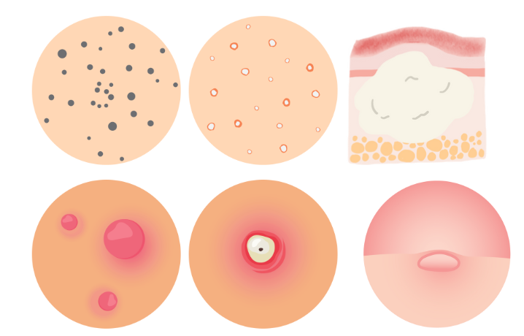
The various types of acne pimples
Blackheads
Small clogged pores
White spots
Similar to blackheads, but white
Papules
Small red spots that can be quite painful
Pustules
Inflamed papules.
Often with a white tip
Nodules
Hard lumps that form under the surface of the skin and can be painful.
Cysts
Similar to subcutaneous furuncles. Form deep down and can be very painful
Notes:
Blackheads - these are small, clogged pores. They can be black or yellow in colour. They can become inflamed if pierced, so it's best to leave them alone and opt for a good cleanser instead.
Whiteheads - these are similar to blackheads, but are often white (hence the name).
Papules - these are small red pimples that can be quite painful.
Pustules - papules often become pustules. Their contents can become inflamed, and pustules often have a white tip. Don't be tempted to pierce them! Instead, opt for a treating cream.
Nodules - these are large, hard bumps that form under the surface of the skin and can be painful.
Cysts - these can be extremely painful. They resemble subcutaneous boils and, as they form deep down, are more likely to heal poorly.

Slide 6

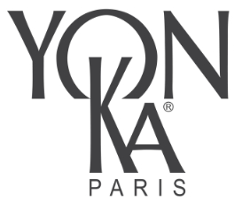
Hormonal factors
Genetics
Hygiene
Food
RISK FACTORS
Sun exposure
Some medicines
Notes:
What are the risk factors?
The risk factors are well known: some of them, if taken into account, can prevent acne worsening.
Heredity: A family history of acne. If your parents had acne, you are more likely to have it.
Hormonal factors:
Hormonal fluctuations during puberty.
Menstruation, pregnancy and the use of hormonal contraceptives by women.
Endocrine disorders such as polycystic ovary syndrome (PCOS).
Exposure to the sun is not recommended, even if it may give the temporary impression of reducing lesions, given its anti-inflammatory effect. In fact, ultraviolet (UV) rays accentuate the corneal plug, which explains why acne worsens after exposure to the sun.
Some medications: such as corticosteroids, androgens and lithium.
Hygiene: inadequate or excessive skin hygiene
Food: A diet rich in refined carbohydrates and dairy products may be linked to acne in some people.Reduce consumption of spicy foods (for some people, chilli irritates the skin, leading to the appearance of acne pimples on the skin).
By taking these factors into account, it is possible to take preventive and management measures to minimise the risk of acne appearing or worsening.

Slide 7
YON-KA
answer

Slide 8
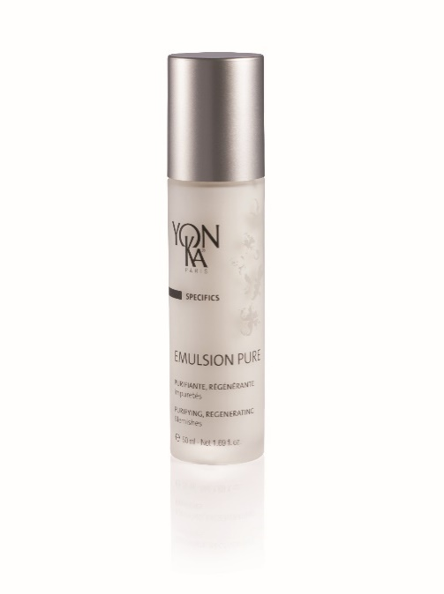
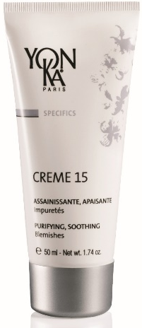
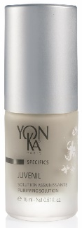
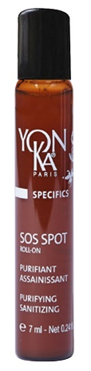
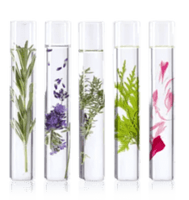
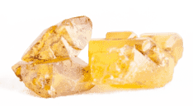
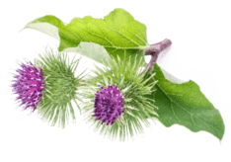
Purity
The perfect skin care products for a flawless skin!
PURIFYING
REGULATING
PURIFYING
SANITIZING
PURIFYING
CALMING
EMULSION PURE
JUVENIL
SOS SPOT ROLL-ON
CREME 15
Notes:
As you know, the purity range now consists of 4 distinct products:
Emulsion pure to purify and regulate
Juvénil and sos spot roll on to purify and sanitize
Cream 15 to purify and calm
Let's take a closer look at the actions and benefits of each:

Slide 9
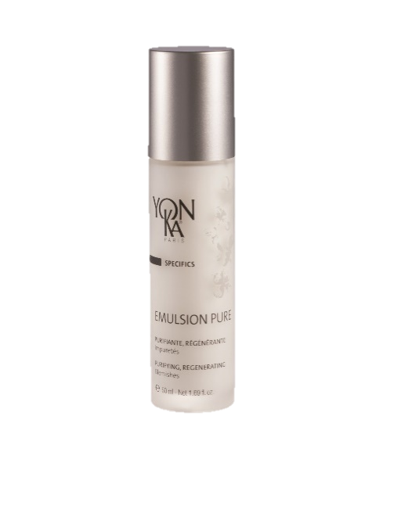
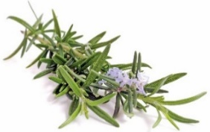
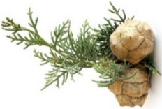
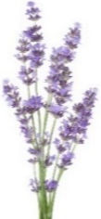
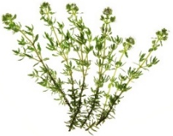
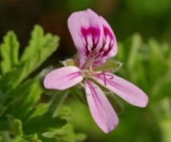
EMULSION PURE
Aromatic treatment emulsion with
5 essential oils
Purifies, soothes and promotes skin regeneration
Treatment area: large
THYME
ROSEMARY
GERANIUM
CYPRESS
LAVANDER
PURIFYING
REGENERATING
ANTI-AGING
DETOXIFYING
SOOTHING
R.50 ml
Notes:
EMULSION PURE
Aromatic treatment emulsion with 5 essential oils
PURIFYING, CLEANSING & REVITALISING
Quintessence: purifies, revitalizes
4,3% QUINTESSENCE + WATER
EMULSION PURE
Description
This alcohol-free treatment lotion, with the 5 essential oils of the Yon-Ka Quintessence, is the ultimate anti-imperfection treatment. It purifies, soothes and promotes skin regeneration, thus limiting the after-effects left by acne. With its fluid texture, Pure Emulsion is quickly absorbed and leaves no greasy film. An unparalleled effectiveness against juvenile or adult impurities to quickly recover a clearer and healthier skin!
Promise
Purifying SOS lotion with 5 essential oils
For whom?
Sensitized oily skin
All ages
"I have occasional imperfections and I am looking for a product to treat them"
"I have shine on my forehead "
Ingredients
Quintessence = rebalancing
Home use
In the morning and/or evening, clean/remove make-up carefully from the face and mist with the appropriate Yon-Ka Lotion. Soak a compress (gauze or cotton) with Pure Emulsion. Apply the compress to the area to be treated. Leave on for 10 to 15 minutes. Finish by applying the appropriate skin care cream.
Tips
For an expert purifying treatment, Pure Emulsion can be combined with the following products: Yon-Ka Scrub, Mask 103, Cream 15, Cream PG.
Pure Emulsion is also recommended as a compress in the following cases: after depilation, to soothe and purify, during a sunburn, to soothe and regenerate and during mosquito bites, to soothe.
Product advantages
Contains 98% natural ingredients
Purifies and cleanses the skin and promotes regeneration
Reduces juvenile and other impurities
Ultra-penetrating and alcohol-free aromatic care

Slide 10
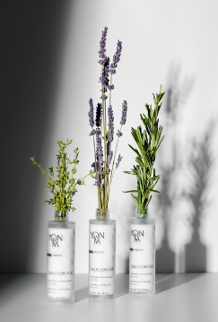
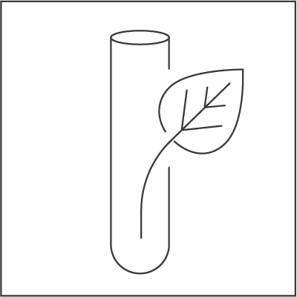

EMULSION PURE
What for ?
Light & early stage blemishes
Sebum regulation
Dilated pores
Sunburn / burns
Insect bites
Old scars
98%
ingredients
Of natural origin
How ?
Apply a compress to the concerned areas.
Leave on for 10 to 15 minutes.
Mix with the treatment cream
As a treating lotion
Alcohol free
Preservative free
Paraben free
Notes:
SOS beauty lotion that will treat light & beginning imperfections, regulate sebaceous secretions, tighten pores, soothe and regenerate the skin in case of sunburn and/or burns, soothe itching from insect bites, regenerate old scars.
Morning and/or evening
As a local application on a compress 10/15 min
Combined with a day cream to regulate the overproduction of sebum (oily skin booster)
98% of ingredients of natural origin
YK TREASURE; treatment lotion without alcohol, preservatives or parabens
EXISTS IN CABIN (Emulsion concentrée)

Slide 11
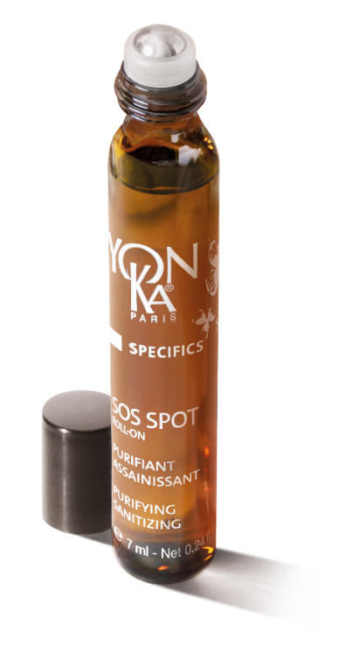
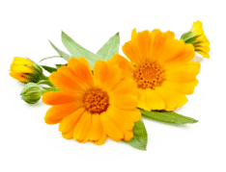

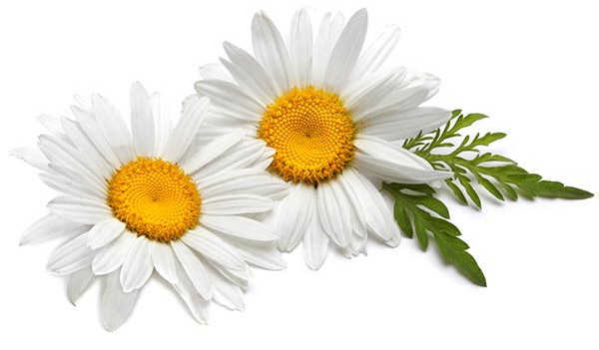
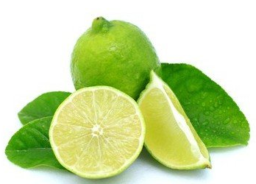
SOS SPOT ROLL-ON & JUVENIL
A unique formula,
An anti-imperfection combo
95%
ingredients
Of natural origin
Sanitizing and soothing solution
Treatment areas: localised (SOS SPOT ROLL-ON)
and extended (JUVENIL).
V.7 ml
V.15 ml
ICHTYOL
BISABOLOL
LIME
QUINTESSENCE
CALENDULA
LACTIC ACID
(postbiotic)
PURIFYING
SEBOREGULATOR, ANTI-BACTERIAL
SOOTHING
REPAIRING
ANTI-INFLAMMATORY
PURIFYING
SANITIZING
SOOTHING
BALANCE THE pH OF THE SKIN
Notes:
SOS SPOT ROLL-ON & JUVENIL
A unique formula for a perfect anti-imperfection combo
SOOTHING SANITIZING SOLUTION
95% ingredients of natural origin
Ichthyol: purifying properties. This active ingredient is rich in sulphur and is naturally found in certain mineral soils. Sulphur is known to be a very effective seboregulator, anti-bacterial and anti-fungal agent.
Thanks to calendula and bisabolol, the skin is soothed.
Bisabolol: repairing and anti-inflammatory properties and its strong healing power. The bisabolol chosen by Yon-ka Laboratories comes from the fractional distillation of the essential oil of the bark of the Candeia tree (Vanillosmopsis Erythropappa) where it is highly concentrated in its most active form.
Calendula has been used for centuries for its soothing properties.
Lactic acid (postbiotic): Lactic acid is a postbiotic which, by maintaining the pH of the skin, actively participates in the maintenance of this environment. The lactic acid selected by Yon-Ka is 100% of natural origin, obtained by fermentation of sugar cane, and is ecocert certified.
Finally, lime & the Yon-Ka quintessence, which you all know, reinforce the purifying and cleansing powers of the formula.
JUVENIL
Description
Juvenil is the undisputed ally of difficult skin, those with long-lasting imperfections, juvenile or otherwise, those with ingrown hairs that turn into pimples... Very purifying thanks to ichthyol, essential oils and lactic acid, it also owes its soothing action to calendula extract. Fluid and alcohol-free, it is applied locally, penetrates instantly and allows the skin to quickly regain a cleaner and healthier appearance.
Promise
Sanitizing and soothing solution
For whom?
Sensitized oily skin
All ages
"I have a lot of acne"
"I have a sebum-regulating cream and I am looking for a product to apply locally on my pimples.
Ingredients
Ichtyol = sanitizer
Lactic acid: sanitizing
Organic Calendula = soothing
Home use
In the morning and/or evening, clean/remove make-up carefully from the face and mist with Yon-Ka PNG Lotion, apply Juvénil locally to the imperfections. Then apply the appropriate skin care cream to the entire face and neck, usually the PG Cream. To reinforce the purifying action, after cleansing and removing make-up and misting with Yon-Ka Lotion, apply Mask 103, alone or mixed with 1 to 2 pumps of Juvénil. Leave on for 15 minutes and re-moisten the mask with Yon-Ka Lotion.
Use in the treatment room
Massage
Mask
Combined with the cream at the end of the treatment
Product advantages
Contains 95% of natural ingredients
Cleanses, purifies and promotes skin regeneration
The skin is soothed and healthier
SOS impurities care

Slide 12

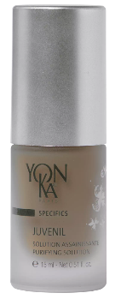
SOS SPOT ROLL-ON & JUVENIL
What for ?
Severe and long-lasting blemishes
Ingrown hairs
R.15 ml
How ?
Portable & at home
Morning and evening
During the day as soon as necessary
At home
Pure in a compress for 5/10 min and/or mixed with the treatment cream or mask
A complementary use
R.7 ml
Notes:
Antiseptic, purifies, calms, promotes healing of severe and long-lasting imperfections
Ideal to fight against ingrown hairs.
2 complementary uses
SOS SPOT ROLL-ON :
Nomadic & ultra practical use at any time of the day. Ultra precise application
JUVENIL :
Morning and/or evening
Pure in a compress for 5/10 min and/or mixed with the treatment cream or mask
EXISTS IN CABIN (ampoule)
Ideal for men to prevent and soothe shaving-related reactions

Slide 13
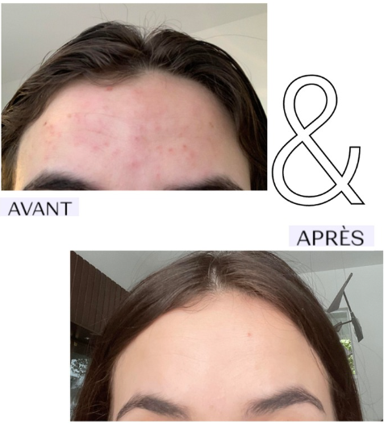
SOS SPOT ROLL-ON
BEFORE
AFTER
Self-evaluation by a consumer over 3 days - Application morning and evening

Slide 14

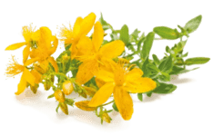
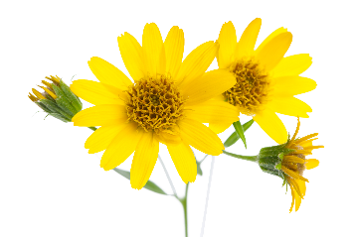
CREME 15
Sanitizing, soothing and softening cream
Rich in soothing plant extracts
Treatment areas: large and localized
BURDOCK
CHAMOMILLE
ST JOHN’S WORT
ARNICA
QUINTESSENCE
SANITIZING
BALANCING
SOOTHING
SOFTENING
REGENERATING
SOFTENING
SOOTHING
SANITIZING
R.50 ml
Notes:
CREAM 15
PURIFYING, SOOTHING & SOFTENING
Rich in soothing plant extracts such as :
Burdock: purifying / balancing
Chamomile, Arnica: softening / soothing
St John's wort : regenerating / soothing
But also mallow, witch hazel, lemon balm... (soothing)
Quintessence: purifying and rebalancing
CREAM 15
Description
This skin care cream with 18 purifying plant extracts, including burdock, is a real answer to the imperfections that arise during adolescence and adulthood. Its non-greasy, ultra-light texture is suitable for all skin types. The cream 15 is applied locally, penetrates quickly and gently purifies your skin. The skin quickly becomes clearer and healthier.
Promise
Purifying and soothing localized care cream
For whom?
Sensitized oily skin
Localized imperfections
All ages
Ingredients
Organic burdock = purifying, balancing
Plant complex (chamomile, St. John's wort) = softening
Home use
In the morning and evening, thoroughly cleanse and remove make-up from the face with Cleansing Gel and mist with the appropriate Yon-Ka Lotion. Then apply Cream 15 locally on the impurities.
In order to optimize the purifying and soothing effect, apply Cream 15 locally in a thick layer for 20 minutes, then massage it in.
In the morning, finish by applying the appropriate care cream: Cream PG, in the case of oily skin, Cream 93, in the case of combination skin
Use in the treatment room
Massage
Mask
Tips
For an expert purifying treatment, the following products can complete the routine: Yon-Ka Scrub, Mask 103, Juvénil or Pure Emulsion.
Product advantages
Contains 98% natural ingredients
Purifies, cleanses and softens the skin
The skin is balanced and soothed
Prevents small pimples after waxing and removal of blackheads
79%: Reduces the appearance of imperfections (Self-evaluation - Clinical study on 19 women aged 19 to 40, mixed to oily skin, all prone to imperfections.
Application: twice a day locally on the imperfections for 4 weeks).

Slide 15
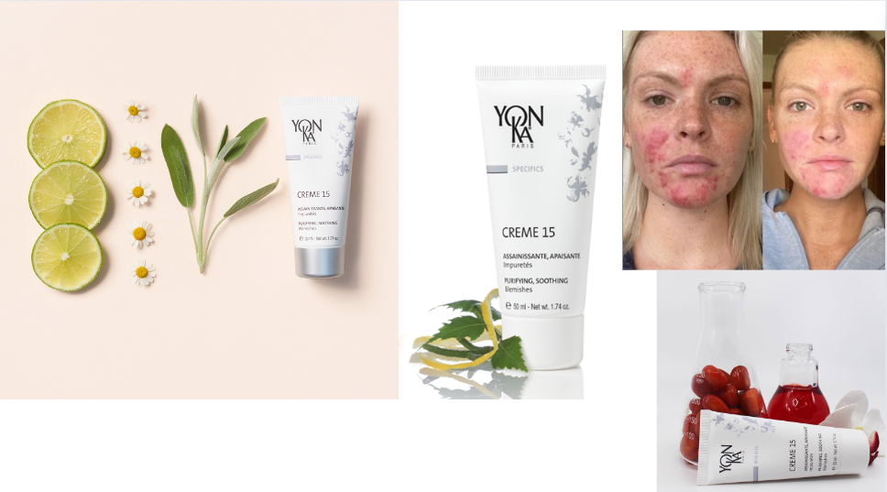
98%
ingredients
Of natural origin
CREME 15
What for ?
Severe & long-lasting, extensive & localized blemishes
Irritations
Pimples after waxing
How ?
Apply a thin layer on imperfections.
Apply a thick layer after waxing or blackhead removal
Notes:
Treats & Purifies severe and long-lasting blemishes, calms irritations and inflammations, avoids small pimples after waxing.
Morning and/or evening
Local application
Apply day cream on top
AVAILABLE IN CABIN
Cream 15 + Juvenil = pimple killer
98% of ingredients of natural origin

Slide 16
CREME 15
BEFORE
AFTER
Self-evaluation by a consumer over 1 month - Application morning and evening

Slide 17
Purity range
 | EMULSION PURE | SOS SPOT ROLL-ON | JUVÉNIL | CRÈME 15
For whom ? | All ages, Women, Men
Indication | Small imperfections, regulation of sebum production | Severe and long-lasting blemishes |  | All types of imperfections with inflammation, redness, sensitivity
Treatment area | Extended areas | Localized | Extended areas | Extended & Localized
Use | Apply a compress to the affected areas. Leave on for 10/15 minutes. | Morning and evening and during the day, as soon as necessary | Pure in a compress for 5/10 min and/or mixed with the treatment cream or mask | Morning and evening, under your usual cream, apply a thin layer on imperfections. Apply a thick layer after waxing or removing blackheads
Product advantages | As a compress after extraction, insect bites, burns, old scars | Ingrown hair, shaving irritation |  | After waxing to soothe

Slide 18

Extra tips
Avoid touching the face
because this can transfer bacteria and impurities to the skin, which can make acne worse
Regularly clean objects that come into contact with the skin
sheets, pillowcases, towels, make-up sponges... to prevent the build-up of bacteria
Relaxation techniques
stress can trigger acne breakouts
Phytotherapy
Oats
Aloe
Stinging nettle
Burdock
Food supplements
Zinc
Brewer's yeast
Vitamin B5
Probiotics
Notes:
Avoid touching your face: Avoid touching your face with dirty hands, as this can transfer bacteria and impurities to the skin, which can make acne worse.
Regularly clean objects that come into contact with the skin: Wash sheets, pillowcases, towels and make-up sponges regularly to avoid the build-up of bacteria and oils that can contribute to acne.
Avoid stress factors: Stress can trigger acne breakouts. Try to manage your stress with relaxation techniques such as meditation, yoga or deep breathing.
Phytotherapy :
Oats
Oatmeal baths are well-known for treating skin disorders caused by excessive activity of the sebaceous glands. These baths could be useful in cases of acne on the back, chest or forearms.
Aloe vera
The gel extracted from aloe vera have an anti-inflammatory action, due to the presence of substances able to block the secretion of histamine (an important substance in the inflammatory reaction).
Stinging nettle
The leaves and roots of stinging nettle are traditionally suggested to slow down sebum secretion in cases of oily skin or acne
Burdock
The leaves and roots of burdock are used to combat oily skin and acne.
5. Food supplements:
Zinc
Zinc is an important mineral in skin health. Medicines containing zinc gluconate are marketed to treat acne outbreaks.
Brewer's yeast
Rich in proteins, trace elements and B vitamins, brewer's yeast is sometimes found in food supplements designed to relieve oily skin problems.
Vitamin B5 (pantothenic acid)
Vitamin B5 is essential for energy production, the transport of oxygen in the blood and the synthesis of fatty acids. Helps relieve mild acne problems.
Probiotics
Relieves digestive problems to limit oily skin and acne.
6. Grandma's tips:
Tomato or lemon
As well as being an antioxidant, tomatoes are also a great ally in the fight against the acne pimples .This recipe is very simple: cut a tomato (preferably organic) into slices and apply them to your face for twenty minutes. Rinse off with lukewarm water. Your skin is healthy and clean!
Cider vinegar
It's an ideal product for cleansing the area to be treated. Using a small cotton pad or compress soaked in cider vinegar, apply a few drops to the pimples or area affected by acne. Leave for a few minutes, then rinse off with lukewarm water.

Slide 19
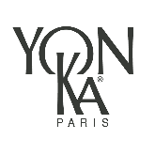
Emulsion Pure, SOS Spot roll-on,
Juvénil and/or Crème 15 ?
QUIZZ
Which product(s) to use and when?
AND/OR
AND/OR
AND/OR
Notes:
It's time to play, the rules are very simple:
According to the cases proposed, you will have to choose which product(s) is/are the most suitable.
Use the chat bar to answer, let's go!

Slide 20
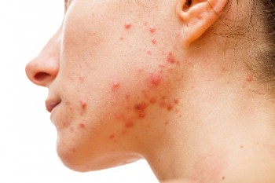
Emulsion Pure, SOS Spot roll-on,
Juvénil and/or Crème 15 ?
I have oily skin and large inflamed imperfections
on my lower face
OR
OR
OR
Notes:
I have oily skin and large inflamed imperfections on my lower face
Ideal response:
We are dealing here with severe and long-lasting acne, so we propose at home Juvenil as a compress 10/15 min to purify, then the cream 15 in local application to calm the inflammation and purify and 5 drops of juvenil mixed with the usual care cream.
At any time of the day apply the sos spot roll on
We could also advise the application of cream 15 twice a week in a thick layer for 20 minutes and make the excess penetrate.

Slide 21
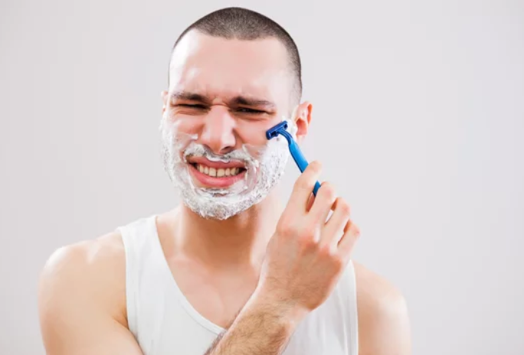
Emulsion Pure, SOS Spot roll-on,
Juvénil and/or Crème 15 ?
When I shave,
I get ingrown hair !
OR
OR
OR
Notes:
When I shave, I get ingrown hairs!
Ideal response:
In the case of localized ingrown hairs, we recommend the use of SOS SPOT roll-on.

Slide 22
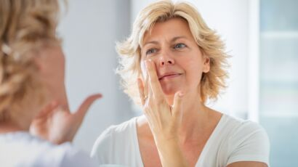
Emulsion Pure, SOS Spot roll-on,
Juvénil and/or Crème 15 ?
Since the menopause, I have noticed the appearance of localized imperfections
OR
OR
OR
Notes:
Since the menopause, I have noticed the appearance of localized imperfections.
Ideal answer:
In the case of localized imperfections, we recommend the use of SOS SPOT roll-on. Here, the appearance of blemishes is linked to hormonal fluctuations.
This type of blemish is common during menopause or pregnancy.

Slide 23
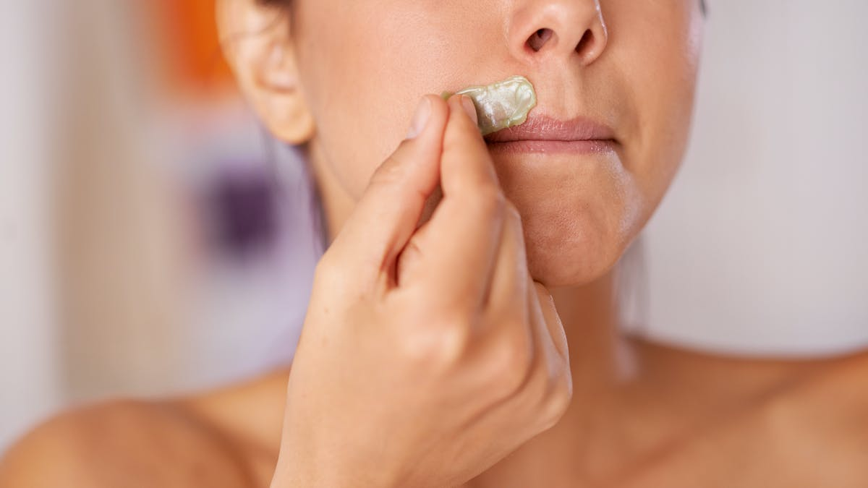
Emulsion Pure, SOS Spot roll-on,
Juvénil and/or Crème 15 ?
After each waxing I have redness and small pimples
that appear
OR
OR
OR
Notes:
After each waxing I have redness and small pimples that appear
Ideal answer:
Here the imperfections are related to the hair removal, to avoid redness and pimples, application of the cream 15 in a thick layer 5/10 min then make penetrate the excess.

Slide 24
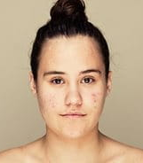
Emulsion Pure, SOS Spot roll-on,
Juvénil and/or Crème 15 ?
My daughter has acne on her face
OR
OR
OR
Notes:
My daughter has acne on her face
Ideal answer :
In this case, we recommend using JUVENIL at home as a compress and mixing it with the treatment cream. During the day, apply SOS SPOT roll-on locally.

Slide 25
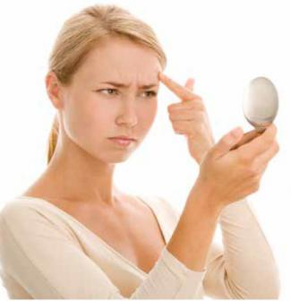
Emulsion Pure, SOS Spot roll-on,
Juvénil and/or Crème 15 ?
I have dilated pores and excessive sebum production
on my forehead
OR
OR
OR
Notes:
I have dilated pores and excessive sebum production on my forehead
Ideal answer:
To regulate sebum secretion and tighten pores, apply emulsion pure in a compress 10/15 min

Slide 26
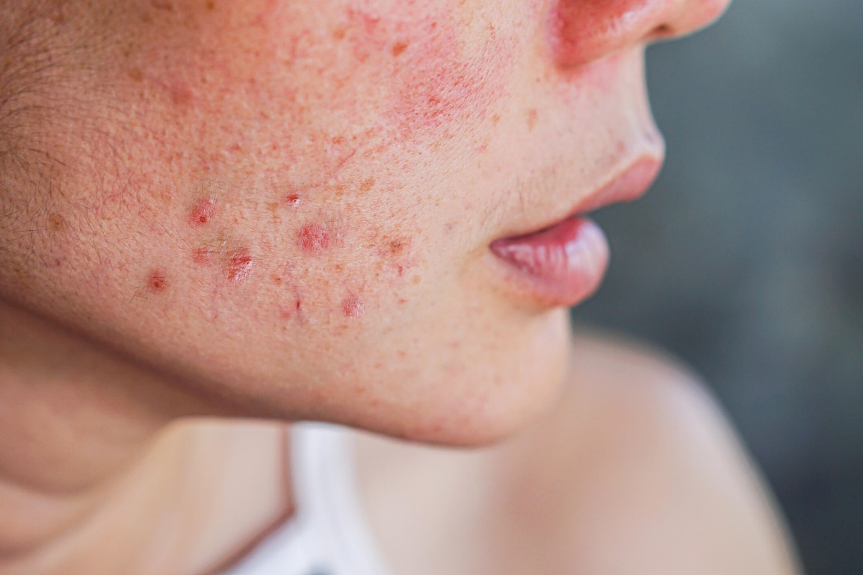
Emulsion Pure, SOS Spot roll-on,
Juvénil and/or Crème 15 ?
I have sensitive skin and imperfections
on my cheeks
OR
OR
OR
Notes:
I have sensitive skin and imperfections on my cheeks
Ideal answer:
Acne and sensitivity often go together, we recommend at home cream 15 locally then Juvenil mixed with the usual day cream

Slide 27
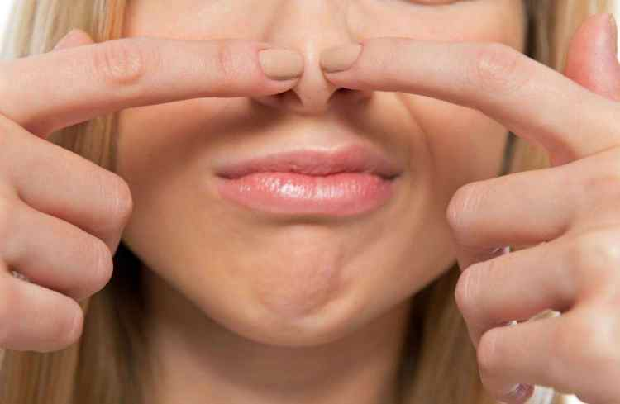
Emulsion Pure, SOS Spot roll-on,
Juvénil and/or Crème 15 ?
I have recurrent blackheads
OR
OR
OR
Notes:
I have recurrent blackheads
Ideal answer:
To avoid the reappearance of blackheads, it is recommended to apply cream 15 and a compress of pure emulsion after extraction to purify, cleanse and soothe.

Slide 28
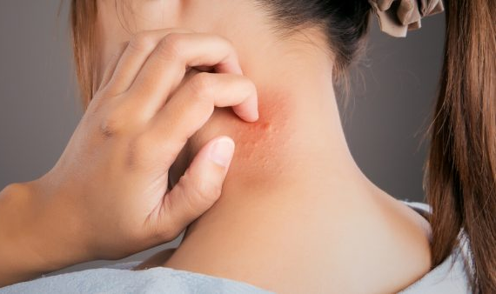
Emulsion Pure, SOS Spot roll-on,
Juvénil and/or Crème 15 ?
I have itchy mosquito bites
OR
OR
OR
Notes:
I have itchy mosquito bites
Ideal response:
Compress with emulsion pure to soothe and facilitate skin regeneration.

Slide 29

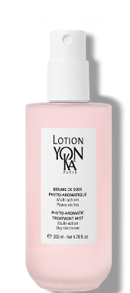
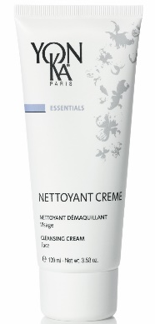
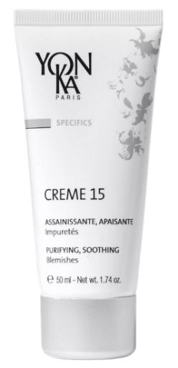
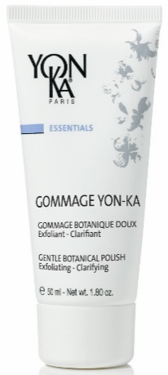
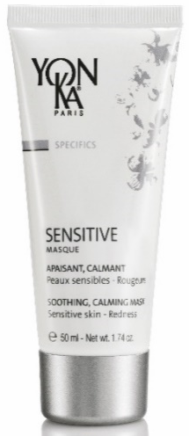
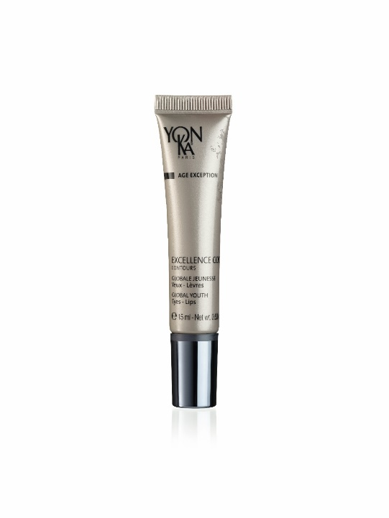

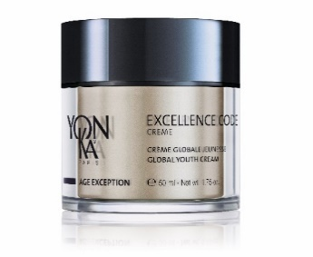
Study case
65 years old
Hormonol disorder
Sensitive skin with redness
Large imperfections on the lower face
+ 5 drops of Juvénil
At home
At any time
1
2
3
4
5
I CLEAN
I PREPARE
I TREAT IMPERFECTIONS
I PROTECT
WEEKLY
In a thick layer
In the evening
Notes:
Study case :
1: nettoyant crème, specific for sensitive skin to provide comfort
2: lotion PS
3: treatment phase with a combination of juvenil + cream 15 locally & SOS spot at any time of the day
4: excellence code eye/lip contour and excellence code cream to fight against all signs of ageing. If there are many imperfections, add 5 drops of Juvénil
5: once or twice a week yon-ka gommage + sensitive mask (as a night mask).

Slide 30
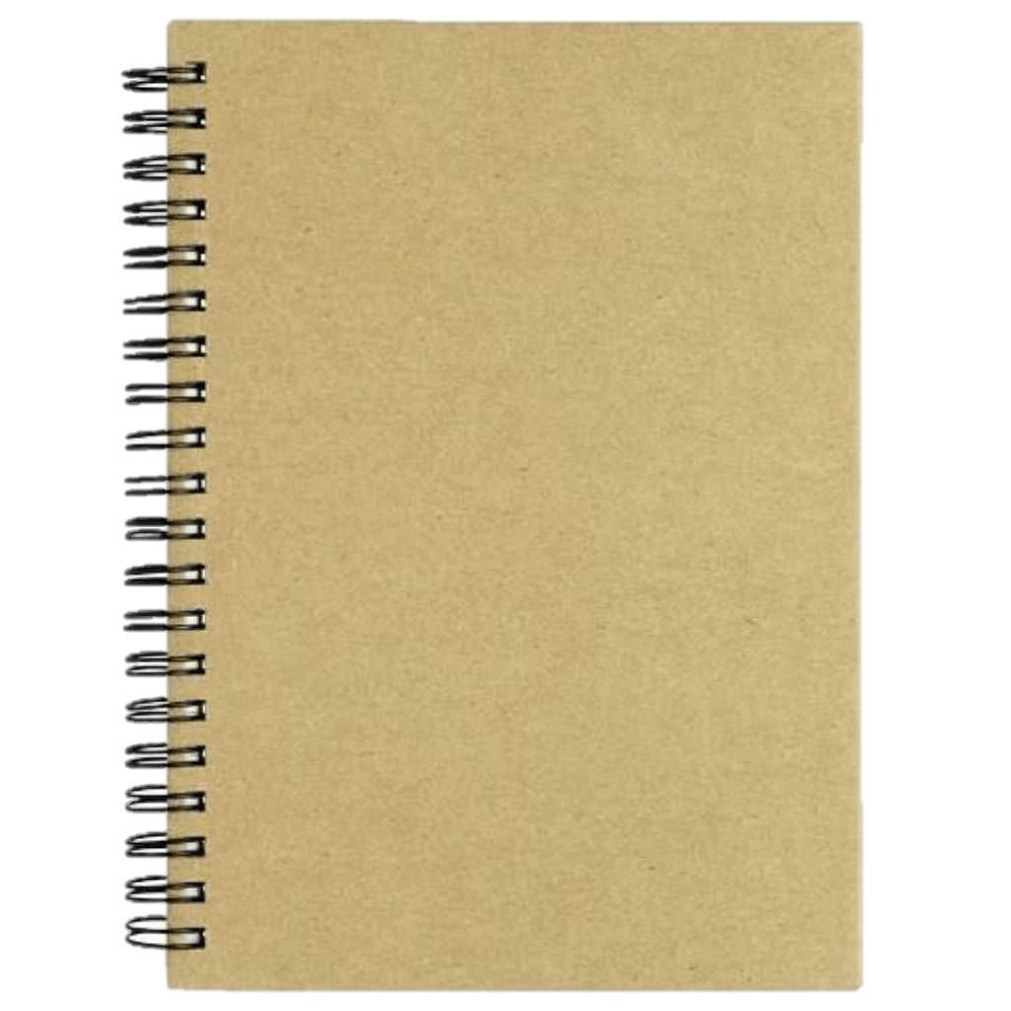
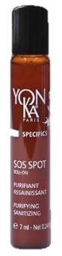


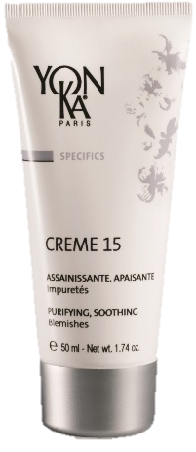
To remember
Nomadic & ultra-practical
Ultra-precise application
Regulates sebum production
Soothes inflammations
Sanitizes severe imperfection
Light imperfection
Anti-redness
Ingrown hair
Quintessence
Burdock / Arnica
Ichtyol
At home
Extended areas

Slide 31
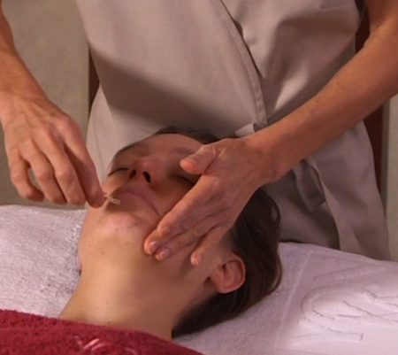
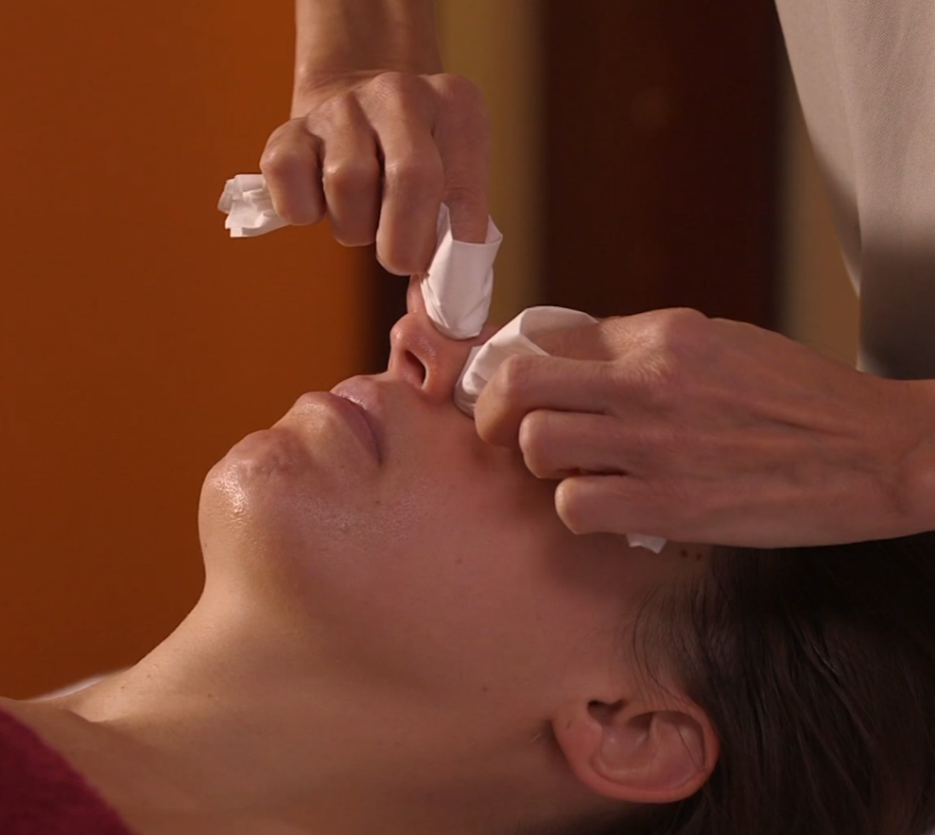
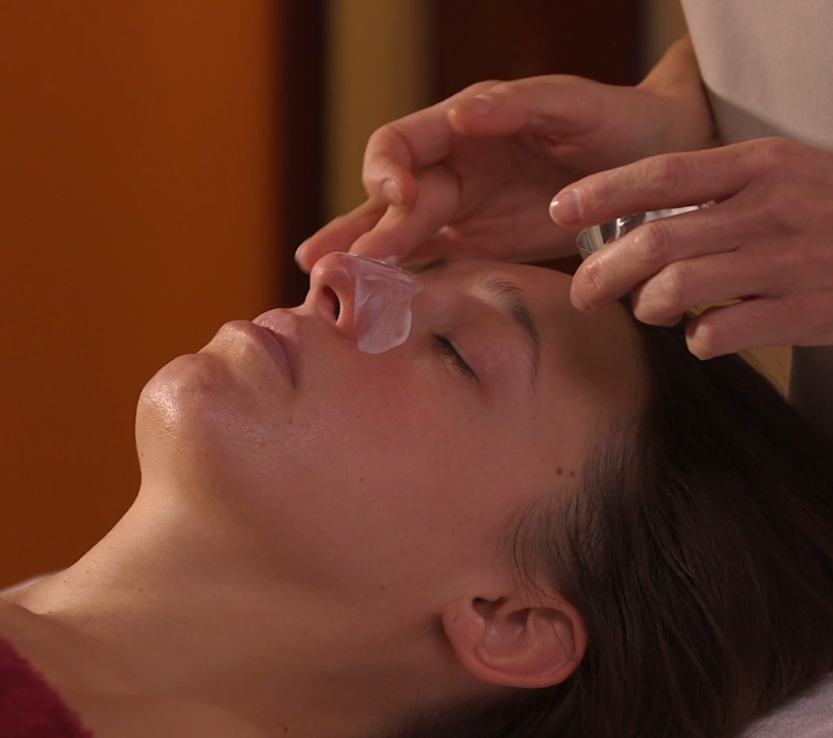




Blackhead removal
in 4 steps
HYDRA + AMPOULE
Emolient action to facilitate extraction
MANUAL EXTRACTION
CREME 15
Sanitizing, calming and soothing action (avoids redness at the end of the treatment)
EMULSION CONCENTREE
As a compress to purify
Notes:
We will conclude this webinar with a reminder of the procedure to follow for professional, effective and invisible blackhead removal:
1: Hydra + Ampoule on the areas to be treated, make it penetrate by small pinches and kneading. Its strong hydrating power (PCA, vegetable glycerin) allows to soften the pores
2: manual extraction, under steam if necessary to facilitate extraction
3: apply a thick layer of cream 15 locally, to avoid reactions/small pimples/redness following the extraction
4: compress of emulsion concentrée to purify

Slide 32
The Experience of
Phyto-Aromatic Skincare

