Slide 1
Notes:
1) Understanding Environmental Pollution
Definition (types of pollutants and sources of pollution)
Impact of air pollution on general health
Impact of air pollution on the environment
2) Domestic Pollution
3) Pollution and Skin
What are the impacts of air pollution on the skin?
Defense mechanism on the skin
4) Yon-Ka Response
Vital Defense Cream: Key ingredients - Myrtle and Moringa Peptide
Vital Defense Mist: Key ingredients - Biosaccharide and Polyphenols
5) Beauty/Well-being Tips

Slide 2

Understand
environmental pollution
Definition: Contamination of the natural environment by substances harmful to living organisms.
Types: Air pollution, water pollution, soil pollution, noise pollution.
Sources :
Natural (volcanic eruptions, forest fires, dust storms)
Human (industrial activities, transport, agriculture, residential)
Main air pollutants :
Fine particles Pm2.5
Nitrogen Dioxide NO2
Tropospheric Ozone O3
Sulphur dioxide SO₂
Carbon monoxide CO
Notes:
Definition: Contamination of the natural environment by substances harmful to living organisms.
Types: Air pollution, water pollution, soil pollution, noise pollution.
Sources of Air Pollution:
Natural:
Volcanic eruptions: Release gases like sulfur dioxide (SO2) and fine particles.
Forest fires: Emit carbon monoxide (CO), particles, and volatile organic compounds (VOCs).
Dust storms: Transport fine particles (PM10, PM2.5).
Human:
Transport: Motor vehicles (cars, trucks, airplanes) emit nitrogen oxides (NOx), VOCs, CO, and particles.
Industries: Factories, refineries, power plants emit SO2, NOx, PM, VOCs, and heavy metals.
Agriculture: Use of pesticides, fumigation, and livestock activities release ammonia (NH3) and VOCs.
Residential: Domestic heating, cooking, combustion of fossil fuels (coal, wood) release PM, NOx, SO2, and CO.
Landfills and Waste Treatment: Emit methane (CH4) and volatile organic compounds (VOCs).
Main air Pollutants:
Fine Particles (PM2.5): Exposure to PM2.5 is particularly dangerous. In 2019, approximately 42 million premature deaths were linked to PM2.5 exposure.
Nitrogen Dioxide (NO2): Exposure to NO2 is responsible for 1.23 million new cases of paediatric asthma per year. NO2 is a gas commonly released during the combustion of fuels used in the industrial and transport sectors.
Tropospheric Ozone (O3): In 2019, around 365,000 premature deaths were attributed to ozone exposure. Ground-level ozone - not to be confused with the ozone layer in the upper atmosphere - is one of the main constituents of photochemical smog. It forms when it reacts with gases under the effect of solar radiation.
Sulphur dioxide (SO2): SO2 is a colourless gas with a pungent odour. It is produced by the combustion of fossil fuels (coal and oil) and the smelting of ores containing sulphur.
Carbon monoxide (CO): Carbon monoxide is a colourless, odourless and tasteless toxic gas produced by the incomplete combustion of carbon-based fuels such as wood, petrol, charcoal, natural gas and paraffin.
Approximately 7 million deaths annually due to air pollution (according to the World Health Organisation). 91% of the world’s population lives in areas where air quality levels exceed World Health Organisation limits.

Slide 3
Impact of Air Pollution on
General Health according to the WHO
20 to 30%
40%
50%
Exposure to air pollution increases the risk of heart attacks and strokes by 20 to 30%.
About 40% of asthma cases in children are linked to air pollution.
A 50% reduction in PM2.5 levels could save approximately 25 million lives per year.
Respiratory
diseases
Effects on pregnancy and development
Lung
cancer
Cardiovascular diseases
Reduced immune capacity
Notes:
Impact of Air Pollution on General Health according to the World Health Organisation
Heart attacks: Exposure to air pollution increases the risk of heart attacks and strokes by 20-30%.
Asthma: Around 40% of asthma cases in children are linked to air pollution.
Improvements and Control Measures
Mortality reductions: Strict pollution control measures could reduce the number of premature deaths. For example, a 50% reduction in Fine Particles PM2.5 levels could save around 2.5 million lives a year.
Local improvements: In Beijing, pollution reduction policies have reduced Fine Particles PM2.5 levels by more than 25% between 2013 and 2017.
These figures show the scale and severity of the impact of air pollution on public health and the economy, underlining the importance of global efforts to reduce pollution levels and protect human health.
Impact of Air Pollution on Health
Respiratory Diseases:
Asthma: Aggravated by pollutants like ozone and fine particles (PM2.5).
Chronic bronchitis and emphysema: Linked to prolonged exposure to pollutants.
Acute respiratory infections: Particularly in children.
Cardiovascular Diseases:
Heart attacks: Increased by high pollution levels.
High blood pressure: Linked to continuous exposure to fine particles.
Lung Cancer:
Increased risk of lung cancer due to pollutants like polycyclic aromatic hydrocarbons (PAHs) and heavy metals. The WHO classifies outdoor air pollution as a definite carcinogen (group 1), responsible for many cases of lung cancer
Effects on the Immune System:
Reduced immune capacity, making individuals more susceptible to infections.
Effects on Pregnancy and Development:
Premature births and low birth weight.
Delayed cognitive and physical development in children exposed to intrauterine pollution.

Slide 4
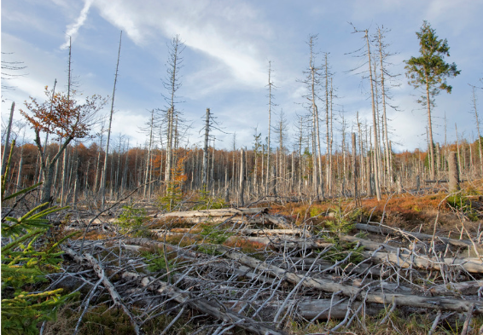
Impact of Air Pollution
on the Environment
CROP DAMAGE
Tropospheric ozone
damaging plants.
ACIDIFICATION
Acid rain affecting soils, lakes, and forests.
EUTROPHICATION
Nutrient deposition in aquatic ecosystems causing algae proliferation.
CLIMATE CHANGE
Greenhouse gases contributing to global warming.
Notes:
Environmental effects
Acidification: Acid rain caused by Sulphur dioxide SO2 and nitrogen oxides NOx, affecting soils, lakes and forests.
Eutrophication: Deposition of nutrients (ammoniac NH3, nitrogen oxides NOx) in aquatic ecosystems, causing algae proliferation.
Crop damage: Tropospheric ozone damages plants, reducing agricultural yields.
Climate Change: Greenhouse gases (carbon dioxide CO2, methane CH4) contribute to global warming.

Slide 5


Domestic Pollution
Contamination of air, water, and surfaces inside homes and buildings by harmful substances.
These pollutants can come from various internal sources and can have adverse effects on human health and the indoor environment.
Cleaning
products
Tobacco
smoke
Combustion appliances
Building
materials
Molds and allergens
Pesticides chemical products
Domestic pollution is a major public health concern but can be effectively managed through preventive measures.
By taking steps to minimize it, we can create a healthier indoor environment for all occupants.
Notes:
Domestic pollution refers to the contamination of air, water and surfaces inside homes and buildings by harmful substances. These pollutants can come from a variety of internal sources and can have harmful effects on human health and the indoor environment.
Sources of Domestic Pollution
Cleaning products :
Often contain volatile chemicals that can release volatile organic compounds (VOCs) into indoor air. (e.g. bleach, washing-up liquid with perfume, oven/carpet cleaner, etc.)
Tobacco Smoke :
Smoking indoors produces thousands of toxic chemicals that can remain in the air and on surfaces. Vaping products produce only a small fraction of the chemicals found in tobacco smoke and produce lower levels of potentially harmful substances.That said, vaping sprays contain chemicals that can sometimes be dangerous. In addition to nicotine, vaping liquids usually contain glycerol (vegetable glycerine) and propylene glycol (PG) as well as chemicals used for flavouring. (source HEALTH CANADA)
Combustion appliances :
Fireplaces, wood-burning stoves and gas cookers can emit fine particles and carbon monoxide (CO). Fuel oil is the most polluting heating system, along with the fire in the fireplace. Only 15% of the wood burnt is actually used for heating. At 85%, it goes up in smoke, producing polluting gases and very high emissions of fine particles.
Building materials and furnishings:
Furniture, carpets, paints and building materials can emit formaldehydes and other volatile organic compounds VOCs.
Moulds and Allergens:
Excessive humidity can lead to mould growth, while dust mites and pet hair can cause allergic reactions. (e.g. Stachybotrys: Commonly known as ‘black mould’, it is particularly toxic and grows on cellulose-rich materials such as wet wood and wallpaper).
Pesticides and Chemicals:
Use of pesticides, antimicrobial products, and other chemicals in and around the home.
Conclusion
Domestic pollution is a major public health concern, but it can be effectively managed through preventive measures and sound domestic practices. By being aware of the sources of pollution and taking steps to minimise them, we can create a healthier indoor environment for all occupants.
Measures to Reduce Domestic Pollution:
Ventilation: Ensure proper ventilation to reduce pollutant concentration in indoor air.
Use of Non-Toxic Products: Opt for eco-friendly cleaning products and low-VOC (volatile organic compounds) building materials.
Humidity Control: Maintain relative humidity between 30-50% to prevent mold growth.
Appliance Maintenance: Regularly maintain heating and cooking appliances for complete combustion and reduced pollutant emissions.
No Indoor Smoking: Ban smoking indoors to eliminate a major source of indoor air pollution.

Slide 6
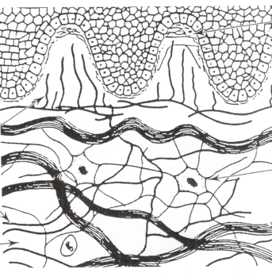

Pollution and Skin
Air pollution has significant effects on the skin, the largest organ of the human body, and serves as the first line of defense against external aggressions.
The skin has several defense mechanisms to protect against pollution aggressions.
Notes:
Air pollution has significant effects on the skin, which is the largest organ in the human body and serves as the first line of defence against external aggression.

Slide 7

What are the impacts of
air pollution on the skin?
PREMATURE
AGING
INFLAMMATION
AND IRRITATION
ACNE AND SKIN ERUPTIONS
HYPERPIGMENTATION
DEHYDRATION
AND DRYNESS
SKIN CANCERS
Free Radicals
Damage skin cells, accelerating skin aging, causing wrinkles, fine lines, and age spots.
Reduced Elasticity
Pollutants can degrade collagen and elastin.
Itching and Redness
Pollutants can trigger inflammatory reactions in the skin.
Atopic Dermatitis
Air pollution exposure can exacerbate chronic inflammatory conditions.
Pore Obstruction
Leading to skin eruptions, blackheads, and acne.
Increased Sebum Secretion
Contributing to acne.
Dark Spots
Pollution can induce melanin production, the skin pigment.
Melasma
Women are more likely to develop brown spots on the face due to high pollution levels.
Compromised Skin Barrier
Altered skin barrier function leading to increased transepidermal water loss, making skin drier.
Reduced Lipids
Pollutants can degrade skin lipids, leading to loss of hydration and suppleness.
Some atmospheric pollutants are known carcinogens and can increase the risk of skin cancers.
Notes:
Here are the main impacts of pollution on the skin:
Premature ageing
Free radicals: Atmospheric pollutants such as fine particles (PM), nitrogen oxides (NOx), ozone (O3) and volatile organic compounds (VOCs) can generate free radicals that damage skin cells. This accelerates the skin's ageing process, leading to the appearance of wrinkles, fine lines and dark spots.
Reduced elasticity: Pollutants can break down collagen and elastin, proteins essential for skin firmness and elasticity, leading to sagging, less toned skin.
2. Inflammation and Irritation
Itching and redness: Pollutants can cause inflammatory reactions in the skin, leading to itching, redness and a burning sensation.
Atopic dermatitis: Exposure to air pollution can exacerbate chronic inflammatory conditions such as atopic dermatitis, worsening symptoms and flare-ups.
3. Acne and Skin Irritations
Pore obstruction: Fine particles and dirt in the air can clog skin pores, leading to skin rashes, blackheads and acne.
Increased sebum secretion: Pollutants can stimulate the production of sebum (oil), contributing to acne.
4. Hyperpigmentation
Dark Spots: Pollution can induce the production of melanin, the skin pigment, which can lead to the appearance of dark spots and areas of uneven pigmentation.
Melasma: Women are particularly susceptible to developing melasma, a condition characterised by brown spots on the face, due to exposure to high levels of pollution.
5. Dehydration and Dryness
Compromised Skin Barrier: Pollution can alter the skin's barrier function, leading to increased transepidermal water loss (TEWL), making skin drier and more prone to cracking and peeling.
Lipid reduction: Pollutants can degrade skin lipids, which are essential for maintaining skin hydration and suppleness.
6. Skin Cancers
Carcinogens: Some air pollutants, such as polycyclic aromatic hydrocarbons (PAHs) and heavy metals, are known carcinogens and can increase the risk of skin cancers, including melanoma and basal and squamous cell carcinomas.

Slide 8
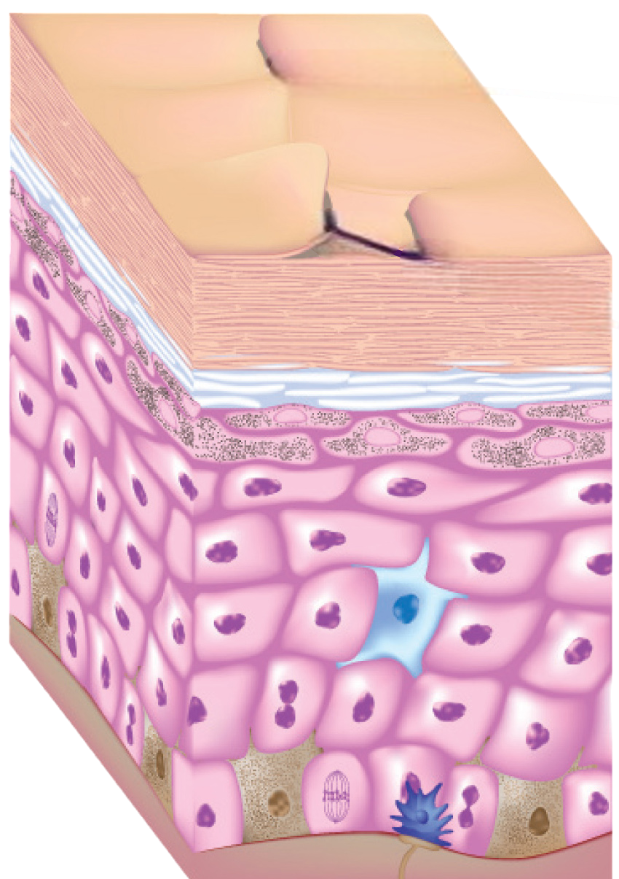
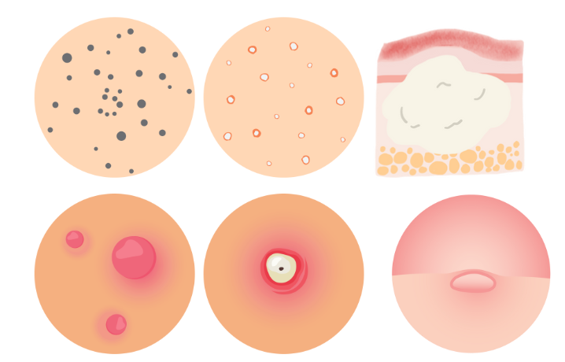
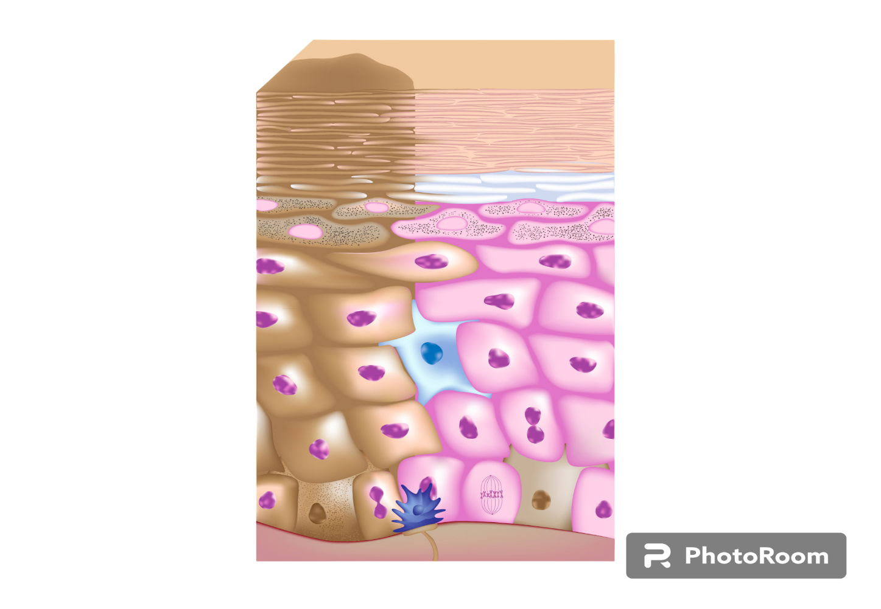
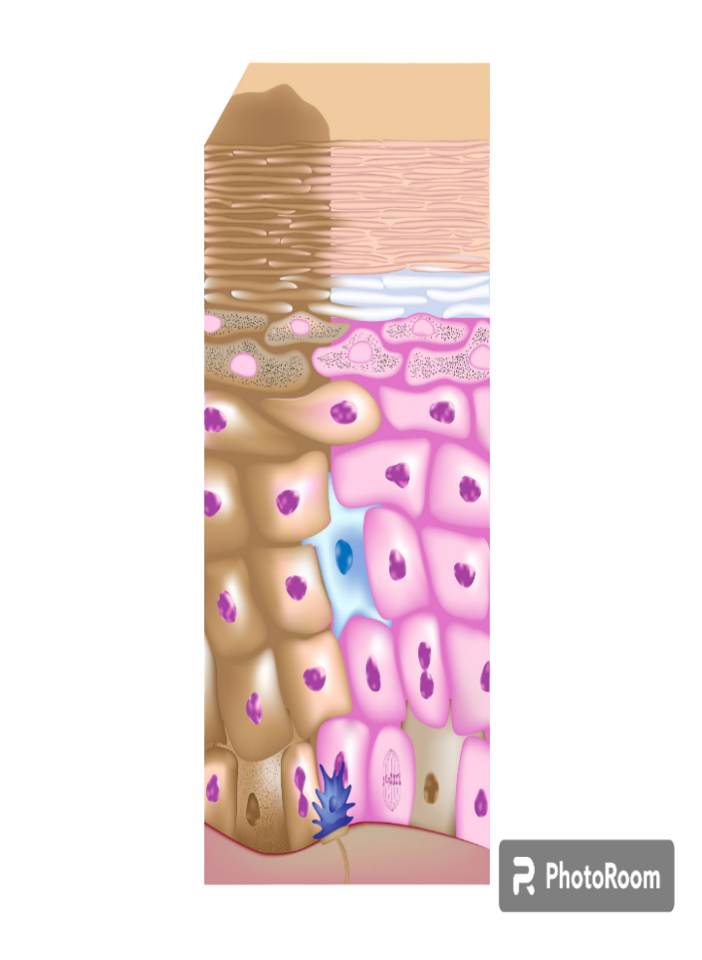
What are the impacts of
air pollution on the epidermis ?
Inflammation, itching, redness
The appearance of wrinkles and fine lines
Imperfections
Dehydration and dryness
Pigment spots, melasma
Notes:
Sum up of the impacts of air pollution on the epidermis

Slide 9
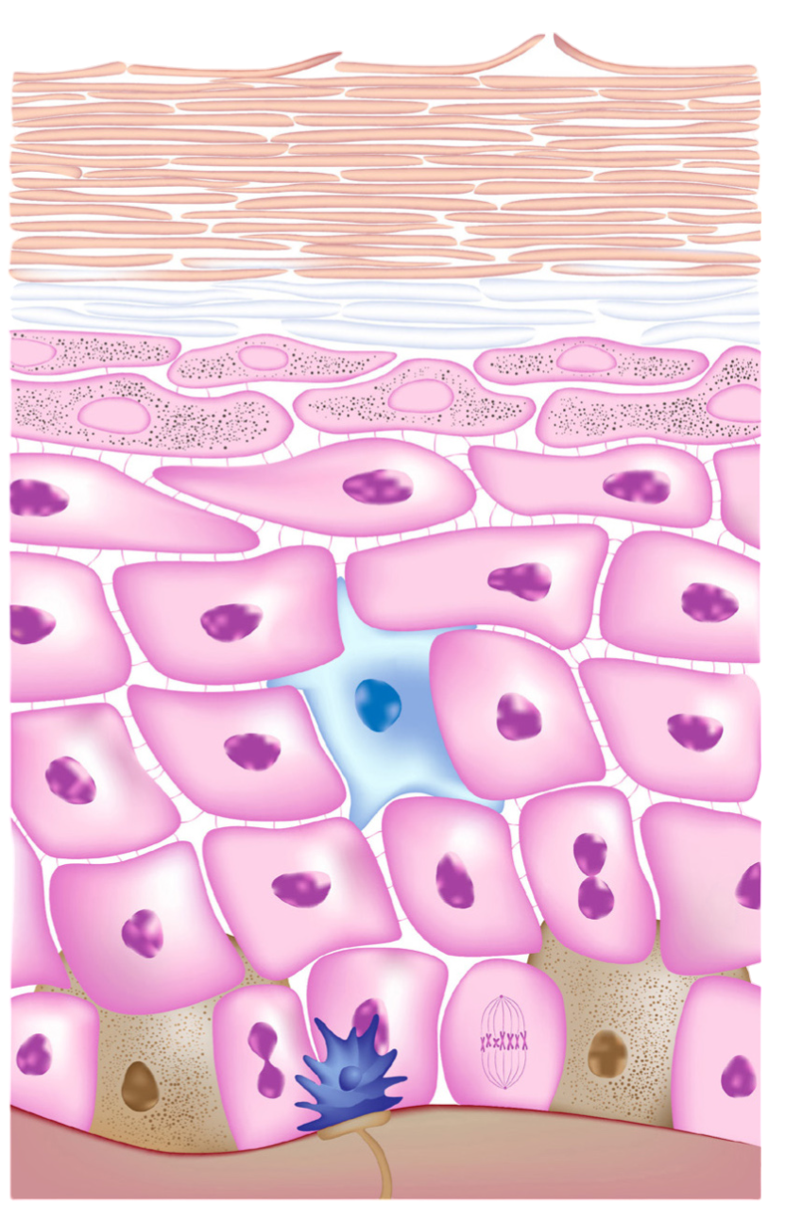
Skin defence mechanisms
STRATUM CORNEUM
PHYSICAL BARRIER
Stratum Corneum Composed of dead cells filled with keratin and lipids that limit the penetration of pollutant particles.
Constant Cellular Renewal
Eliminates damaged superficial cells and replaces them with new cells.
EPIDERMAL BARRIER
Tight Junctions
The cells of the epidermis are connected by tight junctions that prevent the penetration of toxic substances and allergens.
STRATUM LUCIDUM (feet & hands)
STRATUM GRANULOSUM
STRATUM SPINOSUM
STRATUM BASALE
Structure of the epidermis
Notes:
The skin has several defense mechanisms at its disposal to protect itself against pollution. These mechanisms include physical barriers, chemical processes and immune responses.
Here’s how the skin defends itself against pollution :
Physical barrier
Epidermis and Stratum Corneum :Stratum Corneum: The outermost layer of the epidermis, acts as a physical barrier against pollutants. It is made up of dead cells filled with keratin and lipids that limit the penetration of pollutant particles.
Cellular renewal: The skin constantly renews itself, eliminating damaged surface cells and replacing them with new ones.
Epidermal barrier function
Tight Junctions :Tight Junctions : The cells of the epidermis are linked by tight junctions which prevent the penetration of toxic substances and allergens.

Slide 10
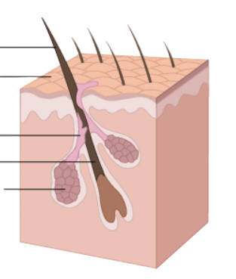
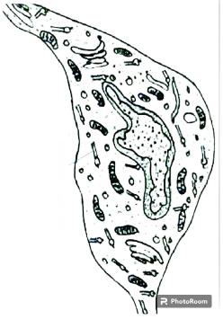
Skin defence mechanisms
LIPIDIC BARRIER
Sebum produit par les glandes sébacées, forme une couche protectrice, empêchant la pénétration des substances nocives.
Lipid matrix such as ceramides, free fatty acids and cholesterol form a matrix that reinforces the skin barrier and protects against external aggression.
IMMUNE RESPONSE
Langerhans cells dendritic cells in the epidermis, play a crucial role in detecting pathogens and activating the immune response.
Cytokines and chemokines attract other immune cells to fight inflammation and infections in response to pollutants.
HAIR
SKIN
SEBUM
FOLICLE
SEBACEOUS GLAND
Cellules de Langerhans
Notes:
3. Lipid barrier
Cutaneous lipids :
Sebum: Sebum, produced by the sebaceous glands, forms a protective layer on the surface of the skin, preventing the penetration of harmful substances and helping to retain moisture.
Lipid matrix: The intercellular lipids of the stratum corneum, such as ceramides, free fatty acids and cholesterol, form a matrix which reinforces the skin barrier and protects against external aggression.
4. Immune Response
Immune cells :
Langerhans cells: These dendritic cells present in the epidermis play a crucial role in detecting pathogens and activating the immune response.
Cytokines and chemokines: In response to pollutants, the skin can release cytokines and chemokines which attract other immune cells to fight inflammation and infection.

Slide 11
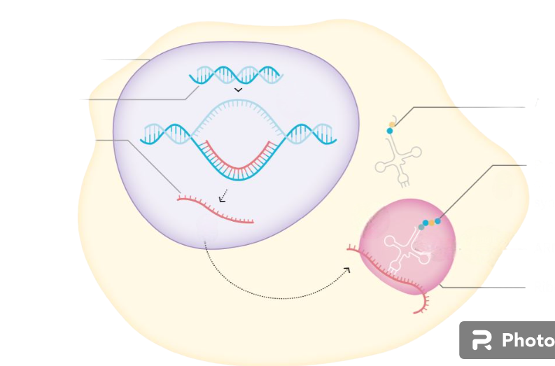
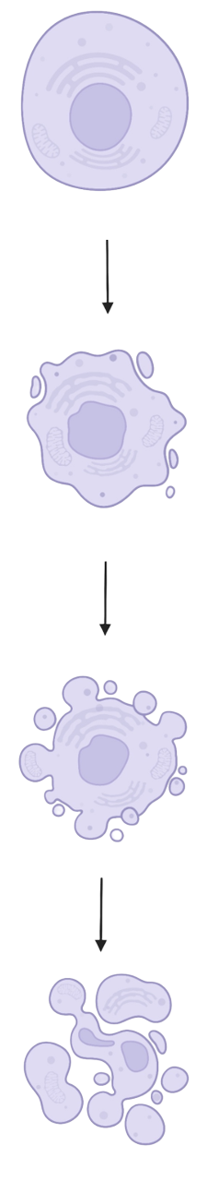
Skin defence mechanisms
LIVING CELL
Plasma membrane
DNA REPARATION
Nucleotide Excision Repair: mechanism for repairing DNA damage caused by free radicals and UV rays.
Apoptosis: If DNA damage is too severe, skin cells can experience programmed cell death to prevent the spread of damaged cells.
NUCLEUS
DNA
Amino acid
Cytoplasmic atrophy & chromatin condensation
mRNA
Protein
Stages of apoptosis
Ribosome
Cytoplasm
Membrane budding & DNA fragmentation
Cellular organisation
ANTIOXIDANTS
Endogenous antioxidants: the skin produces natural antioxidants which neutralise the free radicals generated by pollutants.
Vitamins E and C: present in the diet, help protect skin cells against oxidation.
APOPTOTIC CELL
Notes:
5. Antioxidants
Antioxidant defence :
Endogenous antioxidants: The skin produces natural antioxidants such as superoxide dismutase (SOD), catalase and glutathione peroxidase (a protein present in the cytoplasm of all the body's cells), which neutralise the free radicals generated by pollutants.
Vitamins E and C: Antioxidants such as vitamins E and C, present in the diet, help to protect skin cells against oxidation.
6. DNA repair
Repair mechanisms :
Nucleotide Excision Repair: Skin cells have mechanisms for repairing DNA damage caused by free radicals and UV light, such as nucleotide excision repair.
Apoptosis: If DNA damage is too severe, skin cells can undergo apoptosis (programmed cell death) to prevent the spread of damaged cells.
CCL
The skin is able to respond to pollution and protect itself. However, our modern lifestyles involve an ever-increasing number of pollutants, which have a harmful impact on our skin. We can therefore use topical treatments to help it combat these pollutants.

Slide 12

Yon-Ka answer
YOUR ANTI-POLLUTION ALLIES
Crème VITAL DEFENSE
Antioxidant
Anti-pollution
Intense hydration
VITAL DEFENSE Brume Multi-Protection
Anti-aggression radiance mist
[pollution - blue light and sunlight]
Notes:
That's why Yon-Ka offers 2 perfect allies to help protect our skin and combat pollution.
You already know them, but we're going to review them together

Slide 13
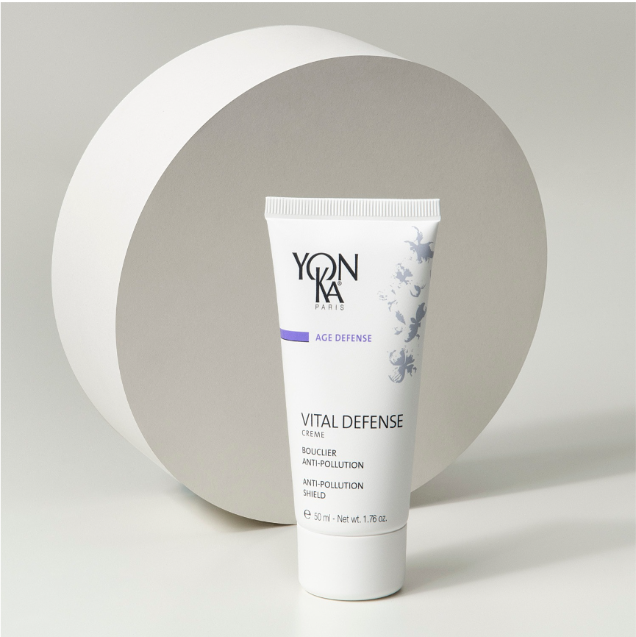
Crème VITAL DEFENSE
COMBAT THE HARMFUL EFFECTS OF ENVIRONMENTAL STRESS
ANTIOXIDANT
Myrtle Extract: Derived from organic farming, it limits the spread of free radicals and strengthens the skin's natural self-defense system.
Co-enzyme Q10 and Vitamin E: Powerful antioxidants that protect the skin from the harmful effects of free radicals
ANTI-POLLUTION
Moringa Peptides: They protect the epidermis from polluting aggressions and purify the skin by eliminating suffocating microparticles produced by the environment.
STRENGTHEN THE EPIDERMIS'S RESISTANCE
HYDRATING COMPLEX
Vegetable Glycerin, Urea, Serine: Provide immediate and long-lasting hydration.
REPARING
Olive Phytosqualane: Anti-dehydration, softening, and nourishing for increased resistance to drying aggressions.
Vitamin A: Regenerative, promotes the renewal of epidermal cells.
VITALIZING COMLPEX
Vitamin C: Protective, known for inducing collagen synthesis.
Essential Oils of Sweet Orange, Mandarin, Magnolia: Vitamin-rich and vitalizing.

Slide 14
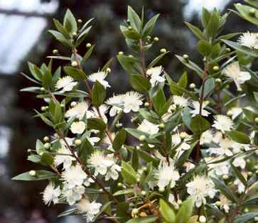
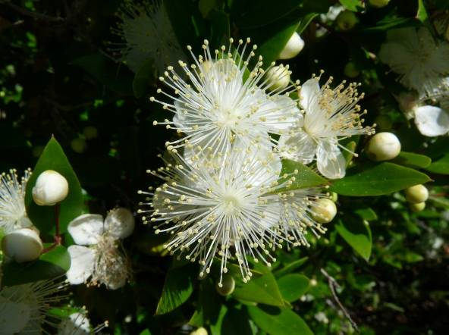
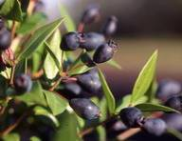
Active focus : Myrtle
Myrtle (Myrtus communis) is a bushy shrub cultivated around the Mediterranean.
The organic myrtle extract used in VITAL DEFENSE comes from its leaves.
In-vitro test on the anti-radical protective effect of myrtle extract :
  - protection of keratinocytes 70%
  - protection of fibroblasts 60%
In-vitro test on antioxidant activity :- Test on fibroblasts exposed to oxidative stress
Myrtle allows significant recovery of cellular glutathione levels by 66%, thereby stimulating natural antioxidant defenses.
Photos issues d’internet – ne pas utiliser à d’autres fins que cette présentation marketing
In-tube test on the chelating activity of myrtle extract :
Environmental iron ions, involved in free radical formation, are chelated by myrtle, forming a stable, inactive, and non-toxic complex, allowing for "detoxification".
→ Iron chelating activity of 93% ("neutralization" of iron)
Notes:
Keratinocytes are the cells that make up 90% of the epidermis. They synthesise keratin, a protein that gives the skin its impermeability and external protection. A fibroblast is a cell found in connective tissue; it is sometimes called a support cell. HX-XO*. = *reconstitutes the effect of free radicals on cells
glutathione = essential molecule involved in the cell protection system

Slide 15
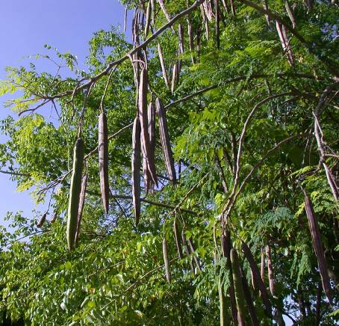
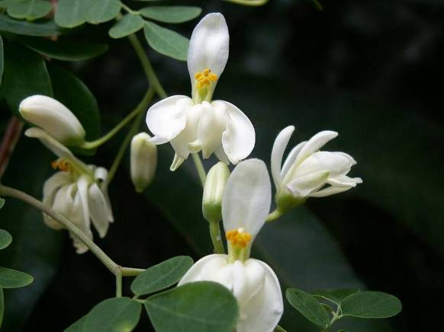
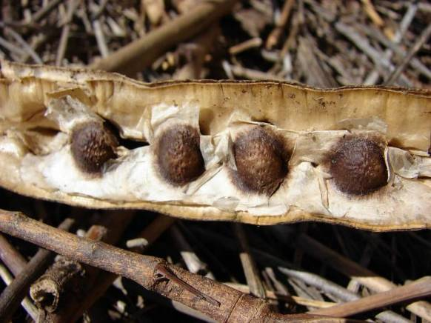
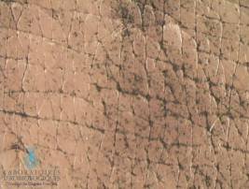
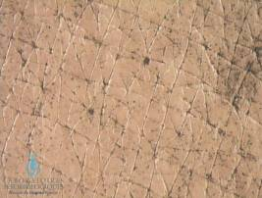
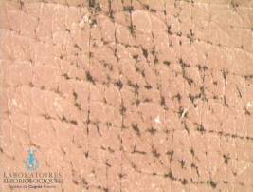
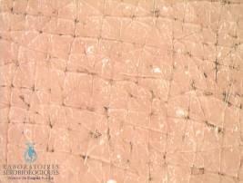
Active Focus : Moringa Peptides
Moringa oleifera is an exotic tree native to India.
The Moringa peptides used in VITAL DEFENSE are derived from the seeds.
Tests on the protective and purifying effect of Moringa peptides:
In-vivo test: videomicroscopy of the skin
The skin is subjected to pollutants and observed on videomicroscopic images. They compared the results between an application of water and an application of lotion containing Moringa peptides.
1-After application
of the charcoal
PROTECTIVE EFFECT
AGAINST POLLUTION
Water Lotion containing Moringa peptides
2 - After stripping*
PURIFYING EFFECT
IN DEPTH
Water Lotion containing Moringa peptides
Notes:
*Stripping is the application of an adhesive strip to the skin, which is then removed. This removes the dead cells from the surface of the skin so that what remains (pollutants, etc.) can be analysed under the microscope.
→ This test has shown that Moringa peptides protect and purify the skin by eliminating asphyxiating micro-particles produced by the environment.
Ex-vivo test
Test carried out on human skin explants kept alive and exposed to cigarette smoke with and without Moringa peptides.
→ This test showed a significant reduction in the formation of stress protein* (HSP) in the presence of Moringa peptides.

Slide 16
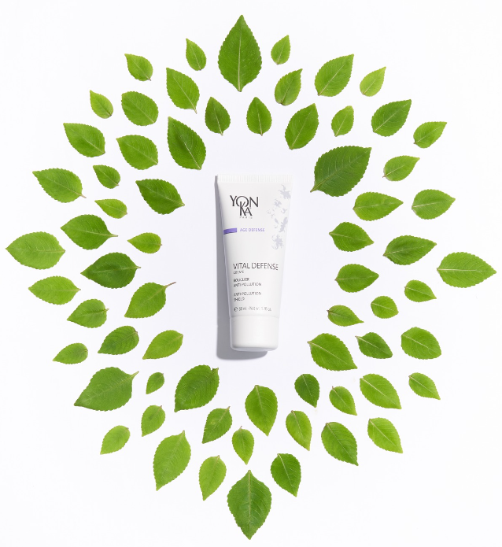
Crème VITAL DEFENSE
The Yon-Ka ‘’+‘’
Antioxidant and anti-pollution polyvitamin cream
Anti-aging prevention
Intense hydration (+37% after 8 hours)
Comfort, suppleness and luminosity
Fine texture quickly absorbed
Combined with Phyto 58 night cream for an oxygenating action

Slide 17
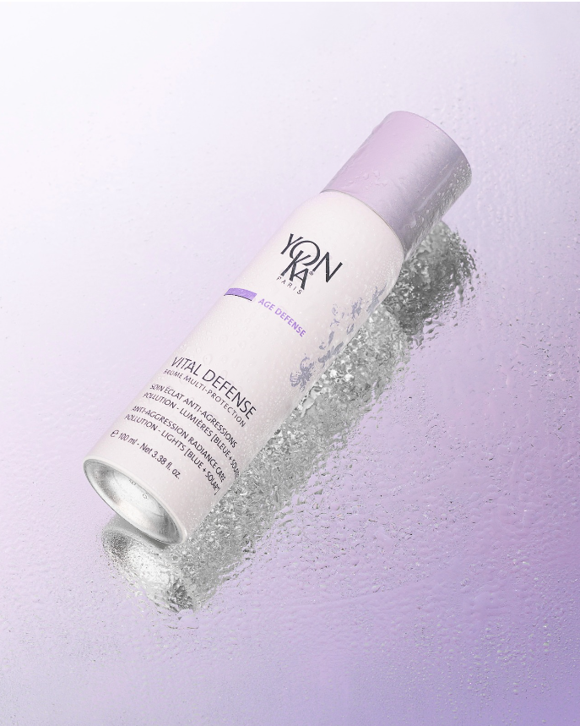
VITAL DEFENSE Brume Multi-Protection
COMBAT THE HARMFUL EFFECTS OF ENVIRONMENTAL STRESS
ANTIOXIDANT
Vegetable Polyphenols: Extracts from Sophora Japonica and butterfly tree, powerful photo-protective antioxidants, stimulate the skin's self-defense systems and activate skin regeneration.
ANTI-POLLUTION
Biosaccharide: A complex sugar obtained through Green Science, forming an instant protective anti-aggression veil that limits the adhesion and penetration of fine particles and pollutants.
STRENGTHEN THE EPIDERMIS'S RESISTANCE
Vitamin B5: Enhances skin hydration and has soothing properties.
Essential Oils of Sweet Orange, Mandarin, Magnolia: Vitamin-rich and vitalizing.

Slide 18
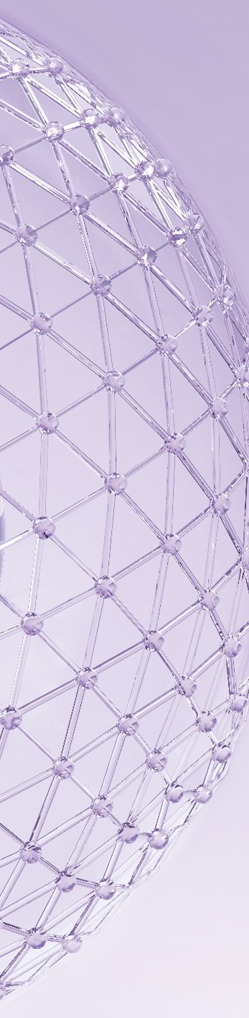
Active Focus : Biosaccharide
Surface protection
Reduces the number of encrusted pollution particles by instantly forming a ‘second skin’:
Resistant
Consistent
Breathable
Invisible
Mitochondrial protection (the cell's energy powerhouse)
This surface shield preserves the cells' key metabolism at a deeper level by effectively protecting the mitochondria from pollution:
-54% mitochondrial toxicity
Less cell damage = preservation of key cell metabolisms.
Notes:
Exposure to pollution, particularly PM2.5, is responsible for cellular and mitochondrial toxicity, which leads to cell death and deficiencies; as a reminder, the mitochondrion is the cell's energy centre.
Without it, cellular metabolisms cannot take place. Thanks to the biosaccharide included in the Vital Defense Multi-Protection Mist, a clear reduction in mitochondrial toxicity is observed.
The barrier effect obtained allows a -54% reduction in toxicity, proving effective protection of the mitochondria against pollution.
Less cellular damage = preservation of key cellular metabolisms.

Slide 19
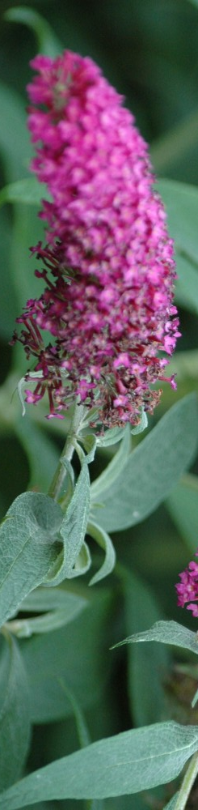
Active Focus : Polyphenols
8 times more effective than vitamin E
Boosts the skin's enzymatic self-defence systems
SOD Super Oxide Dismutase: an enzyme naturally present in humans which helps the skin to defend itself against free radical attacks caused by pollution:
+ 36% SOD
Catalase: an enzyme naturally present in humans, works in conjunction with SOD to protect the skin from free radicals.
+ 29% Catalase
Protects the skin from damage caused by light rays (UV - Blue Light - Infra-Red):
These polyphenols protect cells from dying as a result of damage caused by exposure to light : - 57%
These polyphenols protect the skin from inflammation by reducing the synthesis of certain mediators : - 35%
Notes:
8 times more effective (at % equivalent) than vitamin E, the reference anti-oxidant, these plant polyphenols :
Boost the enzymatic systems of cutaneous defence which are :SOD Super Oxide Dismutase: boost of +36%. This enzyme, naturally present in humans, is used by the skin to defend itself against free radical attacks caused by pollution, exposure to light rays, etc., but if the attacks are too strong, it can no longer cope.
Catalase: boost + 29%. This enzyme, also naturally present in humans, works in conjunction with SOD to protect the skin from free radicals.
Protects the skin from light damage:- These polyphenols protect the cells from dying as a result of exposure to light - These polyphenols protect the skin from inflammation by reducing the synthesis of certain mediators.
Sophora extract stimulates the skin's self-defence systems and activates skin regeneration to help it resist oxidative stress. It stimulates the cellular detoxification mechanisms, reduces free radicals and inflammation mediators. It is therefore a 360° photoprotector, which prevents premature photoaging.

Slide 20
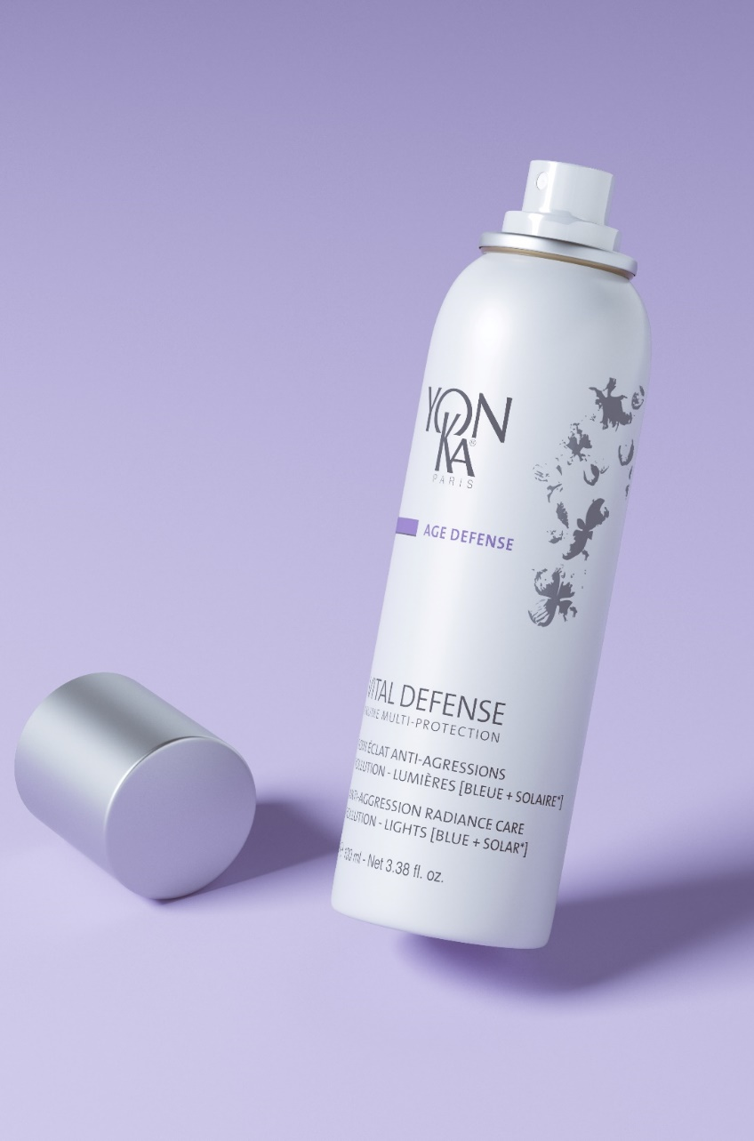
VITAL DEFENSE Brume Multi-Protection
The Yon-Ka ‘’+‘’
Forms an anti-injury shield Pollution - UV* - Blue light
Boosts the skin's self-defence systems
99% natural origin ingredients
Vegan, GMO-free, Alcohol-free
Soothes and hydrates
Fixes make-up all day long
Non-sticky, non-greasy, invisible finish
Any time of the day
Face - Neck - Décolleté - Hands - Hair
*Does not contain sunscreen
Notes:
800 sprays in total (100ml)
2 uses per day, 7 sprays = 2 months minimum

Slide 21
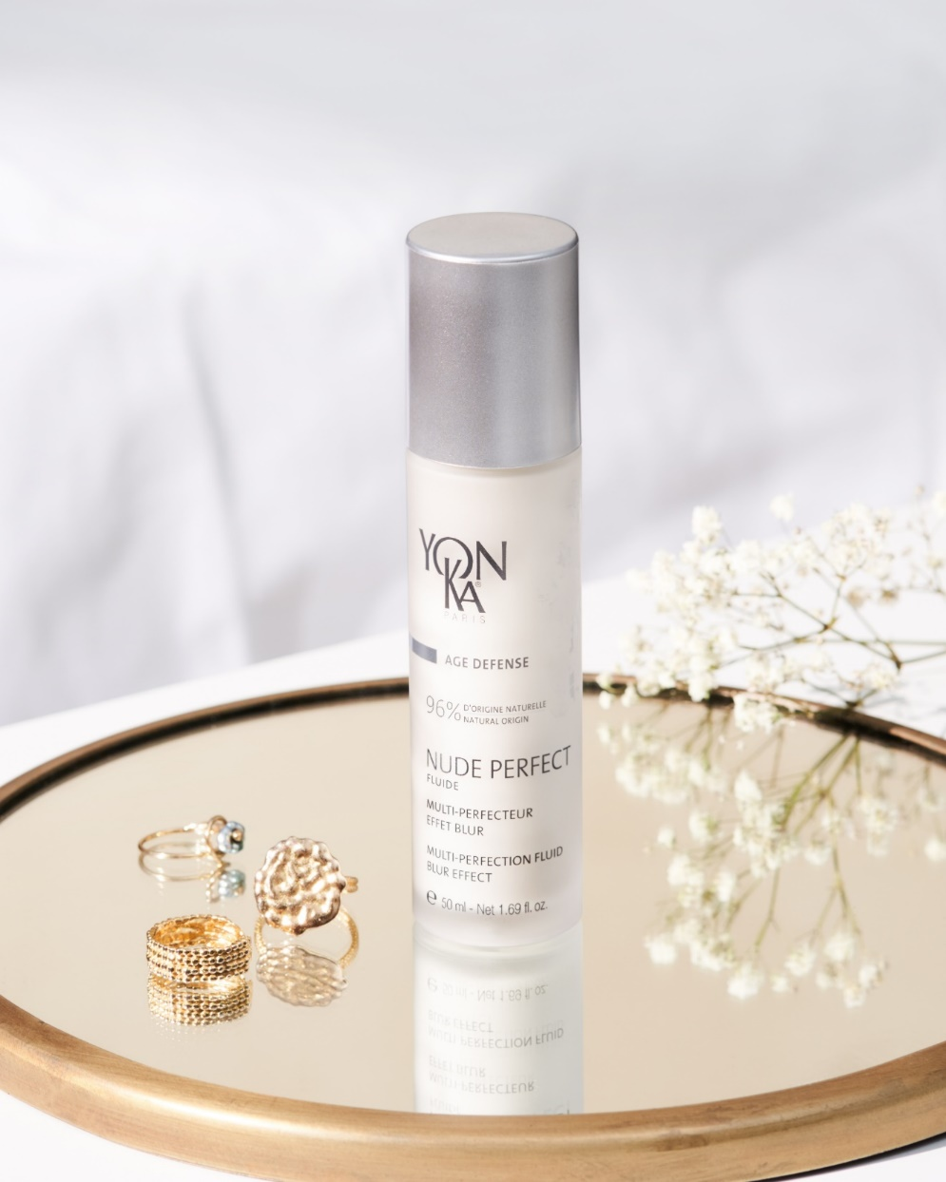




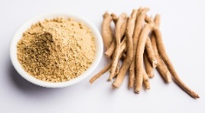

But also : NUDE PERFECT FLUIDE
MINERAL SHEETS, RICE POWDER, AMINO ACID POWDER
Blur effect, soft focus effect, matifying
IRIS, ZINC, VITAMIN A
Purifying, balancing
ORGANIC ASHWAGANDHA
Environmental and digital anti-pollution
SOPHORA JAPONICA FLOWER
AntioxIdant
Multi-perfection fluid with blur effect: perfect skin, naturally.
Notes:
anti-pollution active : organic Ashwagandha
Protect the viability of keratinocytes in the epidermis
Protect fibroblast metabolism in the dermis
Results : - Deeply strengthens the skin
- Revitalizes the skin
- Makes signs of fatigue disappear
- Gives radiance to the complexion
thanks to an ex vivo tests we can aim that the nude perfect protects againt the carbon partciles : -86%
Ex-vivo tests performed on human skin explants
To preserve the blur effect, do not mix Nude Perfect with a booster and do not cover it with a sun cream.

Slide 22
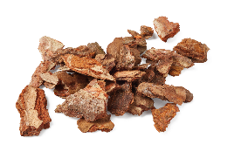
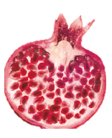

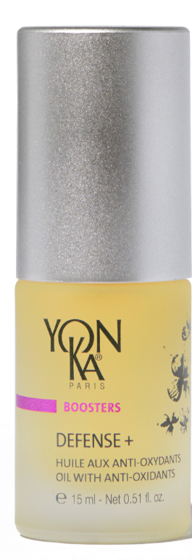
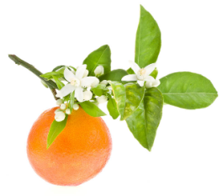
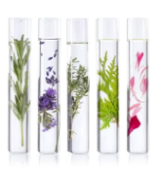
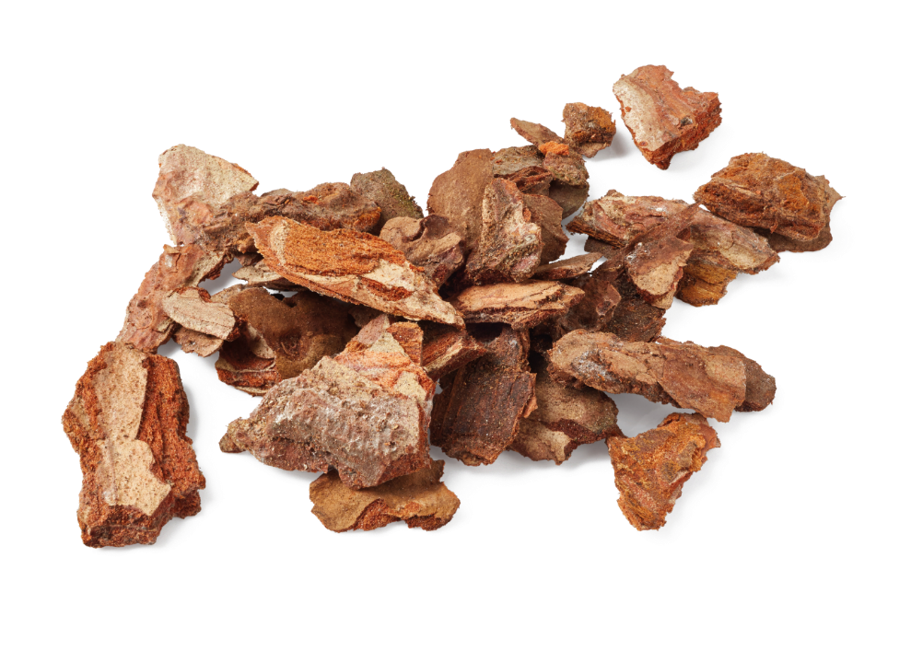


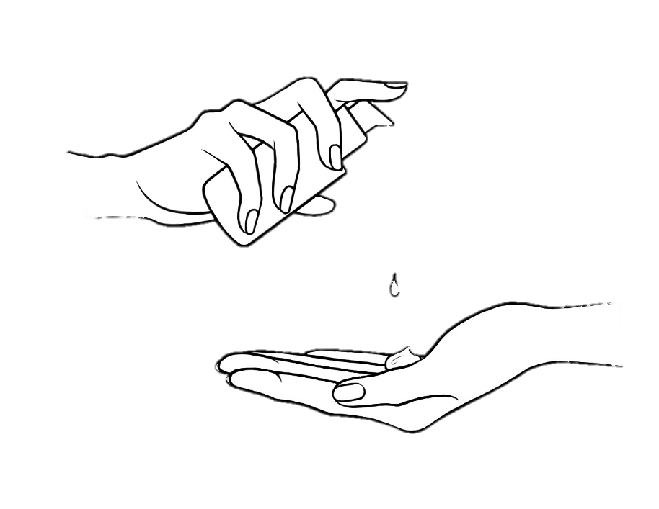

But also : DEFENSE +
Protects against external aggressions
Revives the radiance
Prevents the first signs of aging
PINE BARK POLYPHENOLS, ORGANIC POMEGRANATE OIL, CISTUS E.O
AntioxIdant, prevents skin aging
CAMELIA OIL, ORGANIC SACHA INCHI OIL
Nourishing, protecting
PETITGRAIN, SWEET ORANGE E.O, YON-KA QUINTESSENCE
Calming, soothing
BOOSTER
1 to 2 pumps
+
= 1 month cure
Notes:
Défense + is the best antioxydant booster!
This soft and nourishing oil with pine bark polyphenols and pomegranate oil protects the skin against environmental aggressions (sun, pollution, cold...) and helps fight against the signs of aging.
We definetly like its 99,9% natural composition, its soothing active ingredients, its subtle aroma where sweet orange and the Quintessence Yon-Ka are mixed.
Added to your everyday cream, this booster :
Protects the skin from pollution
The complexion is luminous and relaxed
Suitable for all skin types
And according the RESULTS
The complexion is more radiant 75%
Less blurred 80%
Overall appearance of wrinkles -25%
Luminous complexion : 75% - (Usage test under dermatological control - Application twice a day of 1 to 2 pumps of DEFENSE+ for 4 consecutive weeks in addition to the usual face cream - 20 women aged 40 to 55 years old presenting wrinkles. )
Less blurred complexion: 80% - (Consumer test 4 weeks, 50 women 36-55 years old)
Overall appearance of wrinkles : up to -25% - (clinical scoring by a dermatologist during the usage test - Best result obtained)

Slide 23


Wellness and beauty tips
Steam Bath
thyme,
Mint or eucalyptus
Honey and lemon mask
A diet rich
in antioxidants
Double
cleansing
Regular and
restorative sleep
Turmeric and yoghurt mask
Notes:
To combat the effects of air pollution on the skin, there are a number of grandmotherly remedies that can help boost the skin's natural defences, soothe inflammation and restore moisture. Here are a few effective remedies:
Honey and lemon mask
Ingredients:
1 tablespoon honey
1 tablespoon lemon juice
How to use:
Mix the honey and lemon juice.
Apply to the face and leave on for 15-20 minutes.
Rinse off with lukewarm water.
Benefits:
Honey has antibacterial and moisturising properties.
Lemon is rich in vitamin C, an antioxidant that helps fight free radicals.
Turmeric and yoghurt mask
Ingredients:
1 teaspoon turmeric powder
2 tablespoons plain yoghurt
To use:
Mix the turmeric and yoghurt.
Apply to the face and leave on for 15-20 minutes.
Rinse off with lukewarm water.
Benefits:
Turmeric has anti-inflammatory and antioxidant properties.
Yoghurt moisturises the skin and contains lactic acids that gently exfoliate.
Herbal Steam Bath
Ingredients:
Boiling water
Dried herbs such as thyme, mint and eucalyptus.
How to use:
Boil some water and add the dried herbs.
Cover your head with a towel and place your face over the steaming water for 10-15 minutes.
Benefits:
The steam helps to open pores and remove impurities.
The herbs add antibacterial and soothing properties.
Double cleansing
Urban life disrupts the skin's natural protective barrier, whether it's normal, combination, oily or dry, which can cause damage in the short term, such as the appearance of imperfections, but also in the long term.
Regular skin cleansing is essential to eliminate all the pollutants and impurities that have accumulated on the skin's surface and deep down throughout the day. Before protecting the skin, it is also important to remove the day cream on which the fine particles of pollution have settled. It is therefore advisable to cleanse your face twice every evening.
A diet rich in antioxidants
Given the role of oxidation in the harmful effects of pollution, anti-oxidant foods are highly recommended. All foods containing vitamin C (parsley, peppers, lemons, etc.) and vitamin E (wheat germ oil, hazelnuts, olive oil, etc.) are also recommended.
To keep your skin hydrated and preserve the skin barrier, it's essential to drink enough throughout the day. Drinks rich in antioxidants and vitamins, such as green tea, fresh fruit juices and smoothies (lemon, grapefruit, orange) are perfect for fighting free radicals and preventing the signs of ageing.
When preparing your meals, think about wholemeal cereals, seeds and vegetable oils (linseed, olive, walnut or rapeseed) rich in omega 3. They help strengthen the hydrolipidic film and protect the skin from external aggression!
Regular, restorative sleep
And because we can't talk about healthy living without talking about sleep, try to maintain a regular sleep cycle, with at least 7 hours of sleep per night. This time of rest allows your skin to oxygenate itself and regenerate better, making it more resistant to pollution.
These grandmotherly remedies can be used regularly to protect the skin from the harmful effects of pollution and maintain healthy, radiant skin.

Slide 24
Annexe
ANTI-OXYDANTS EXOGENES
Vitamin C
Acts by neutralizing harmful substances, but it is also essential for strengthening the immune system and for the synthesis/repair of tissues throughout the body (it is necessary for collagen synthesis).
Found in: oranges, strawberries, kiwis, bell peppers, spinach, and broccoli.
Quercetin
A plant pigment that helps eliminate senescent or "old" cells; it's an anti-aging mechanism. It also has anti-inflammatory properties.
Found in: red grapes, onions, green tea, apples, or berries.
Vitamin E
Protects polyunsaturated fatty acids, such as omega-3s, in cell membranes and the brain from oxidation. Also important for maintaining healthy tissues such as skin and eyes, participates in the formation of red blood cells, and has anti-inflammatory properties.
Found in: vegetable oils (wheat germ oil is the richest in vitamin E), and to a lesser extent, seeds, and cereals.
Trans-Resveratrol
A plant pigment with anti-aging properties due to its antioxidant activity.
Found in: the skin of red grapes, currants, blackberries, and peanuts.
Astaxanthin
A natural carotenoid pigment with powerful antioxidant properties. It has an antioxidant power 14 times greater than vitamin E and 64 times greater than vitamin C. It has anti-inflammatory properties, protects against damage caused by UV rays from the sun, and improves skin health.
Found in: seafood, salmon, trout, shrimp, crayfish.
Notes:
Exogenous Antioxidants
Vitamin C
Vitamin C works by neutralizing harmful substances, but it is also essential for boosting the immune system and for tissue synthesis/repair throughout the body (it is necessary for collagen synthesis as it is involved in hydroxylation reactions, which stabilize collagen structure). Severe vitamin C deficiency after a period of reduced intake can lead to scurvy (resulting in impaired collagen synthesis). According to the European Food Safety Authority (EFSA), there is no maximum daily limit for this vitamin.
To obtain vitamin C through diet, we can consume fruits such as oranges, strawberries, or kiwis, and vegetables such as bell peppers, spinach, and broccoli.
Quercetin
Quercetin is a plant pigment with a primary senolytic function, meaning it helps to eliminate senescent or "old" cells; this is an anti-aging mechanism. It also has anti-inflammatory properties that contribute to overall well-being.
Some foods particularly rich in quercetin are of plant origin, such as red grapes, onions, green tea, apples, or berries.
Vitamin E
Vitamin E is particularly effective in protecting polyunsaturated fatty acids, such as omega-3s, present in cell membranes and the brain, from oxidation. It is also important for maintaining healthy tissues such as the skin and eyes, aids in red blood cell formation, and has anti-inflammatory properties. According to the EFSA, the recommended daily intake is 300 mg/day for adults.
Foods rich in vitamin E include vegetable oils and, to a lesser extent, seeds and cereals. Wheat germ oil is the richest natural source of vitamin E.
Trans-Resveratrol
Resveratrol is a plant pigment that, in addition to having anti-aging properties due to its antioxidant activity, is associated with increased insulin sensitivity and cardiovascular health benefits.
It is found in certain plant foods such as the skin of red grapes, currants, blackberries, and peanuts. It is also found in high concentration in the root of Fallopia japonica (Polygonum cuspidatum), a shrub with healing properties.
Astaxanthin
Astaxanthin is a natural carotenoid pigment with powerful antioxidant properties. It has an antioxidant power 14 times greater than that of vitamin E and 64 times greater than that of vitamin C. It is also attributed with various health benefits, such as reducing the risk of heart disease due to its anti-inflammatory properties, protecting against UV damage from the sun, and improving skin health.
It is naturally present in seafood, salmon, trout, krill, shrimp, crayfish, and certain types of algae and microalgae.

Slide 25
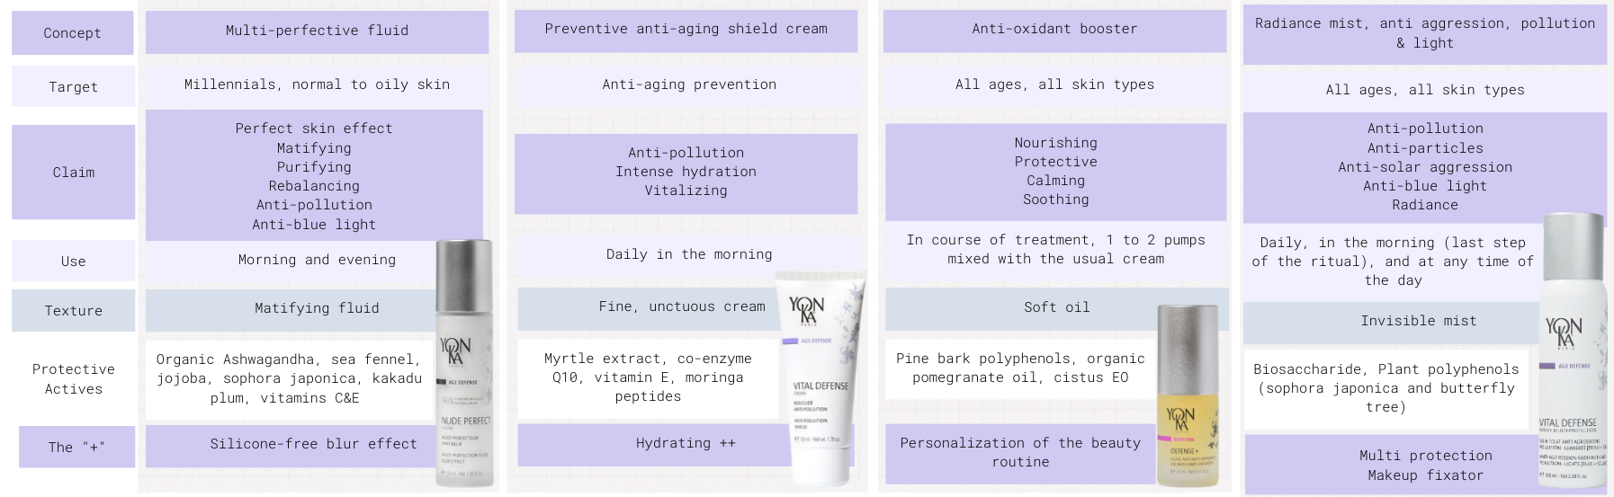
Annexe
NUDE PERFECT
Fluide
VITAL DEFENSE
Crème
DEFENSE +
VITAL DEFENSE
Brume multi protection

Slide 26
Notes:
MERCI

