Slide 2
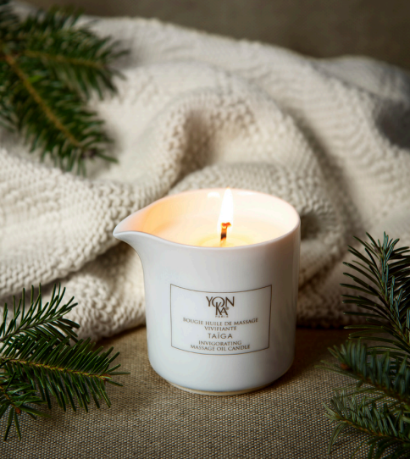
BOUGIE TAÏGA
Massage candle
invigorating and rejuvenating
Notes:
To begin this new Yon-Ka rendez-vous, we'll be talking for the first time about the Taiga candle. I'm sure you're already familiar with it, but let's dive into this invigorating and rejuvenating candle and this special world of treatment together.

Slide 3
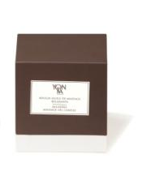
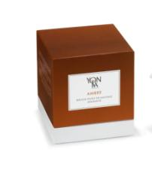
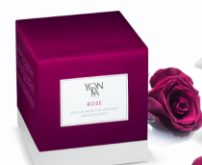
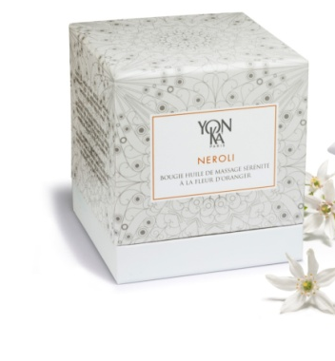
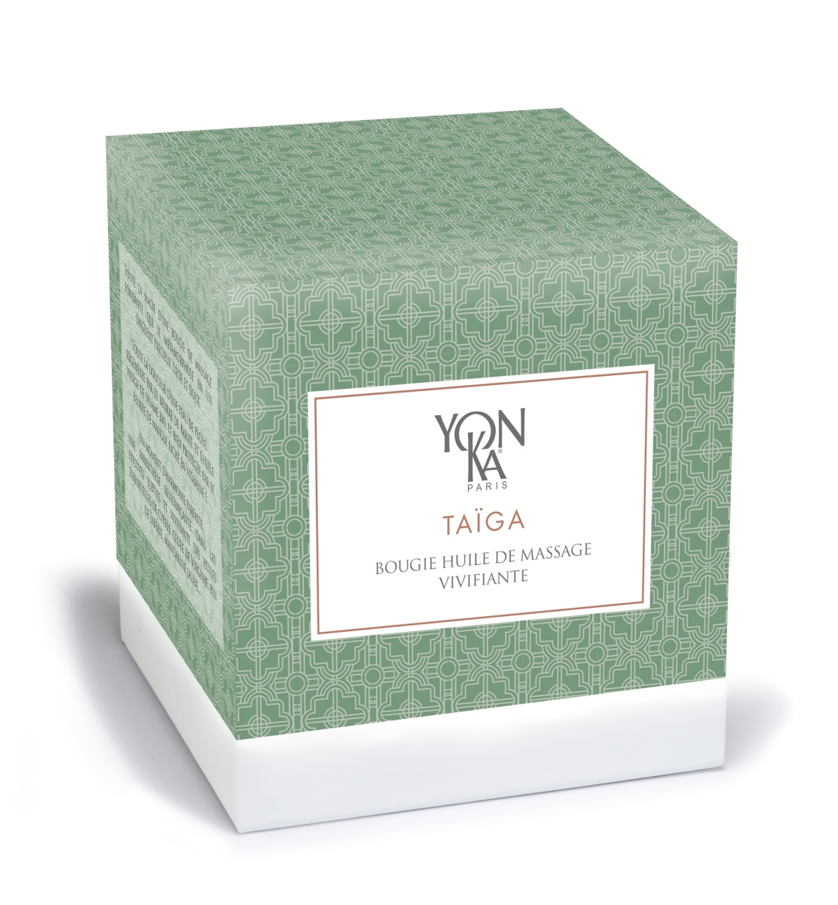
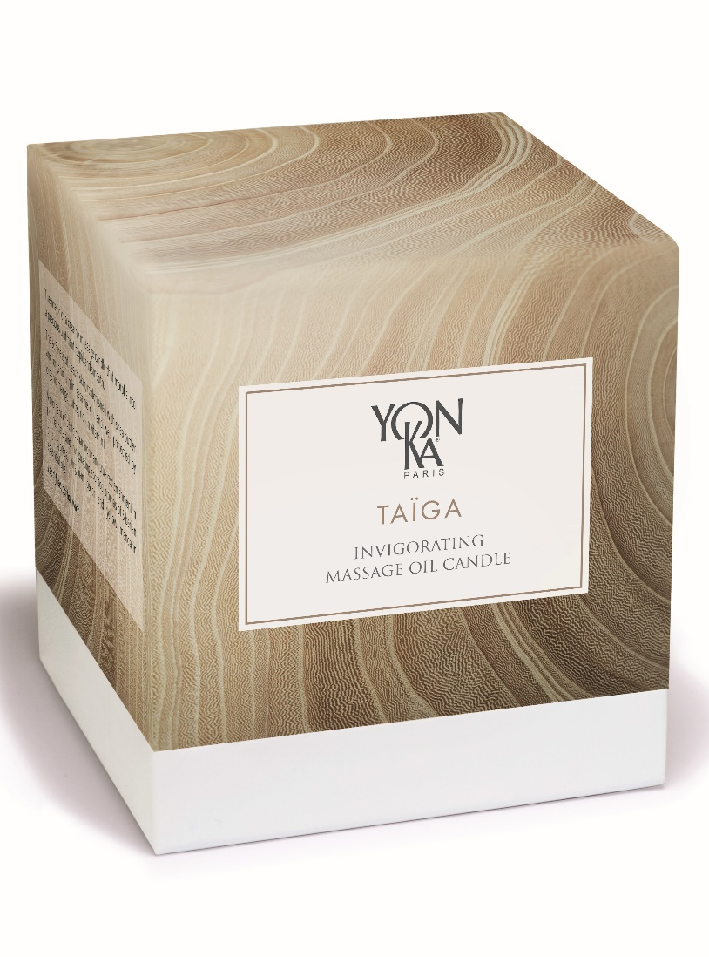
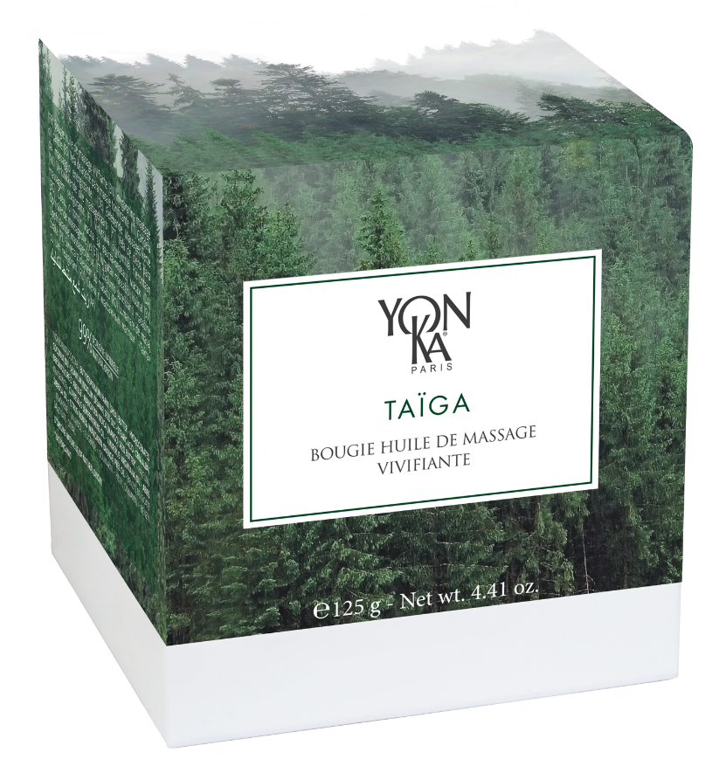
HISTORY
2009
2010
2011
2013
2015
2019
2022
Relaxing
massage oil candle
AMBRE
Soothing massage
oil candle
ROSE
Replenishing massage
oil candle
NEROLI
Orange blossom serenity massage oil candle
TAÏGA
Invigorating massage oil candle
TAÏGA
New pack
TAÏGA
New pack
Notes:
First of all, let's relive the history of the Taiga candle, and more generally, the different Yon-Ka massage candles.
the very first of which appeared in 2009 based on petitgrain, lavender and verbena essential oils
the following year saw the launch of the ‘AMBRE’ candle, with its oriental notes of Rose and Patchouli
followed by the ‘ROSE’ candle with the delicate scent of Bulgarian Rose essential oil
then in 2013, the ‘NEROLI’ candle with essential oils ofNeroli, Petitgrain, Orange
2015 saw the launch of the 1st Taiga candle with the same formula but different design
since 2022 you can find the 3rd version of the Taiga candle.
Massage candles have long been a seasonal product, marketed for the festive season.Today, the Taiga candle is a permanent fixture in our catalogue, allowing our customers to use it all year round.

Slide 4
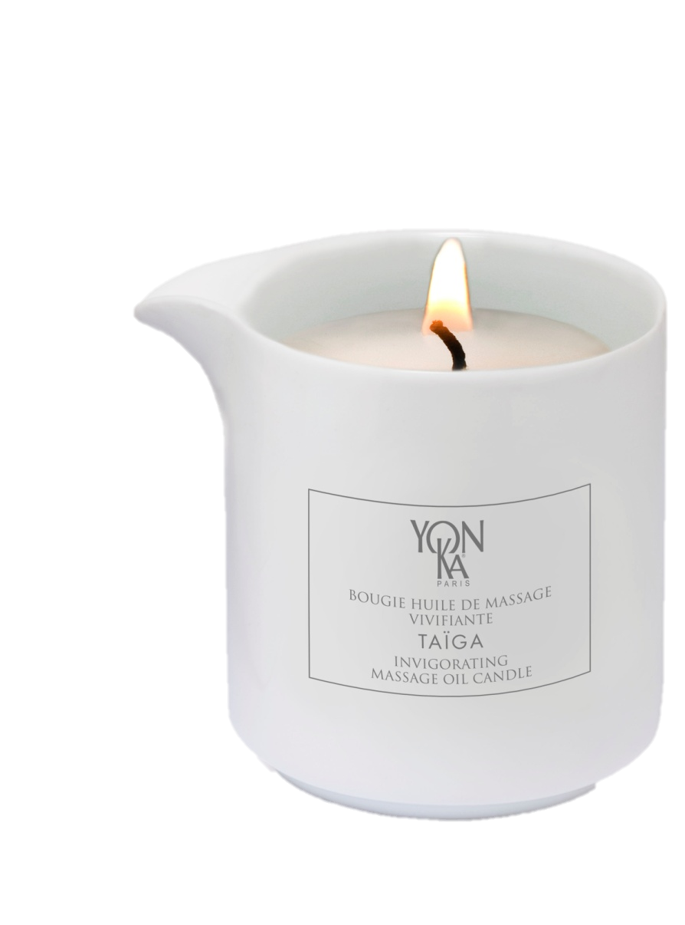
BOUGIE TAÏGA
CONDITIONNEMENT
4.4 oz (125 g) ceramic jar with spout (about 5 massages).
Protective cover. Lead-free wick.
Notes:
The container has remained the same: a 125g ceramic jar for an average of 5 full-body massages with a protective cover. Lead-free wick.

Slide 5
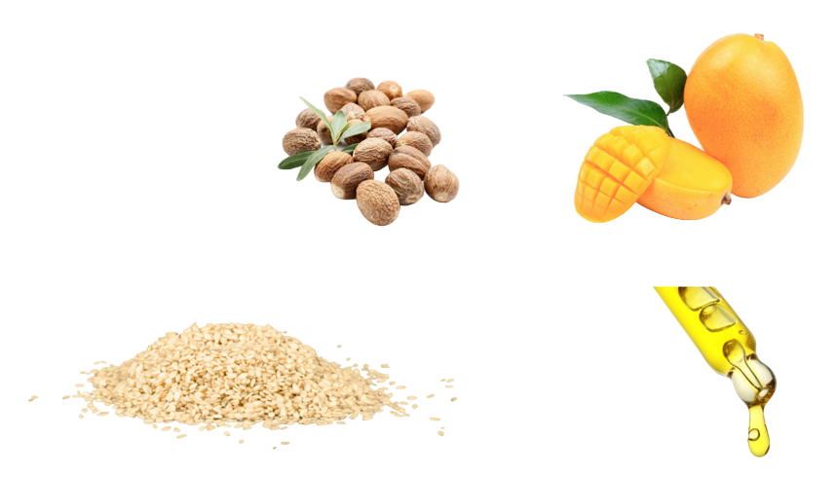
BOUGIE TAÏGA
99% of ingredients of natural origin
Natural ingredients with precious cosmetic properties
SHEA BUTTER
Nourishing & Reparative
ORGANIC MANGO BUTTER
Hydrating & Anti-oxidant
ORGANIC VIRGIN SESAME OIL
Restructuring & Nourishing
SIBERIAN PINE, CYPRESS, VIRGINIAN CEDAR, YELLOW MANDARIN ESSENTIAL OILS
Purifying & Sanitising
Notes:
discover the ingredients responsible for this silky, comfortable texture :
Shea butter
softening, reparative and nourishing
Organic Mango butter
rich in vitamin E, anti-oxidant, keeps skin from aging
Organic virgin sesame oil
Restructuring, prevents dehydration, anti-aging
Siberian pine, Cypress, Virginian Cedar, Yellow mandarin essential oils
see next slide

Slide 6

BOUGIE TAÏGA
Zoom on Essential Oils
SIBERIAN PINE
Abies sibirica
Antiseptic, air purifying, anti-inflammatory, soothes respiratory system
CYPRESS
Cupressus sempervirens
Decongestant, restores balance to nervous system, tonic for blood circulation
VIRGINIAN CEDAR
Juniperus virginiana
Décongestionnant et tonique veineux
YELLOW MANDARIN
Citrus nobilis
Puissant calmant et relaxant. Elimine le stress, les angoisses et prépare à un sommeil réparateur
Invigorating essential oils
Notes:
Woody notes with a touch of citrus (=mandarin) - subtle, invigorating fragrances
These essential oils are invigorating and revitalizing.
SIBERIAN PINE
Fresh, resinous scent
Antiseptic, air purifying, anti-inflammatory, soothes respiratory system
CYPRESS
Woody, amber scent
Decongestant, restores balance to nervous system, tonic for blood circulation
VIRGINIAN CEDAR
Notes of sandalwood, smooth, distinctive cedar.
Primarily known as a decongestant and tonic for blood circulation
YELLOW MANDARIN
Soft, floral scent
Powerful, calming and relaxing. Perfect for eliminating stress and anxiety and for winding down before a restorative night's sleep.
6

Slide 7

BOUGIE TAÏGA
SELLING POINTS
A great gift idea
For a relaxing atmosphere at home
An enveloping texture
Precious ingredients
For silky, velvety skin
Notes:
A gift idea for yourself or someone else: to be enjoyed alone or with a partner
The Candle creates a relaxing atmosphere with its soft glow and the stress-relieving and soothing power of aromatic essential oils of Siberian pine, Cypress, Virginian Cedar, Yellow mandarin essential oils
The texture is surprising. The ointment melts into oil that can be used for a comforting massage with new perceptions of touch.
The ingredients are precious, with shea butter (over 50%) to soften, repair, and nourish; organic virgin sesame oil (restructuring, prevents dehydration, anti-aging), and anti-oxidant mango butter.
Skin is silky and renewed. No white residue is left on clothing as with wax.

Slide 8
BOUGIE TAÏGA
How to sell the treatment
Who the treatment is intended for
How to describe the treatment
Esthetician advantages
Massage lovers (utter relaxation)
Original treatment with surprising sensations
Exceptional treatment for well-being and stress relief
A multi-sensorial treatment
Unique treatment: Yon-Ka method, quality candle
A spa treatment
Chance to boost sales and gift certificates
Notes:
Yon-Ka offers a unique moment of relaxation with this exceptional candle. exceptional candle for total pampering from head to toe and a feeling of total relaxation.
As a preamble, a warm aromatic compress is applied to the ankles and feet to begin relaxing. to begin the relaxation process.
This is followed by a long, relaxing full-body massage with Massage Oil Candles, in the balancing atmosphere of essential oils.
To conclude the treatment and revitalise body and mind, olfactory stimulation with the scent of rosemary is followed by stretching and a neck, shoulder and back massage

Slide 9
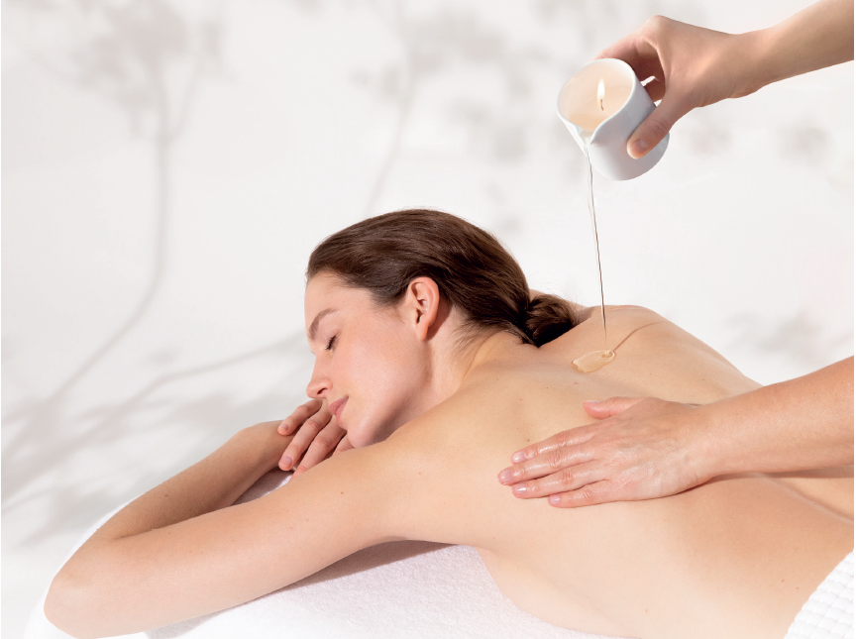
CANDLE MASSAGE - 1H
1 – Introduction signature
5 min
PHYTO-BAIN on a warm compress
BOUGIE TAÏGA – Aroma Luxe techniques
2 – Massage
45 min
2 min
PHYTO-BAIN on 2 small towels + 1 hot compress
3 – Set of 3 compresses
4 – Conclusion signature
3 min
PHYTO 152 + LAIT CORPS

Slide 10
CANDLE MASSAGE - 1H
Cost price
TAÏGA 115€
REF | PRODUCTS | CAPACITY (ML/G) | QUANTITY USED / TREATMENT (ML/G) | PRODCUT PRICE | TOTAL PRICE OF THE PRODUCT USED IN THE TREATMENT
56430 | PHYTO-BAIN | 500 | 6 | 80,00 € | 0,96 €
21920 | CANDLE "TAÏGA" Invigorating massage oil candle" | 125 | 25 | 22,50 € | 4,50 €
55140 | PHYTO 152 | 150 | 0,5 | 36,00 € | 0,12 €
56550 | LAIT HYDRATANT (LAVANDE-HELICHRYSE) | 500 | 2 | 30,00 € | 0,12 €
 |  |  |  |  | 5,70 €

Slide 11
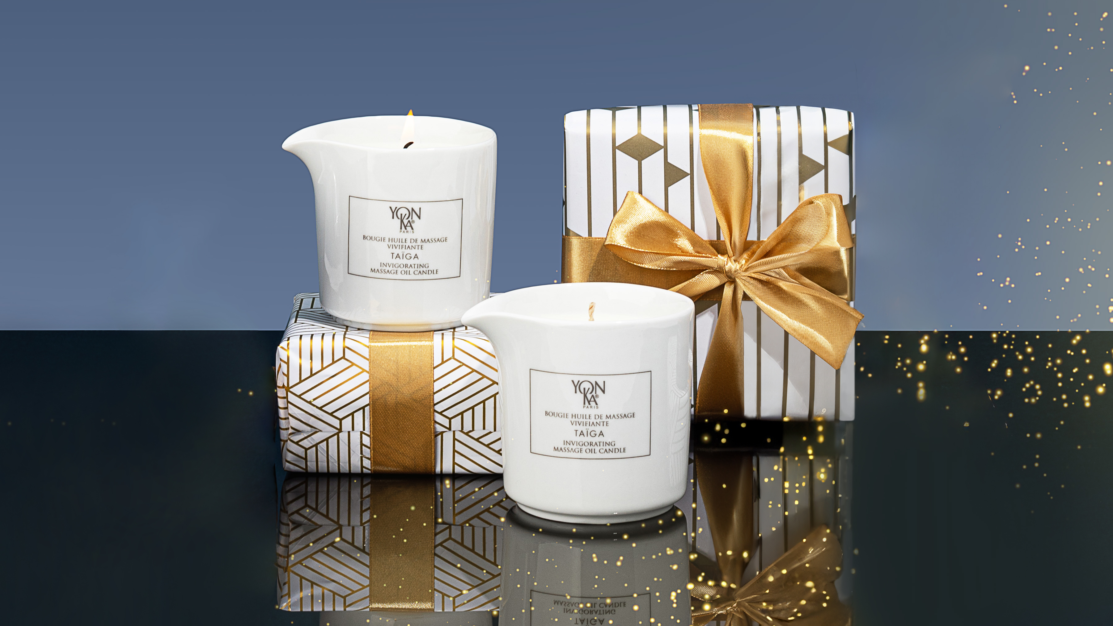

Slide 12
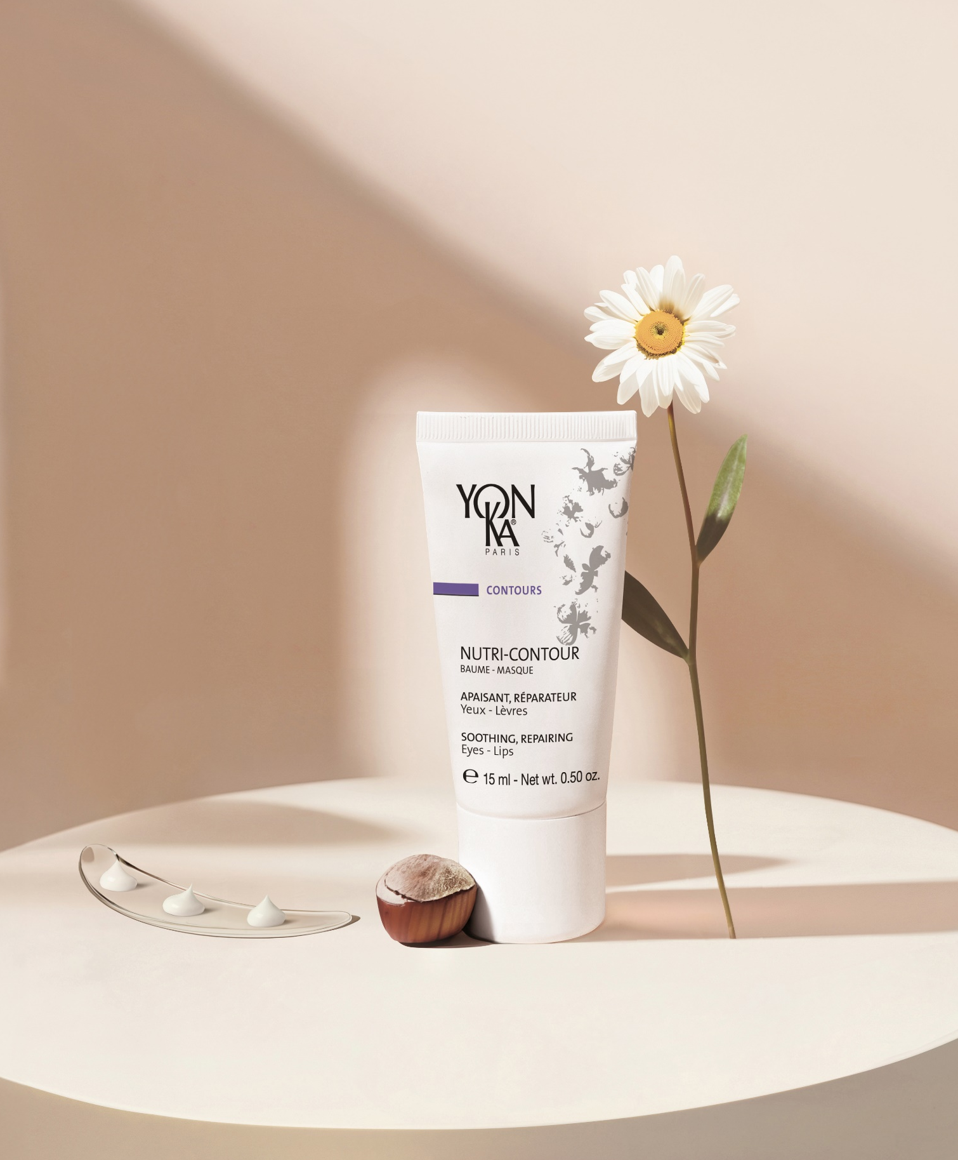

Nutri-Contour
Reformulation
Increase in the percentage of ingredients of natural origin
Increase in the number and percentage of certified organic ingredients
Highlighting its use as a balm and mask
Notes:
2nd topic for today's Yon-Ka rendez-vous : reformulation of our Nutri Contour
As you know, Yon-Ka's aim and objective is to increase the naturalness of our formulas.
Nutri Contour has been reformulated with this in mind, in order to increase the percentage of ingredients of natural origin and the number and percentage of certified organic ingredients.
Thanks to its new texture, which we are about to discover, this has also enabled us to emphasise its use in the form of a mask and/or balm.

Slide 13
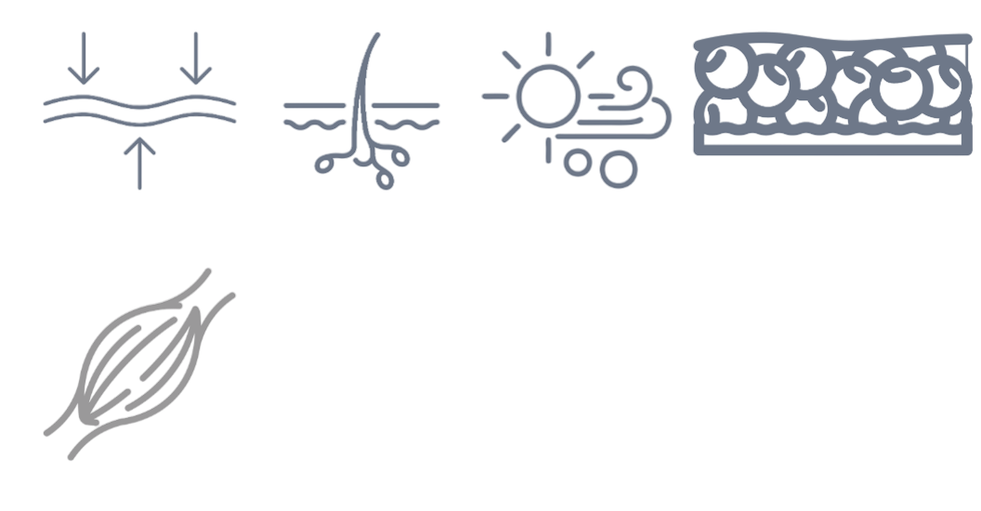





What are the particularities of the
EYE & LIPS CONTOUR AREA ?
The skin around the eyes and lips is particularly delicate and sensitive
THIN AND DELICATE SKIN
FEWER SEBACEOUS AND SWEAT GLANDS
LACK OF ADIPOSE TISSUE
PRESENCE OF MUSCLES AND REPEATED MOVEMENTS
CONSTANT EXPOSURE TO EXTERNAL ELEMENTS
Notes:
We've already covered this in a previous rdv, but it's worth recalling the particularities of the eye contour area, as well as those of the lips.
Thin and delicate skin: The skin around the eyes is much thinner than the skin on the rest of the face, with an average thickness of about 0.5 mm. This thinness makes it more vulnerable to damage and signs of aging.
Fewer sebaceous and sweat glands: The eye contour has fewer sebaceous and sweat glands compared to other parts of the face, meaning it has less ability to produce sebum to moisturize the skin and expel sweat, making it more prone to dryness.
Lack of adipose tissue: Unlike other facial areas, the eye contour has little to no subcutaneous fat tissue to protect and cushion it. This makes the skin more prone to dark circles, puffiness, and wrinkles.
Presence of muscles and repeated movements: The muscles around the eyes and lips are constantly in motion due to facial expressions such as smiling, blinking, and frowning. This repeated muscular activity can contribute to the development of wrinkles and fine lines.
Constant exposure to external elements: The eye and lips contour is often exposed to external elements such as sunlight, wind, and pollution, without the natural protection provided by eyelashes and eyebrows. This can lead to premature skin degradation and UV damage.

Slide 14
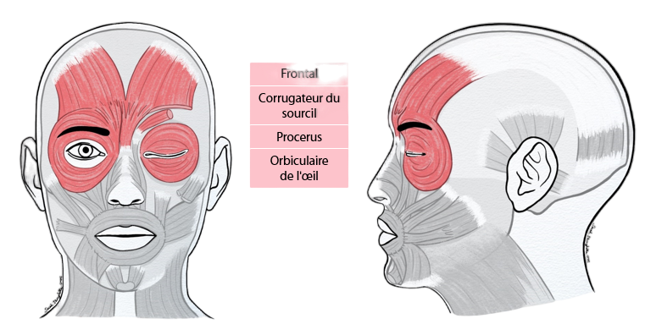
FACIAL MUSCLES– upper part
Frontal
Lifts the eyebrows and lowers the hairline
Eyebrow corrugator
For frowning the eyebrows
Eye orbicularis
Allows you to blink and close your eye
Procerus (pyramidal)
Lowers the head of the eyebrow
Notes:
here are the muscles of the upper face in detail :
FRONTAL :
Origin: anterior edge of the epicranial aponeurosis.
Termination: skin of the eyebrow and brow bone regions.
Action: raises the eyebrows and wrinkles the skin of the forehead.
Mimics: astonishment, attention
BROW CORRUGATOR (EYEBROW) :
Origin: inner part of the superciliary arch
Termination: deep side of the eyebrow skin
Action: draws the head of the eyebrow downwards
Mimics: severity, pain. Creates a longitudinal furrow between the eyebrows which may become permanent with age
ORBICULARIS OF THE EYE:
Palpebral portion: ensures the eyelid flutter reflex
Orbital portion: complete occlusion of the eyelids
PROCERUS (PYRAMIDAL):
Origin: nasal bone
Termination: skin of the inter-superciliary space
Action: lowers the interbrow space
Mimics: aggressive, determines a transverse furrow at the root of the nose

Slide 15
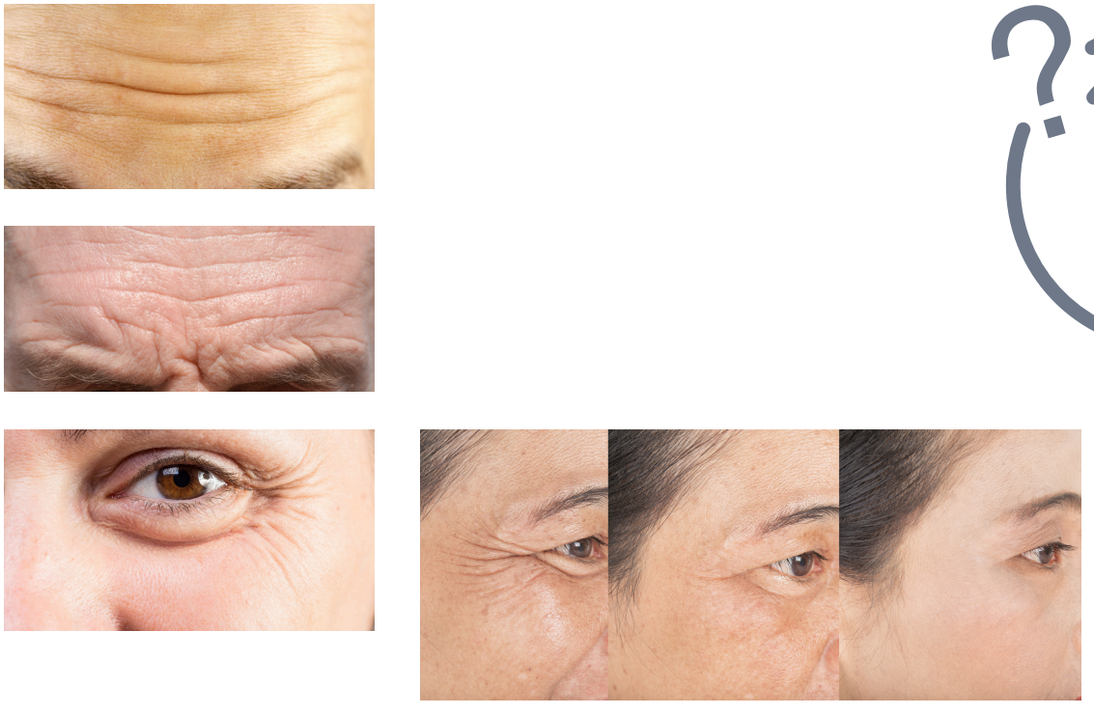
VISIBLE SIGNS
Periorbital skin ages more rapidly:
The skin around the eyes appears older (biologically) than the skin on the rest of the face by 20 years (on average).
Fundamentally different structure, making the eye area more vulnerable (thinness, lack of sebaceous glands, muscular activity).
Increased cellular senescence: reduced capacity for regeneration and DNA repair.
TAKING CARE OF THE EYE CONTOUR AREA IS THEREFORE ESSENTIAL TO SUPPORT THE SKIN'S DELICATE STRUCTURE AND ELASTICITY,
AND PREVENT THE EARLY SIGNS OF AGING.
Notes:
Because of the Presence of muscles and repeated movements the skin around the eyes tends to show the signs of aging more quickly than other areas of the body.
In one study, scientists measured the biological age of the skin around the eyes and compared it to the skin around the temples. They found that the skin under the eyes was biologically 20 years older than the skin of the rest of the face.
In fact, the structure of the skin around the eyes is fundamentally different from that of other parts of the body. In fact, several factors make the eyes more vulnerable.
Periocular skin has been shown to express significantly higher levels of cellular senescence than other areas of the face. This means that the skin around the eyes loses its ability to effectively repair and regenerate damage, with an irreversible interruption in the proliferation of skin cells. In addition, DNA repair pathways were also found to be weaker in this area, suggesting that insufficient DNA repair could be an underlying factor in the rapid signs of visible aging.
TAKING CARE OF THE EYE CONTOUR AREA IS THEREFORE ESSENTIAL TO SUPPORT THE SKIN'S DELICATE STRUCTURE AND ELASTICITY,
AND PREVENT THE EARLY SIGNS OF AGING.

Slide 16
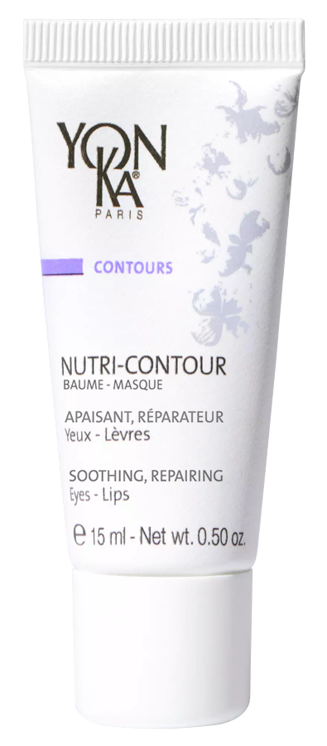
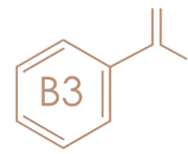

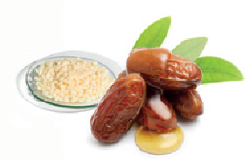
Nutri-Contour
A new, cleaner and more natural formula
98% of ingredients of natural origin including 20% of organic origin
Main ingredients :
+
+
15 ml recyclable tube
FSC case without leaflet
Organic Chamomile
Niacinamide
Trio of vegetable waxes
Notes:
Current % of ingredients of natural origin: 65%, with no organic ingredient.
We will now have 98% ION, including 20% of organic origin (chamomile, glycerin and olive oil) )= clean & more natural formula.
Main ingredients : Organic chamomile + Niacinamide
Switched to organic chamomile
Niacinamide already present but not valorized (= vit B3/PP). Niacinamide is a fashionable ingredient with soothing and repairing properties

Slide 17
Active focus: Chamomile
INCI name : Anthemis nobilis Flower Extract
Chamomile extract has a number of protective properties:
Antioxidant : Neutralises free radicals, protecting cells and membranes against oxidative damage.
Soothing : Reduces inflammation by regulating the anti-inflammatory response.
Regenerating : Accelerates healing and promotes skin repair.
Antiseptic : Inhibits the proliferation of pathogenic micro-organisms (bacteria, yeast, mould).
Composition
Chamomile extract is rich in :
Phenolic compounds (flavonoids such as apigenin and luteolin)
Organic acids (ascorbic, citric and malic acid)
Oligosaccharides and polysaccharides (fibre, fructose, glucose, sucrose, trehalose, etc.)
Amino acids and trace elements (such as calcium, magnesium, potassium)
Notes:
Scientific Name: Anthemis nobilis or Chamaemelum nobile
Roman chamomile, also known as true chamomile or common chamomile, is a slow-growing perennial plant. Its stems are branched, and its leaves are green and fuzzy, giving the plant a feathery appearance. The flowers, which bloom from late July to September, closely resemble daisies.
Cosmetic Properties
Chamomile extract has several protective activities:
Antioxidant: Neutralizes free radicals and protects cells and membranes against oxidative damage.
Chamomile is particularly rich in phenolic compounds (phenolic acids, flavonoids), which are powerful antioxidant compounds. These compounds can directly neutralize free radicals, reduce peroxide levels, repair oxidized membranes, or decrease the production of reactive species. These molecules inhibit biological oxidation, which causes cellular and tissue damage, thereby accelerating skin mechanisms.
Soothing: Modifies the inflammatory response by inhibiting COX-2 activity, thereby reducing inflammation.
One of chamomile’s anti-inflammatory activities involves inhibiting the release of prostaglandin E(2) induced by LPS and limiting cyclooxygenase (COX-2) activity. Certain sugars isolated from chamomile inhibit the main inflammation pathway. Chamomile is also capable of inhibiting VEGFR-2 activity, a receptor of VEGF. VEGF induction increases skin vascularization and the development of chronic inflammatory skin lesions. VEGFRs are constitutively expressed in normal human keratinocytes and overexpressed after UV radiation and in psoriatic epidermis.
Regenerating: Accelerates healing and promotes skin repair.
Chamomile is known for its healing and reparative properties. It promotes wound healing by reducing wound area and accelerating the healing process.
Antiseptic: Inhibits the proliferation of pathogenic microorganisms (bacteria, yeasts, fungi).
Chamomile has antiseptic properties capable of inhibiting the proliferation of multiple microorganisms: Gram-positive and Gram-negative bacteria (notably Pseudomonas aeruginosa), yeasts, and fungi. Chamomile extract helps purify the skin. Thus, chamomile extract can limit the proliferation of pathogenic microbial strains.
Traditional and Medicinal Uses
Roman chamomile was used in antiquity, for example, to embalm Ramses II with its essential oil. It is recognized for its medicinal properties and is used as an infusion to treat various ailments, such as insomnia and joint pain.
Composition
Chamomile extract is rich in phenolic compounds (flavonoids like apigenin and luteolin), organic acids (ascorbic, citric, malic acids), oligo- and polysaccharides, as well as amino acids and trace elements (calcium, magnesium, potassium, etc.).
INCI Name: Anthemis nobilis Flower Extract

Slide 18
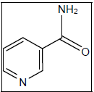
Active focus: Niacinamide
INCI name : Niacinamide
Name used: Niacinamide, vitamin PP, vitamin B3
A large number of properties, including :
Anti-inflammatory : soothes and calms skin prone to inflammation or redness, notably by reducing the synthesis of pro-inflammatory cytokines.
Antioxidant : Protect the skin from the attack of free radicals, known to induce the formation of premature signs of aging
Brightening : Diminishes the appearance of brown spots by inhibiting the transfer of melanin from melanosomes present at the base of the epidermis to neighbouring epidermal cells (keratinocytes)
Hydrating : Reduces transepidermal water loss and maintains moisture content in the skin by reinforcing the skin's barrier function, supported by an increase in the production of ceramides in the stratum corneum and an acceleration in the differentiation of keratinocytes.
Notes:
Anti-inflammatory : soothes and calms skin prone to inflammation or redness, notably by reducing the synthesis of pro-inflammatory cytokines.
Antioxidant : Protect the skin from the attack of free radicals, known to induce the formation of premature signs of aging
Brightening : Diminishes the appearance of brown spots by inhibiting the transfer of melanin from melanosomes present at the base of the epidermis to neighbouring epidermal cells (keratinocytes)
Hydrating : Reduces transepidermal water loss and maintains moisture content in the skin by reinforcing the skin's barrier function, supported by an increase in the production of ceramides in the stratum corneum and an acceleration in the differentiation of keratinocytes.

Slide 19

Active focus: Trio of vegetable waxes
RICE WAX
+
CANDELILLA WAX
+
JOJOBA WAX
PROVIDES A POWDERY TEXTURE
PROVIDES NUTRITION AND LIMITS TWL
MAKES IT EASY TO APPLY AND LEAVES SKIN FEELING SOFT
UNIQUE COMPLEX
TRIO OF VEGETABLE WAXES
CAN ABSORB UP TO 6 TIMES ITS WEIGHT IN WATER
NOURISHING AND PROTECTIVE
GIVES THE PRODUCT ITS CREAMY TEXTURE

Slide 20
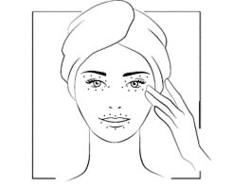
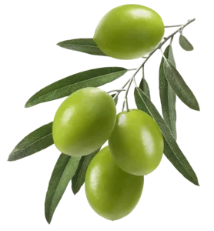

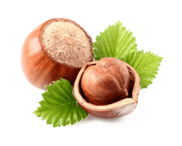


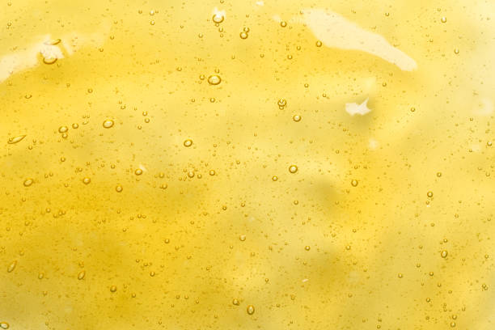
Nutri-Contour
Nutrition - prevention
Eye/lip contour (morning and evening)
Lip balm (as soon as needed)
Mask (once or twice a week for 5 minutes)
R.15 ml
ORGANIC CHAMOMILE
NIACINAMIDE
ORGANIC OLIVE SQUALENE
RICE – JOJOBA – CANDELILA
PHOSPHOLIPIDS & POLYSACCHARIDES
HAZELNUT OIL
VITAMIN E&F
REPAIRING
NOURISHING
SOOTHING
REPAIRING
HYDRATING
RESTORING
HYDRATING
PROTECTING
SOFT FINISH
EASY MAKE-UP APPLICATION
REPAIRING
NOURISHING
PROTECTING
REGENERATING
ANTI-OXIDANT
ANTI-DEHYDRATION
Notes:
NUTRI-CONTOUR
Description
A true cocoon of softness with chamomille and niacinamide, this 2-in-1 nourrishing cream - eye and lip contour - intensely nourishes the skin and protects it from drying out as well as from the first signs of ageing. Perfectly moisturized and protected from free radicals, which are ageing factors, Nutri-Contour provides the skin with the active repairing ingredients necessary for its balance. It is also an excellent SOS balm for chapped lips.
Promise
Intense nutrition and repair eye and lip care
For whom?
All skin types
All ages
"I have a tightness around my eyes
"I have chapped lips"
"I'm afraid I'll get wrinkles like my mother«
Ingredients
Organic chamomille
Niacinamide
olive squalene (cosmos certified) that helps restore the skin barrier and plays a fundamental role in skin suppleness and hydration
a trio of vegetable waxes from rice, jojoba and Candelilla (shrub) to protect fragile areas from dehydration
a patented synergy of phospholipids and polysaccharides for an ultra-smooth finish and to make makeup application easier.
phospholipids = natural lecithin
polysaccharides = pullulan
In the formula you still find the hazelnut oil and the vitamins E and F + organic vegetable glycerin
Home use
In the morning and/or evening, after cleansing and de-moistening with the appropriate Yon-Ka Lotion, apply a thin layer of Nutri-Contour cream to the lip and eye area - one pea-sized amount per area. Gently massage it into the skin. Pay particular attention to crow's feet. Use in the treatment room
Tips
Are your lips dry and chapped? Apply a thick layer of Nutri-Contour in the evening. A simple gesture to make your lips soft, naturally!
Product advantages
2 in 1: eyes & lips
Triple use: daily, SOS chapped lip balm, sleeping mask
98% ION, including 21% of organic origin (chamomile, glycerin and olive oil) )= clean & natural formula
Nourishes, moisturizes and smoothes the eye and lip area
Prevents wrinkles and fine lines
Creamy texture that penetrates quickly

Slide 21
Nutri-Contour
A new more effective* and more pleasant** formula
Visible effectiveness in as little as 7 days**
Reduction of irritation around the eyes 82%
Protected eye area from drying out 90%
Eye makeup is more even and with better hold for 7 out to 10 women
Nourished and protected lip contour from dryness 9 out to 10 women
Lips are more supple and comfortable after just 7 days 95%
Chapped lips are repaired and instantly relieved after just 7 days 77%
Texture is pleasant to use 100%
Notes:
Proven: a new more effective* and more pleasant** formula
RESULTS ON THE EYE AREA
Visible effectiveness in as little as 7 days**
Reduction of irritation around the eyes 82%
Protected eye area from drying out 90%
Eye makeup is more even 7 out of 10 women
and with better hold for
RESULTS ON LIPS AND LIP CONTOURS
Nourished and protected lip contour 9 out of 10 women
from dryness
Lips are more supple and comfortable 95%
after just 7 days
Chapped lips are repaired and instantly 77%
relieved after just 7 days
Texture is pleasant to use 100%
*Effectiveness as from 7 days
** Test conducted under dermatological and ophthalmological control. Application of NUTRI-CONTOUR around the eyes and lips every day, morning and evening for 28 days on perfectly cleansed skin. Test carried out by 22 adult female volunteers, aged between 30 and 60, with dehydrated, weakened and irritated skin.

Slide 22
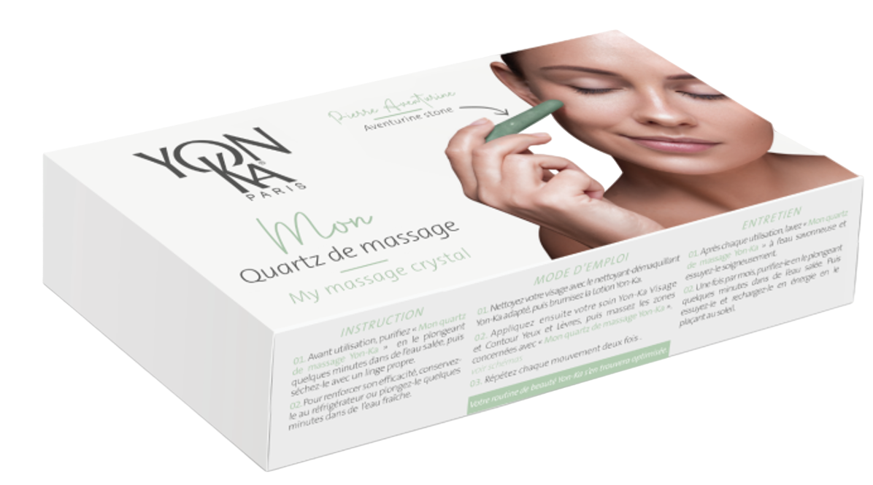
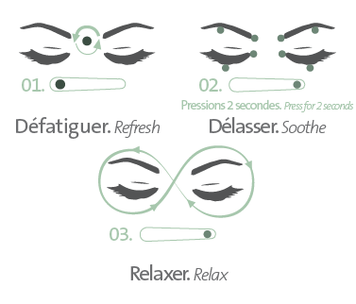
Eye techniques
TAKE TIME FOR YOURSELF
REDUCE PUFFINESS AND DARK CIRCLES
SMOOTH FINE LINES AND WRINKLES
RELAX THE MUSCLES OF THE UPPER FACE
BRING RADIANCE TO THE SKIN
Notes:
It's good and essential to apply an eye contour morning and night. Applying it consciously while taking care of yourself and your skin is even better.
using our massage quartz allows you to :
REDUCE PUFFINESS AND DARK CIRCLES
SMOOTH FINE LINES AND WRINKLES
RELAX THE MUSCLES OF THE UPPER FACE
BRING RADIANCE TO THE SKIN
INSTRUCTIONS FOR USE
Cleanse your face with the appropriate Yon-Ka cleanser-makeup remover, then spray the YON-KA LOTION.
Next, apply your eye and lip contour cream and your Yon-Ka face care product, then massage the concerned areas using “My Yon-Ka massage quartz.”
BENEFITS
A radiant complexion, reduced puffiness and dark circles, smoothed wrinkles, and fine lines.
GUIDELINES
Before use, purify “My Yon-Ka massage quartz” by soaking it in salt water for a few minutes, then dry it with a clean cloth.
To enhance its effectiveness, keep it in the refrigerator or immerse it in a bowl of cold water for a few minutes.

Slide 23

Notes:
very quick and easy to make, here's the tutorial to share and distribute

Slide 24
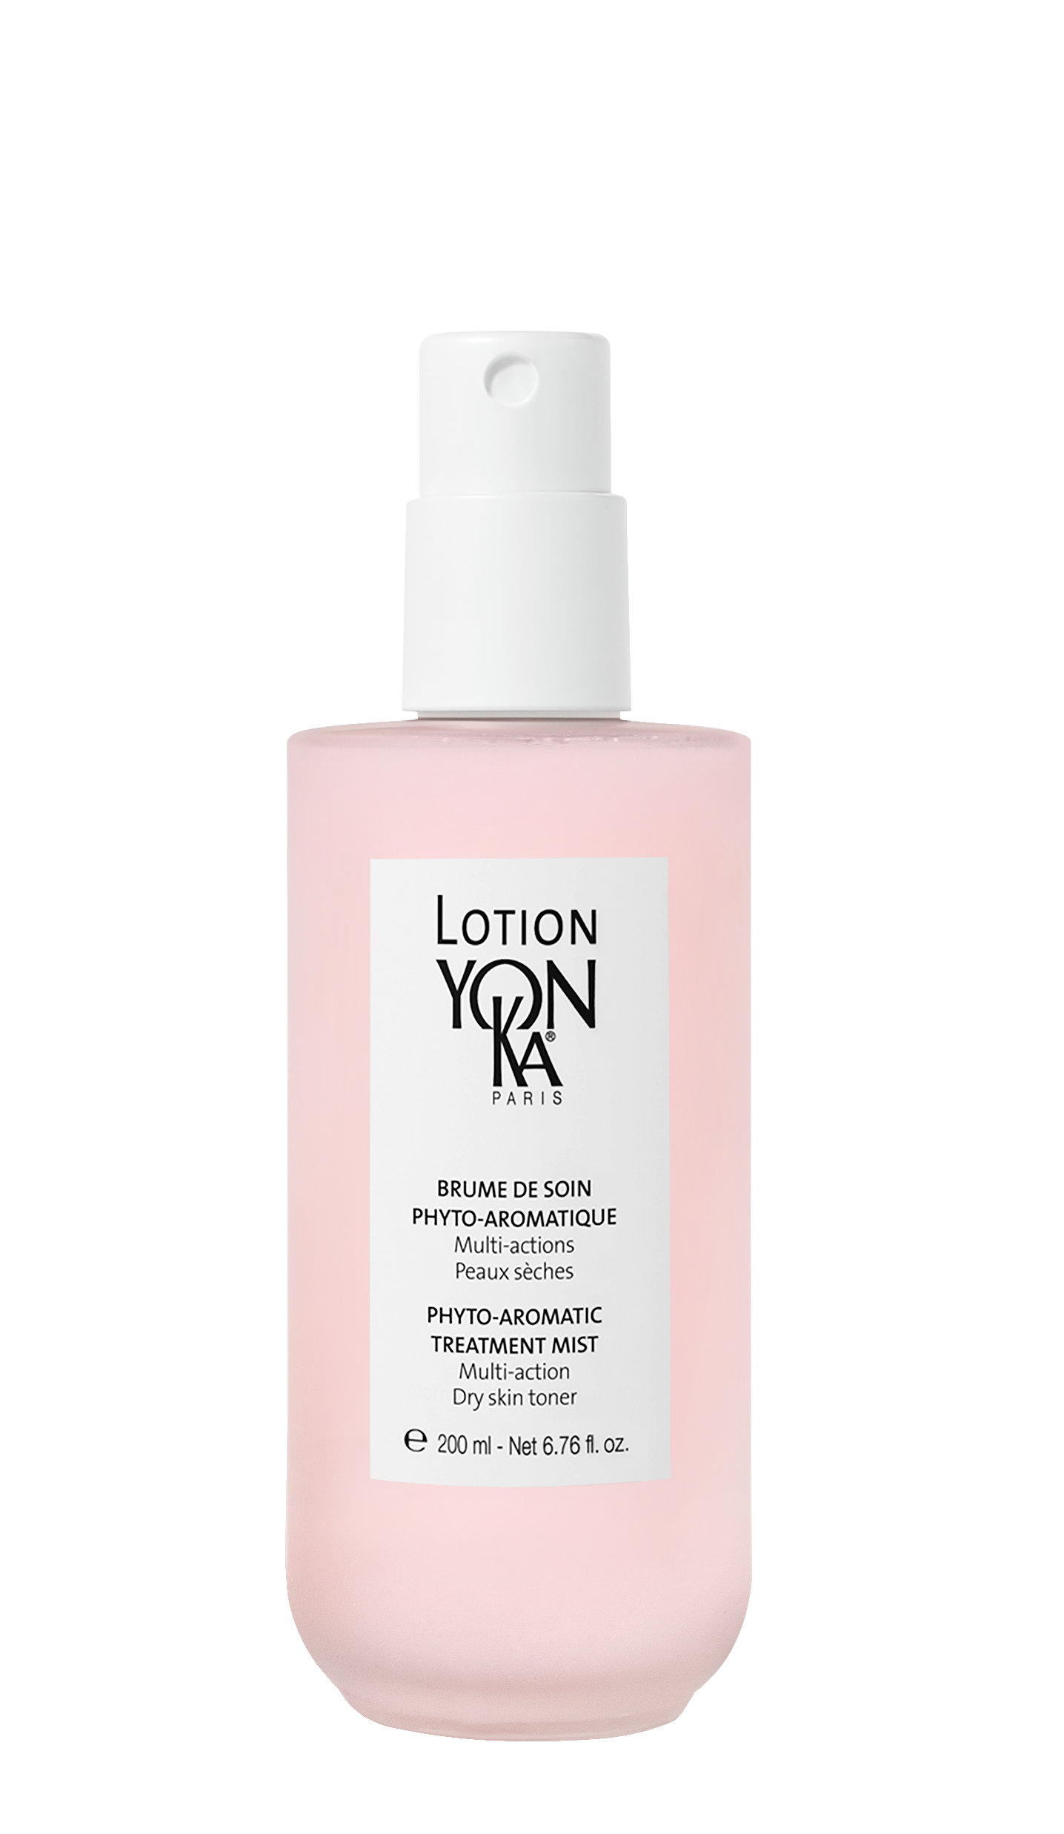
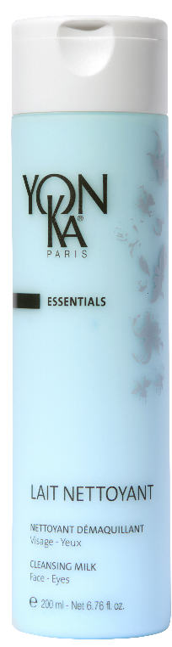
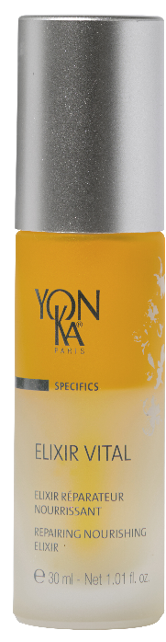
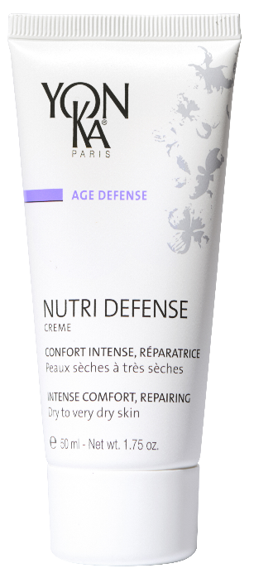
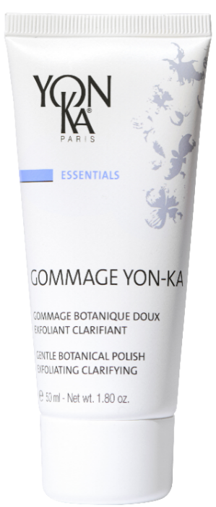
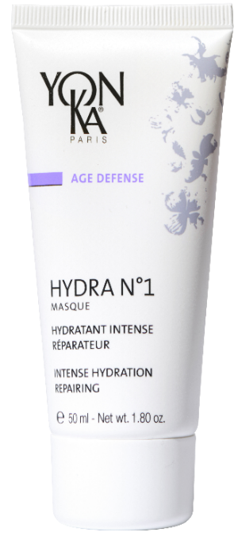
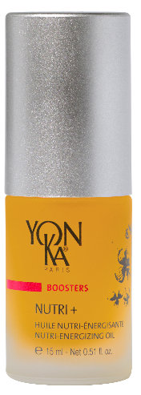
Nutrition routine
DAILY
WEEKLY
CURE
Soin adapté : NUTRILESSENCE
Notes:
Nutri Contour can be easily integrated into any routine for people with dry and/or sensitive eye contours and dry lips.Here's an example of a routine for very dry skin, ideal for use in winter

Slide 25

‘seen in l'Officiel
DARK LIPS
« First, I apply Yon-Ka Nutri-Contour to the lips, which helps the product last longer. Then, after applying the lipstick, I cover it with a tissue, so I'm 100% sure it's going to last. »
makeup artist Aurélie Payen
Notes:
To round off this Yon-Ka rendez-vous, here's a press release from L'officiel magazine revealing one of the make-up artist's secrets from the filming of Emily in Paris. He uses Nutri Contour before lipstick for maximum comfort and hold.

