Slide 2
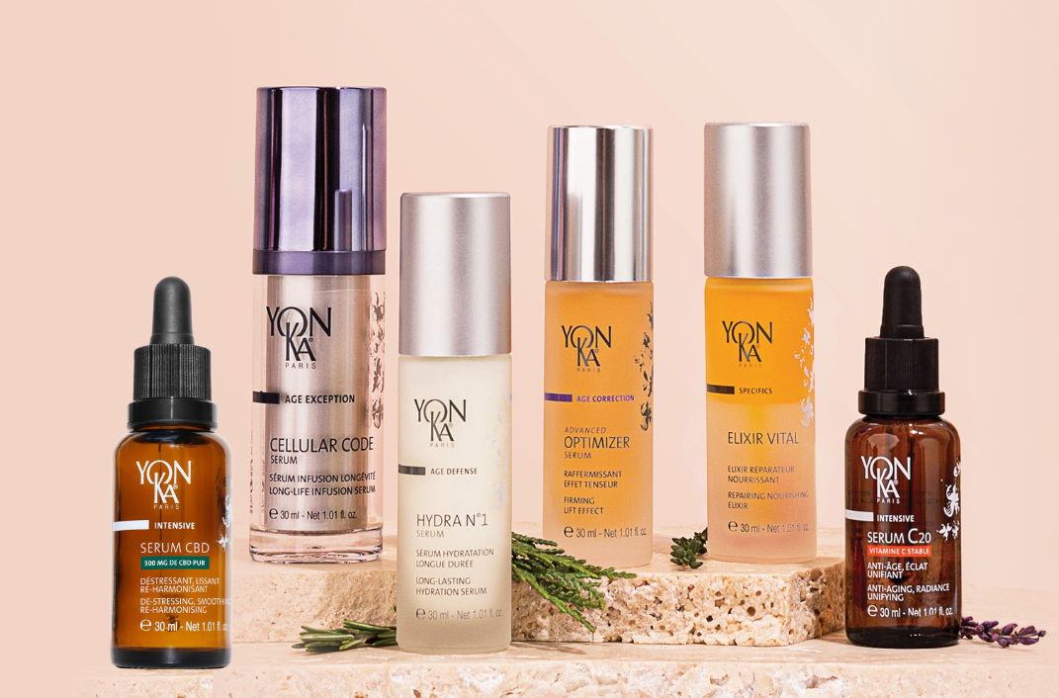
Why use a serum under a cream?
Notes:
PLAN :
What is a serum?
Benefits of combining serum and cream
Yon-Ka serum offer reminder
Serum vs booster
Our trainers' favourite combination of serum and cream.

Slide 3

What is a Serum?
GALENIQUE
Light, fluid texture that absorbs quickly.
Formulation rich in concentrated active ingredients.
USES
Apply after cleansing and before cream.
Suitable for a morning and evening routine, depending on the skin's specific needs.
BENEFITS
Fast absorption thanks to its fine texture.
Ability to reach the deep layers of the epidermis.
Adaptability: each serum is formulated for targeted problems.
PROFITS
Reinforces the skin's natural functions.
Optimising the results of complementary product.
Improving the appearance of the skin according to its objective.
Notes:
What is a cosmetic serum?
A cosmetic serum is a skincare product designed to provide a high concentration of active ingredients targeting specific needs, such as hydration, firmness, radiance or reducing the signs of ageing. It is distinguished by :
Galenics :
Light, fluid texture (often watery or oily) that penetrates quickly.
Formulation rich in concentrated active ingredients.
Uses:
Apply to clean skin, generally after cleansing and before cream.
Suitable for a morning and evening routine, depending on the skin's specific needs.
Advantages:
Fast absorption thanks to its fine texture.
Ability to reach the deep layers of the epidermis.
Adaptability: each serum is formulated to target specific issues (anti-ageing, hydration, radiance, etc.).
Benefits :
Reinforces the skin's natural functions.
Optimising the results of complementary treatments (such as cream).
Visible improvement in the appearance and health of the skin thanks to concentrated, high-performance active ingredients.

Slide 4

In your opinion, what are the advantages of applying a serum under a cream?

Slide 5


Why use a serum under a cream?
  The serum has a deep action : thanks to its fine galenic structure, it penetrates quickly to diffuse its active ingredients into the deeper layers of the epidermis.
  The cream, which is often thicker, forms a protective film on the surface, sealing in moisture and protecting the skin from external aggressors.
COMPLEMENTARY TEXTURES AND FUNCTIONS

Slide 6

Why use a serum under a cream?
  The serum, applied directly to clean skin, prepares the ground and deeply nourishes the skin.
  The cream then completes the action by extending the benefits and targeting secondary needs (nutrition, protection, anti-pollution).
OPTIMISING ASSET EFFICIENCY

Slide 7

Why use a serum under a cream?
  The concentrated serums act as an intensive treatment, while the cream acts as an overall protective product.
  For example, a moisturising serum with hyaluronic acid combined with a moisturising cream will strengthen the skin barrier while preventing dehydration.
MAXIMUM SYNERGY OF INGREDIENTS

Slide 8

Why use a serum under a cream?
  For example :
  In the morning: an antioxidant serum under a protective cream prepares the skin to face external aggression.
  In the evening: a regenerating serum applied before a nourishing or repairing cream optimises night-time cell regeneration.
A RITUAL ADAPTED TO THE SKIN'S NATURAL RHYTHMS

Slide 9
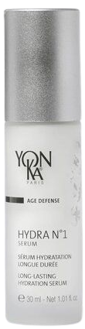
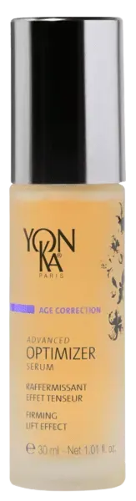
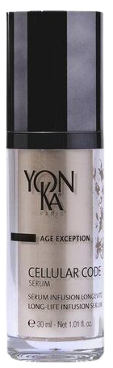
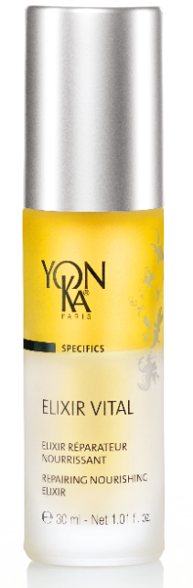
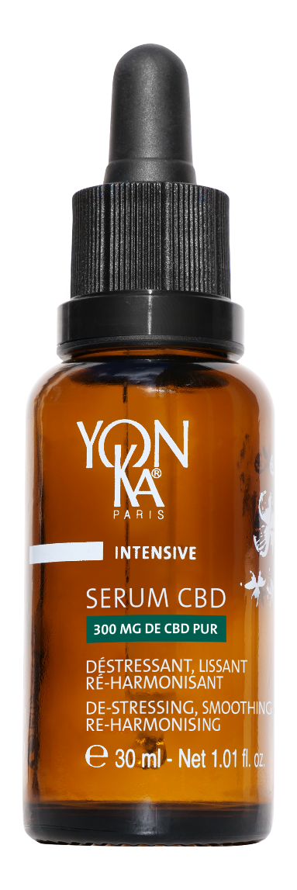
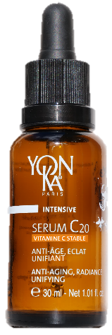


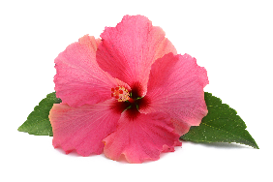

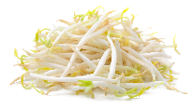
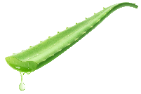
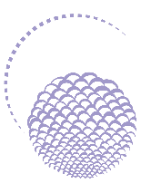

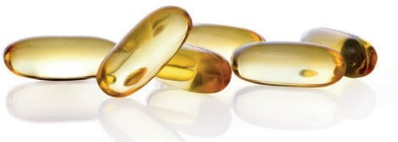
YON-KA Serums
Serums for in-depth action and optimised results
NEW
GLOBAL ANTI-AGING
PREVENTION &
ANTI-AGEING REPAIR
FIRMING
GLOBAL ANTI-AGEING
PREVENTION &
REPAIR
ANTI-AGING
SMOOTHING
DE-STRESSING
RE-HARMONISING
HYDRATING
RAFFERMISSANT
ANTI-AGING - RADIANCE
UNIFYING
HYDRATING
ANTI-AGEING - RADIANCE
EVEN SKIN TONE
DE-STRESSING, SMOOTHING
RE-HARMONISING
hyaluronic
acid
Hibiscus
peptides
Cell-Energy complex
Beech bud
and soy
peptides soya
Pomegranate
& Turmeric Native Cells
CBD
Native sacred lotus cells
Collagen
Vitamin C
stable
Niacinamide
Aloe vera
Reishi
HYDRA N°1 SERUM
ADVANCED
OPTIMIZER SERUM
CELLULAR CODE
SERUM
ELIXIR VITAL
SERUM C20
SERUM CBD
Notes:
HYDRA N1 SERUM
Description
This moisturising serum with hyaluronic acid is the SOS treatment for very dehydrated skin, providing deep, long-lasting hydration. Enriched with restructuring and anti-oxidant ingredients such as vitamins A, C and E, Hydra N° 1 Sérum intensely nourishes and regenerates the skin, leaving it soft, supple and plump. An ally for thirsty, tired and lacklustre skin. Its gel-cream texture is quickly absorbed, leaving the skin with a light, floral rose and jasmine fragrance that's 100% natural.
Promise
Genuine moisture booster with an intense, long-lasting effect
Who is it for?
Dehydrated skin
All ages
"My skin is uncomfortable and tight".
"My skin is flaky
"My foundation plaque
"I've just come back from the sun and my skin is dull and uncomfortable".
Ingredients
Low molecular weight hyaluronic acid: moisturiser
NMF (serine, PCA sodium): moisturiser
Imperata cylindrica: long-lasting moisturiser
Organic aloe vera: moisturising
ADVANCED OPTIMIZER SERUM
Description
Advanced Optimizer Sérum, a redensifying treatment with a firming effect, works in synergy with the cream, reinforcing its firming action and multiplying its anti-ageing action. Its fluid texture is instantly absorbed. Rich in hibiscus peptides that stimulate collagen production, it visibly firms the skin on the face and neck. The features appear redefined, the skin more toned and smoother.
Promise
Firming serum, tensing effect
Who is it for?
Sagging skin
"I have sagging in the oval of my face".
"I've got slackness in my arms".
"My bust is losing its firmness".
"I have a crumpled neckline".
Ingredients
Hibiscus peptides: firming, tensing effect
Collagen: moisturising, smoothing
Horsetail: firming
CELLULAR CODE SERUM
Description
A veritable rejuvenating serum, Cellular Code helps reactivate the skin's youth code thanks to the "Cell-Energy" complex, a combination of super-powerful natural active ingredients that combat cellular ageing. Day after day, this intelligent serum energises and regenerates the epidermis. Wrinkles and signs of fatigue fade, and the skin becomes smoother, firmer and more radiant. We love its fine, silky texture, its refined fragrance, its airless pump bottle and the fact that it can be used morning and night under your usual cream to fight the passage of time.
Promise
Intelligent serum that resets skin's youthful appearance
Who is it for?
For mature skin
"My skin shows wrinkles, spots and loss of firmness".
"With the hormonal upheaval, I'm looking for a global routine that treats all the signs of ageing".
Ingredients
Cell-Energy Complex
ELIXIR VITAL
Description
This aromatic plant-based double serum, with its biomimetic formula modelled on the hydrolipidic film, is a genuine anti-ageing and repairing treatment for all skin types. It respects and consolidates the skin's barrier, protecting it from external aggression and the effects of the passing of time. This face serum is the multi-regenerating SOS treatment for skin in distress. It is highly recommended after fatigue, too much sun, emotional stress, etc.
Promise
Double phyto-aromatic serum Prevention & Repair Anti-ageing
Who is it for?
All skin types
Tired, stressed and damaged skin
"I've just had a baby, I'm very tired and I don't recognise my skin any more".
"I'm 45 and I've just spent a month in Martinique. My skin has been damaged by the sun and the heat".
Ingredients
Peptides [beech + soya]: restructuring, moisturising
Organic soya and sunflower oil and corn oil (GMO-free): nourishing, repairing
Niacinamide and vitamin B5: soothing, revitalising
SERUM C20
Turmeric
Epidermal level +16% keratinocytes.
Dermal level +17% synthesis of collagen and elastin fibres.
Grenada
Acts on cell oxygenation*: +22% CO2 release in extreme conditions
Acts to regulate melanogenesis *: -15% melanin synthesis
Native pomegranate and turmeric plant cells.
These cells are obtained by cell culture, a patented biotechnology made in France that respects the environment and biodiversity. This technology does not require cultivation in the field, and only a micro-sampling of the plant is needed to obtain these native plant cells.
Natural resources are preserved and these native active plant cells are obtained without traumatizing or destroying the plant.
Native plant cells have a high molecular content (essential amino acids, vitamins and minerals, etc.) which means they complement the action of the other active ingredients in serum C20 and C25.
Each⁽³⁾ vial of serum contains more than 1.5 million cells, i.e. around 12,500 native cells per application.
Turmeric :
With its beautiful orange colour and strong flavour, turmeric has exceptional properties. It has been used since the dawn of time as a condiment, tincture or medicine. Known as the "spice of long life", turmeric is widely used in traditional Ayurvedic and Chinese medicine for its anti-inflammatory and antioxidant properties, particularly in the treatment of digestive and intestinal disorders, but also to protect the liver and promote healing.
Turmeric appears to hold great promise in the treatment of a number of diseases, and research into its anti-cancer potential is currently underway.
There are many varieties of Turmeric (around 80), the most widely used being Curcuma Longa.
Grenada :
Originally from Asia, pomegranates are now grown in Europe, mainly in Tunisia, Morocco and Israel.
Mentioned in holy manuscripts, the pomegranate has been a symbol of life and fertility, but also of power, since time immemorial. Extremely rich in polyphenols, powerful antioxidants, over 250 scientific studies show that pomegranates could have a positive effect on cardiovascular disease, cancer and arthritis.
A real superfood, pomegranate, here in its native plant cell form, helps boost skin radiance and even out skin tone:
Pomegranate's native plant cells act on cell oxygenation:
Action on cellular respiration⁽⁴⁾ + 22% in extreme conditions . ⁽⁵⁾
Native pomegranate plant cells regulate melanogenesis :⁽⁴⁾
By regulating tyrosinase (18% inhibition), native plant cells reduce melanin synthesis by 15%.
Through these actions, native pomegranate plant cells help the skin to better protect itself from free radical attacks, to be more luminous and more even-toned. They reinforce the radiance and anti-dark spot action of vitamin C.
Organic apricot oil
Obtained from organic apricots, the oil extracted from the kernel contains mainly Omega 9 and Omega 6, renowned for their nourishing, softening and soothing properties.
This organic apricot oil is also rich in vitamins A and E (photo-protective, anti-oxidant) and phytosterols (restoring the skin's barrier function, UV protection, anti-ageing).
With its ability to 'illuminate the complexion' (healthy glow effect), it is particularly recommended in toning skin care formulas for dull, devitalised and dehydrated skin.
Its rapid penetration, without leaving an oily feel, is suitable for all skin types, including oily and combination skin.
Sweet orange is renowned for its toning action on the skin.
SERUM CBD
Description :
A night-time oleo-serum with a self-adapting formula inspired by neurocosmetics (product/skin/nervous system interactions) to de-stress, smooth and re-harmonise all types of skin, while acting on emotions to significantly reduce stress.
Promise:
Smoothing, reharmonising action.
Who is it for?
All skin types
Dry skin: comfort and hydration
Combination to oily skin: regulates sebum
Sensitive skin: soothes feelings of discomfort and calms redness
Ingredients:
CBD = CannaBiDiol.
300mg pure CBD: (for 30 mg = 1% pure CBD in the solvent-free extraction process)
100% natural, THC-free
Made from hemp grown sustainably in Colombia.
Anti-inflammatory, anti-oxidant, anti-ageing and regulating.
30% organic vegetable oils: Hemp + Sacha Inchi
Rich in omega-3/6 and vitamin E
Moisturises, regulates and soothes for optimum comfort
Native sacred lotus plant cells
Anti-stress (stimulates the synthesis of melatonin, the molecule responsible for sleep and relaxation) 750,000 native cells in 30ml)
10% extracts of adaptogenic Reishi mushroom (mushroom of immortality)
Reinforces resistance to stress = helps the skin adapt to stress and fatigue.
Relaxing and soothing essential oils
Lavender + chamomile + neroli
Quintessence: maximises the power of the formula

Slide 10
YON-KA Serums
Serum name | Main active ingredients | Benefits | Targets | Use | The « + »
Hydra N°1 | Hyaluronic acid, imperata cylindrica | Intense, long-lasting hydration, comfort | Dry and/or dehydrated skin | Morning and/or evening under cream | Light, penetrating texture, ideal for all seasons.
Advanced Optimizer | Collagen, hibiscus peptide, hyaluronic acid | Lifting, firming and firmness-boosting effect | Sagging skin | Morning and/or evening under cream | Combine with Advanced Optimizer Cream for an optimised firming protocol.
Elixir Vital | Organic beech bud peptides, soy peptides organic oils (soybean, sunflower, corn), niacinamide | Revitalising, nourishing, repairing, soothing, moisturising | Tired, stressed or damaged skin | Morning and/or evening, alone or under cream | Ideal as a seasonal treatment or after stress or post-treatment stress.
Cellular Code | Cell-energy complex (lipo-amino acid, baicalin, D-ribose, garden nasturtium) | Global anti-aging, cell regeneration, radiance, wrinkle smoothing, firmness | Mature skin | Morning and/or evening before cream | Premium airless packaging, vegan, refined sensoriality.
Serum C20 | Stable vitamin C (20%), native turmeric and pomegranate cells, organic apricot oil | Radiance, even skin tone, anti-aging, anti dark spot | All skin types, including sensitive skin | Morning and/or evening, alone or under cream | Ideal as a course of treatment, high tolerance, proven efficacy in as little as 5 days.
CBD Serum | Pure CBD, native sacred lotus cells, adaptogenic Reishi, organic oils (hemp, Inca Inchi) | De-stressing, smoothing, re-harmonising | All types of stressed skin | In the evening, alone or under cream | Relaxing effect enhanced by massage with Yon-Ka quartz.

Slide 11
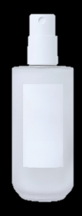
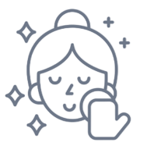

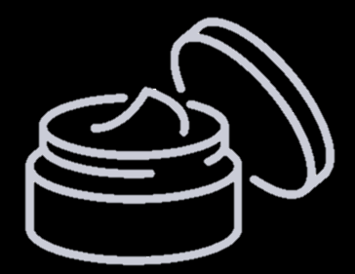
Cosmetic routine
REMOVE MAKE-UP / CLEANSE
LOTION
SERUM
CREAM + SUNSCREEN
To ensure the serum absorption capacity
To optimise penetration
Gently massage the product into your skin using upward movements over each part of the face and neck until it is completely absorbed
Protect the skin from external aggression and limit skin dehydration and lock the key ingredients of the serum into the skin
Notes:
Step 1: Remove make-up and cleanse your skin.
To ensure that the serum's absorption capacity is not impaired, it should always be applied to a clean base. In the morning and evening, wash your with an appropriate gentle cleanser to help remove traces of make-up and impurities, thus removing any barriers that might prevent the formula from penetrating as deeply as necessary into the skin and thus avoiding interfering with the product's effectiveness.
Step 2: Apply the lotion
To optimise penetration, you can lightly moisten the face with a lotion.
Step 3: Apply the serum.
You don't need to apply a large amount of serum to give your skin all the benefits possible.
Using your fingertips, gently massage the product into your skin using gentle upward movements over each part of your face and neck until it is completely absorbed. Finish by tapping the skin with your fingertips.
Step 4: Moisturise your skin.
Moisturisers help prevent moisture loss by creating a protective barrier on the skin's surface, but they also help seal the ingredients of serums into the skin. Once the serum has been absorbed, apply a dab of moisturiser to the face and neck to lock the key ingredients into the skin.
The cream has a much thicker texture than the serum. Its primary role is to protect the skin from external aggression and limit skin dehydration by reinforcing the hydrolipidic film.

Slide 12

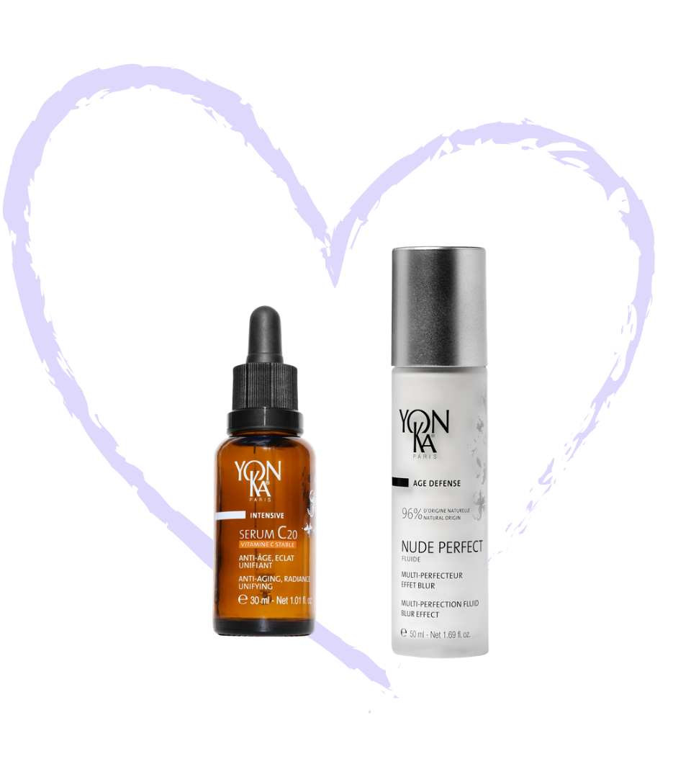
Testimonials from the YON-KA training team
"
Apolline
MY FAVOURITE DUO: SERUM C20 + NUDE PERFECT
I love taking the time to massage SERUM C20 with the massage quartz. The sweet orange scent is a big plus. The NUDE PERFECT allows me to matify my oleo serum + get optimum protection against external aggressors.
"

Slide 13
Testimonials from the YON-KA training team
"
Marie
MY EVENING DUO: CBD SERUM + PHYTO 52
My skin needs comfort in the evening, so SERUM CBD and its oleo-serum texture is perfect for moisturising and providing the comfort it needs.
It also soothes inflammation and makes my skin smoother.
The sensorial quality of PHYTO 52 cream relaxes me in the evening before going to bed, and works on my milium spots.
"

Slide 14

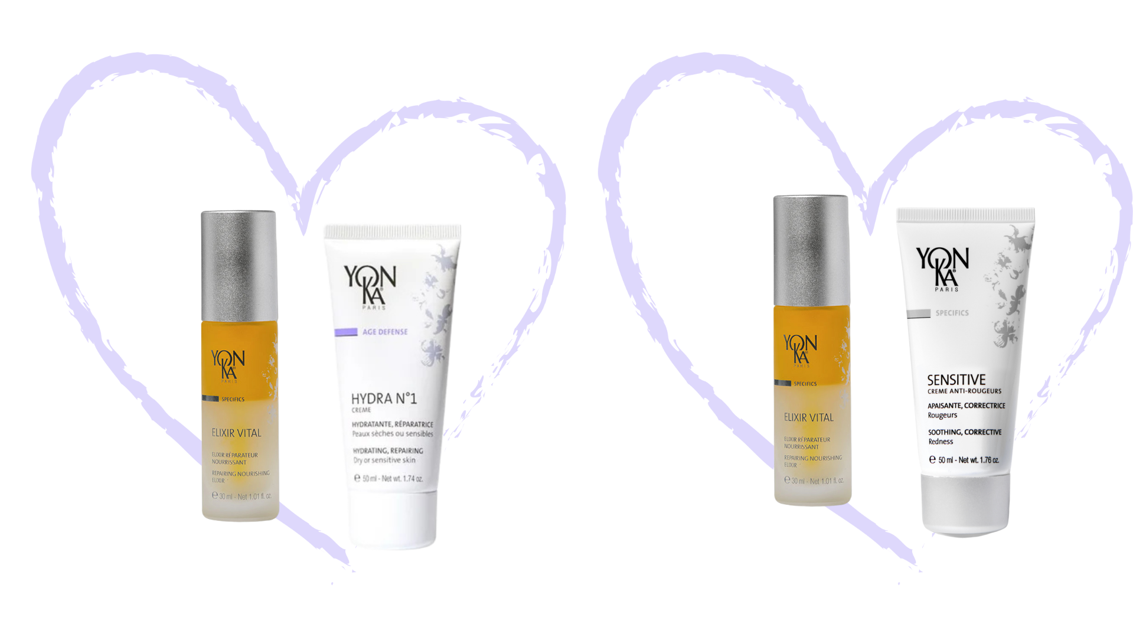
Testimonials from the YON-KA training team
"
Noémie
MY COMFORT DUO: ELIXIR VITAL + CREME HYDRA N°1
With the cold weather gradually arriving, ELIXIR VITAL is my ideal ally against possible imbalances due to climate change, preventing the chain reaction of dehydration, dryness, sensitivity and then pimples.
When my skin feels better, I switch to HYDRA N°1 SERUM in the morning and CBD SERUM in the evening, always combined with HYDRA N°1 CREAM. This routine keeps my skin hydrated and prevents imbalances linked to stress.
Thanks to this routine, I'm able to keep my skin balanced all year round.
"

Slide 15

Testimonials from the YON-KA training team
"
Clémence
MY REBALANCING DUO: ELIXIR VITAL + SENSITIVE ANTI-REDNESS CREAM
I apply the serum on its own at night, and under the cream in the morning. Contrary to my fears, VITAL ELIXIR is not at all too oily: the balance between the aqueous and oily phases is very pleasant. It feels comfortable immediately after application, and the texture is not too rich.
To date, my skin is less unbalanced: it's clear, comfortable, and my redness and skin sensitivity have improved significantly. In the morning, I apply SENSITIVE ANTI-REDRESS cream alone or as a base before my foundation. This visibly reduces redness and evens out my complexion for a harmonious base.
"

Slide 16
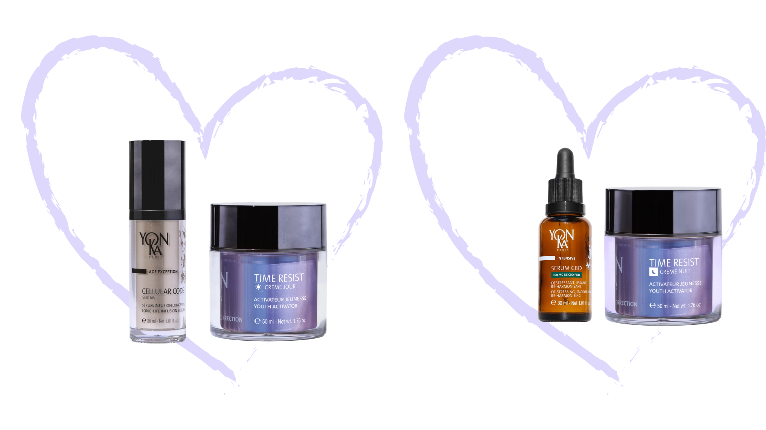
Testimonials from the YON-KA training team
"
MY DUO POST PREGNANCY: morning CELLULAR CODE SERUM + TIME RESIST DAY
evening CBD SERUM + TIME RESIST NIGHT
Since my pregnancy, the skin on my face and body has changed enormously.
Since then, it has been gradually rebalancing. My skin is uncomfortable, slightly sensitive and shiny at the end of the day on the T-zone. My complexion is dull and more tired and my wrinkles are more pronounced.
My Tips: In the evening, when I remove my make-up, I take the time to analyse the fascia of my face and massage the areas concerned with the CBD SERUM. If necessary, I add TIME RESIST NUIT cream on top.
Since then, my skin has been moisturised, nourished and less sensitive.
Laurence
"

Slide 17
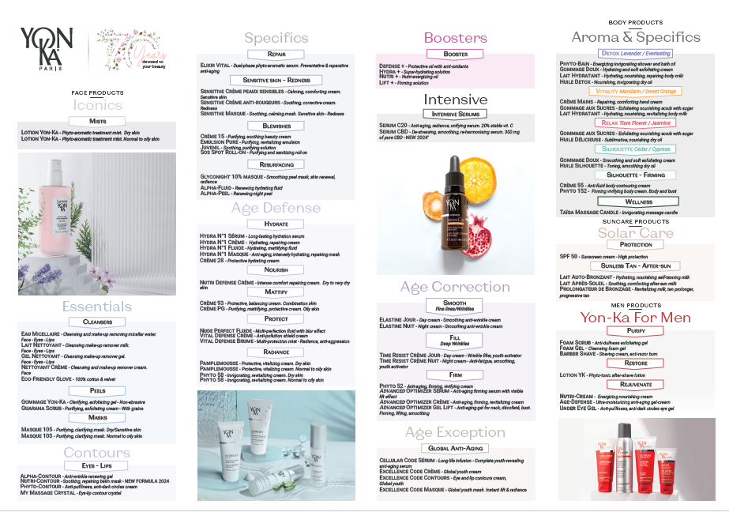
Full of possibilities
6 SERUMS x 23 CREAMS = 138 POSSIBLE COMBINATIONS

Slide 18
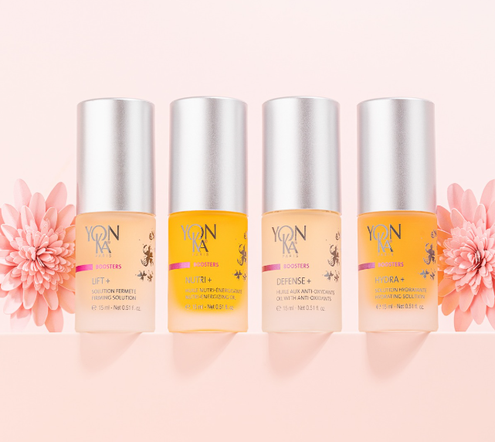
Serums VS Boosters
VS
Notes:
Yon-Ka serums and Yon-Ka boosters differ in their role, concentration of active ingredients and method of use, although both ranges aim to enhance daily skincare to meet the skin's specific needs.

Slide 19
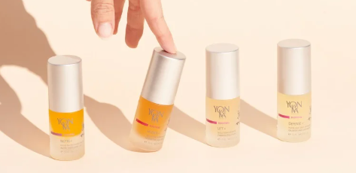
Serums VS Boosters
What are the main differences between serums and boosters?
USE
FUNCTION
CONCENTRATION AND TARGETS
Serums are often used directly on the skin under a cream, while boosters are added to a cream to enhance its benefits.
Serums act as specific intensive treatments, while boosters offer the flexibility to enrich a skincare product from time to time according to the skin's needs.
Boosters are particularly concentrated for a single objective, while serums are multi-benefit and can target complex issues.
Notes:
Key differences
Use: Serums are often used directly on the skin under a cream, while boosters are added to a cream to enhance its benefits.
Function: Serums act as specific intensive treatments, while boosters offer the flexibility to enrich a skincare product from time to time according to the skin's needs.
Concentration and targets: boosters are particularly concentrated for a single objective, while serums are multi-benefit and can target complex issues.
In short, integrating the two into a routine allows for a complementary approach: serums for a deep, long-lasting treatment, boosters for an adjusted, immediate response depending on the skin's external and internal conditions.

Slide 20
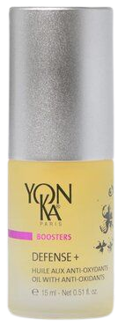
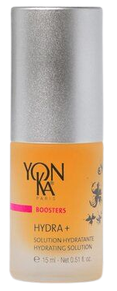
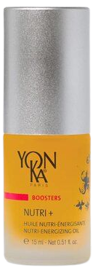
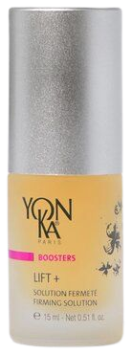

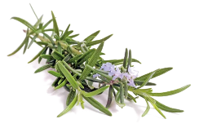
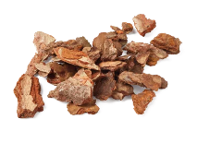
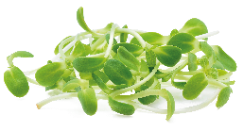
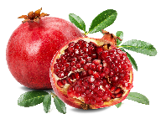
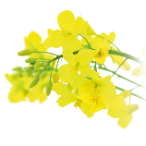


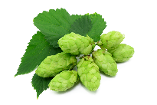
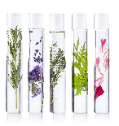
BOOSTERS
Boosters to meet the needs of the moment and personalise your cream
PROTECTING
HYDRATING
NOURISHING
FIRMING
Pine bark polyphenols
PCA
Cereal germ oil
Rosemary
Pomegranate oil
Vegetable glycerin
Vitamins
Hop
DEFENCE +
HYDRA +
NUTRI +
LIFT +
Notes:
DEFENSE+
Description
Defense + is the ultimate anti-oxidant booster! This gentle, nourishing oil with pine bark polyphenols and pomegranate oil protects the skin against environmental aggressors (sun, pollution, cold...) and helps fight the signs of ageing. We love its 100% natural composition, its soothing active ingredients and its subtle aroma, which combines sweet orange and Yon-Ka Quintessence. Added to your everyday cream, this booster leaves your skin better protected, stronger and more radiant.
Promise
Protective oil rich in antioxidants
Who is it for?
All skin types
All ages
"I want to strengthen my skin's defences against oxidative stress".
"I have a dull, blotchy complexion. I want to protect my skin and restore its radiance.
"I want to protect my skin from environmental aggressors that accelerate skin ageing".
Ingredients
Organic pine bark polyphenols and pomegranate oil: anti-oxidant, anti-ageing prevention
Pomegranate oil: antioxidant
Home use
Morning and/or evening, remove make-up and cleanse your face and mist with the appropriate Yon-Ka Lotion. Place the appropriate cream in the palm of your hand and add 1 to 2 pumps of your Défense+ booster. Mix the 2 products and apply this protective cocktail to your face and neck.
Tips
Has a hard day in a "hostile" environment (smoking, pollution, stress) taken its toll on your complexion? Apply Défense + on its own at bedtime and wake up to a radiant complexion.
Product benefits
Contains 99.9% ingredients of natural origin
+75% luminous complexion
Protects the skin from pollution
The complexion is luminous and relaxed
Suitable for all skin types
HYDRA+
Description
An excellent booster for all types of dehydrated skin, Hydra + immediately reduces tightness and roughness! Ultra-moisturising and rich in vitamins, a few drops added to your day or night cream are all you need to personalise your skin care to suit your needs. Very quickly, the skin becomes supple, rebalanced and radiant. We love its 100% natural blackcurrant scent and the speed with which the skin becomes softer, more comfortable and more radiant.
Promise
Ultra-moisturising solution
Who is it for?
Dehydrated and sensitive skin
All ages
"After the summer, I feel like my cream is no longer enough for me".
"I have combination skin but my skin pulls".
Ingredients
PCA: moisturiser (pyrrolidone carboxylic acid)
Vegetable glycerine: moisturising
Blackcurrant and raspberry: soothing
Home use
Morning and/or evening, after cleansing and removing make-up and misting with the appropriate Yon-Ka Lotion, improve your skin's hydration by customising your treatment with the Hydra + booster. Depending on your skin's needs, place a small amount of your usual cream in the palm of your hand. Add 1 to 2 pumps of Hydra +. Mix the 2 products together and apply to the face and neck.
Use in the treatment room
- Extraction of blackheads
- End of treatment mixed with Yon-Ka adapted cream
Tips
Hydra + combined with your usual cream will also help set your make-up.
Product benefits
Contains 94% ingredients of natural origin
+30% hydration
Skin is supple, comforted and luminous
Boosts and customises your day and night care
NUTRI+
Description
Nutri + is the best booster for dry skin and all skin that's down on form! A real SOS treatment, this energising oil, bursting with vitamins E and F, nourishes and revitalises skin that has been badly damaged by the stresses of everyday life (climate, fatigue, pollution...). A few drops added to your day or night cream are all you need to personalise your skincare routine according to your needs, to give your skin comfort, tone and radiance. We love its regenerating action and the invigorating aromatic scent of the 5 essential oils in Quintessence Yon-Ka.
Promise
Nutri-energising oil
Who is it for?
All skin types, especially for dry and sensitised skin
All ages
"Winter is approaching and my skin feels tight, uncomfortable and rough to the touch".
"At the change of seasons, my skin seems tired, I'd like to give it a little more energy".
Ingredients
Cereal germ oil: nourishing
Vitamins E and F (from linseed, soya and sunflower oil): anti-dehydrating.
Home use
Morning and/or evening, after removing make-up/cleansing and misting with the appropriate Yon-Ka Lotion, mix 1 to 2 pumps of Nutri + in the palm of your hand with your usual treatment cream. Gently massage this nourishing cocktail into the face and neck. Nutri + helps to nourish and regenerate the skin, and is suitable for both dry and oily skin. It helps balance the skin's hydrolipidic film and provides a truly tailor-made skin care product. It reduces the drying effects of the sun, cold, wind and certain treatments that may have damaged or stripped the skin.
Use in the treatment room
- Massage
- End of treatment mixed with Yon-Ka adapted cream
Tips
It can be used alone in the evening
Product benefits
Contains 99.8% ingredients of natural origin
+89% nourished skin
Intensely nourishes, boosts day and night care
Skin is more supple, toned and radiant
Highly vitaminised fine oil
LIFT+
Description
Lift + is the ultimate firming booster! Fluid and quickly absorbed, this booster with 20 plant extracts, including rosemary, tones the face and neck and allows you to create a truly tailor-made skin care programme by combining it with your day or night cream. It firms skin lacking in tone, whether dry or oily. Skin is visibly firmer and smoother, and the contours of the face and neck are redefined.
Promise
Firming solution
Who is it for?
Skin lacking tone
Mature skin
People who have lost a lot of weight
All ages
"I have pigmentation spots but I also lack firmness".
"My skin is fragile but I also want to improve the shape of my face".
Ingredients
Rosemary: firming
Organic hop: firming
Sage: firming
Home use
Morning and/or evening, after cleansing your face and spraying on the appropriate Yon-Ka Lotion, mix 1 to 2 pumps of Lift + in the palm of your hand with your usual treatment cream. Apply this Firming cocktail to the face and neck using light, toning strokes.
Tips
For an intensive anti-slackening treatment, try the Lift + shock duo and Phyto 52 night cream. Every evening for a month, apply a thin layer of this mixture to the face and neck. An ideal concentration of rosemary to plump up the skin and redefine the contours of the face!
Product benefits
Contains 92% ingredients of natural origin
+90% firmer skin
Firms, regenerates and tones
Skin is smoothed and moisturised
Effective from the very first wrinkles

Slide 21
BOOSTERS
99%
99%

Slide 22
YON-KA Boosters
Booster name | Main active ingredients | Benefits | Targets | The « + »
Hydra + | PCA, vegetable glycerine, blackcurrant, horse chestnut, raspberry | Ultra-moisturising, soothing, revitalising | Dehydrated skin | Binds make-up and helps prepare the skin for blackhead removal.
Nutri+ | Cereal germ oil, vitamin F, vitamin E | Nourishing, energising, regenerating | Dry, deficient skin | Ideal for regenerating after sun exposure.
Defense+ | Pine bark polyphenols, sunflower oil, vitamin E | Anti-oxidant, protective, strengthens natural defences | Skin exposed to aggression | Perfect in urban environments to protect against pollution.
Lift+ | Rosemary extracts, plant peptides | Immediate tightening and firming effect | Sagging skin | Ideal before an event for an instant lifting effect.

Slide 23


In conclusion
PERSONALISE and ADAPT THE BEAUTY PRESCRIPTION
SKIN DIAGNOSIS
PRODUCTS RECOMMANDATION
BEAUTY OBJECTIVES
Diagnosis is essential to understand expectations and needs.
Achieve the beauty objective set, combining skincare routine, institute treatments and personalized advice.
Products work in synergy, enabling us to tailor our products as closely as possible to our customers' needs.
KNOW THE SKIN'S PHYSIOLOGY
ASK THE RIGHT QUESTIONS
KNOW YON-KA PRODUCTS

Slide 24
Skin diagnosis
ASK THE RIGHT QUESTIONS
1. How does your skin feel today ?
The skin is a living organ, influenced by many factors. So it's essential to ask this question every time you see a client for a treatment.
2. What is your skincare routine (morning, evening and weekly) ?
It is important to determine how much time the client spends on her routine and what textures she likes, in order to propose an adapted routine.
3. If you had a magic wand, what would you like to improve ?
Open question. Let the customer express herself, then combine her needs and desires.

Slide 25
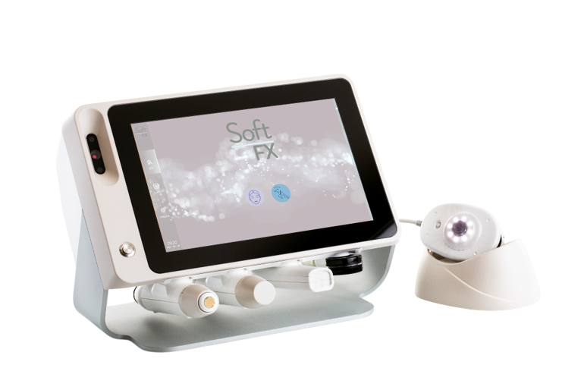
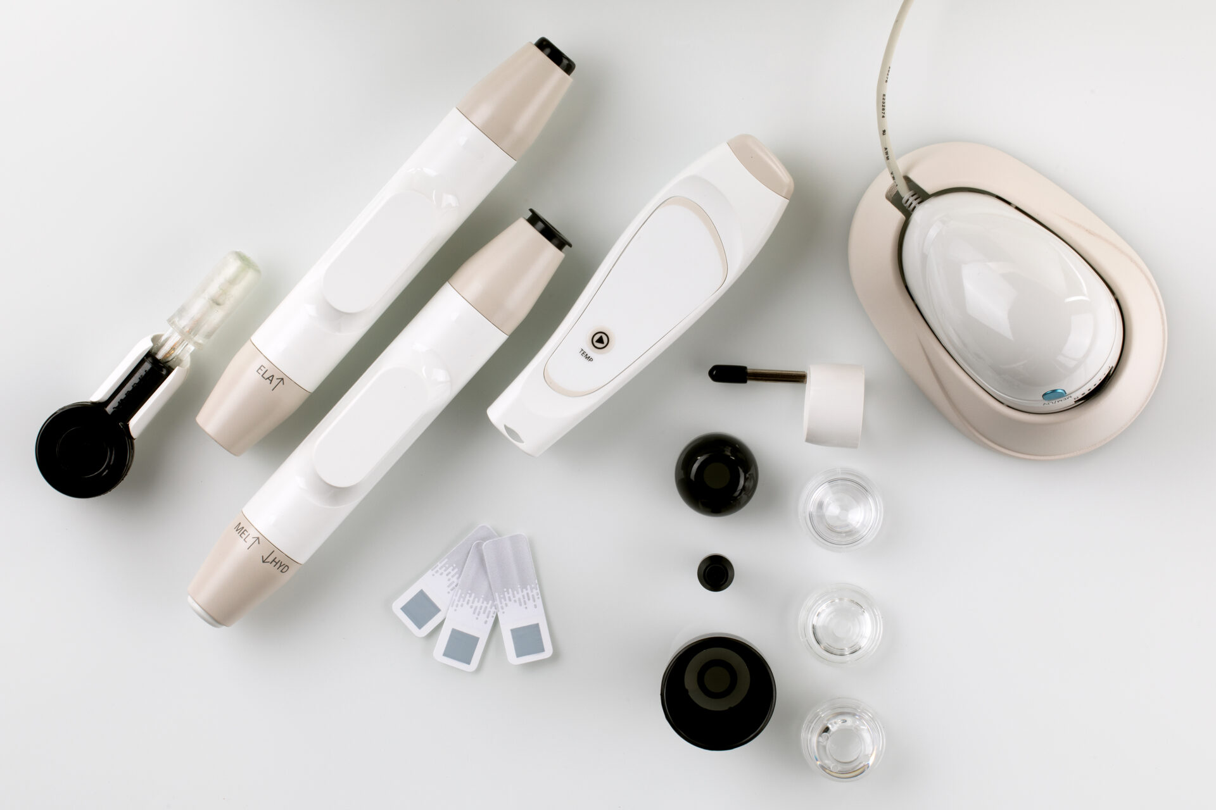
COMBINE your PROFESSIONAL KNOWLEDGE
with measured SCIENTIFIC ANALYSIS
CREDIBILIZES oral and visual diagnosis
BOOST sales of retail products and treatments
PROMOTE your beauty centre as a professional EXPERT centre
BUILD customer loyalty by offering them the ideal routine
RECRUIT new customers with a check-up as soon as they arrive
PROOVE the effectiveness of products and treatment techniques
ANIMATE the point of sale
Probes to measure elasticity, melanin, hydration, T°, pH, sebum
Camera (X 100) for wrinkles, texture, dark spots, keratin, redness, pores

Slide 26
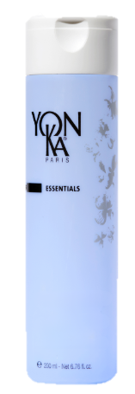
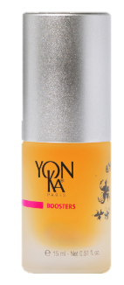


Ideal YON-KA routine (morning and night)
REMOVE MAKE-UP / CLEANSE
YON-KA LOTION
EYE / LIPS CONTOUR
SERUM
BOOSTER +
CREAM (+ SUNSCREEN)

