Slide 2
The skin's nocturnal rhythm - Understand and optimise your skin's regenerative potential -
Notes:
The skin's nocturnal rhythm - Understand and optimise your skin's regenerative potential -
PLAN :
What is the circadian rhythm ?
Biological changes during the night
Review of skin biology in 5 essential points
Review of our Yon-Ka Day/Night duo

Slide 3
CIRCADIAN rhythm A fundamental biological cycle
The Circadian rhythm regulates the body's biological functions over 24 hours, influenced by the alternation of day and night.
Day
→ Protection against external aggression (UV rays, pollution, oxidative stress).
Night
→ Skin repair and regeneration phase.
Notes:
The skin's circadian cycle refers to all the physiological and biochemical variations undergone by the skin over a 24-hour period, in synchronisation with the internal biological clock.
This cycle is characterised by distinct phases:
During the day, the skin adopts a protective mode: it produces more sebum to strengthen its barrier, activates defence mechanisms against external aggression (UV rays, pollution, oxidative stress) and maintains a moisture level that preserves its integrity.
At night, the skin enters a phase of intense repair and regeneration. Between 11pm and 4am, cell renewal is at its peak, microcirculation intensifies to supply oxygen and nutrients, and collagen and elastin production is stimulated. Lymphatic drainage is also activated, facilitating the elimination of toxins accumulated during the day.
This cycle is regulated by internal mechanisms (notably the secretion of melatonin and other hormones) that synchronise skin functions with the alternation of day and night. Understanding the skin's circadian cycle enables us to adapt our skincare routine: for example, we should opt for protective, moisturising skincare during the day and repairing, regenerating skincare at night to maximise the effectiveness of our treatments.
➡️ Key message: Night is the time when the skin renews itself most effectively.

Slide 4
What do you think happens to the skin during sleep?
Biological changes during the night

Slide 5
Biological changes during the night
CELL RENEWAL :
THE SKIN REGENERATES
MICROCIRCULATION: OXYGEN AND NUTRIENTS IN FULL ACTION
SKIN BARRIER FUNCTION: PROTECTION AND HYDRATION
PRODUCTION OF COLLAGEN AND ELASTIN: FIRMNESS AND ELASTICITY
DETOXIFICATION PROCESS :
PURIFIES THE SKIN

Slide 6
CIRCADIAN rhythm
6am – 8am
Reactivation of skin metabolism, mild dehydration.
8am – 10am
Increased sebum, natural protection.
10am – 12pm
Peak cellular oxygenation, absorption of skin care products.
12pm – 2pm
Reduced microcirculation, duller complexion.
2pm – 4pm
Maximum sebum production, reinforced protection.
4pm – 6pm
Reduced skin barrier function, increased sensitivity.
Slight water loss, skin in transition.
Skin barrier forms, skin is better protected.
Improved absorption of active ingredients, boosted oxygenation.
Visible drop in energy, complexion may appear tired.
Excess sebum possible, shine on the T-zone.
More vulnerable skin, may feel tight.

Slide 7
CIRCADIAN rhythm
6pm – 8pm
Start of regeneration, increased microcirculation.
8pm – 10pm
Activates cell renewal and absorption of skincare products.
10pm – 12am
Peak cell renewal, repair and regeneration.
12am – 3am
Maximum regeneration, toxin drainage.
3am – 6am
Recovery phase, preparing for the day.
Cellular repair begins, skin is more receptive to skincare products.
Optimum absorption of care products, in-depth repair.
Maximising the benefits of skincare, skin is intensely renewed.
Elimination of accumulated toxins, revitalised skin.
End of the night cycle, skin ready for a new day.

Slide 8
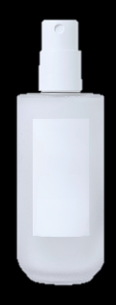
Night Beauty Routine : Optimising skin regeneration
REMOVE MAKE-UP / CLEANSE
LOTION
SERUM
NIGHT CREAM
DEEP CLEANSING TO ELIMINATE MAKEUP AND IMPURITIES
OPTIMISE PENETRATION
TARGETED TREATMENT TO MAXIMISE CELL RECOVERY
REPAIRING CARE
AND NOURISHING

Slide 9
Review of Skin Biology in 5 Key Points
CELL RENEWAL: THE SKIN REGENERATES ITSELF
Definition
Cell renewal is the skin's ability to produce new cells to replace dead ones.
When?
Peak activity between 11pm and 4 am.
Mechanism
Skin cells divide more rapidly to regenerate the epidermis.
This process slows down with age (28 days in a young adult, 40 days after the age of 50).
Slow renewal leads to a dull complexion and skin that is more prone to imperfections.
Notes:
Definition: Cell renewal is the skin's ability to produce new cells to replace dead ones.
When is it? 🔹 Peak activity between 11pm and 4am
Mechanism:
Skin cells divide more rapidly to regenerate the epidermis.
This process slows down with age (28 days in a young adult, 40 days after the age of 50).
Slow renewal leads to a dull complexion and skin that is more prone to imperfections.

Slide 10
Review of Skin Biology in 5 Key Points
MICROCIRCULATION: OXYGEN AND NUTRIENTS IN FULL ACTION
Definition
Microcirculation refers to blood flow in the small vessels under the skin.
When?
Blood flow increases from 10 pm, peaking around 1am.
Mechanism
Supplies oxygen and nutrients to regenerating cells.
Helps eliminate toxins accumulated during the day.
Helps to reduce signs of fatigue and brighten the complexion.
Notes:
Definition: Microcirculation refers to blood flow in the small vessels under the skin.
When? 🔹 Increase in blood flow from 10pm, peak around 1am
Mechanism:
Supplies oxygen and nutrients to regenerating cells.
Helps eliminate toxins accumulated during the day.
Helps to reduce signs of fatigue and brighten the complexion.

Slide 11
Review of Skin Biology in 5 Key Points
SKIN BARRIER FUNCTION: PROTECTION AND HYDRATION
Definition
The skin barrier is a protective film that prevents dehydration and protects the skin from external aggression.
When?
Progressive weakening of the barrier during the night, with peak dehydration between 2 am and 4 am.
Mechanism
The skin loses up to 25% more water at night than during the day.
The hydrolipidic film renews itself less quickly.
The absence of sebum promotes dryness and irritation.
Notes:
Definition: The skin barrier is a protective film that prevents dehydration and protects the skin from external aggression.
When? 🔹 Progressive weakening of the barrier during the night, peak dehydration between 2 and 4 a.m.
Mechanism:
The skin loses up to 25% more water at night than during the day.
The hydrolipidic film renews itself less quickly.
The absence of sebum encourages dryness and irritation.

Slide 12
Review of Skin Biology in 5 Key Points
PRODUCTION OF COLLAGEN AND ELASTIN: FIRMNESS AND ELASTICITY
Definition
Collagen and elastin are essential proteins that maintain the skin's structure and elasticity.
When?
Production starts at midnight and peaks between 1 am and 3 am.
Mechanism
Collagen provides firmness and resistance to the skin.
Elastin ensures suppleness and elasticity.
Their production decreases with age, which favours the appearance of wrinkles and sagging skin.
Notes:
Definition: Collagen and elastin are essential proteins which maintain the structure and elasticity of the skin.
When does it start? 🔹 Production activated from midnight with a peak between 1am and 3am
Mechanism:
Collagen provides firmness and resistance to the skin.
Elastin ensures suppleness and elasticity.
Their production decreases with age, which favours the appearance of wrinkles and sagging skin.

Slide 13
Review of Skin Biology in 5 Key Points
DETOXIFICATION PROCESS: THE SKIN IS PURIFIED
Definition
The skin eliminates the toxins accumulated throughout the day via natural drainage.
When?
The lymphatic system is activated between midnight and 5am.
Mechanism
Skin cells eliminate residues from pollution, oxidative stress and skin metabolism.
Effective lymphatic drainage prevents inflammation and the accumulation of impurities responsible for a dull complexion.
Notes:
Definition: The skin eliminates toxins accumulated throughout the day via natural drainage.
When does it happen? 🔹 The lymphatic system is activated between midnight and 5am.
Mechanism:
Skin cells eliminate residues from pollution, oxidative stress and skin metabolism.
Effective lymphatic drainage prevents inflammation and the accumulation of impurities responsible for a dull complexion.

Slide 14
Chronotherapy
Your skin lives according to nature's rhythm: during the day, it defends itself; at night, it regenerates. Ignoring this biological cycle slows down its potential. With Yon-Ka Chronotherapy, adapt each treatment to the right moment to maximise the effectiveness of the active ingredients and reveal a radiant, healthy complexion.
Yon-Ka has developed high-performance Day & Night duos designed to meet your skin's specific needs at every moment. An intelligent ritual for visible results.

Slide 15
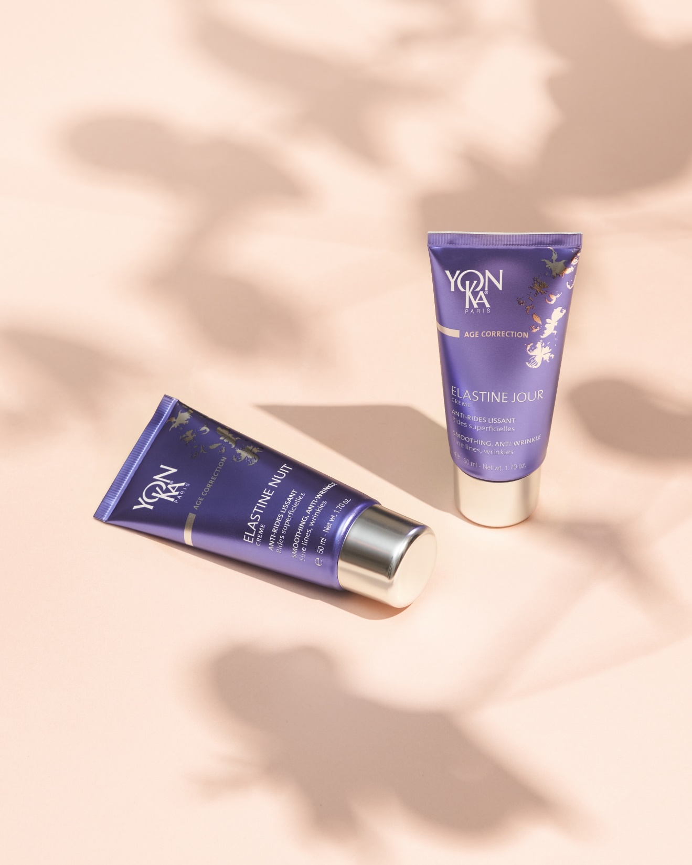
Age Correction
DUO ELASTINE

Slide 16
What is elastin?
Elastin is a protein organised into fibres that gives tissues elasticity and strength.
ELASTINE
FUNCTIONAL
perpendicular fibres
to the dermis
LOXL* action
(Lysyl Oxidase Like)
Shapes the structure
Toned, supple skin
FIBROBLASTE
ELASTINE
DEGRADED
thicker, less elastic horizontal fibres
Elastasa share
Enzyme secreted by fibroblasts which degrades elastin
summary
proteins
Formation of deeper wrinkles
WITH AGE :
Reduced protein synthesis
Reduction of
the action of LOXL*.
Increase
of the
elastase**.
reduction in fibroblasts
Notes:
For skin to be toned and supple, elastin fibres need to be reorganised, not just synthesised.
Recent discoveries have shown that elastin synthesis remains constant over time. However, the assembly of elastin into functional elastic fibres becomes defective...
The cause is LOXL (Lysyl Oxidase Like), the enzyme that cross-links elastin. In other words, it enables molecules to bind together to form a network/structure. LOXL decreases with age.
Without it, fibroblasts secrete an enzyme that breaks down elastin, leaving us with non-functional elastin. The skin loses its ability to stretch and reposition itself: wrinkles and sagging appear.
With age, there is a reduction in the number of fibroblasts and a reduction in protein synthesis. This leads to a reduction in the action of LOXL and an increase in the activity of elastase (the enzyme that breaks down elastin): elastin therefore loses its quality and protection.
Conclusions:
We need to act on 3 levels on elastin:
stimulate their synthesis
act on their quality
protect it
*collagen, elastin, reticulin, proteoglycans and structural proteins

Slide 17
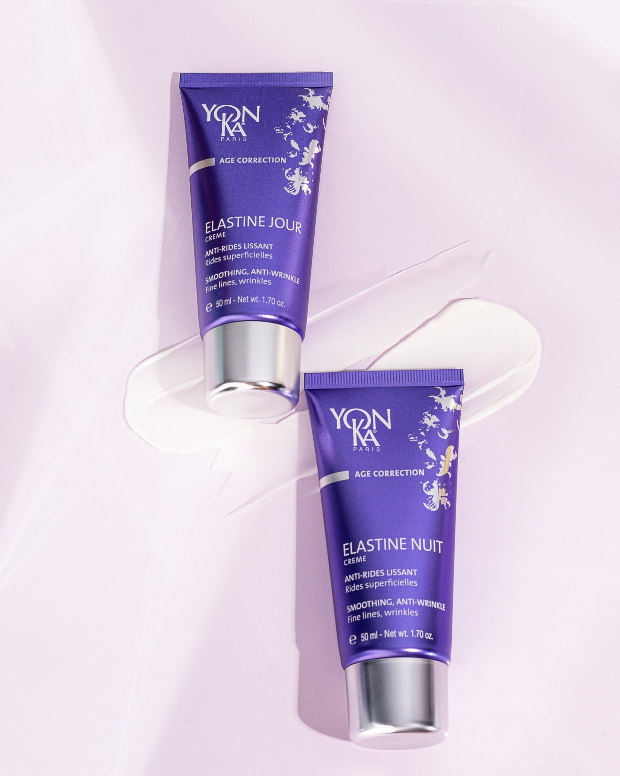
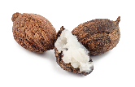
DUO ELASTINE DAY / NIGHT
Morning and evening duo with a light texture to erase the first wrinkles.
ELASTIN PEPTIDES
Anti-wrinkle, smoothing
MILK PEPTIDES
Anti-wrinkle, smoothing
SHEA BUTTER
Repairs, protects
VITAMIN C
Anti-oxidant
The Yon-Ka Plus
Duo rich in 19 essential amino acids
No essential oils
Duo - skin regains its elasticity: 82.5%*.
Notes:
Can you give me 1 or 2 active ingredients in the Elastine duo common base?
amino acid composition :
Cystine
Histidine
Isoleucine
Leucine
Lysine
Methionine
Phenylalanine
Threonine
Tryptophan
Tyrosine
Valine

Slide 18
Focus on Elastin Peptides
Water-soluble elastin hydrolysate from bovine neck ligaments, composed of :
Low molecular weight peptides
High molecular weight peptides
Collagen hydrolysate.
Low molecular weight elastins are used for their action in the dermis:
Stimulation of elastin biosynthesis by fibroblasts.
Blocks elastases (enzyme responsible for the breakdown of elastin)
.
High molecular weight elastins have properties in the superficial layers of the skin, and are essentially highly effective moisturisers and tensors.
This improves skin elasticity.

Slide 19
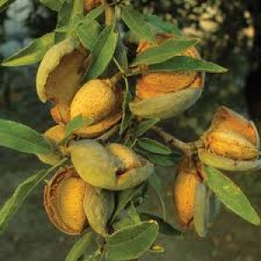
ELASTINE DAY
Superficial wrinkles.
COMMON BASE + :
SWEET ALMOND PROTEIN
Tensor film, immediate smoothing effect
SERINE
Moisturising, replenishing
VITAMIN A
Regenerating, stimulates collagen production
VITAMIN E
Antioxidant

Slide 20
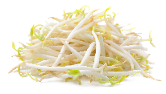
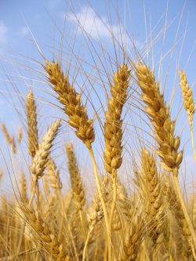
ELASTINE NIGHT
Superficial wrinkles.
COMMON BASE + :
SOY PEPTIDES
Restructuring
WHEAT GERM OIL
Rich in EFAs, regenerating

Slide 21
Focus on Soya Peptides
Obtained by enzymatic hydrolysis of soya proteins (non-GMO soya, natural active ingredient of plant origin).
These small peptides can penetrate the layers of the epidermis and have a :
Nourishing
Revitalising
Moisturising
Restructuring (strengthens the skin barrier)
Protective (anti-aging and anti-pollution)
In vitro test: biostimulant activity
tested at 5%, fibroblast growth increased by 64% after 1 day in culture and 70% after 3 days.

Slide 22
Sum up
Smoothes and prevents wrinkles
Hydrates and protects the skin
Sweet Almond protein and milk peptides
Light texture, quick absorption
Supple, plump skin
Deeply regenerates and revitalizes
Nourishes and plumps
Soy and Wheat germ peptides
Night-time anti-fatigue action
Wake up with rested skin
1st wrinkles & firmness corrective treatment: elastin peptides and vitamin C to restore suppleness and tone. Targeted action, proven effectiveness.

Slide 23
Age Correction
TIME RESIST

Slide 24
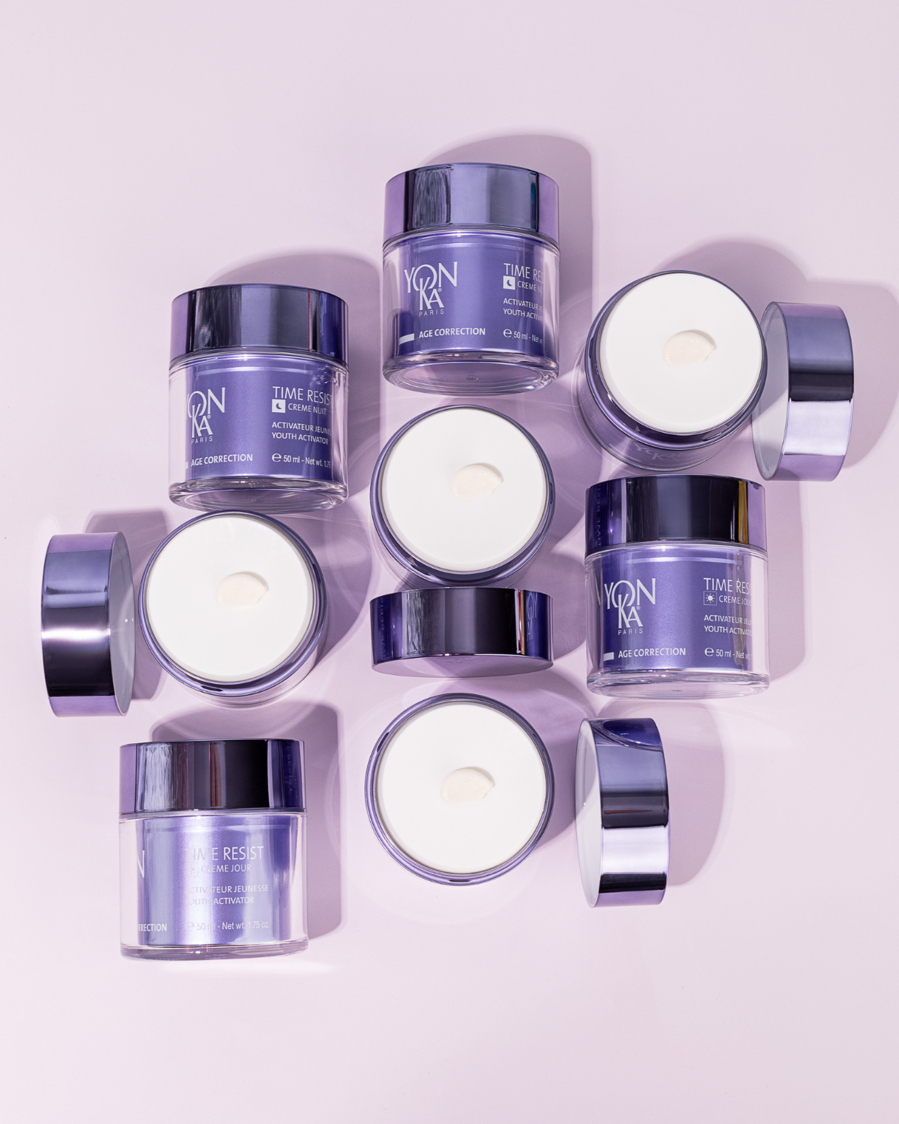
COMMON BASE
DUO TIME RESIST
SAPONARIA PUMILA STEM CELLS
Protects and preserves dermal stem cells
YOUTH ENERGY (lipoamino acid)
Anti-inflammatory action
WAKAME EXTRACT
Restores skin volume for a visible anti-aging effect
VEGETABLE GLYCERINE
Preserves skin hydration by reducing the speed of TWL
SHEA BUTTER
Protects, soothes, moisturises and nourishes.
Deep wrinkles.
GRAPE SEED OIL
Reduces transepidermal water loss, increases skin comfort and elasticity
Notes:
Perfect duo for mature skin wanted to erase deep lines, have comfort and hydration troughtout the day
RESULTS: Wrinkles are visibly smoothed, skin shows more volume and density, signs of tiredness are diminished and complexion is much brighter.
Velvety and soft texture
COMMON BASE
SAPONARIA PUMILA: Protects and preserves dermal stem cells
In the heart of TIME RESIST formula, saponaria pumila plant based stem cells :
Protect cells against UV rays and visible light sources
Preserve cells vitality and self-renewal ability
Increase dermal density
Improve skin firmness and elasticity
YOUTH ENERGY: Protects and strengthens the skin's defenses against chronic and silent reactions; anti inflamm’aging action
Actions :
protects the skin from chronic and silent reactions induced by external aggressions and responsible for skin aging.
Reduction inflamm'aging
Protection of collagenase activity
Construction of the collagen
Improvement of the micro-vascular circulation
What is Inflamm’aging?
Inflamm’aging is a contraction of the words "inflammation" and "aging". It is responsible for 80% of all pathologies to do with age and skin aging. With age, repetitive micro-inflammations spread through skin tissues and weaken the cells' defense systems. Wrinkles, dehydration, skin slackening, dull complexion, etc. are the consequences of this. It concerns all individuals.
This phenomenon is enhanced with age, due to internal or external stimuli:
environmental pollutants
UV rays (sun or artificial)
chemical agents
Etc.
WAKAME restore skin volume in the face for a visible anti-aging effect by acting on 3 elements:
Collagen
Elastin
Hyaluronic Acid
Olfactory notes
A subtle association of Essential oil of Neroli, with delicate, flowery and sweet scents, and its calming and relaxing properties with The Yon-Ka Quintessence, perfect ally for the energizing and revitalizing scent.

Slide 25
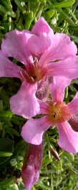
Focus SAPONARIA PUMILA
One of the oldest species of mountain fauna: survived the Ice Age
Constantly exposed to :
high UV radiation
Extremely cold temperatures
Has developed protective and restorative properties to survive in its extreme environment.
Production method: Phyto CellTecTM biotechnology
Create and collect plant stem cells, which are then harvested in bioreactors to obtain the required number of stem cells.
Action: (in vitro tests)
Protects dermal stem cells from the harmful effects of UV and visible light
Maintains the vitality of dermal stem cells and therefore their capacity for self-renewal
Increases the density of the dermis by protecting it against breaks in its architecture
Improves skin firmness and elasticity
Notes:
Saponaria Pumila protects and preserves the dermal stem cells.
History : During the ice age from 110 000 BC to 10000 BC, 90% of terrestrial life disappeared. Some plants survived this ice age, such as the nunataks. These extremophilic alpine plants survived the ice age because they migrated during periods of extreme cold to unglaciated mountain peaks called Nunatak (hence their name). They can still be found in the Alps and are considered the most ancient species of the alpine fauna. Saponaria Pumila is one of these Nunataks that, being constantly exposed to strong UV radiation but also very cold temperatures, has developed protective and restorative properties to survive its extreme environment.
Method of production: Eco-Innovation
A very small amount of plant material (e.g. a fruit or a leaf) is needed to establish a plant stem cell culture. Thus rare and endangered plants are preserved.
This technique does not require agricultural land
It is water-efficient compared to conventional processes
It does not require pesticides or fertilizers.
Action:
The extraordinary survival potential of Saponaria Pumila allows them to protect and revitalize the skin's stem cells (dermal stem cells) so that they have the weapons to protect themselves against environmental stresses that are the main cause of skin aging. This ability translates into:
Protection of dermal stem cells from the harmful effects of UV and visible light
Increase in the density of the dermis by protecting it against breaks in its architecture (arrangement of elastin and collagen fibres).
Thus, Saponaria pumila stem cells are able to allow dermal stem cells to maintain their regenerative potential despite UV exposure.

Slide 26
Focus LIPOAMINOACIDE YOUTH ENERGY
1st cosmetic active ingredient that acts against inflamm'aging by regulating the production of interleukin-6
Origin: lipoamino acid with excellent affinity for the skin
The structure of this active ingredient is the same as that of the PalGly molecule (biomimetic).
ANTI-INFLAMM'AGING ACTIVITY
Preserves the youthfulness of fibroblasts⁽¹⁾
- 39 %
Reduction in the amount of IL 6
Protection of the MEC⁽²⁾
- 100 %
Collagenase activity
Construction of the collagen network⁽³⁾
+ 124 %
proteins that help collagen to take shape
Improving the micro-vascular network⁽⁴⁾
+ 18 %
the formation of new vessels and their organisation
Moldecule PalGly :
Naturally present in the brain and skin, it has anti-stress and anti-inflammatory properties.
Yon-Ka drew her inspiration from this molecule of serenity
+ Firmness ⁽¹⁾
- Wrinkles ⁽⁶⁾
+ Radiance ⁽⁴⁾
Notes:
Youth Energy lipoaminoacid active ingredient that acts against inflamm'aging by regulating interleukine-6 production.
Background information: Some individuals have developed a resistance to inflamm'aging which allows them to age gracefully. Their bodies naturally resist the stress and illnesses brought on by aging. Hundred-year-olds are those who best represent this population. During the course of a study on pain and inflammation in 2008, a team of American researchers in pharmacology discovered the PalGly molecule. Naturally present in the brain and skin, it presents anti-stress and anti-inflammatory properties, which gave it its name: the bliss molecule. Yon-Ka drew its inspiration from this serenity molecule when creating the TIME RESIST creams, offering the biological secrets to graceful aging by inserting a biotechnological active ingredient that mimics the PalGly molecule in the heart of their formulas.
Origin: this active ingredient is a lipoaminoacid, a structure that shows excellent affinity with the skin. It is made up of a chain of 16 palmitic acid carbons, originating from vegetable palm oil, and an amino-acid - glycerin - prepared by synthesis. (Overall, it is 76% natural).
Creating a lipoaminoacid
The structure of this active ingredient is the same as the PalGly molecule.
Actions: Given its anti-inflamm'aging activity, this lipoaminoacid affects skin and its cells more or less directly, namely acting directly on the reduction of IL-6 quantities, a key marker in inflammation:
Tests conducted to verify YOUTH ENERGY efficiency:
Comparative in vitro tests, between aged fibroblasts treated with YOUTH ENERGY, non-treated aged fibroblasts and non-treated young fibroblasts.
In vitro tests comparing YOUTH ENERGY activity to another renowned anti-collagenese molecule
In vitro tests studying the behavior of these proteins - for fibroblasts treated with YOUTH ENERGY and non-treated.
In vitro tests studying cells and the changes in their micro-vascular networks
Ex vivo tests: applying YOUTH ENERGY on human skin explants and measuring skin brightness
Consumer tests: applying a cream containing the YOUTH ENERGY agent for 42 days in the morning and evening

Slide 27
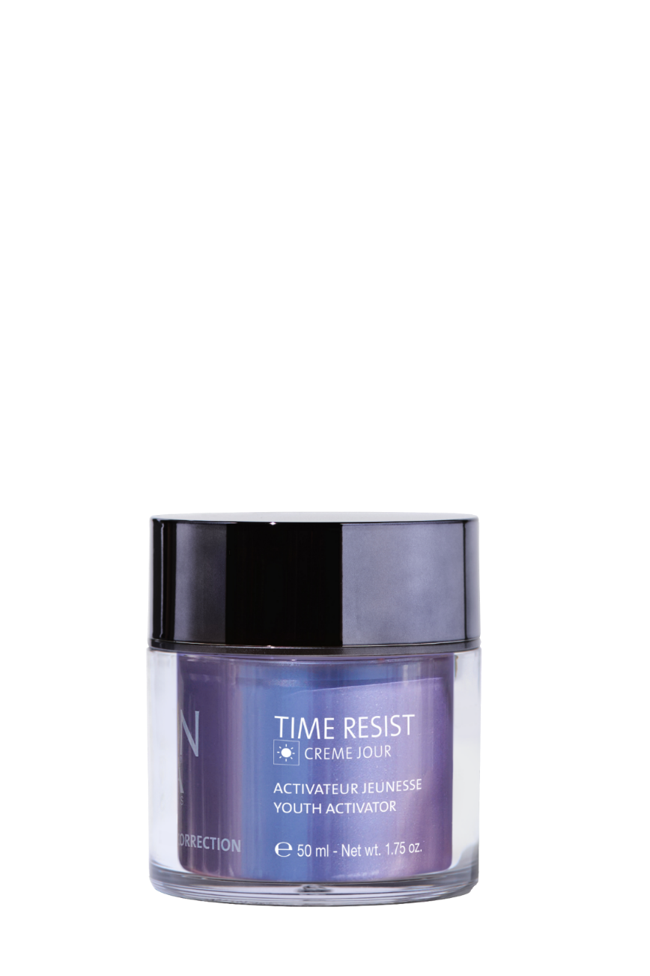
COMMON BASE + :
TIME RESIST JOUR
Enriched with wrinkle-filling active ingredients.
FILLING SPHERES (Konjac + low molecular weight HA)
Wrinkle filler, smoothing
HYALURONIC ACID (high molecular weight)
Moisturising, smoothing, plumping
OAT POLYOSE
Smoothing, immediate tensor
Notes:
Filling sphere
Combined with low molecular weight hyaluronic acid → forms filling spheres which, once in the epidermis, absorb the water that naturally evaporates from the dermis (insensible water loss). These spheres swell (x6 - in vitro test) for a long-lasting wrinkle-filling, smoothing and moisturising effect.
High molecular weight hyaluronic acid
surface action (smoothing and plumping effect)
- Forms a moisturising, protective film
- Able to maintain water in tissues
- Slowing down evaporation (insensible loss of water)
without being occlusive or greasy
Oat polyose
Oat polyoses immediately and visibly smooth and lift the skin's micro-relief. It binds to the skin's surface and forms a highly cohesive biological film capable of visibly tightening the skin. The smoothing/tensing effect is immediately visible, and long-term anti-wrinkle efficacy has also been demonstrated.

Slide 28
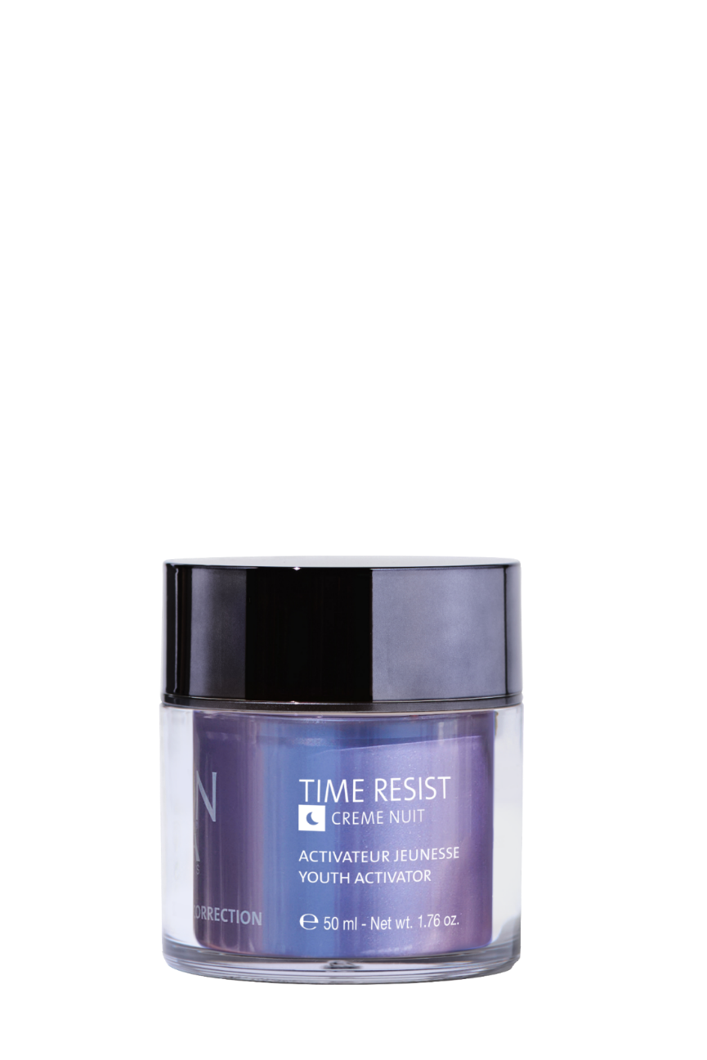
COMMON BASE + :
TIME RESIST NIGHT
Enriched with smoothing, anti-fatigue active ingredients.
EUGLENA GRACILIS EXTRACT
Stimulates ATP production
SACHA INCHI OIL
Nourishing, soothing
SILK TREE EXTRACT
Detoxifying, anti-glycation
Notes:
Euglena Gracilis
Euglene has a metabolism similar to that of skin cells, with a metabolism controlled by alternating light and darkness (day and night). It also contains phosphoinositides which act as precursors to stimulate skin cells. Euglene is therefore a source of vitality and cellular energy.
- Stimulation of ATP production: +48% in 2 hours
- Increased production of IP3 (a molecule involved in fibrobast/collagen communication)
- Activation of calcium release, meaning that the cell moves from a "resting" state to an "activated" state. (Ca is involved in many metabolic reactions),
Sacha Inchi Oil
Replenishes epidermal lipids, prevents redness and irritation
Omega 3 → anti-inflammatory, soothing
Omega 6 → softening, nourishing
Omega 9 → nourishing, softening
Silk tree extract :
Plant extract specially developed to combat signs of fatigue thanks to its action on the detoxification processes of cellular metabolism. It combats the signs of skin fatigue caused by glycation and glycoxidation.
- Maintains the mechanical viability of cells and their optimal energy production
- Rebalances melatonin synthesis by fibroblasts fatigued by glycation.
- Elimination of cellular waste
Note: Glycation: attachment of a sugar to proteins, causing a structural rearrangement. These glycated proteins cannot be destroyed naturally by our cells' destruction systems. These products then pile up in the cells without the cells being able to get rid of them. Little by little, these substances cause the cell's metabolism to malfunction and eventually lead to its death.

Slide 29
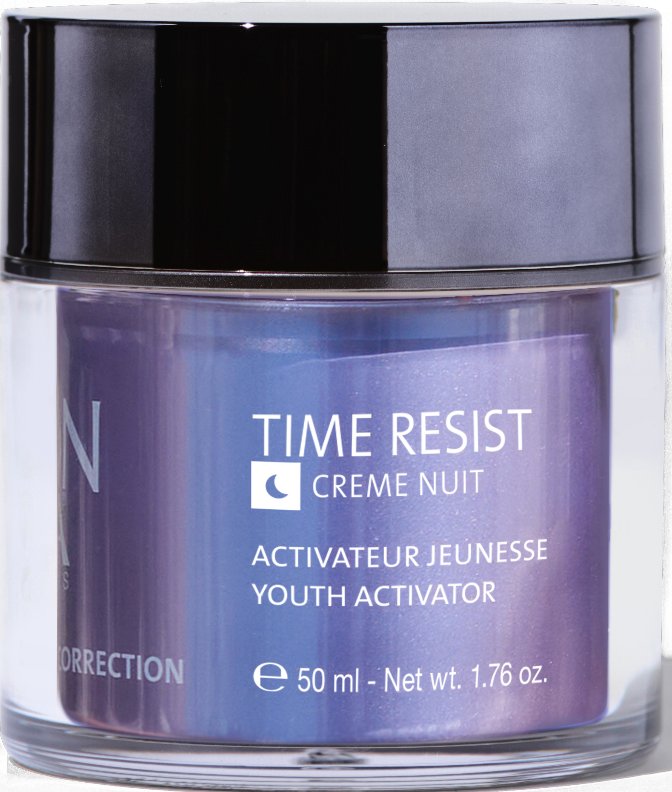
Sum up
Smoothes and fills wrinkles
Protects against oxidative stress
Hyaluronic acid (low & high)
Velvety, silky texture
Plumped, radiant skin
Regenerates and relaxes
Stimulates cell renewal
Euglena Gracilis and Sacha Inchi extracts
Wrapping texture and comfort
Rested, plumped skin
Advanced anti-aging duo: fills deep wrinkles, cell stimulation & antioxidant protection. High-tech formulas for regenerated skin.

Slide 30
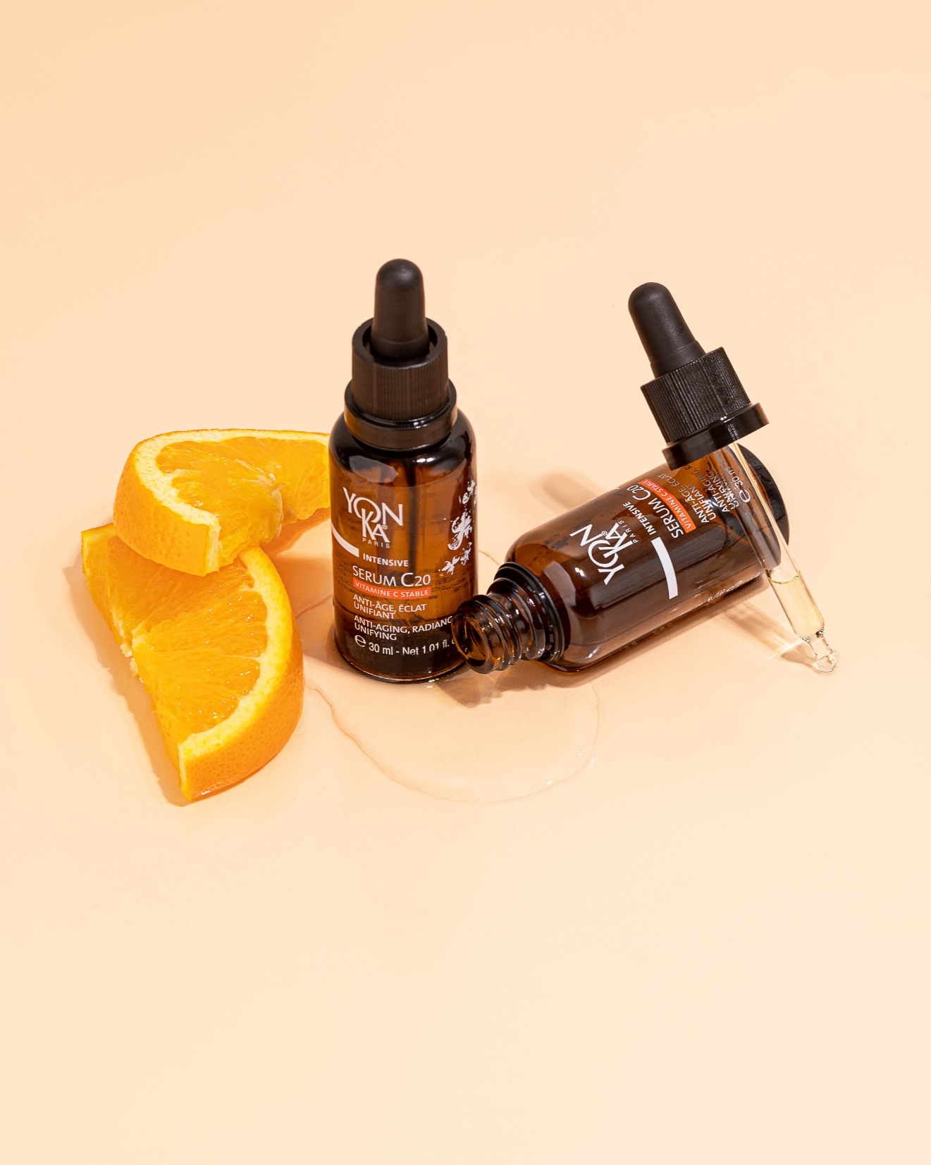
Intensive
SERUM C20

Slide 31
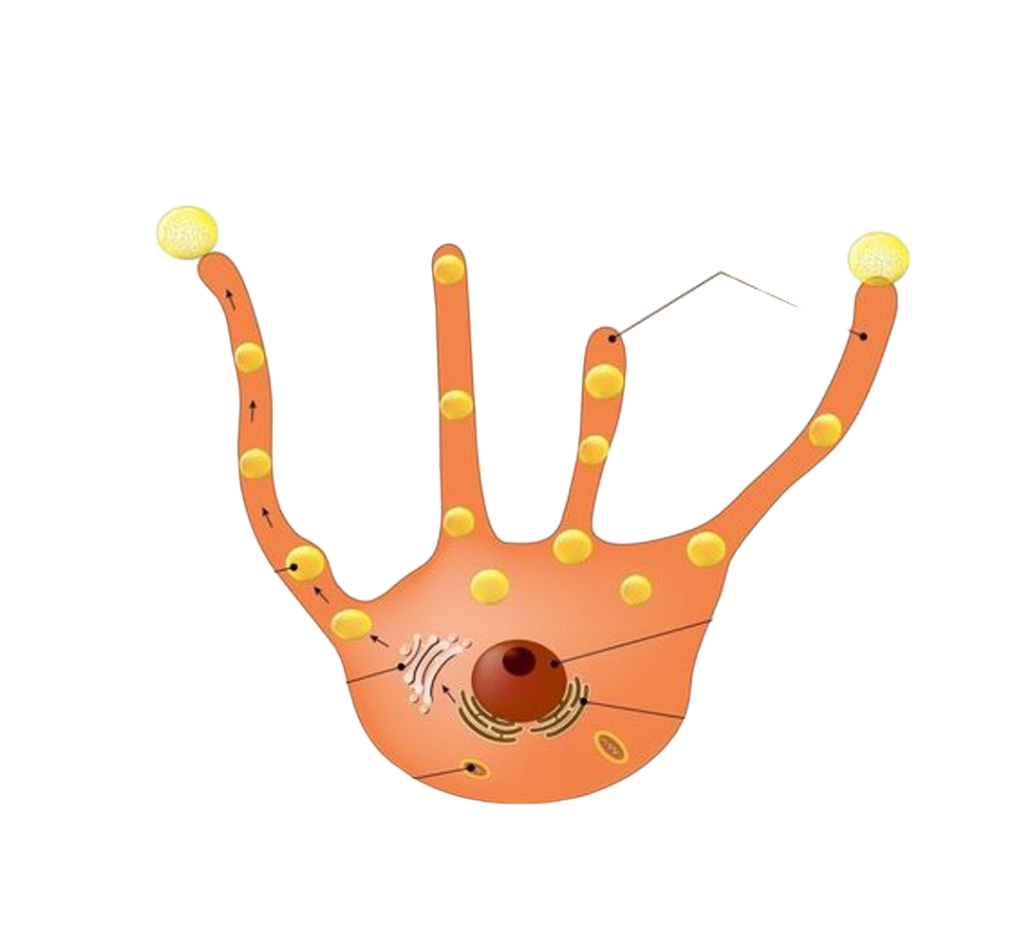
SERUM C20
Focus on melanogenesis
Melanogenesis is the complex process by which pigmentary melanin is produced in melanosomes by melanocytes.
There are 2 types of melanin:
Eumelanin: Large black-brown pigments responsible for dark skin tones.
Pheomelanin: Small yellow-orange pigments responsible for light colours.
This process can be derailed by the influence of
a number of factors:
UV exposure
Hormonal changes
Skin ageing
Dendrites
Melanosome transfer to keratinocytes
Melanosome
Core
Golgi apparatus
Endoplasmic reticulum
Mitochondria
Notes:
Melanogenesis is the biological process by which melanin, the pigment responsible for skin, hair and eye colour, is produced. This process is essential for understanding how our skin reacts to the sun and why some people have lighter or darker skin than others. Here is a simplified explanation of melanogenesis aimed at an audience of beauticians.
1. The role of melanin
Melanin is a natural pigment produced by specialised cells called melanocytes, which are found mainly in the epidermis, the outer layer of the skin. There are two main types of melanin:
Eumelanin (black or brown), which is responsible for the darker colours of skin and hair.
Pheomelanin (yellow or red), which gives skin, hair and eyes lighter or reddish tones.
The amount and type of melanin produced determines the colour of an individual's skin. The more melanin produced, the darker the skin.
2. The melanogenesis process
Melanogenesis takes place in several stages:
Stimulation of melanocytes: When a person is exposed to the sun, UV (ultraviolet) rays cause damage to skin cells. In response, the body activates melanocytes to produce melanin. This is known as the tanning reaction.
Melanin synthesis: After being stimulated, melanocytes convert an amino acid called tyrosine into melanin. This conversion is carried out by an enzyme called tyrosinase. Tyrosinase is therefore essential for melanin production.
Melanin transport: Once produced, melanin is transferred to skin cells called keratinocytes, which are responsible for protecting and regenerating the skin.
Protection and colour: Melanocytes disperse melanin into the superficial layers of the skin, where it absorbs UV rays and protects skin cells from sun damage. The skin then takes on a darker colour (bronze) due to the increased concentration of melanin.
3. Factors influencing melanogenesis
Several factors can influence melanin production:
UV rays: The sun's ultraviolet rays directly stimulate melanocytes to produce melanin. This is why tanned skin is a response to sun exposure.
Heredity: Genetics play a key role in the amount of melanin produced and skin colour. Some people naturally have more melanin than others.
Hormones: Certain hormones, such as those produced during pregnancy (for example, in the case of the pregnancy mask) or under the effect of hormonal contraceptives, can affect melanin production.
Age: With age, melanin production can decrease, sometimes leading to the appearance of grey or white hair.
Nutrition: A diet rich in antioxidants and vitamins (such as vitamin C and vitamin E) can support melanocyte health and promote balanced melanin production.

Slide 32
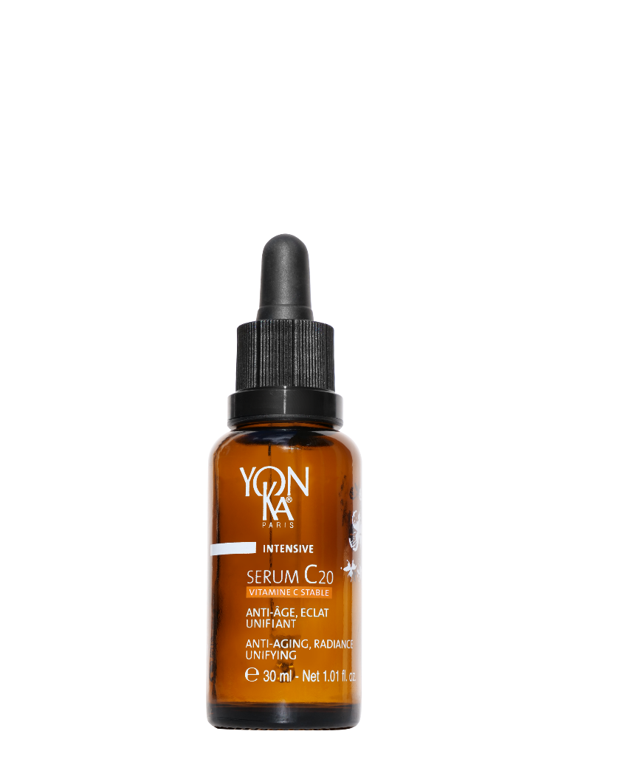
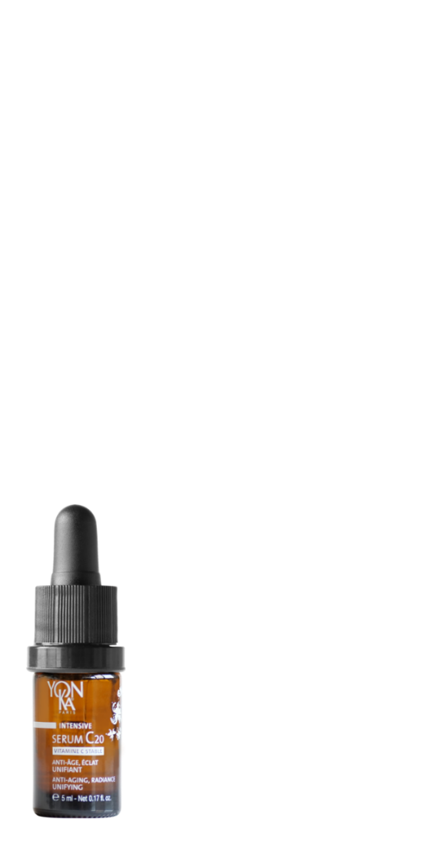
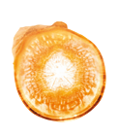
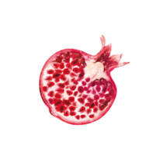
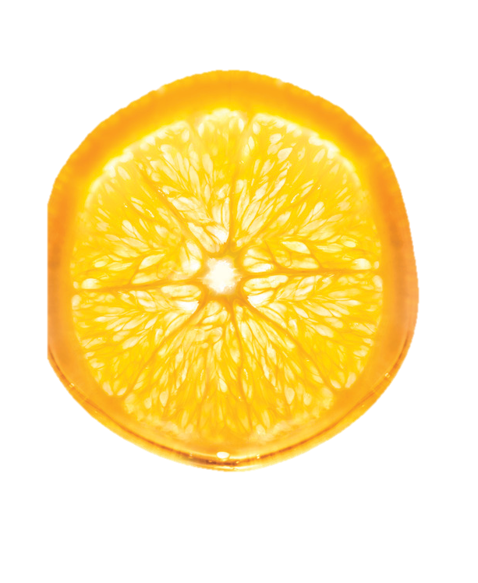
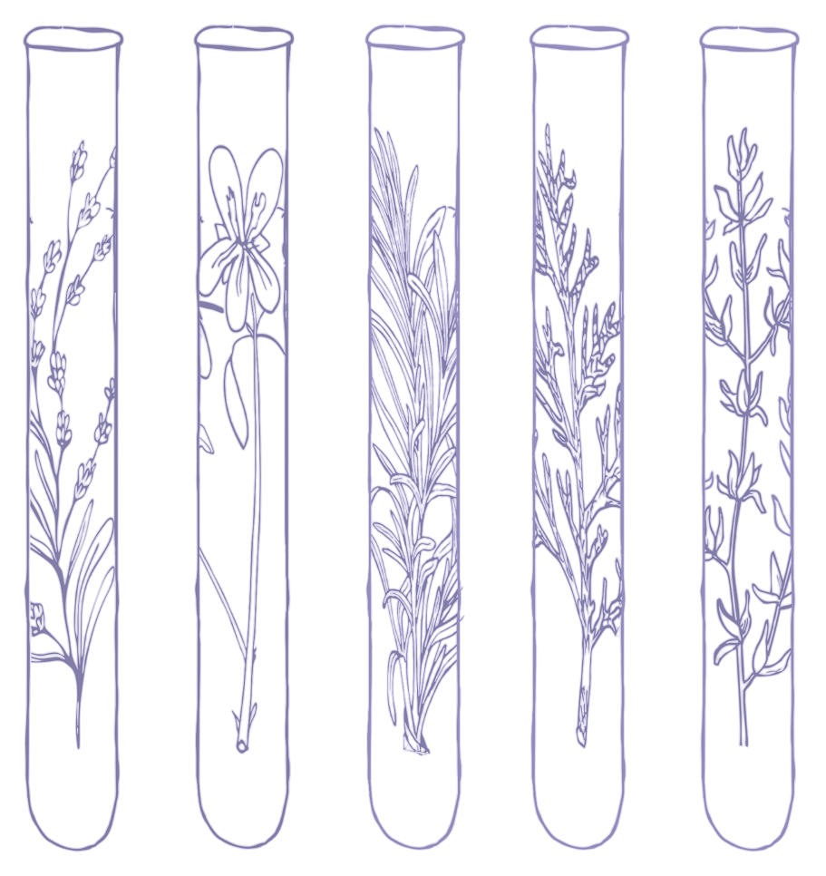
SERUM C20
Anti-aging, radiance, unifying.
20% STABLE VITAMIN C
Anti-aging, radiance, unifying
NATIVE TURMERIC CELLS
Anti-aging, antioxidant
NATIVE POMEGRANATE CELLS
Radiance, anti-dark spot
ORGANIC APRICOT OIL
Comfort, radiance
SWEET ORANGE E.O
Toning, energizing
The Yon-Ka Plus
Ideal from the first rays of sunshine, under sun care products for enhanced antioxidant protection
QUINTESSENCE
Optimizes the power of the formula

Slide 33
Focus VITAMIN C STABLE
Vitamin C stabilised by Yon-Ka research: ascorbyl tetraisopalmitate.
Developed from ultra-active natural vitamin C obtained by bio-fermentation.
This vitamin is combined with 4 isopalmitic acids, also obtained by bio-fermentation.
Ultra-stable against light, heat and air. Its power is guaranteed throughout its use.
Non-acidic, so better tolerated.
Liposoluble for optimised bio-assimilation and penetration.
Neutralises free radicals
Combats cellular oxidative stress
Prevents premature aging
Antioxidant
Inhibits melanin production
Anti dark spot
Contributes to the production and synthesis of collagen, for firmer, smoother skin
Anti-aging

Slide 34
Focus on native cells
(obtained by cell culture)
NATIVE TURMERIC CELLS
Anti-aging
NATIVE POMEGRANATE CELLS
Turmeric is used for its anti-inflammatory and antioxidant properties
On the epidermis :
Promotes epidermal cell renewal by increasing keratinocyte proliferation by 16%.
In the dermis :
17% increase in the synthesis of collagen and elastin fibres.
20% increase in the synthesis of GAGs, including hyaluronic acid.
Conclusion:
The skin is more toned and elastic.
Complements the protective, anti-aging action of vitamin C.
The pomegranate is a symbol of life and fertility, but also of power.
Very rich in polyphenols, powerful antioxidants
Acts on cell oxygenation: +22% CO2 release in extreme conditions
Acts to regulate melanogenesis: -15% melanin synthesis
Conclusion:
The skin is better protected against radical attacks
The skin is brighter and more even.
Reinforces the radiance and anti-spot action of vitamin C.

Slide 35
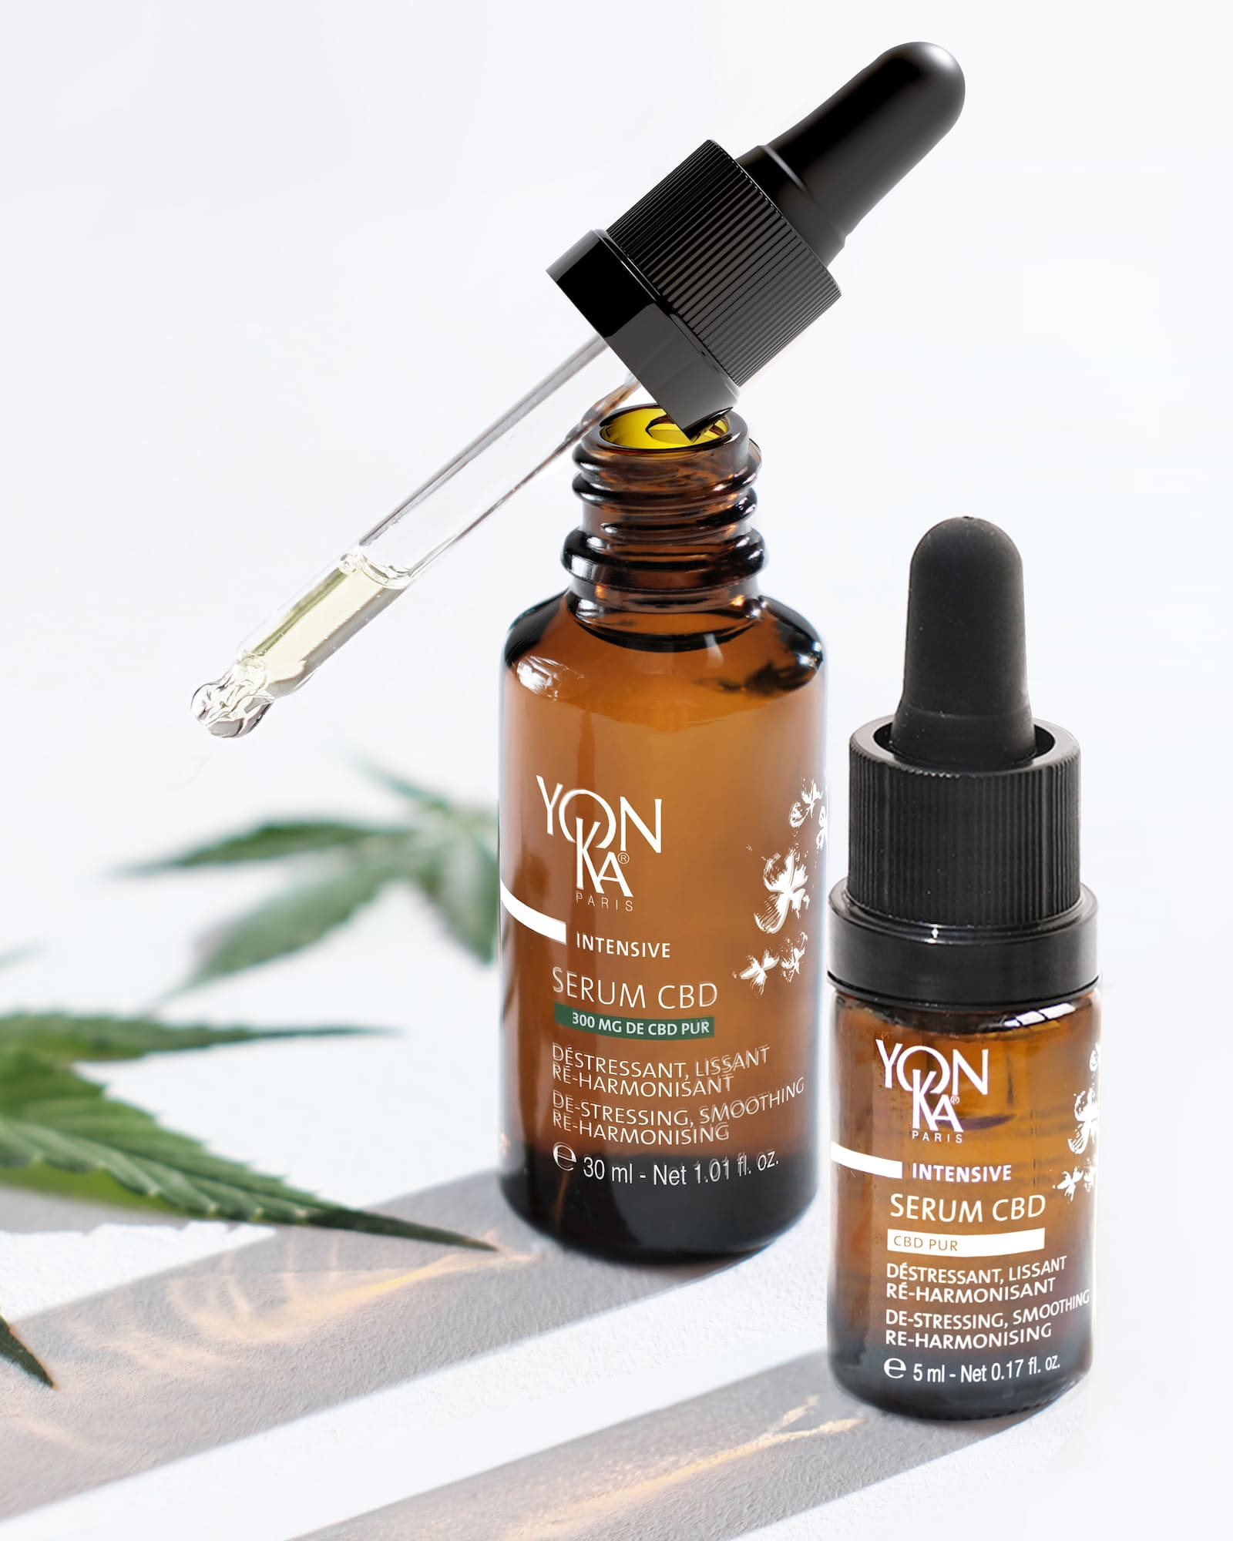
Intensive
SERUM CBD

Slide 36
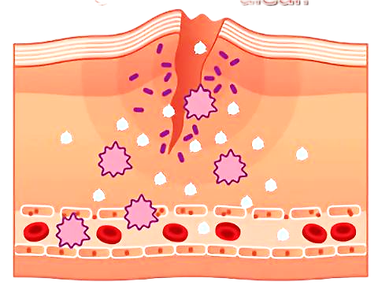
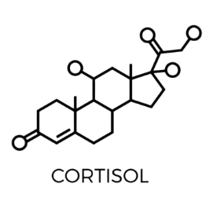
SERUM CBD
Focus on the harmful effects of stress on the skin
During intense stress, our bodies produce various hormones, such as adrenaline and cortisol.
However, cortisol (the stress hormone) can have harmful effects on our skin when produced in large quantities:
Accelerated skin aging
Adult acne
Loss of radiance
Dehydration
Irritation (redness)
Transepidermal water loss
Inflammation
Excess sebum
Deficits in the
healing
Cell renewal
Lower defences
immune system

Slide 37
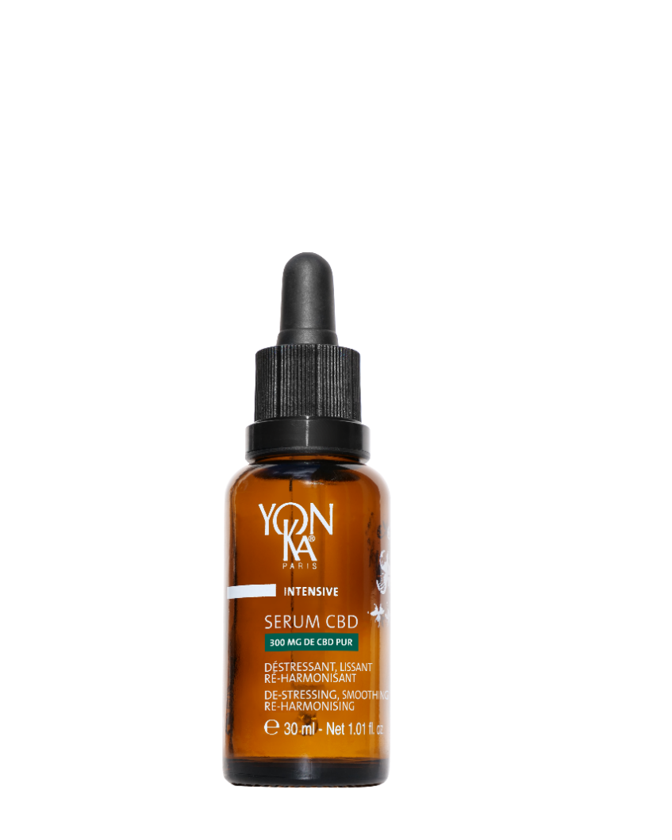
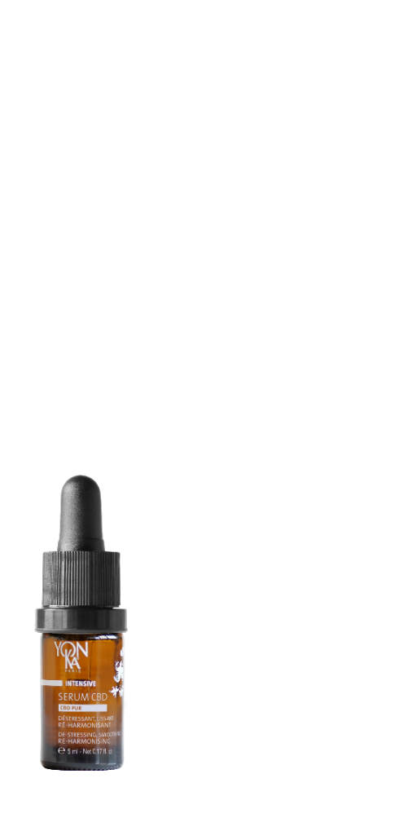
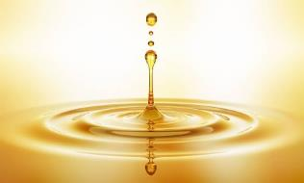
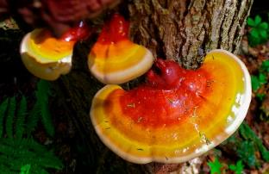
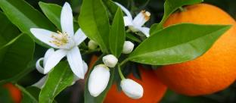
SERUM CBD
De-stressing, smoothing, re-harmonising.
CBD PUR from hemp leaf
De-stressing, smoothing, re-harmonising
NATIVE SACRED LOTUS CELLS
Relaxing, soothing
ADAPTOGENIC REISHI EXTRACT
Anti-oxidant, moisturising
30% ORGANIC VEGETABLE HEMP OIL + INCHA INCHI
Moisturises, regulates, soothes
QUINTESSENCE
Potentiates the power of the formula
E.O. OF LAVENDER, CHAMOMILE AND NEROLI
Soothing, relaxing
Notes:
Native Sacred Lotus plant cells (obtained in France through biotechnology)
A fragile, sacred plant, the Lotus is the symbol of divine beauty and purity. Widely used in Ayurvedic medicine for its rebalancing properties, it helps combat sleep disorders and regain inner strength. Native Lotus plant cells have been shown to have an anti-stress effect on the skin, acting on the synthesis of several neurotransmitters:
Boosts expression of melatonin, a powerful antioxidant molecule known for its positive effect on relaxation and sleep, by +55%.
Reduces the synthesis of Substance P and Interleukins (-20 to -24%), which are mediators of inflammation.
Through these actions, Sacred Lotus native plant cells de-stress, calm the skin and help reduce feelings of irritation.
Adaptogenic Reishi extract:
Reishi, or "long-life mushroom", has been used in traditional Chinese medicine for its therapeutic virtues for over 2,000 years. Renowned for its adaptogenic power, it contains 150 antioxidants and nutrients (polyphenols, triterpenes...). A composition close to perfection, which explains why this mushroom is also widely used in nutrition.
Its many qualities help to maintain good health, while eliminating energy blockages responsible for insomnia. It helps the skin adapt to stress and fatigue. Antioxidant / Moisturizing
30% organic plant oils of hemp and Inca Inchi, rich in omegas 3 and 6 and vitamins (A, E, B), to help rebalance skin disorders, whatever the skin type
Essential oils of lavender, chamomile and neroli for a relaxing, soothing effect, ideal before bedtime. Invites relaxation and promotes sleep for an intense, regenerating night of recuperation.
And, of course, the brand's signature Quintessence Yon-Ka, which enhances the formula.

Slide 38
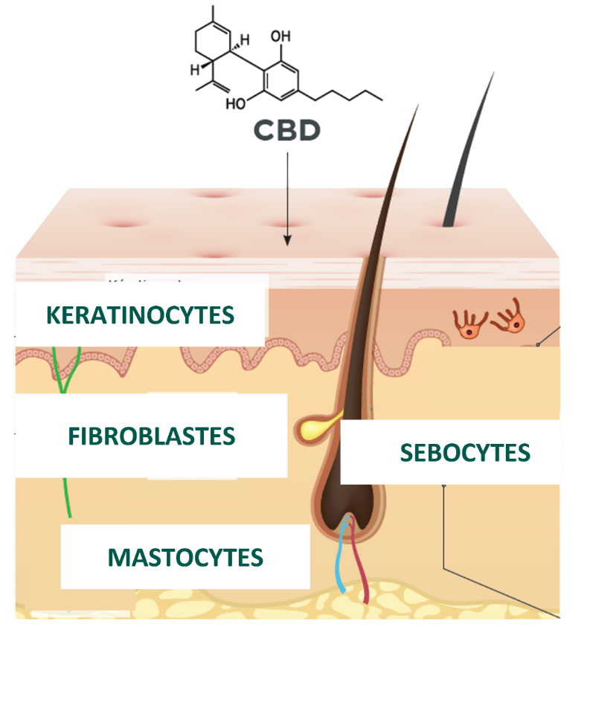
Focus CBD
Hemp and cannabis belong to the species Cannabis sativa L, of the Cannabaceae family.
The difference between the two lies in their THC (tetrahydrocannabinol) content, the psychoactive substance in cannabis.
Cosmetic legislation regulates the CBD used: No psychotropic effect 0 < THC < 0.2%.
ANTI-INFLAMMATORY
Reduces the synthesis of certain inflammation molecules (IL-6 and 8), CBD combats redness and irritation, and soothes sensitive skin.
ANTIOXIDANT
Protects cells from free-radical attacks and boosts the cell defense system .
ANTI-AGING
Boosts fibroblast expression of key proteins involved in dermal matrix quality (dermal-epidermal junction).
SEBOREGULATOR
Lipostatic effect, reduces the multiplication of sebocytes.
ANTI-STRESS
Mind-soothing properties
The skin's endocannabinoid system
Notes:
Extraction with supercritical CO ₂
It's a Greenscience extraction method. Although it is expensive and complex to implement, it is very interesting because it combines a number of advantages:
An ecological method that does not use chemical solvents that are aggressive and/or harmful to people and the environment. The solvent is CO2 (captured before it is released into the environment) in its supercritical form (a state between gas and liquid obtained by adjusting the pressure and temperature of the CO2). It is then trapped for further use.
A high-purity method that enables advanced extraction of the components, obtaining pure molecules with no residue as the C02 evaporates completely.
A gentle method (relatively low temperatures) that guarantees the quality of the extracted molecules.
A selective method which, by adjusting pressure and temperature parameters, selects and isolates the molecule or molecules to be extracted.
The efficacy of CBD on the skin has already been the subject of hundreds of scientific studies, demonstrating its remarkable effectiveness on numerous parameters.CBD interacts with a large number of cellular receptors, particularly those of the endocannabinoid system (CB1, CB2), which are expressed by all skin cells.
This gives CBD a wide range of actions and quite extraordinary power!
keratinocytes (which make up 90% of epidermal cells and synthesise keratin),
fibroblasts,
mast cells (involved in skin immunity) ,
sebocytes (sebum-producing epithelial cells located in the sebaceous gland), sweat gland cells and certain hair follicles.
This anti-stress coach acts on the various cutaneous signs of stress
- Anti-inflammatory action: by inhibiting the synthesis of certain inflammation molecules (IL-6 and 8), CBD combats redness and irritation, and soothes sensitive skin. CBD also shows great promise in the treatment of certain pathologies such as eczema and psoriasis.
- Anti-aging action It boosts fibroblast expression of key proteins involved in dermal matrix quality (dermal-epidermal junction) and fibroblast-matrix interactions: collagen VII, integrin β-1 and integrin α-2. It also helps reduce the synthesis of certain MMPs).
- Anti-oxidant action Protects cells from free-radical attacks and boosts the cell defense system via NRF2.
- Seboregulating action It controls the multiplication of sebocytes and inhibits their lipid synthesis.
Anti-stress action CBD also has numerous mind-soothing properties.
Preliminary studies demonstrate CBD's beneficial action on anxiety and stress. It is often used as a supplement to help alleviate the symptoms associated with these issues, particularly in the case of depressive episodes. Recent research has provided evidence of the essential role of the endocannabinoid system in skin homeostasis and function. As a non-psychotropic phytocannabinoid, similar to endogenous endocannabinoids, CBD is a biomimetic active ingredient. Applied to the skin, it could modulate the cutaneous endocannabinoid system.

Slide 39
Sum up
Brightens and evens the complexion
Corrects pigmentation spots and wrinkles
20% stable vitamin C
Dry oil texture, rapidly absorbed
Radiant, revitalised skin
Soothes and balances the skin
Reduces stress and fatigue
300 mg pure CBD
Silky texture, immediate comfort
Relaxed, harmonised skin
Intense correction: 20% vitamin C to even out and boost the skin,
300 mg CBD to soothe and rebalance deep down.

Slide 40
Conclusion
WHY TAKE CARE OF YOUR SKIN AT NIGHT ?
Night is the key time when the skin repairs, regenerates and strengthens itself.
Adopting a targeted skin care routine helps to maximise these natural mechanisms.
Yon-Ka skincare products are formulated to accompany each stage of the night's rhythm and optimise the skin's beauty and health when you wake up.
Taking care of your skin at night means investing in its youthfulness and radiance in the long term !

