Slide 2
The Fundamentals of Skin Hydration

Slide 3
PROGRAMME
2
3
4
1
Mechanism for
Hydration
Key factors
Hydra n°1 range
Quiz

Slide 4
PROGRAMME
1
2
3
4
Mechanisms for
Hydration
Key factors
Hydra n°1 range
Quiz
Notes:
The programme includes:
Hydration mechanisms
Key factors
Review of the hydra n°1 range
And a little quiz to conclude

Slide 5
Focus on hydration mechanisms
At any age, the skin needs water to keep its shape and appearance:
Well-moisturised skin looks younger.
Hydration is essential for the skin to maintain its suppleness, softness, tone and radiance.
Skin hydration is based on three major biological mechanisms:
Water absorption and capture
Water retention
Limiting water loss
AGE UV STRESS POLLUTION TOBACCO
SKIN IN GOOD CONDITION
WEAKENED SKIN
Notes:
At any age, the skin needs water to keep its shape and appearance:
Well-hydrated skin looks younger.
Hydration is essential for the skin to maintain its suppleness, softness, tone and radiance.
Hydration is regulated by 3 phenomena:
Water absorption and capture
Water retention
Limiting water loss
The skin is like a structure made of bricks (keratinocytes) and mortar (lipid intercellular cement). When the skin is in good condition, it ensures water balance, preventing excessive evaporation of water.
Without this barrier, the skin loses its ability to retain moisture. It becomes tight, rough, dull, loses its bounce and is marked by dehydration wrinkles.
Fundamental hydration for the skin, for a plumper, smoother appearance and to combat the signs of ageing.
HYDRATION is therefore the 1er ANTI-AGEING GESTURE

Slide 6
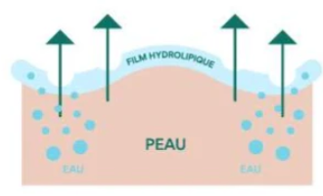
Focus on hydration mechanisms
Water absorption and capture
Water enters the skin mainly internally: it is carried by the blood via the capillaries in the dermis.
A small proportion can be absorbed from the environment in conditions of high humidity (e.g. hammam).
Hydrophilic molecules in the epidermis, particularly in the stratum corneum, play a key role here:
they attract and retain water molecules like "water magnets".
The skin as a whole contains 70% water:
The dermis contains more than 80% of it
The epidermis contains up to 70%.
The stratum corneum contains 10 to 13%.
Notes:
The skin as a whole contains 70% water.
The dermis contains over 80% of it (i.e. 10% of all the water in the human body).
The epidermis contains 65% water,
and the stratum corneum 10 to 13%.
Water is diffused continuously from the dermis to the epidermis. The dermis acts like a sponge, supplying water to the epidermis. The water then diffuses continuously and evenly through the epidermis to the surface of the skin, where it evaporates.
The dermis remains naturally hydrated. Barring exceptional circumstances, it never loses water. It is therefore in the epidermis, and particularly in the stratum corneum (the outermost layer of the epidermis), which normally contains very little water, that the skin dries out.

Slide 7
Focus on hydration mechanisms
2 . Water retention: the heart of the hydration mechanism
A. NMFs (Natural Moisturizing Factors)
These are natural components of the dead cells (corneocytes) in the stratum corneum.
Mainly made up of 22-28% amino acids, urea, lactates, mineral salts, PCA acid, etc.
They attract and retain water in the stratum corneum.
Location: in the cytoplasm of corneocytes.
They work like "biological sponges" to maintain surface hydration.
B. Hyaluronic acid
Present in the dermis and epidermis, this molecule acts as a water reservoir.
It can retain up to 1,000 times its weight in water.
Its quantity decreases with age, which contributes to skin dryness.
C. Intercellular lipids (lipid barrier)
Made up of ceramides, free fatty acids and cholesterol.
Arranged between the corneocytes, they form a lamellar structure that prevents evaporation.
Act as a "cement" between cells, guaranteeing the cohesion of the skin barrier.
Notes:
A. NMFs (Natural Moisturizing Factors)
These are natural components of the dead cells (corneocytes) in the stratum corneum.
Mainly made up of 22-28% amino acids, urea, lactates, mineral salts, PCA acid, etc.
They attract and retain water in the stratum corneum.
Location: in the cytoplasm of corneocytes.
They work like "biological sponges" to maintain surface hydration.
B. Hyaluronic acid
Present in the dermis and epidermis, this molecule acts as a water reservoir.
It can retain up to 1,000 times its weight in water.
Its quantity decreases with age, which contributes to skin dryness.
C. Intercellular lipids (lipid barrier)
Made up of ceramides, free fatty acids and cholesterol.
Arranged between the corneocytes, they form a lamellar structure that prevents evaporation.
Act as a "cement" between cells, guaranteeing the cohesion of the skin barrier.

Slide 8
Focus on hydration mechanisms
3 . Limiting water loss
Transepidermal Water Loss (TEWL)
This is the amount of water that evaporates naturally from the skin (even without visible perspiration).
It is inevitable, but healthy skin knows how to regulate it.
The aim of skin care: to limit excessive TEWL by reinforcing the skin barrier and maintaining the integrity of the hydrolipidic film.
The Hydrolipidic Film
A mixture of sweat (water), sebum (lipids) and cellular debris.
Cushions the surface of the skin.
Maintains an acid pH, prevents bacterial proliferation and slows evaporation.
TEWL =
300 to 400 ml of water/day, under "normal" conditions.
Notes:
Transepidermal Water Loss (TEWL)
This is the amount of water that evaporates naturally from the skin (even without visible perspiration).
It is inevitable, but healthy skin knows how to regulate it.
The aim of skin care: to limit excessive TEWL by reinforcing the skin barrier and maintaining the integrity of the hydrolipidic film.
The Hydrolipidic Film
A mixture of sweat (water), sebum (lipids) and cellular debris.
Cushions the surface of the skin.
Maintains an acid pH, prevents bacterial proliferation and slows evaporation.
TEWL = 300 to 400 ml of water/day, under "normal" conditions.

Slide 9
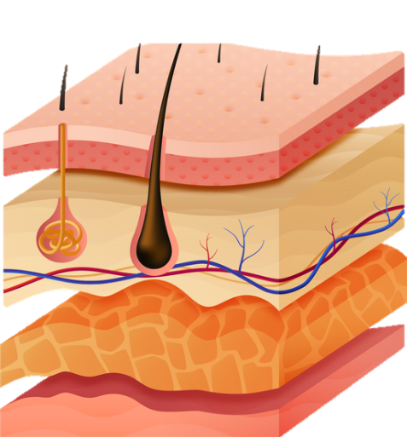
Skin structure and hydration
Hydrolipidic film (water + sebum + sweat) | Protects against evaporation (external barrier)
Corneal layer (corneocytes + NMF + lipids) | Retains water, controls TEWL
Epidermis (keratinocytes, tight junctions) | Physical barrier
Dermis (hyaluronic acid, capillaries) | Water reservoir + nutrient transport
Hypodermis (adipocytes) | Indirect role (support, insulation)
Muscle

Slide 10
In your opinion, what are the
factors in dehydration?
Skin aging
Inadequate nutrition and hydration
Stress and hormonal imbalances
Climatic factors (cold, wind, UV)
Pollution: Damage to the skin barrier
Unsuitable care: aggressive products, excessive exfoliation
Internal factors
Consequences of dehydrated skin
Sensation of tightness and discomfort
Dull, tired complexion
Appearance of dehydration lines
External factors
Notes:
🔸 Skin aging
Natural decrease in the production of :
Hyaluronic acid,
Ceramides and epidermal lipids,
NMF (natural moisturising factors).
The result is thinner, drier skin that is less able to retain water.
🔸 Inadequate nutrition and hydration
Deficiency in essential fatty acids, vitamins A and E,
Low water consumption = poor tissue hydration.
🔸 Chronic stress and fatigue, hormonal imbalances
Cortisol, the stress hormone, can alter the skin's barrier function.
Hormonal changes (puberty, pregnancy, menopause, pathologies) modify sebum production and skin permeability.
🔸 Climate and weather conditions
Dry air, wind, cold, extreme heat: all favour the evaporation of water.
Heating in winter and air conditioning dry out the ambient air.
UV rays destroy collagen and hyaluronic acid and oxidise lipids.
Blue light (screens) increases oxidative stress → inflammation and disruption of the skin barrier.
🔸 Pollution
Fine particles and oxidants attack the skin, destroying the hydrolipidic film and causing inflammation and dryness.
🔸 Unsuitable or aggressive care products
Soaps that are too alkaline, stripping cleansers, excessive exfoliation → breakdown of the hydrolipidic film.
Forget to use moisturiser, use too much skincare or use skincare products that are non-suited to your skin type.

Slide 11
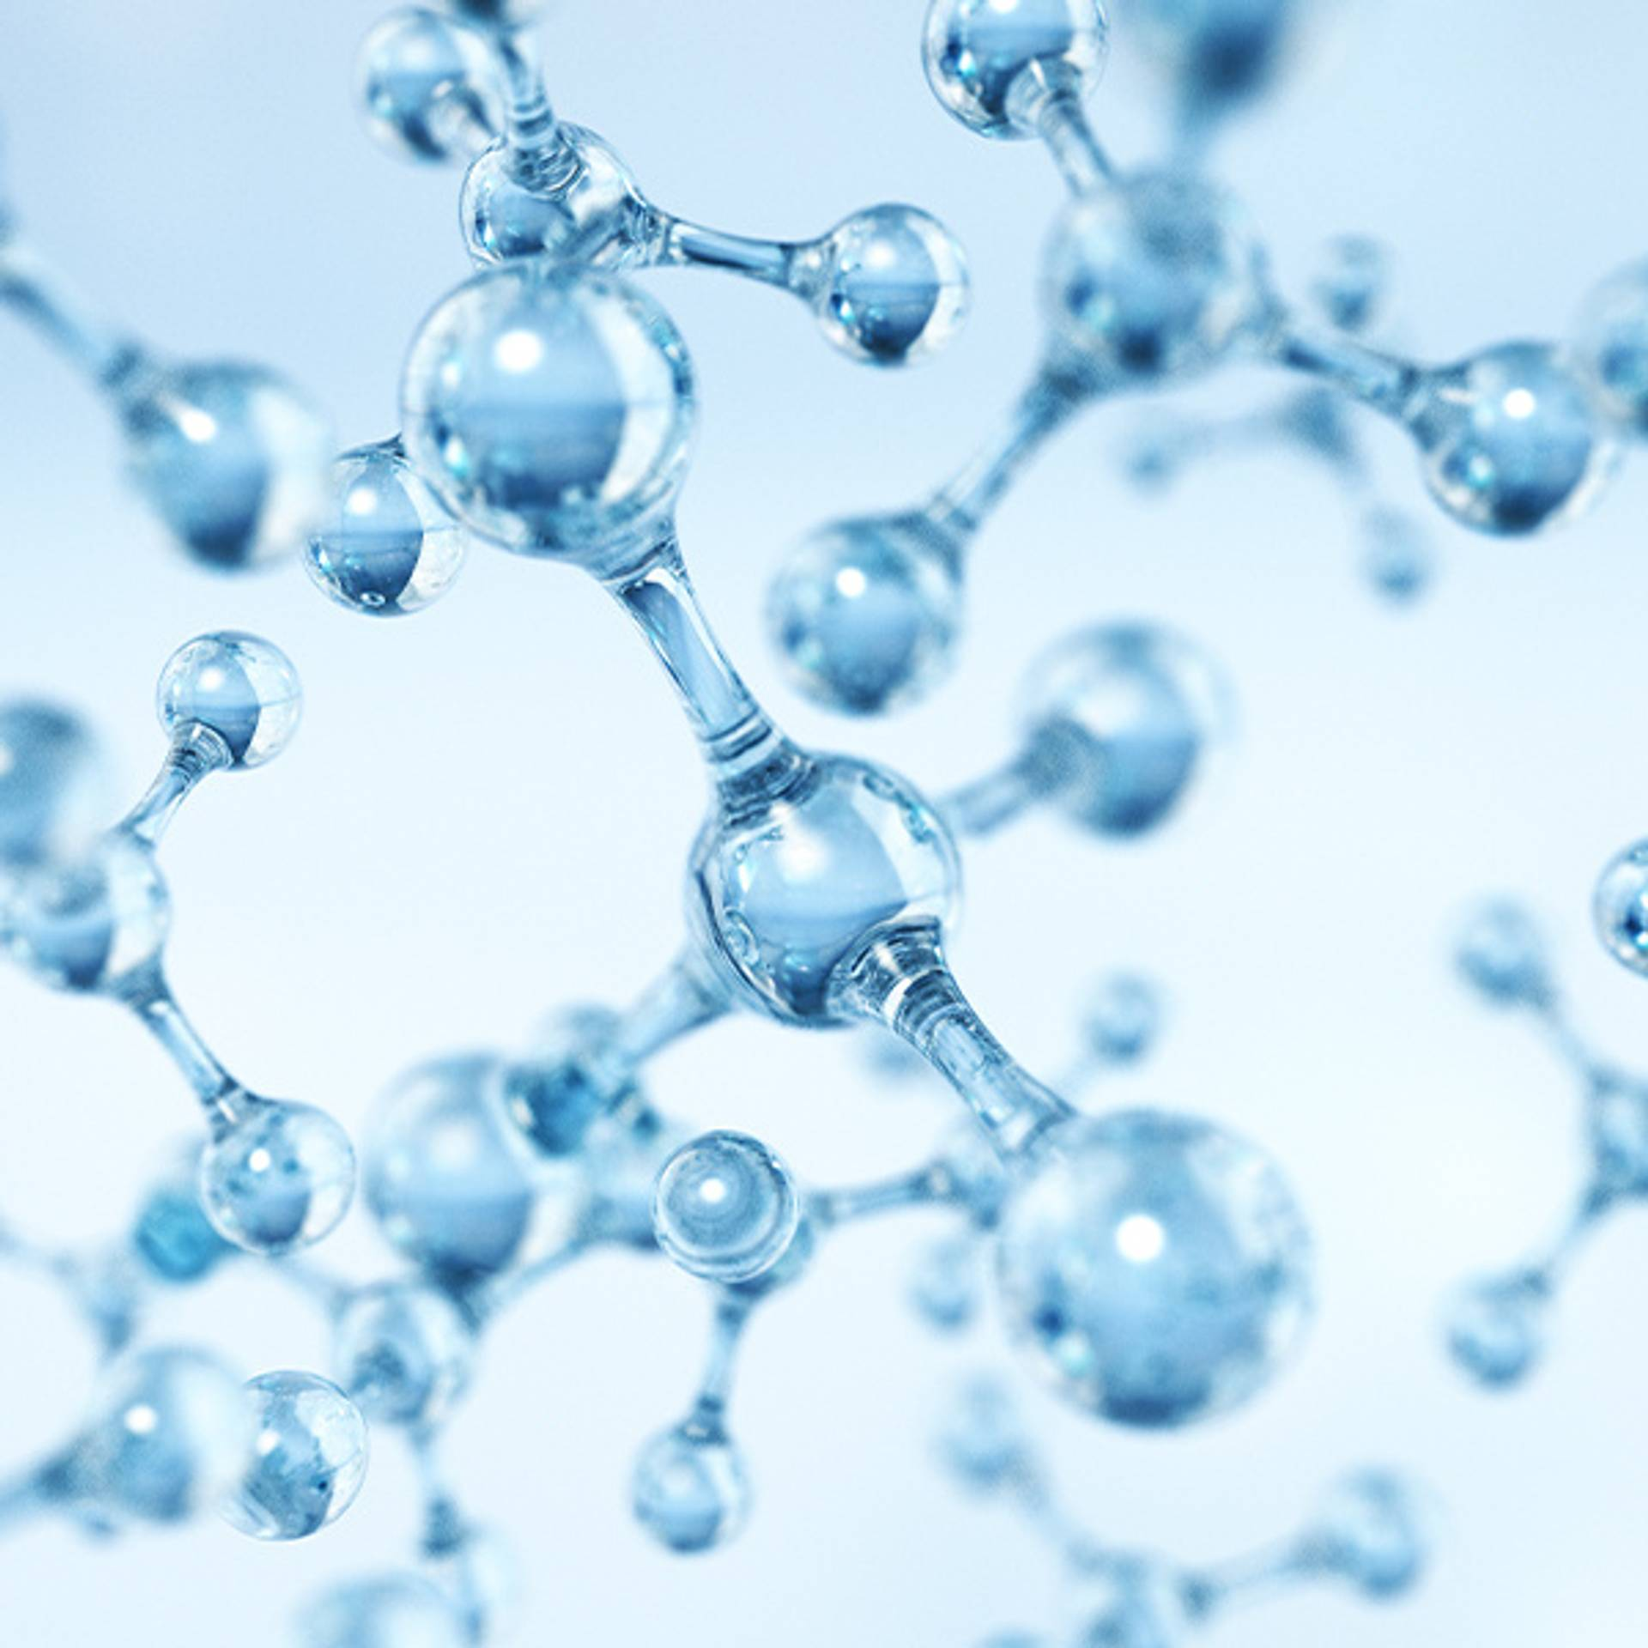
To sum up: Hydration is ...
A universal and
fundamental need
For all ages
For all skin types
Well-moisturised skin
lasts longer!
It preserves: appearance, suppleness, softness, tone and radiance.
Notes:
Hydration is a universal and fundamental need because it plays an important role in the quality of life.
At any age,
All skin types:
No skin is immune to dehydration:
Ill-treated" skin: use of unsuitable, overly aggressive products, dermo-aesthetic procedures, etc.
Dry skin: dry skin is inevitably dehydrated
Older skin: because with age, the epidermis thins and the barrier function is less effective.
And all skin types, because of daily aggressions such as wind, sun, reflection, heat, pollution, heating, temperature variations and a dry environment, all these factors reduce the skin's natural water reserve.
Moisturisation is essential for the skin to maintain its appearance, suppleness, softness, tone and radiance.
That's why moisturising the skin helps to prevent the signs of ageing.
Well-moisturised skin lasts longer.

Slide 12
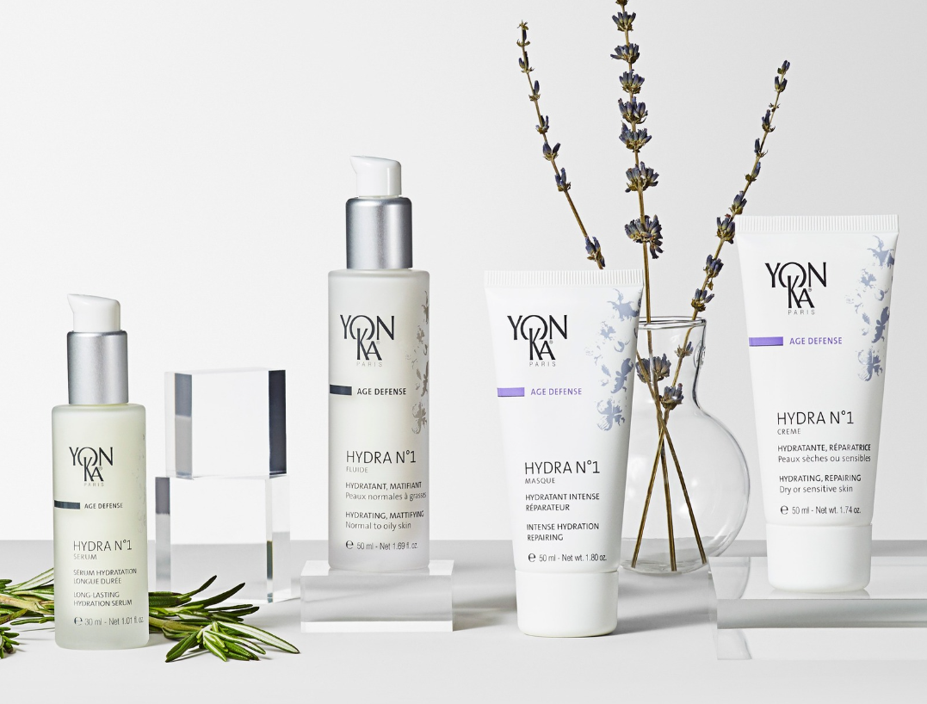
HYDRA N°1

Slide 13
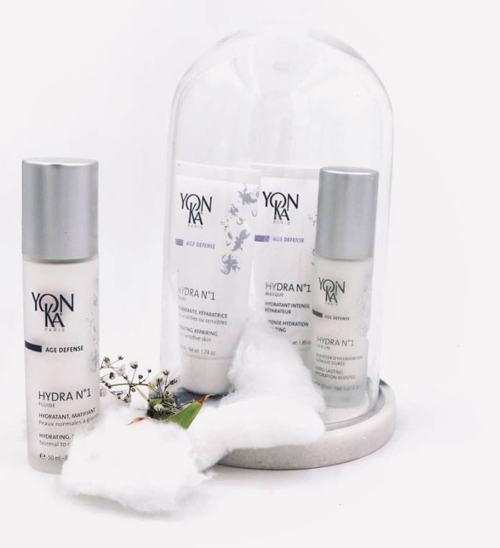
A common hydrating complex*.
OLIVE PHYTOSQUALAVE / ALOE VERA
IMPERATA CYLINDRICA
HIGH MOLECULAR WEIGHT HYALURONIC ACID 1000kDa - 140kDa
LOW MOLECULAR WEIGHT HYALURONIC ACID 150kDa - 600kDa
VITAMINS A, C, E
*Present in the Serum, Cream and Fluid
Notes:
THE YON-KA ANSWER FOR WELL-MOISTURISED SKIN: A MOISTURISING COMPLEX DEVELOPED FROM OUR OWN RESEARCH.
The hydra n°1 range combines the following ingredients:
Aloe Vera
Imperata cylindrica
Olive Phytosqualane
Hyaluronic Acid* (of 2 different molecular weights) *Except HYDRA N°1 SERUM which contains only low molecular weight HA and hydra n°1 Masque which contains no HA.
And vitamins A, C and E.

Slide 14
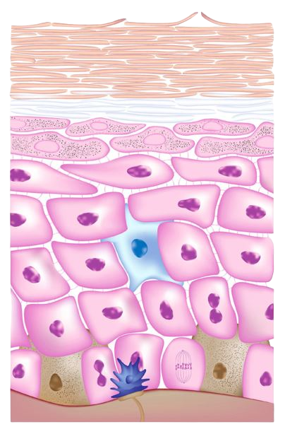
For hydration at every level
HORN LAYER
OLIVE PHYTOSQUALANE / ALOE VERA
Reinforces the skin's barrier function
IMPERATA CYLINDRICA
Regulates water transfer
EPIDERME
HIGH MOLECULAR WEIGHT HYALURONIC ACID
Keeps water in the skin
VITAMINS A, C, E
Protect water-binding molecules
DERME
LOW MOLECULAR WEIGHT HYALURONIC ACID
Replenishes water reserves
Notes:
And to ensure good hydration, you need to act at all levels of the skin: that's exactly what this combination of active ingredients will allow us to do!
In the stratum corneum
To reinforce the skin's barrier function (hydrolipidic film*) to limit evaporation (PIE*) and thus slow down dehydration.
= ALOE VERA AND OLIVE PHYTOSQUALANE
ALOE VERA: FILM-FORMING - MOISTURISING ACTION
Ancestral moisturising active ingredient.
A botanical miracle, baptized the "plant of immortality" by the Egyptians.
It is also known as the "divine plant", the "elixir of youth", the "silent healer" and the "remedy of harmony".
Composed of over 70 nutrients, including minerals, amino acids and vitamins, it has essential and exceptional properties.
Because of its genetic structure, it has very interesting characteristics for the skin: skin hydration, healing, cell regeneration, anti-inflammatory.
PHYTO OLIVE SQUALANE: REINFORCES THE HLF
Squalane is one of the main components of human sebum and the hydrolipidic film.
Here extracted from olives.
Spreads easily and penetrates well into the skin.
The epidermis
To regulate water transfers to prevent cellular water leakage = Osmoregulating active ingredients
IMPERATA CYLINDRICA: INTENSE, LONG-LASTING HYDRATION
Ancestral moisturising active ingredient.
Subtropical plant native to Asia and Australia.
This grass, also known as Saccharum cylindricum, belongs to the common saccharum (sugar cane) family.
It grows in sandy, saline areas by the sea or in flooded, desert areas of the Australian desert, where it manages to survive. Its roots contain starch, sugar and are rich in potassium.
This plant has the ability to trap water in the cells and maintain this capital. *
To maintain water in the skin = Substances that capture water (= hygroscopic* actives)
HIGH MOLECULAR WEIGHT HYALURONIC ACID and/or PCA
HYALURONIC ACID
Active ingredient produced by biosynthesis from plant substrates
Natural constituent of the skin: GAG (glycoaminoglycan) the most abundant in the skin
Hydration superstar molecule: it can retain more than 1000 times its weight in water.
Recognised for stimulating cell renewal in the skin, which becomes denser (=anti-ageing action).
→ Skin is naturally plumper, fuller and wrinkle-free.
High molecular weight = surface action
forms a moisturising and protective film capable of maintaining moisture levels and slowing evaporation without being occlusive or greasy + immediate smoothing and plumping effect
In the dermis
Replenish water reserves (regenerate GAGs*) = Dermal restorers
LOW MOLECULAR WEIGHT HYALURONIC ACID
For in-depth action: renewal of skin cells, hydration + plumps up the skin.
Keep the molecules that bind water in the skin intact (=protect the GAGs) = Anti-oxidants
VITAMINS A (regenerating) C, E (antioxidants)
_________________________________
Hydrolipidic film = This is a natural emulsion of water and lipids that covers the surface of the skin. Indispensable for keeping the skin supple, the main function of the hydrolipidic film is to retain water on the skin's surface and prevent dehydration.
IWL = Insensible Water Loss = water evaporation
Hygroscopic = that captures water
GAGs = glycoaminoglycans, molecules that capture and store water
NMF = Natural Moisturizing Factor
The stratum corneum is the most superficial layer of the epidermis, essentially made up of cells called corneocytes, bound together by epidermal lipids. In the deepest layers, the corneocytes contain a protein matrix, filagrin, which captures and binds water intimately. In the event of low ambient humidity, this protein can break down and release water (as well as low molecular weight, hygroscopic and water-soluble substances), some of which will form what is known as NMF - Natural Moisturising Factor.

Slide 15
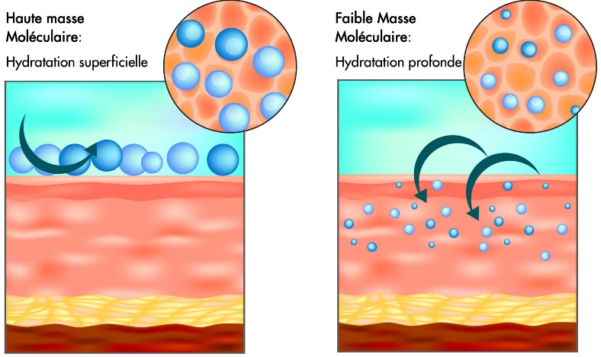
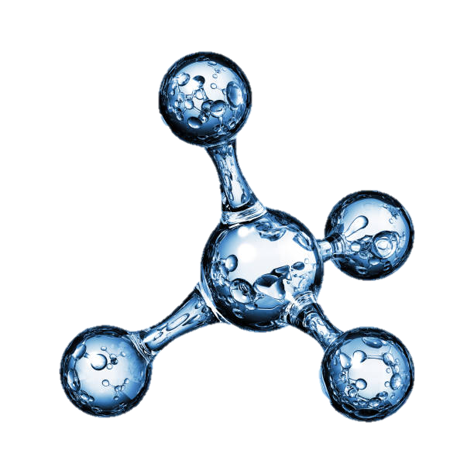
Focus on HYALURONIC ACID
A molecule naturally present in the skin, essential for its hydration, suppleness and firmness.
Imagine a sponge:
Like hyaluronic acid, it retains water in tissues. 1 gram can store up to 1 litre of water - a veritable reservoir of hydration.
There are different molecular weights:
High molecular weight: surface action, immediate smoothing effect.
Low molecular weight: penetrates deeper, stimulates hydration from within.
With age and external aggression, our reserves are depleted.
The external contribution becomes essential to keep a plump, comfortable and luminous skin.
Notes:
HYALURONIC ACID
Active ingredient produced by biosynthesis from plant substrates
Natural constituent of the skin: GAG (glycoaminoglycan) the most abundant in the skin
Hydration superstar molecule: it can retain more than 1000 times its weight in water.
Recognised for stimulating cell renewal in the skin, which becomes denser (=anti-ageing action).
→ Skin is naturally plumper, fuller and wrinkle-free.
High molecular weight = surface action
forms a moisturising and protective film capable of maintaining moisture levels and slowing evaporation without being occlusive or greasy + immediate smoothing and plumping effect
Low molecular weight = For in-depth action
Renews skin cells, moisturises + plumps up the skin.
MOLECULAR WEIGHT (extract from Plurielles.fr - Molecular weight in our creams, kézako? )
A bit of science.... In cosmetic product formulas, there are many active ingredients developed in laboratories that can vary in size, including 'polymers'. A polymer is an ingredient made up of identical sub-units, like a chain of several links. The molecular weight indicates the length of the chain, which is the sum total of the weight of each link.
So the more links there are, the longer the chain and the greater its weight, indicating its size: heavy molecules are therefore large molecules.
What's the difference? The molecules in skincare products sit on the skin waiting to be absorbed by the epidermis. But they don't penetrate in the same way, depending on their size! The larger ones remain on the surface of the epidermis, the medium-sized ones pass through the skin barrier and the smaller ones act deep down. Benefits and effects By combining an active ingredient of different molecular weights in a single formula, it is possible to exploit all its abilities, at different levels in the skin, and to accumulate its effects. This is the advantage of a skincare product containing a molecule in two sizes: it acts at several levels, on the surface and deep down.
Example of hyaluronic acid Its molecules swell with water like sponges. The use of low- and high-molecular-weight hyaluronic acid enables the skin's surface to be smoothed and plumped up immediately, reducing micro-relief and fine lines, while low-molecular-weight hyaluronic acid penetrates much further into the skin, restoring maximum hydration and plumping it up from the inside.

Slide 16
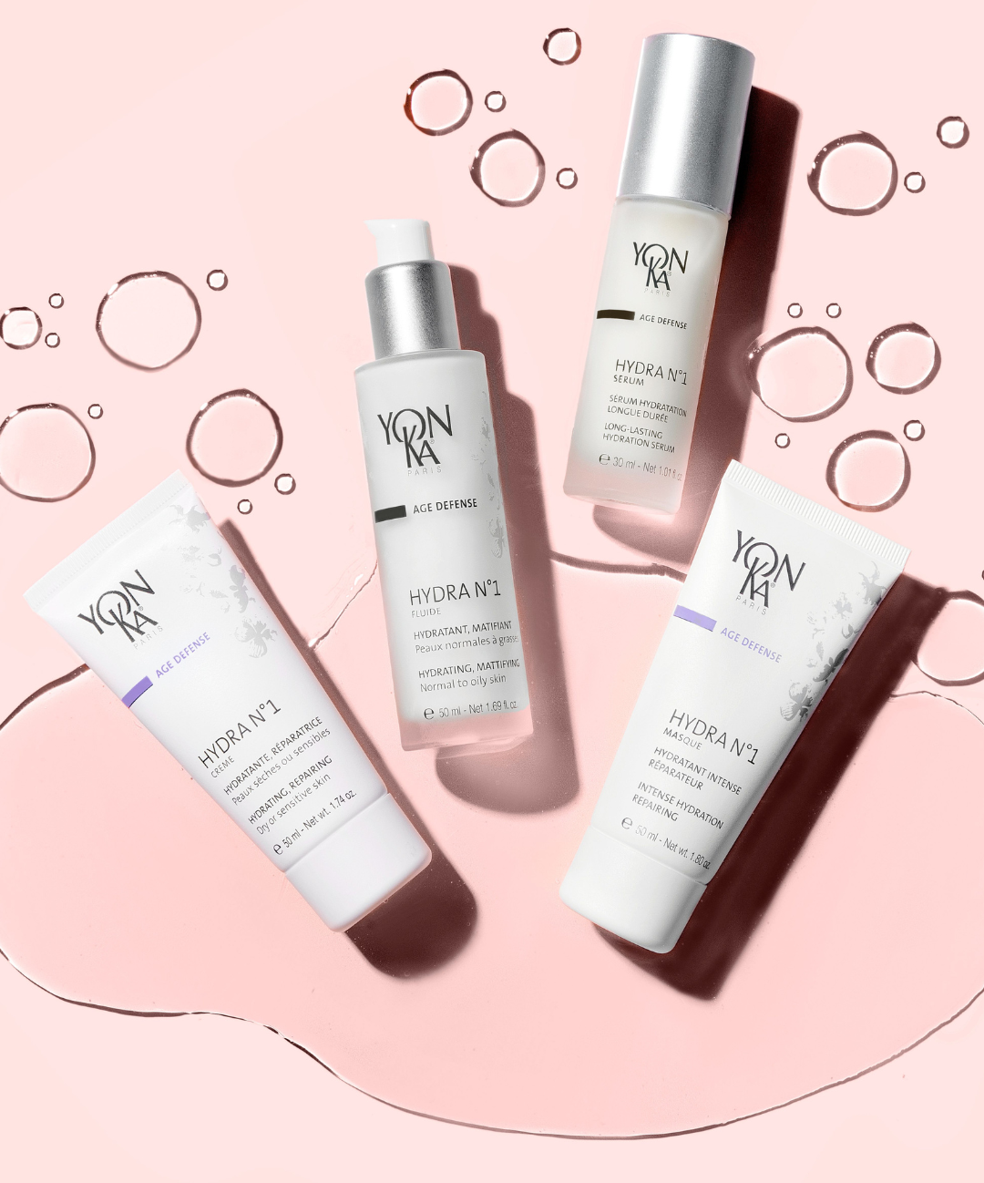
HYDRA N°1
The range of choice for dehydrated skin!
Notes:
HYDRA N°1 offers a range of products for intense hydration, precisely formulated to restore and maintain an immediate, powerful and long-lasting level of hydration at all levels of the skin, thereby combating the signs of ageing.
Without further ado, let's discover our personalised programme based on the needs of each skin type,

Slide 17
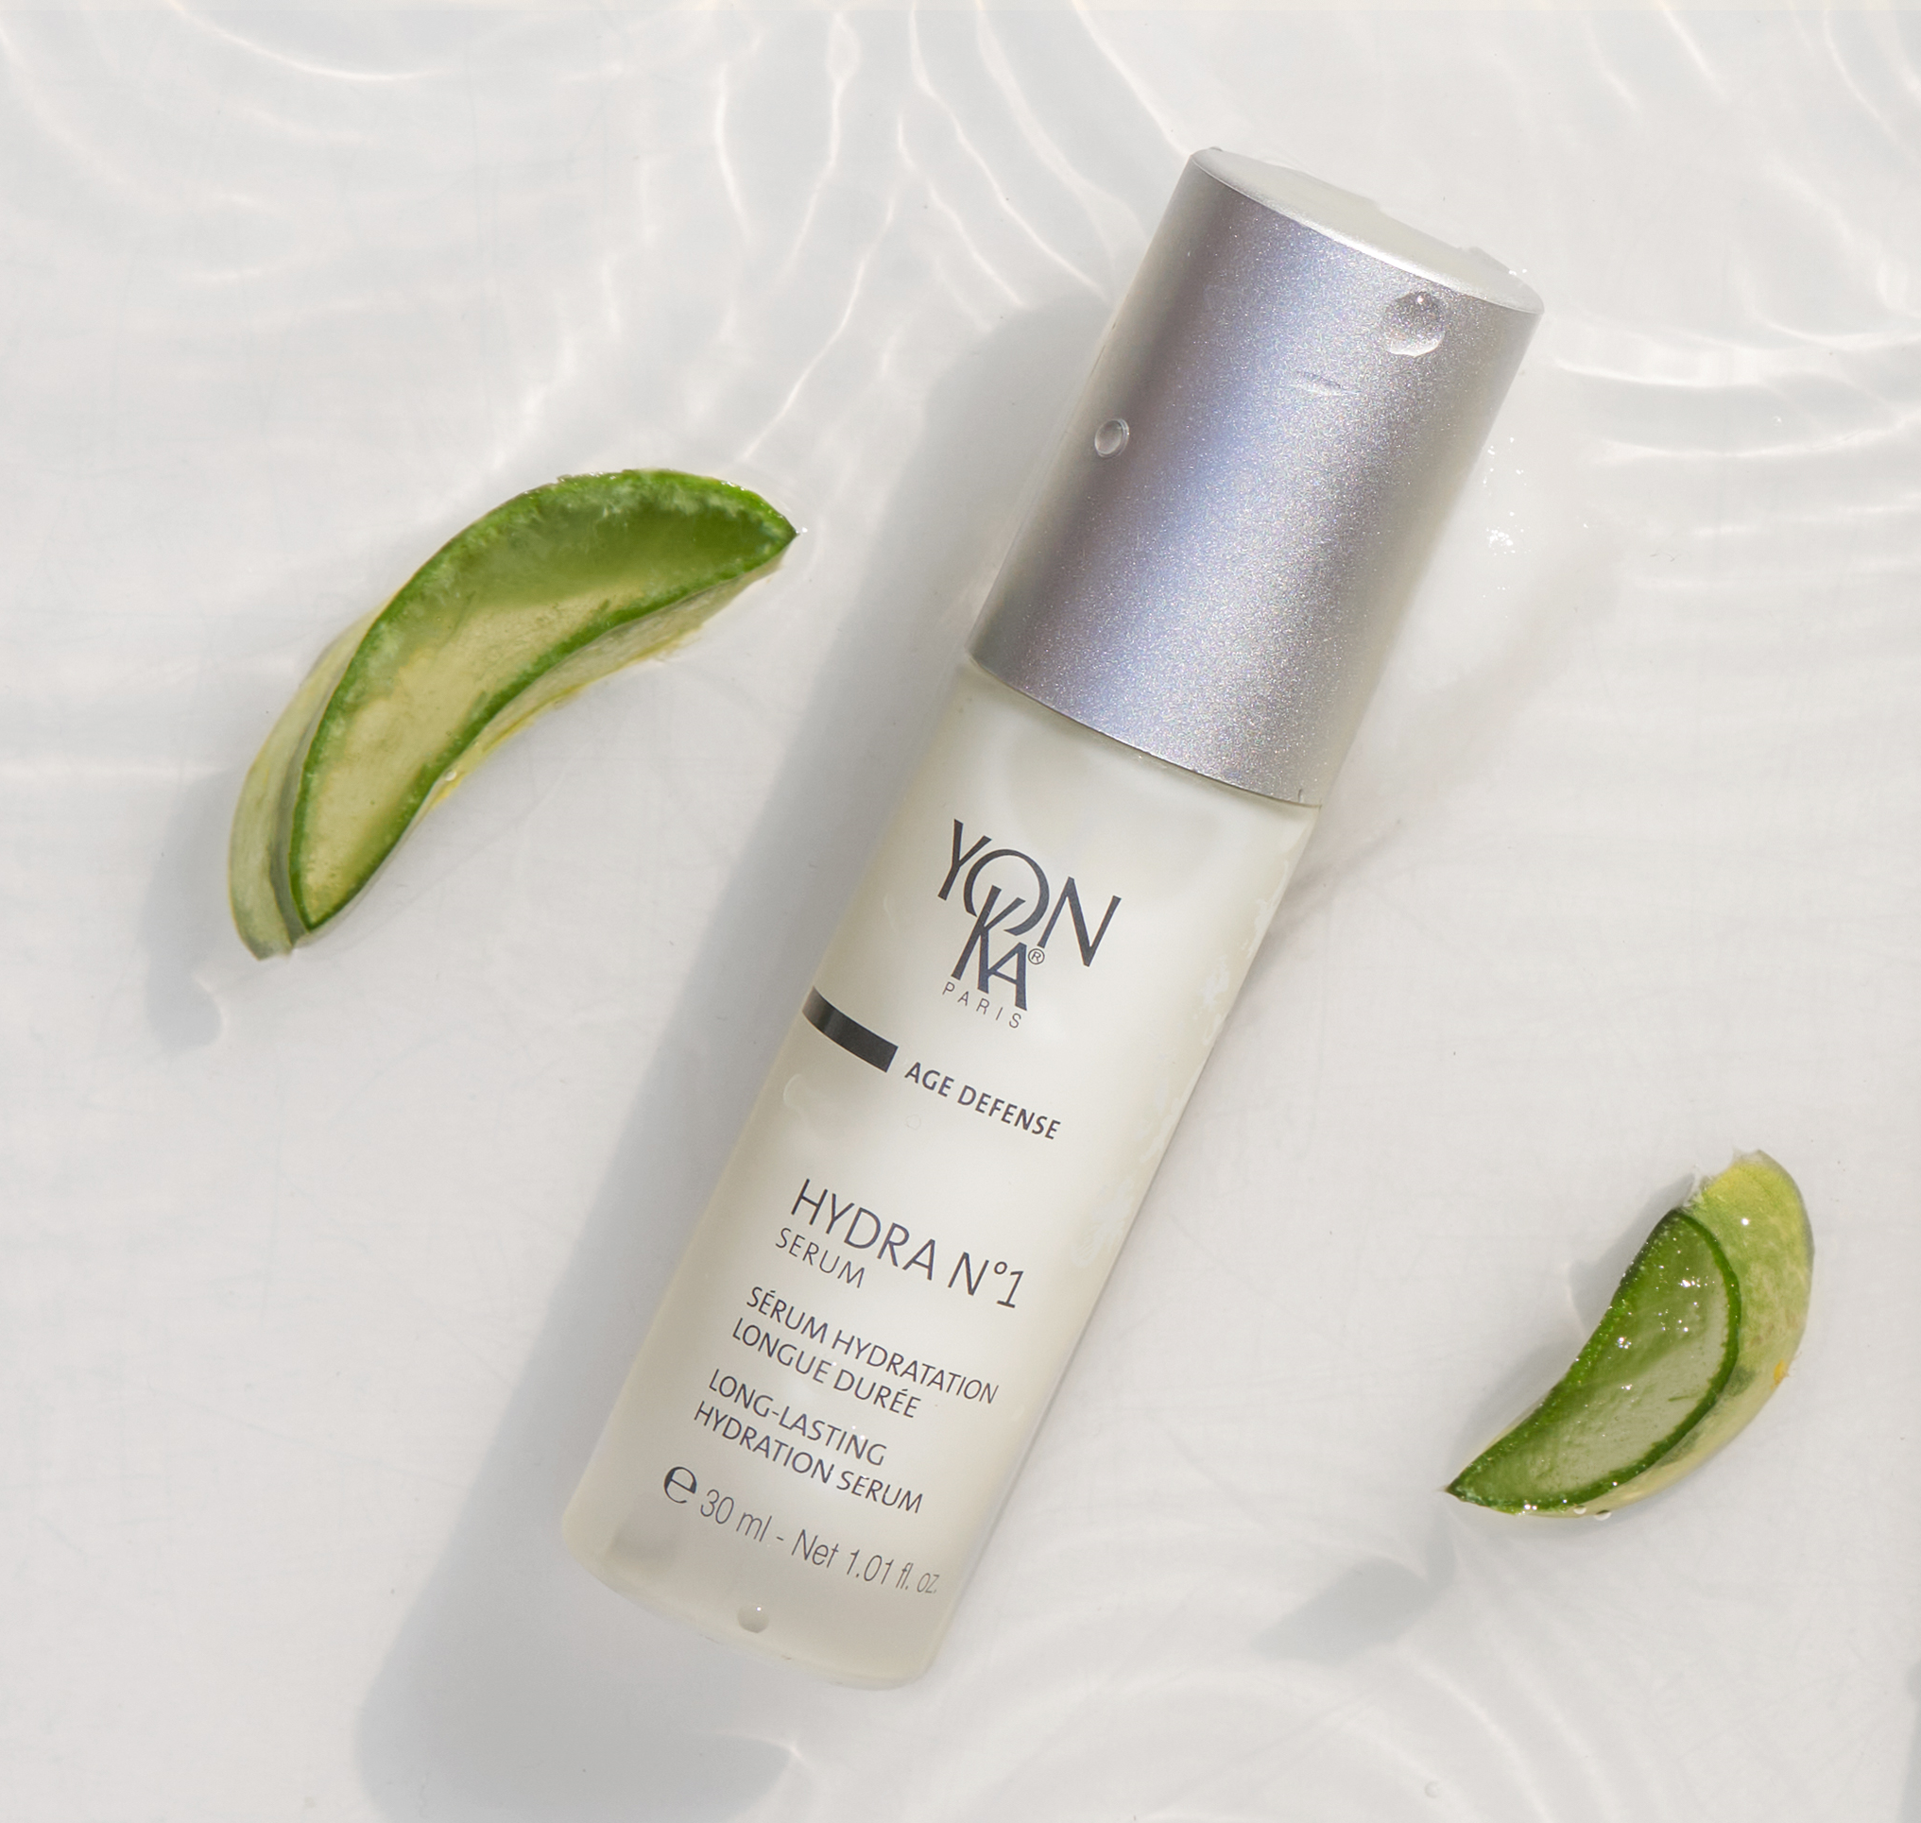
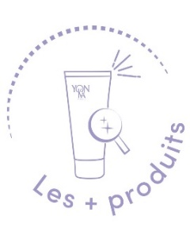
HYDRA N°1 SERUM
Long-lasting hydration serum.
The ally of thirsty skin!
MOISTURISING COMPLEX *
*Low molecular weight hyaluronic acid only
PCA, VEGETABLE GLYCERINE, SERINE
Moisturisers
SILICON, YEAST EXTRACT
Restructuring, redensifying
ROSE, JASMINE, CHAMOMILE E.O.
Relaxing, balancing
93% Ingredients of Natural Origin
Fast-absorbing gel texture
Ideal for everyone, all year round or as a spa treatment
With Hydra n°1 Cream
+144% hydration immediately and +102% after 8 hours
With Hydra n°1 Fluid
+122% hydration immediately and +76% after 8 hours
Notes:
HYDRA N°1 SERUM: An ally for thirsty skin
Description
This moisturising serum with hyaluronic acid is the SOS treatment for very dehydrated skin, providing deep, long-lasting hydration. Enriched with restructuring and anti-oxidant ingredients such as vitamins A, C and E, Hydra N° 1 Sérum intensely nourishes and regenerates the skin, leaving it soft, supple and plump.
Results :
Used with hydra n°1 cream
+144% hydration immediately and +102% after 8 hours
Used with hydra n°1 fluid
+122% hydration immediately and +76% after 8 hours
Product benefits
Contains 93% ingredients of natural origin
Its gel-cream texture is quickly absorbed
Leaves a light, floral aroma of rose, jasmine and chamomile on the skin, 100% natural.
Anti-ageing action (or preserves the skin's youthful appearance)
Who is it for?
▪ Ideal for everyone: men, women, all ages, all skin types, all year round!
▪ As a treatment before and after summer and/or winter.
▪ 1 press added to foundation for extended wear!
▪ In addition, use the hydra mask n°1 once or three times a week.
▪ Hydra n°1 serum - under nude perfect or anti-redness cream - TOP TOP
"My skin is uncomfortable and tight".
"My skin is flaky
"My foundation plaque
"I've just come back from the sun and my skin is dull and uncomfortable".
Ingredients:
Moisturising complex :
organic aloe vera & olive phytosqualane: Moisturising, reinforces the barrier function
imperata cylindrica: hygroscopic action = intense, long-lasting hydration
AH de BPM: In-depth moisturising, cell renewal, redensifying/restructuring action
ACE vitamins: Protect cells, antioxidant and regenerating action.
Polysacharides, serine, PCA, vegetable glycerine: moisturiser
+
VEGETABLE GLYCERIN (ECOCERT ingredient, from European rapeseed) Action: Humectant and moisturising, it reduces the rate at which water evaporates from the surface of the skin, making it suppler, softer and less rough.
SERINE: amino acid which is part of the Natural Moisturizing Factor (NMF) which is the moisturizing factor that maintains the skin's normal hydration.
PCA: PYRROLIDONE CARBOXYLIC ACID = used in the composition of NMF, hygroscopic > retains water in the skin
Origin: Beetroot
POLYSACCHARIDE : Immediate and prolonged moisturising power, provides a silky feel
Origin: biotechnology
Composition: polysaccharide (complex sugar made up of several simple sugar molecules) obtained by natural bacterial fermentation using maize sorbitol and soya peptone as substrates.
MILK EXTRACT: promotes the formation of lipid cement
SILICON: replenishes the skin's water reserves. Present in many foods. It induces or regulates the multiplication of fibroblasts.
It has been observed that silicon is essential for the synthesis of collagen and elastin fibres. A shortage of organic silicon from the age of forty onwards causes the skin to dry out significantly and wrinkles to appear. Organic silicon derivatives (silanols) are therefore indicated to act on wrinkles and stretch marks and to improve skin elasticity.
Home use
Morning and/or evening, after cleansing and removing make-up and spraying with the appropriate Yon-Ka Lotion, apply 2 to 3 pumps of serum to the face, neck and décolleté. Gently massage the serum into the skin. Follow with your complementary skincare product: Hydra N°1 Moisturising Matifying Fluid for normal to oily skin or Hydra N°1 Moisturising Repair Cream for dry skin.
Use in the treatment room
Massage
End of care

Slide 18
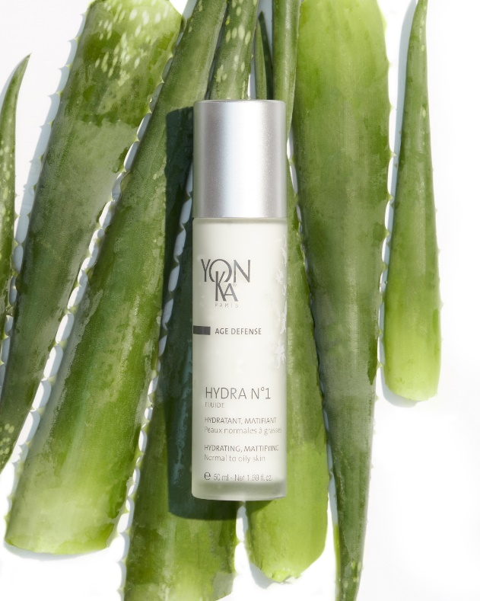
HYDRA N°1 FLUID
Mattifying moisturising fluid.
The ultra-moisturising, mattifying fluid!
MOISTURISING COMPLEX
SILICE
Matifying
PCA, VEGETABLE GLYCERINE
Moisturisers
ROSE, JASMINE, CHAMOMILE E.O.
Relaxing
Non-greasy mattifying fluid
Fast-absorbing gel-cream texture
Ideal for everyone, all year round or as a spa treatment
Intense, long-lasting hydration
+110% immediately +59% after 8 hours
Combined with Hydra Serum n°1
+122% immediately +76% after 8 hours
Notes:
HYDRA N1 FLUID : The ultra-moisturising, mattifying fluid (88% ION)
Description
Non-greasy, fast-absorbing mattifying fluid
Replenishes normal to oily skin
Supple, soft, radiant, plump skin
Results
Intense, long-lasting hydration
+110% immediately
+59% after 8 a.m.
Product benefits
Fast-absorbing gel-cream texture
Matifying effect on the T-zone
Natural rose, jasmine and chamomile fragrance
Who is it for?
"My skin is uncomfortable and tight on my cheeks, but I tend to shine on my forehead.
"I've just come back from the sun and my skin is slightly dehydrated".
Tips
▪ Ideal for dehydrated oily or combination skin.
▪ Light texture perfect for summer.
▪ In the evening, one to three times a week, optimise the routine with Hydra N°1 Mask, leave on overnight.
▪ To maximise results, combine with a Serum or Booster
Ingredients:
Moisturising complex :
organic aloe vera & olive phytosqualane: Moisturising, reinforces the barrier function
imperata cylindrica: hygroscopic action = intense, long-lasting hydration
BPM HA: Low molecular weight: deep hydration, cell renewal, redensifying/restructuring action
HPM HA: High Molecular Weight = surface action
forms a moisturising and protective film capable of maintaining moisture levels and slowing evaporation without being occlusive or greasy + immediate smoothing and plumping effect
ACE vitamins: Protect cells, antioxidant and regenerating action.
+
SILICE: (ECOCERT) Made up of porous spherical beads - Absorbs excess sebum & provides a soft, slippery feel
+
VEGETABLE GLYCERIN (ECOCERT ingredient, from European rapeseed) Action: Humectant and moisturising, it reduces the rate at which water evaporates from the surface of the skin, making it suppler, softer and less rough.
PCA: PYRROLIDONE CARBOXYLIC ACID = used in the composition of NMF, hygroscopic > retains water in the skin
Origin: Beetroot
POLYSACCHARIDE : Immediate and prolonged moisturising power, gives a silky feel
Origin: biotechnology
Composition: polysaccharide (complex sugar made up of several simple sugar molecules) obtained by natural bacterial fermentation using maize sorbitol and soya peptone as substrates.
+
SILICON: replenishes the skin's water reserves. Present in many foods. It induces or regulates the multiplication of fibroblasts.
It has been observed that silicon is essential for the synthesis of collagen and elastin fibres. A shortage of organic silicon from the age of forty onwards causes the skin to dry out significantly and wrinkles to appear. Organic silicon derivatives (silanols) are therefore indicated to act on wrinkles and stretch marks and to improve skin elasticity.
+
ROSE CAMOMILE AND JASMINE EO: Balancing and relaxing
Home use
Morning and evening, apply Hydra N°1 Fluid to the face and neck after cleansing/make-up removal and misting with Yon-Ka Lotion for normal or oily skin. Gently massage the fluid into the skin.

Slide 19
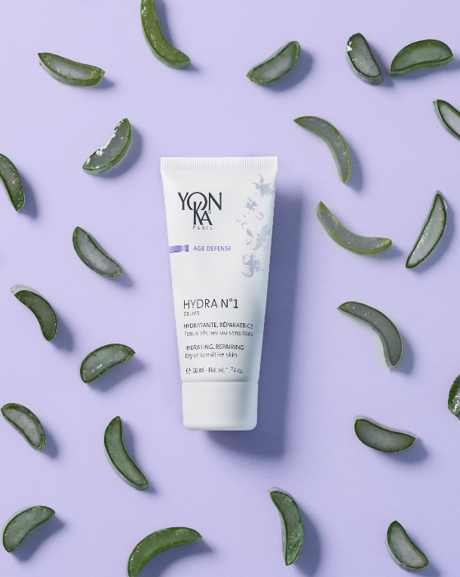
HYDRA N°1 CREAM
Moisturising repair cream.
A real comforting cocoon for very dehydrated skin
MOISTURISING COMPLEX
SHEA BUTTER, GRAPESEED AND HAZELNUT OILS
Repairers
VITAMIN B5 AND F
Soothing and anti-dehydrating
ROSE, JASMINE, CHAMOMILE E.O.
Relaxing
94% Ingredients of Natural Origin
Reinforces the skin's barrier function
Provides immediate comfort
Intense, long-lasting hydration
+138% immediately +86% after 8 hours
Combined with Hydra Serum n°1
+144% immediately +102% after 8 hours
Notes:
HYDRA N1 CREAM: 94% ION
Benefits
Rich in repairing ingredients
Reinforces the skin's barrier function
Provides immediate comfort
Supple, soft, radiant, plump skin
Results
Intense, long-lasting hydration
+138% immediately +86% after 8 a.m.
Combined with Hydra Serum n°1
+144% immediately +102% after 8 hours
Product benefits
Contains 94% ingredients of natural origin
Intensely moisturises the skin
Preserves the skin's youthful appearance
Who is it for?
"When I get out of the shower, my skin feels uncomfortable and tight".
"When I put on make-up, my foundation runs into the creases".
Tips
▪ Ultra-comforting cocooning texture
▪ Ideal mixed with foundation for very dehydrated skin.
▪ As a complement, use hydra mask n°1
once or three times a week, as a night mask.
▪ To maximise results, combine with a Serum or Booster
Ingredients:
Moisturising complex :
organic aloe vera & olive phytosqualane: Moisturising, reinforces the barrier function
imperata cylindrica: hygroscopic action = intense, long-lasting hydration
BPM HA: Low molecular weight: deep hydration, cell renewal, redensifying/restructuring action
HPM HA: High Molecular Weight = surface action
forms a moisturising and protective film capable of maintaining moisture levels and slowing evaporation without being occlusive or greasy + immediate smoothing and plumping effect
ACE vitamins: Protect cells, antioxidant and regenerating action.
KARITE BUTTER
Vegetable butter extracted from the shea nut (shea tree: Central Africa, savannah trees)
Rich in unsaponifiables and vitamins (A, D, E, F)
Nourishing, smoothing, healing and anti-inflammatory
GRAPE SEED OIL : Action: Its high linoleic acid content (75%) gives it moisturising and restructuring properties, reducing insensible water loss and restoring the skin's elasticity. Provides the skin with essential fatty acids (linoleic acid, oleic acid, stearic acid, palmitic acid). Contains bioflavonoids, oligomeric proanthocyanidins, which are excellent antioxidants. Several studies have demonstrated the influence of proanthocyanidins on collagen stability and healthy elastin.
HAZELNUT OIL
Origin: extracted from the fruit of the hazelnut tree (Corylus Avellana)
Action: High moisturising power: high phospholipid content / high resistance to oxidation / non-comedogenic
Helps the penetration of active elements, such as aromatherapy.
VEGETABLE GLYCERIN (ECOCERT ingredient, from European rapeseed) Action: Humectant and moisturising, it reduces the rate at which water evaporates from the surface of the skin, making it suppler, softer and less rough.
MILK EXTRACT: promotes the formation of lipid cement
SILICON: replenishes the skin's water reserves. Present in many foods. It induces or regulates the multiplication of fibroblasts.
It has been observed that silicon is essential for the synthesis of collagen and elastin fibres. A shortage of organic silicon from the age of forty onwards causes the skin to dry out significantly and wrinkles to appear. Organic silicon derivatives (silanols) are therefore indicated to act on wrinkles and stretch marks and to improve skin elasticity.
VITAMIN B5: Soothing
hygroscopic ~ healing ~ anti-inflammatory
reaches the deeper layers of the skin while leaving a thin film on the surface.
VITAMIN F: Anti-dehydrating
~ composed mainly of linoleic acid
~ allows epidermal cells to regain their full water tension by reducing their impermeability
~ role in the hyperkeratinisation process: normalises the epidermal lipid barrier
ROSE CAMOMILE AND JASMINE EO: Balancing and relaxing
Home use
Morning and evening, apply Hydra N°1 Cream to the face and neck after cleansing/make-up removal and misting with Yon-Ka Lotion for Dry Skin. Gently massage the cream into the skin.
Use in the treatment room
Massage
End-of-care cream

Slide 20
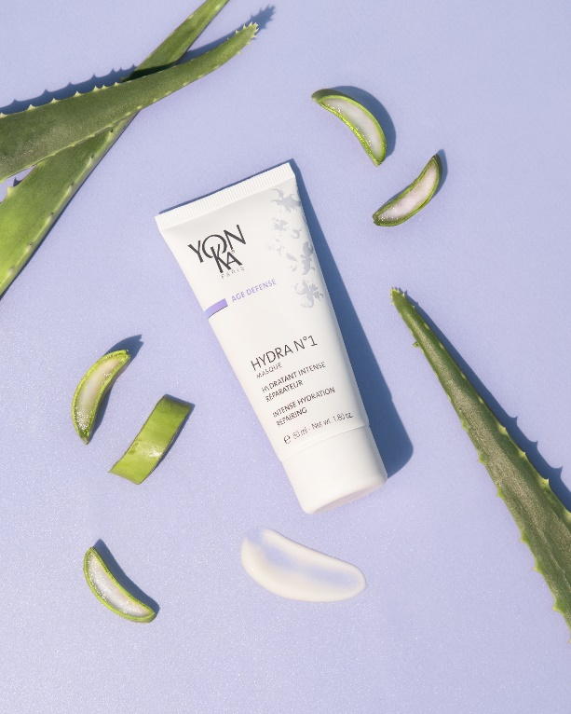
HYDRA N°1 MASK
Anti-aging, moisturising and repairing mask.
A real hydration bath for all dehydrated skin types
IMPERATA CYLINDRICA, ORGANIC ALOE VERA
Moisturisers
VITAMIN A AND SILICON DERIVATIVE
Regenerating
BISABOLOL, VITAMIN B5 AND JOJOBA
Soothing and repairing
E.O. OF ROSE, JASMINE, SHIU
Relaxing
Suitable for all skin types
Use as a night mask
Smoothes the skin's surface and reduces fine lines
Softer, firmer skin
Intensive moisturising action
+124% after 2 hours
+73% after 8 hours.
Notes:
HYDRA N1 MASK: 89% ION
Benefits
Smoothes skin relief
Reduces fine lines
Softer, firmer skin
Preserves the skin's youthful appearance
Results
Intensive moisturising action
+124% after 2 hours
+73% after 8 a.m.
(Corneometry hydration test, 10 female volunteers aged between 48 and 70 with dry skin)
Product benefits
For all dehydrated, damaged, dry or oily skin
Enriched with vitamins A, E, C, B5 and Jojoba
Gel texture
Use as a night mask
Who is it for?
This mask is the best face mask for dehydrated, dry or oily skin:
"My skin is uncomfortable and tight".
"I've been to winter sports, I've got a tan but I feel like I'm getting wrinkles".
Tips
Steam mask
▪ Add hydra N°1 serum before applying your mask.
▪ 1 to 3 times a week, after cleansing/make-up removal and misting with suitable Yon-Ka Lotion, apply the mask generously to the face, neck and décolleté. Leave on for 20 minutes to 1 hour as required, then absorb any excess with a tissue. Do not rinse off.
▪ For very dehydrated skin: Use as a night mask for 1 week in place of our usual cream.
▪ As an SOS treatment for skin in distress, attacked by the sun: Use as a night mask for 3 weeks.
Ingredients:
imperata cylindrica, organic aloe vera, olive phytosqualane, plant glycerine, PCA: Moisturizer
Vitamins A and silicon: Regenerating
SILICON: replenishes the skin's water reserves. Present in many foods. It induces or regulates the multiplication of fibroblasts.
It has been observed that silicon is essential for the synthesis of collagen and elastin fibres. A shortage of organic silicon from the age of forty onwards causes the skin to dry out significantly and wrinkles to appear. Organic silicon derivatives (silanols) are therefore indicated to act on wrinkles and stretch marks and to improve skin elasticity.
Bacopa monniera, Vitamins e AND c: Anti OXIDANT, ANTI RADICALLATE
Origin: Indo-Pakistani continent Extract of the leaves
Action: anti-inflammatory (prevents the onset of irritation by acting on oxidation induced by products that generate free radicals and UV rays). anti-radical and anti-oxidant.
Additional information: Plant recognised for its calming properties in Ayurvedic medicine
Main constituents: alkaloids, glycosaponins, triterpenoids including bacosin.
JOJOBA: ANTI-DEHYDRATING, REPAIRING
VITAMIN B5: Soothing
hygroscopic ~ healing ~ anti-inflammatory
reaches the deeper layers of the skin while leaving a thin film on the surface.
BISABOLOL
Origin :Brazil, extracted from the Vanillosmopsis erythropappa tree - same active ingredient as chamomile.
Wood oil extract
Action: anti-inflammatory, antibacterial and antimycotic, inhibits UV-induced erythema
ROSE CAMOMILE AND SHIU EO: Balancing and relaxing
Cinnamomum camphora with linalool (E.O. of shiu/Shiu leaf oil)
Origin: China
also known as Japanese laurel
Extraction method:Distillation of shiu sho tree leaves
Action : Used for its fragrance, soothing, relaxing
Scent similar to lavender essential oil
ROSA DAMASCENE (H.E. de rose/Rose flower Oil)
Origin: Turkey
Extraction method : Flower distillation
Action : Used for its fragrance, soothing, relaxing, anti-wrinkle
JASMINUM SAMBAC (Jasmine E.O./Jasmine Oil)
Origin: India
Extraction method: Ethanol extraction of the concrete
Action : Used for its fragrance, softening
ANTHEMIS NOBILIS ( Chamomile EO)
Origin: Central Europe. Grown in Europe (Belgium, England, Italy, France). The Egyptians worshipped it.
Extraction method: steam distillation of the flowers
Action: Anti-inflammatory, healing, antiseptic and antispasmodic
This plant, also known as Roman chamomile or English chamomile, is one of the most commonly used plants for chamomile infusions.

Slide 21
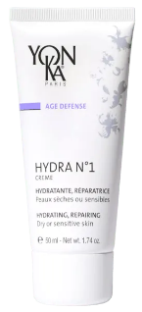
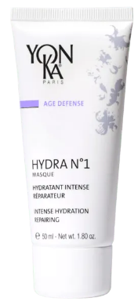
The yon-ka hydrating range
Deep moisturising
Moisturise
Mattify
dehydrated combination skin
Moisturise
Repair
Moisturise
Comfort
very dehydrated skin
Hydra n°1
Serum
Hydra n°1 Fluid
Hydra n°1 Cream
Hydra n°1 Mask
Notes:
To sum up our YON-KA moisturising range we have :
Hydra Serum n°1: for deep hydration thanks to Low Molecular Weight Hyaluronic Acid + Serine and PCA
Hydra fluid n°1: moisturises and mattifies dehydrated combination skin thanks to AH + Sillice
Hydra n°1 cream: moisturises and comforts very dehydrated, uncomfortable skin thanks to HA + Shea butter and vitamin B5.
Hydra Mask n°1: moisturises and repairs thirsty skin thanks to imperata cylindrica + jojoba.

Slide 22
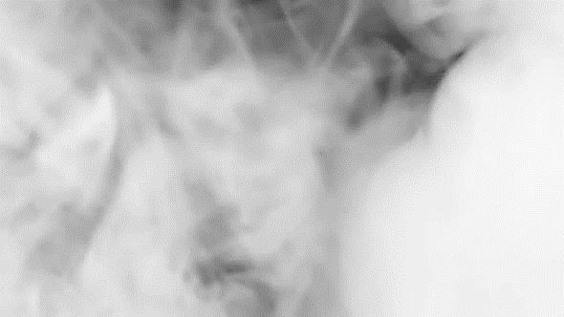
Professional care

Slide 23
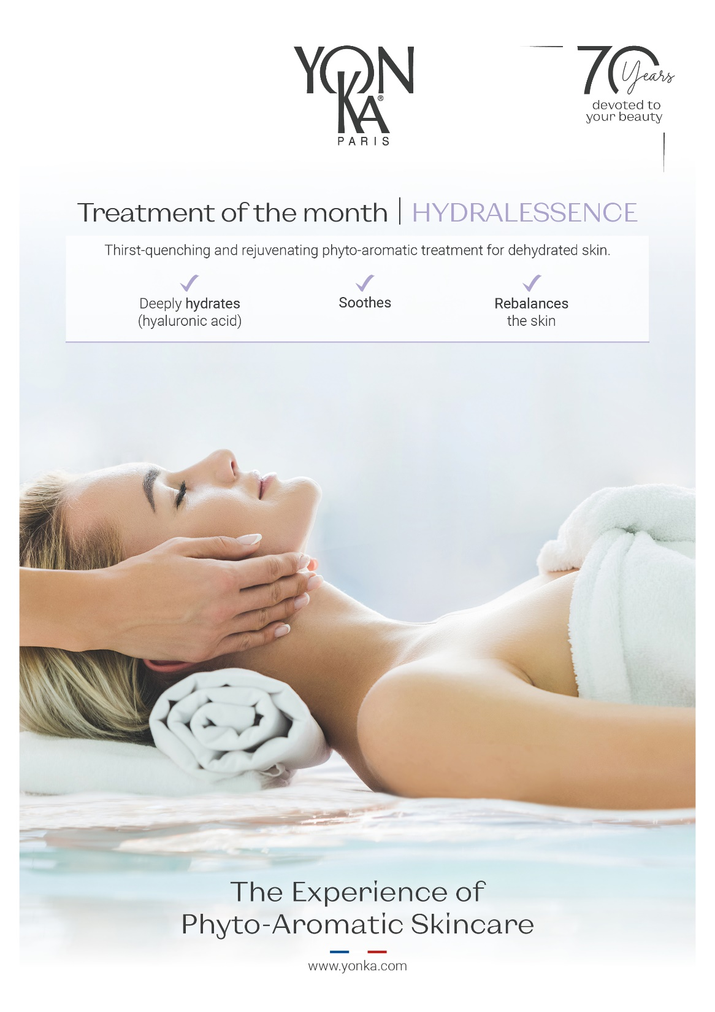
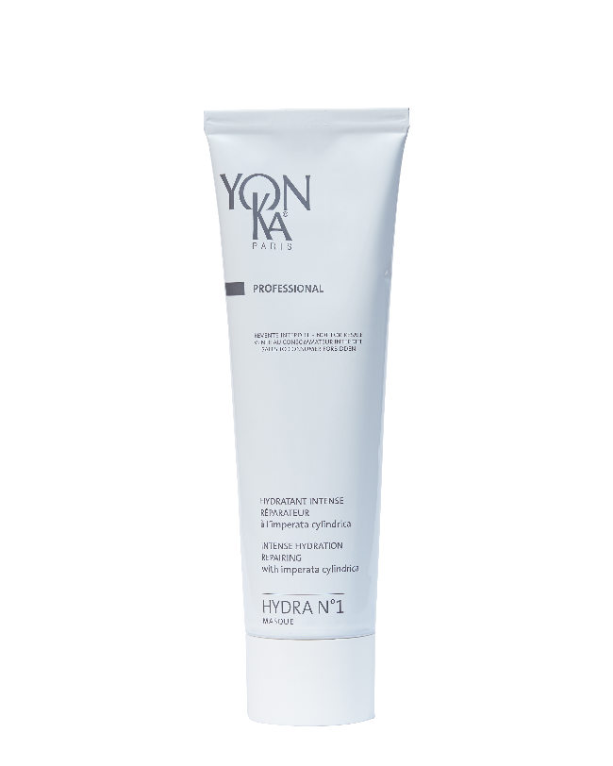
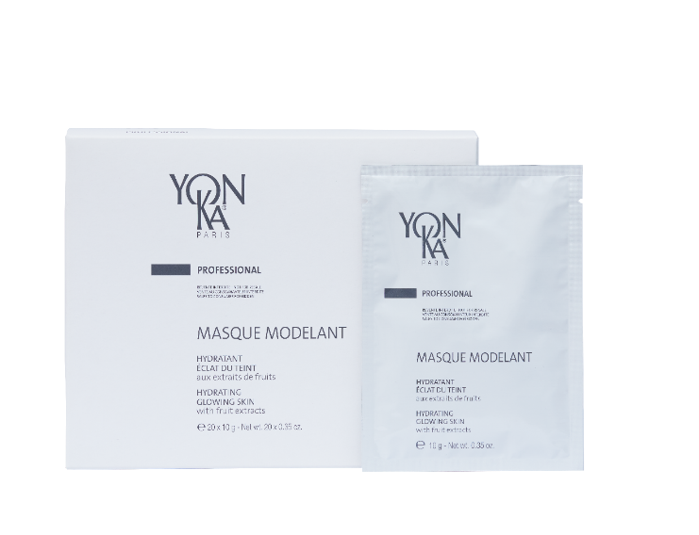
Our professional allies
Moisturises dry/dehydrated skin
Moisturises and brightens
Modeling Mask
Aloe vera, algae (diatoms) : Moisturizer
Blackcurrant, pineapple: Skin radiance - soothing
Lesser celandine: Anti-inflammatory
Green tea: Anti-oxidant
Hydra N°1 Mask
Imperata cylindrica, organic aloe vera, olive phytosqualane: Moisturising
Vitamin A and silicon derivative: Regenerating
Bacopa monniera, Vitamins E & C: anti-oxidant
Jojoba: anti-dehydrating, repairing
Vitamin B5, Bisabolol: soothing
Rose, chamomile and shiu EOs: balancing and relaxing
Notes:
HYDRA MASK N°1
Identical to retail.
Steam massage and mixed with the modelling mask to maximise hydration / Double dose of hydration.
MODELLING MASK : Laminating mask
Mask alone in face care products - Place 2 sachets of mask in a dish and pour in approximately 60 ml of fresh water.
Double Hydrating Mask: prepare the Modelling Mask - Then, add a teaspoon of Hydra N°1 Mask: to the Hydralessence treatment.
Modelling Mask + Grapefruit: same preparation, application and removal as above. - in Cocoon Radiance treatment
Mask alone in the Perfection Eye and Lip treatment: Place 1 sachet in a dish and pour in approximately 30 ml of fresh water.
The temperature of the water is important: cool water or room temperature. If the water is too cold or too hot, the mask coagulates/dries more quickly and becomes difficult to apply.
aloe vera, algae (diatoms) : Moisturizer
blackcurrant, pineapple: complexion radiance Softening
Lesser celandine: Anti-inflammatory
green tea: Anti-oxidant
- For professional use only - Film-on mask - A sensation of freshness - Gourmet mask with fruity scents (blackcurrant, pineapple) - Moisturises, softens and tones - Radiant complexion

Slide 24
LET'S PLAY!

Slide 25
What are the components of the HYDRATING complex in the HYDRA N°1 range?
HYALURONIC ACID
PCA
VEGETABLE GLYCERINE
ALLANTOIN
ALOE VERA
ROSEMARY
CYPRESS
GERANIUM
LAVENDER
THYM
HYALURONIC ACID
ALOE VERA
IMPERATA CYLINDRICA
OLIVE PHYTOSQUALANE
VIT. A, C, E
Notes:
Thanks to this moisturising and anti-ageing complex, HYDRA N°1 products act on all levels of the skin to provide intense hydration:
COUCHE-CORNEE
- Reinforces the skin's barrier function: Olive phytosqualane / Aloe vera
EPIDERME
- Regulating water transfers: Imperata cylindrica
- Maintain water in the skin: High molecular weight hyaluronic acid and/or PCA
DERME
- Replenish water reserves: Low molecular weight hyaluronic acid and/or silicon
- Protect water-binding molecules: Vitamins A, C and E

Slide 26
What is the matifying active ingredient
in hydra n°1 fluid?
KONJAC
SILICA
SILICIUM
Notes:
SILICE: (ECOCERT) Made up of porous spherical beads - Absorbs excess sebum & provides a soft, slippery feel
Not to be confused with silicon:
SILICON: replenishes the skin's water reserves. Present in many foods. It induces or regulates the multiplication of fibroblasts.
It has been observed that silicon is essential for the synthesis of collagen and elastin fibres. A shortage of organic silicon from the age of forty onwards causes the skin to dry out significantly and wrinkles to appear. Organic silicon derivatives (silanols) are therefore indicated to act on wrinkles and stretch marks and to improve skin elasticity.

Slide 27
What are the star active ingredients
in Hydra n°1 Mask?
HYALURONIC ACID
+
NMF
(SERINE AND SODIUM PCA)
IMPERATA CYLINDRICA
+
JOJOBA
HYALURONIC ACID
+
ALOE VERA
Notes:
Imperata cylindrica + Jojoba
(AH + NMF: serum)
(HA + Aloe vera: fluid)
Hydra n°1 Mask contains sodium PCA instead of HA
PCA: PYRROLIDONE CARBOXYLIC ACID
Origin: Beetroot
Part of the composition of NMF, hygroscopic
+ Imperata cylindrica + Jojoba + Organic aloe vera, olive phytosqualane, glycerine....

Slide 28
Hygroscopic, I keep water at the surface
of the skin, who am I?
VITAMIN E
ALOE VERA
IMPERATA CYLINDRICA

Slide 29
The last word
"
Naïma Watigny
naima.watigny@yonka.com
+33 6 08 10 83 22
With 25 years' experience in cosmetics, I've had the opportunity to work for a variety of brands with very different concepts, in different distribution channels (beauty salons, hotel spas, perfumeries, pharmacies) in France and abroad.
As the new Head of Training for Yon-Ka France and International, I'm determined to take the training department into a new dimension. My team and I are going to provide you with new, more relevant, more expert and more technical tools to improve your product knowledge.

